Slide 1

PBIS Leadership: Arranging Opportunities for Successful Implementation
George Sugai University of Connecticut George.sugai@uconn.edu
National Technical Assistance Center on Positive Behavioral Interventions & Support Center on Behavioral Education and Research www.pbis.org www.neswpbs.org

Slide 2
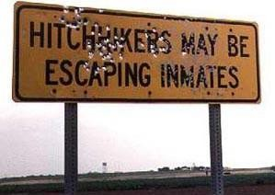

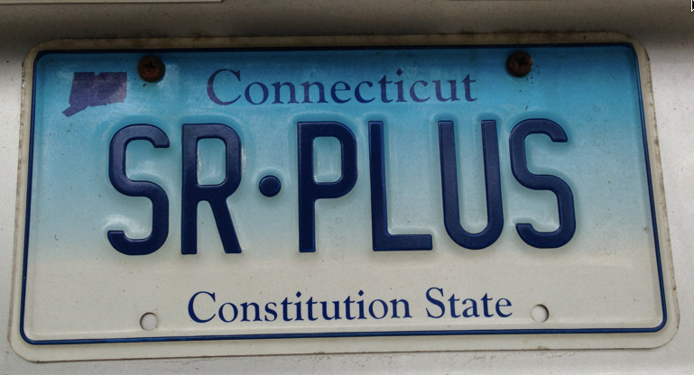
Jin An, Jack, Randy, Ronnie
Past & present Wingers
Participants
Praise & Acknowledgement
Notes:
No vetting
No accountability to data and questions
Not motivated by threat of w/h or reimbursement

Slide 3
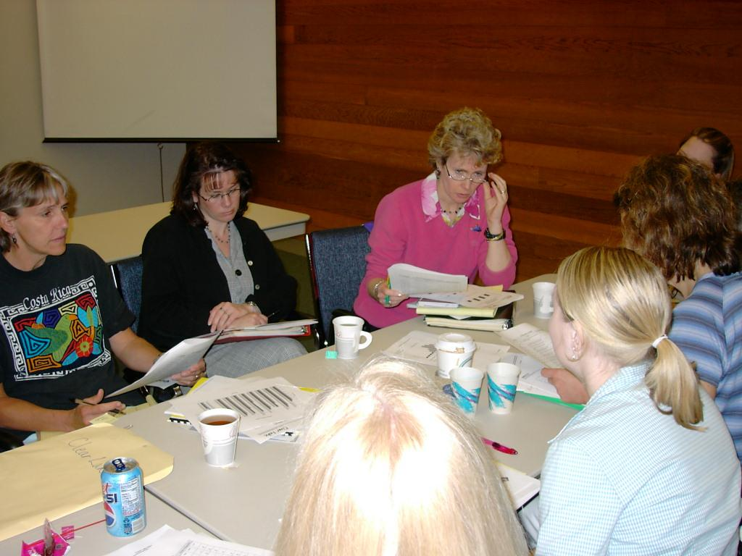
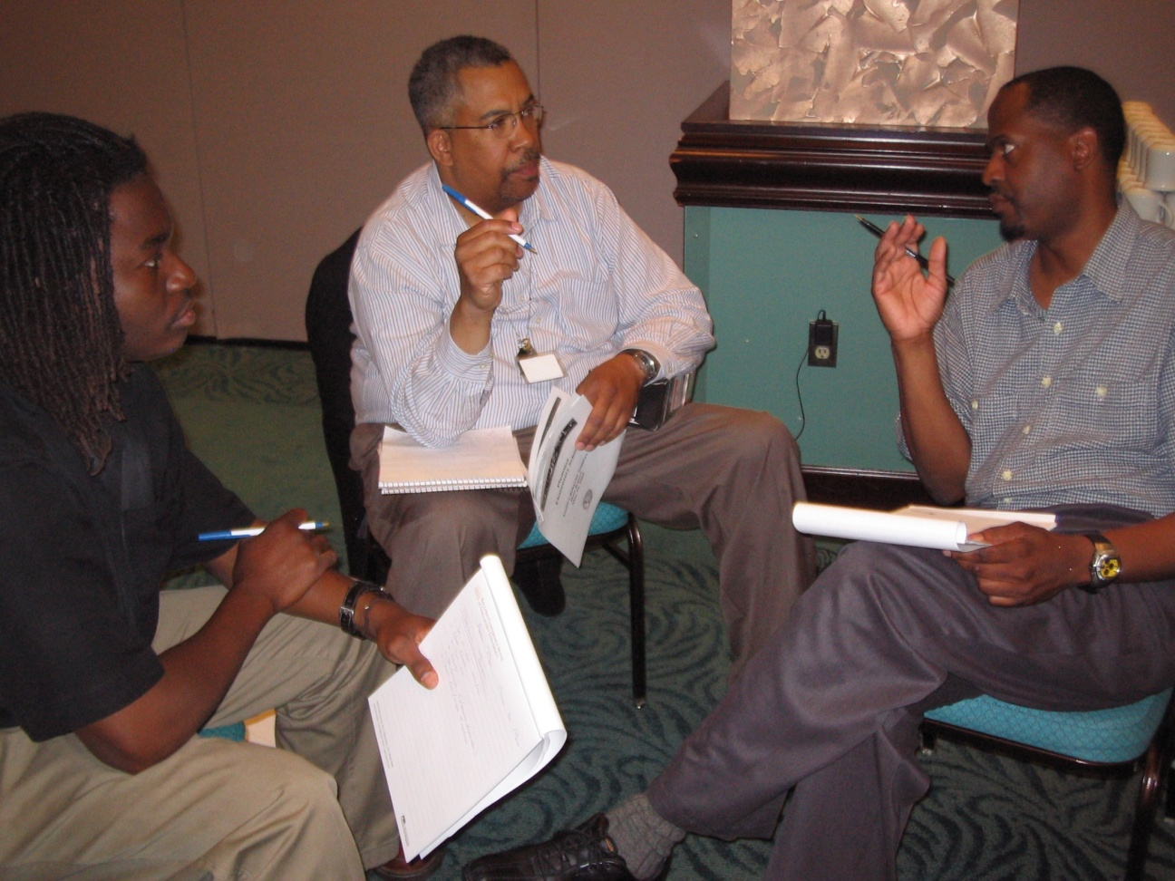
PURPOSE
A couple of leadership lessons from PBIS implementation (& from yesterday & today!)
Sneak in reinforcement of things I agree with!

Slide 4
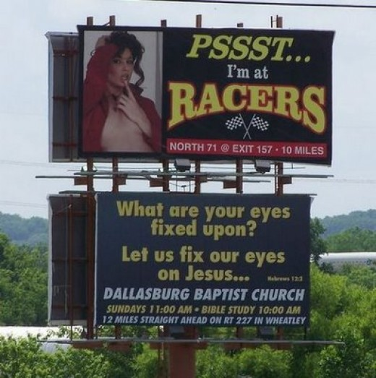
What am I fixed upon?

Slide 5
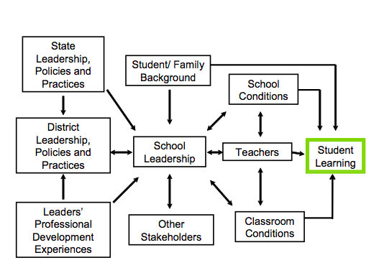
School leadership & contributing factors on student learning.
School Conditions
School Leadership
Teachers
Classroom Conditions
Louis, Leithwood, Wahlstrom, & Anderson (2010).

Slide 6
Administrator Leadership
Collective Leadership
Shared
Distributed
Wahlstrom, Louis, Leithwood, & Anderson, 2010

Slide 7
Planning, Coordinating, & evaluating teaching & curriculum (ES .42)
Promoting & participating in teaching learning & development (ES .84)
Strategic Resourcing (ES .34)
LEADERSHIP DIMENSIONS
Establishing goals & expectations (ES .35)
Ensuring orderly & supportive environment (ES .27)
Robinson (2007)

Slide 8
School leaders needed to turn school around
Be instructional leader & organizational CEO
Hiring & retaining quality teaching force important
5+ years to turn school around to last
Instructional leader transfers 3-4 years
????
Center for Public Education

Slide 9
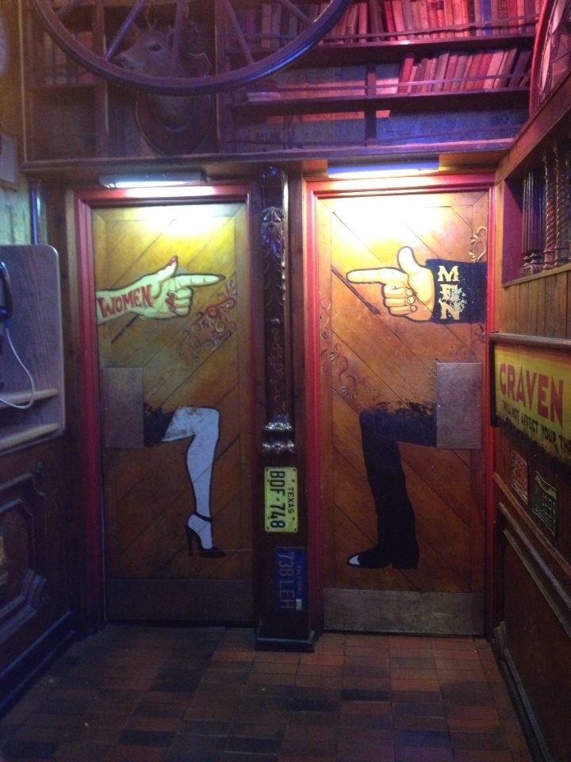
Explicit (v. Experiential), Expert (v. Process), Positively Reinforcing (v. Negative Reinforcing) Leadership Preparation
Leslie Krupa & Jessica Daly
Dark Horse in Boulder
15 Sep 2013
“Which door would you enter?”

Slide 10
“Analyze” wicked problems…but no data
Randy
Making Explicit
Look for outcomes of implementation systems
David
Reauthorization creates opportunities
Sam
Leaders are effective & explicit teachers
Brian
“Doing” works if “doing” is positively reinforced
Ronnie
Research-informed designing backward
Tom
Deliberate preparation of Principal’s as competent instructional leader
Jack
Research- & implementation-based practices
Bryan

Slide 11
Effective Organizations
Common Language
“Organizations are groups of individuals whose collective behaviors are directed toward a common goal & maintained by a common outcome”
Skinner, 1953, Science of Human Behavior
Common Experience
Common Vision/Values
Quality
Leadership

Slide 12
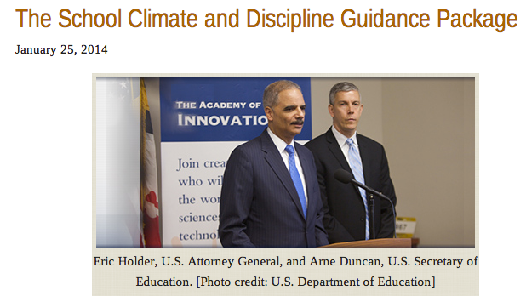

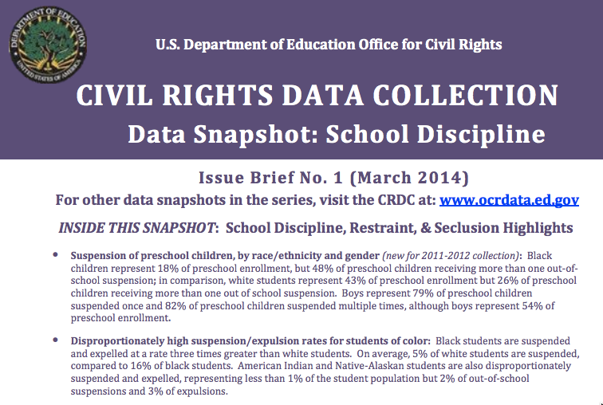
Role of Leadership?
School Climate & Discipline
School Violence & Mental Health
Disproportionality & School-Prison Pipeline

Slide 13
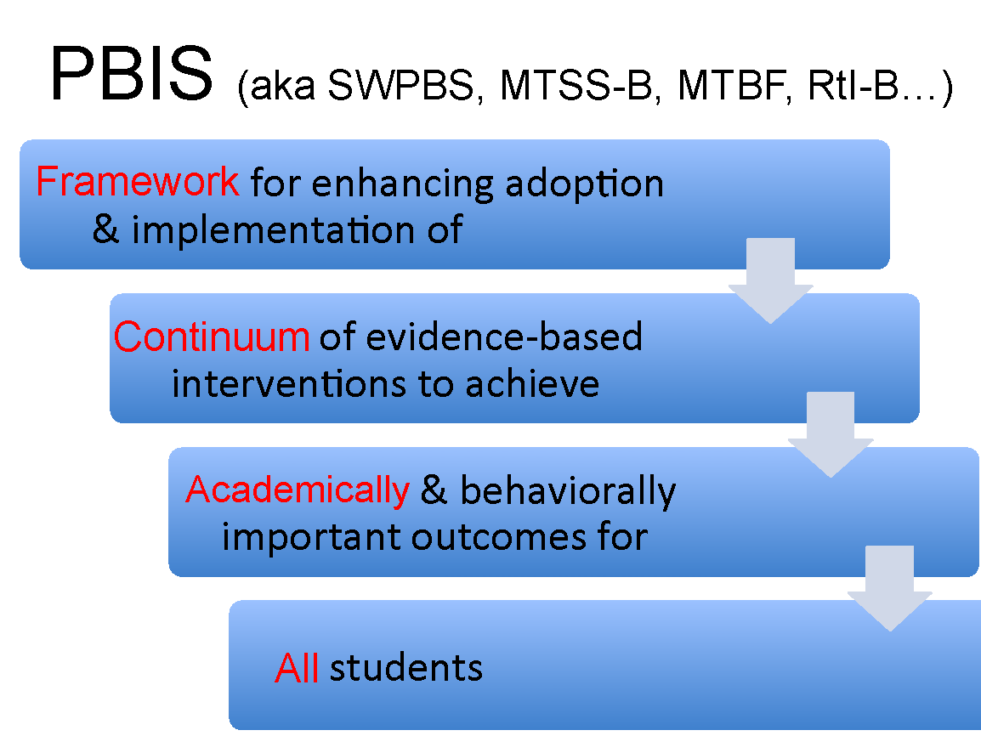
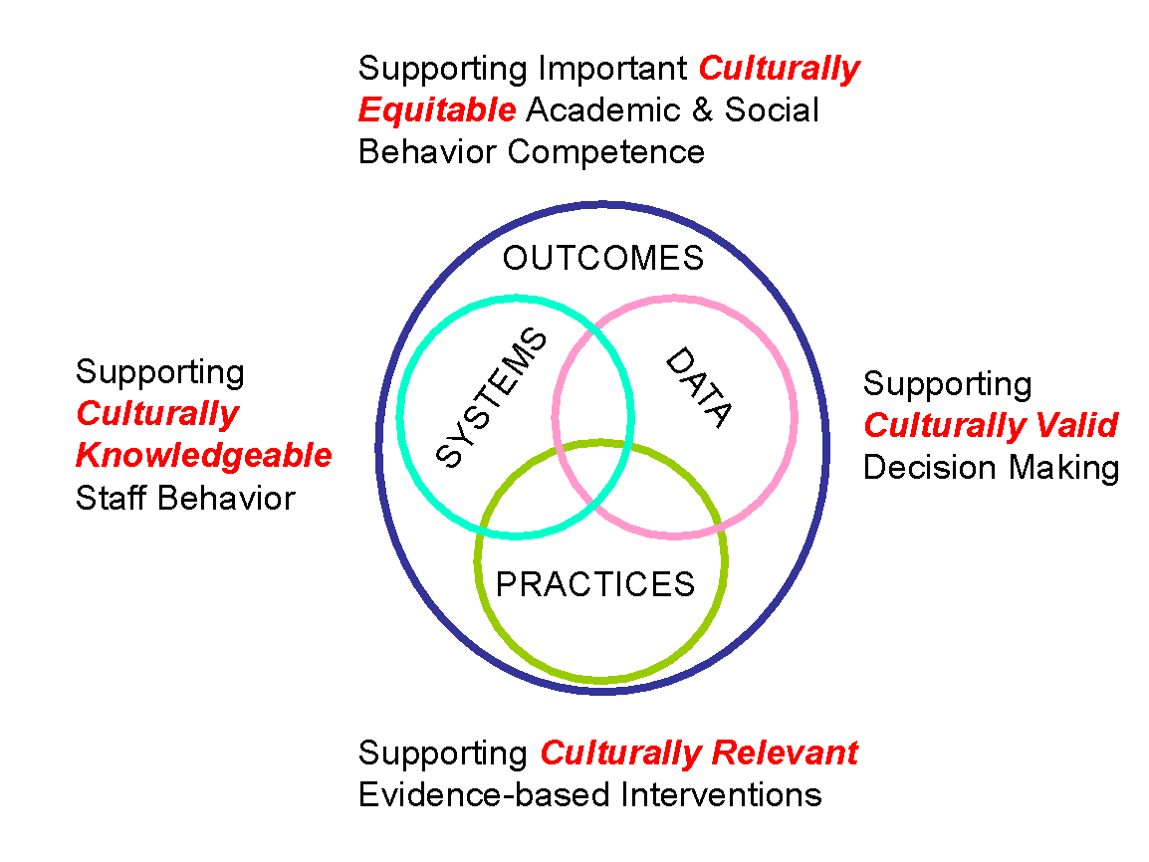
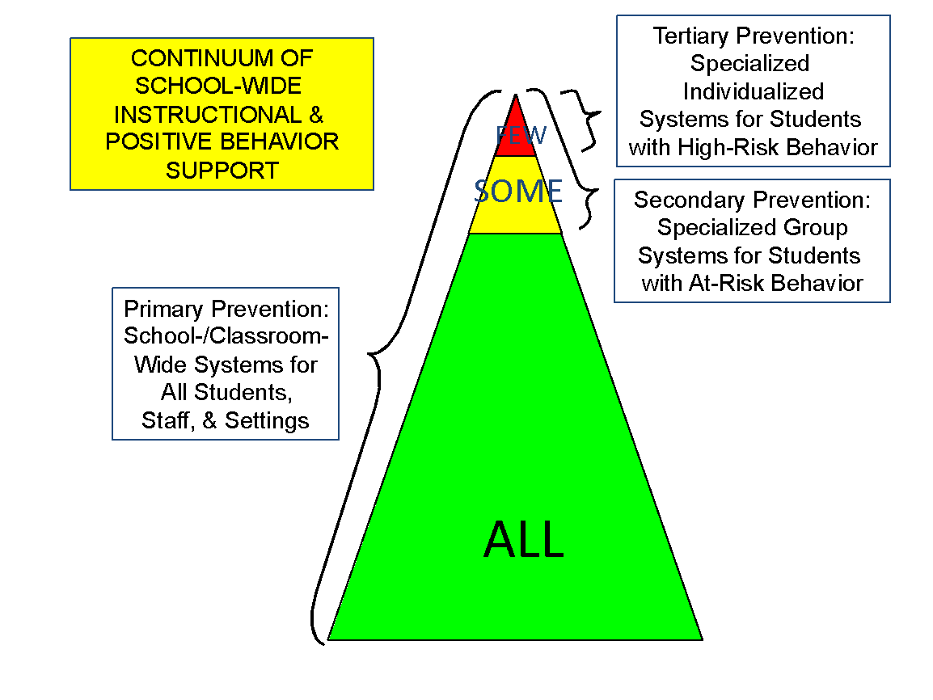
PBIS Framework

Slide 14
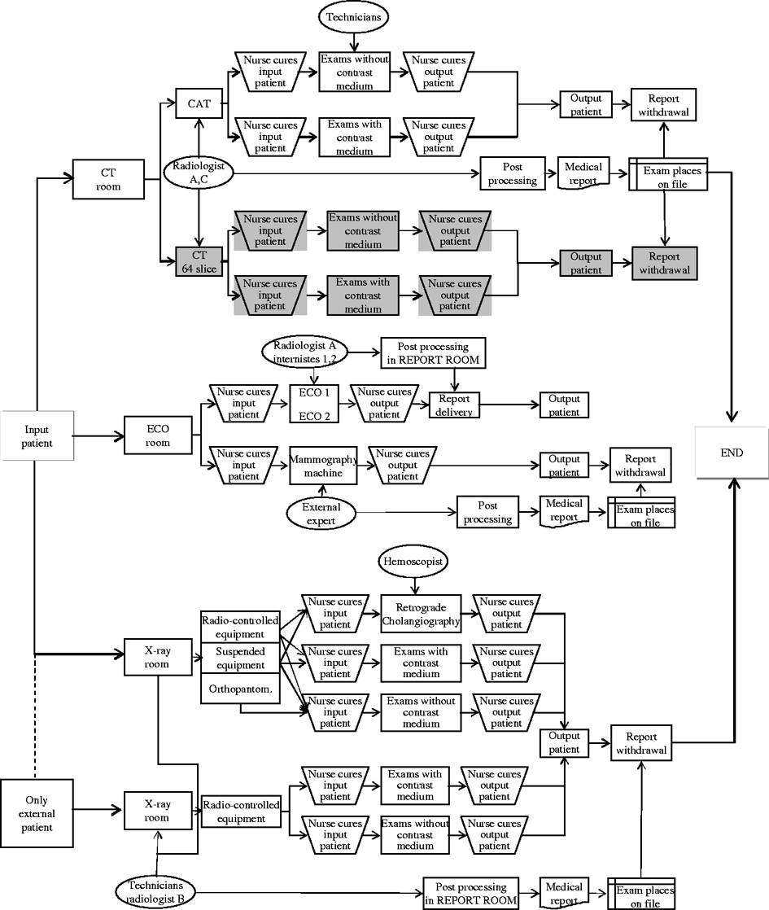
State/District Dept. of _______
“How’s that working for ya?”
Notes:
Lucille quote

Slide 15
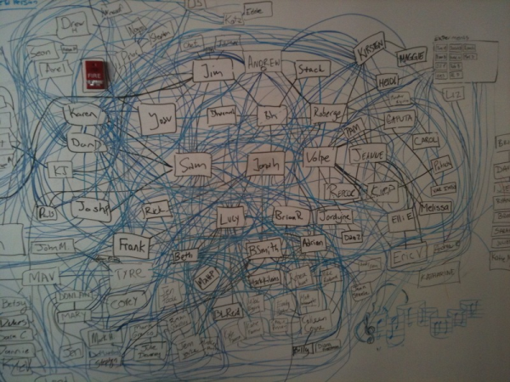

SIG/SPDG
Draw me operational chart of your leadership organization.
Restorative Systems
PBIS Initiative
Social Emotional Learning
GBG & 2nd Steps
Outcome:
SWPBS
RtI/MTSS
SSHS/SDFS
Character Education
School Climate
Alternative Schools
BCBA

Slide 16
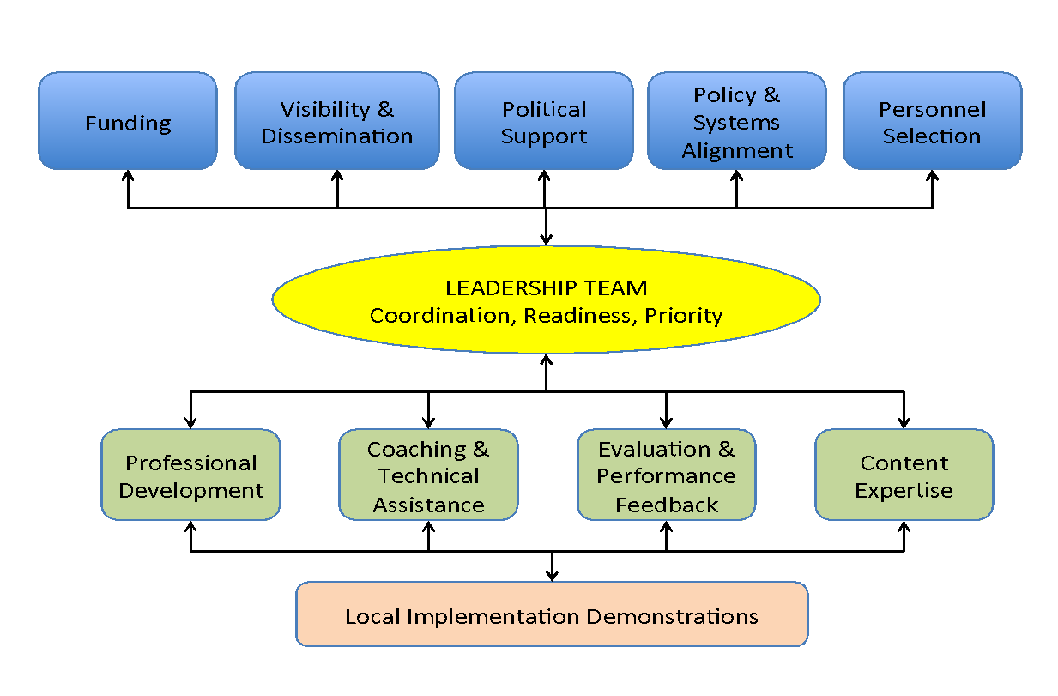
Implementation Drivers

Slide 17
Basic PBIS Implementation Framework
Regional/State Leadership
Internal Coaching Support
School Behavior Team
Student Benefit
  SWPBS practices, data, systems
  Policy, funding, leadership, priority, agreement
  SWPBS
  CWPBS
  Small group
  Individual student
  2 yr. action plan
  Data plan
  Leadership
  Team meeting schedule
  Academic
  Expectations & routines
  Social skills
  Self-management
District Behavior Team
School Staff
External Coaching Support
Team Support
LEADERSHIP

Slide 18
General Implementation Process
Team
State
District
School
Agreements
Students
Staff
Principal, Superintendent
= Leadership
Data-based
Action Plan
“Plan”
Evaluation
“Check”
Implementation
“Do”
All Staff, Students,
Administrators

Slide 19
Technical Assistance
Political Support
Leadership Team
Collect data, analyze, & decide
Select evidence-based practice
Establish measurable outcome
Develop implementation plan/system
Monitor implementation & progress
Arrange to implement with fidelity
Implement deliberately & continuously
Policy
Visibility
School/District/State

Slide 20
What general practices/actions in PBIS leadership?
Team-driven
Universal screening
Instructional leadership
Continuum of evidence-based practices
Continuous progress monitoring
Defendable theory of action & logic model
Application of RtI logic
Data driven decision making
Treatment & procedural fidelity
Scientific method
Prevention science
Behavioral sciences
Professional development
Content fluency
Selection & alignment of practice
Measurable definition of need

Slide 21
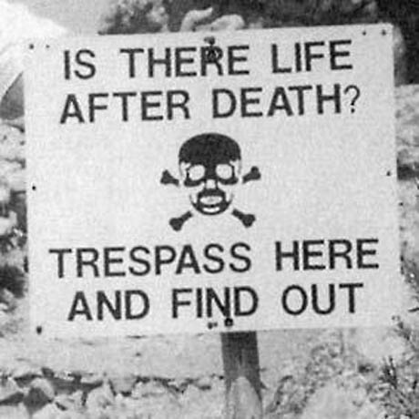
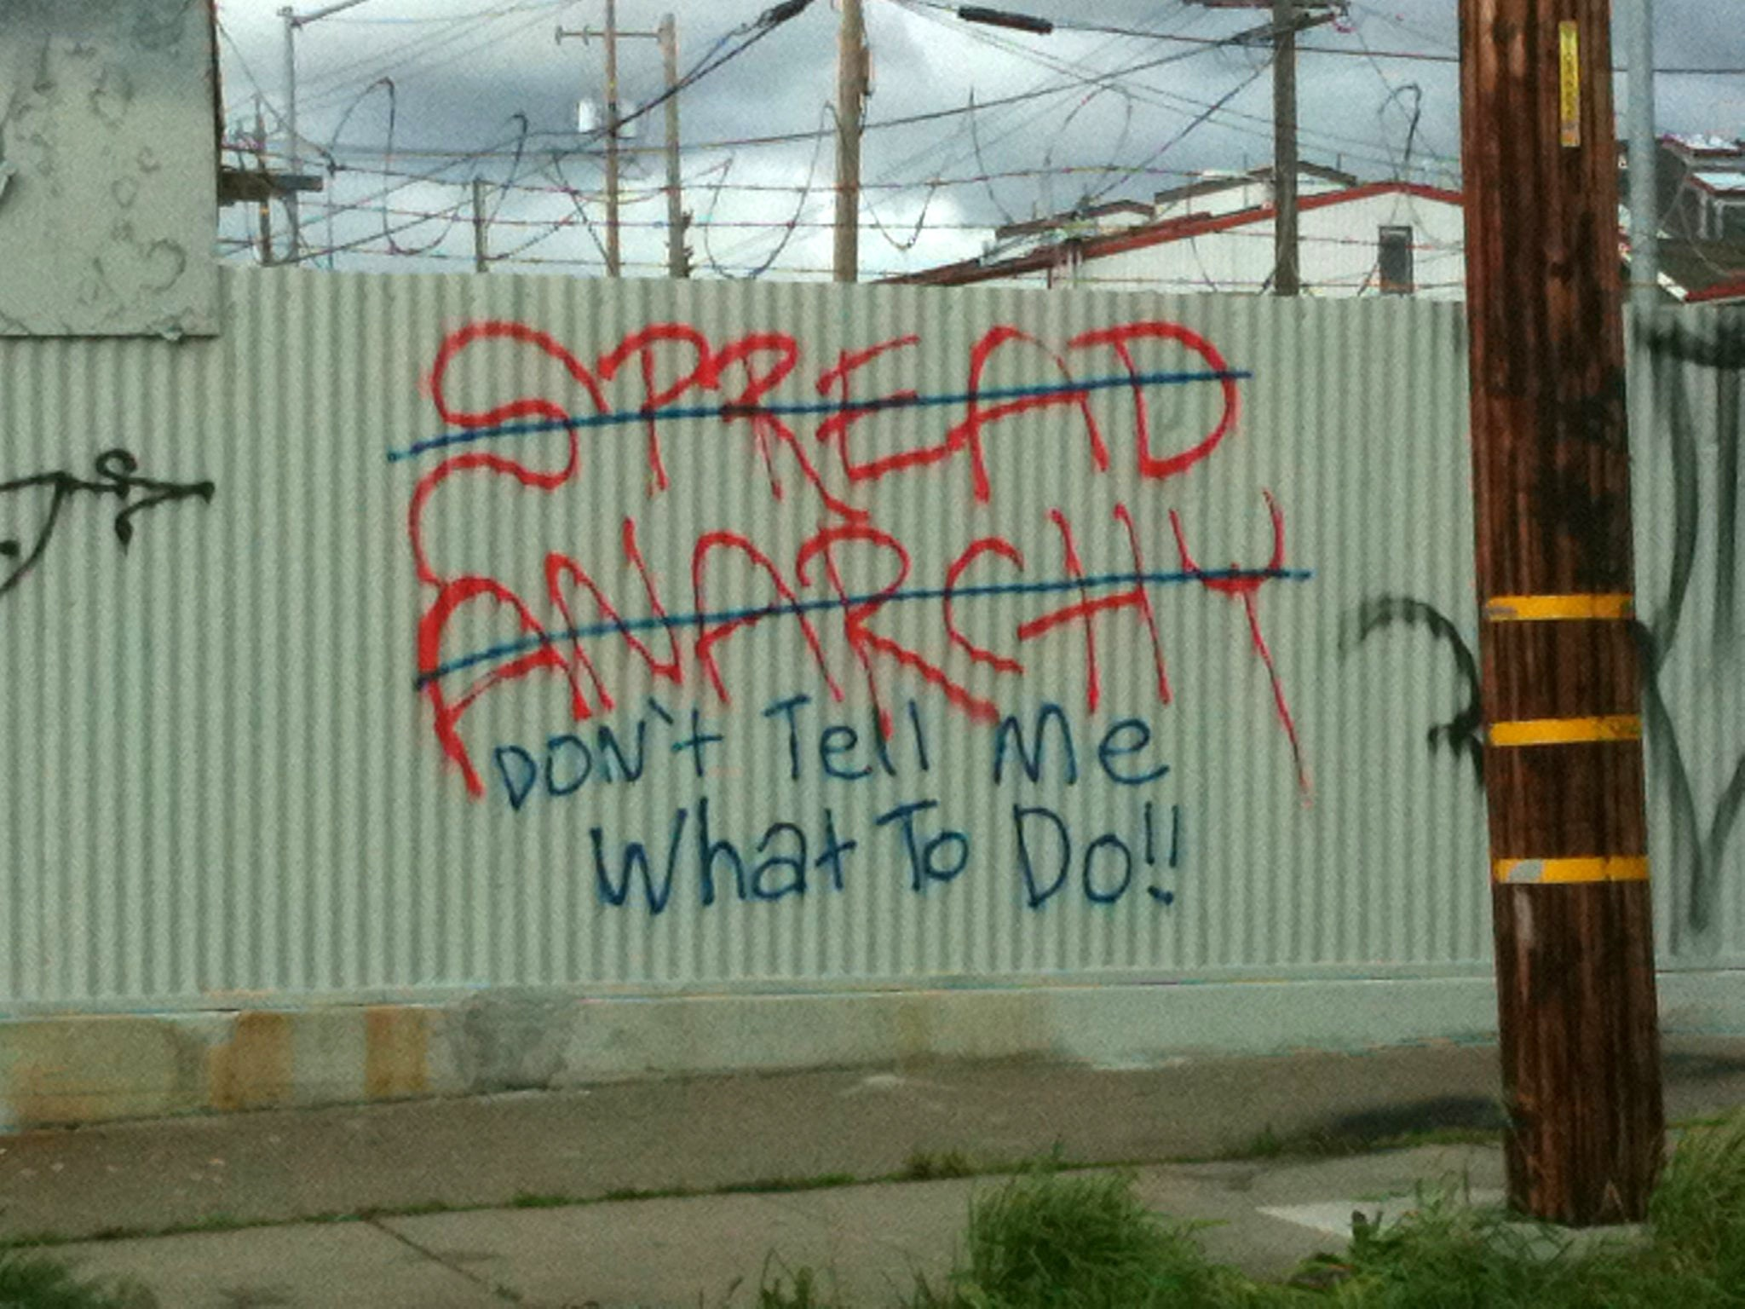
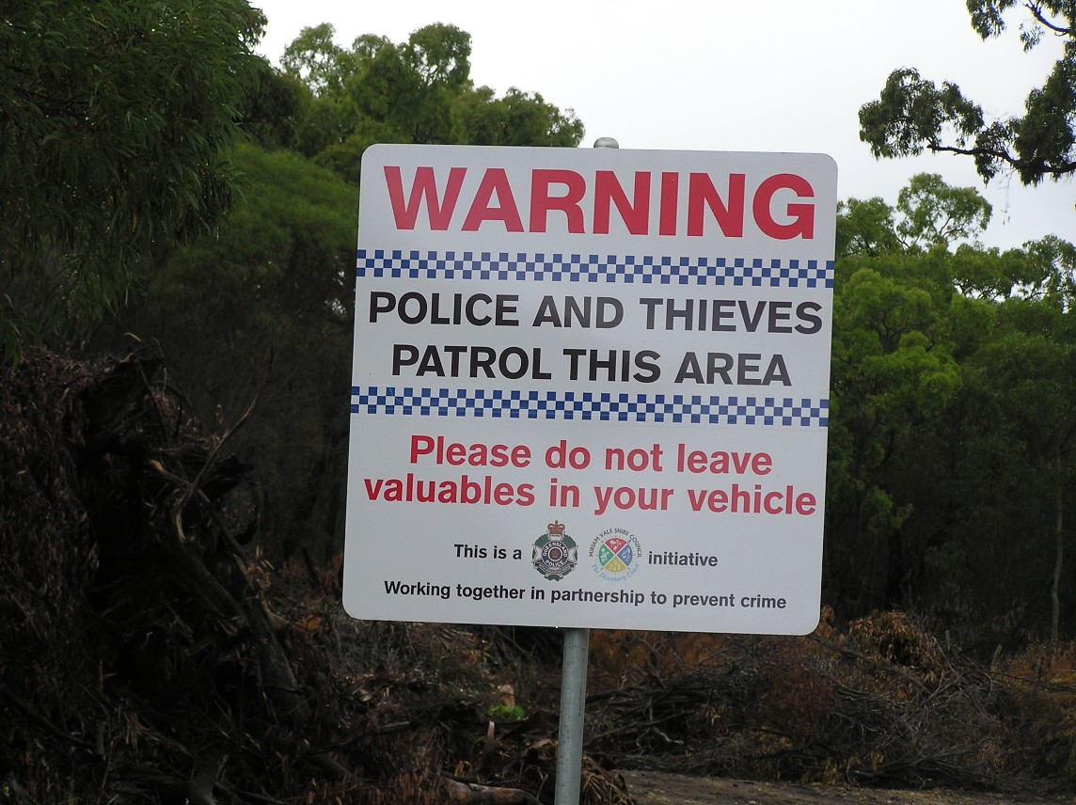
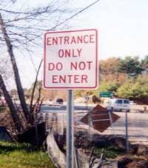
WHAT IS MOTIVATION TO CHANGE?

Slide 22
“Power of Habits”
Charles Duhigg, 2012
CUE
HABIT
REWARD
Healthy diet
Exercise
Problem solving
Reteach SS
  Satisfied?
  Entertained?
  Teasing stops?
  Student removed?
  Dessert
  Tv
  Tease
  Rule violation
  Eat
  Sit
  Hit
  Suspend Student
  Satisfied
  Entertained
  Teasing stops
  Student removed
CHALLENGE: Leadership preparation is capacity to change habits of organizations
Subtitle: “Why We Do What We Do in Life & Business”

Slide 23
Establishing/Replacing Habit
Charles Duhigg (2014)
CUE
  Remove competing cue
  Add desired cue
HABIT
  Teach acceptable alternative
  Teach desired alternative
REWARD
  Remove reward for old habit
  Add reward for new habit
Successful leadership behavior considers all 6 elements

Slide 24
SUGAI LEADERSHIP GUIDING PRINCIPLES
Am I conditioned positive reinforcer?
What’s smallest thing I can do to have biggest effect?
What 2 things can I stop doing to do that 1 new thing?
Will student benefit be maximized?
Am I willing to bet my next month’s salary on that decision?

Slide 25
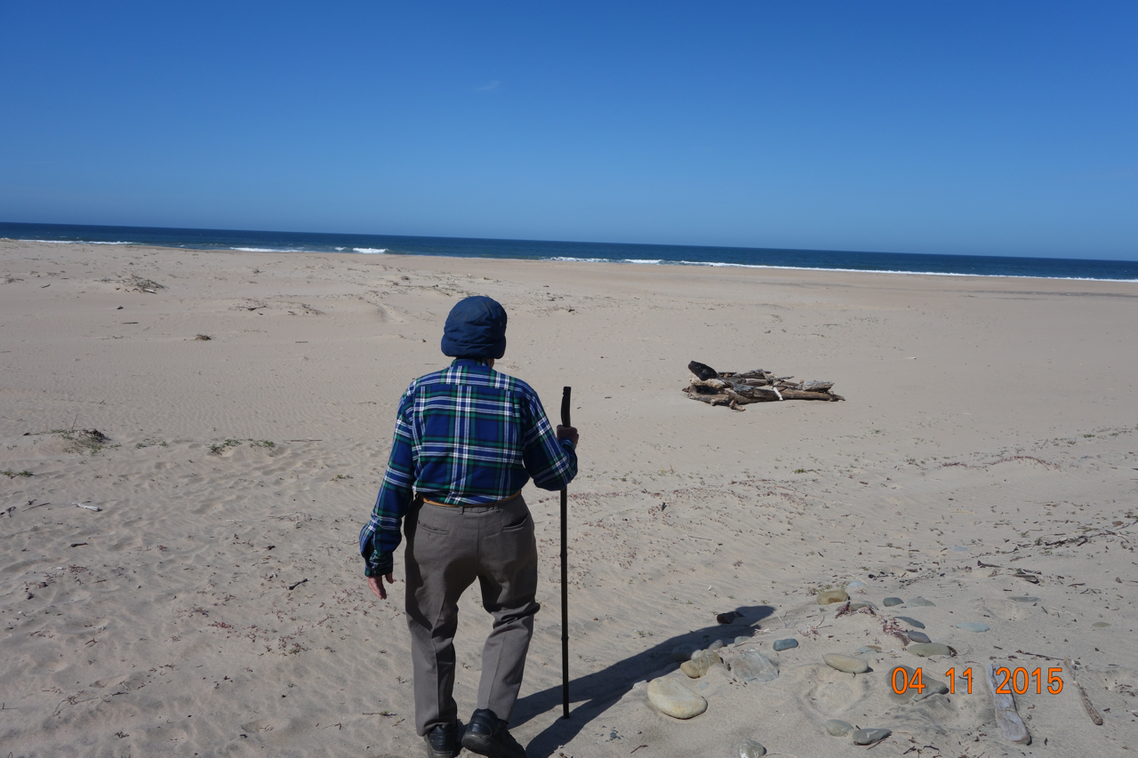
“In sum, I ask you to remain open to the possibility that we could improve human well-being by greatly increasing positive reinforcement for all the prosocial things people do—not simply through extrinsic rewards, which may often be needed, but through all the ways in which we show interest, support, love, and appreciation for what others do” (p. 29)
Biglan, T. (2015). The nurture effect: How the science of human behavior can improve our lives & world. Oakland, CA: Harbinger.

Slide 26
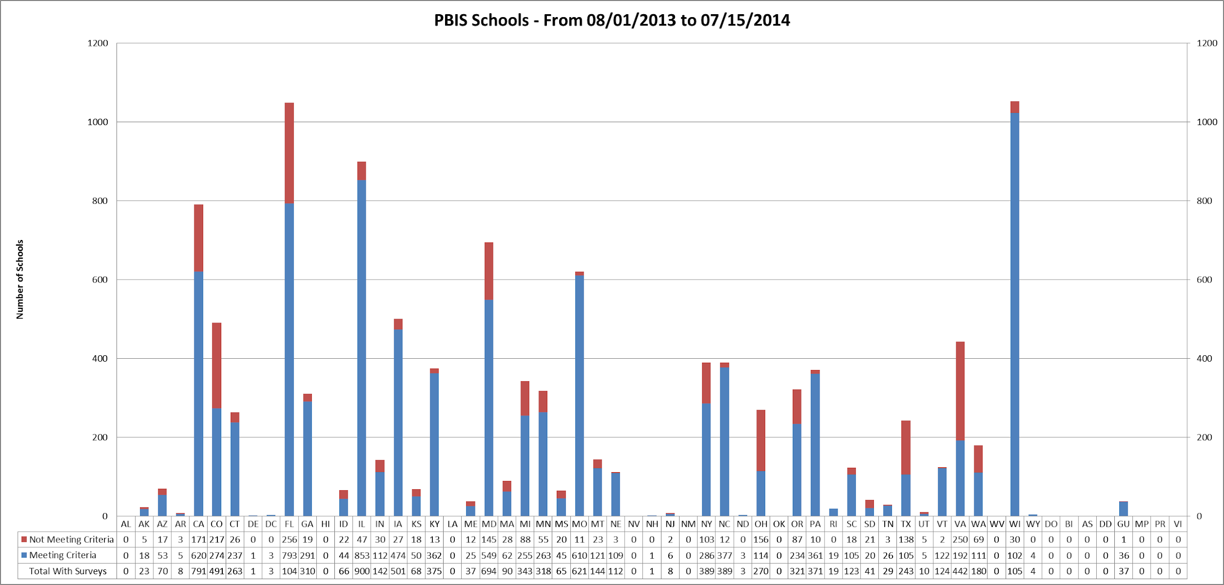
# Reporting & # Meeting (red) T1 Fidelity by State July 2013

Slide 27
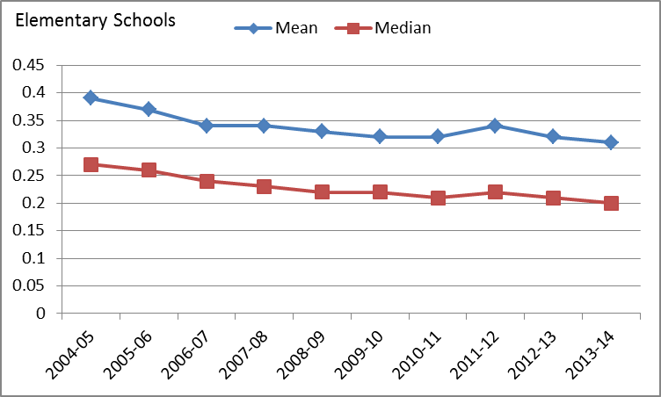
Elem Major ODR

Slide 28
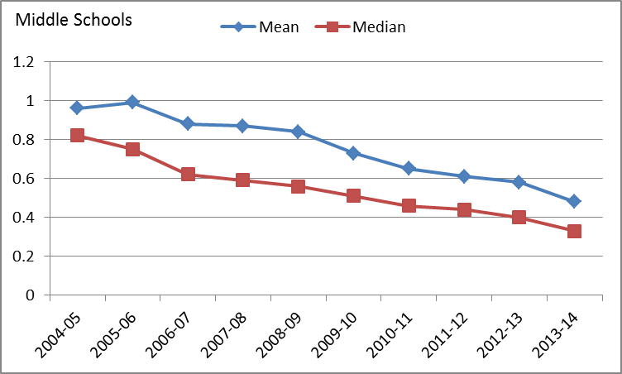
Middle Major ODR

Slide 29
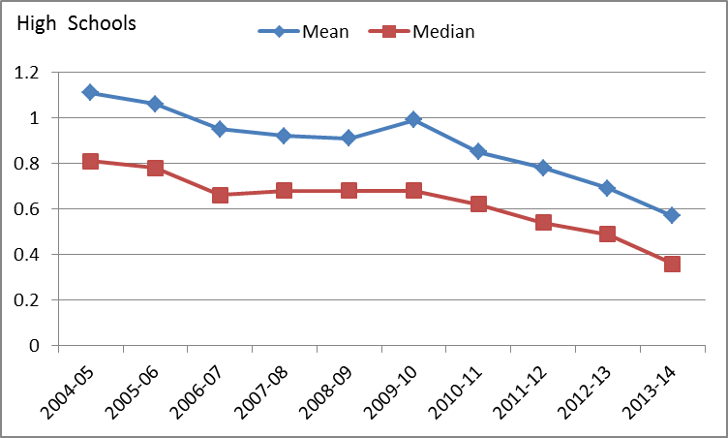
High Major ODR

