Slide 1
Effective Teaching Practices: Narrowing the Field
William L. Heward
The Ohio State University
The Wing Institute’s 8th Annual Salon
Leverage Points for Improving Teacher Effectiveness
April 25-26, 2013

Slide 2
Outline
the problem and assignment
definitions and assumptions
effective teaching practices: some candidates
factors for rating & prioritizing practices
example applied to one practice

Slide 3
Problem & Suspected Cause
Too many students doing poorly in school
Research-to-practice gap
Education research over the past few decades has identified numerous strategies, practices, programs, techniques, models, and curriculum that can improve the quality of education. However, this information is seldom applied in real world classrooms. The education landscape is strewn with practices that have poor or no research backing yet continue to be implemented despite poor performance. ~ Detrich, States, & Keyworth
The separation between research and application in education can be characterized not merely as a gulf but as an abyss. ~ Murray Sidman

Slide 4
Summit Purpose
Try to improve educational practice by answering three questions:
What are effective teaching practices?
How can we best assess teacher performance?
How can we best teach/support these skills?

Slide 5
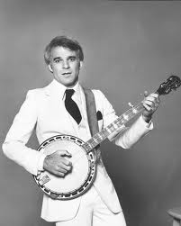
Steve Martin ~
How to become a millionaire.

Slide 6
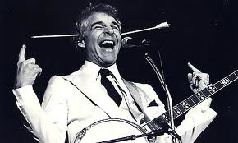
Steve Martin ~
How to become a millionaire.
First, get a million dollars.

Slide 7

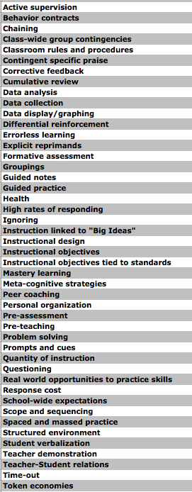

Slide 8
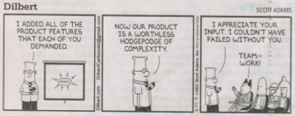

Slide 9
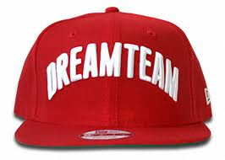
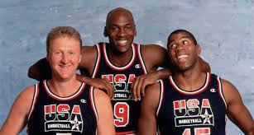

Slide 10

Reserves
Murray Sidman
Steve Martin
Dilbert
Tom Lovitt
Benjamin Bloom
Donald Cook
M.I.T. linguistics prof
Wolfgang Pauli
Casey Stengel
Frank “Bobo” Nickerson
Siegfried Engelmann
Rogers Hornsby
Bill Klem
Ernie Banks
Dick Mallot
B. F. Skinner
Yogi Berra
Dirty Harry

Slide 11
Further work needed to:
sort by level of analysis
sort by function
combine related practices
identify critical features
identify implementation tactics
create “how-to” task/check lists for each tactic
produce tools for assessing teachers’ use of tactics
produce tools for training/supporting teachers’ use of tactics
narrow the field
Notes:
Sort Level of Analysis system, package, tactic, element Sort by function: planning, delivery, evaluation - Combine: formative assessment, data collection, data display/graphing, & data analysis; Sort: principles of differential SR+ guided ID critical features - group contingencies, interdependent, IC’s; ID Tactics - Heads Together, Mystery Motivators; How-to Lists & Tools for assessing & teaching Narrow the field - {SLIDE]

Slide 12
Hard reality: Can’t do it all.
Given the realities that limit pre-service and in-service time and resources, we would like you to prioritize those practices you consider most important.
~ Detrich, States, & Keyworth

Slide 13

And the survey said ..
Notes:
too many, too little time, resources, control. Group asked which were most important practices. Which practices provide the most bang for the buck. The most impact on student learning for the least cost. Suggest some questions/factors that may be helpful in assessing/judging the relative impact and cost considerations of teaching practices. I’ll apply each question to one of the practice element that topped out the summit list, high rates of responding. So you can judge the usefulness/sanity of my take on each impact and cost factor, here are definitions and assumptions that drive/guide my approach.

Slide 14
Definitions
learning – behavior change
teaching – directed/orchestrated learning
curriculum – knowledge/skills to be learned
instruction – methods teachers use to promote learning
effective lesson
immediate - at lesson’s end students know/can do something they didn’t know/couldn’t do before the lesson
longer term - students later use knowledge/skills in relevant settings/situations (maintenance & generalization)

Slide 15
Assumptions
What teachers do/don’t do influences learning.
Effective teaching practices should be identified by their function not their form.
“The proof of the process is in the product.” ~ Tom Lovitt
The more knowledge/skills teachers impart per minute of instruction the better.
Effective teachers focus on alterable variables.
Notes:
per minute: efficiency

Slide 16


Alterable variables . .
reliably affect student learning, and
can be controlled by the teaching practices
~ Benjamin Bloom
Notes:
Examples: time allocated for instruction, selection and sequence of exemplars/non-exemplars of a concept, pacing of instruction, frequency of student responses, whether students make recognition or recall responses, whether, how, and when students receive praise or other forms of reinforcement for their efforts how errors are corrected
Non-examples: genetic, bio-chemical, societal, and cultural factors

Slide 17
Target audience
Teachers in public schools where student achievement is miserable.
Notes:
not the teachers’ fault. Today’s teachers taught poorly.

Slide 18
Poor instruction doesn't simply "fail to teach." Some students, those with a favored history, will learn from it. As a result, poor instruction increases the gap between the haves and the have nots by giving knowledge and skills to favored students only.
~ Donald A. Cook

Slide 19
Target audience
Teachers in public schools where student achievement is miserable.
Many have limited knowledge and skills re: effective instruction
Notes:
not the teachers’ fault. Today’s teachers taught poorly.

Slide 20
Help for struggling readers
Struggling readers most likely experience difficulty in one or more of the essential components of reading: phonemic awareness, word recognition, reading fluency, vocabulary, and comprehension. Corrective instruction needs to focus squarely and rigorously on these essential components of reading. (p. 11) …
Rasinski & Padak - Effective Reading Strategies: Teaching Children Who Find Reading Difficult, 3e (2004)

Slide 21
Yeah, right!
Struggling readers most likely experience difficulty in one or more of the essential components of reading: phonemic awareness, word recognition, reading fluency, vocabulary, and comprehension. Corrective instruction needs to focus squarely and rigorously on these essential components of reading. (p. 11) …
In [this book] we provide descriptions of instructional strategies and activities. As we suggested earlier, however, these strategies are not aimed at remediating any particular or precise skill such as learning consonant blends, mastering sight words, or determining the main idea of a paragraph. (p. 15)
Rasinski & Padak - Effective Reading Strategies: Teaching Children Who Find Reading Difficult, 3e (2004)
Notes:
linguistics prof - was lecturing his class. "In English," he said, "a double negative forms a positive. However, in some languages, such as Russian, a double negative remains a negative. But there isn't a single language, not one, in which a double positive can express a negative." A voice from the back of the room retorted, "Yeah, right."

Slide 22
Belief is key ...
A knowledgeable teacher who can draw from an array of approaches—and believes in the approaches he or she is using—will be an effective reading teacher.
Harp & Brewer - The Informed Reading Teacher: Research-Based Practice (2005, p. 59)

Slide 23
First, decide what you believe
The first step .. is to decide what you believe about the reading process, children as language learners, and role of the teacher. ... Also, you may want to consider the extent to which your beliefs are research- or theory-based.
Rasinski & Padak - Effective Reading Strategies: Teaching Children Who Find Reading Difficult, 3e (2004, p. 224)

Slide 24
Next, create your own theory of pedagogy
To make the most mindful professional decisions, you will need to consider … your own emerging philosophy of literacy instruction.
Harp & Brewer - The Informed Reading Teacher: Research-Based Practice (2005, p. 59)

Slide 25
Then expect unfettered influence
U.S. Secretary of Education Rod Paige pushed to the forefront initiatives that support comprehensive reading programs involving “scripted” materials (i.e., those that literally tell teachers word for word what should be said during instruction). We advocate comprehensive reading programs that call for the unfettered influence of highly educated and skilled teachers in the reading classroom.
Reutzel & Cooter - The Essentials of Teaching Children to Read: What Every Teacher Needs to Know (2005, p. 9)

Slide 26
Target audience
Teachers in public schools where student achievement is miserable.
Many have limited knowledge and skills re: effective instruction
Many hold faulty notions about teaching and learning.
Notes:
Faulty notions, e.g., eclecticism is good, students should construct their own knowledge, isolating skills for instruction renders them meaningless, drill and practices exercises are waste of time. Some ideas crazy things that, in the words of the Nobel prize-winning physicist Wolfgang Pauli, aren’t even wrong. In response to the question, how many do 2+2 make, answers of 3, 5, or 27 are wrong. But the answer “lawn mower” is so far off it’s not even wrong.

Slide 27
Facts about reinforcement*
Fundamental laws of reinforcement were derived by psychologists, such as Pavlov and Skinner, who did research using food to shape the behavior of captive starved lower animals. As such, the “laws of reinforcement” are generalizable to the conditioning of single captive starved lower animals and mentally retarded and very young human students, but not beyond. Therefore, reinforcement is not applicable to human instruction when the objective is academic achievement.
* Friedman and Fisher (1998). Handbook on Effective Instructional Strategies (pp., 233-234). Published by The Institute for Evidence-Based Decision-Making in Education.
Notes:
For example, many educators today believe that behavioral techniques are useful and appropriate only for children with very limited intelligence or severe behavior problems as illustrated in this extract that appears under the heading “Facts About SR+” in a book published by the Institute for Evidence-Based Decision Making in Education. This kind of misinformation and disinformation is not only widely available, it’s required reading in many teacher training programs.

Slide 28
Target audience
Teachers in public schools where student achievement is miserable.
Many have limited knowledge and few skills re: effective instruction.
Many hold faulty notions about teaching and learning.
All face multiple demands and are strapped for time.
Notes:
Assume the worst-case scenario Pick low-hanging fruit idea

Slide 29
One more assumption: Evidence doesn’t matter
Most educational leaders don’t recognize what constitutes meaningful evidence.
When presented with evidence that counters beliefs, beliefs win.
Notes:
You won’t find much of evidence If it did, there would be no need for The Wing Institute for EBP. There is more than enough solid research evidence showing what works. Examples of education disregarding evidence long sad story that continues today.

Slide 30
Notes:
too many, too little time, resources, control. Group asked which were most important practices. Which practices provide the most bang for the buck. The most impact on student learning for the least cost. Suggest some questions/factors that may be helpful in assessing/judging the relative impact and cost considerations of teaching practices. I’ll apply each question to one of the practice element that topped out the summit list, high rates of responding. So you can judge the usefulness/sanity of my take on each impact and cost factor, here are definitions and assumptions that drive/guide my approach.

Slide 31
Impact Factors
scope
size
speed
sustainability
Notes:
4 certain impact factors: Scope first, because the problem is large, so a practice w/o significant scope won’t be highest priority.

Slide 32
Impact Factors Cost Considerations
scope
size
speed
sustainability
money
time
equipment/materials
difficulty to learn/apply
cultural fit
acceptability by students
sustainability
caveats/limitations

Slide 33
Active Student Response
ASR occurs each time a student makes a detectable lesson-related response.
The basic measure of ASR is a count or tally.
The kinds of responses that qualify as ASR are as varied as the kinds of lessons that are taught.
Six Teaching Mistakes (W. L. Heward)

Slide 34
Active Student Response
ASR occurs each time a student makes a detectable lesson-related response.
The basic measure of ASR is a count or tally.
The kinds of responses that qualify as ASR are as varied as the kinds of lessons that are taught.
Words read - Problems solved - Facts stated
Sentences written - Workbook questions answered
Positive comments spoken - Molecules analyzed
Artists identified - Packages sorted - Scales played
Boards cut- Animals classified
Etcetera – Etcetera – Etcetera
Six Teaching Mistakes (W. L. Heward)
Notes:
When all other variables are equal: A high-ASR lesson will produce better achievement than one in which students make few active responses to the lesson's content.

Slide 35

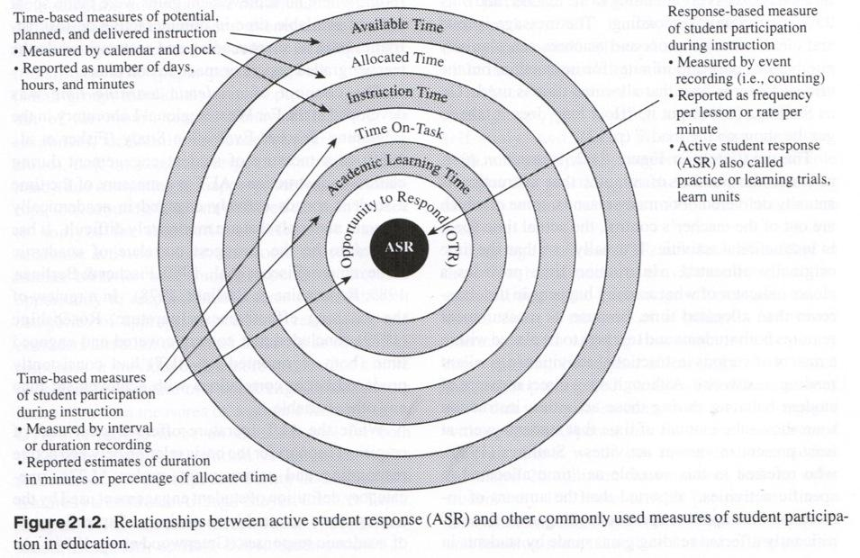
ASR: Frequency-based Variable
Notes:
Time is seen as the ongoing dimension in which all instruction and learning must take place instead of the primary independent variable. In other words, the time that a student is engaged is less important than the number of academic responses the student makes within that time. So: Aim for the bull’s eye on the ASR archery target.

Slide 36

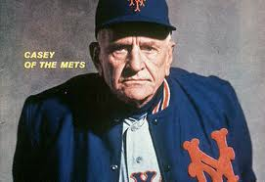
We are a much improved ball club, now we lose in extra innings! ~ Casey Stengel
Notes:
[length of lesson not as important as what happens during the time Morningside: frequent active responding gives a teacher the best ROI, and yes, with giant caveats about the design of the tasks. e do focus alot of our teacher coaching on rate of active student responding. Primary grade programs in beginning reading require approximately 10-15 cpm before students are ready for practice. More advanced reading programs require fewer cpm because response duration is longer. Smaller components are also being combined in more complex tasks which require more prior covert responses ("think time"). For ex we're looking for 8-10 correct main ideas of short passages in 3 min, and 3 correct decisions per minute about whether the author's purpose of a short passage is to inform, entertain or persuade.
Precision Teaching, with higher rate of response criteria for success than during instruction. Our aims range widely, given the tasks, but we're usually talking about 40-120 responses per minute during timings, plus 5-10 responses per minute in the peer coaching time between successive timings.
HeadSprout Early Reading program, learners make an average of 180 responses in a 20 min episode. This is about 9 responses per minute, but these are not simply mouse clicks. We prefer the term learner interactions.

Slide 37
Tactics for increasing ASR:
choral responding
response cards
structured worksheets
fluency-building activities (e.g., repeated reading, SAFMEDs)
classwide peer tutoring
CBI (e.g., Headsprout/Mimeosprout)
collaborative learning groups (e.g., Think-Pair-Share, Heads Together)
guided notes
etc.
Six Teaching Mistakes (W. L. Heward)
Notes:
Headsprout - 9 per min, 180 per 20-min episode/lesson

Slide 38
Tactics for increasing ASR:
choral responding
response cards
structured worksheets
fluency-building activities (e.g., repeated reading, SAFMEDs)
classwide peer tutoring
CBI (e.g., Headsprout/Mimeosprout)
collaborative learning groups (e.g., Think-Pair-Share, Heads Together)
guided notes
etc.
Six Teaching Mistakes (W. L. Heward)

Slide 39
Choral Responding
Students respond orally in unison to each question, problem, or item presented by the teacher.

Slide 40
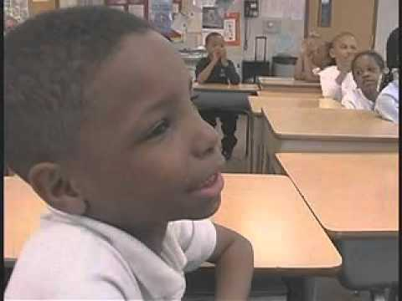
Source: Exceptional Children: An Introduction to Special Education (9th ed.)
by William L. Heward. © 2009 by Pearson Education.

Slide 41
Impact Factors
scope
size
speed
sustainability
Notes:
4 certain impact factors: Scope because there’s lots that needs to be done - Scope first, because the problem is large, so a practice w/o significant scope won’t be highest priority.because there’s lots that needs to be done - Scope first, because the problem is large, so a practice w/o significant scope won’t be highest priority. applies across learners, curriculum content, instructional setting, instructional format, stage of instruction/learning, complements/supports other effective practices.

Slide 42
Scope of Practice
learner variables
age (pre-K to 12)
learner characteristics: typically developing, students with disabilities, gifted/talented
performance level: beginning, competent, advanced
curriculum
3 R’s, academic subjects, social skills, vocational, art/music, etc.

Slide 43
Choral Responding
Appropriate for curriculum content that meets three criteria. Each question . .
has only one correct answer
can be answered with a relatively brief response
is suitable for lively-paced presentation

Slide 44
Scope of Practice
learning channels
hear-say; see-say
instructional settings
whole class, small groups

Slide 45


Group instruction challenges teachers to ..
maintain students' attention
provide each student with sufficient opportunities to respond
provide feedback for student responses
prevent and deal with disruptive behavior
monitor students' learning
Notes:
Teaching more than one student at the same time is difficult. None of you listening and looking in needed me to tell you that, and I’m confident all of you can relate to the challenges posed by group instruction shown here. Just maintaining students’ attention during a lesson is an achievement, and when we manage to do that we often accept it as evidence of a successful lesson.

Slide 46

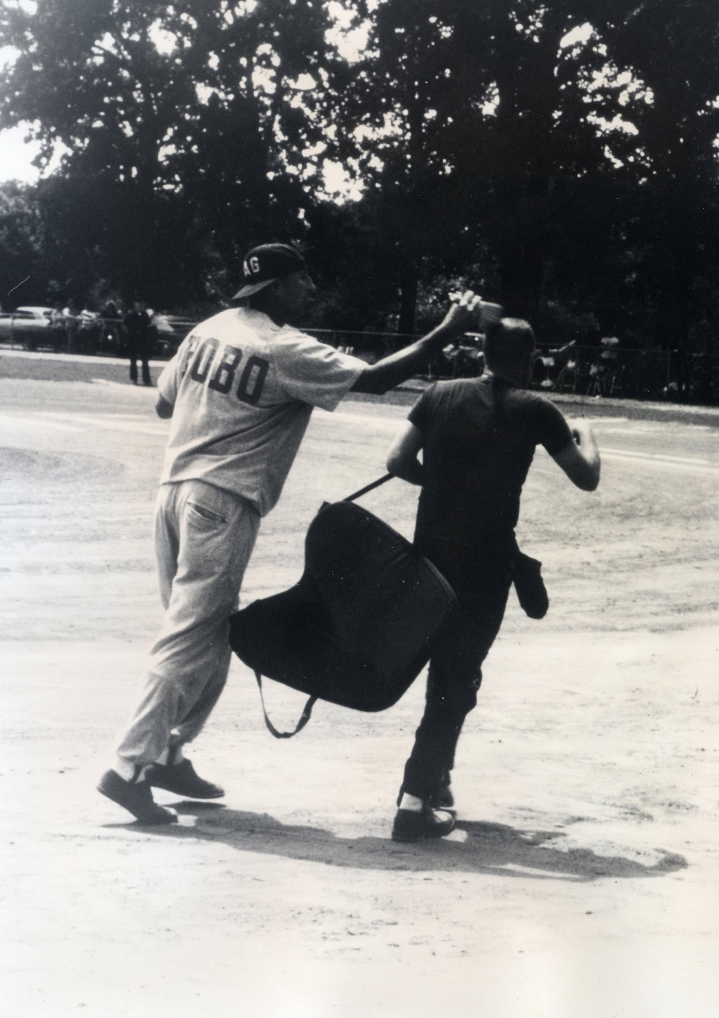

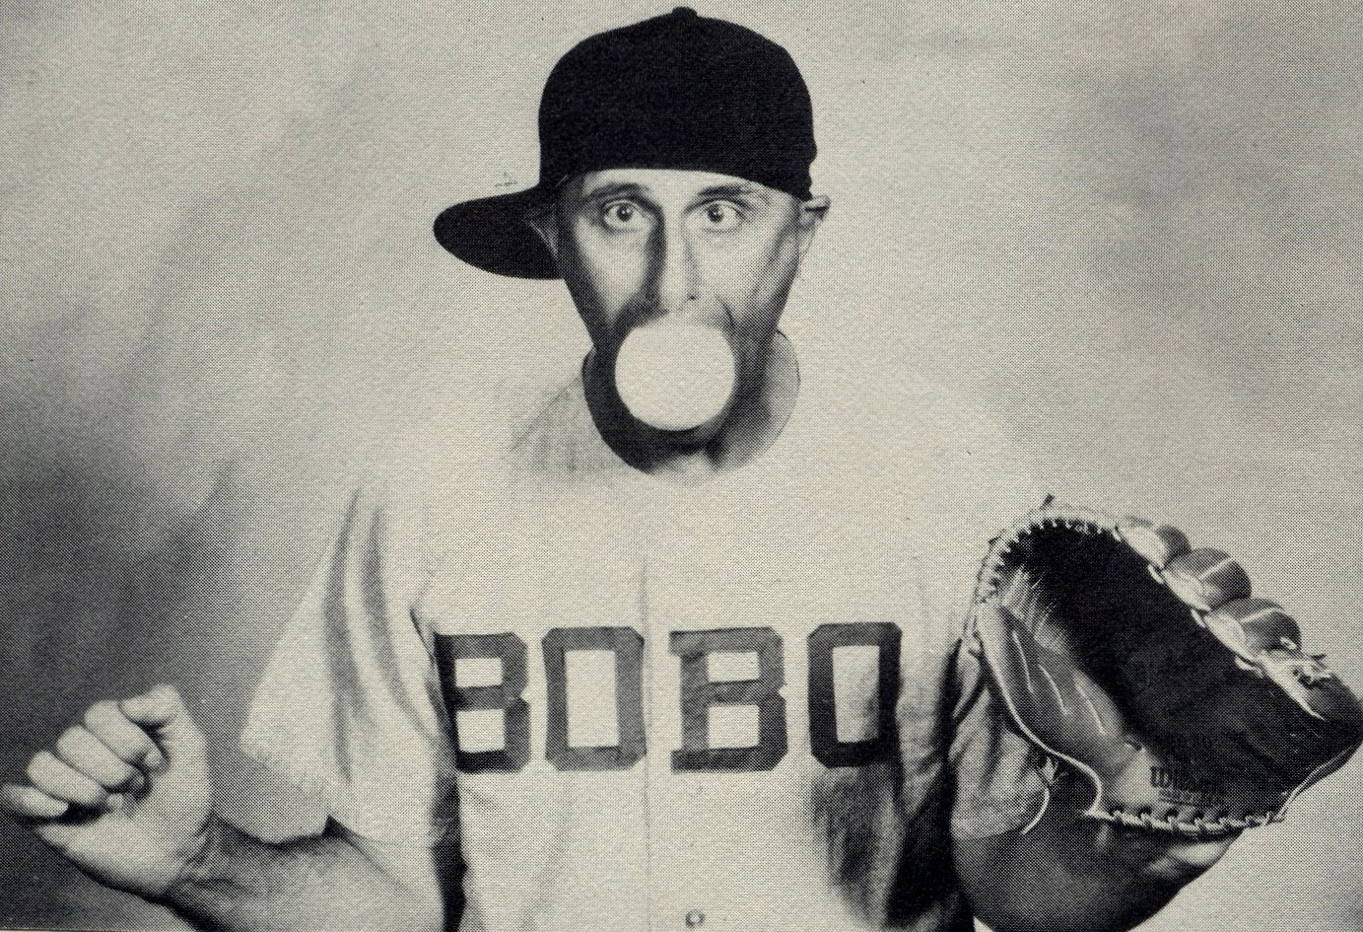
You gotta be low ball hitter and a high ball drinker.
~ Frank “Bobo” Nickerson
Notes:
I mastered only one of those skill areas, need the whole package/don’t teach splinter skills. Gotta do multiple tasks.

Slide 47
Scope of Practice
learning channels
hear-say; see-say
instructional settings/formats
whole class, small groups
teacher directed, can be student-directed
stage of instruction/learning
acquisition, practice, fluency, application, generalization, review

Slide 48
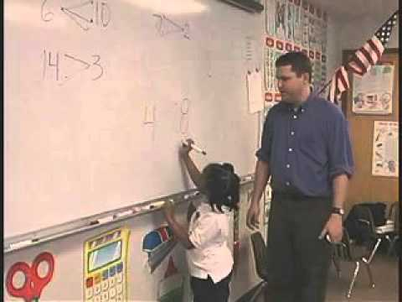
Source: Exceptional Children: An Introduction to Special Education (9th ed.)
by William L. Heward. © 2009 by Pearson Education.

Slide 49
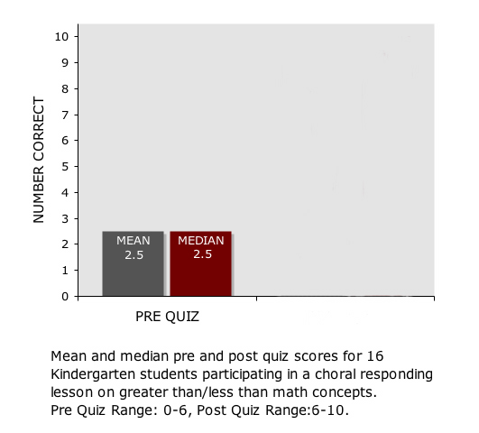

Slide 50
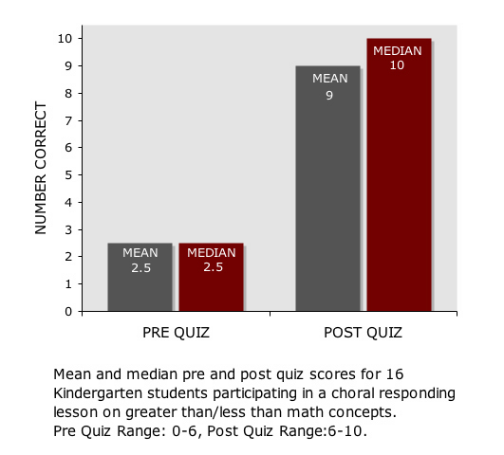

Slide 51
Scope of Practice
collateral benefits
more on-task behavior
less off-task/disruptive behavior
better classroom climate
Notes:
especially when conducted at brisk pace with brief ITI’s
Carnine ’76 in JABA ->

Slide 52

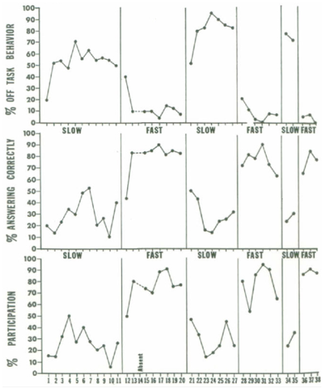
The recommendation to conduct choral responding at a lively pace is supported by research showing that when teachers present items to students with short inter-trial intervals (e.g., 1-2 sec), students
emit more responses compared to lessons with longer inter-trial intervals
respond with higher accuracy
engage in less off-task, self-stimulatory, and disruptive behavior
Six Teaching Mistakes (W. L. Heward)
Carnine, D. W. (1976). Effects of two teacher presentation rates on off-task behavior, answering correctly, and participation. Journal of Applied Behavior Analysis, 9, 199-206.

Slide 53
Scope of Practice
collateral benefits
more on-task behavior
less off-task/disruptive behavior
better classroom climate
use of other EBP’s
more teacher praise
systematic error correction

Slide 54
The Major Difference
The major difference between the average Reading Mastery I teacher, who teaches most of the children, and the outstanding teacher, who teaches all of the children, is the ability to correct.
- Siegfried Engelmann

Slide 55
Scope of Practice
collateral benefits
more on-task behavior
less off-task/disruptive behavior
better classroom climate
use of other EBP’s
more teacher praise
systematic error correction
more formative assessment
Notes:
responses by students during CR enables formative/on-going assessment of lesson’s effectiveness (thus student learning) PROVIDE FEEDBACK TO TEACHER

Slide 56

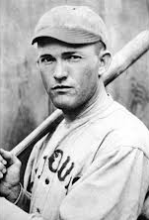
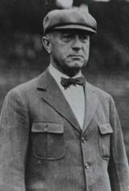
Son, when you pitch a strike, Mr. Hornsby will let you know. ~ Umpire Bill Klem
Rogers Hornsby
Bill “It An’t Nothin’ Until I Call It” Klem
Notes:
Rogers Hornsby one of greatest hitters of all-time. A rookie pitcher was facing Hornsby. Threw pitch close to plate, ump Bill Klem called it a ball. Pitcher scowled. Ball 2. Son, when you pitch a strike Mr. H. will let you know Like Rogers Hornsby’s unquestioned ability to judge a strike, students are best source of info when we teach a good lesson, our students will let us know -- but only if we put bats in their hands If we teach effectively, students will let us know.

Slide 57
Scope of Practice
collateral benefits
more on-task behavior
less off-task/disruptive behavior
better classroom climate
use of other EBP’s
more teacher praise
systematic error correction
more formative assessment
other ASR tactics!

Slide 58
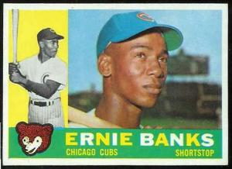
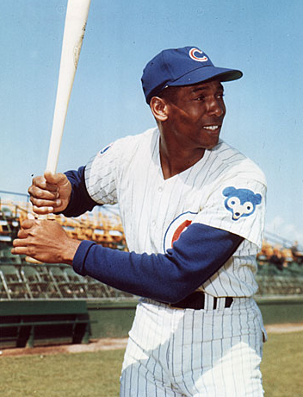
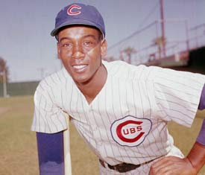
“It's a great day for a ball game; let’s play two!”

Slide 59
Tactics for increasing ASR:
choral responding
response cards
structured worksheets
fluency-building activities (e.g., repeated reading, SAFMEDs)
classwide peer tutoring
CBI (e.g., Headsprout/Mimeosprout)
collaborative learning groups (e.g., Think-Pair-Share, Heads Together)
guided notes
etc.
Six Teaching Mistakes (W. L. Heward)

Slide 60


Response Cards
Cards, signs, or other items all students in the class hold up simultaneously to display their responses to questions or problems presented by the teacher.
Notes:
A potential advantage of RC over choral responding: easier for teacher to assess each student’s performance.

Slide 61
Tactics for increasing ASR:
choral responding
response cards
structured worksheets
fluency-building activities (e.g., repeated reading, SAFMEDs)
classwide peer tutoring
CBI (e.g., Headsprout/Mimeosprout)
collaborative learning groups (e.g., Think-Pair-Share, Heads Together)
guided notes
etc.
Six Teaching Mistakes (W. L. Heward)

Slide 62
Size & Speed of Effect
huge, immediate increases in ASR:
educationally significant increases in learning outcomes
experimental analyses show students earn higher scores on post-lesson quizzes/tests over material taught with CR
evidence of learning after 1 session
both factors greatly dependent upon quality of lesson design
Notes:
More responses in first 15 min than most kids do all day Hermosillo video – 1st and 2nd graders

Slide 63

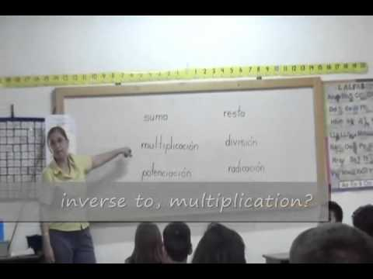
1st Graders: Arithmetic Operations
Six Teaching Mistakes (W. L. Heward)
Video courtesy Nuevos Horizontes School - Hermosillo, México

Slide 64

2nd Graders: Algebra
Six Teaching Mistakes (W. L. Heward)
Video courtesy Nuevos Horizontes School - Hermosillo, México

Slide 65
Sustainability of Effect
greatly dependent upon quality of lesson design; extent to which lesson design to promote generalization and maintenance
Notes:
More responses in first 15 min than most kids do all day Hermosillo video – 1st and 2nd graders

Slide 66
Money, Equipment, Time Requirements
$0.00 required
no special equipment or materials needed
time needed to prepare depend upon curriculum content/lesson objectives
implementation time ranges from 5-30 min per school day
Notes:
use in various parts/times of day and lesson

Slide 67
How Difficult to Learn/Apply
with coaching and performance feedback teacher can become reasonably competent in 1 week and highly skilled in about a month
many teachers can attend a workshop or webinar/read a how-manual and begin using CR with positive effects
Notes:
of course most things are bit more involved than they appear, skilled teachers make CR look like a breeze -- but there aren’t too many moving parts (pacing, signals, praise, correction procedures, having fun) teachers start using the practice with positive impact (tomorrow better than next week; next month better than next – S. Korea slides

Slide 68
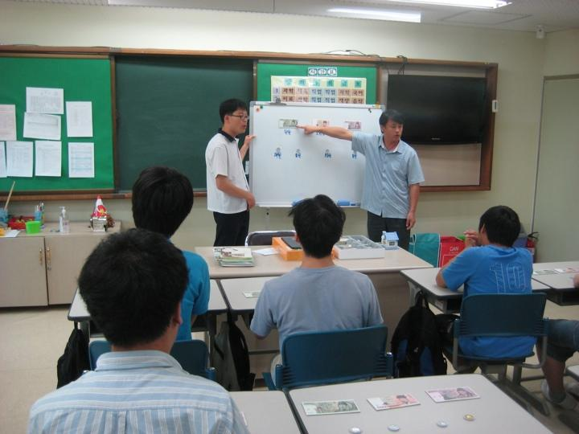
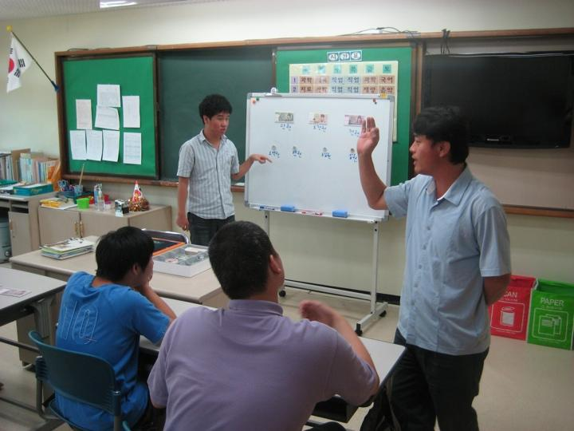
Using Choral Responding to Teach Money Skills to Secondary Students with Disabilities in Seoul, S. Korea

Slide 69

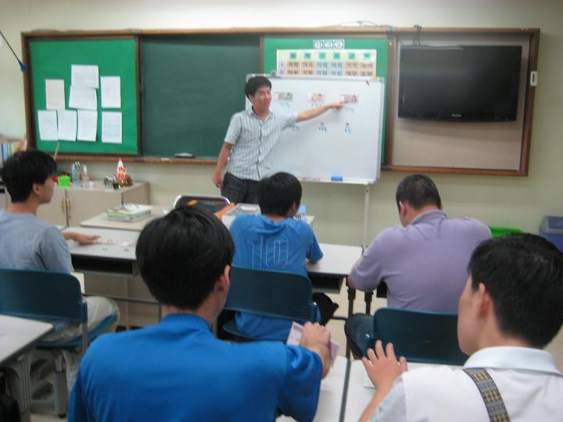
Mr. Yoon’s Students Use Choral Responding to Teach Money Skills to Each Other

Slide 70
Logistical Fit with Demands on Teachers
can be into part of lessons at various times of school day
Notes:
review/preview -- intersperse CR in lecture/demonstration, even used CR during transitions

Slide 71
Cultural Fit Teachers
POSITIVE - consistent with two nearly universal goals of teachers:
increase student participation
decrease off-task/disruptive behavior
Notes:
consistent with widely held ideas about teaching & learning/instruction better than opposing) -- ask 1,000 teachers
teachers want to decrease off-task

Slide 72
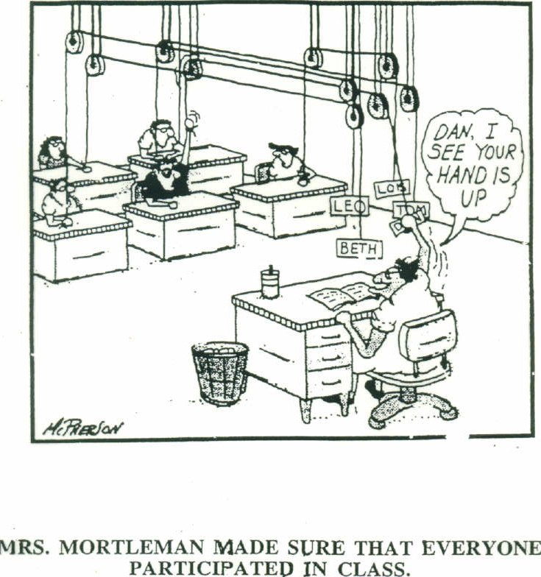
One way to make sure students participate!
Notes:
how to do it when -- it’s an engineering progra

Slide 73
Cultural Fit Teachers
NEGATIVE: at odds with commonly held beliefs teachers
drill & practice produces only “rote learning” and dulls students’ creativity
simple responses don’t enable students to achieve deep understanding
too structured/fast paced/consistent
association with Direct Instruction
students should construct their own meanings
Notes:
Kyle is strong swimmer. All Navy Seals
DI association -- source of best data on effectiveness of CR is also “kiss of death” for many teachers who’ve been told that DI is bad news
How can misguided/misinformed notions assumptions be countered/neutralized?

Slide 74
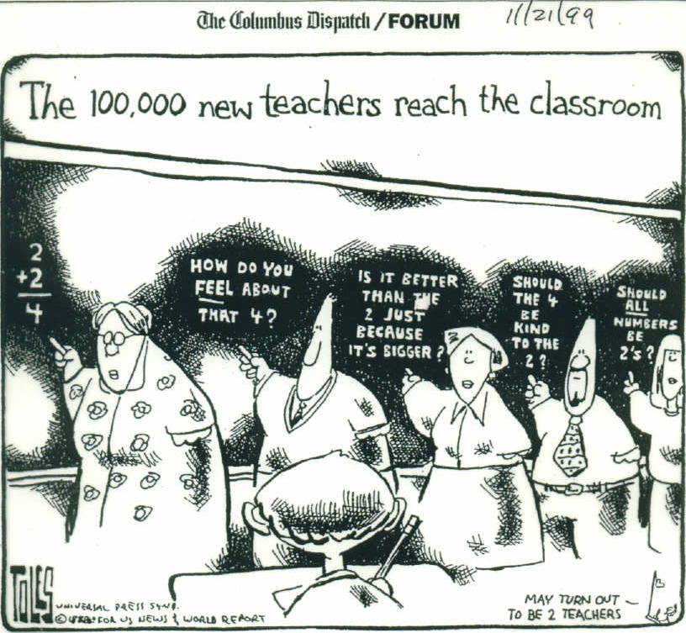
Six Teaching Mistakes (W. L. Heward)

Slide 75
Acceptability by Students
students prefer being active over having to be still, quiet and docile
students like making many correct responses
lots of ways to have fun with CR
Notes:
acceptability by students (social validity) (students prefer “it” to alternative/usual practice better than they say it’s okay, in tern better than they don’t like it)
overwhelmingly prefer CR to hand raising - lots of correct responses: successful -
Fun?

Slide 76


A behavioral analysis of fun
It’s gotta be fun, or else . .

Slide 77

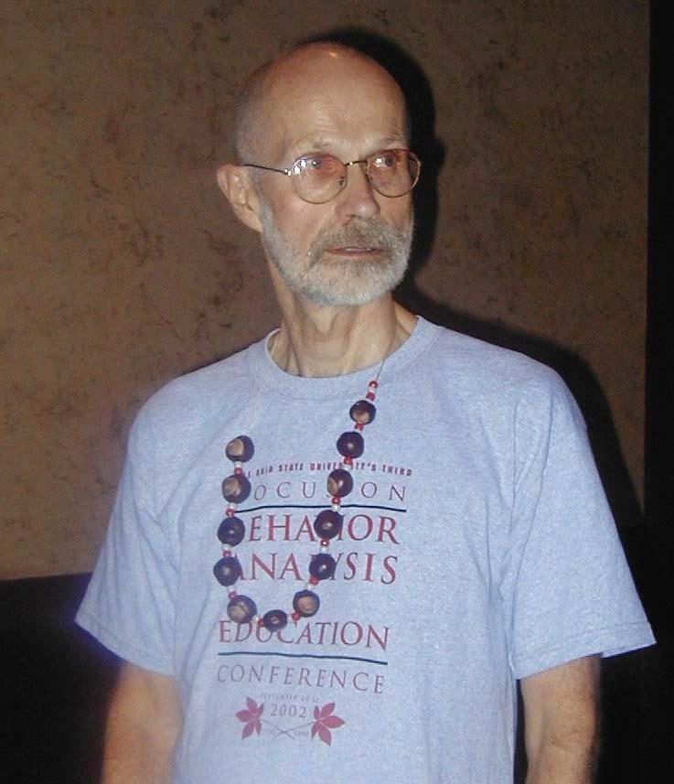
A behavioral analysis of fun
It’s gotta be fun, or else . .
it won’t be fun!
Richard W. Mallot
(1968, 1969, 1970, . 2012, 2013)

Slide 78
Have Fun with Choral Responding
Students as teachers
Speed-up/Slow-down
Match my voice
Simon Says
Back and forth counting
Group contingencies/rewards
Teacher-Student game
Hot Potato/Around the World

Slide 79

Source: Exceptional Children: An Introduction to Special Education (9th ed.)
by William L. Heward. © 2009 by Pearson Education.

Slide 80

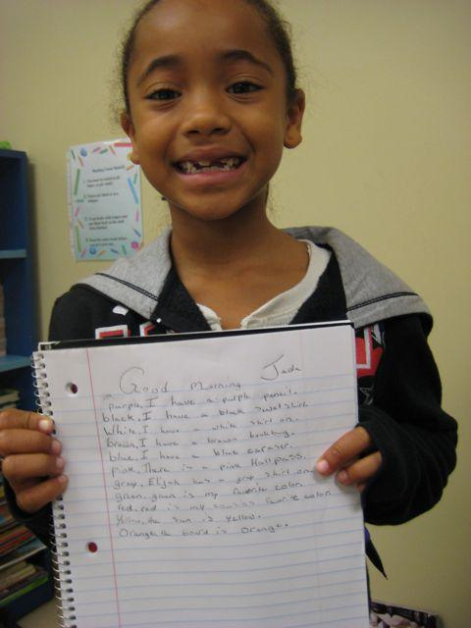
A Powerful Reinforcer
It does not need to be contrived for instructional purposes; it is unrelated to any particular kind of behavior and hence always available. We call it success.
~ B. F. Skinner

Slide 81
Sustainability of Practice
POSITIVE INFLUENCES -
student achievement
decreased off-task behavior
Notes:
likelihood of teachers maintaining the practice – 162-game season, not for the meek and mild -- 180-day school year -- continued learning good, likely when teacher can see it, but reductions in off-task behavior -- a lot of lessons begin well, but students drift off and get fussy as lesson goes on -- sometimes that happens pretty quickly or as Yogi would say

Slide 82

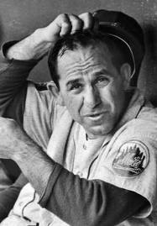
It gets late early out there. ~ Yogi Berra
Notes:
gets late early

Slide 83
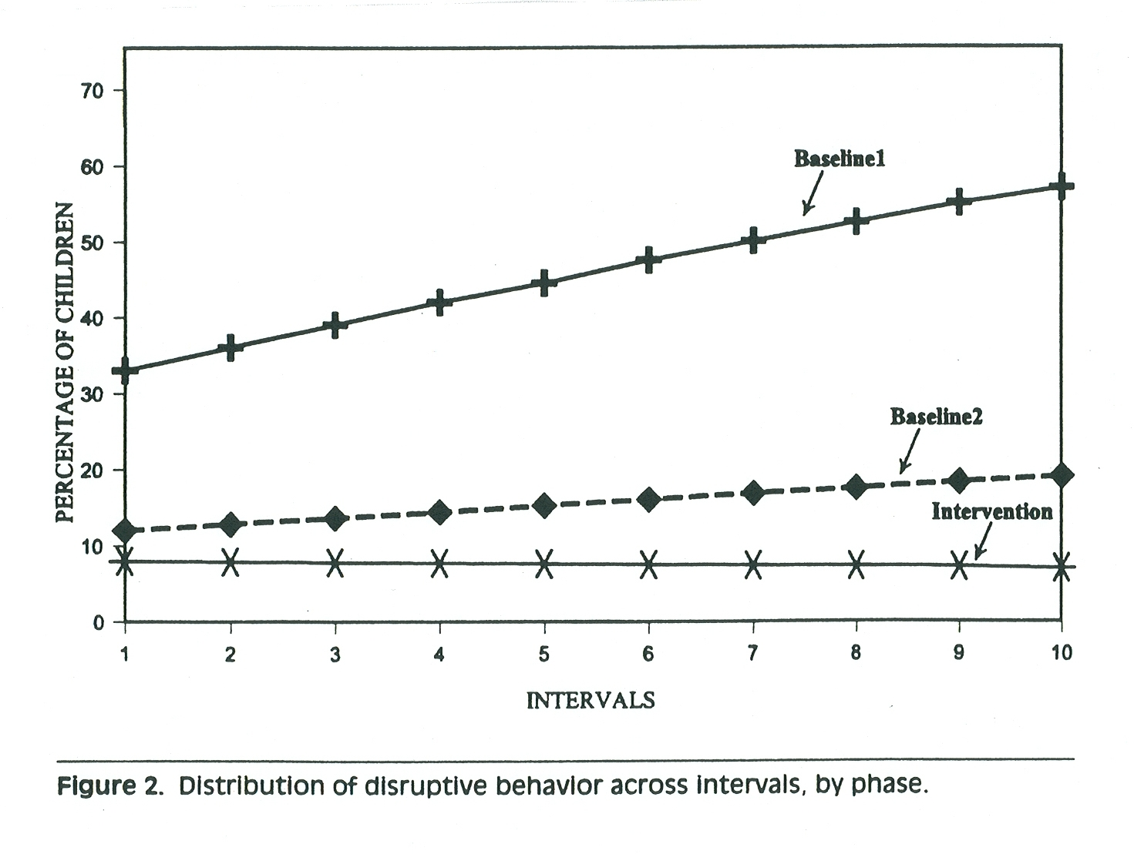
Armendariz, F., & Umbreit, J. (1999). Using active responding to reduce disruptive behavior in a general education classroom. Journal of Positive Behavior Interventions, 1, 152-158.

Slide 84
Sustainability of Practice
POSITIVE INFLUENCES -
student achievement
reductions in off-task behavior
impact on classroom climate
students having fun
support by colleagues/principal
positive comments by parents
Notes:
sustainability – likelihood of teachers maintaining the practice – 162-game season, not for the meek and mild -- 180-day school year

Slide 85

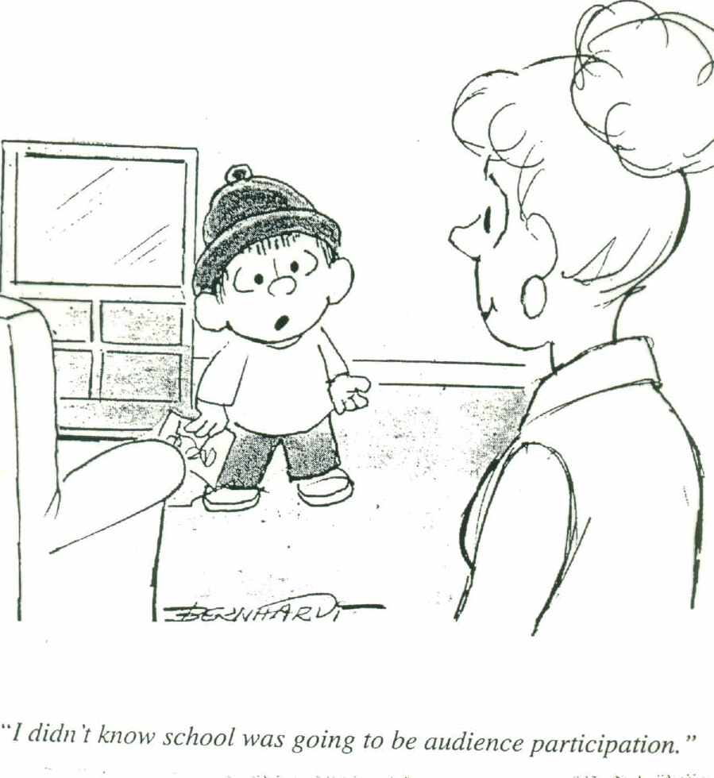
Notes:
A potential advantage of RC over choral responding: easier for teacher to assess each student’s performance.

Slide 86
Sustainability of Practice
NEGATIVE INFLUENCES -
poorly designed lessons yield limited learning
overuse
criticism by colleagues/principal
teacher’s belief that changing methods is good
Notes:
sustainability – likelihood of teachers maintaining the practice – 162-game season, not for the meek and mild -- 180-day school year

Slide 87
Key Limitations
Responses must be under relevant stimulus control.
More ASR is not necessarily better.
Notes:
caveats/limitations not previously considered under categories above (fewer better than many, but which ones are key,) – here are 2 that would be game stoppers:
• responses must be under relevant stimulus control – triangles
• more ASR not necessarily better We don’t know much ASR is necessary for optimal learning outcomes? However, both common sense and some research tells us there is a ceiling above which more ASR is neither effective nor efficient. For example, Cuvo and colleagues found that having students with developmental disabilities practice spelling words 10 or 15 times did not result in better learning than 5 practice trials.

Slide 88

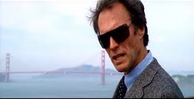
It all comes down to methods. Everybody wants results, but nobody wants to do what it takes. ~ Dirty Harry (Sudden Impact)

Slide 89

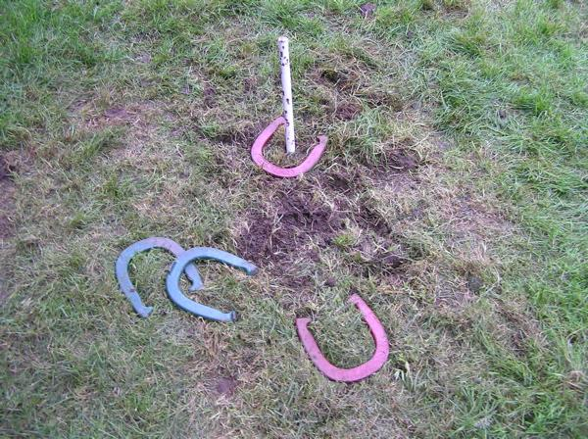
A failure is not always a mistake: it may simply be the best one can do under the circumstances. The real mistake is to stop trying.
~ B. F. Skinner
Notes:
Skinner’s “The real failure is to stop trying”

Slide 90
Thank you.

