Slide 1
The Granite Way Professional Learning
Understanding Learning Progressions to Improve Lesson Design in a Culture of Proficiency-Based Learning
October, 2021
Instructional/Student Learning Process
Expanded Instruction and Support

Slide 2
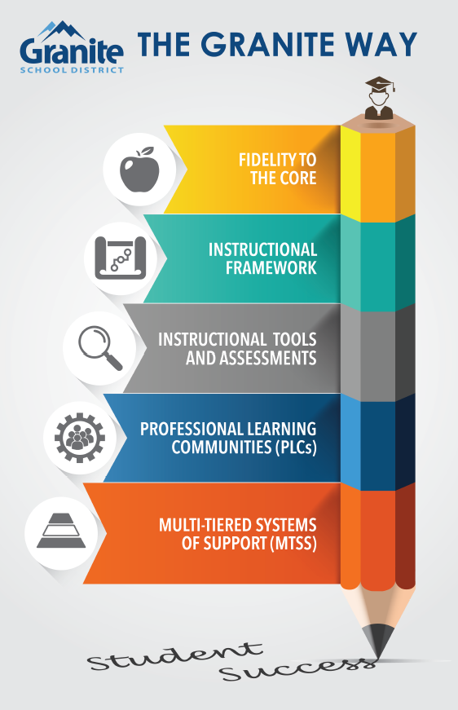
Our work centers on five essential practices that promote student achievement.
Our commitment to student achievement is non-negotiable.
Notes:
Setting the stage. The Granite Way professional learning topics stem from Our Charge and Responsibility from the Granite Board of Education and our Superintendent
Several years ago, the District established the Granite Way as the 5 essential practices that must be evident in our daily work and outcomes.
These demonstrate our non-negotiable commitment to student success.
This month, we are focusing on Fidelity to the Core as a fundamental non-negotiable
Fidelity to the Core ensures that our teaching practices and learning progress and outcomes are firmly anchored in access to the grade-level core curriculum

Slide 3
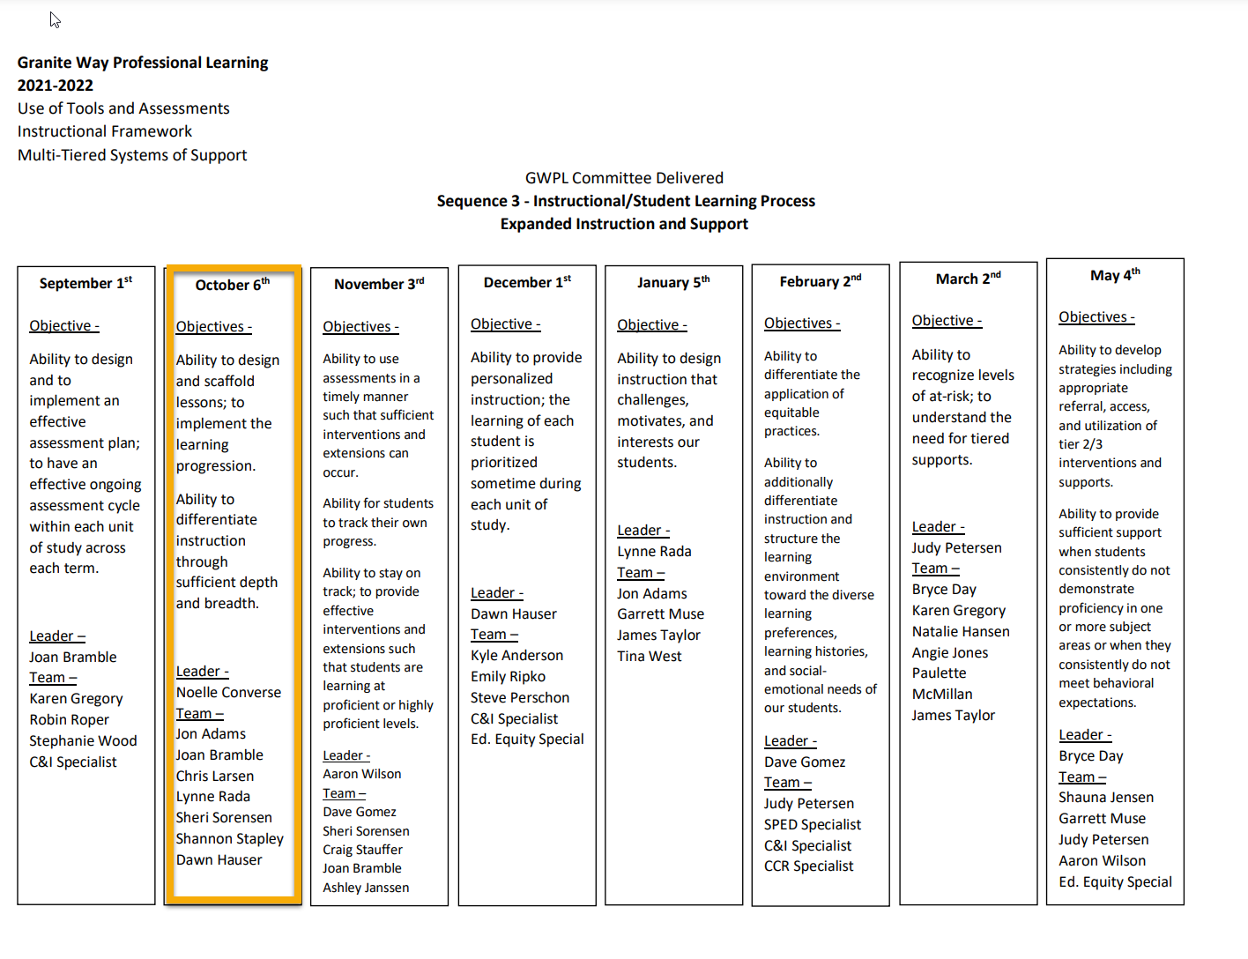
Notes:
We are presenting the October GWPL today and want to note that we have made a slight change in the order of the presentations that will come next.

Slide 4
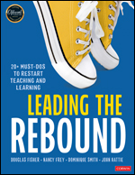
Read the excerpt from Leading the Rebound...
With peers near you, share an experience that you have had this school year that makes this quote relevant for you.
LINK TO EXCERPT
Handout pg. 1
Notes:
Click on the bottom of the image to see the excerpt. p 24 in the rebound book handouts on table half sheets. We understand that we are still going through this together, but we need to “deal with it” and get moving forward. Own that there is learning loss due to COVID, but this is also something we see in a regular school year. Add Handout Page No.

Slide 5
Remediating versus Accelerating Learning
Grade level standards are in place to provide consistency, coherence and high expectations for all students.
Attempting to remediate student learning by teaching a previous grade’s standards only leads to increased gaps in learning over time.
Instead, we can accelerate learning by:
focusing on the what the students are learning now
understanding the prerequisite concepts and skills associated with the current learning
identifying when and for whom the prerequisite concepts and skills need to be firmed up through formative assessment
incorporate those concepts and skills through scaffolds during the current learning
"REMEDIATION DOESN'T WORK. IN FACT, IT HAS DONE DAMAGE BY LOCKING STUDENTS INTO LONG-TERM LEARNING GAPS THAT WORSEN EACH YEAR. THEY NEVER CATCH UP."
David Steiner
Executive director, Institute for Education Policy at the Johns Hopkins School of Education
Notes:
Connect to discussion that stems from quote (previous slide). Explain that often our “default” is remediation, which only increases learning gaps as we focus on previous skills/standards and students fall farther behind. Instead, we should accelerate learning (not in the sense of advanced learners), but in the sense that we “press the gas pedal harder” to get more out of our instruction. We do this by focusing on the current grade level standards with an understanding of prerequisite concepts and skills associated with current learning, identifying when these skills need to be “firmed up” and then incorporating them into our current learning through scaffolding.
INCLUDE IN BOTH OCTOBER AND NOVEMBER PRESENTATION - PLACE TO START FOR NOVEMBER

Slide 6
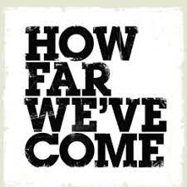
Where we have been...
In Granite we have laid a great foundation over the past decade of establishing fidelity to the core and improving vertical alignment across content areas from grade to grade.
To implement PBL systemically, we have established clear examples of what students should learn and be able to do through district-created curriculum maps, proficiency scales, instructional tools and assessments.
Through continued dedication to PBL, teachers are creating proficiency-based learning targets/intentions and success criteria in student friendly language and helping students to become more reflective about their learning.
Notes:
We have spent time in previous years, working in our grade level and school PLCs, to map out the core and look at the vertical alignment between grade levels. This was good work, and time well spent, and we have more tools now so that the work can move forward from completing/creating the work to making informed decisions about how we can use this information to advance student learning.

Slide 7
Next steps from here...
Recognize the value of understanding learning progressions and how knowledge of progressions can add breadth and depth to lesson design.
Understand how the district proficiency scales and learning progressions can be used as a tool for scaffolding and differentiating lessons.
Deepen learning of how to design and scaffold lessons to help students to move from “approaching proficiency” to “highly proficient” across the standards.
Deepen learning of how to provide differentiated opportunities to meet the needs of students at all proficiency levels.
Notes:
Why is this new learning important?
For these reasons, and… there are clear ties to our educator standards. The most clear connection is to the Planning Domain - on the following slide we see elements from the Planning Domain - how specifically do you look for evidence of these standards in your observations and provide feedback (for Principals; for Teachers what does it look like to be effective or highly effective in these areas). This presentation will provide some examples of what this standard looks like...

Slide 8
Notes:
These next steps align with the Educator Standards and teacher expectations outlined in Domain II - Planning and Preparation. The standard and indicator is listed on left of the screen, with descriptions of “effective and highly effective” on the right. Think of how you might articulate the “next steps” goals from the previous slide into your goal setting conversations, observations, and debriefing conversations with teachers.
THIS DOMAIN CAN BE ONE OF THE HARDEST TO DISCUSS WITH TEACHERS, ESPECIALLY REGARDING THE EVIDENCE THEY COLLECT AND WHAT WE LOOK FOR. WHAT DATA ARE YOU USING TO EVALUATE A TEACHER’S EFFECTIVENESS IN DOMAIN 2? YOU WILL DELIVER THIS GWPL ON QUARTER ONE SNAD - HOW CAN YOU SET UP EXPECTATIONS WITH YOUR TEACHERS AND HELP THEM THINK ABOUT A PLAN OF ACTION FOR QUARTER TWO AROUND THIS DOMAIN? These next steps align with the Educator Standards and teacher expectations outlined in Domain II - Planning and Preparation. The standard and indicator is listed on left of the screen, with descriptions of “effective and highly effective” on the right. Think of how you might articulate the “next steps” goals from the previous slide into your goal setting conversations, observations, and debriefing conversations with teachers.
REPEAT AGAIN AT THE END TO REITERATE HOW YOU WILL USE/DISCUSS WITH TEACHERS - WHAT DO YOU EXPECT TO SEE WHEN YOU OBSERVE INSTRUCTION IN YOUR TEACHERS’ CLASSROOMS?

Slide 9
Learning Objectives/Targets
Success Criteria
Participants will:
Identify what learning progressions are and how they inform instruction
Articulate how learning progressions can be used to provide all students access to grade-level curriculum
Understand learning progressions as they span grade levels and curriculum
Understand that design of lessons includes assessment planning and plans for scaffolding and extensions
Notes:
Identify the targets and success criteria for this presentation- at the conclusion of the lesson,, write the success criteria in terms of speaking, listening, reading and writing-use the verbs of the actions participants will perform.
REVIEW/READ TOGETHER: THESE ARE THE LEARNING OBJECTIVES/TARGETS FOR TODAY’S GWPL - THE SUCCESS CRITERIA ARE THE ACTIONS WE WILL PERFORM THAT WILL SHOW WE HAVE MET THE LEARNING OBJECTIVES/TARGETS.

Slide 10
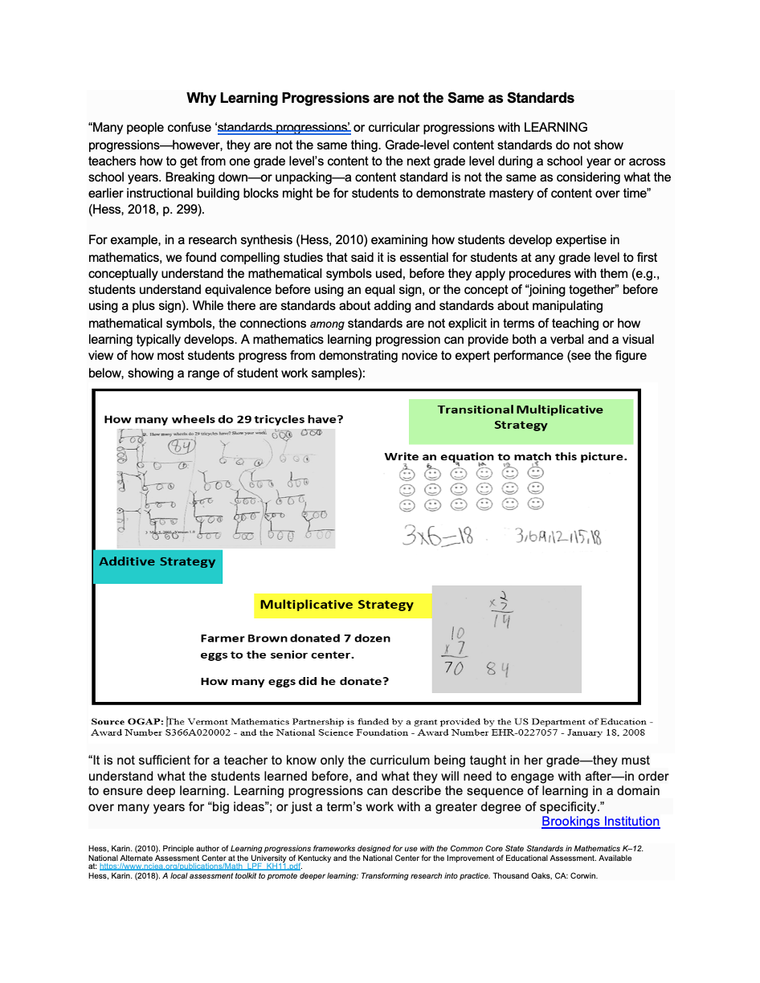
Learning Task
Read the excerpts describing learning progressions and why they are important.
Annotate the text with words, phrases, or ideas that will help you understand learning progressions.
Summarize your annotations into a one sentence definition of learning progression.
Share.
Handout pg. 2-3
Notes:
This doc is linked-click on the bottom to read it. We will have handouts for this. A BIG TAKE-AWAY IS THAT LEARNING PROGRESSIONS ARE MORE THAN JUST VERTICAL ALIGNMENT - MAKE SURE THEY PULL THIS NUANCE OUT OF THE TEXT.
5 MINUTES

Slide 11
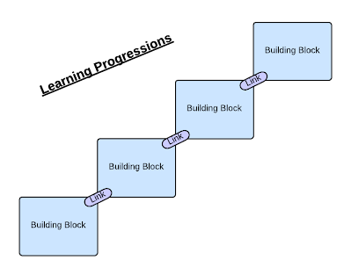
Four Principles of Learning Progressions
Based on research and state core standards.
Represent “big ideas” or “essence” of concepts/processes.
Articulate movement toward increased understanding - proficiency and beyond.
Go hand-in-hand with well-designed/aligned assessment.
Karen Hess, 2018
Notes:
Many of you already use these regularly and we will show some examples of learning progressions available to us. MANY OF THESE are already created, so our task will not be to create these progressions, but use them for better instructional design.

Slide 12
Learning Progressions
Acquire a thorough understanding of the target curricular aim If the student can do _____, they have mastered ____.
Identify requisite subskills and bodies of enabling knowledge If the student cannot do or does not understand this subskill, the learning will not be mastered.
Determine the measurability of each building block If the skill or knowledge cannot be measured, your learning progression is useless
Arrange all building blocks into a sensible sequence What is the best order in which most students should learn the set of sub-skills and knowledge in the building blocks you’ve identified
Notes:
This helps us frame how we understand learning progressions. We start with a clear curriculum aim from the standards. This ties to what we did last month when we looked specifically at writing learning targets and success criteria.
This month we consider learning progressions as we identify subskills that students must know before the current standard is taught.
Next, knowing how to measure whether students have mastered these is skills is important. This is another element that we spent some time on last month as we developed assessment plans.
The final step is arranging the subskills in a sequence.

Slide 13
Elementary Task: Sort the Learning Progression
Anchor Standard 6: Assess how point of view or purpose shapes the content and style of a text.
Grades 1-5th
1st- Distinguish between information provided by pictures or other illustrations and information provided by the words in a text.
2nd- Identify the main purpose of a text, including what the author wants to answer, explain, or describe.
3rd- Distinguish their own point of view from that of the author of a text.
4th- Compare and contrast a firsthand and secondhand account of the same event or topic; describe the differences in focus and the information provided.
5th- Analyze multiple accounts of the same event or topic, noting important similarities and differences in the point of view they represent.
Notes:
Elementary
This will be a sorting task where at tables they get a piece of paper with 5 rows labeled with only the grade level and strips of paper jumbled without grade levels-they have to determine the progression of learning for the strand of standards.
ladder of progression of what you have learned or should have learned
ACES structure- the actions that come after the verbs are the most important

Slide 14
Secondary Task: Sort the Learning Progression
Anchor Standard 5: Analyze the structure of texts, including how specific sentences, paragraphs, and larger portions of the text (e.g., a section, chapter, scene, or stanza) relate to each other and the whole.
4th- Describe the overall structure (e.g., chronology, comparison, cause/effect, problem/solution) of events, ideas, concepts, or information in a text or part of a text.
5th- Compare and contrast the overall structure (e.g., chronology, comparison, cause/effect, problem/solution) of events, ideas, concepts, or information in two or more texts.
7th- Analyze the structure an author uses to organize a text, including how the major sections contribute to the whole and to an understanding of the topic.
9-10th- Analyze in detail how an author’s ideas or claims are developed and refined by particular sentences, paragraphs, or larger portions of a text (e.g., a section or chapter).
11-12th- Analyze and evaluate the effectiveness of the structure an author uses in his or her exposition or argument, including whether the structure makes points clear, convincing,
and engaging.
Notes:
Secondary
This will be a sorting task where at tables they get a piece of paper with 5 rows labeled with only the grade level and strips of paper jumbled without grade levels-they have to determine the progression of learning for the strand of standards.
Learning progressions Elementary ELA Standards: https://drive.google.com/drive/folders/10I7pF9bgYMGuFYEmDqtr6GbbJ6t9cqXC?usp=sharing
ACES structure- the actions that come after the verbs are the most important

Slide 15
Learning Progression: ELA Theme Example
Task: Organize a set of standards from 3rd through 8th grade in the sequence they are taught
Standard 2 Anchor Standard 2: Determine the central ideas or themes of a text and analyze their development; summarize the key supporting details and ideas.
Handout pg. 4
Notes:
We will take an example of a learning progression in ELA to help clarify the importance of the sequence. The strips you have are grade level standards from 3rd through 8th grade in ELA that are taught as part of the Anchor Standard identified here: Determine the central ideas or themes of a text and analyze their development; summarize the key supporting details and ideas.
Arrange the strips in the order you think they are taught.
Provide time for this activity - 5 minutes.
Reveal the order on the slide and discuss. The differences in the standards at each grade level are subtle, but build on each other.
This example may trip people up-not as explicit as the other two-the others were chosen to help people be successful with the task-show the video of this instead on the next slide if there is time-see what big group thinks : LARGE GROUP PREFERS THIS EXAMPLE - BE SURE TO NARRATE A VERTICAL ALIGNMENT AND LEARNING PROGRESSIONS DIFFERENCE DISCUSSION AND REMOVE GRADE SPECIFIC LABELS. NEED HANDOUT WITH STRIPS
Using this example, place these standards in the correct sequence for this anchor standard
(how about using just one that overlaps for elem and sec?)

Slide 16
Video Example of Teacher Use of Learning Progressions: ELA Theme CCSS.ELA-LITERACY.CCRA.R.2
Video Link of Teacher Use of Learning Progressions
What do you notice about the clarity of learning targets and success criteria?
In what ways was evidence used to support the match to learning progressions?
How were students involved in the feedback loop as the teacher used assessment AS learning?
How would you use this approach in your classroom/content area? Share an example.
Notes:
Set the stage: The purpose of this video is to have you see an example of a teacher developing an understanding of learning progressions with her students. She is working with a very small group of students and your focus should be on observing the process she uses to make the learning target and the learning progressions clear. As you watch the first section, consider these two questions (read question 1 & 2).
Pause at 6:39 and discuss the first two questions. Finish the video and then discuss last two questions on next slide. Call for examples to be shared with the whole group.

Slide 17
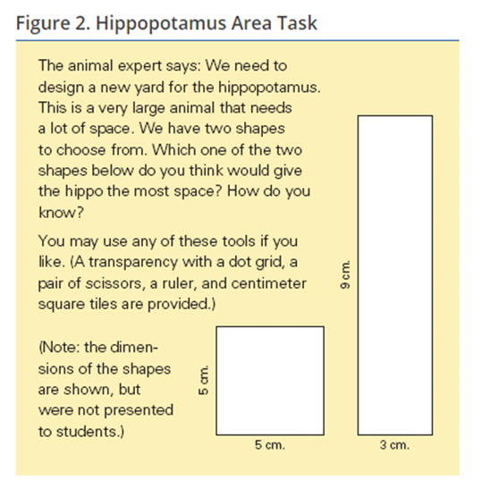
Applying Learning Progressions
What does Thomas know and understand?
Handout pg. 5
Notes:
Now that we have looked at an example of how ELA progressions are sequenced, we will look at how you might apply learning progressions as a teacher in math using area as an example. The task given to a student is displayed on the left. On the right we see Thomas’s response to this task. Discuss with your team what Thomas knows and understands about area based on his response.
Make a copy of these documents

Slide 18
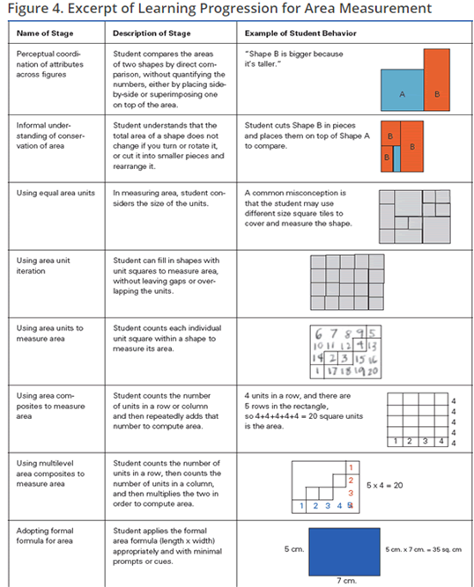
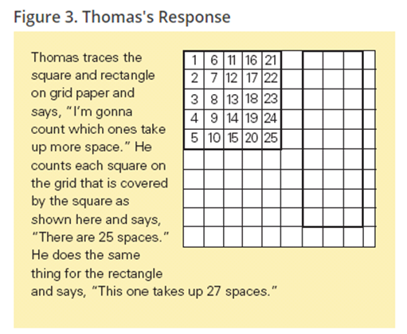
Use the Learning Progression for Area Measurement to build on your previous answer: What does Thomas know and understand?
Handout pg. 6
Notes:
Elementary Only Here we see Thomas’s Response, but we will also look at a learning progression for Area Measurement and use this progression to see where Thomas’s understanding of area fits.
Now looking at the learning progression for this skills, discuss with your team how you might build on your previous answer. - 12 minutes. Handout Figure 4
(print handout of learning progression handout)
Further discussion to make sure you address how this progression helps both a teacher and a student know where they are and where they will go next in their learning.

Slide 19
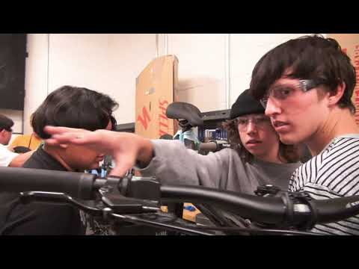
CTE: Bicycle Repair
https://youtu.be/jrFpp-Cyd7U
Handout pg. 6
Notes:
Secondary only example: what examples do you see of how the teacher uses learning progressions (skills, content) from other courses in this singleton course to build foundational skills that may be lacking and extend learning beyond the standard?-for secondary only copy another set of the blank learning progression sheets

Slide 20
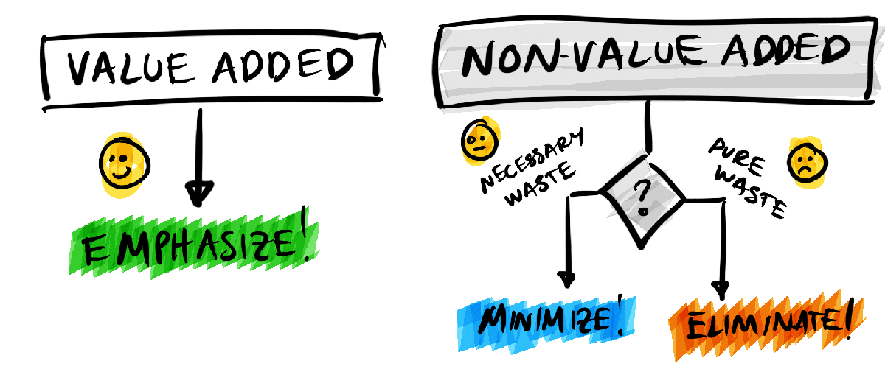
What is the added value of deepening our understanding of learning progressions and criteria at proficiency levels in regard to improving lesson design?
Notes:
REMIND PRINCIPALS THAT TEACHERS SHOULD BE TAKING THINGS OFF THEIR PLATES THAT DON’T FIT/WORK ANYMORE. ELIMINATE THINGS THAT NO LONGER MAKE SENSE. We just discussed what learning progressions are and their connection to proficiency, so what is the value of addressing learning progressions and proficiency scales during lesson design? Keep in mind that we instruct teachers that after you consult curr maps, next step is to look at prof scales. Always looking for “value added” we are trying to streamline and eliminate non-essentials, building on the good work we have been doing, not revising or changing. This allows a focus on the standards and by knowing the progressions, teachers can focus on accelerating the learning of their students as they scaffold prerequisite knowledge to make sure they are addressing grade level core standards and NOT just remediating (per info in previous slide).

Slide 21
Lesson design begins with knowing the standard and developing an Assessment Plan
Identify grade level standard and use proficiency scales to develop learning targets/objectives and success criteria
Determine how you will assess
Of Learning: What evidence will you accept?
For Learning: Formative tools to continually adjust instruction
As Learning: Self-reflection and feedback
Notes:
In September, we looked at this piece of an assessment plan when we identified specific standards and determined how these would be assessed...These are the first steps in designing a lesson. REFER BACK TO THE VIDEO OF THE TEACHER IN THE VIDEO DOING THIS WITH HER SMALL GROUP OF STUDENTS.

Slide 22
Lesson design also includes an understanding of Learning Progressions
3. Use Assessment Of Learning
Pre-assessment tools help determine where students are in the Learning Progression for the standard.
4. Using Learning Progressions, plan for
Scaffolding knowing pre-requisite skills and the results of pre-assessments
Extensions knowing where you need to go after proficiency
Notes:
This month we move to the next phase of lesson development where we use the ASSESSMENT OF LEARNING tools to determine where students are in the Learning Progression and then plan for scaffolding and extensions. THE BICYCLE REPAIR CLASS VIDEO IS A VERY GOOD EXAMPLE OF NUMBER 4, AS DOES THE FIGURE FOUR HANDOUT OF THOMAS’ HIPPO AREA.

Slide 23
Notes:
COMIC RELIEF :)

Slide 24
Notes:
Let’s walk through how to access and use the supports and resources already available to us in GSD to design lessons in a strategic way.

Slide 25
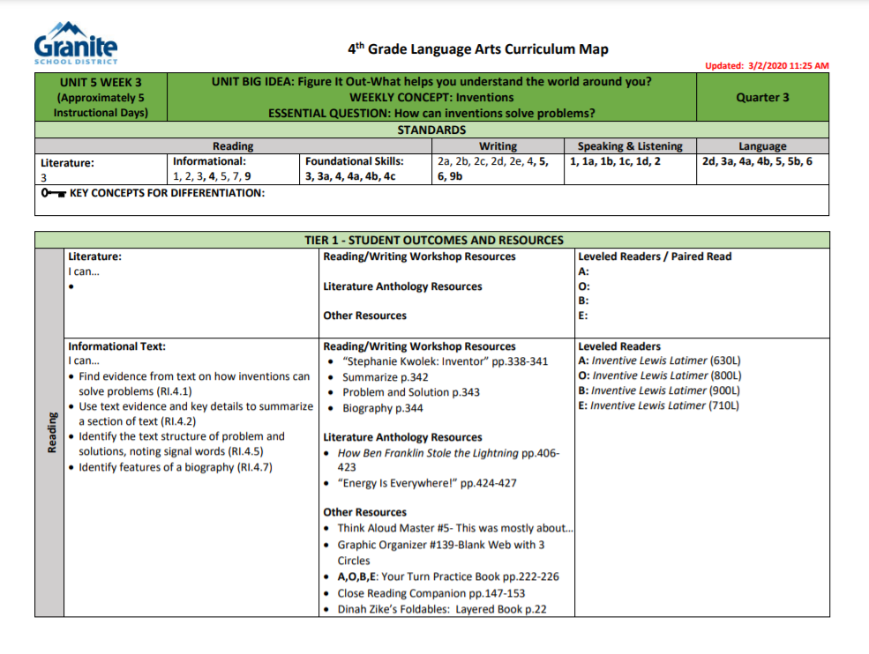
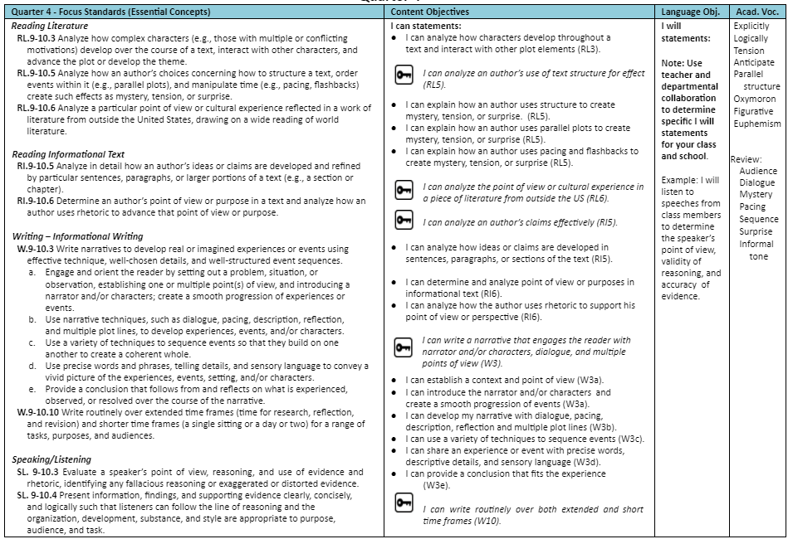
Start with the grade level standard(s), concepts and skills.
4TH GRADE LANGUAGE ARTS
10TH GRADE LANGUAGE ARTS
Notes:
These are our curriculum maps that include the standard and other relevant info to help design, sequences, key standard, learning objective, targets, success criteria ideas.

Slide 26
Determine how you will assess of, for and as learning.
Understand that learning progressions go hand-in-hand with well-designed formative uses of assessment.
Knowing where to plan assessment along a progression of learning can:
Empower teachers to develop more useful pre- and post-assessments (along that unifying thread).
Plan next steps and strategically scaffold instruction.
Promote student agency and reflection on progress, such as asking students (a) to compare their work to descriptors or samples of work along a progression; and (b) to explain how they might move to the next stage on the progression.
Hess (2018)

Slide 27
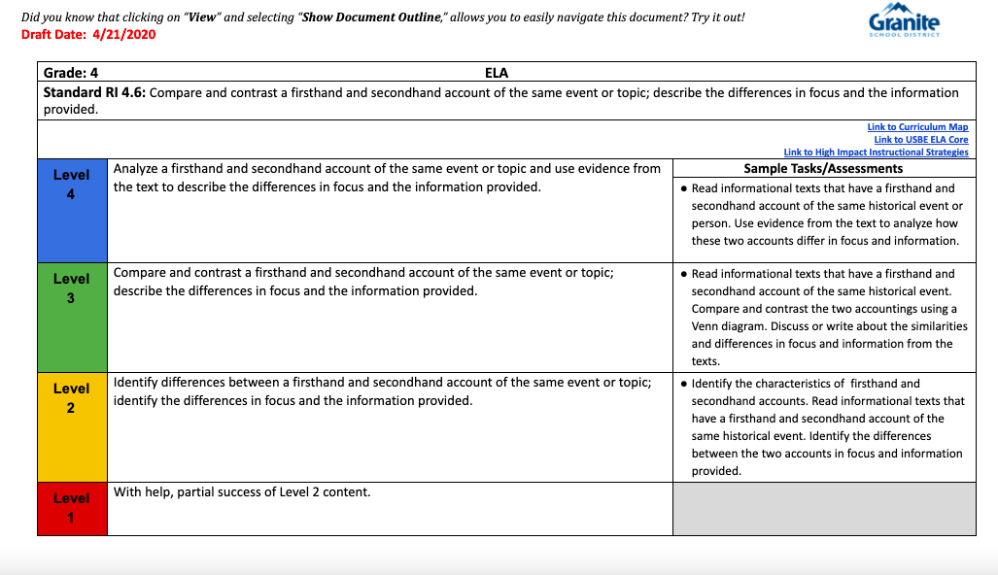
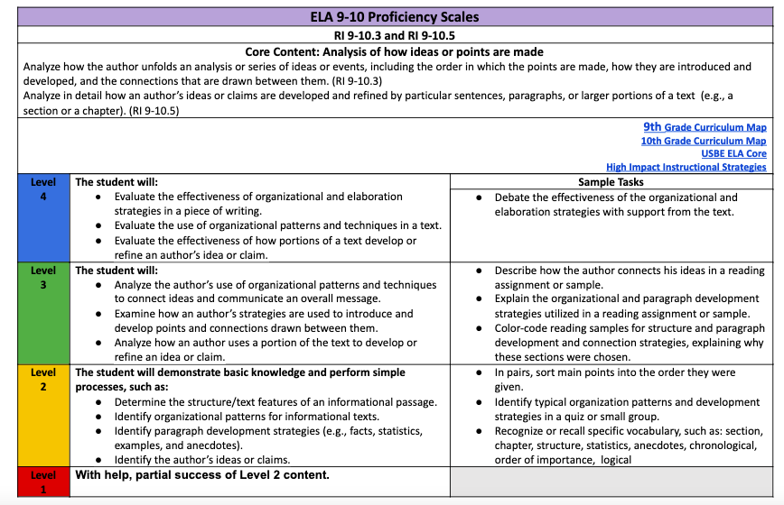
Know the criteria for each proficiency level.
4th RI.6
9-10th RI.3 and RI.5
Notes:
These are the proficiency scales, which help teachers understand what proficiency looks like at the different levels. Notice the VERBS for level 4 - ACE - the actions that come after the verbs are the most important-
The verbs lead to the way to assess the actions - the rigor of the assessment or task. Share ACE handout.
ACE Handout

Slide 28
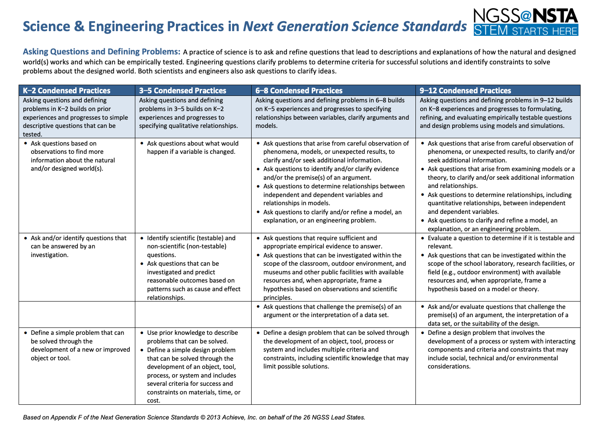
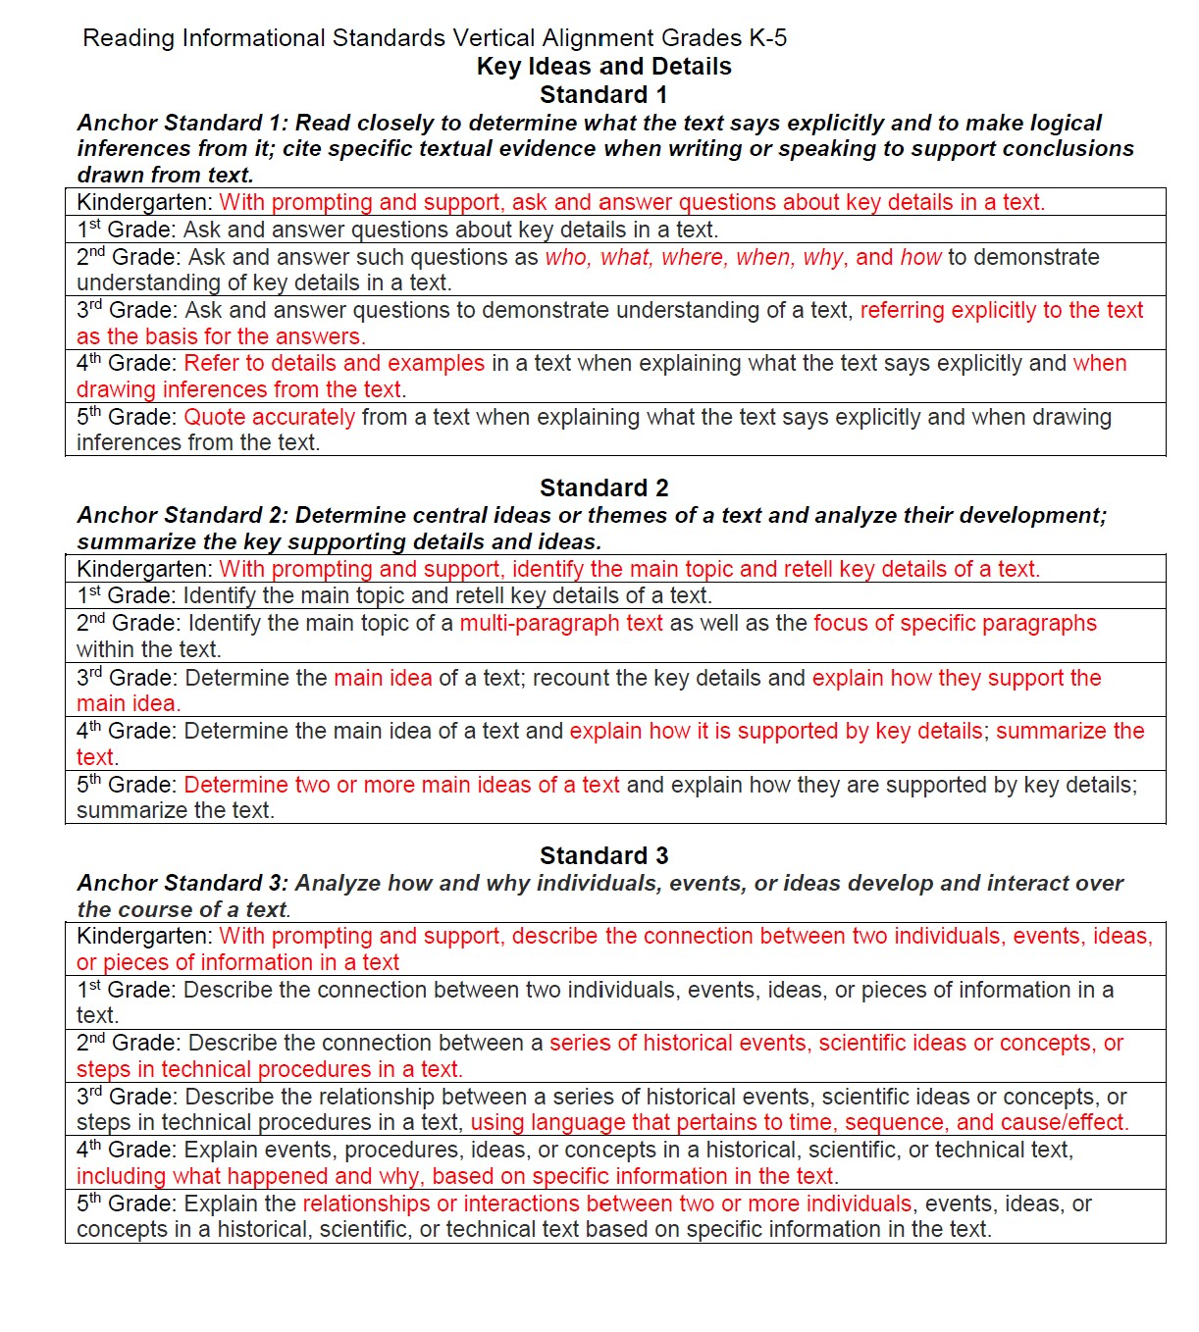
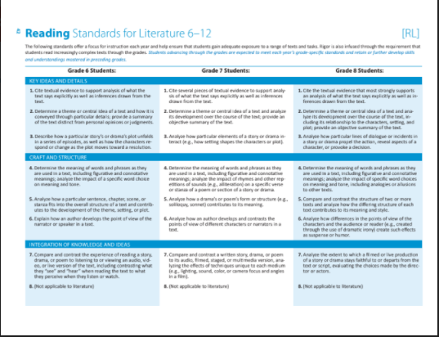
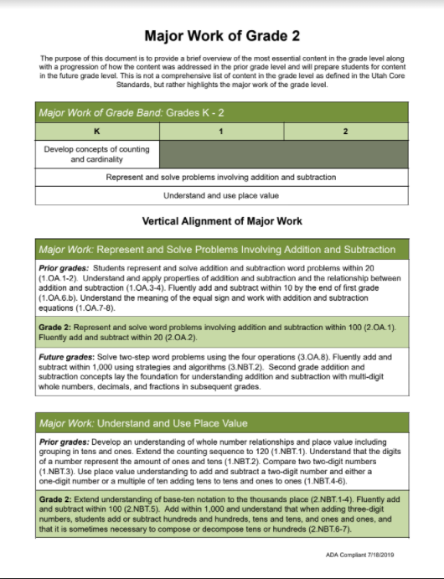
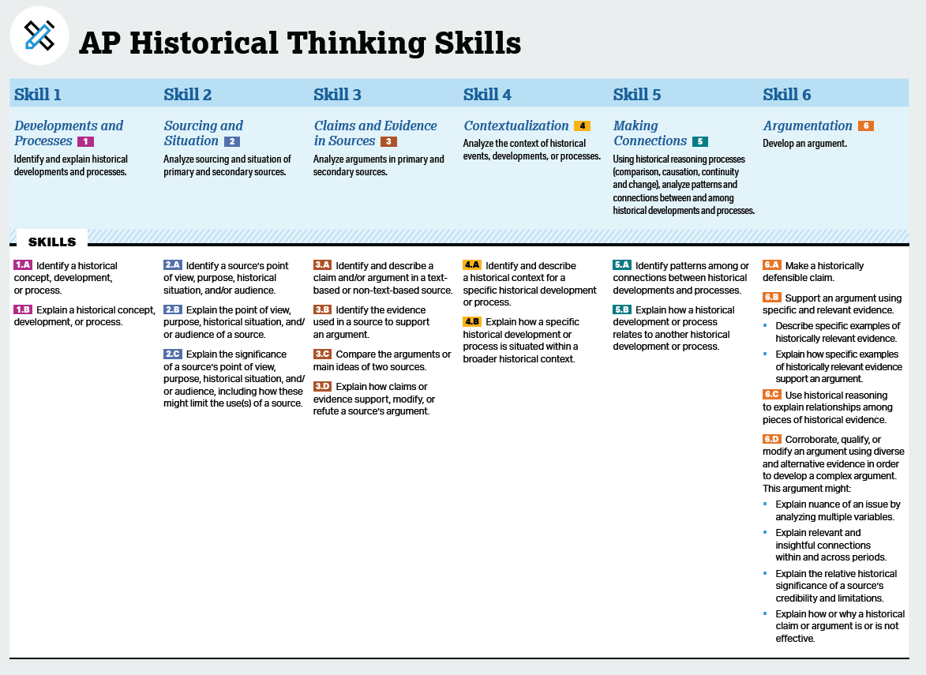
Use the standards’ learning progressions to consider scaffolds and extensions.
NGSS K-12 Science Skills
AP Social Studies
Major Works Link
ELA 6-12 Link
ELA K-5 Link
Notes:
IN the past, we have focused on unpacking standards-standard by standard; we need to moving to understanding skill and concept progression over span. These documents allow teachers during PLC time to focus on these progressions instead of trying to work from memory, experience or from scratch to make connections across strands, domains, skill bands….Social Studies commonly uses the ELA anchors standards as their progressions. CTE courses may access science and math progressions.
Recognize that some progressions can be integrated across content areas-e.g. ELA Info Text progression used to build analysis skills during social studies content. Some secondary courses (Bicycle Repair)

Slide 29
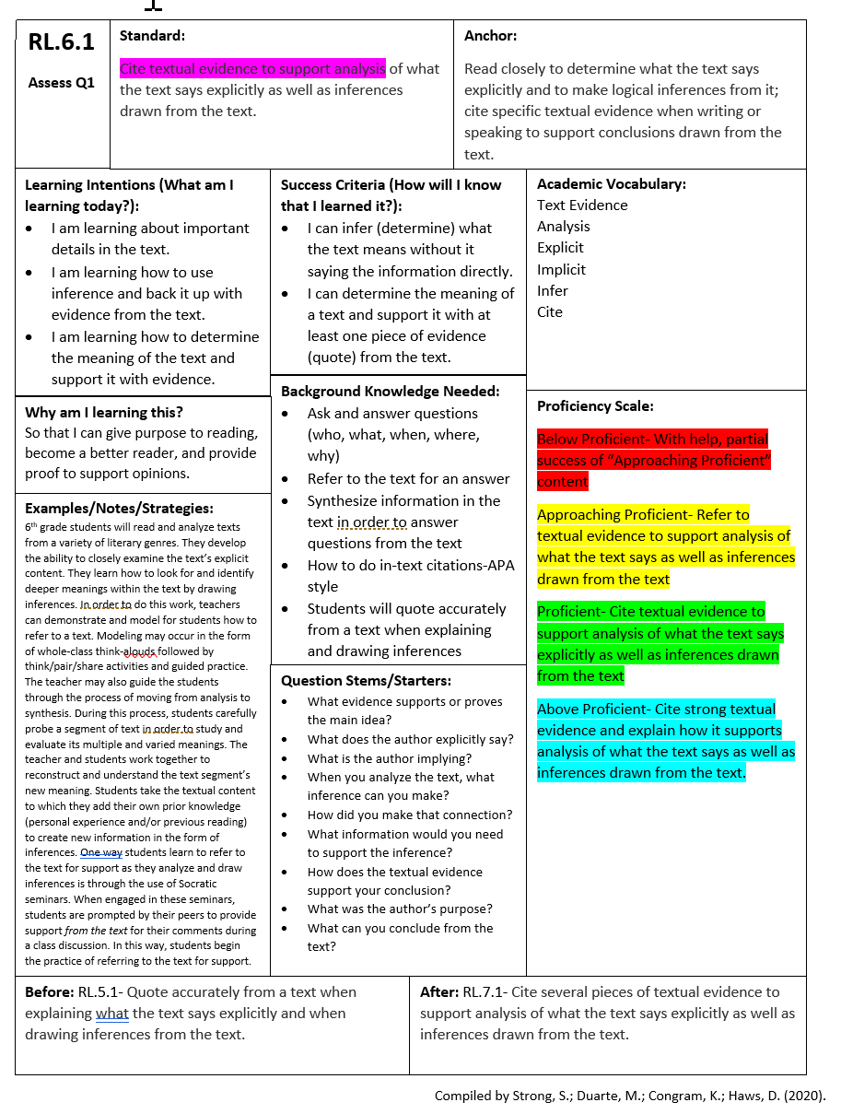
Grade 6 ELA Example with All Components
Link to Template
Learning Targets/Success Criteria
Background Knowledge
Proficiency Scales
Standard in Grade Below and Above
Notes:
This is an example of a sixth grade standard in ELA with the information compiled in a single document. This was done by a multi-grade level team in Granite District who put together all of these pieces on a single document to help plan instruction. They started with a grade level standard and added learning targets and success criteria from the curriculum maps and proficiency scales online. They considered the background knowledge students would need and added the specific proficiency scales from the Granite District documents. They also placed the standard below and above the grade level to clarify the teachers’ understanding of where the student had been and where they needed to go next. There is a link to a template for this. This is one way a school found helpful to look at learning progressions. Make the point, that these are not static documents because your students change-and when that happens you need to change your learning intention and success criteria. Blank Handout with screenshot on the back

Slide 30
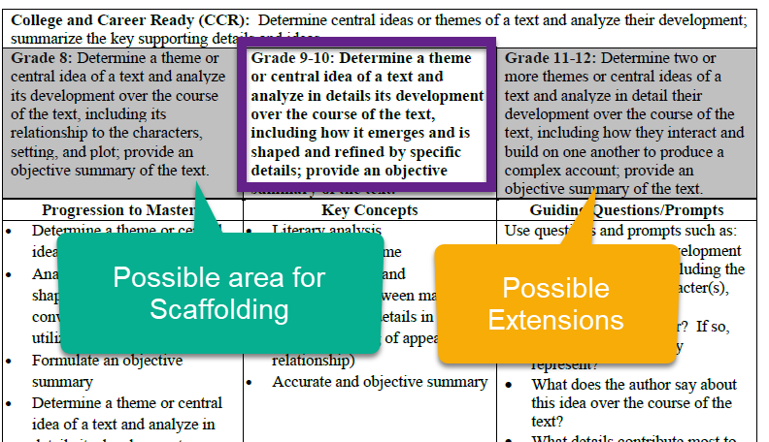
Grade 9-10 ELA Example With All Components
Notes:
Another example of how teachers might use learning progressions is shown here. This is a secondary example from ELA showing a 9-10 grade band. This example again shows the standard below and above the grade level being taught. When we consider how scaffolding is used, it may be helpful to look at the standard below and determine where students are and what supports, or scaffolds may need to be in place. The standard for the grade level above allows the teacher to see where the students need to be prepared to go next and also might provide ideas for ways to extend learning for students who need this.
END HERE - BUILD NOVEMBER’S PRESENTATION FROM HERE; WE ARE GOING TO FINISH THIS CONVERSATION NEXT MONTH.

Slide 31
Notes:
REPEAT OF EARLIER SLIDE. AGAIN, REITERATE HOW YOU WILL USE/DISCUSS WITH TEACHERS - WHAT DO YOU EXPECT TO SEE WHEN YOU OBSERVE INSTRUCTION IN YOUR TEACHERS’ CLASSROOMS DURING SECOND QUARTER?
EXIT TICKET FOR PRINCIPALS: HOW WILL YOU USE THIS NEW KNOWLEDGE TO INFORM WHAT YOU LOOK/HOW YOU ASSESS THIS DOMAIN DURING QUARTER 2? WHAT WILL YOU BE LOOKING FOR DURING QUARTER 2?
EXIT TICKET FOR TEACHERS: HOW WILL YOU USE LEARNING PROGRESSIONS IN YOUR LESSON PLANNING DURING QUARTER 2? CITE A SPECIFIC EXAMPLE OF WHAT YOU WANT ME (THE ADMIN) TO LOOK FOR AS “EVIDENCE” WHEN I OBSERVE YOUR INSTRUCTION.

Slide 32
Turn and Talk-Closing Activity
Reflect on your understanding of learning progressions, proficiency scales and how to approach scaffolding and extensions within the grade-level standard.
Principal Scenario: A teacher approaches you and wants access to lower grade level standards and materials because kids “are behind.” How do you respond?
Teacher Scenario: Why do we only teach within the grade level standards? How do I meet my student’s needs within the grade level standards based on today’s discussion of how to design lessons using learning progressions?
Notes:
Elevator speech/response. What will you say to THAT teacher?

Slide 33
Learning Objectives/Targets
Success Criteria
Participants will:
Identify what learning progressions are and how they inform instruction
Articulate how learning progressions can be used to provide all students access to grade-level curriculum
Understand learning progressions as they span grade levels and curriculum
Understand that design of lessons includes assessment planning and plans for scaffolding and extensions
Notes:
Identify the targets and success criteria for this presentation- when the tasks of the lesson are finalized, write the success criteria in terms of speaking, listening, reading and writing-use the verbs of the actions participants will perform

Slide 34
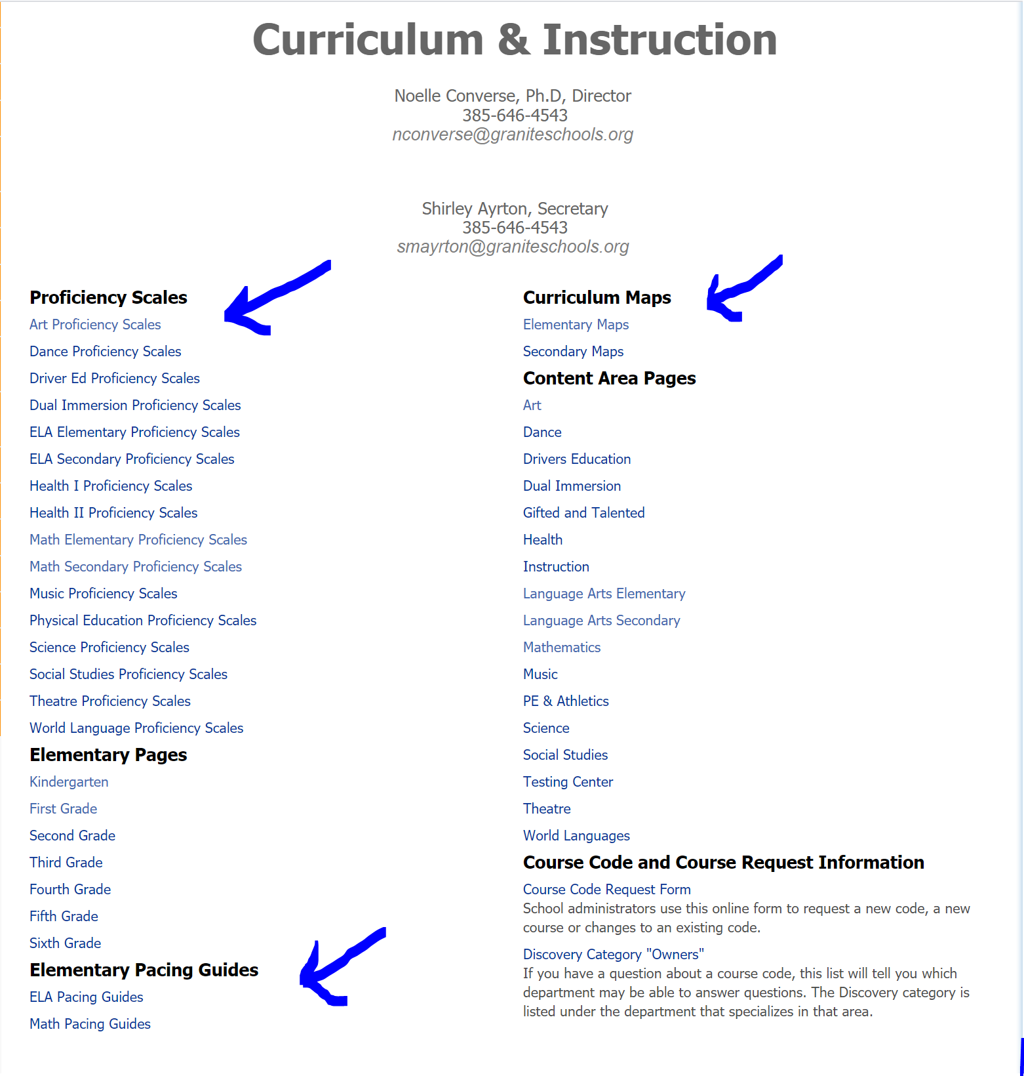
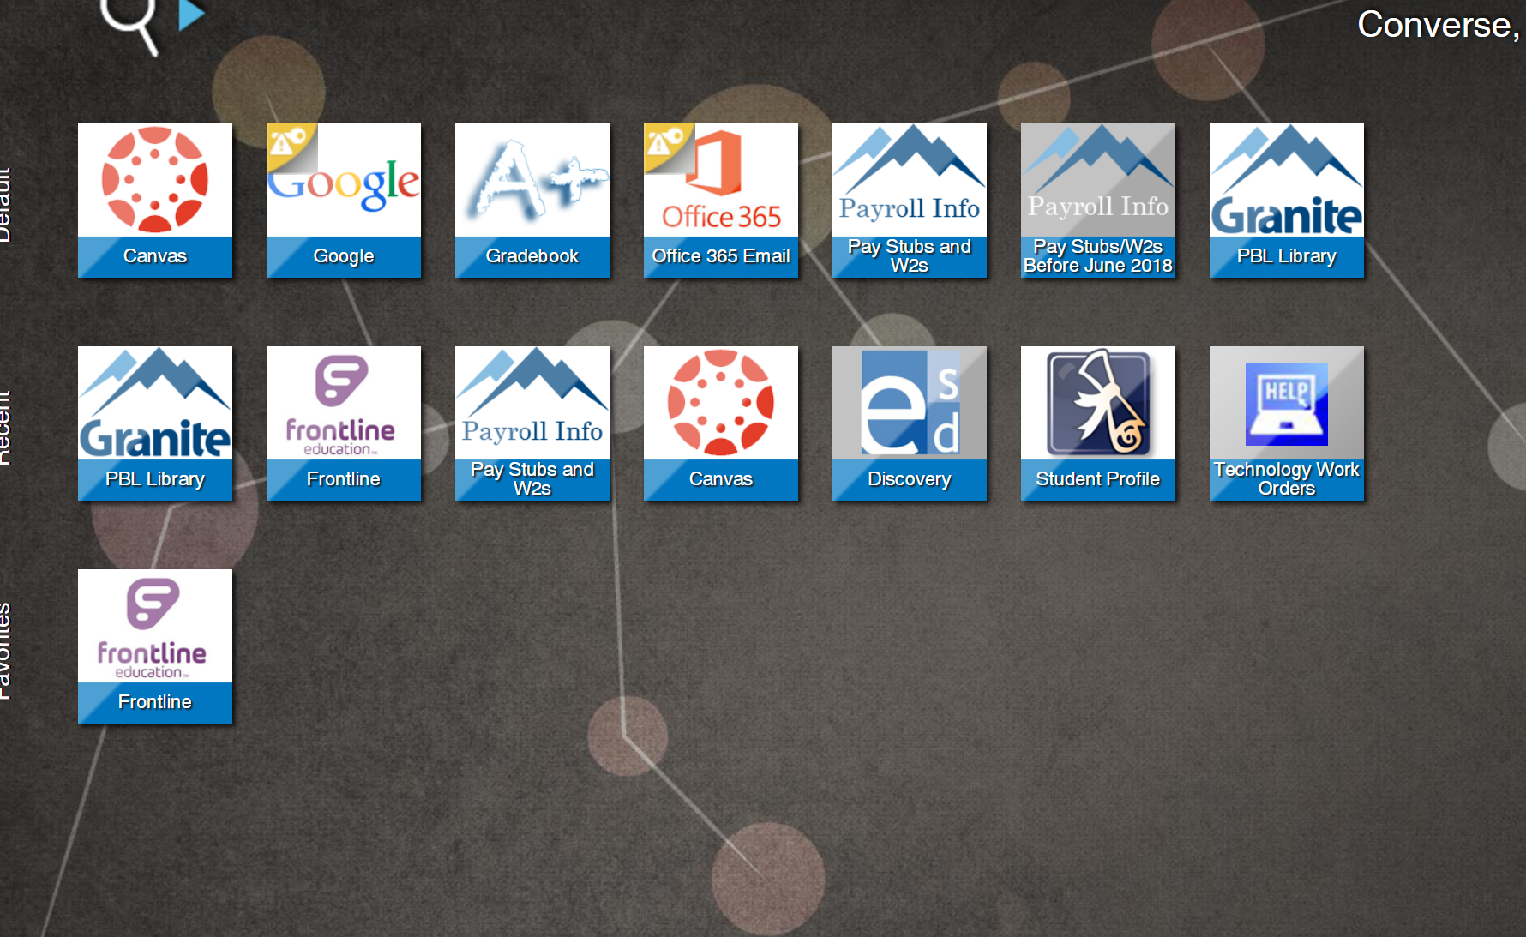
Where do I access the tools?
Go to GSDsites.graniteschools.org
Select Departments/Curriculum and Instruction
Click on
Curriculum Maps
Proficiency Scales
USBE Math Core Guides
USBE Major Works
ELA K-5 Progressions
ELA 6-12 Progressions
NGSS K-12 Science Skills
AP Social Studies Thinking Skills
Go to: Employee Portal
Click on PBL Library
Notes:
Optional: Have teachers actually go to the site and locate their curriculum maps and proficiency scales
How are you going to share this with your faculty and use these with PLCs and in coaching cycles? Turn and talk to a neighbor and make a plan. This may be something that your SLID follows up during coaching sessions.
Consider what data could be used to measure the desired outcome during PLCs and coaching cycles.

Slide 35
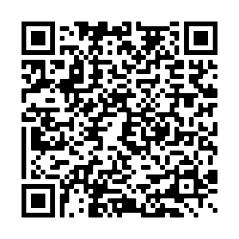
GWPL Feedback
https://tinyurl.com/59769k8z
Notes:
Where is the link? CHRIS LARSEN. The words “GWPL Feedback” are linked, there is a link below that, and there is a QR code.

Slide 36
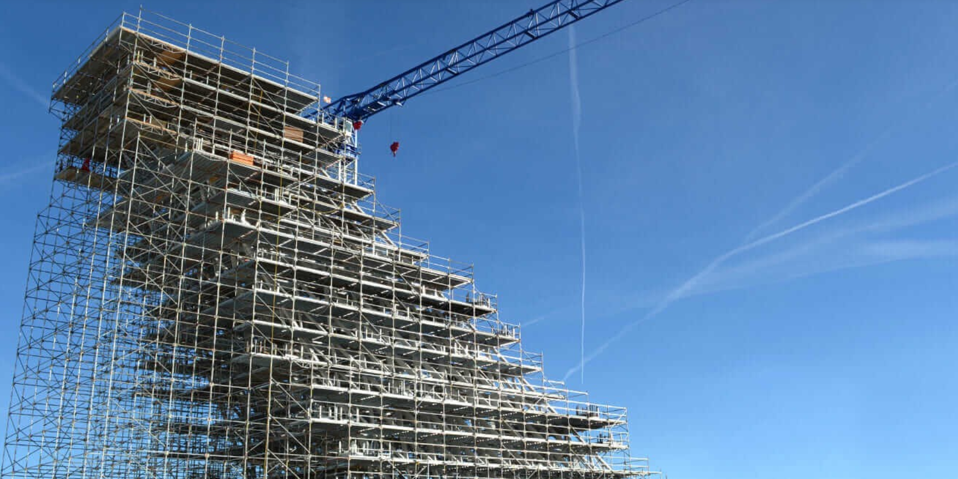
On the next episode of GWPL……
TO BE CONTINUED….
SCAFFOLDING & EXTENSION
SCAFFOLDING & EXTENSIONS
Notes:
PREVIEW OF NOVEMBER GWPL - EXPLAIN WHY WE ARE TWEAKING THE SEQUENCE BECAUSE OF THE IMPORT AND DEPTH OF THIS DISCUSSION. WE WANT TO TAKE OUR TIME AND REALLY UNDERSTAND BEFORE WE MOVE FORWARD.

Slide 37
Plan your lesson.
Notes:
next three slides are a trailor for deeper learning of scaffolds and extensions next month-

Slide 38
What evidence of learning should I consider?
Notes:
It is important to remember that PBL is not about grading, it is about LEARNING. The focus of PBL is improving learning through teacher clarity and reporting progress on specific standards. Fidelity to the core is the foundation of PBL. (Suggestion: Skip the next three slide and reinforce understanding of what learning progressions are and why we are not remediating - save these activities for next month)

Slide 39
What scaffolds should I consider?
Notes:
It is important to remember that PBL is not about grading, it is about LEARNING. The focus of PBL is improving learning through teacher clarity and reporting progress on specific standards. Fidelity to the core is the foundation of PBL. The scaffolds are considered based on the learning progressions as well as the proficiency scales

Slide 40
What extensions should I consider?
Notes:
It is important to remember that PBL is not about grading, it is about LEARNING. The focus of PBL is improving learning through teacher clarity and reporting progress on specific standards. Fidelity to the core is the foundation of PBL. Extensions are also based on what I know about the learning progressions

Slide 41
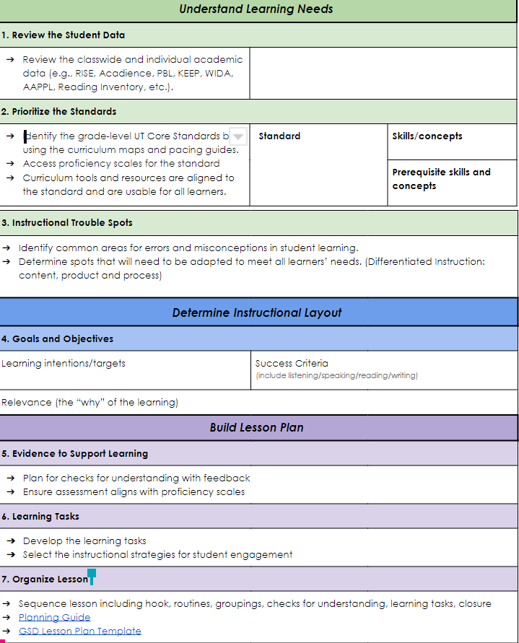
Teacher Clarity Tool for Lesson Design Process
Notes:
Referenced in the resources slide-May be good to include next months

