Slide 1


Anchor Layer Teacher Guide
A curriculum companion for Anchor Layer users
Grade 5
Water Cycle & Earth’s Systems
Unit Web Link • Pacing Guide • Other Units

Slide 2
Water Cycle & Earth’s Systems • Grade 5
Anchor Layer Teacher Guide
Unit Summary
In this unit, students consider the profound importance of water as a natural resource. Students investigate the distribution of fresh water and salt water on Earth. They explore how water cycles through Earth’s systems, investigating how the hydrosphere and atmosphere interact. Students also consider how water affects human societies and design solutions to mitigate effects of weather-related natural hazards. Assessments
Performance Expectations | Science & Engineering Practices | Disciplinary Core Ideas | Crosscutting Concepts
• 5-ESS2-1. Develop a model using an example to describe ways the geosphere, biosphere, hydrosphere, and/or atmosphere interact. • 5-ESS2-2. Describe and graph the amounts and percentages of water and fresh water in various reservoirs to provide evidence about the distribution of water on Earth. • 3-5-ETS1-1. Define a simple design problem reflecting a need or a want that includes specified criteria for success and constraints on materials, time, or cost. • 3-5-ETS1-2. Generate and compare multiple possible solutions to a problem based on how well each is likely to meet the criteria and constraints of the problem. • 3-5-ETS1-3. Plan and carry out fair tests in which variables are controlled and failure points are considered to identify aspects of a model or prototype that can be improved. | • Analyzing and Interpreting Data • Using Mathematics and Computational Thinking • Developing and Using Models • Obtaining, Evaluating, and Communicating Information • Engaging in Argument from Evidence • Planning and Carrying Out Investigations • Asking Questions and Defining Problems | • ESS2.A: Earth Materials and Systems • ESS2.C: The Roles of Water in Earth’s Surface Processes • PS1.A: Structure and Properties of Matter • ETS1.A: Defining and Delimiting Engineering Problems • ETS1.B: Developing Possible Solutions • ETS1.C: Optimizing the Design Solution | • Scale, Proportion, and Quantity • Systems and System Models • Patterns
Water Cycle & Earth’s Systems Lesson Flow on Next Page
‹#›

Slide 3
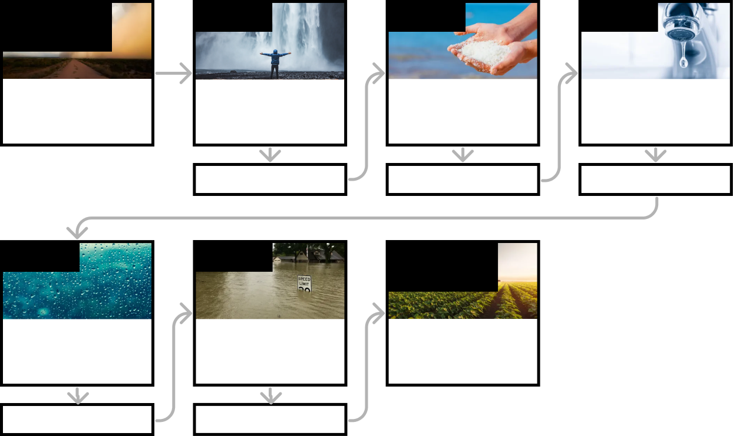
Water Cycle & Earth’s Systems • Grade 5
Anchor Layer Teacher Guide
Ecosystems & The Food Web Lesson Flow
Anchor Phenomenon
Lesson 1
Lesson 2
Lesson 3
Interaction of Earth’s Spheres & Modeling
Dust Bowl Disaster
Hydrosphere & Water Distribution
How much water is there in the world?
Mixtures & Solutions
How much salt is in the ocean?
Groundwater as a natural resource
When you turn on the faucet, where does the water come from?
Anchor Connection
Anchor Connection
Anchor Connection
Lesson 4
Lesson 5
Performance Task
Water Cycle
Can we make it rain?
Natural Disasters & Engineering
How can you save a town from a hurricane?
Interaction of Earth’s Spheres & Argumentation
How can you protect a farm from the next Dust Bowl?
Anchor Connection
Anchor Connection
‹#›

Slide 4
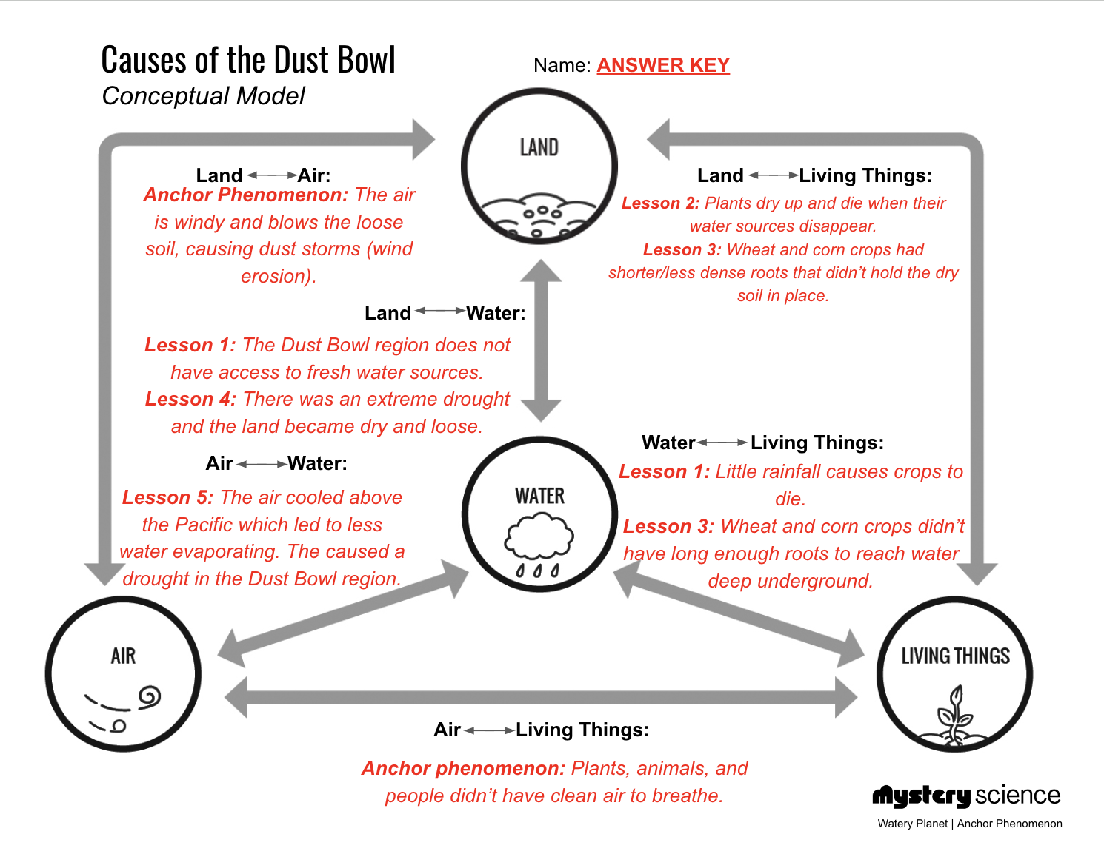
Water Cycle & Earth’s Systems • Grade 5
Anchor Layer Teacher Guide
Anchor Phenomenon Background
How did changes in the interactions between the land, water, air, and living things cause the Dust Bowl?
‹#›

Slide 5
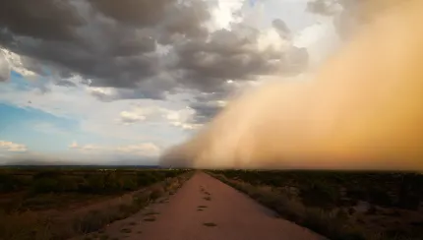
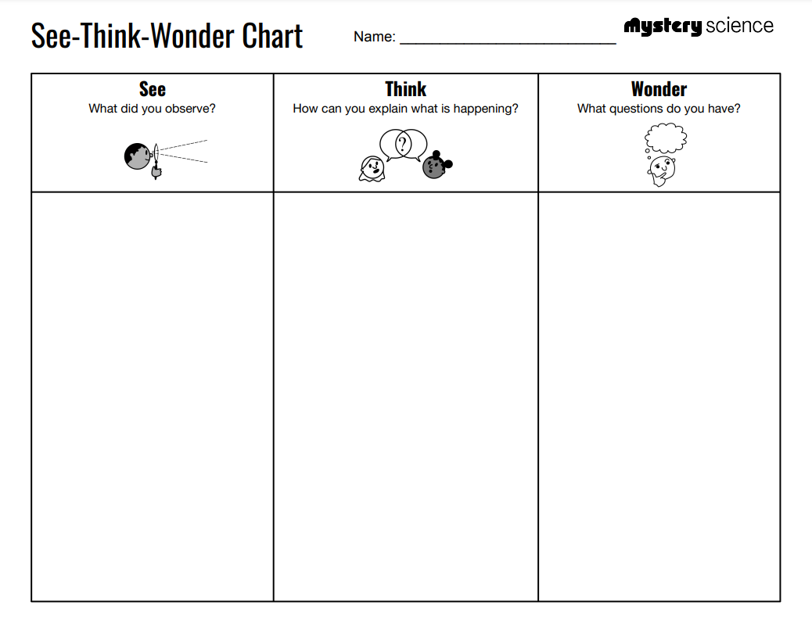
Water Cycle & Earth’s Systems • Grade 5
Anchor Layer Teacher Guide
Anchor Phenomenon: Dust Bowl Disaster
Interaction of Earth’s Spheres & Modeling
Anchor Phenomenon Lesson Overview
Note: This lesson is part of this unit’s Anchor Layer. If you have the Anchor Layer turned on, we recommend teaching all lessons in the remainder of this unit in order.
The anchor phenomenon for this unit is the Dust Bowl. Students generate observations and questions about the phenomenon and create an initial model to explain how Earth's four spheres interacted to cause the Dust Bowl. Students will revisit their model after each Mystery to add new information to it.
Anchor Phenomenon 10 mins
Guided Inquiry 20 mins
Hands-On Activity 30 mins
Student Work Samples & Notes
It is important to encourage students to recognize that even if they don't know the perfect answer yet, they are going to learn a lot throughout the unit and have an opportunity to change or add to their first model.
The grasses that covered the land were
plowed up.
The soil became dry.
The land was no longer covered with plants (the plants died).
It was windy.
There was little water and rain.
The farmers planted crops like wheat and corn that were not native to the dry Great Plains.
They pulled the grasses up which were holding the soil together.
There wasn’t a lot of rain which made the land very dry.
Why wasn’t there a lot of rain?
Why did all of the new plants die?
Why did farmers move there to grow crops?
How far did the dust travel?
What happened to the people?
‹#›

Slide 6

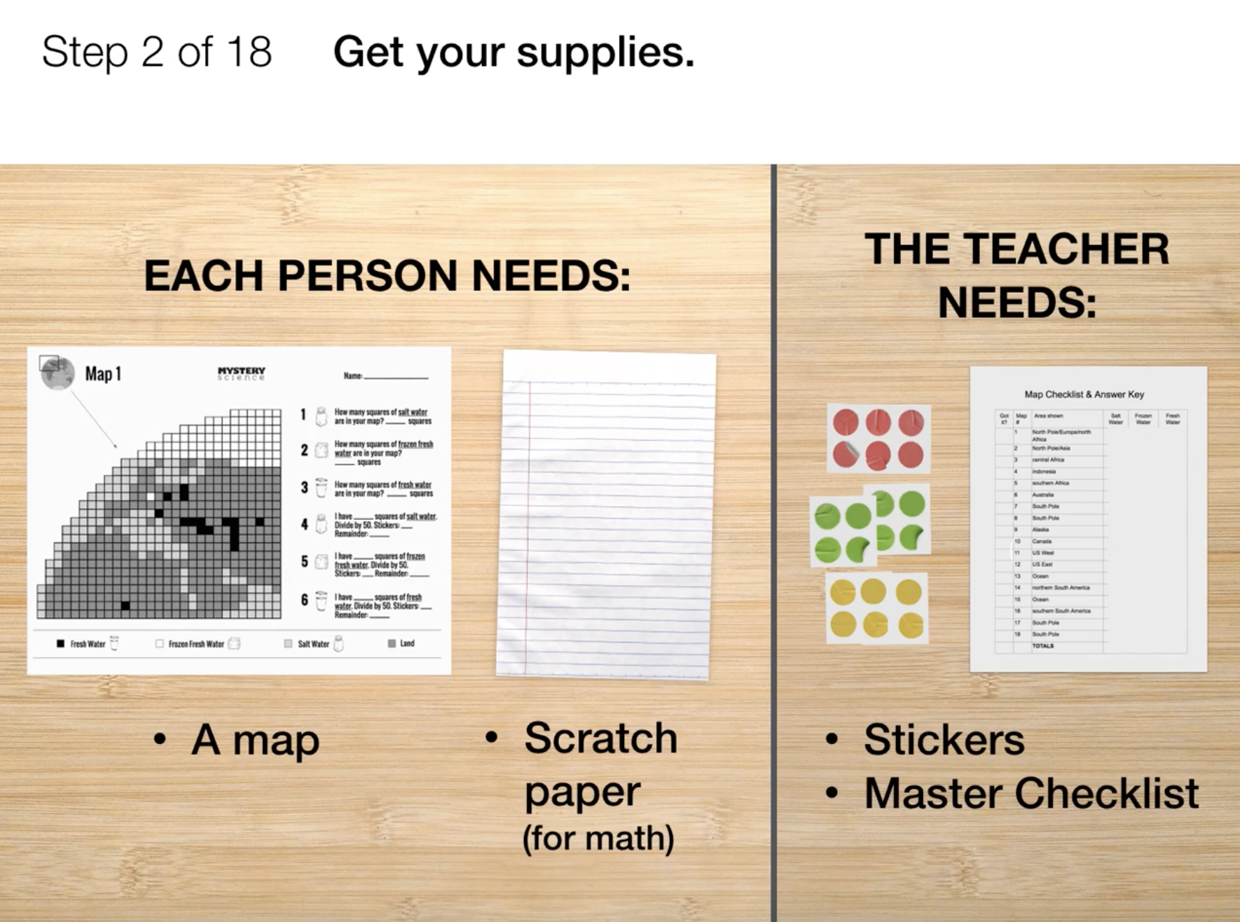
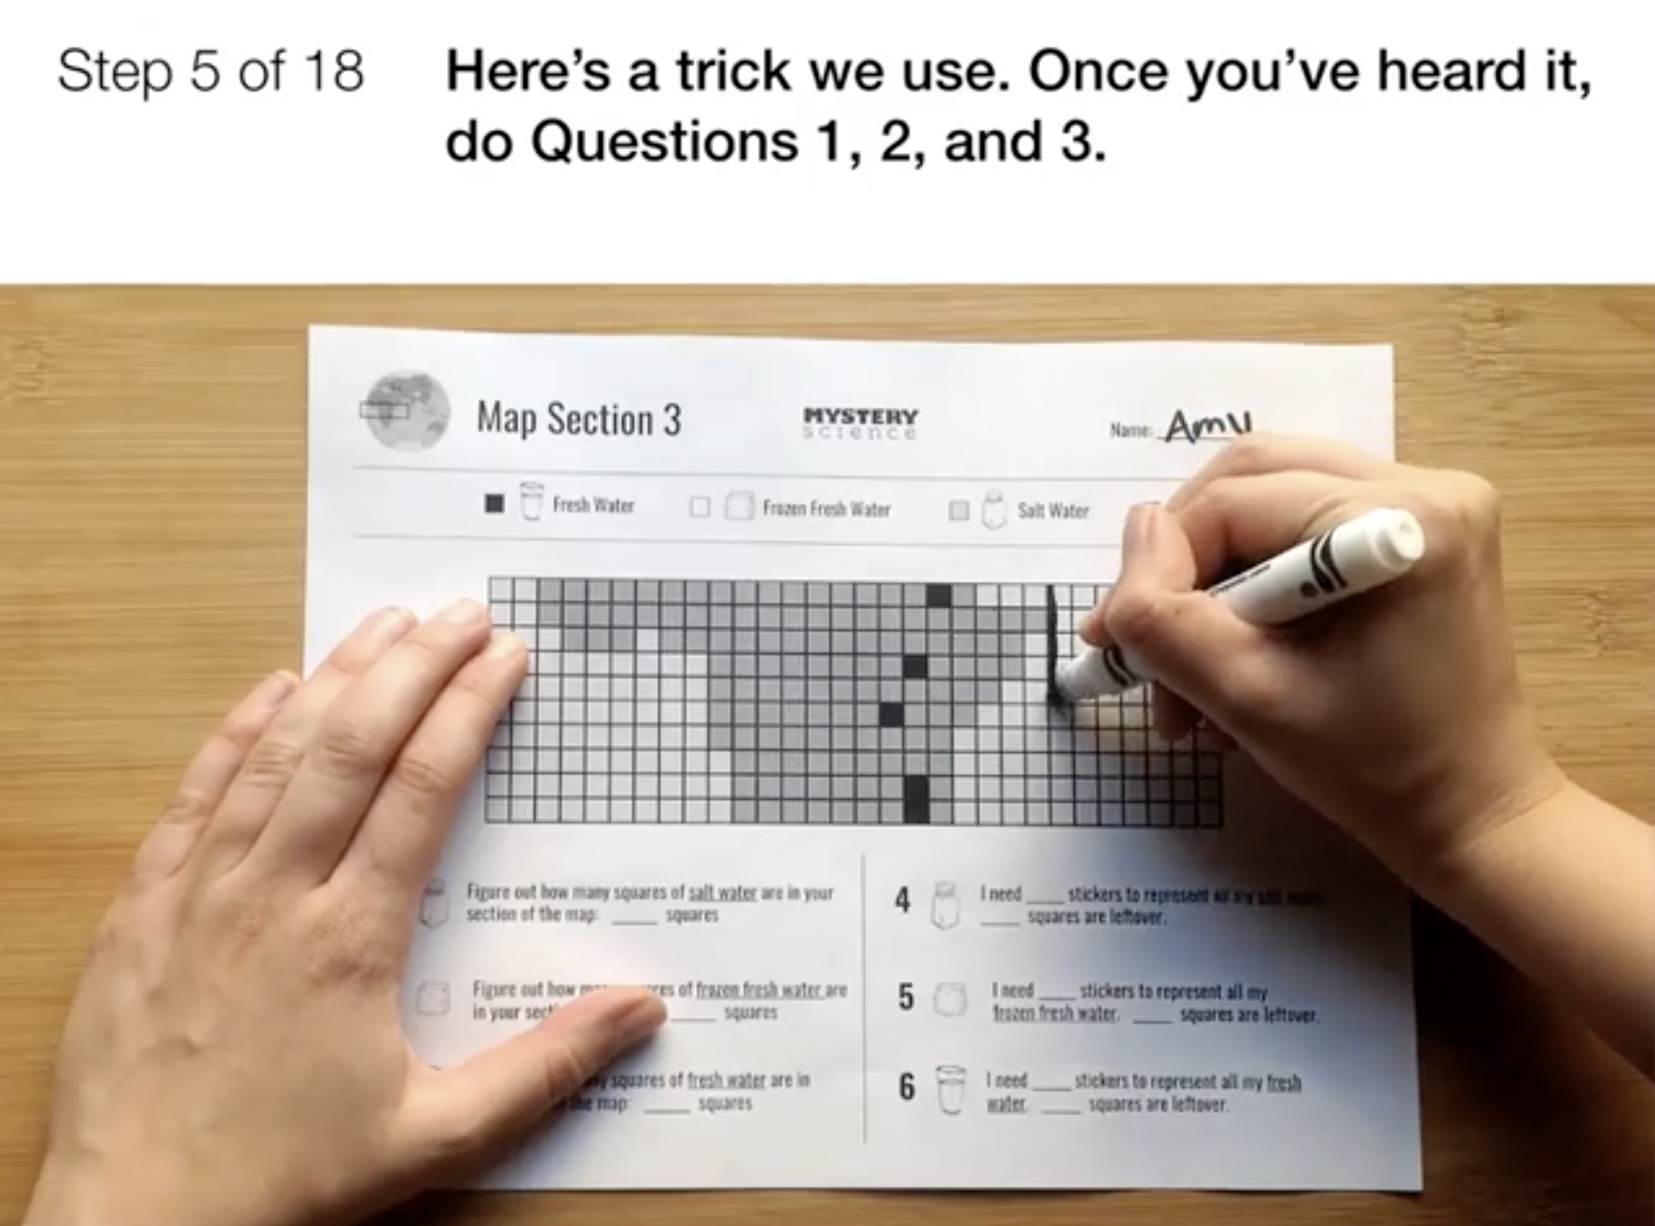
Water Cycle & Earth’s Systems • Grade 5
Anchor Layer Teacher Guide
Lesson 1: How much water is there in the world? (pg 1 of 2)
Hydrosphere & Water Distribution
Overview
In this lesson, students use estimation and graphing to discover the surprising difference in the amounts of freshwater and saltwater on Earth.
In the activity, Map the World's Water, students count squares on maps and record the amount of fresh, frozen, and salt water found in their assigned area of the world. Then students calculate and graph how much of each type of water is present on the planet.
If you have limited time, you can divide this lesson into two sessions. Part 1 (counting and recording squares on a map) takes 10 to 15 minutes. Part 2 (making the graph) takes another 15-20 minutes. Part 2 begins at Step 6.
Exploration 25 mins
Hands-On Activity 25 mins
Wrap-Up 5 mins
Anchor Connection 30 mins
Assessment 25 mins
Activity Notes
We suggest students work in pairs. Each student will work on a separate portion of the World Map, but students in pairs can help check each other’s work.
You will need enough space on a wall or door to accommodate a graph that’s 76 stickers high and 3 bars wide. See the lesson page for more detailed prep instructions and tips for completing the activity.
Teacher Tip: Be aware that counting lots of little squares can be tricky, and counts may vary, even among students working on the same maps. We suggest you remind students that their work should be as accurate as possible, but a few squares off here or there won’t change the graph. Any answer that’s close to the count on the “Map Checklist & Answer Key” will work out fine.
Anchor Connection on Next Page
‹#›

Slide 7
Water Cycle & Earth’s Systems • Grade 5
Anchor Layer Teacher Guide
Lesson 1: How much water is there in the world? (pg 2 of 2)
Hydrosphere & Water Distribution
Anchor Connection
The Dust Bowl region is in the Midwest which is a very dry region of the country. The Dust Bowl region does not have any large bodies of freshwater nearby to get water from.
Students revisit the explanation and/or drawings that they worked on during the Anchor Phenomenon. They should understand that the region where the Dust Bowl happened did not have large bodies of freshwater nor did it have significant rainfall.
Students can update their explanations and/or drawings by:
Showing the relationship between water and living things: little rainfall causes crops to die
Showing the relationship between land and water: The Dust Bowl region does not have access to fresh water sources
Connecting Storyline Question
How did a lack of fresh water and rain contribute to the Dust Bowl?
Exploration 25 mins
Hands-On Activity 25 mins
Wrap-Up 5 mins
Anchor Connection 30 mins
Assessment 25 mins
‹#›

Slide 8
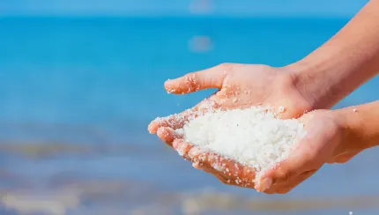
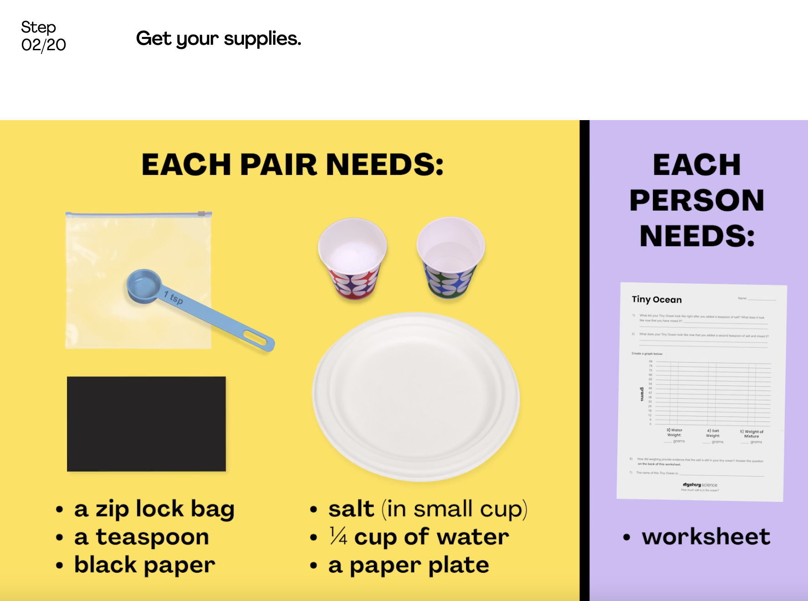
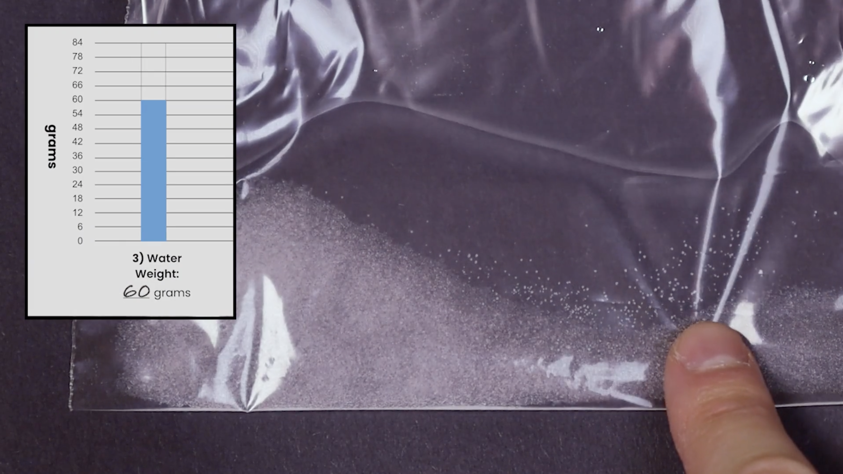
Water Cycle & Earth’s Systems • Grade 5
Anchor Layer Teacher Guide
Lesson 2: How much salt is in the ocean? (pg 1 of 2)
Mixtures & Solutions
Overview
In this lesson, students explore how incredibly salty the ocean is, even though we can't see the salt!
In the activity, Tiny Ocean, students create a model ocean to observe how salt seems to completely vanish when dissolved in water. Students then measure and graph quantities of the water and salt to provide evidence that, even though we can’t see it, the salt still weighs the same amount. Students also create a model salt flat, allowing the water to evaporate, leaving the salt behind.
If you have limited time, you can divide this lesson into two sessions. Part 1 (create a Tiny Ocean) takes 35 to 40 minutes. Part 2 (create a Paper Bag Landscapes) takes 15-20 minutes.
Exploration 10 mins
Hands-On Activity 35 mins
Wrap-Up 20 mins
Anchor Connection 15 mins
Assessment 25 mins
Activity Notes
We suggest students work in pairs. Each pair will make a Tiny Ocean in a plastic sandwich bag. We suggest four pairs of students (8 students) then work together in a group to add their Tiny Ocean to a Paper Bag Landscape.
Each Paper Bag Landscape needs to dry on a cookie sheet. So if you have 30 students, you will need enough space for 4 cookie sheets. See the lesson page for more detailed prep instructions.
Teacher Tip: After creating their Tiny Ocean, students will observe as their ocean dries, seeing the salt flat that is left behind. The time it takes for the Tiny Ocean to dry depends on humidity where you live. In Nevada, our Tiny Ocean dried in an afternoon. In foggy San Francisco, it took a few days.
Anchor Connection on Next Page
‹#›

Slide 9
Water Cycle & Earth’s Systems • Grade 5
Anchor Layer Teacher Guide
Lesson 2: How much salt is in the ocean? (pg 2 of 2)
Mixtures & Solutions
Anchor Connection
Without an influx of fresh water from rain or streams and rivers, the Dust Bowl region became progressively more and more dry. This left behind dry lake and river beds where there was once available fresh water. This dry soil could no longer support as many living things
Students revisit the explanation and/or drawings that they worked on during the Anchor Phenomenon. They should understand that with a lack of freshwater and rain, much of the water in the area simply dried up. This left dry ground behind.
Students can update their explanations and/or drawings by:
Showing the relationship between water and living things: living things could no longer survive as well as they could in the past with the lack of water
Showing the relationship between the land and water: the land became progressively more and more dry
Connecting Storyline Question
How did plants survive without water on the surface of the ground?
Exploration 10 mins
Hands-On Activity 35 mins
Wrap-Up 20 mins
Anchor Connection 15 mins
Assessment 25 mins
‹#›

Slide 10
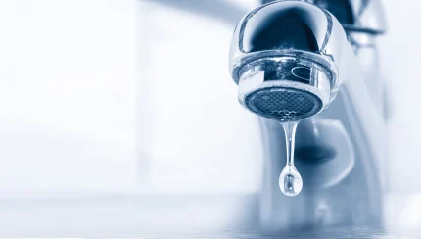
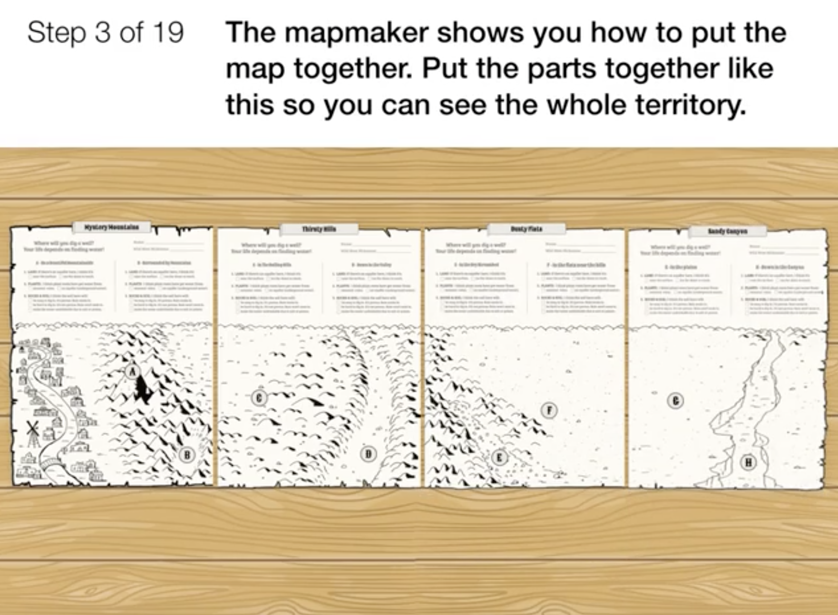
Water Cycle & Earth’s Systems • Grade 5
Anchor Layer Teacher Guide
Lesson 3: When you turn on the faucet, where does the water come from?
Groundwater as a natural resource (pg 1 of 2)
Overview
In this lesson, students construct an explanation about a surprising phenomenon: the existence of underground water.
In the activity, Wanted: A Well, students play a game in which they must obtain and combine information about groundwater in order to select the best site to build a town. They evaluate the features of the landscape, plants in the area, and clues from the soil and then decide where to dig a well.
Exploration 20 mins
Hands-On Activity 25 mins
Wrap-Up 10 mins
Anchor Connection 30 mins
Assessment 25 mins
Activity Notes
We suggest students work in groups of four. If there are just a few students, they can form a smaller group. A solo student can do the activity alone, but we think it’s more fun with friends. See the lesson page for an extension activity on aquifers.
Anchor Connection on Next Page
‹#›

Slide 11
Water Cycle & Earth’s Systems • Grade 5
Anchor Layer Teacher Guide
Lesson 3: When you turn on the faucet, where does the water come from?
Groundwater as a natural resource (pg 2 of 2)
Anchor Connection
The Dust Bowl region was covered with native prairie grasses that had long and dense root structures. Not only were they adapted to survive in dry conditions, but their root structures helped them reach water deep underground. Their roots also kept the dry soil in place. The crops they were replaced with - -wheat and corn - were not adapted to dry conditions and had shorter, less dense roots.
Students revisit the explanation and/or drawings that they worked on during the Anchor Phenomenon. They should understand that in the Dust Bowl region, native grasses were the only plants with deep roots that could access groundwater.
Students can update their explanations and/or drawings by:
Showing the relationship between water and living things: wheat and corn crops didn’t have long enough roots to reach water deep underground
Showing the relationship between land and living things: wheat and corn crops had shorter/less dense roots that didn’t hold the dry soil in place
Connecting Storyline Question
Why are some plants better suited for certain environments than others?
Exploration 20 mins
Hands-On Activity 25 mins
Wrap-Up 10 mins
Anchor Connection 30 mins
Assessment 25 mins
‹#›

Slide 12

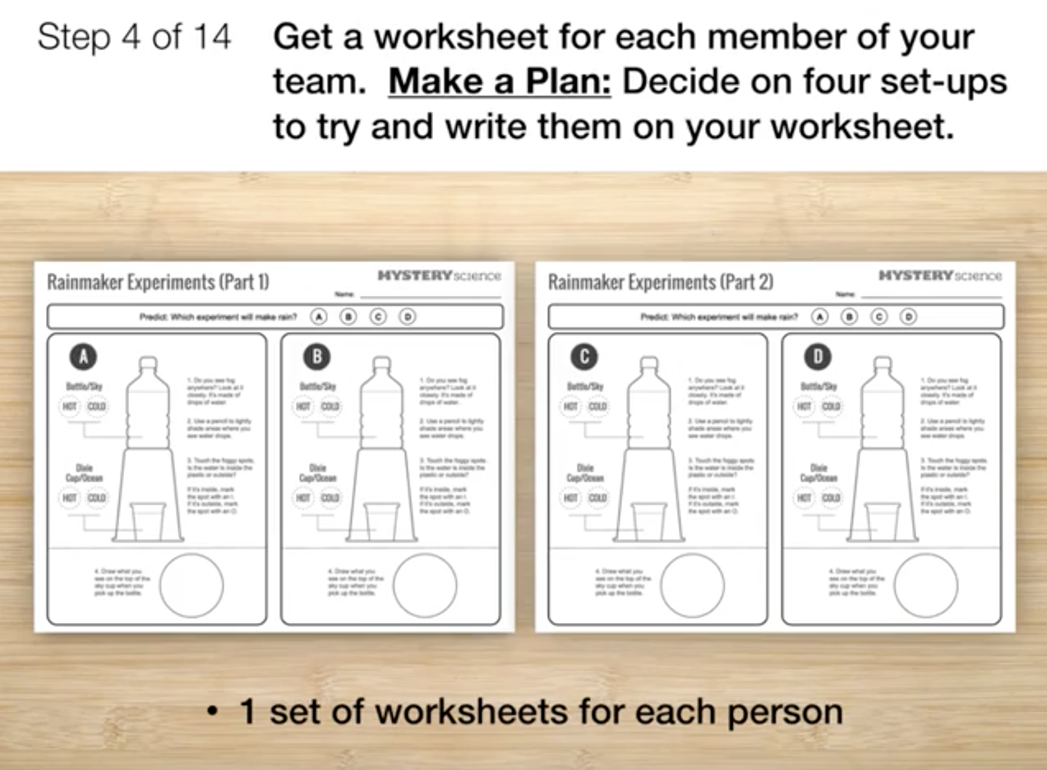
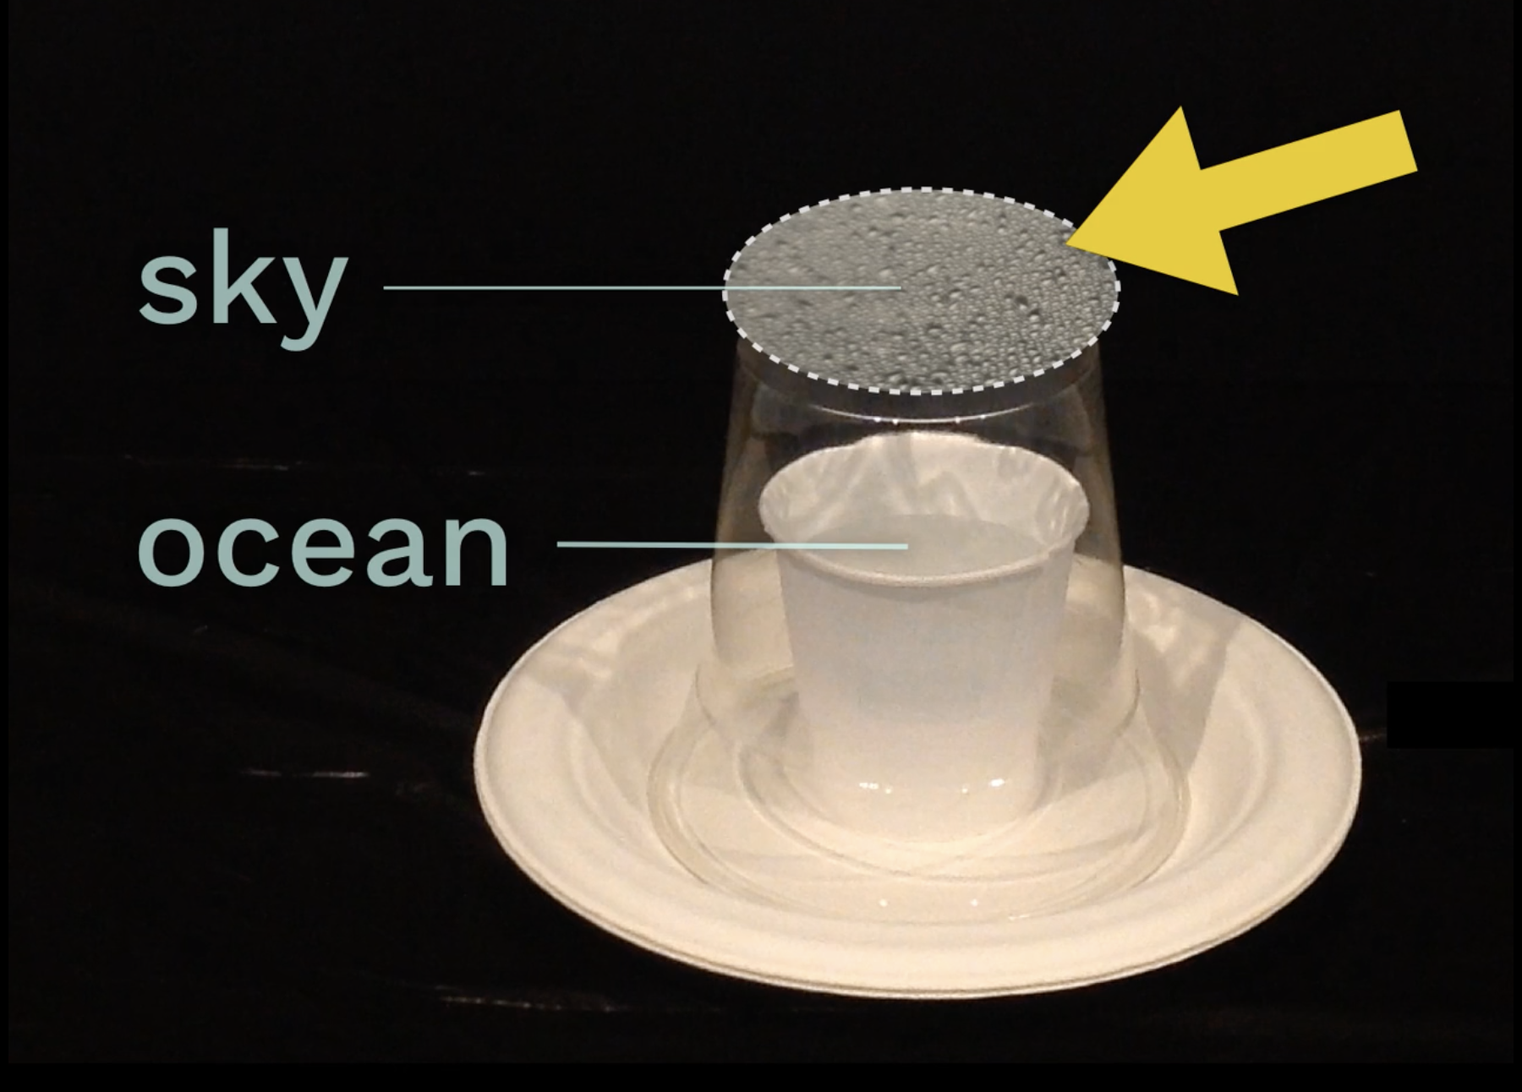
Water Cycle & Earth’s Systems • Grade 5
Anchor Layer Teacher Guide
Lesson 4: Can we make it rain? (pg 1 of 2)
Water Cycle
Overview
In this lesson, students develop a model to explain how water cycles from the Earth’s surface to the atmosphere and back again.
In the activity, Make It Rain, students create simple models of the ocean and sky to see how these two systems interact. Students compare how the temperature of the ocean and the temperature of the sky affect evaporation and condensation.
Exploration 23 mins
Hands-On Activity 25 mins
Wrap-Up 7 mins
Anchor Connection 30 mins
Assessment 25 mins
Activity Notes
You will need access to a refrigerator and microwave for this activity. We suggest students work in groups of four, which works well because there are four experimental set-ups.
You will need several small plastic bottles for this activity (4 bottles for every group of four students, plus a few extras to have on-hand). We encourage you to use recycled bottles when possible
See the lesson page for detailed prep instructions and suggestions on how to separate the materials for easier distribution.
Anchor Connection on Next Page
‹#›

Slide 13
Water Cycle & Earth’s Systems • Grade 5
Anchor Layer Teacher Guide
Lesson 4: Can we make it rain? (pg 2 of 2)
Water Cycle
Anchor Connection
The Dust Bowl occurred during an extreme drought in the region.
Students revisit the explanation and/or drawings that they worked on during the Anchor Phenomenon. Students reason that a severe drought led to dry soil and dying plants. Without the plants’ roots, there was nothing to hold the soil in place.
Students can update their explanations and/or drawings by:
Showing the relationship between land and water: there was an extreme drought and the land became dry and loose
Connecting Storyline Question
How does the amount of rainfall in an area impact the soil of that area?
Exploration 23 mins
Hands-On Activity 25 mins
Wrap-Up 7 mins
Anchor Connection 30 mins
Assessment 25 mins
‹#›

Slide 14
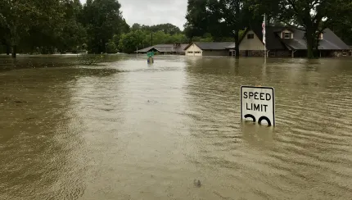
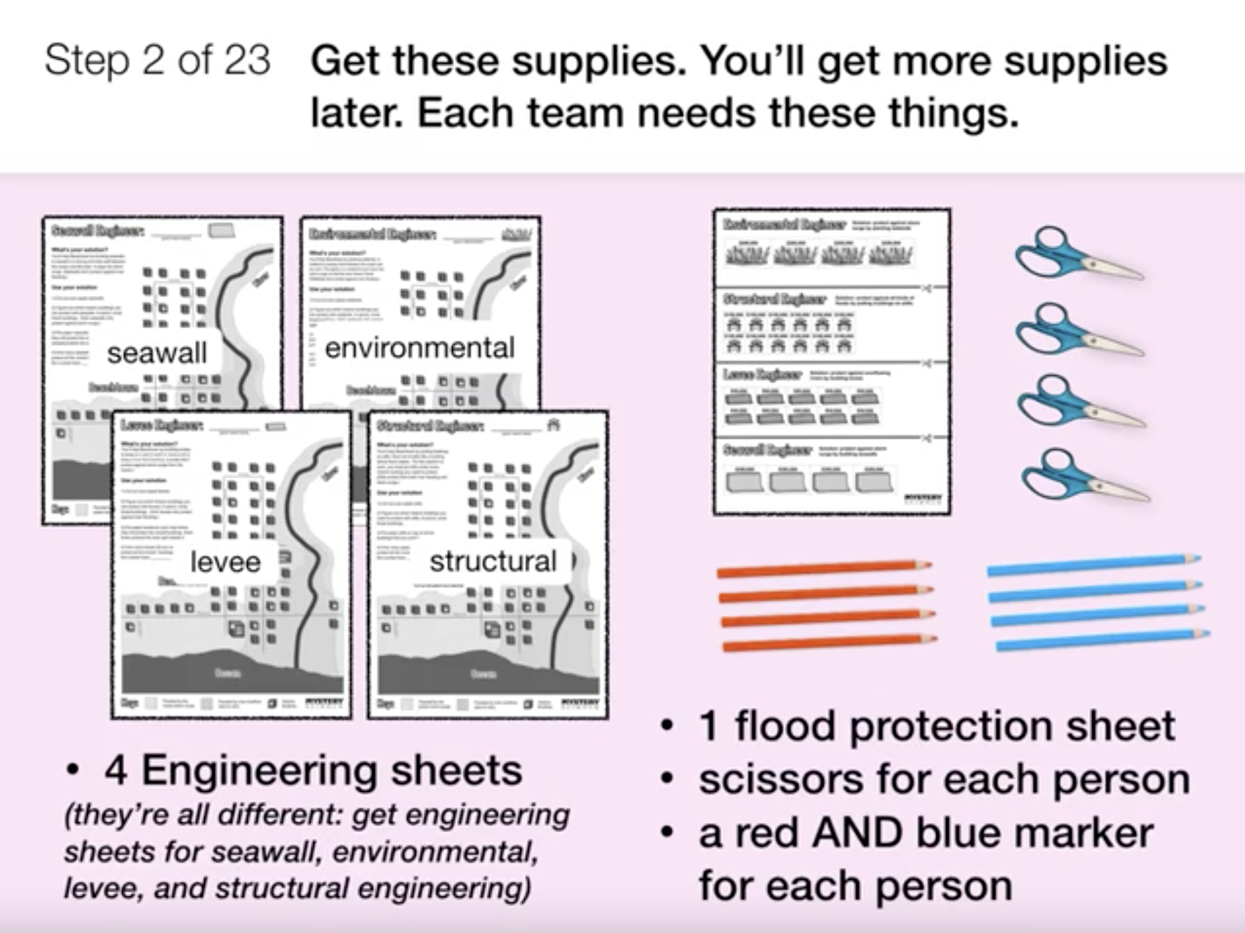
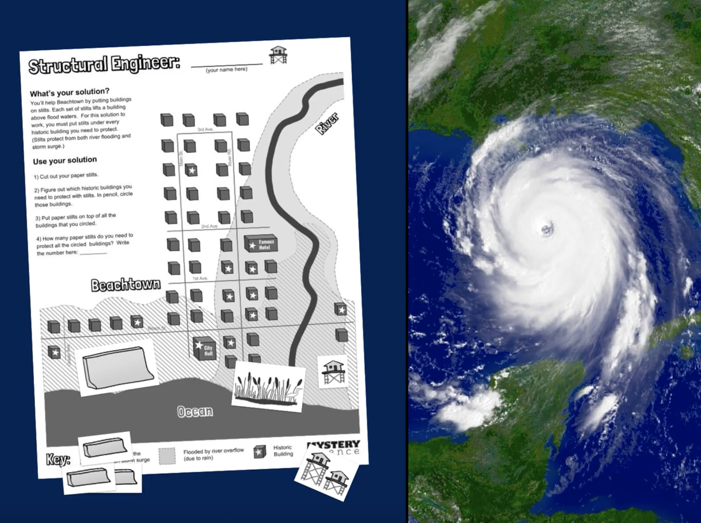
Water Cycle & Earth’s Systems • Grade 5
Anchor Layer Teacher Guide
Lesson 5: How can you save a town from a hurricane?
Natural Disasters & Engineering (pg 1 of 2)
Overview
In this lesson, students examine the causes of flooding using the real-world example of Hurricane Katrina.
In the activity, Save Beachtown, students propose plans to prevent flooding and save historic buildings in a coastal town–all while staying within budget!
This simulation is very engaging and may take more than 20 minutes for students to complete. Consider dividing this lesson into two class periods. We’ve provided challenge questions in the Extensions for those who want to extend the activity.
Exploration 15 mins
Hands-On Activity 35 mins
Wrap-Up 5 mins
Anchor Connection 30 mins
Assessment 25 mins
Activity Notes
We suggest students work in groups of four. Each student will need 6-7 glue dots. You may want to prep this prior to class to make distribution easier.
At the start of the activity, students will need the Beachtown Engineers printout, scissors, and colored pencils. They will later need the Beachtown Budget, Final Plan, and some sticky glue dots. You may want to separate these supplies into two piles for easier classroom distribution.
You may want students to post their work so that each group can see the similarities and differences in the engineering solutions. If you decide to do this, you’ll need wall space and supplies (tape or push pins) to display The Final Plan of each group.
Anchor Connection on Next Page
‹#›

Slide 15
Water Cycle & Earth’s Systems • Grade 5
Anchor Layer Teacher Guide
Lesson 5: How can you save a town from a hurricane?
Natural Disasters & Engineering (pg 2 of 2)
Anchor Connection
Warm water evaporates more than cool water does. During the Dust Bowl, the temperatures in the Pacific Ocean cooled to an abnormally low temperature, leading to less evaporation over the ocean and therefore less water in the air. This led to decreased precipitation--a drought--in the Dust Bowl region.
Students revisit the explanation and/or drawings that they worked on during the Anchor Phenomenon. This investigation suggests that changes in ocean temperatures impact rainfall patterns. When the ocean temperatures cool, rainfall can decrease, causing droughts.
Students can update their explanations and/or drawings by:
Showing the relationship between air and water: the air cooled above the Pacific which led to less water evaporating. This caused a drought in the Dust Bowl region
Connecting Storyline Question
What interaction between air, water, land, and living things do you think had the biggest contribution to causing the Dust Bowl?
Exploration 15 mins
Hands-On Activity 35 mins
Wrap-Up 5 mins
Anchor Connection 30 mins
Assessment 25 mins
‹#›

Slide 16
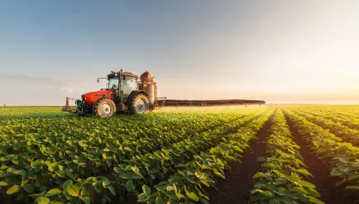
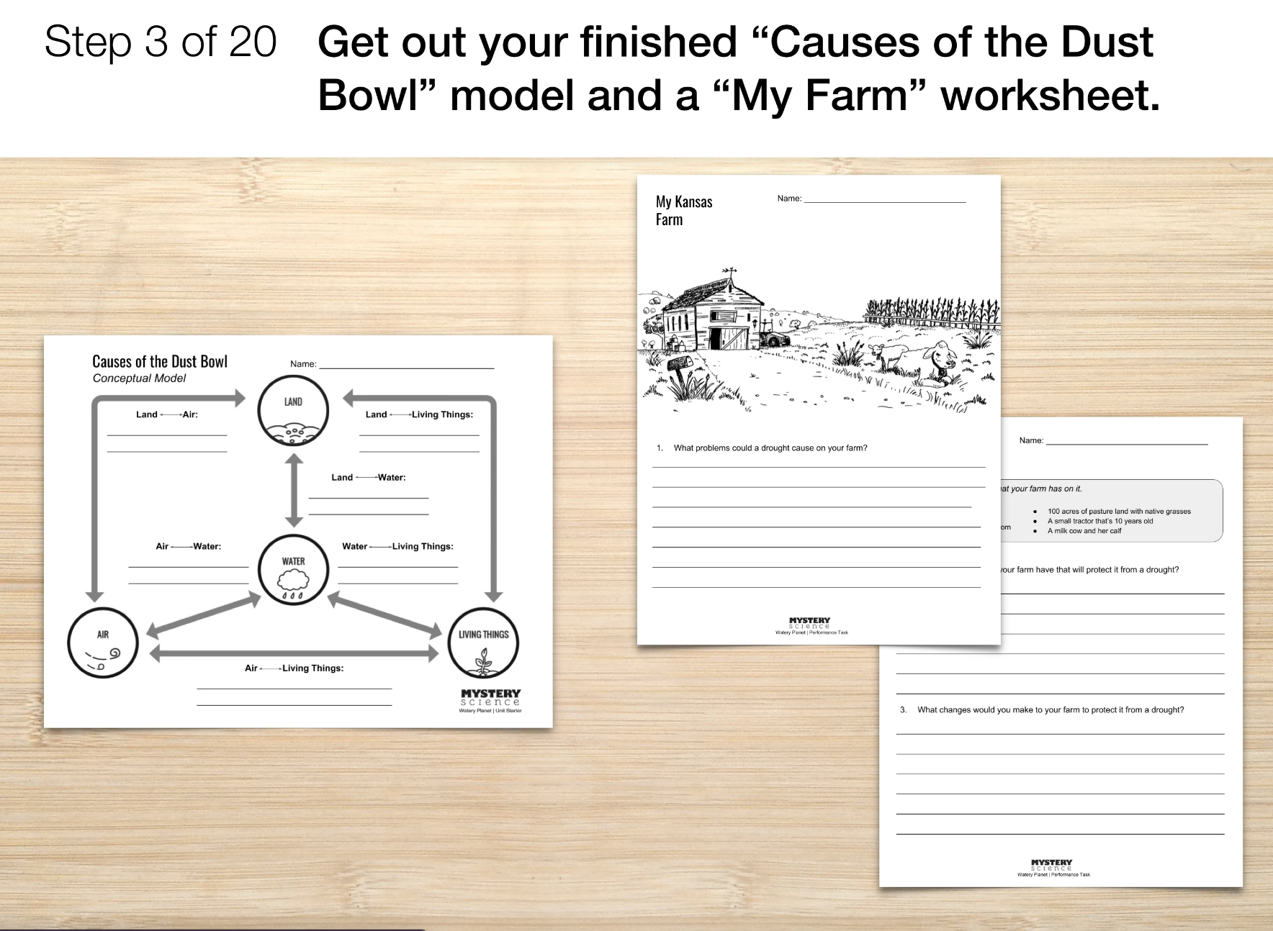
Water Cycle & Earth’s Systems • Grade 5
Anchor Layer Teacher Guide
Performance Task: How can you protect a farm from the next Dust Bowl?
Interaction of Earth’s Spheres & Argumentation
Overview
In this performance task, students inherit a farm in the Midwest that they must protect from an extreme drought - they don't want to end up in another Dust Bowl. They are offered a choice of four Drought Protection kits and evaluate the pros and cons of each. Next, students write an argument, using evidence from the unit, in support of the Drought Protection kit they selected.
Unit Review 20 mins
Hands-On Activity 120 mins
Performance Task Notes
Choose 4 separate spots in your classroom to hang the Drought Protection Kits posters. We recommend using the 4 corners!
Students will need their completed Causes of the Dust Bowl Model that they have been adding to after each Mystery.
Crosscutting Concepts
Systems and System Models: A system is a group of related parts that interact to perform a function.
The land, water, air, and living things on earth function as a system. When one changes, the others are affected.
‹#›

