Slide 1


Anchor Layer Teacher Guide
A curriculum companion for Anchor Layer users
Grade 4
Electricity, Light, & Heat
Unit Web Link • Pacing Guide • Other Units

Slide 2
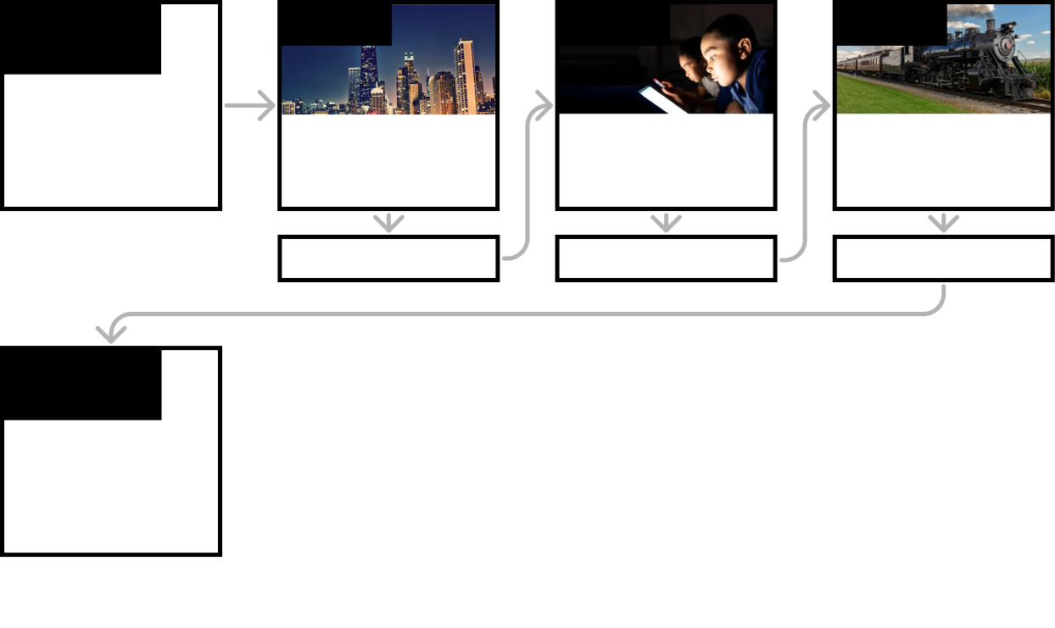
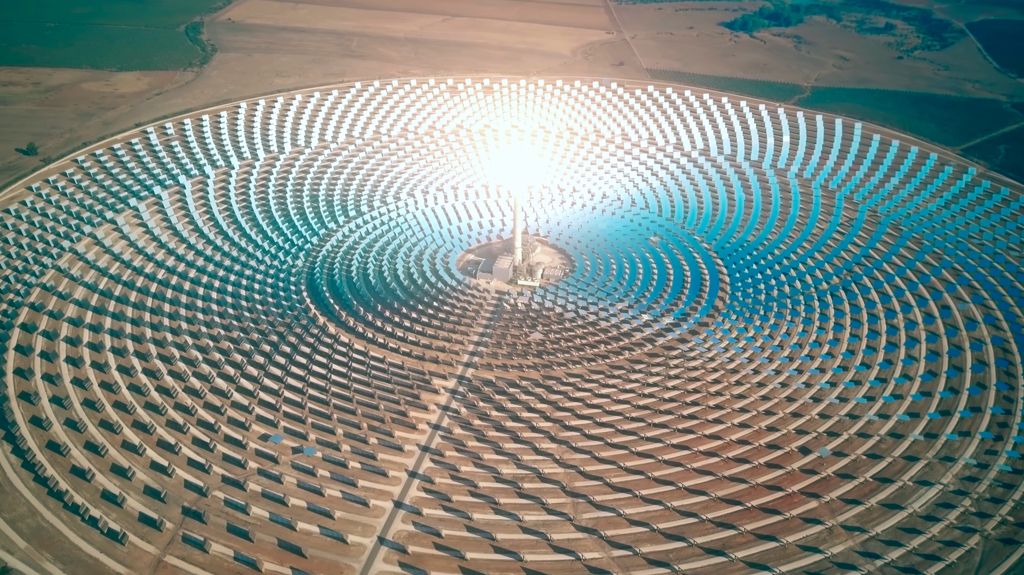
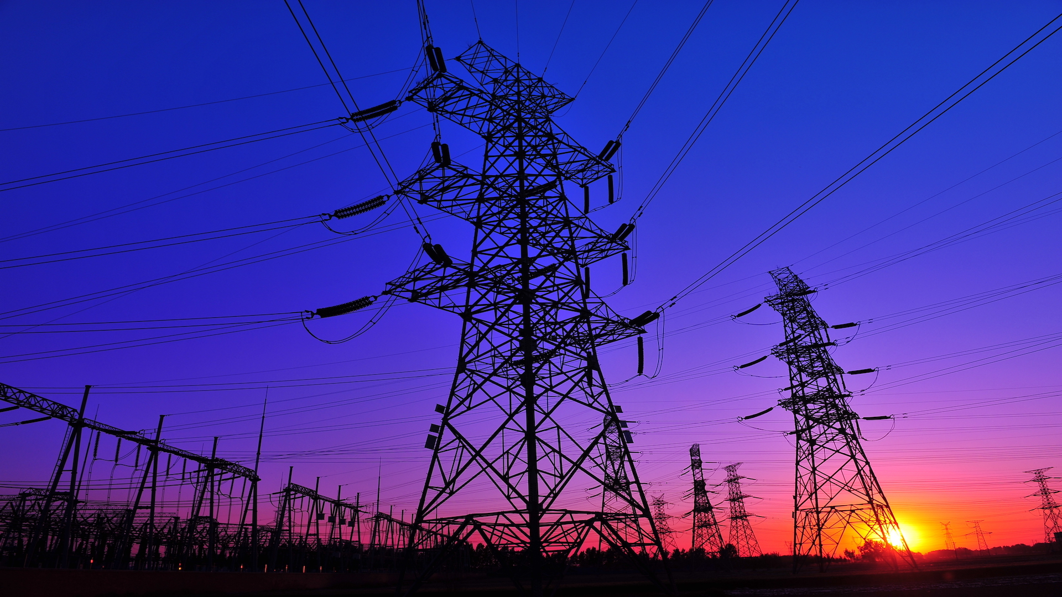
Electricity, Light, & Heat • Grade 4
Anchor Layer Teacher Guide
Unit Summary
In this unit, students explore the different forms of energy! Students investigate how energy can change form from heat energy into electrical energy. Students also construct devices that convert energy from one form into another, such as heat into motion and electricity into light.
Performance Expectations | Science & Engineering Practices | Disciplinary Core Ideas | Crosscutting Concepts
• 4-ESS3-1. Obtain and combine information to describe that energy and fuels are derived from natural resources and their uses affect the environment. • 4-PS3-2. Make observations to provide evidence that energy can be transferred from place to place by sound, light, heat, and electric currents. • 4-PS3-4. Apply scientific ideas to design, test, and refine a device that converts energy from one form to another. • 3-5-ETS1-1. Define a simple design problem reflecting a need or a want that includes specified criteria for success and constraints on materials, time, or cost. • 3-5-ETS1-3. Plan and carry out fair tests in which variables are controlled and failure points are considered to identify aspects of a model or prototype that can be improved. | • Obtaining, Evaluating, and Communicating Information • Using Mathematics and Computational Thinking • Developing and Using Models • Constructing Explanations and Designing Solutions • Planning and Carrying Out Investigations | • SS3.A: Natural Resources • PS3.D: Energy in Chemical Processes and Everyday Life • ETS1.A: Defining and Delimiting Engineering Problems • ETS1.B: Developing Possible Solutions • ETS1.C: Optimizing the Design Solution • PS3.B: Conservation of Energy and Energy Transfer | • Energy and Matter • Cause and Effect
Anchor Phenomenon
Lesson 1
Lesson 2
Lesson 3
Electricity, Light, & Heat
The Three Towers
Renewable Energy & Natural Resources
What's the best way to light up a city?
Electrical Energy
What if there were no electricity?
Heat Energy & Energy Transfer How long did it take to travel across the country before cars and planes?
Anchor Connection
Anchor Connection
Anchor Connection
Performance Task
Renewable Energy
Can we get energy from the Sun at night?
‹#›

Slide 3
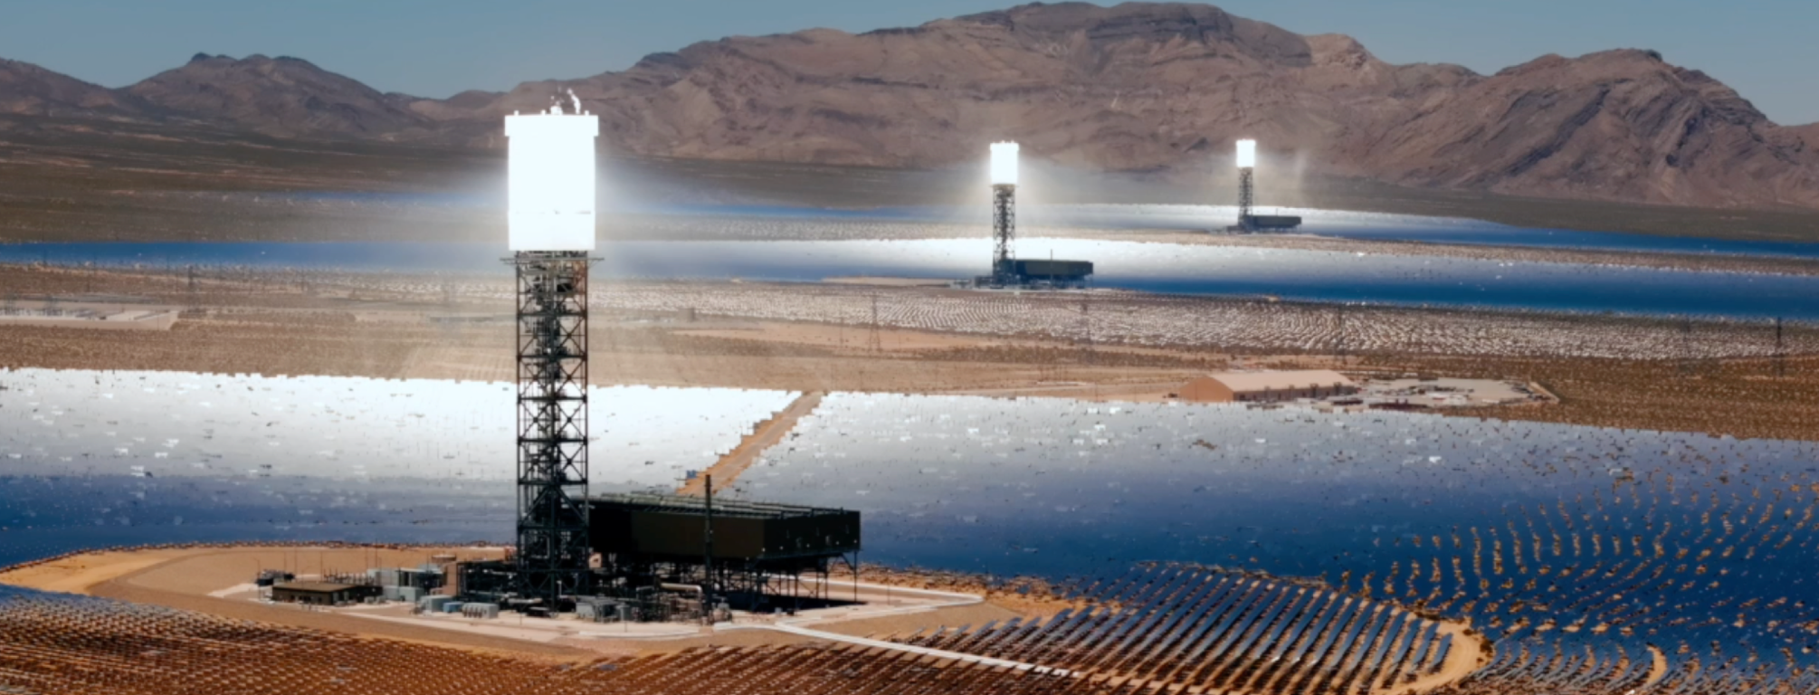
Electricity, Light, & Heat • Grade 4
Anchor Layer Teacher Guide
Anchor Phenomenon Background
What are these blindingly bright towers in the desert? And what are they for?
When people think of solar energy, they usually think of simple solar panels. Solar panels are able to take energy from sunlight and directly transform it to electric energy.
But that isn’t the only way to generate electricity from solar energy. Solar thermal towers take a different approach. Instead of converting sunlight directly into electricity, solar thermal towers first use the sunlight to boil water, and then use the resulting steam to spin turbines and generators. Those generators are responsible for the final step of producing electricity.
This seems much, much more complicated than regular solar panels. Why would people choose to build such a complex system when solar panels exist?
One of the main benefits of solar thermal towers is that they can continue to generate electricity hours after the Sun sets in the evening. Some are even designed to continue generating electricity throughout the entire night! They can do this because different parts of the solar tower remain hot after the Sun sets. This serves as a way to store the energy that originally came from the sunlight.
Solar towers are not without their drawbacks, though. They take up huge amounts of space, which can be harmful to fragile ecosystems. The focused sunlight can also be very dangerous to animals, such as birds that fly into the path of the focused light. Some towers also require fossil fuels to operate, and while they consume far less than a typical fossil fuel plant, this does have a negative impact on the environment.
‹#›

Slide 4
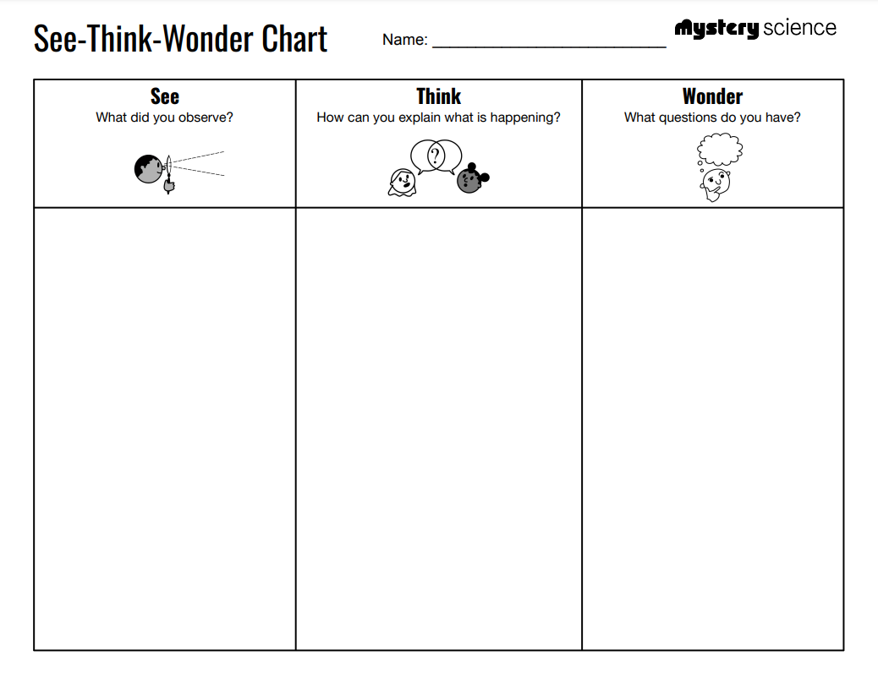
Electricity, Light, & Heat • Grade 4
Anchor Layer Teacher Guide
Anchor Phenomenon: The Three Towers
Animal Adaptations
Anchor Phenomenon Lesson Overview
Note: This lesson is part of this unit’s Anchor Layer. If you have the Anchor Layer turned on, we recommend teaching all lessons in the remainder of this unit in order.
The anchor phenomenon for this unit is a mysterious set of three glowing towers in the desert. Students generate observations and questions about the phenomenon and create an initial conceptual model to explain what is happening.
Anchor Phenomenon 15 mins
Guided Inquiry 20 mins
Hands-On Activity 20 mins
Wrap-Up 2 mins
Student Work Samples & Notes
Students will gather clues during and after each lesson to help them improve their explanation. It is important to encourage students to recognize that even if they don't know the perfect answer yet, they are going to learn a lot throughout the unit and will have an opportunity to change or add to their first explanation.
Giant towers
Shiny things on the ground
Super bright light
There are three of them
It’s in the desert
I think they are solar panels
I think the towers shine light down
I think these make electricity somehow
I wonder how they work
I wonder why they look so different from other solar panels
I wonder why it’s in the desert
‹#›

Slide 5
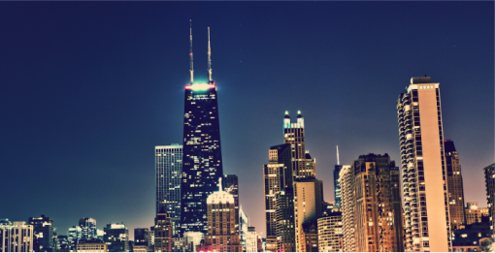
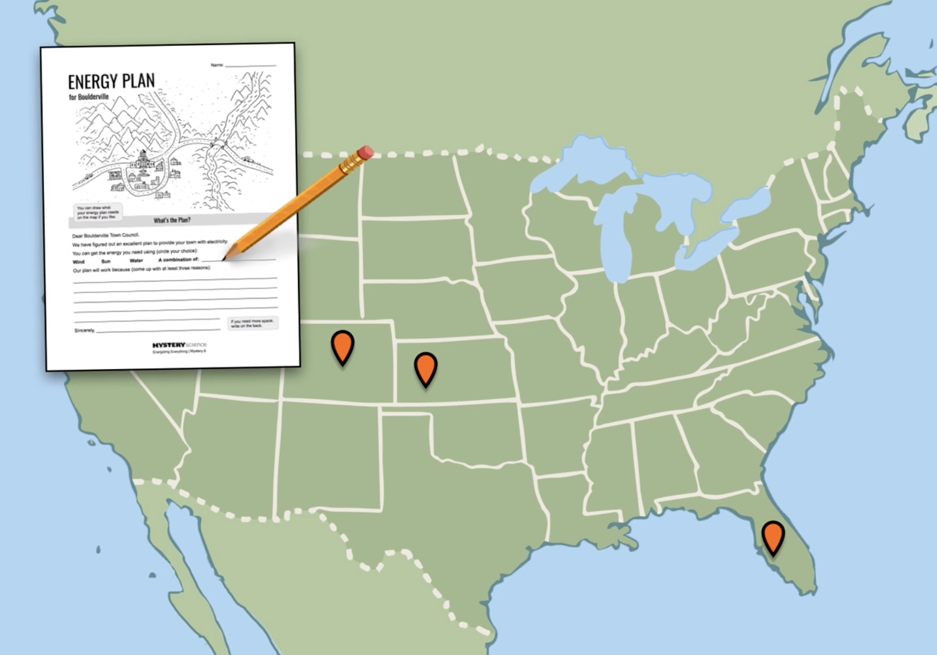
Electricity, Light, & Heat • Grade 4
Anchor Layer Teacher Guide
Lesson 1: What's the best way to light up a city? (pg 1 of 2)
Renewable Energy & Natural Resources
Overview
In this lesson, students explore how a city's electricity is derived from natural resources such as coal, sunlight, wind, and water. They investigate how using these different energy sources affects the environment.
In the activity, Power this Town, students obtain and combine information about different types of renewable energy and evaluate the advantages and disadvantages of each energy source.
Exploration 15 mins
Hands-On Activity 35 mins
Wrap-up 5 mins
Assessment 25 mins
Anchor Connection 15 mins
Activity Notes
We suggest students work in pairs.
Place each Energy Sign in a separate area of the room so that students can easily see them.
Teacher Tip: Some classes may want to do research on the towns we featured in the readings. All of them are real towns, but we changed the name of one town. We called the solar-powered town in Florida “Ranchtown,” but the actual name is “Babcock Ranch.”
Anchor Connection on Next Page
‹#›

Slide 6
Electricity, Light, & Heat • Grade 4
Anchor Layer Teacher Guide
Lesson 1: What's the best way to light up a city? (pg 2 of 2)
Renewable Energy & Natural Resources
Anchor Connection
There are many different ways that people generate electricity. The three towers in the desert are one example.
Clearly, these towers are doing something with very bright sunlight, but there is more to story. Simple solar panels can generate electricity from sunlight, and they don’t require huge towers like these. So why are the towers there? It turns out that there is water inside the towers, and that is somehow used to generate electricity.
Students revisit the explanation and/or drawing that they worked on during the Anchor Phenomenon. They can revise their thinking by showing that sunlight reflects off of the mirrors on the ground. They now know that water is also involved, so they should mention that fact. However, they may not know exactly how the water is involved.
Connecting Storyline Question
How does the electricity go from the towers to places where people use electricity?
Exploration 15 mins
Hands-On Activity 35 mins
Wrap-up 5 mins
Assessment 25 mins
Anchor Connection 15 mins
‹#›

Slide 7

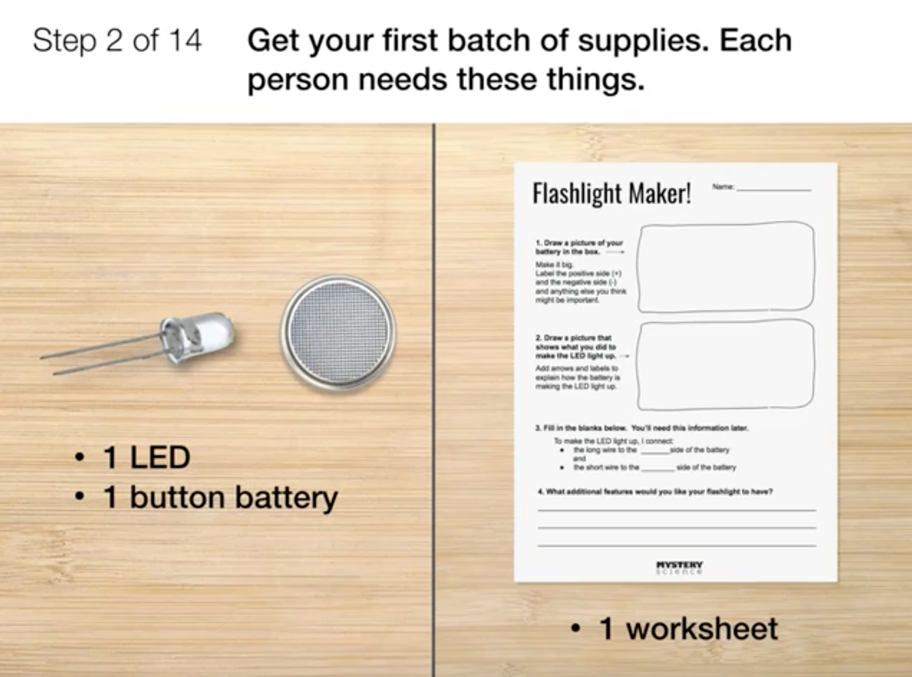
Electricity, Light, & Heat • Grade 4
Anchor Layer Teacher Guide
Lesson 2: What if there were no electricity? (pg 1 of 2)
Electrical Energy
Overview
In this lesson, students are introduced to electricity as a form of energy.
In the activity, Build a Flashlight, students investigate how electrical energy requires a circuit and make their own mini flashlights from LEDs, button batteries, and strips of aluminum foil. Along the way, they’ll learn about the anatomy of a battery, begin to see how circuits work, and discover how handy an on-off switch can be.
Exploration 22 mins
Hands-On Activity 35 mins
Wrap-up 3 mins
Assessment 25 mins
Anchor Connection 15 mins
Activity Notes
Teacher Note: If you purchase the batteries in advance, please read this document for how to safely store them.
We suggest students work in pairs.
For each student, tear off a strip of aluminum foil that’s about 4 inches wide and as long as the roll (usually about 12 inches).
Anchor Connection on Next Page
‹#›

Slide 8
Electricity, Light, & Heat • Grade 4
Anchor Layer Teacher Guide
Lesson 2: What if there were no electricity? (pg 2 of 2)
Electrical Energy
Anchor Connection
Regardless of which way that humans generate electricity, they have to figure out a way to distribute that electricity out to the places where it is used.
The main way that people distribute electricity is to use extremely long wires to conduct the electricity. This is true at the three towers, too!
Students revisit the explanation and/or drawing that they worked on during the Anchor Phenomenon. They can revise their thinking by explaining that the electricity from the towers is transmitted to far-away cities with long wires that are hung from other tall towers.
Connecting Storyline Question
How do the towers even make electricity?
Exploration 22 mins
Hands-On Activity 35 mins
Wrap-up 3 mins
Assessment 25 mins
Anchor Connection 15 mins
‹#›

Slide 9
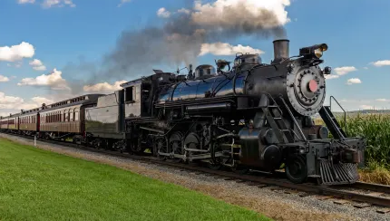
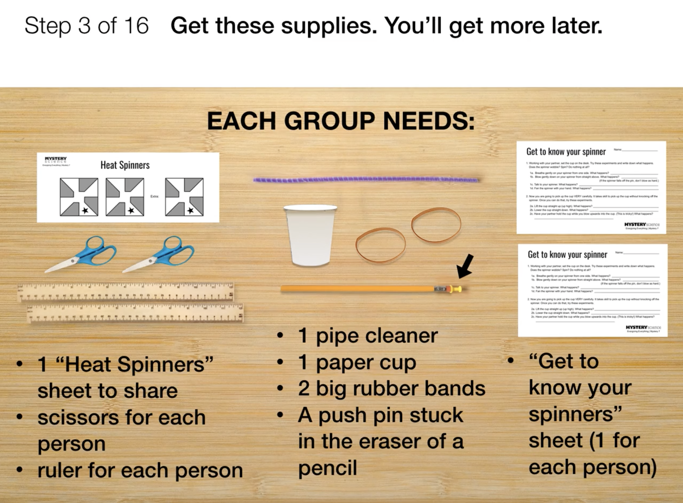
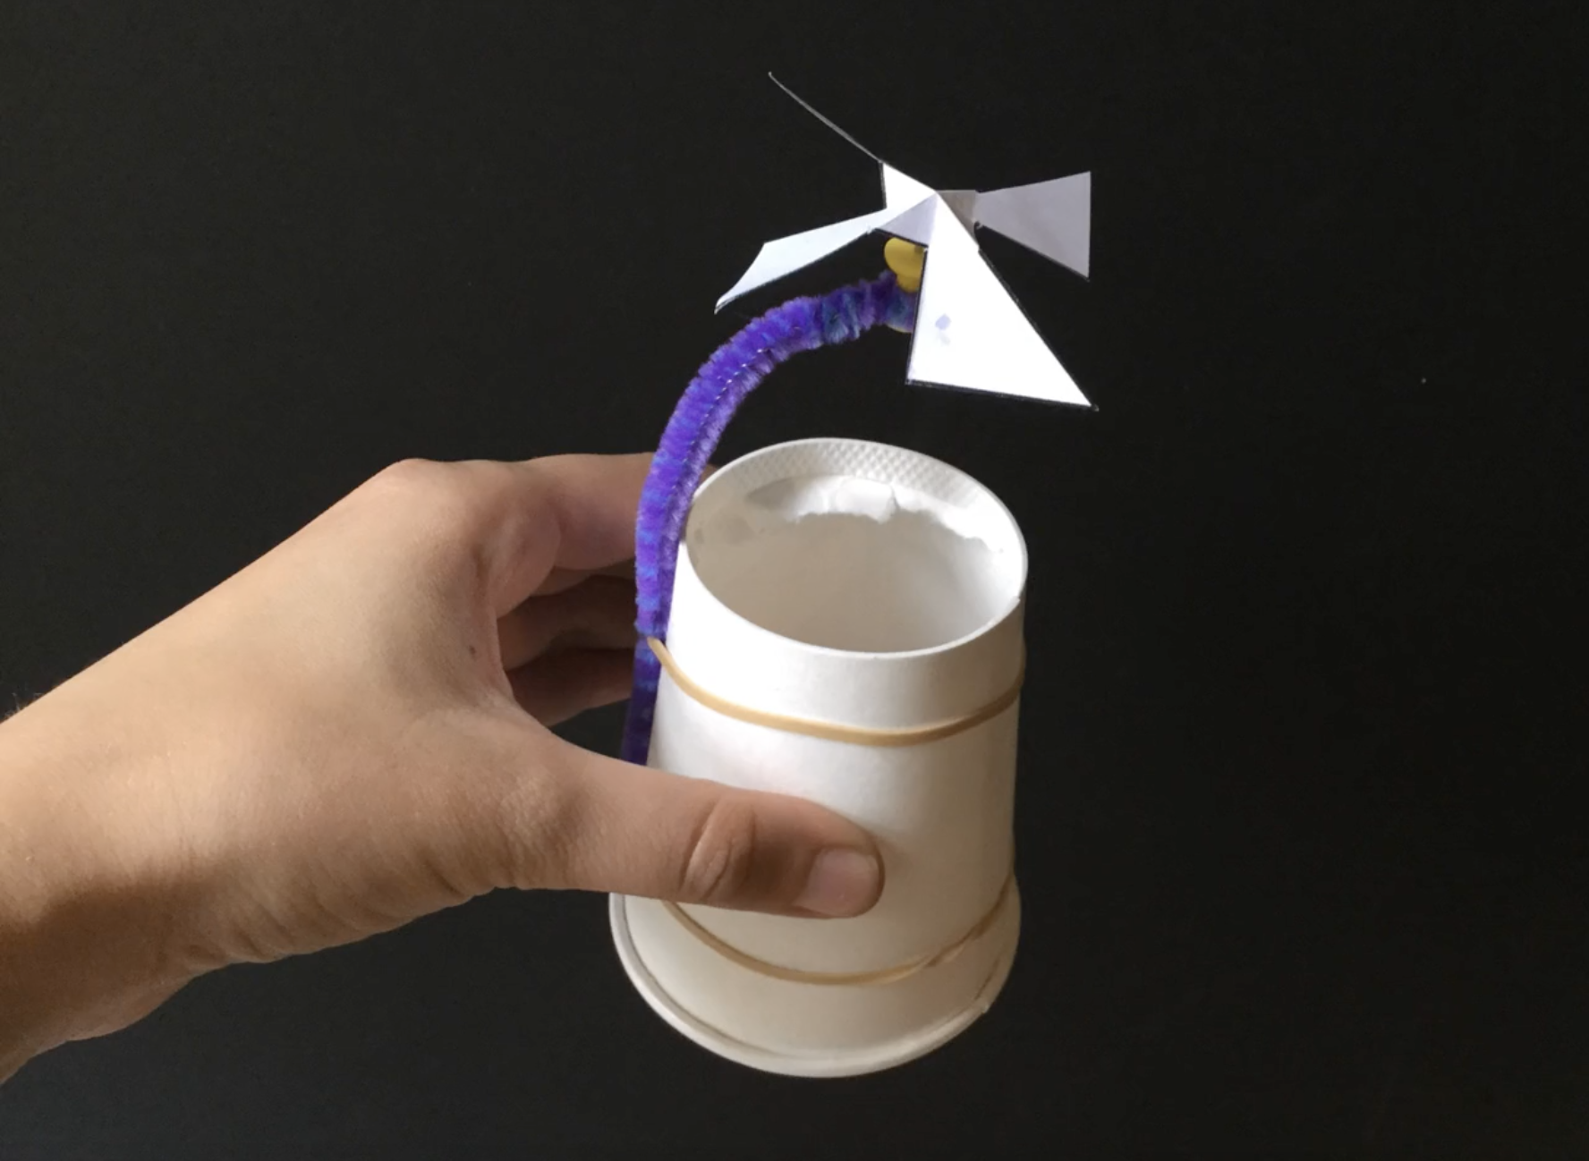
Electricity, Light, & Heat • Grade 4
Anchor Layer Teacher Guide
Lesson 3: How long did it take to travel across the country before cars and planes? (pg 1 of 2)
Heat Energy & Energy Transfer
Overview
In this lesson, students explore how heat is another form of energy that can make things go.
In the activity, Heat Spinner, students first make a paper Heat Spinner and observe how air can create movement. Then, students use their Heat Spinners to experiment with a heat source (an incandescent bulb) and discover how heat energy can make the spinner move in different ways.
Part 1 (building a Heat Spinner) takes 15 to 20 minutes. Part 2 (experimenting with the Heat Spinners) takes another 15 to 20 minutes. You may want to divide this lesson into two sessions, stopping after Part 1 and continuing with the Experimental Stations another day.
Exploration 11 mins
Hands-On Activity 45 mins
Wrap-up 4 mins
Assessment 25 mins
Anchor Connection 15 mins
Activity Notes
In Part 1 of this activity, we recommend students work in pairs. In Part 2 of this activity, we recommend students work in groups of four.
You need to set up at least two Experimental Stations with a heat source: a desk lamp with an incandescent bulb or a heated gel pack (you can heat the gel packs in the microwave, but they’ll only stay warm for about 30 minutes). For a class of 32 students, we recommend having two or more Experimental Stations. Four students will use each station at a time. When students are not using the Experimental Stations, they will be discussing ideas.
See our lesson page for more detailed prep instructions.
Anchor Connection on Next Page
‹#›

Slide 10
Electricity, Light, & Heat • Grade 4
Anchor Layer Teacher Guide
Lesson 3: How long did it take to travel across the country before cars and planes? (pg 2 of 2)
Heat Energy & Energy Transfer
Anchor Connection
The solar towers generate electricity in a sequence of steps. First, they convert light energy into heat energy. This is done by focusing the light from the mirrors onto the towers. The towers then transfer that heat into water that’s inside of pipes in the tower. The water gets hot enough to turn to steam, which has a huge amount of thermal energy. That thermal energy makes a turbine spin, which means that it has energy of movement. Finally, that energy of movement turns a generator, and the generator converts the energy of movement into electric energy.
Students revisit the explanation and/or drawing that they worked on during the Anchor Phenomenon. They can revise their thinking by explaining heated water inside of the towers is used to drive turbines that are connected to generators.
Connecting Storyline Question
How are the towers different from other ways of using solar energy?
Exploration 11 mins
Hands-On Activity 45 mins
Wrap-up 4 mins
Assessment 25 mins
Anchor Connection 15 mins
‹#›

Slide 11
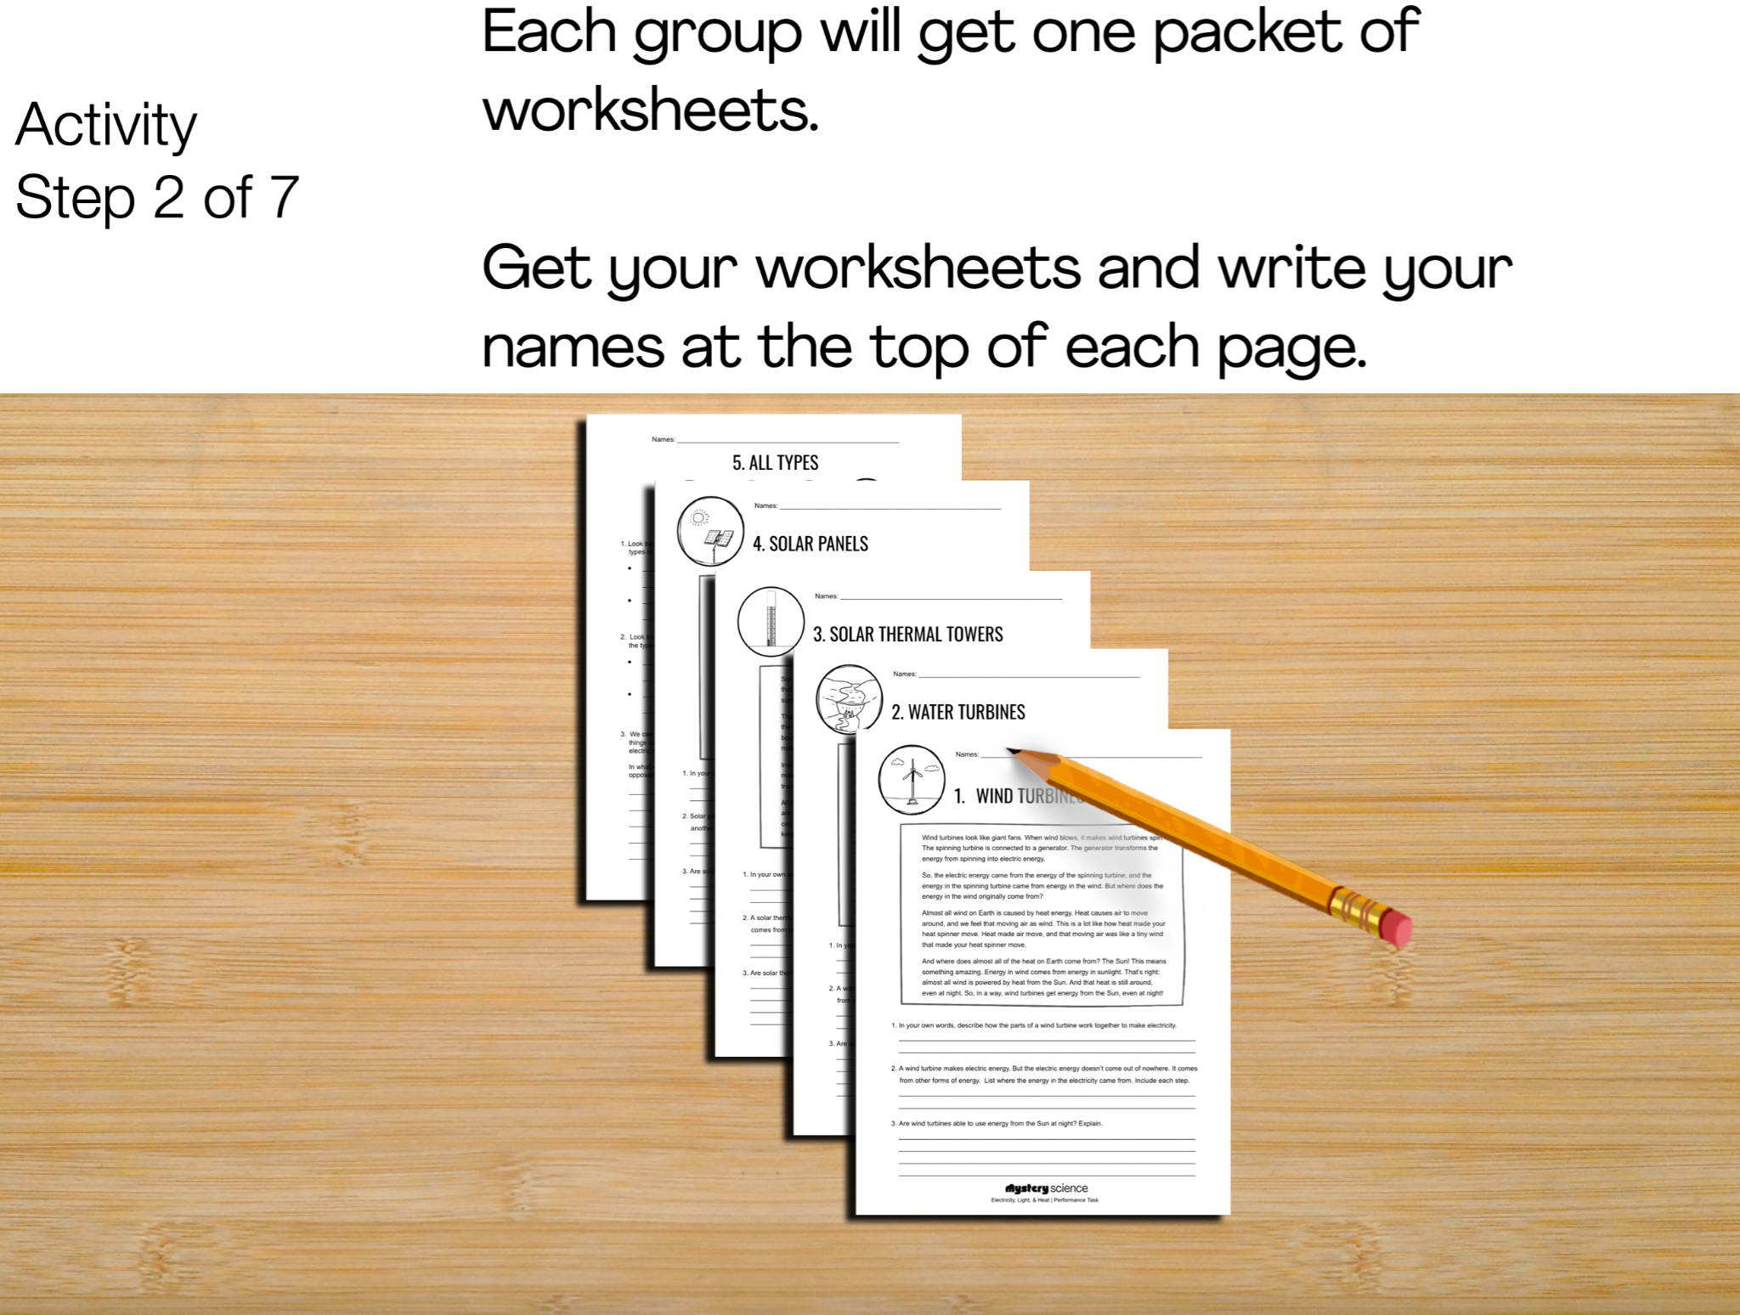
Electricity, Light, & Heat • Grade 4
Anchor Layer Teacher Guide
Performance Task: Can we get energy from the Sun at night?
Renewable Energy & Natural Resources
Overview
In the performance task, students obtain and combine information to explain the similarities and differences in how we can get energy from the Sun. They make the connection that a surprising number of different energy sources are not so different after all: they all come from the Sun!
The performance task begins with a brief unit review and moves into a step-by-step walkthrough of the student worksheets.
Unit Review 15 mins
Hands-On Activity 60 mins
Performance Task Notes
We recommend having students work in groups of four.
The worksheet packets have students work independently initially before sharing and learning from one another. This is a great opportunity to encourage students to support and learn from one another.
Crosscutting Concepts
Cause and Effect: The different ways that humans create electric energy provide a wonderful opportunity to study cause and effect relationships. Within the power plants that generate electricity, simply following the energy transformations gives an opportunity to look at how each form of energy can cause different things to happen.
For example, light energy can cause things to heat up, and electric energy can cause things to cool down, move, or glow. And beyond the power plants, we should always be aware of the cause and effect relationships with our environment. All power plants can have positive and negative effects on the environment.
‹#›

