Slide 1
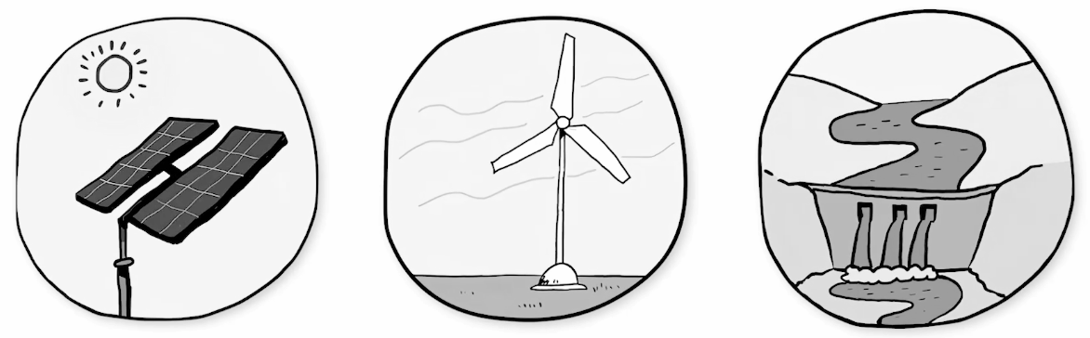



Name _____________________
People Power
We use electricity to do so much. But the more we use, the more we need. To get electricity, we need to change other kinds of energy into electric energy. You might already know about some kinds of energy we change into electricity.
SOLAR ENERGY from the Sun can be changed into electric energy.
HEAT ENERGY from burning things like coal or gas can be changed into electric energy.
And anything that MOVES has energy. So energy from moving WIND or WATER can also be changed into electric energy.
?
But wait. Wind and water aren’t the only things that can move. And fires aren’t the only things that give off heat. Like, what about…humans?
Human bodies give off heat. And humans move. Doesn’t that mean humans have ENERGY? Could we use the energy from a human to get electricity?
Well, yes…maybe.
Electric machines powered by humans aren’t new. Hand-crank flashlights are one example. These flashlights work when a person moves the flashlight’s handle over and over. That moving handle has energy. The parts inside the flashlight change that moving energy into electricity. These flashlights don’t need batteries to work. As long as a person moves the handle, the light stays on.
And some scientists are exploring other ways to use energy from humans to power electric machines.
1
Electricity, Light, & Heat

Slide 2

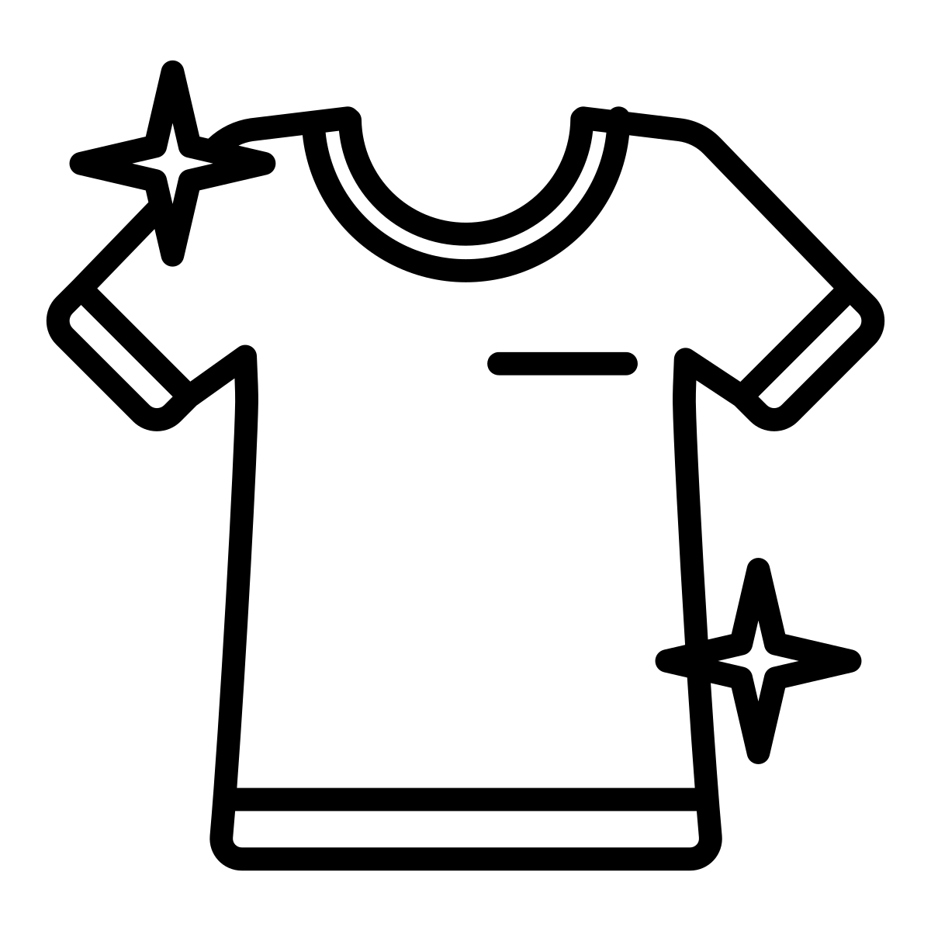

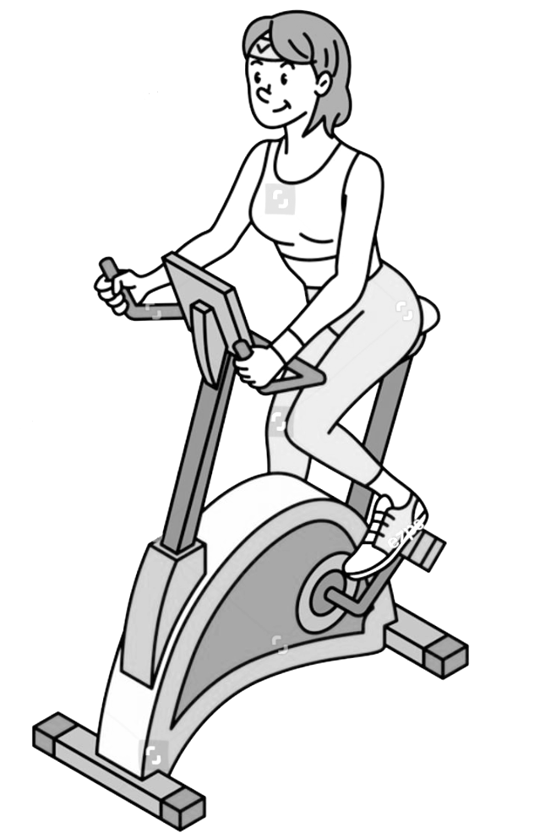
Scientists in Spain and Italy are working on a t-shirt that can change body heat into electricity.
Some gyms have built exercise bikes that do something like this, too. These bikes change the energy of people pedaling into electricity.
A few companies in Europe are even working on dance floors that can change stomping feet into electricity that powers colorful lights.
This technology is still new. And a lot of it doesn’t work very well yet. One problem is that human bodies don’t always have ENOUGH energy to make a lot of electricity.
Human bodies give off heat energy, but not as much as a fire. Not even close.
And people get tired. Even the best cyclist in the world needs to stop pedaling and rest sometime. And when she does, she’ll stop producing energy.
But these inventions are still exciting. Could you someday wear a watch powered by the heat of your arm? Could you invent a playground that helps keep the lights on at a school? There’s a lot more explore.
2
Electricity, Light, & Heat

