Slide 1

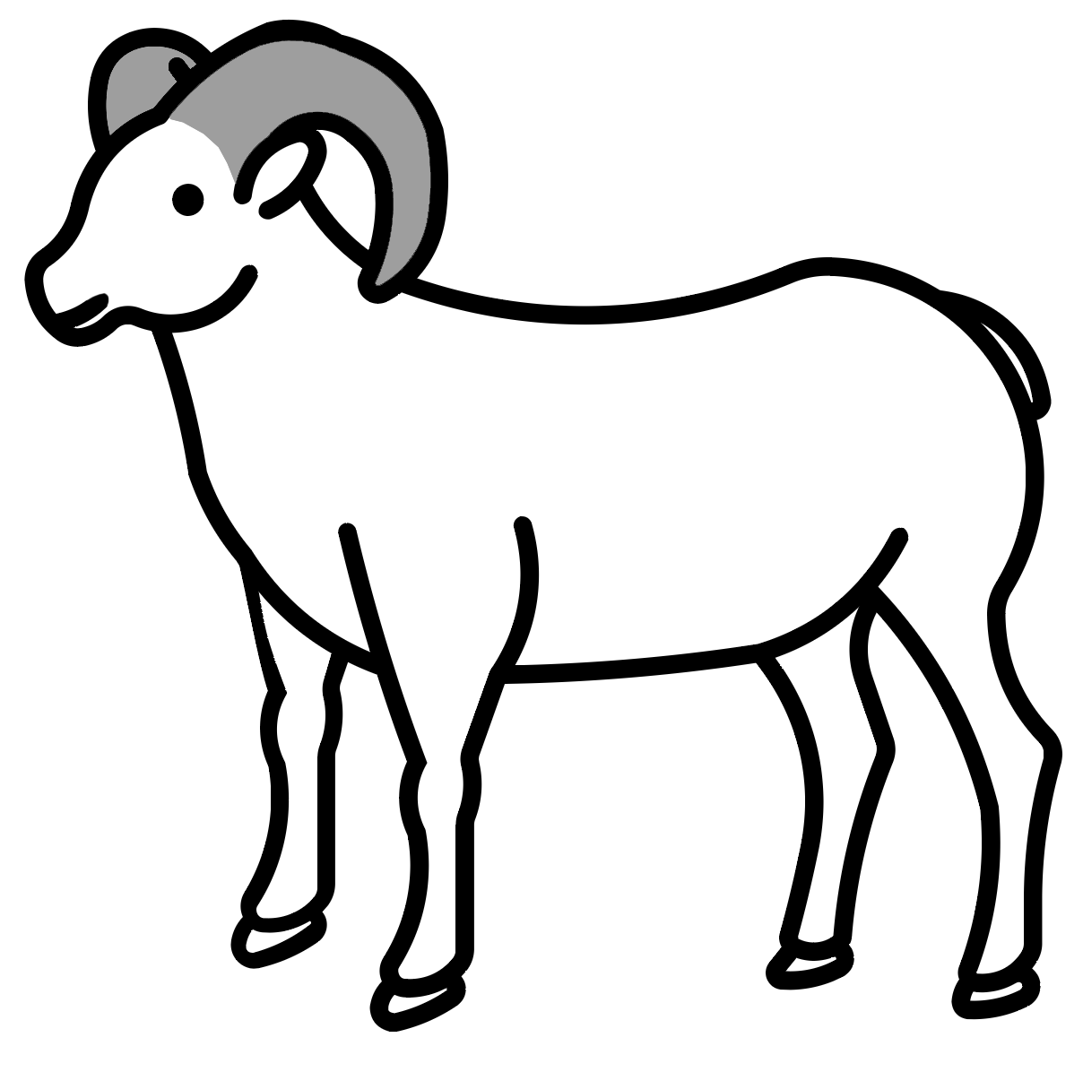








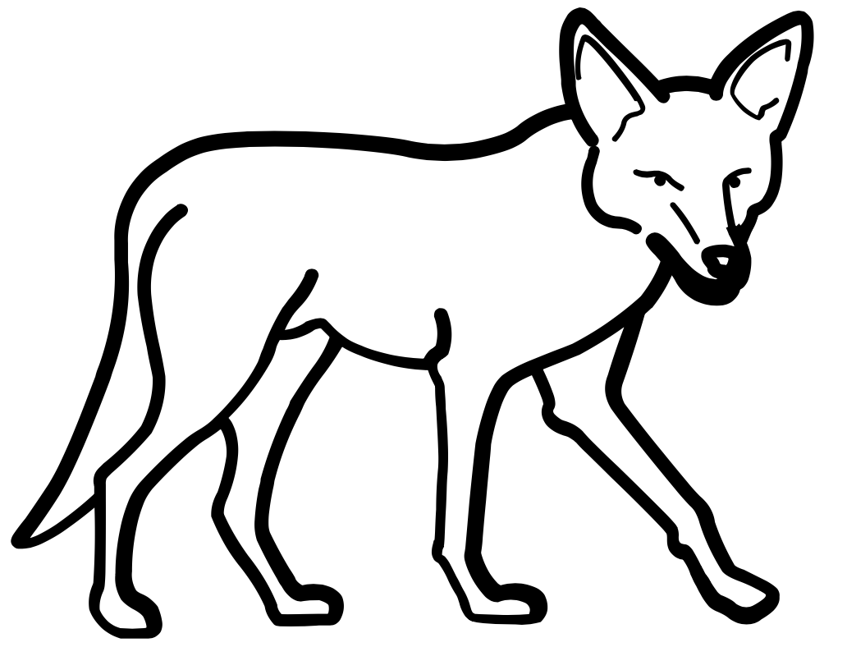
2. Where can the bighorn sheep find the
most food? (Circle your answer)
DESERT PARK
3. Where can the bighorn sheep hide from
predators? (Circle your answer)
DESERT PARK
4. Why do you think the bighorn sheep go
back to the desert habitat at night?
__________________________________
__________________________________
__________________________________
__________________________________
The Mystery of
the Bighorn Sheep in the Park
The desert habitat provides the bighorn sheep with more places to hide from predators, like coyotes or cougars. When they sleep at night, it’s more important for the bighorn sheep to be in a habitat that provides safety.
ANSWER KEY*
Name: ____________________________
Date: ____________________________
* Orientation adjusted to make grading easier!
Why would a wild animal visit a playground?
Park Habitat
Desert Habitat
X
X
X
X
X
X
X
X
X
X
X
X
X
X
X
X
X
X
X
X
X
What was the total number of animals that you found in the PARK? _____________
What was the total number of animals that you found in the DESERT? _____________
9
12
1. Did you find some kinds of animals in both habitats? YES NO

