Slide 1


Jim Knight
  INSTRUCTIONAL COACHING
  GROUP
JIMKNIGHT@MAC.COM
Professional Learning that Makes an Impact

Slide 2

4
big ideas

Slide 3
NO. 1
Partnership

Slide 4
NO. 2
High-Impact Instruction

Slide 5
NO. 3
Instructional Coaching

Slide 6
NO. 4
Impact Schools

Slide 7
My first
teaching experience

Slide 8
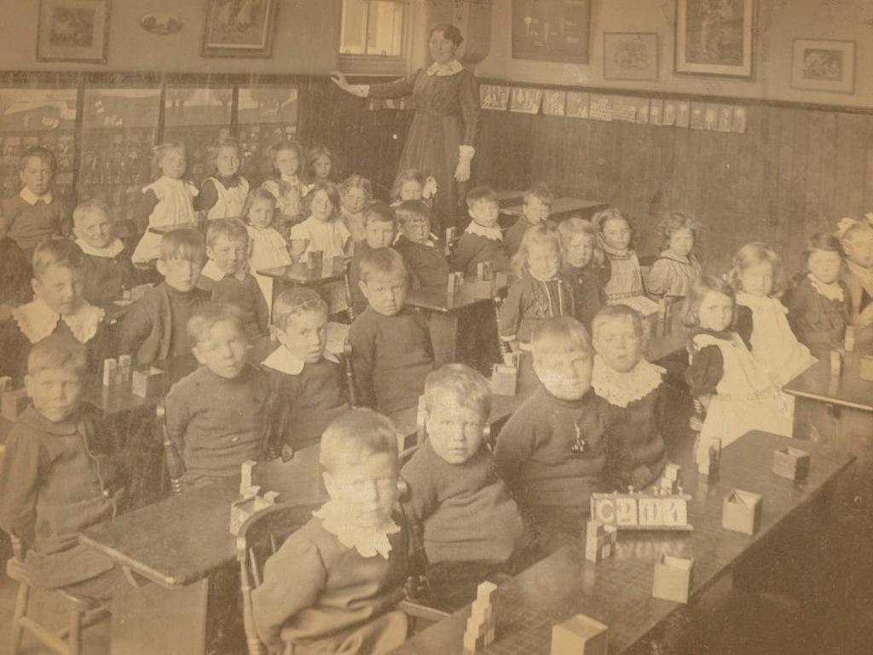

Slide 9
My first
teaching experience

Slide 10


Slide 11
NONE

Slide 12
FOUR BIG IDEAS
1
no.
Partnership

Slide 13

Helping

Slide 14
Helping
CHANGE
IDENTITY
THINKING
STATUS
MOTIVATION

Slide 15
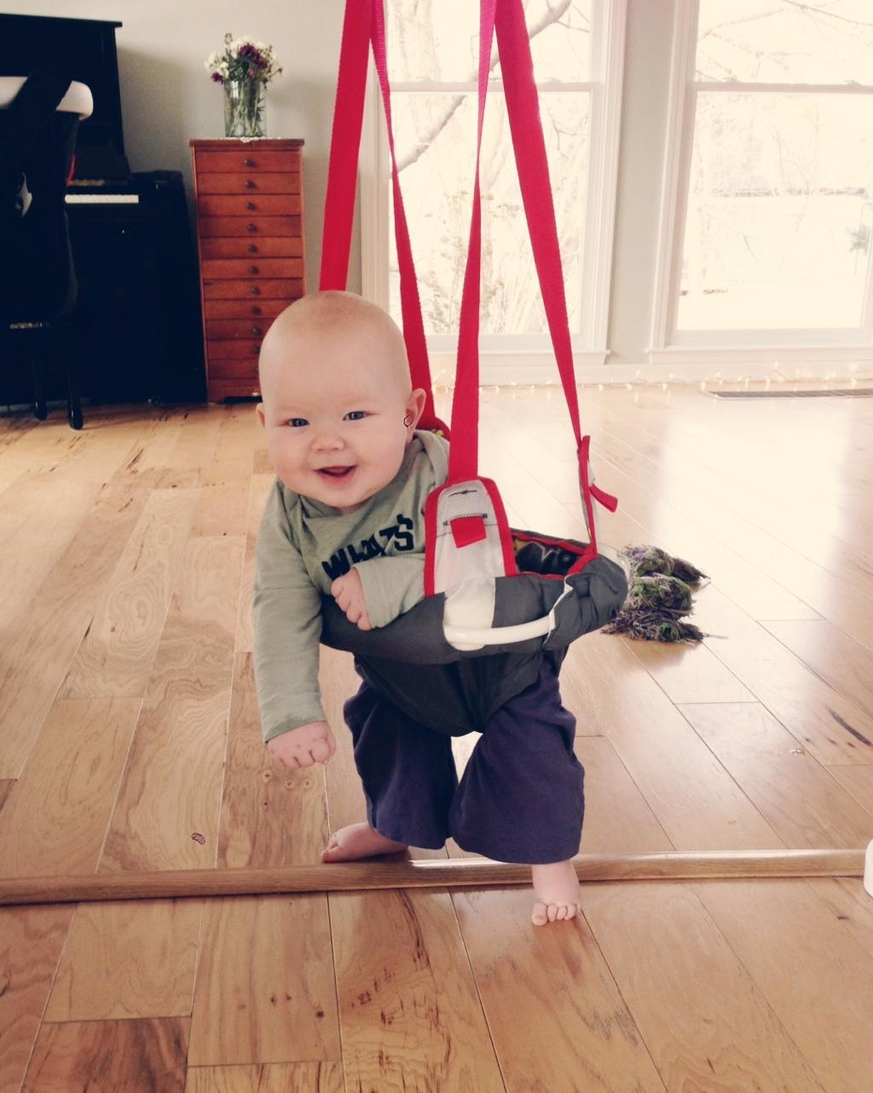

Slide 16
Helping
CHANGE
IDENTITY
THINKING
STATUS
MOTIVATION

Slide 17

Equality

Slide 18


Slide 19

Voice

Slide 20

Dialogue

Slide 21

Reflection

Slide 22
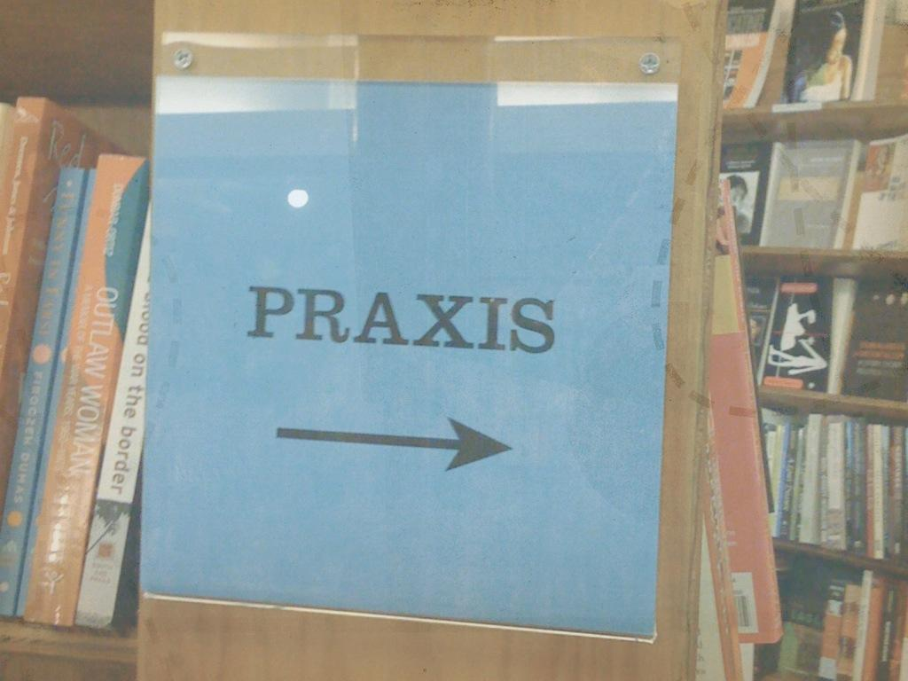

Slide 23

Reciprocity

Slide 24
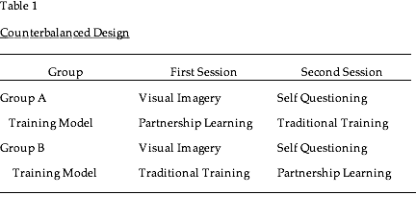
Design
Notes:
Traditional Training
advance organizer
overheads
summary statements every 20 minutes
every 10 minutes paused to ask questions
extensive elaboration of content on each overhead
Partnership Learning (timed to be equal; same outline)
Experiential Learning
attending to images or questions while I read
Question Recipes
used to debrief almost all learning structures
Tell me more about that ... How do you see this working
Reflection Learning modeling
Thinking Devices modeling & feedback
Stories M. Hunter; teaching experiences
Cooperative Learning TTYN; scoring

Slide 25
Implementation Question**
    Partnership Learning: 59
    Traditional Training: 14
**Now that you have learned about two strategies, which of the two do you believe you are most likely to teach?

Slide 26

Should professional developers see teachers as partners? Why? Why not?

Slide 27
FOUR BIG IDEAS
2
no.
    High-Impact
    Instruction

Slide 28
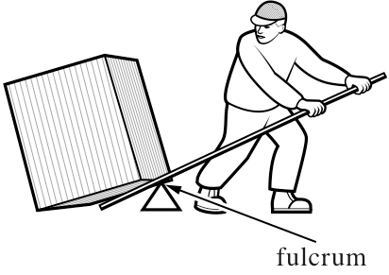

Slide 29
The Big Four
4
Content Planning
Assessment for Learning
Instruction
Community Building

Slide 30
FOUR BIG IDEAS
3
no.
    Instructional
    Coaching

Slide 31
Coaching done well may be the most effective intervention designed for human performance.
(Atul Gawande)

Slide 32


Slide 33
Top-down Coaching
COACH
uses data to shape
TEACHER

Slide 34
Partnership Coaching
DATA
dialogue
TEACHER
COACH

Slide 35
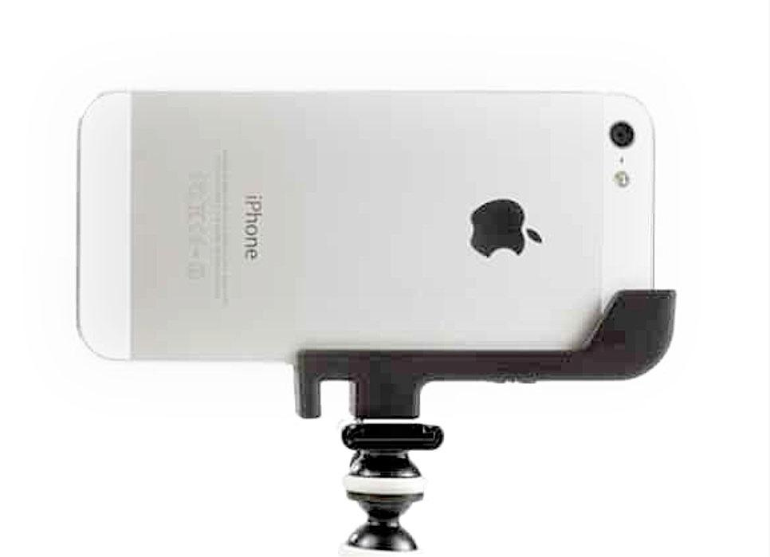

Slide 36
Components
Enroll
Identify
Explain & Mediate
Model
Observe
Explore
Support & Refine
Notes:
My two examples, coffee and running

Slide 37
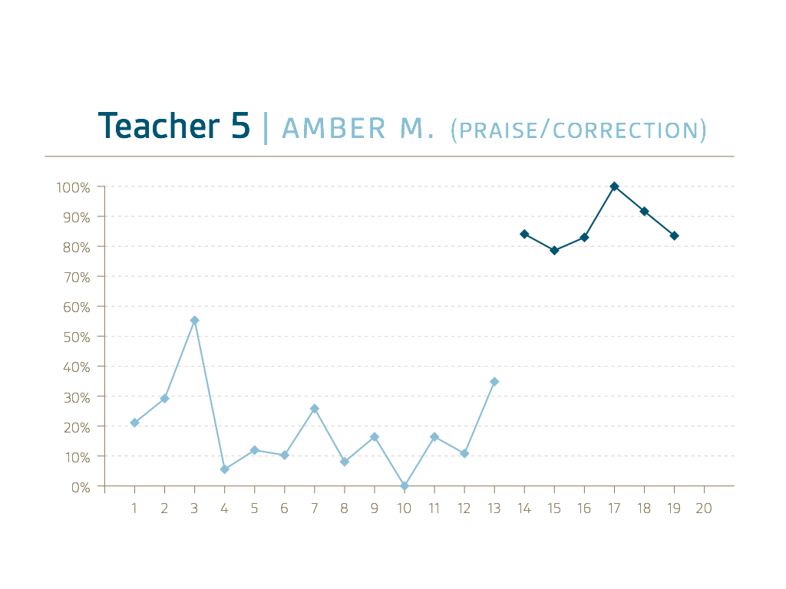

Slide 38
Is partnership coaching an essential part of professional learning ? Why? Why not?

Slide 39
FOUR BIG IDEAS
4
no.
    Impact
    Schools

Slide 40
Three critical elements
Understanding
Agreement
Commitment

Slide 41
Target design team

Slide 42
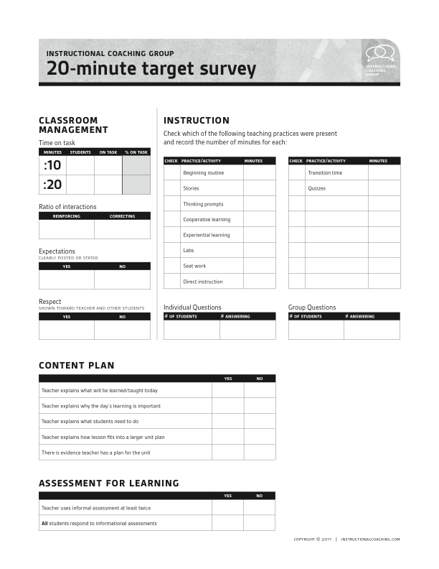

Slide 43
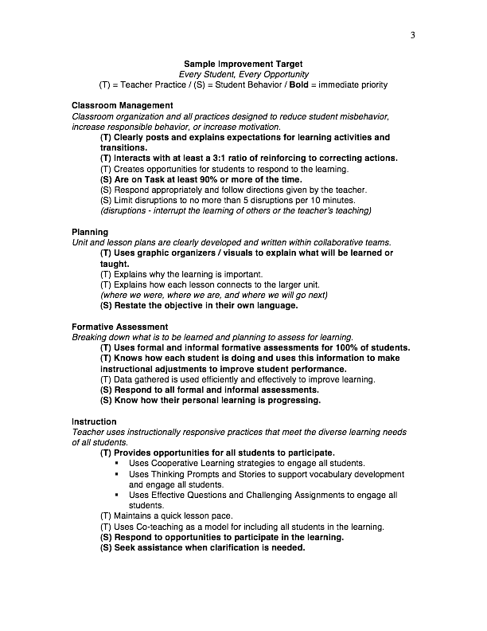

Slide 44
Teacher meetings

Slide 45
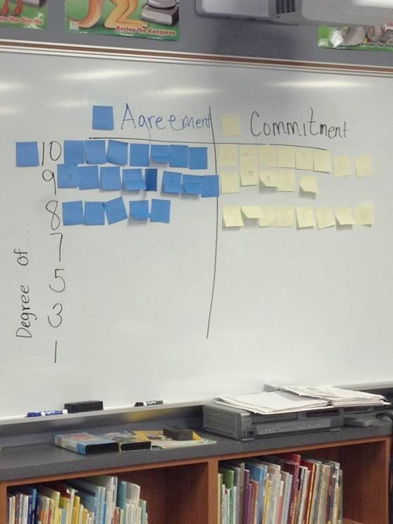

Slide 46
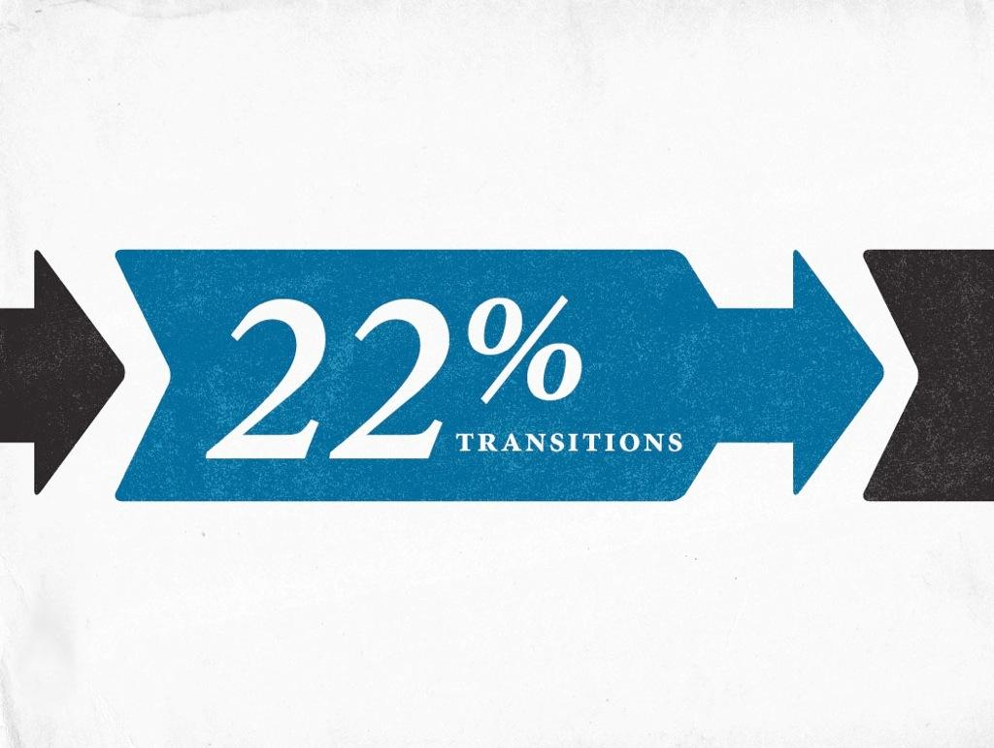

Slide 47

20 months later...

Slide 48
Should teachers have a voice in school-wide professional goals ? Why? Why not?

Slide 49
NO. 1
Partnership

Slide 50
NO. 2
High-Impact Instruction

Slide 51
NO. 3
Instructional Coaching

Slide 52
NO. 4
Impact Schools

