Slide 1


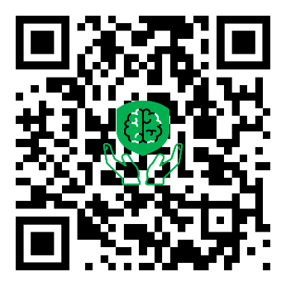
Mind Sure – Digital Mental Health Insurance
“Protecting Minds, Securing Futures”
Building a Mentally Resilient Generation.
NATIONAL PRODUCT DESIGN COMPETITION (NPDC) 2026
Presented By :
Mind Sure Team – Maseno University
Scan to Get The Presentation Online.

Slide 2
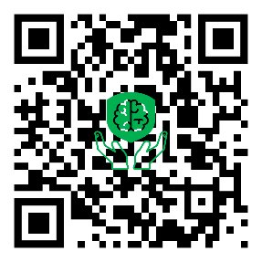
The Problem : Mental Health Care Remains Inaccessible, Expensive & Underinsured
Severe Access and Treatment Gaps
Growing Global Mental Health Burden
Underinvestment in Mental Health Budgets
High Cost of Care
Stigma and low awareness
Limited insurance coverage, where mental health benefits are often excluded or minimal
Impact of the COVID-19 Pandemic
Rising Mental Health Insurance Claims
Disproportionate Impact on Vulnerable Groups
Digital Accessibility Gaps
<2% Mental Health Budget Allocation | 70%+ Treatment Gap in LMICs |
“Mental health support is still expensive, inaccessible, underinsured and reactive rather than preventive - especially for students, young professionals and underserved communities.”
CITATIONS : WHO 2024 , ECONOMIC TIMES 2024, DELLOITE 2025, ILO 2025, MC KINSEY 2025

Slide 3
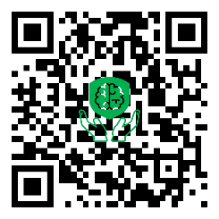
Why It Matters : Mental Health Is Human, Economic & Productivity Issue
Mental Health Affects Daily Life
Impacts learning, productivity & relationships
Increases burnout, stress & absenteeism
Reduces quality of life and performance
Rising Demand for Mental Health Support
Post-pandemic increase in mental health cases
Growing therapy & insurance claims globally
More youth seeking digital wellness support
Economic & Institutional Impact
Mental illness leads to productivity losses
Employers & institutions face reduced efficiency
Untreated conditions increase healthcare costs
Large Untapped Market
Millions remain uninsured or underserved
Students, gig workers & informal sectors lack coverage
Limited affordable mental health microinsurance solutions
Accessibility & Inclusion Matter
Many communities lack nearby professionals
Internet limitations exclude vulnerable users
Mental healthcare should be available anywhere
Prevention Is Better Than Treatment
Early engagement reduces severe claims
Wellness incentives encourage healthier behaviour
Preventive care improves long-term outcomes
“Mental health is no longer optional healthcare it is essential for productivity, well-being, economic stability and social resilience.”
CITATIONS : World Mental Health Report 2022 ,WHO Action Plan 2022 Update, MC Kinsey Health Institute 2024, Deloitte Insights 2024,
The Guardian 2024,The Economic Times 2025

Slide 4

The Solution : Mind Sure | Accessible . Preventive . Rewarding . Inclusive
Integrated Mental Health Services
Therapy Booking & Telehealth Sessions
Medication Access
AI Powered Mental Wellness Assessments
Gamified Mental Health Scanner
Multi-Platform Accessibility
Mobile App ( My Mind sure App)
Web Platform
USSD & Short Code
WhatsApp & Social Platforms
Lite & Offline Ready Access
Digital Mental Health Microinsurance
Institution & Employer Integration
Universities, Workplaces , HR Systems ,Organizations, Partners
Individuals
Students
Families
Behavioural Rewards & Incentives
Ubongo Points ( Mind Sure Rewards )
Premium Discounts
Airtime and Shopping Vouchers
Loyalty Rewards
Higher Engagement = Lower Premiums (Dynamic Pricing)
Personalized Preventive Care

Slide 5

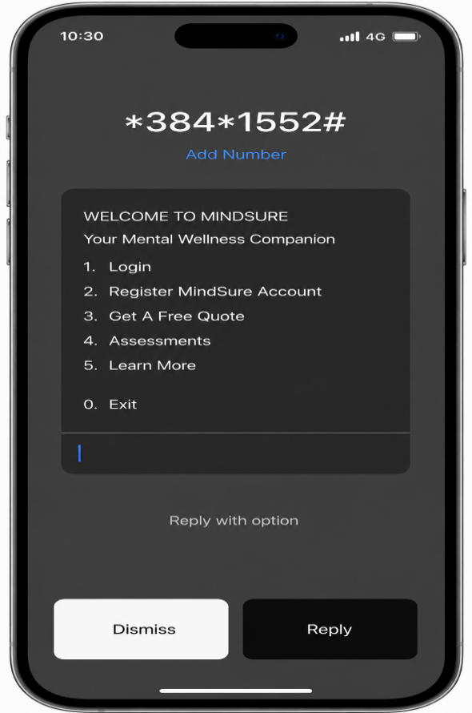
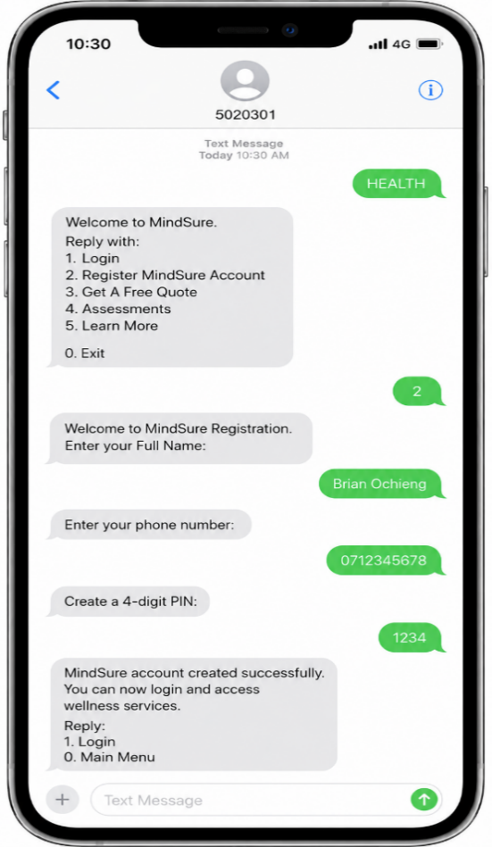


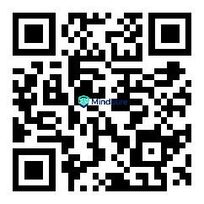

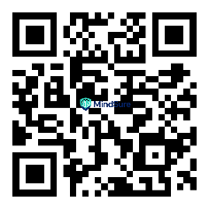
How Mind Sure Works : A Seamless Digital Mental Health Ecosystem
My Mind sure App
Website
USSD
Short Code
WhatsApp & Social Platforms
My Mind sure App
www.mindsure.co.ke
Multichannel Platform
Create Account & Complete KYC
Wellness Assessment & Gamified Scanning
Earn Rewards & Premium Discounts
Access Care & Support
Integrated Provider & Partner Network
“Mind Sure transforms mental healthcare into an accessible, preventive and reward-driven digital experience.”
SCAN TO EXPERIENCE MINDSURE

Slide 6
Technical Architecture: Secure . Scalable . Integrated
Frontend Layer
Backend & Core System
Secure Database Layer
Integrated APIs & External Services
User access platforms:
Mobile App
Web Platform
Lite App
USSD & Short code
WhatsApp & Social Bots (Mind Guide)
Central processing engine handles:
Authentication & KYC
User Management
Wellness Tracking
Rewards Engine
Premium Calculations
Claims Processing
Provider Accounts Management
Stores:
User Records
Claims Data
Wellness Scores
Health Index
Rewards & Transactions
Provider Records
Connected Systems:
Payment APIs
Provider Portals
Telehealth Systems
SMS/Notification APIs
Rewards & Voucher APIs
Institutional Portals
Pharmacy & Medication Access
Secured & Compliance | Scalable | Automated System
“Mind Sure combines secure digital infrastructure, behavioral intelligence and scalable integrations to deliver
accessible mental healthcare anywhere.”
SCAN TO EXPERIENCE MINDSURE

Slide 7
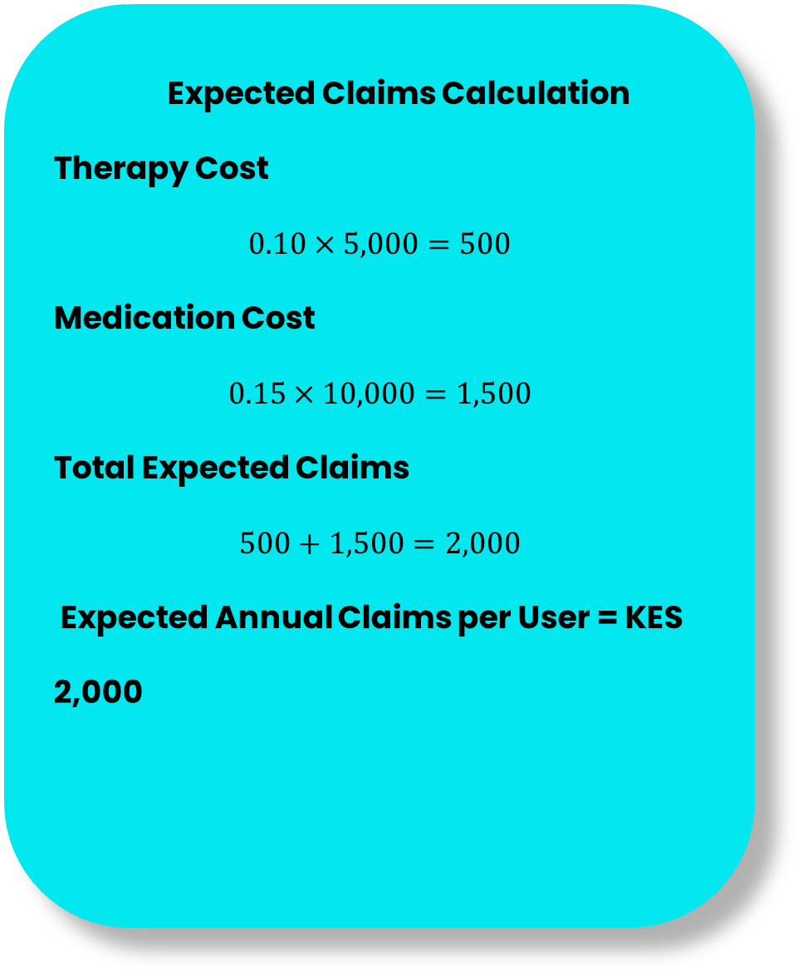
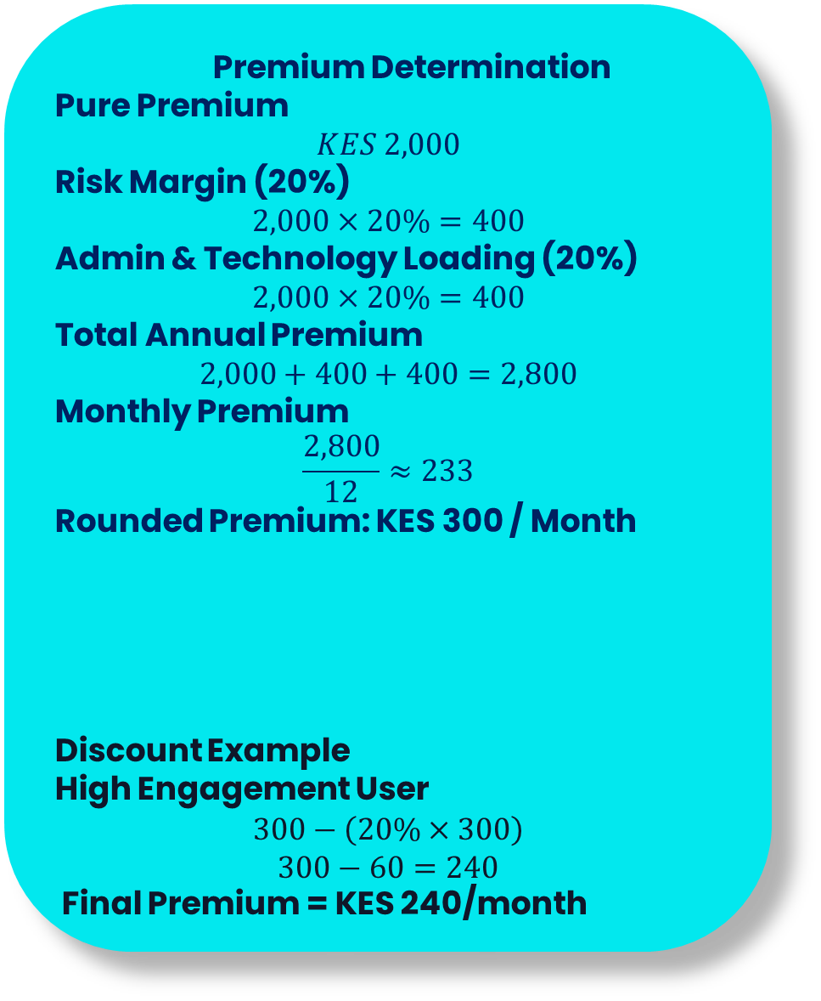
Pricing & Actuarial Assumptions:
1
2
3
Expected Claims Calculation
Therapy Cost
$$0.10×5,000=500$$
Medication Cost
$$0.15×10,000=1,500$$
Total Expected Claims
$$500+1,500=2,000$$
Expected Annual Claims per User = KES 2,000
Premium Determination
Pure Premium
$$KES 2,000$$
Risk Margin (20%)
$$2,000×20\%=400$$
Admin & Technology Loading (20%)
$$2,000×20\%=400$$
Total Annual Premium
$$2,000+400+400=2,800$$
Monthly Premium
$$\frac{2,800}{12}≈233$$
Rounded Premium: KES 300 / Month
Discount Example
High Engagement User
$$300−\left(20\%×300\right)$$
$$300−60=240$$
Final Premium = KES 240/month
Parameter | Assumption
Population Size | 10,000 Users
Mental Health Incidence Rate | 15%
Therapy Utilization | 10%
Medication Utilization | 15%
Annual Therapy Cover Limit | KES 5,000
Annual Medication Cover Limit | KES 10,000
Monthly Base Premium | KES 300
Engagement Level | Discount
High Engagement | 20%
Moderate Engagement | 10%
Low/Inactive | 0%
“Mind Sure uses behavioral actuarial pricing where healthier engagement lowers premiums
while improving sustainability.”
SCAN TO EXPERIENCE MINDSURE

Slide 8


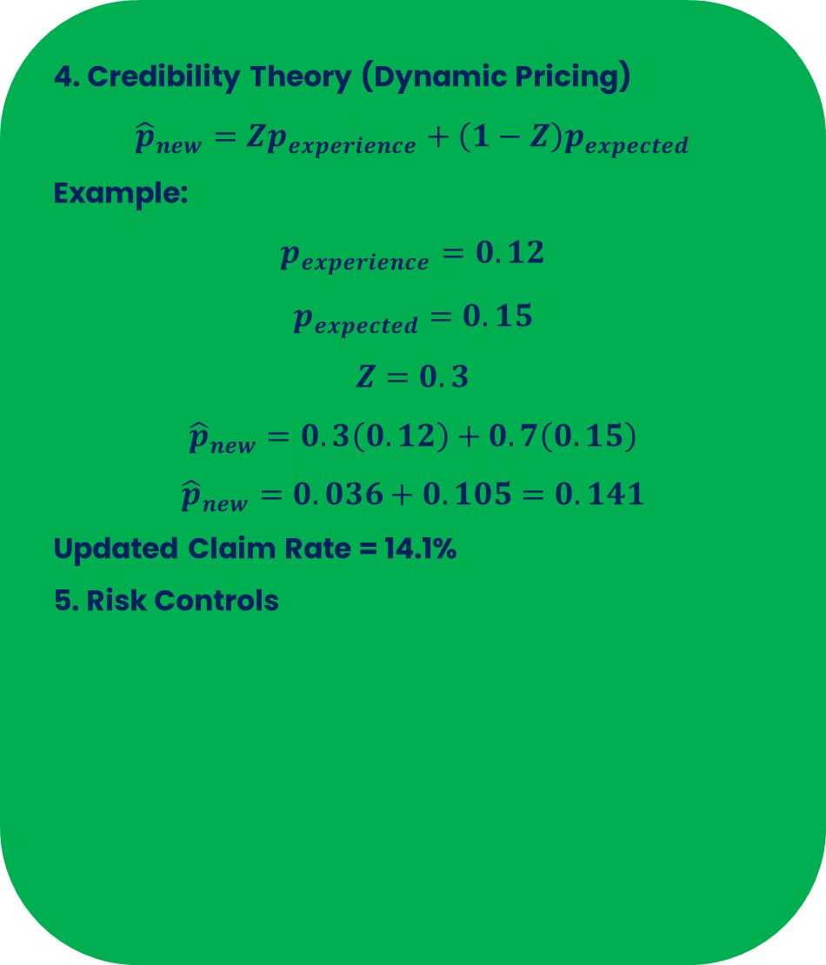
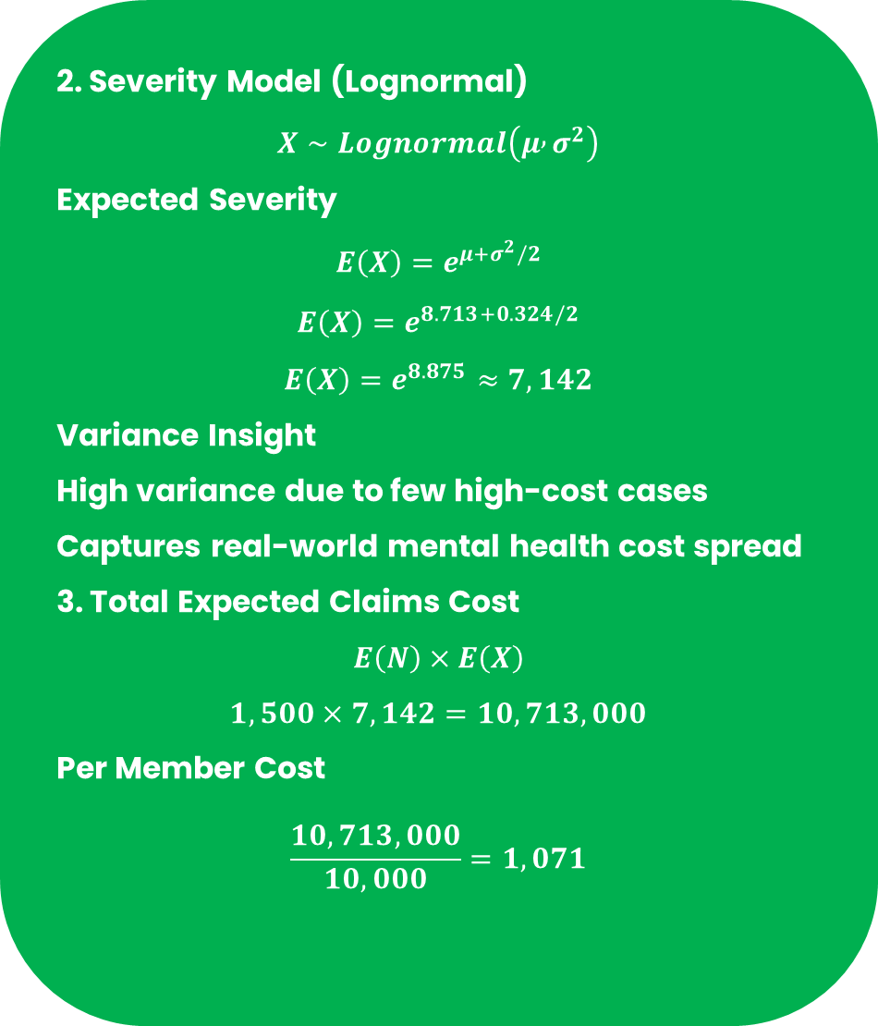
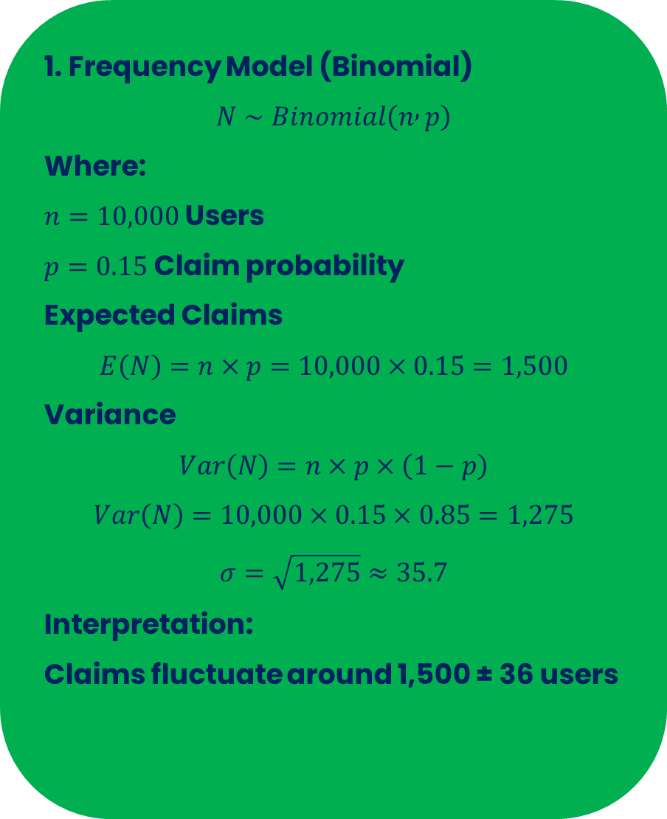
Actuarial Models & Risk Controls :
1. Frequency Model (Binomial)
$$N∼Binomial\left(n , p\right)$$
Where:
$n=10,000$ Users
$p=0.15$ Claim probability
Expected Claims
$$E\left(N\right)=n×p=10,000×0.15=1,500$$
Variance
$$Var\left(N\right)=n×p×\left(1−p\right)$$
$$Var\left(N\right)=10,000×0.15×0.85=1,275$$
$$σ=\sqrt{1,275}≈35.7$$
Interpretation:
Claims fluctuate around 1,500 ± 36 users
2. Severity Model (Lognormal)
$$X∼Lognormal\left(μ , σ^{2}\right)$$
Expected Severity
$$E\left(X\right)=e^{μ+σ^{2}/2}$$
$$E\left(X\right)=e^{8.713+0.324/2}$$
$$E\left(X\right)=e^{8.875}≈7,142$$
Variance Insight
High variance due to few high-cost cases
Captures real-world mental health cost spread
3. Total Expected Claims Cost
$$E\left(N\right)×E\left(X\right)$$
$$1,500×7,142=10,713,000$$
Per Member Cost
$$\frac{10,713,000}{10,000}=1,071$$
4. Credibility Theory (Dynamic Pricing)
$${\hat{p}}_{new}=Zp_{experience}+\left(1−Z\right)p_{expected}$$
Example:
$$p_{experience}=0.12$$
$$p_{expected}=0.15$$
$$Z=0.3$$
$${\hat{p}}_{new}=0.3\left(0.12\right)+0.7\left(0.15\right)$$
$${\hat{p}}_{new}=0.036+0.105=0.141$$
Updated Claim Rate = 14.1%
5. Risk Controls
Reinsurance Cover
Vetted Professionals
Waiting Period – 6 Months
“Mind Sure applies actuarial rigor, behavioral modeling and risk controls to ensure sustainable, fair
and adaptive mental health insurance pricing.”
SCAN TO EXPERIENCE MINDSURE

Slide 9
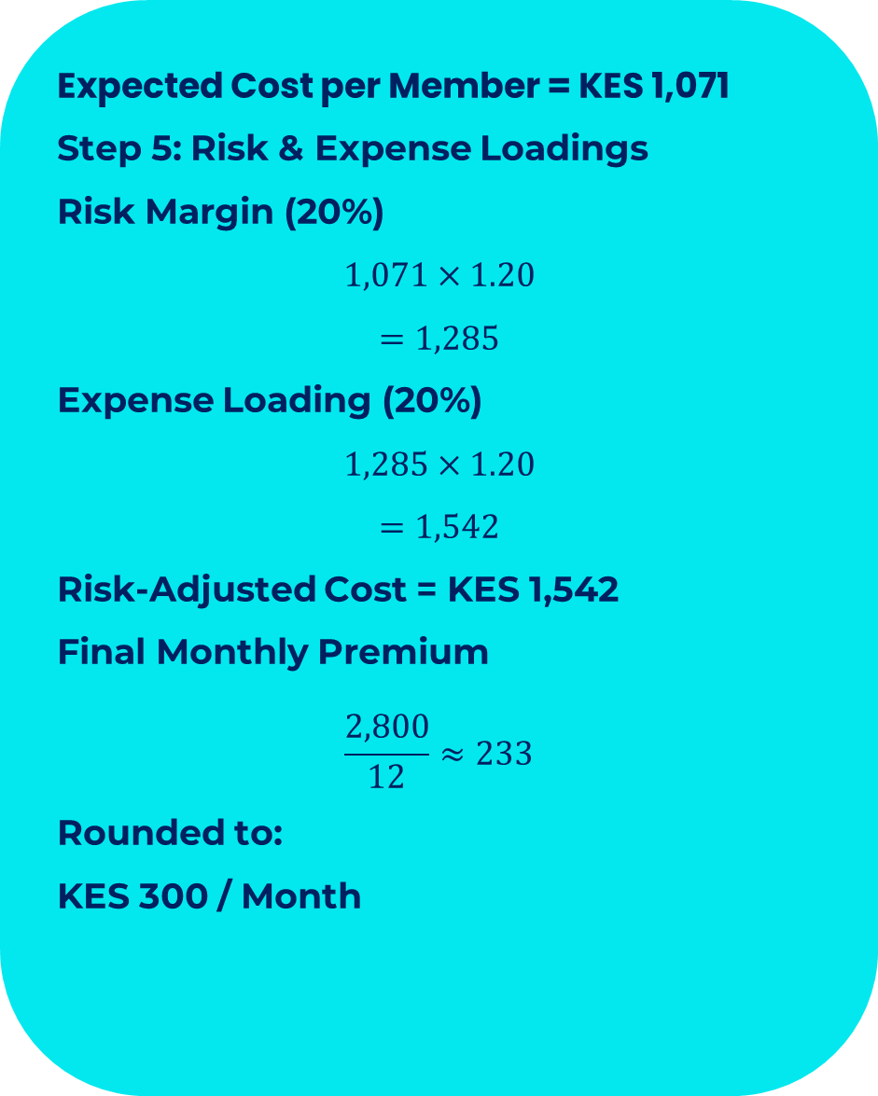
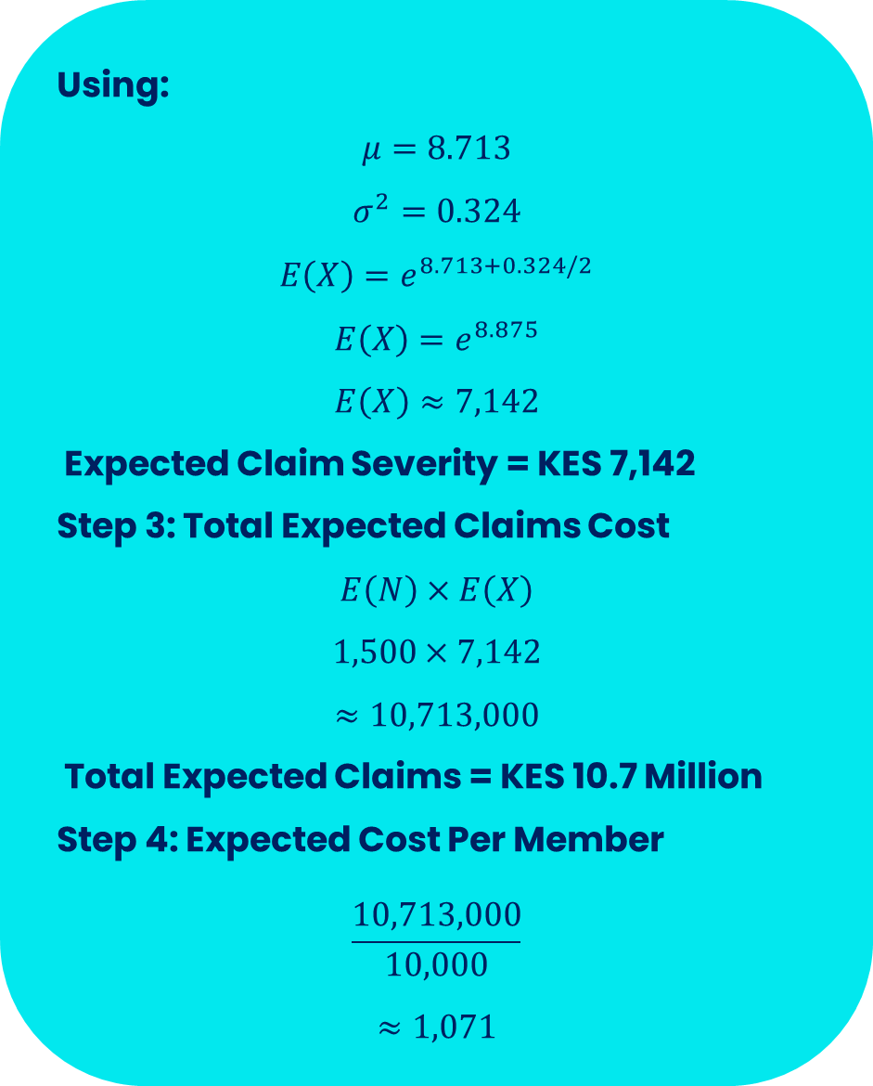
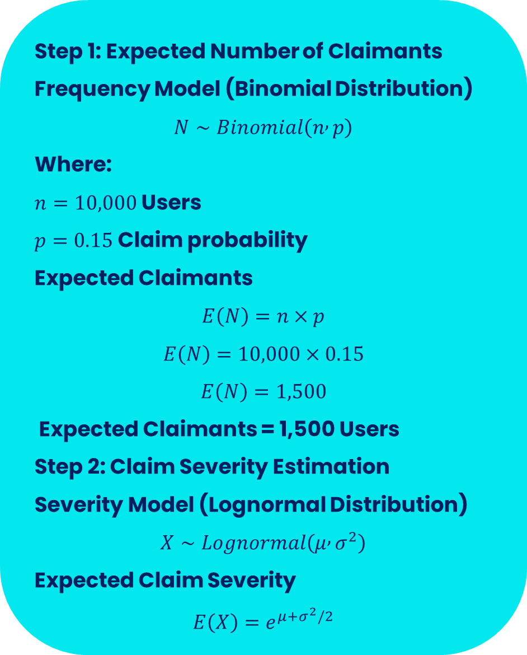
Expected Claims & Premium Pricing :
Balancing Affordability, Risk & Sustainability :
Step 1: Expected Number of Claimants
Frequency Model (Binomial Distribution)
$$N∼Binomial\left(n , p\right)$$
Where:
$n=10,000$ Users
$p=0.15$Claim probability
Expected Claimants
$$E\left(N\right)=n×p$$
$$E\left(N\right)=10,000×0.15$$
$$E\left(N\right)=1,500$$
Expected Claimants = 1,500 Users
Step 2: Claim Severity Estimation
Severity Model (Lognormal Distribution)
$$X∼Lognormal\left(μ , σ^{2}\right)$$
Expected Claim Severity
$$E\left(X\right)=e^{μ+σ^{2}/2}$$
Using:
$$μ=8.713$$
$$σ^{2}=0.324$$
$$E\left(X\right)=e^{8.713+0.324/2}$$
$$E\left(X\right)=e^{8.875}$$
$$E\left(X\right)≈7,142$$
Expected Claim Severity = KES 7,142
Step 3: Total Expected Claims Cost
$$E\left(N\right)×E\left(X\right)$$
$$1,500×7,142$$
$$≈10,713,000$$
Total Expected Claims = KES 10.7 Million
Step 4: Expected Cost Per Member
$$\frac{10,713,000}{10,000}$$
$$≈1,071$$
Expected Cost per Member = KES 1,071
Step 5: Risk & Expense Loadings
Risk Margin (20%)
$$1,071×1.20$$
$$=1,285$$
Expense Loading (20%)
$$1,285×1.20$$
$$=1,542$$
Risk-Adjusted Cost = KES 1,542
Final Monthly Premium
$$\frac{2,800}{12}≈233$$
Rounded to:
KES 300 / Month
“Mind Sure combines actuarial science, behavioral economics and digital engagement to create affordable
and sustainable mental health microinsurance.”
SCAN TO EXPERIENCE MINDSURE

Slide 10
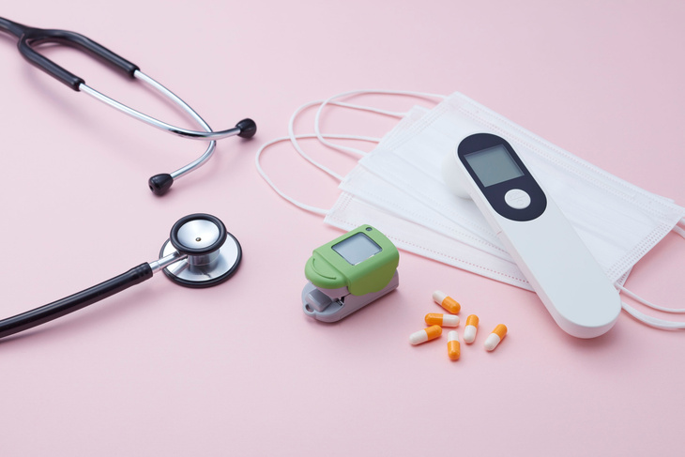

Target Market & Scalability:
🏢
Students & Youths
University & college students
Secondary school transitioning youth
High exposure to stress, anxiety & burnout
High digital adoption (mobile-first users)
Young Professionals & Gig Workers
Freelancers, creatives, tech workers
Startup ecosystem participants
Informal & flexible income earners
High financial + emotional stress exposure
Institutions & Organizations (B2B)
Universities & colleges
Corporates & SMEs
NGOs & development organizations
Government & public institutions
Families (B2B2C)
Household-based mental health coverage
Shared wellness plans
Preventive care for dependents
Market Problem Fit:
High Mental Health Burden across all demographics
Low insurance penetration for Mental Health
High Out- Of Pocket healthcare costs
Lack of preventive mental wellness systems
“Mind Sure is built for mass adoption - combining digital accessibility, institutional integration and behavioral
incentives to scale across Africa and beyond.”
SCAN TO EXPERIENCE MINDSURE

Slide 11

Business Model & Revenue Streams
Mind Sure operates as a Digital Mental Health Microinsurance Ecosystem that connects users, healthcare providers, insurers, institutions and reward partners through one integrated platform.
Revenue Streams
How Mind Sure Acquire Users
Premiums
Corporate Partnerships(B2B)
Provider Network Commissions
Data Insights(Aggregated & Anonymized)
API & SDK Integrations
Rewards Ecosystem & Partner Promotions
Strategic Partnership
Multi-Platform Accessibility
App & Platform Integration
Referral & Reward Program
Digital & Social Media Marketing
Acquisition Funnel
Awareness
Sign Up
Account Activation
Preventive Care
Insurance Subscription
Wellness Engagement
Care Access

Slide 12

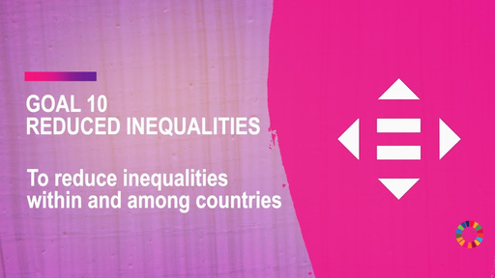
Business Impact :
1
2
3
4
Economic Impact
Reduces mental health treatment costs through prevention
Improves insurer loss ratios via behavioral engagement
Creates new revenue streams in digital health & Insurtech
Supports financial inclusion through microinsurance
Instituition Impact
Enhances workplace productivity & student performance
Reduces absenteeism, burnout & dropout rates
Enables scalable employee & student wellness programs
Strengthens CSR & ESG alignment for organizations
User & Societal Impact
Affordable access to mental health services
Reduced stigma through digital & private access channels
Improved early detection via assessments & scanning tools
Increased engagement through rewards & gamification
Public Health Impact
Bridges mental health treatment gap
Supports preventive healthcare systems
Contributes to national & regional mental health goals
Expands access to underserved populations
“Mind Sure is built for mass adoption - combining digital accessibility, institutional integration and behavioral incentives
to scale across Africa and beyond.”
SCAN TO EXPERIENCE MINDSURE

Slide 13

Cost Structure , Sustainability Controls & Future Vision:
1.Cost Structure Overview
2.Sustainability Controls
Claim Costs
Technology & Admin Costs
Customer Acquisition Costs
Provider Network Costs
Compliance & Risk Costs
Behavioral Cost Reduction Model
Dynamic Premium Adjustment
Risk Management Framework
Claims Optimization Strategy
Data – Driven Efficiency
Future Vision
1. Regional Expansion
2. AI-Driven Mental Health Ecosystem
3. Full Ecosystem Integration
4. Market Leadership Vision

Slide 14
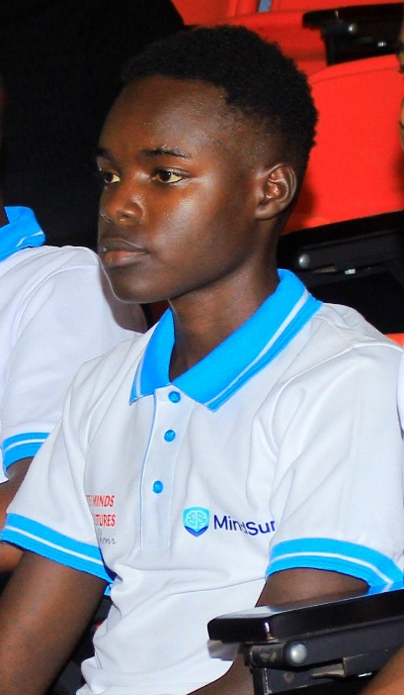


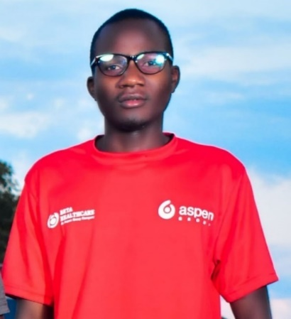

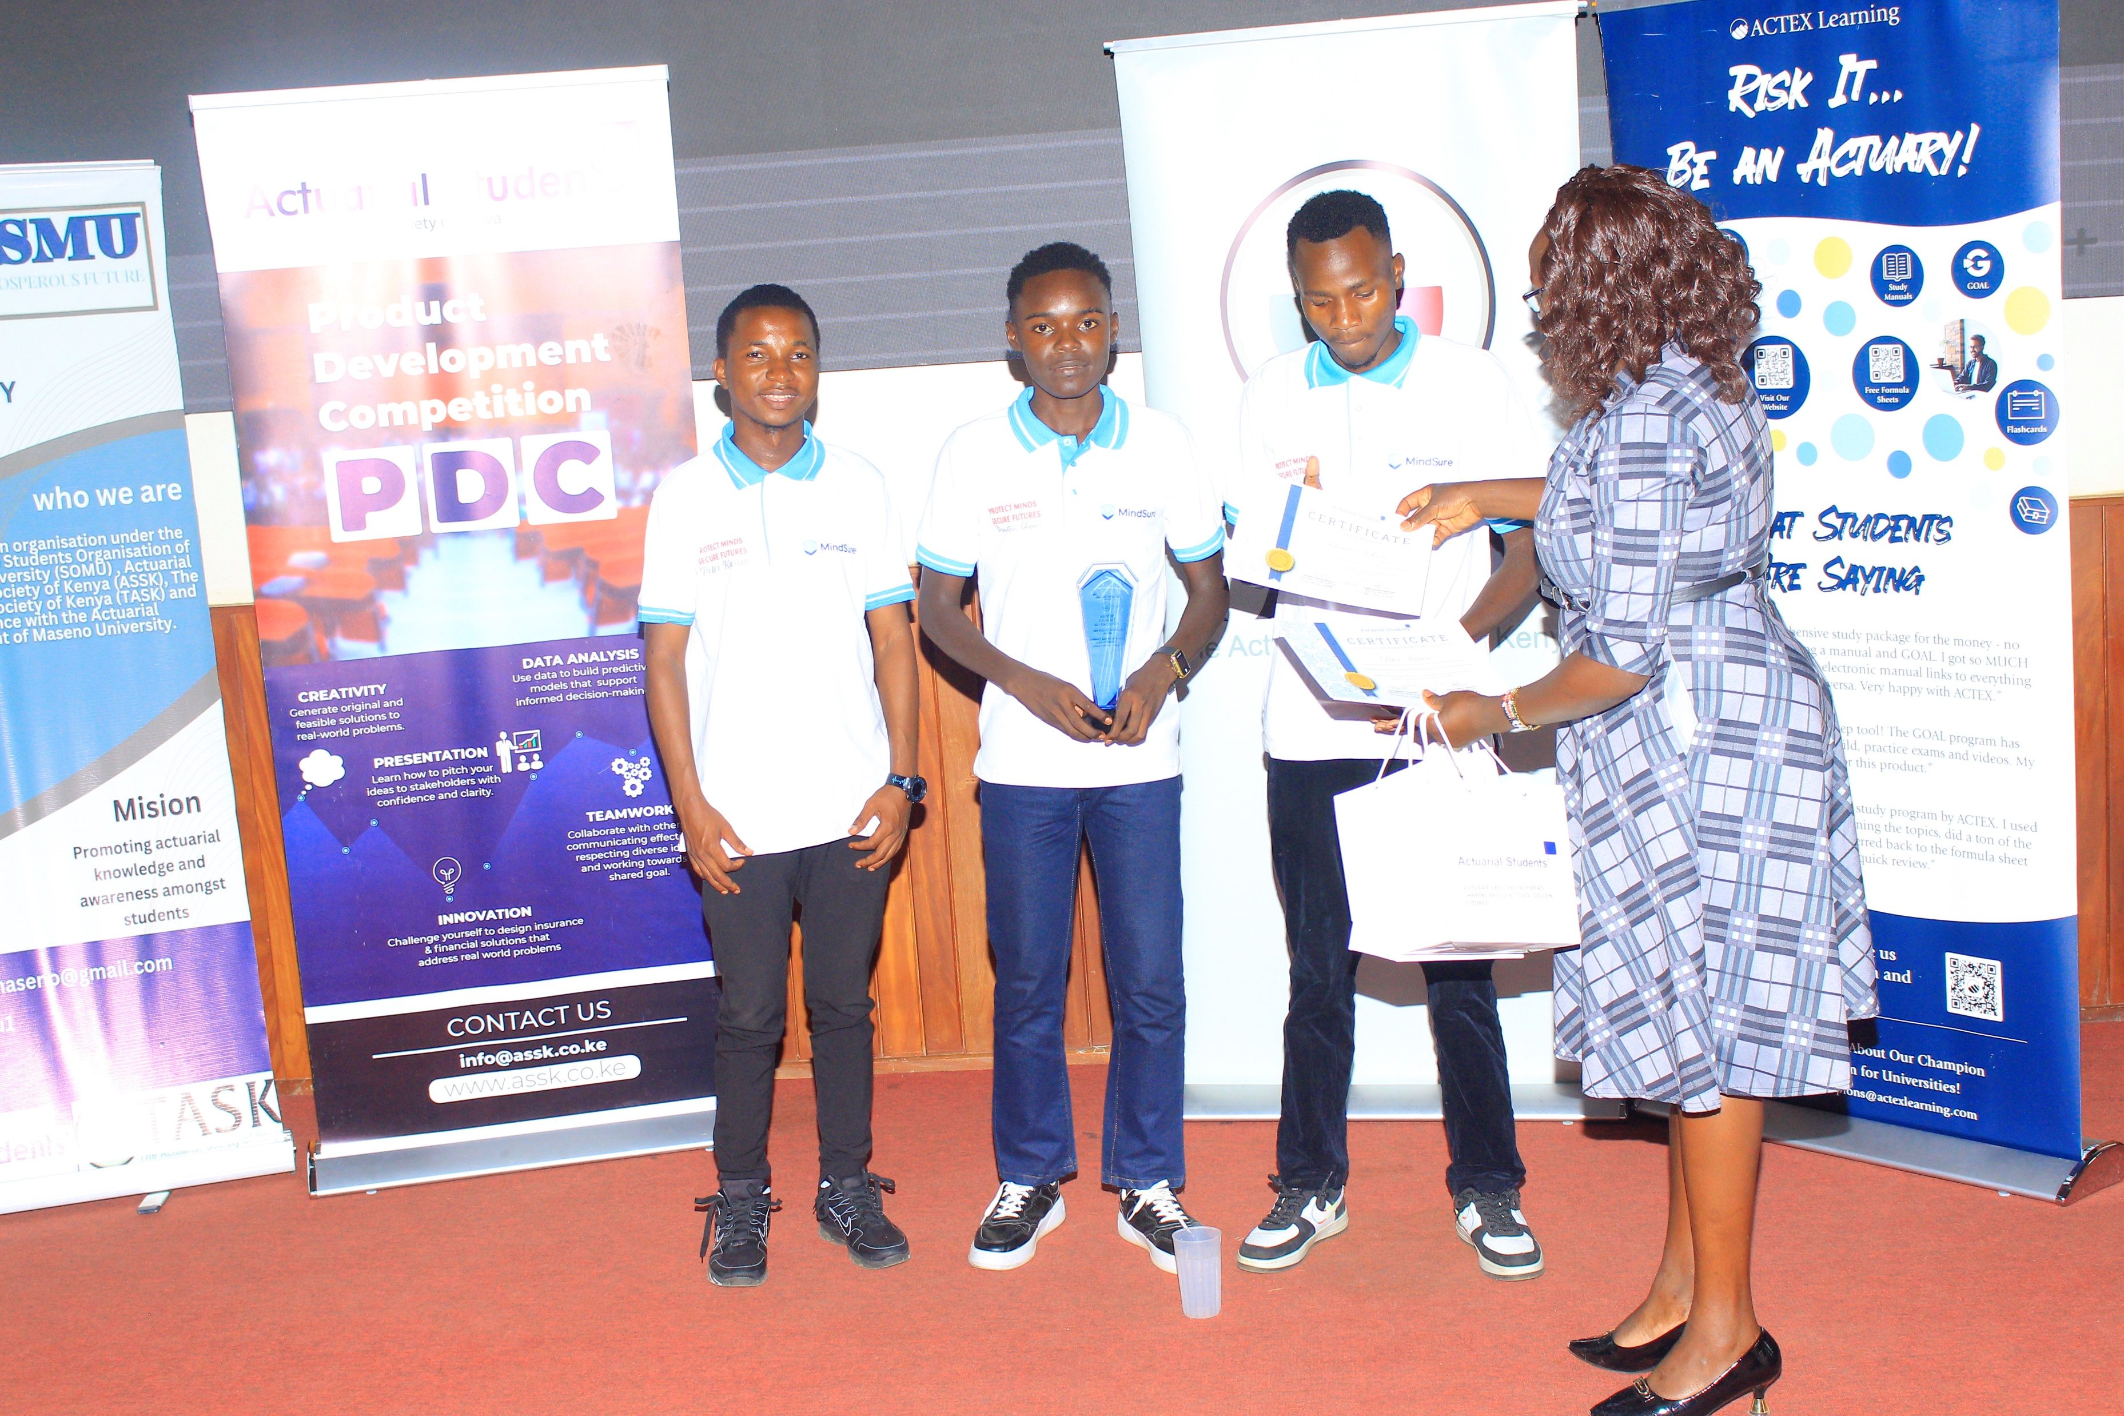
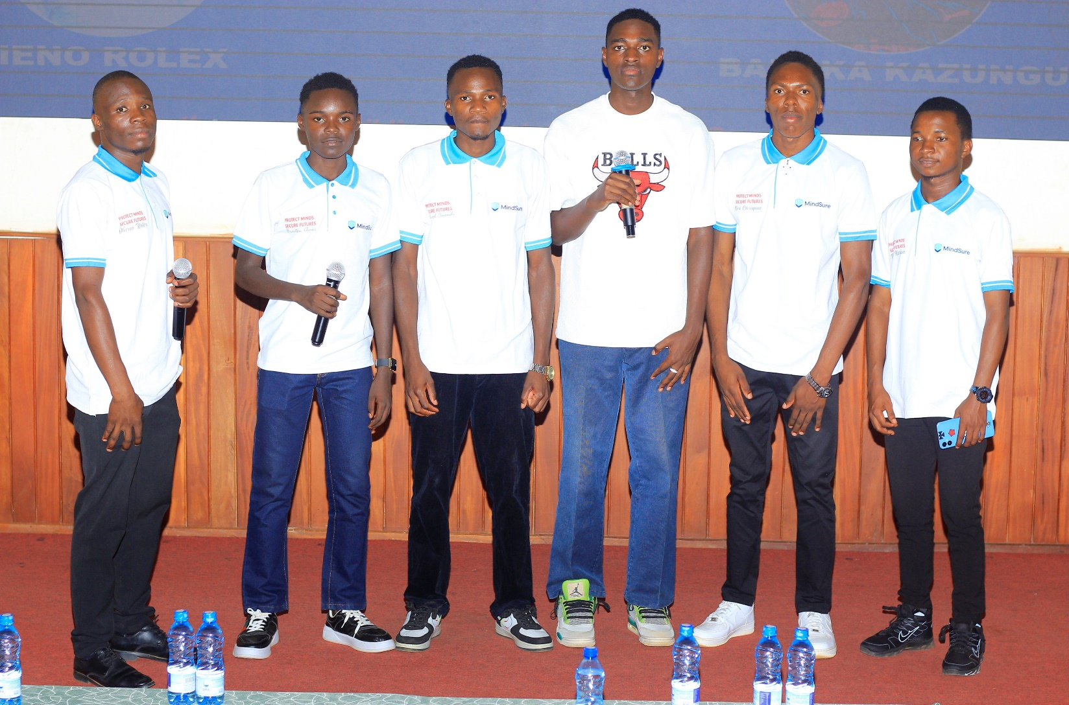
7 Builders . 1 Vision . Transforming Mental Health Access:
BRAVTON CHONI
Founder/Chief T. Officer
OTIENO ROLEX
Partnership & Compliance Lead
CHARLES OUMA
Risk & Sustainability Analyst
DANIEL OMONDI
Product Manager
KERI CHRISPINE
Health & Research Lead
PETER KARISA
Actuarial & Pricing Lead
BARAKA KAZUNGU
Business Analyst
“Mind Sure is powered by a young, innovative team committed to building scalable, accessible and impactful mental health solutions.”

Slide 15
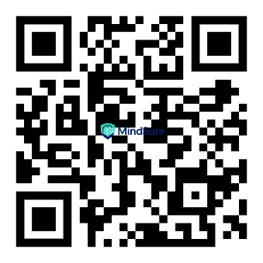
Conclusion : Join Us In Revolutionizing Mental HealthCare
Together, We can make mental healthcare more accessible, affordable and preventive for everyone. We invite partners, healthcare Providers, Institutions, organizations, families and individuals to join Mind sure in building a mentally resilient future. Support, adopt, partner or invest in Mind Sure and be part of the movement transforming mental wellness across Africa
Thanks For Your Time!
Quick Connect With Us!
www.mindsure.co.ke
info@mindsure.co.ke
+254 727 345 738

