Slide 1
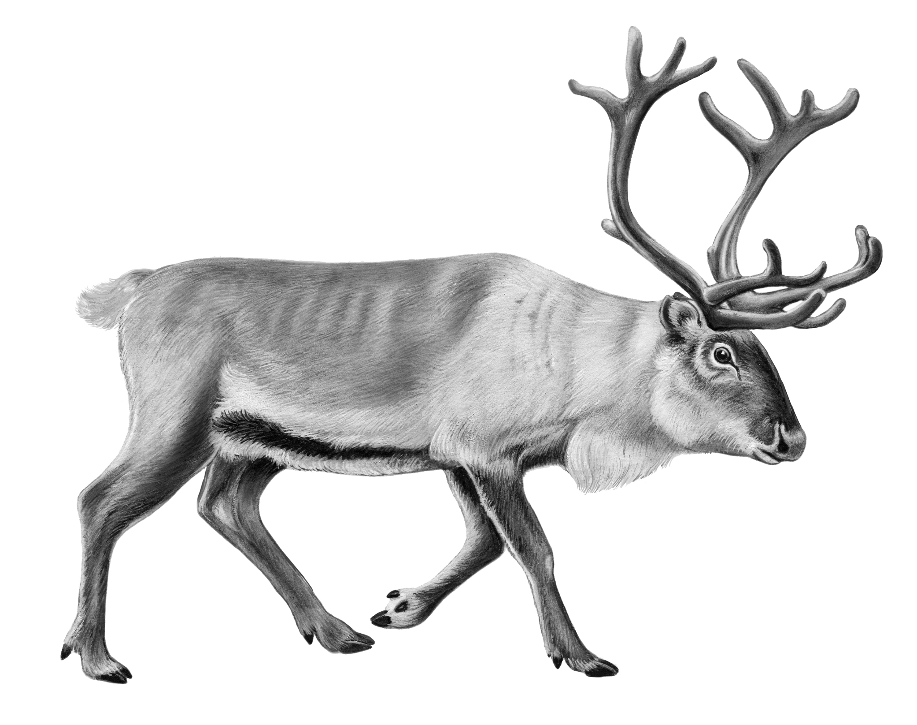

Name _____________________
Why Some Caribou Need Ice
In the far north, near the North Pole, there is a group of islands. An island is an area of land that has water all around it. These far north islands are very, very cold.
If you visit, you might see caribou. Caribou are
furry animals with big horns. They eat plants.
But there are not a lot of plants to eat on the islands.
So caribou need to move from one island to another to
find enough plants to eat.
That is tricky! Each island has water all around it. When water is liquid, it is wet and drippy. To get across liquid water, caribou must swim. It is hard work to swim between islands. What if you had to swim for 20 minutes to get to lunch? You would get so tired.
But remember, this area is very, very cold. Sometimes the water gets so cold that it freezes. When water freezes, it is ice. Ice is solid. If there is a lot of ice, you can walk on it.
When the water freezes to ice, caribou don’t have to swim. They can walk on the ice. Caribou walk on ice from one island to another to find food. Ice is very important to caribou. It helps them live!
States of Matter

