Slide 1


CASE STUDY
Free presentation template

Slide 2

WELCOME
Welcome to the world of fantasy! Join us on a journey to explore the mystical creatures, enchanted lands, and magical wonders that exist beyond our reality. Discover the wonders and secrets of this exciting realm and unlock the power of imagination.

Slide 3

TABLE OF CONTENTS
01
INTRODUCTION
02
PROBLEMS
The Extraordinary Realm
Unicorn Sightings
03
METHODOLOGY
04
ANALYSIS
Wishes Granted
Spellcasting
05
SOLUTIONS
06
CONCLUSION
Happily Ever After
Embrace the Fantasy

Slide 4


INTRODUCTION
Welcome to the Fantasy World, a realm of wonder and enchantment where anything is possible. Here, dragons breathe fire, unicorns prance through meadows, and rainbows shine brightly. This world is a place where wishes come true, where potions can be cursed and spells are cast. It's a place of treasure and adventure, where the impossible becomes possible. But the greatest treasure of all is the one that lies within.

Slide 5
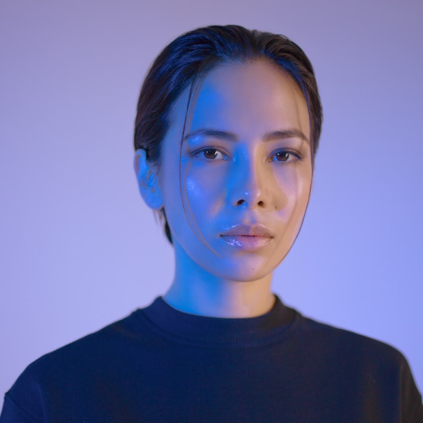


OUR TEAM
ELDRUIN
ELEMENTALEN
LUNARIA
The Fire Mage
The Guardian
The Moon Priestess

Slide 6




PROBLEMS
UNICORN SIGHTINGS
A record of the number of unicorns spotted in the fantasy realm and the beauty and mystery that surrounds these enchanting creatures.
DRAGON TAMING
A closer look at the art of taming dragons and the brave adventurers who dare to take on these fearsome creatures.

Slide 7





UNICORN SIGHTINGS
DRAGON TAMING
A record of the number of unicorns spotted in the fantasy realm and the beauty and mystery.
A closer look at the art of taming dragons and the brave adventurers who take on these creatures.

Slide 8


FANTASY IS THE GATEWAY TO THE IMPOSSIBLE, THE LAND WHERE THE ORDINARY BECOMES EXTRAORDINARY, AND THE IMPOSSIBLE BECOMES POSSIBLE. IT IS THE REALM OF THE IMAGINATION, WHERE ANYTHING CAN HAPPEN AND EVERYTHING IS POSSIBLE.
THE DREAM WEAVER

Slide 9
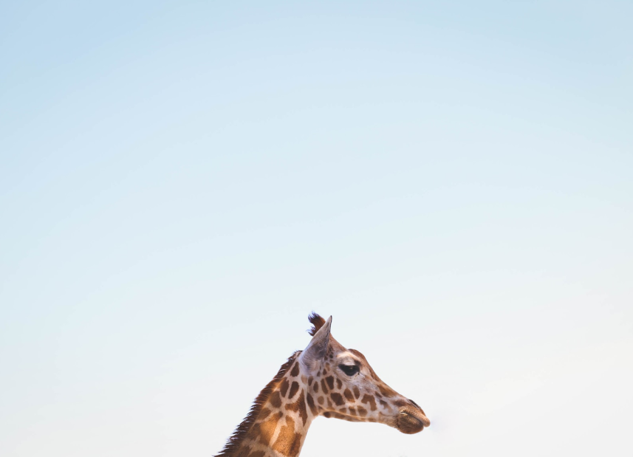
METHODOLOGY
DRAGON TAMING TECHNIQUE
A guide to taming and caring for dragons in the realm of magic.
THE ART OF UNICORN SIGHTING
Tips and tricks for spotting the elusive unicorns in their natural habitat.

Slide 10

THE MAGIC OF DRAGONS: A RESEARCH
6.7M
4.4M
2.3M

Slide 11





THE ELVES: A GLIMPSE INTO THEIR WORLD
Elegant inhabitants of enchanted forests, known for their mastery of magic and their close connection to nature. They possess an innate sense of harmony and balance, making them protectors of the natural world.
"The Art of Archery": Discover the intricacies of the Art of Archery as practiced by the graceful and precise elves.
"The Music of the Elves": Immerse yourself in the enchanting music of the elves, whose songs have the power to heal.
"The Life of an Elf": Learn about the customs and daily life of the elves, from their familial structure to their religious beliefs.

Slide 12


ANALYSIS
75%
ENCHANTED CREATURES
possess the ability to cast spells.
60%
MAGIC-WIELDING INDIVIDUALS
practice the art of illusions.
90%
SPELLS CAST
are dark magic, foretelling danger.

Slide 13
234,567
Unicorn sightings
A tally of the number of unicorns spotted in the fantasy realm.

Slide 14



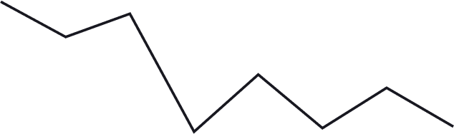

SOME GRAPH
100
90
80
70
60
50
34.574
40
Total
30
20
10
0
1
2
3
4
5
6
7
8
SPELLCASTING PROGRESS
TREASURE FOUND
A record of the amount of treasure found per month
A record of the number of spells cast per year

Slide 15


SOLUTIONS
A WEB APPLICATION
A web application designed for discovering the world of fantasy
PORTAL TO ADVENTURE

Slide 16


AN MOBILE APP
An app designed for exploring and experiencing the enchanting realm of fantasy
THE FUTURE OF FANTASY
  Explore a magical world
  Experience fantasy firsthand
  Immerse in a realm of magic
  Discover untold wonders
  Live your fantasy dreams

Slide 17

RECOMMENDATIONS
DISCOVER THE SECRETS
FIND YOUR OWN PATH
1
2
Explore the lush, vibrant forest and uncover the mysteries that lie within.
Choose your own path through the forest, and see where it takes you.
MEET THE CREATURES
UNCOVER THE MAGIC
3
4
Encounter the mythical creatures that call the forest home, from talking animals to fairies.
Learn about the powerful magic that pervades the forest and how it affects all who enter.

Slide 18
IMPLEMENTATION PLAN
TRANSFORMATION
  Kingdoms clash in conflict.
  Peasant discovers magical powers.
  Plot to assassinate leader uncovered.
WAR
  Eclipse
  Quest for artifact
  Volcano disaster
2021
2022
2020
RISE
2022
INVASION
  Humans acquire Crystal
  Shimmering City established
  City expands, conquers neighbors.
  Kingdom invaded
  Betrayal
  Hero's festival

Slide 19












PLAN
CHLOE NG
The Mage
VALTORIN
AURIELLE
THERONIS
DARIANA
The Assassin
The Priestess
The Warrior
The Shaman
LYRISA
LUCIAN
ELVINA
KAELEN
The Dreamer
The Conjurer
The Oracle
The Sentinel
CEDRIC
SERAPHINA
The Timekeeper
The Lightbringer
To download more editable chart, click here

Slide 20

A MAGIC PICTURE

Slide 21

PLAN
THE ENCHANTED FOREST
A magical forest filled with talking animals and enchanted creatures.
THE CRYSTAL CAVES
A network of underground caves filled with precious gems and crystals.
THE DRAGON'S LAIR
A dangerous and mysterious place where dragons reside.

Slide 22

THANK YOU FOR CHOOSING EATEMP
We offer free and high-quality slides templates for your presentations. We appreciate you choosing us and hope our templates have been helpful.
As a new website, we rely on your support to grow, so please help us by sharing our site with your friends and colleagues.

