Slide 1


INTERNET OF THINGS COURSE
LAUNCH - MICRO:BITS & JAVASCRIPT BLOCKS
CRASH COURSE
COURSE
SESSION 1
MODULE 1

Slide 2
Objectives
CORE
Understand what is meant by the Internet of Things (IoT)
Be able to write a simple program for a microcontroller
CHALLENGE
Appreciate the potential benefits and risks of IoT

Slide 3

Session activities
1.1 – What is the Internet of Things?
1.2 - Benefits and risks of IoT
What is the micro:bit?
Programming the micro:bit
Programming extension
1.3 - Homework
What are the risks?

Slide 4
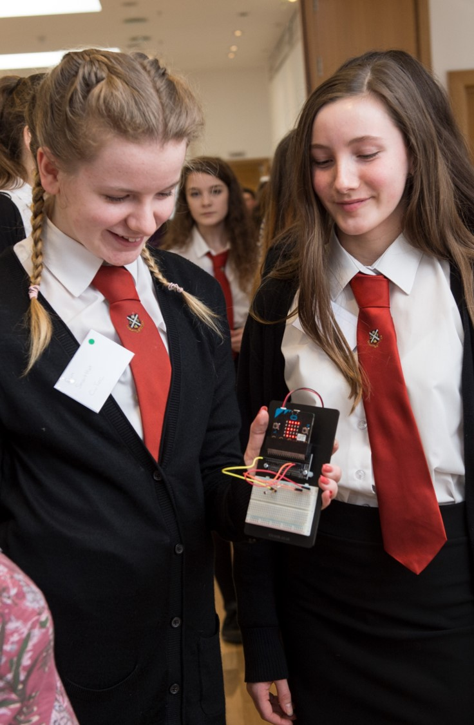
Welcome to Apps for Good
Over the next few weeks, you and your team mates will set up your own startup company.
You will work together to design an IoT project that solves a problem.
You will back up your idea with market research and you will consult potential users.
After this you will create an IoT prototype and pitch your design to investors.

Slide 5
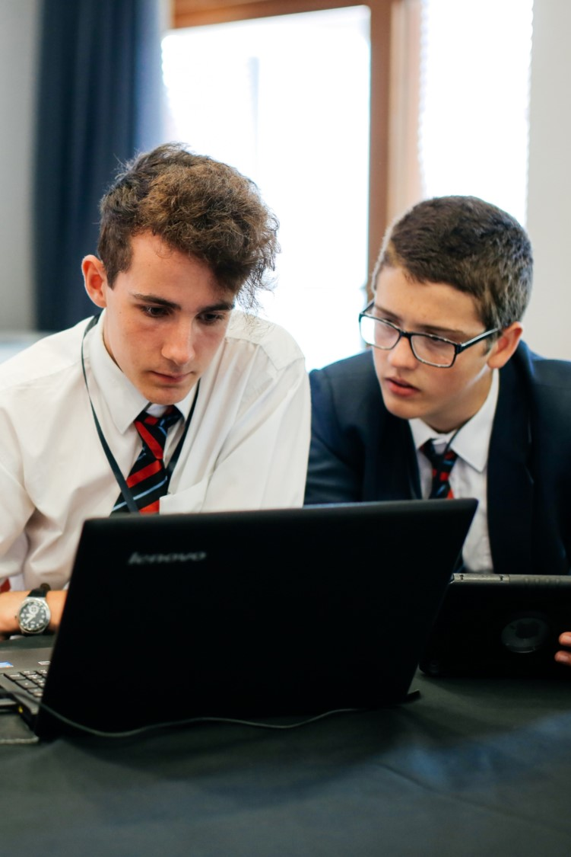
1.1 What is the Internet of Things?
Activity
In your workbook write down what you think the Internet of Things means.
Can you give any examples of Internet of Things devices in day to day life?

Slide 6

ACTIVITY 1.1
WHAT IS INTERNET OF THINGS?
MODULE 1
CRASH COURSE
Questions to answer before you watch the video
Have you heard of the term Internet of Things? YES / NO
If yes what do you think it means?
After you have watched the video
What is the Internet of Things?
Give an example of an Internet of Things device from the video?
Extension - What has made the Internet of Things possible?
Understanding what IoT is and how it functions should help you recognise where you are interacting with IoT devices in real life.

Slide 7
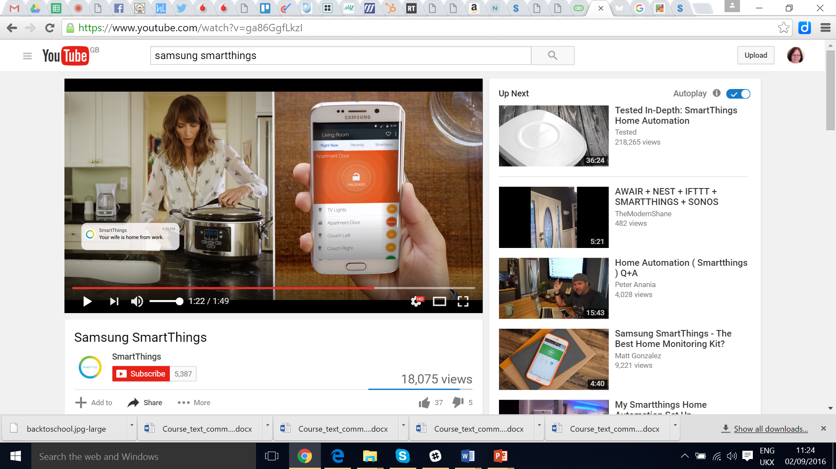
1.1 What is the Internet of Things?
Watch this Video “No matter how you live, SmartThings brings your home to life.” (1 min 49s)

Slide 8
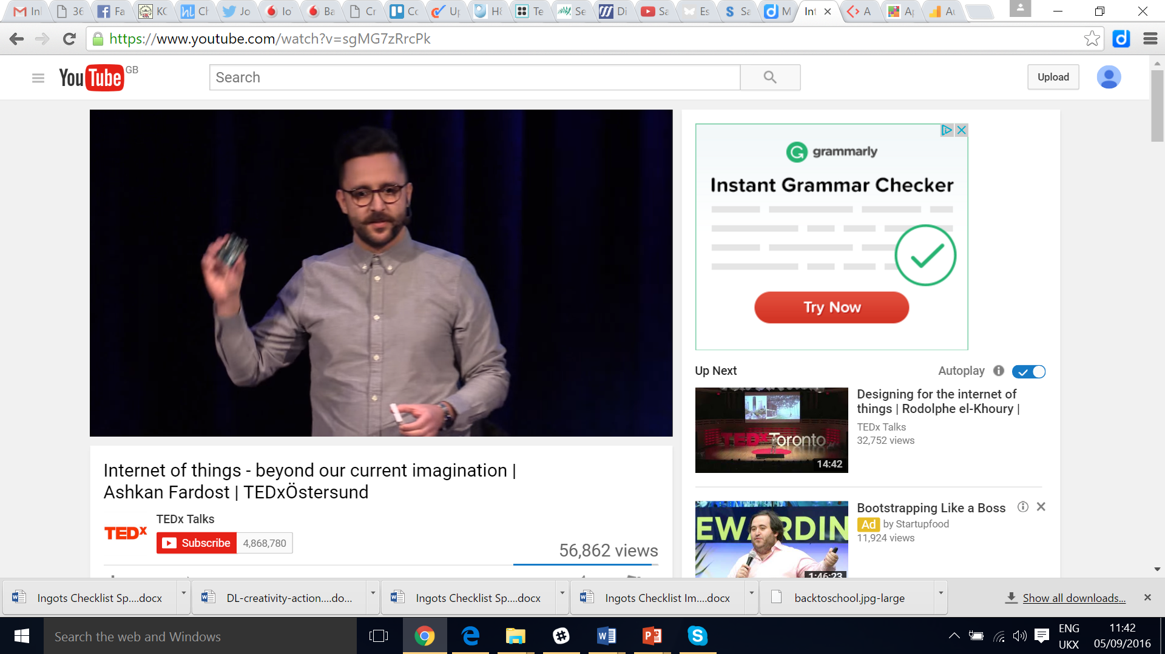
1.1 What is the Internet of Things?
Watch this TED Talk video: “Ashkan talks about internet of things, what we can expect in the future and how far the development has come.” (16 mins 57, the most relevant section is from 8 mins 47)

Slide 9
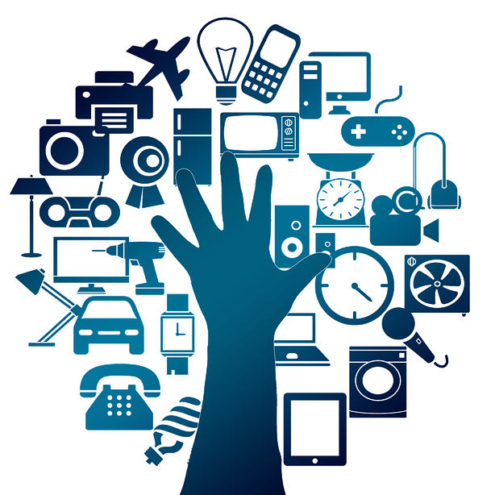
1.2 Benefits and risks of IoT
In your teams, create a mindmap of all the potential benefits of IoT you can think of. This could include the impact on:
Homes
Health
Work
Shopping
Transport
Leisure
Communities
Can you think of any potential risks of this new technology? Add these to your mindmap.
Notes:
Image source - https://www.google.co.uk/url?sa=i&source=images&cd=&cad=rja&uact=8&ved=2ahUKEwi-5OeDy9_cAhUCJhoKHa12DGcQjB16BAgBEAQ&url=https%3A%2F%2Fpixabay.com%2Fen%2Fcommunication-internet-1927697%2F&psig=AOvVaw2S6G0rqJObmDYYmIOlCbNw&ust=1533890821414751

Slide 10
ACTIVITY 1.2
BENEFITS AND RISKS OF IoT
MODULE 1
CRASH COURSE
Homes
Health
Work
Shopping
Transport
Uses of IoT
Leisure
Communities
Risks
Use this page to draw out your mindmap of the benefits and risks of IoT

Slide 11
What is the micro:bit?
This short video (1 min 40) introduces the BBC micro:bit

Slide 12
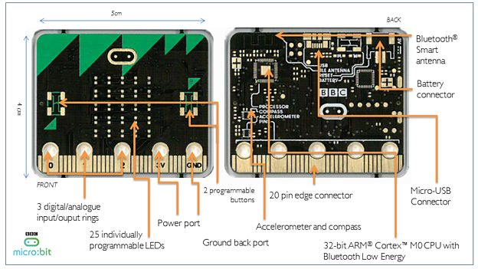
What is the micro:bit?

Slide 13
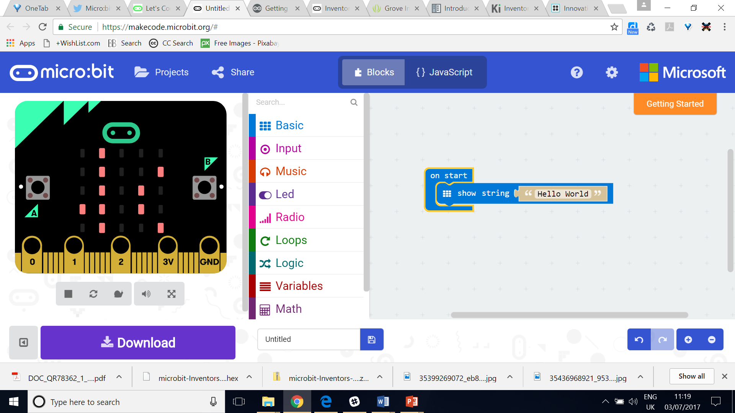
Programming the micro:bit -
MakeCode JavaScript Blocks Editor
The MakeCode editor can be found here: https://microbit.org/code/
Drag the Show String block from Basic and drop it into the On Start Block. Right click on the Forever block or drag it left to delete. To load your code onto the micro:bit click on download and then drag the hex file produced from the download folder to the micro:bit

Slide 14
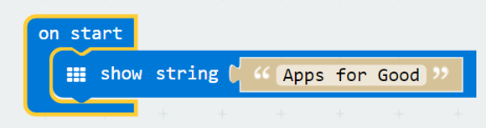
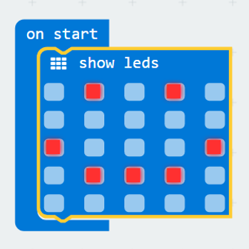

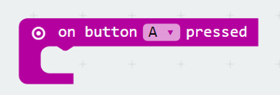
Micro:bit programming extensions
1. Add your own script to ‘show string’
2. Use the ‘show leds’ block from the Basic menu to create patterns on your micro:bit
3. Use ‘forever’ loop to keep the script scrolling
4. Use ‘on button’ or ‘on shake’ from Input to display your script if a button is pressed or the micro:bit is shaken

Slide 15
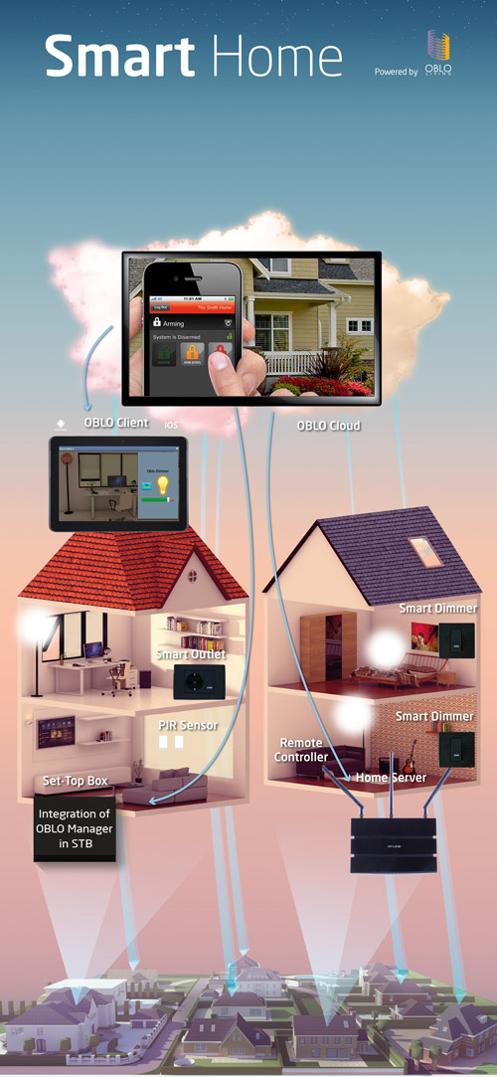
1.3 Homework
For homework, each member of the team should conduct internet research on IoT products currently available.
Find at least 3 devices available on the market and record:
Name of device
What it does
Who makes it
Price
Be prepared to share your research with the rest of the team next lesson.
Notes:
Image source - https://www.google.co.uk/url?sa=i&source=images&cd=&cad=rja&uact=8&ved=2ahUKEwiJ9dPZ4t_cAhVRrxoKHWLNB3EQjB16BAgBEAQ&url=https%3A%2F%2Fen.wikipedia.org%2Fwiki%2FRT-RK&psig=AOvVaw2S6G0rqJObmDYYmIOlCbNw&ust=1533890821414751

Slide 16
ACTIVITY 1.3
HOMEWORK - RESEARCHING IoT DEVICES
MODULE 1
CRASH COURSE
IoT device 1
IoT device 2
IoT device 3
Device name
What it does
Who makes it?
Price
Device name
What it does
Who makes it?
Price
Device name
What it does
Who makes it?
Price
Use this page to record you homework research

Slide 17
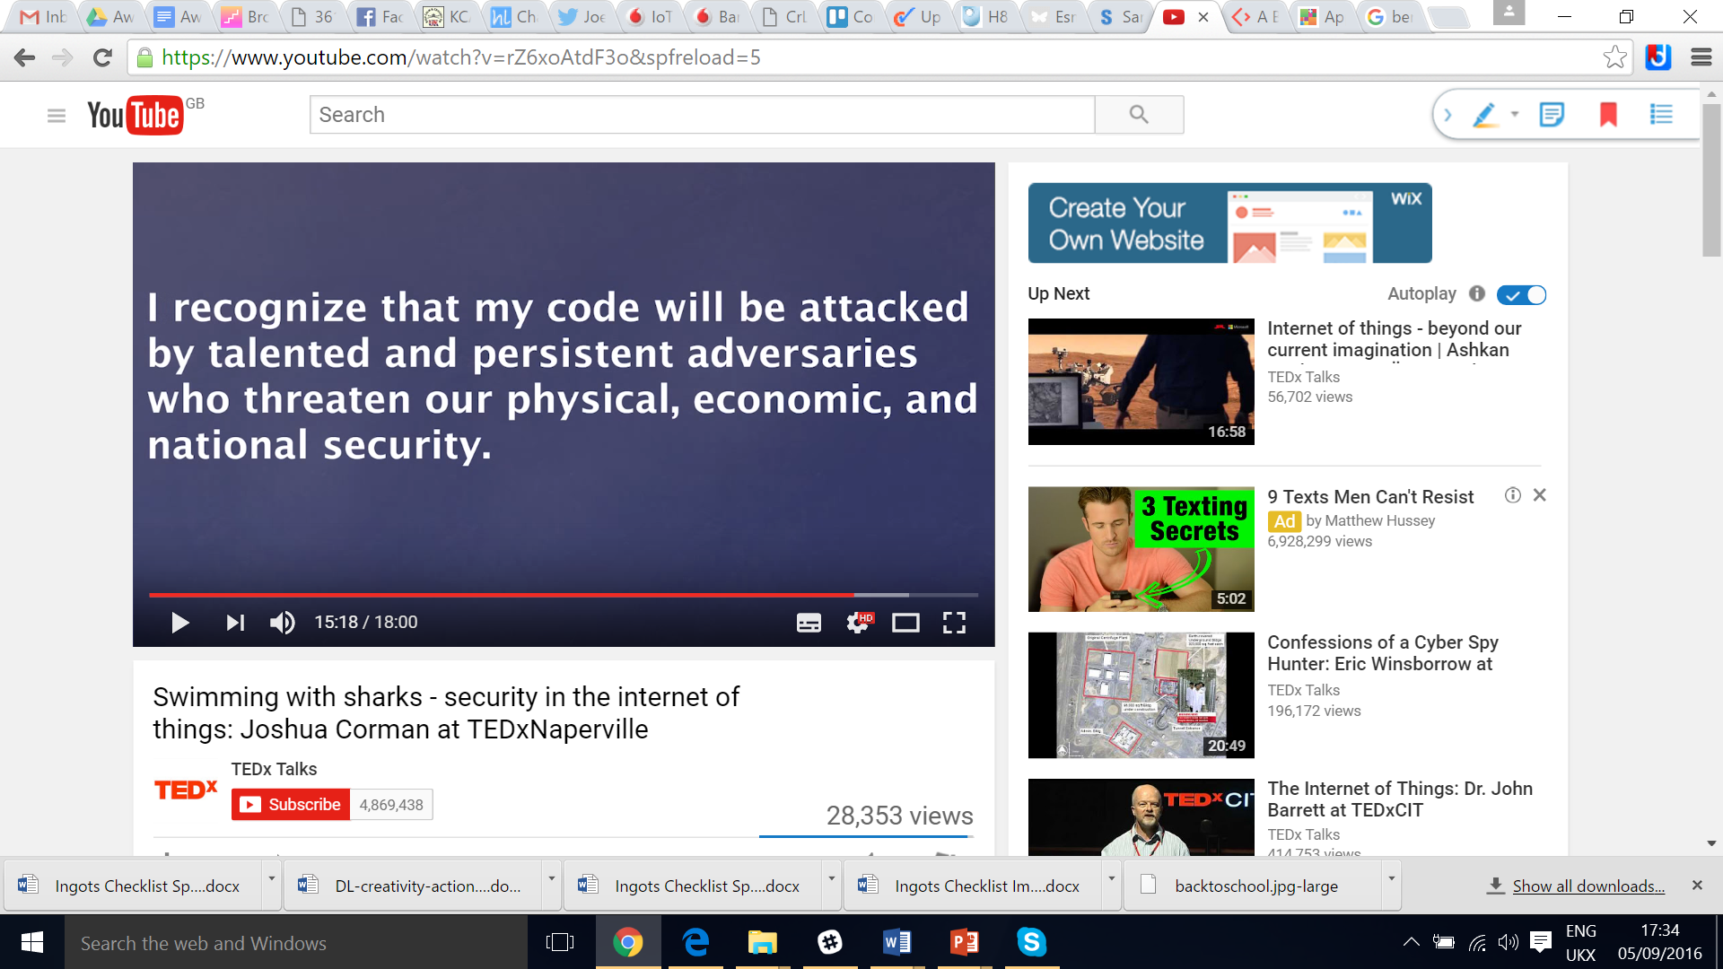
Extension - What are the risks?
This TED video (18 mins) explores the potential risks of an interconnected world

Slide 18
SENSORS AND BOARDS
CRASH COURSE
NEXT SESSION…
SESSION 2
MODULE 1

Slide 19


Using these materials
Apps for Good materials are licensed under the Creative Commons Attribution-NonCommercial-ShareAlike CC-BY-NC-SA License
You are free to:
Share — Copy and redistribute the material in any medium or format
Adapt — Remix, transform, and build upon the material
Under these terms:
Attribution – You must attribute the material to Apps for Good
Non Commercial – You may not use the material for commercial purposes
Share Alike – If you remix, transform, or build upon the material, you must distribute your contributions under the same license as the original

