Slide 1
CPaaS
Phone System -
December 2024 -

Slide 2
Problem Statement & Solutions
Introduction
Key Features
Value Propositions
Integration
Snapshots
Success Stories

Slide 3
Problem Statements & Solutions
Business Communication
Up-to Pace
CPaaS Phone System is effortlessly modified after some clicks. Allowing you to scale up or down your business make it suitable to any requirements.
In a competitive market, solutions will be alway be moving ahead, new features will be available at no time. CPaaS Phone System will allow to user to experience the latest innovation without the worry of obsoletion.
The world is rapidly changing. It leads to the urge to make remote work-enabled solutions more necessary than ever.
Scaling Business
With a complete Phone System, your agents can connect to the service from anywhere while maintaining an efficient and personalized customer service delivery with a user-friendly interface on any smart and internet-accessible device.
With a complete Phone System, your agents can connect to the service from anywhere while maintaining an efficient and personalized customer service delivery with a user-friendly interface on any smart and internet-accessible device.
Organizations are bound to have peak periods with increased call volumes and times when it is low. At peak periods such as sales week, holidays, Black Friday, Valentine’s day, and even worse, unprecedented events.

Slide 4







What is CPaaS Phone System?
The CPaaS Phone System is an advanced cloud-based telephony system that runs entirely on the internet.
VOIP technology converts your voice into a digital signal, allowing you to make calls over the internet. That means you spend less money on hardware and maintenance.
It also gives you the flexibility to take calls from both your desk phone and your computer or mobile device. Hence, you can utilise all the features of the office phone system wherever you are. With the cloud telephony, you will never miss your important calls again.
Cloud
Internet
Security
IT
Office
Communication

Slide 5
Key Features
Call Filter
Web-based Control
Call Settings
Third Party CRM Integration
General
Management
Time Dependent Call Handling
Integrated Enterprise Database
In/Outbound Rules
Call History & Reporting
Call Recording
IMPRESSIVE SET OF FEATURES
Call Group
IP Phones
Team Chat
VoIP App for iOS and Android
Unified Communication
Mobility
Conference Calls
VoIP App for MacOS and Window
Busy Lamp Field (BLF)
Webphone

Slide 6

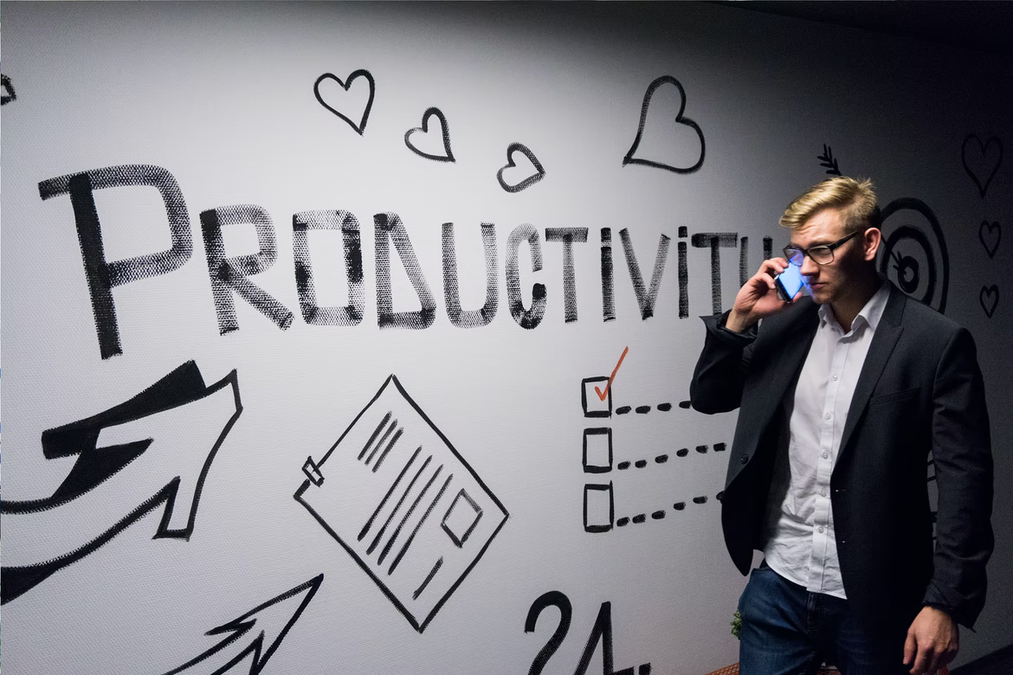


Key Features
General Features:
Define rules for filtering the incoming calls:
  Block Anonymous calls
  Actions to handle specific phone numbers.
Customized System Self Administration:
  How the phone rings?
  Where the phone rings?
  Announcement messages?
  What actions to execute when missed calls?
Time Dependent Call Handling
  Working/Non-working/Public Holiday
Inbound rules help to set up how Caller ID will display on receivers phone.
Outbound rules help you skip the extra steps when dialling out, and make calls only to countries specified by your company.
Able to perform call recording for monitoring purposes.

Slide 7


Key Features
Unified Communication:
Call Group allows your team to answer a call ringing at any extension in the group – no more missed calls, for you and your customers.
Team Chat with files sharing (documents, videos, pictures,..) that elevates the conversation to a whole new level.
Meetings with your team and/or clients made easy yet secured by setting up a Conference Room for 3-Way Conference calling.
By creating a Busy Lamp Field (BLF) Group, you can monitor whether an extension is on a call or not, and can make sure that all incoming calls are attended to.

Slide 8

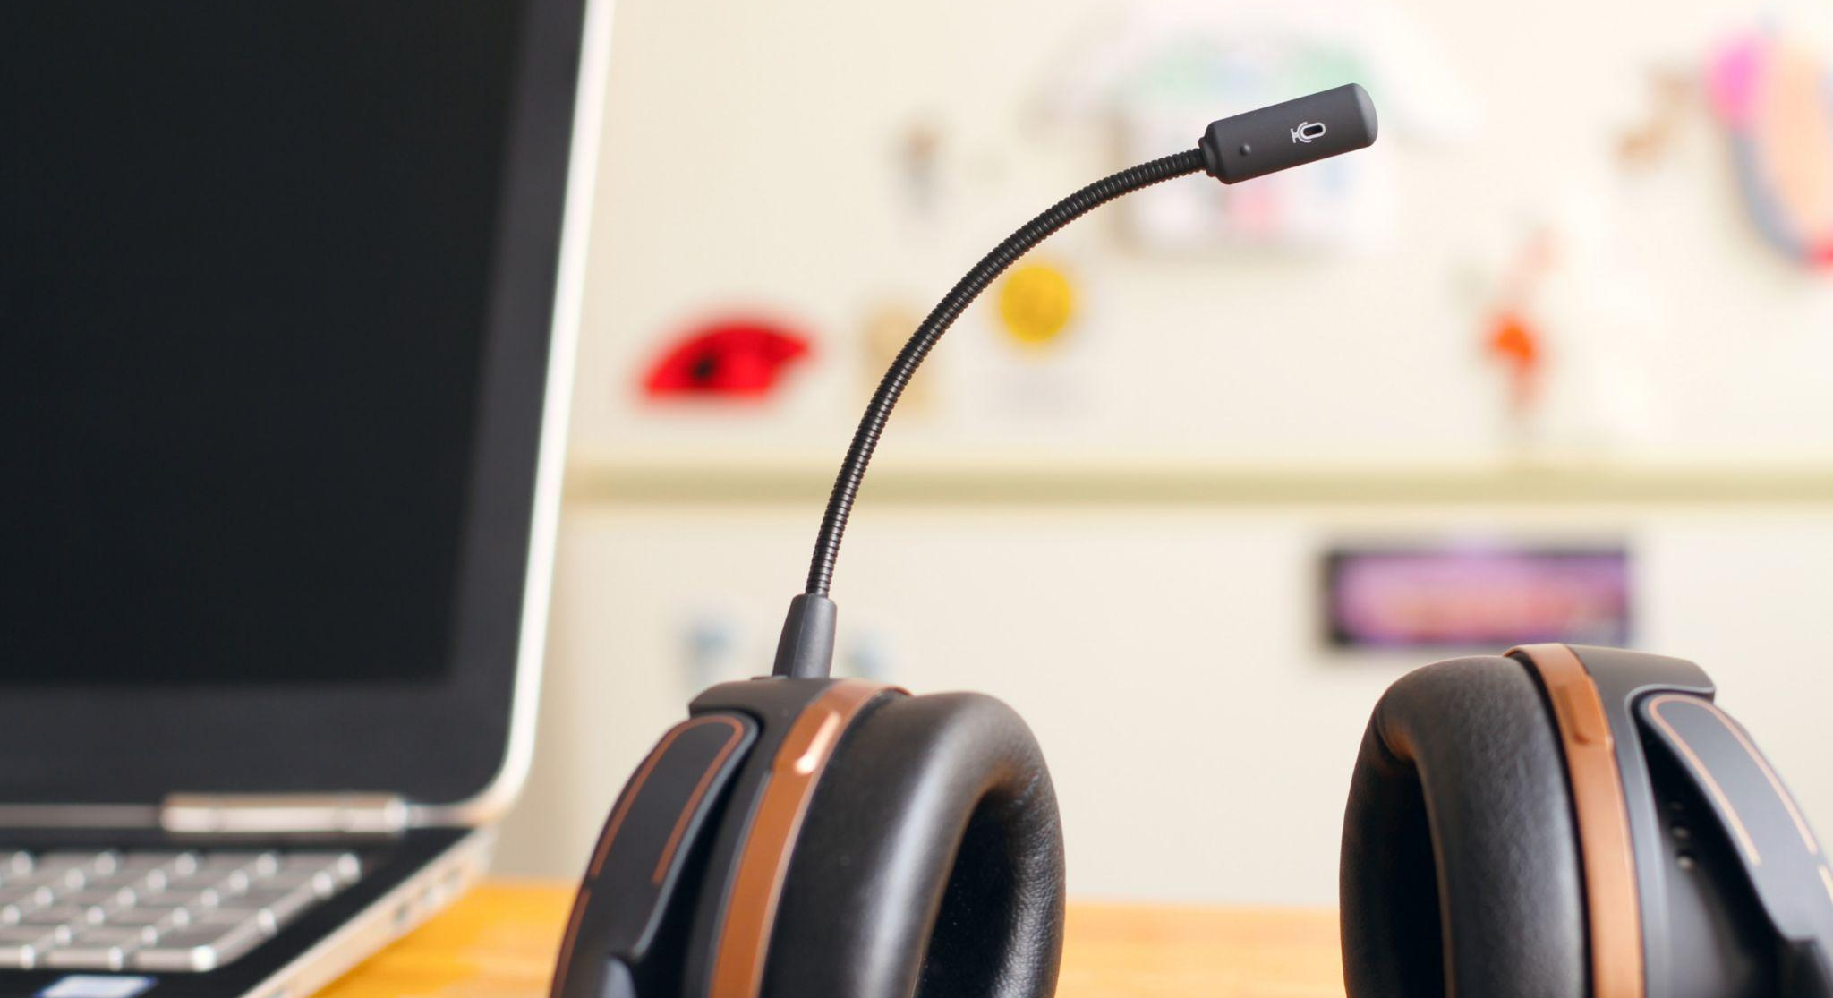
Key Features
Management Features:
User-friendly interface for managing and controlling the configuration.
Capable to integrate with different systems such as API Webhook or Company Database system.
All reports can be saved to a CSV file. It’s also possible to get all your reports right from your email or the system application.
Give accessibility for specific users in the Organization.

Slide 9

Key Features
Mobility Features:
Ability to receive or make call across different platform or devices
Support desktop on Mac and Windows
Support mobile devices on IOS / Android
Support IP Phone
Support Web Phone
Support conventional phone on ATA

Slide 10
Value Propositions
CPaaS Phone System is an open-platform, software VoIP phone system which is compatible with multiple devices, offering a complete advance solution with incredible features. It is more than just the average business telephone system.
Affordable, Easy to Install and Manage
CPaaS eliminates the cost and management headaches of outdated, traditional phone systems.
It can be set up effortlessly in minutes without any further assistance.
1
Unified Communication Solution
No matter how big or small your company is, CPaaS solution can take your business to next level, helping improve collaboration, boost productivity, increase mobility and enhance the customer experience.
2
Freedom to Users
CPaaS gives total freedom to the user, by enhancing mobility and allowing staff to work remotely.
The system provides a web-based user portal that gives extension
users complete mobility and independence to configure by themselves.
3
Scalability
CPaaS gives total freedom to the user, to add and remove licenses as and when they need, unlike hardware once it is purchased, it cannot be reduced, or increase easily.
4

Slide 11





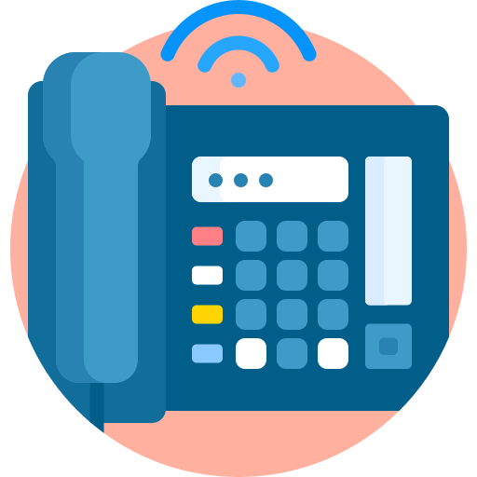


Integration
Auto-Attendant
Cloud PBX Solution
Uniform Greeting
Option Selection
CPaaS Phone System can integrate with the Auto-Attendant to create a Cloud PBX Solution.
It is responsible for routing incoming calls, enabling call transfers to other extensions and running all of your phone system’s communications features, such as call waiting and voicemail.
Your system can be managed using a call flow, which is a collection of features and rules you assign to a given phone number.
Phone System Users
Ext 101
Ext 102
Ext 103
Ext Group
Desktop App/ WebPhone
IP Phone
Mobile App

Slide 12
Integration
Auto-Attendant
Uniform Greeting
Option Selection
Inbound Contact Center
Contact Center Queues
CPaaS Phone System integrates with the Contact Center to create Inbound Contact Center:
  Processing orders
  Providing dispatch services
  Offering help desk support
  Answering and transferring calls
Phone System Agents
Ext 101
Ext 102
Ext 103
Ext Group
Desktop App/ WebPhone
IP Phone
Mobile App

Slide 13

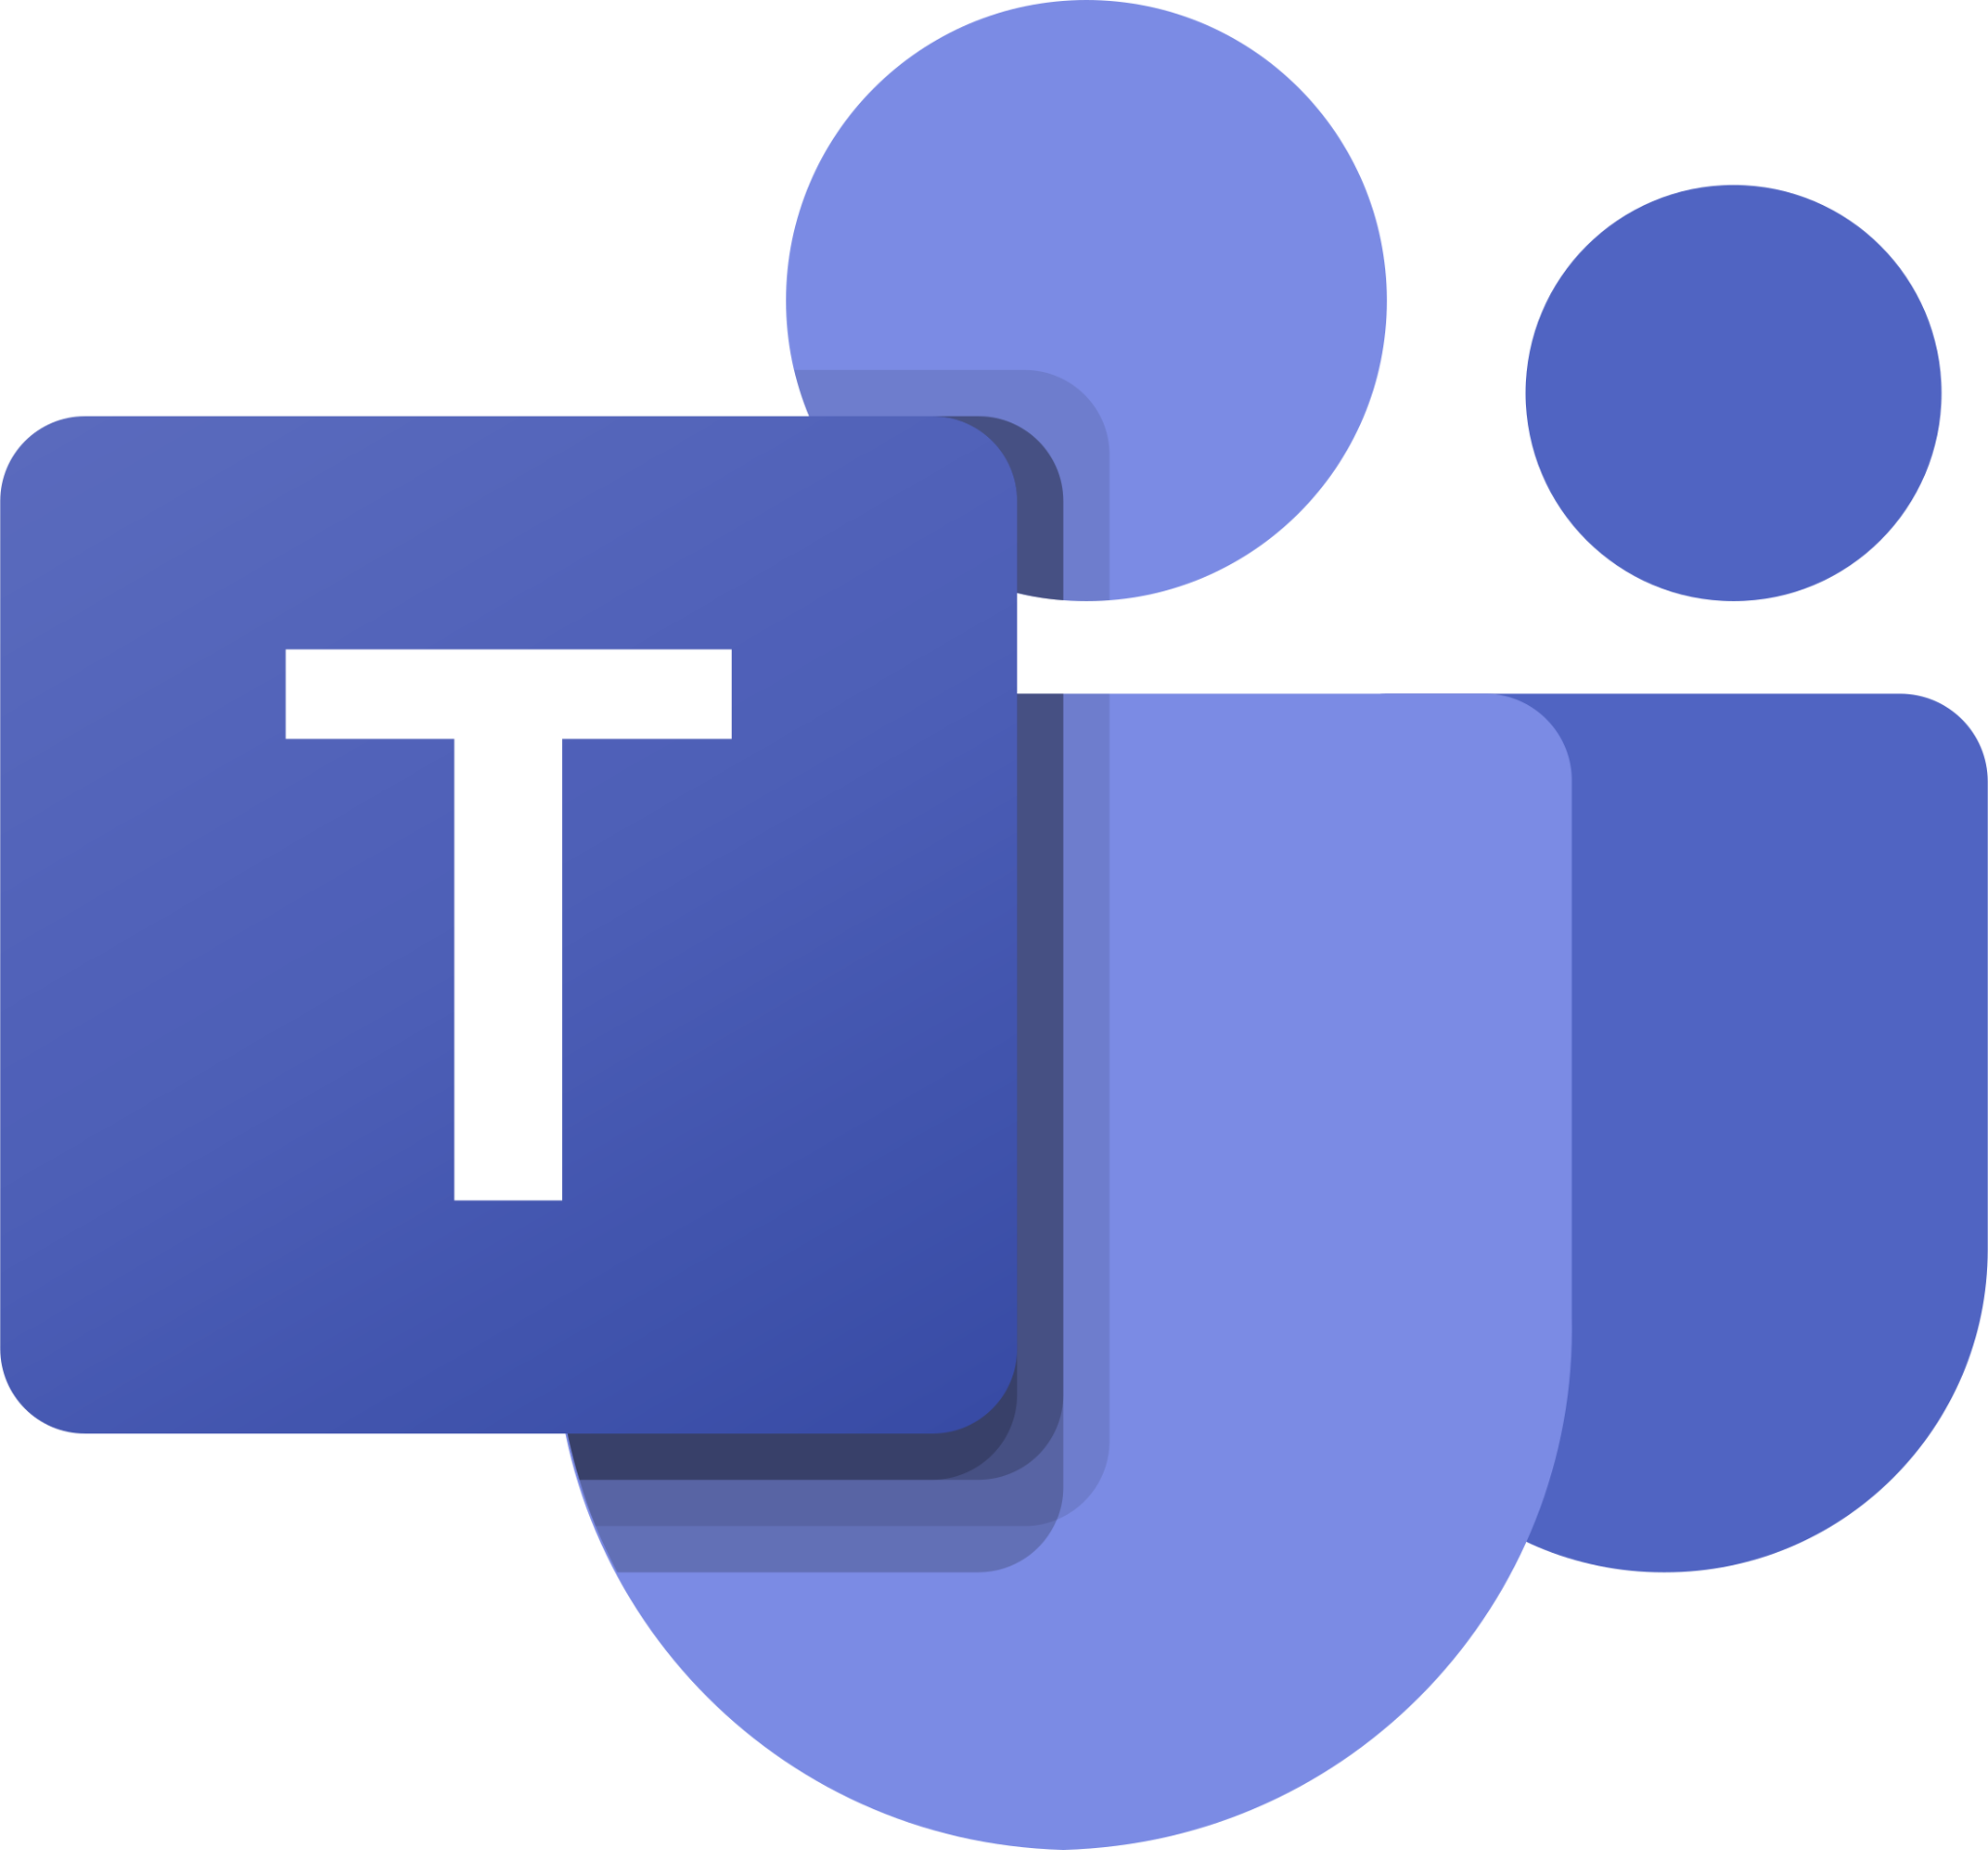
Integration
Auto-Attendant
MS Teams
Uniform Greeting
CPaaS Phone System natively supports Microsoft Teams offering a cost-effective alternative to MS365’s Calling Plan. With Microsoft Teams phone system integration, users can call out via CPaaS SIP trunks, leveraging low cost domestic and international tariffs offered by regional SIP providers. CPaaS Phone System provides a seamless unified calling experience both for CPaaS Phone System users dialing Teams users and for Teams users who can dial out. Additionally, admins can benefit from a full-featured PBX that’s much easier to use and configure than Teams.
Option Selection
Contact Center Queues
Phone System Agents
Ext 101
Ext 102
Ext 103
Ext Group
By MS Teams App

Slide 14

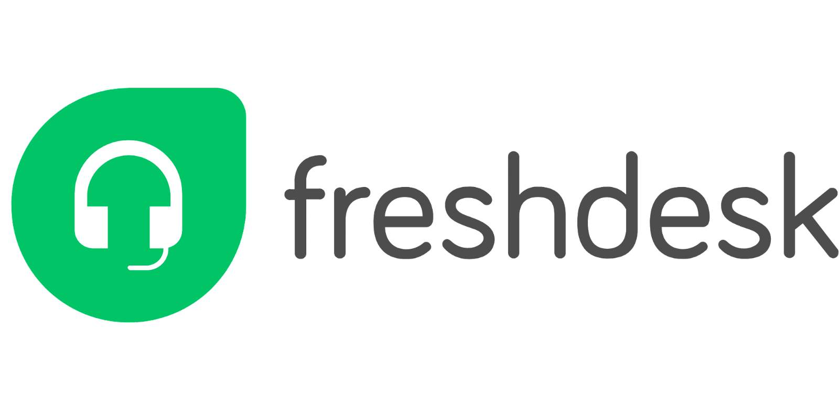


Integration
Auto-Attendant
CTI with CRM
(Simultaneously)
Computer Telephony Integration (CTI) technology allows computers and telephones to interact and exchange information. With auto-identification of the callers from CRM, the users can answer them better by checking the basic customer details. Computer Telephony Integrations solution is prominently used in Contact Center to manage inbound and outbound calls to increase human agents’ productivity.
Contact Center Queues
Freshdesk Data
Phone System Agents
Private Number
Existing Customer
New Customer
Ext 101
Ext 102
Ext 103
Ext Group
Fetch Customer
Create New Customer
Create Ticket
Freshdesk Portal

Slide 15
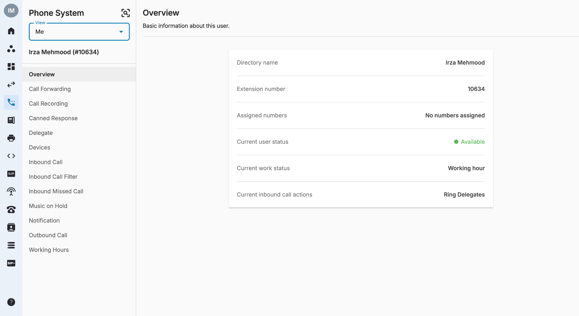
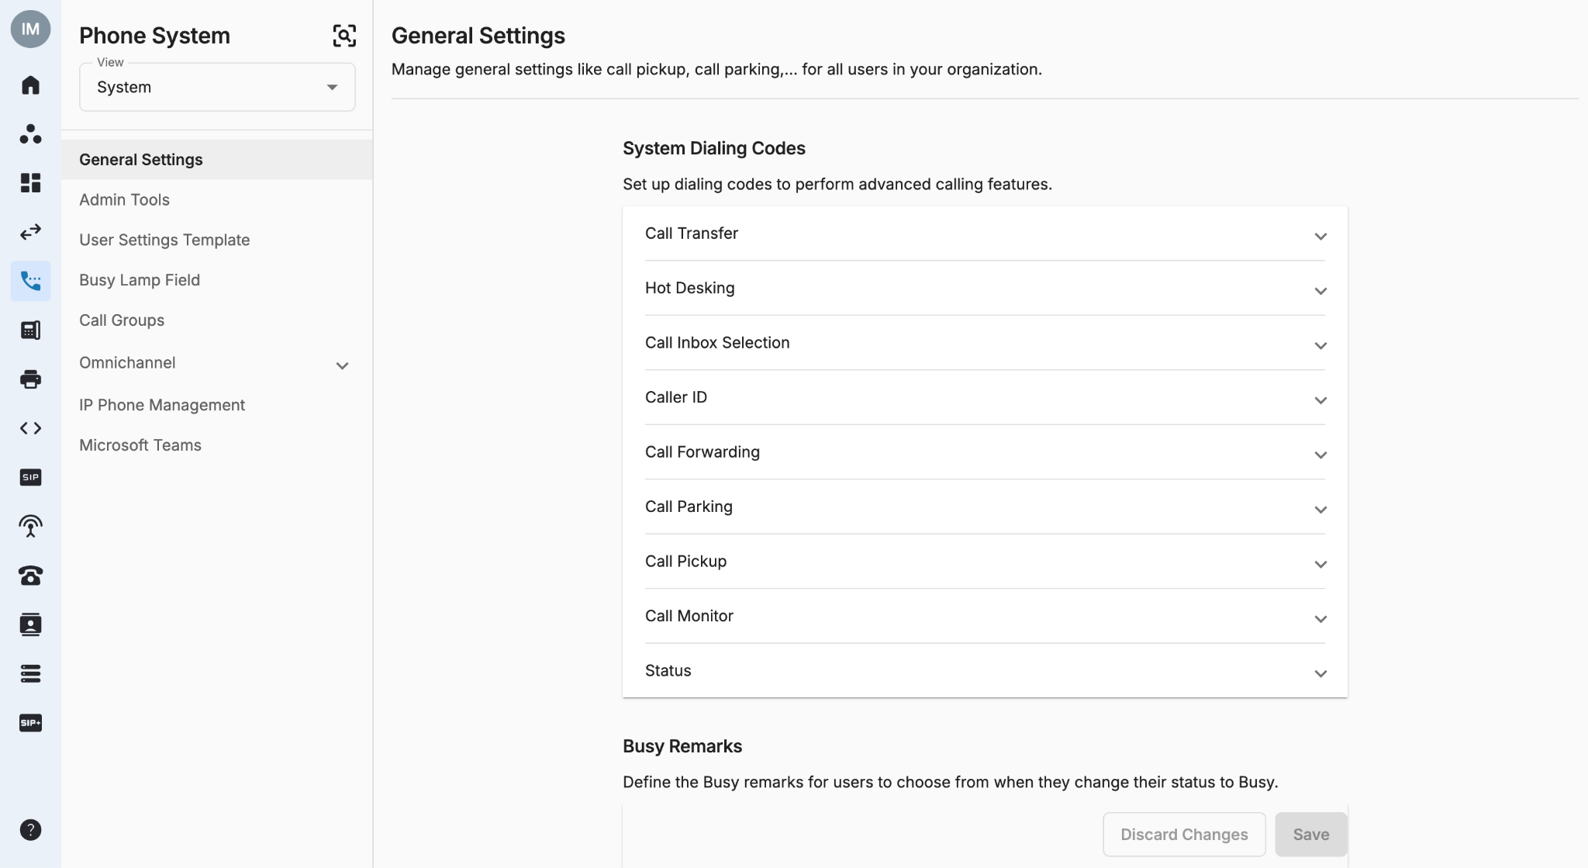
Settings Portal

Slide 16
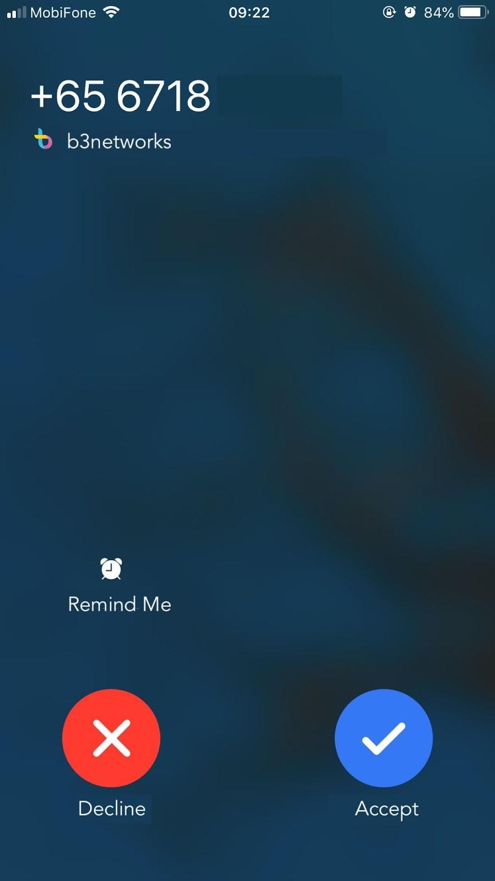
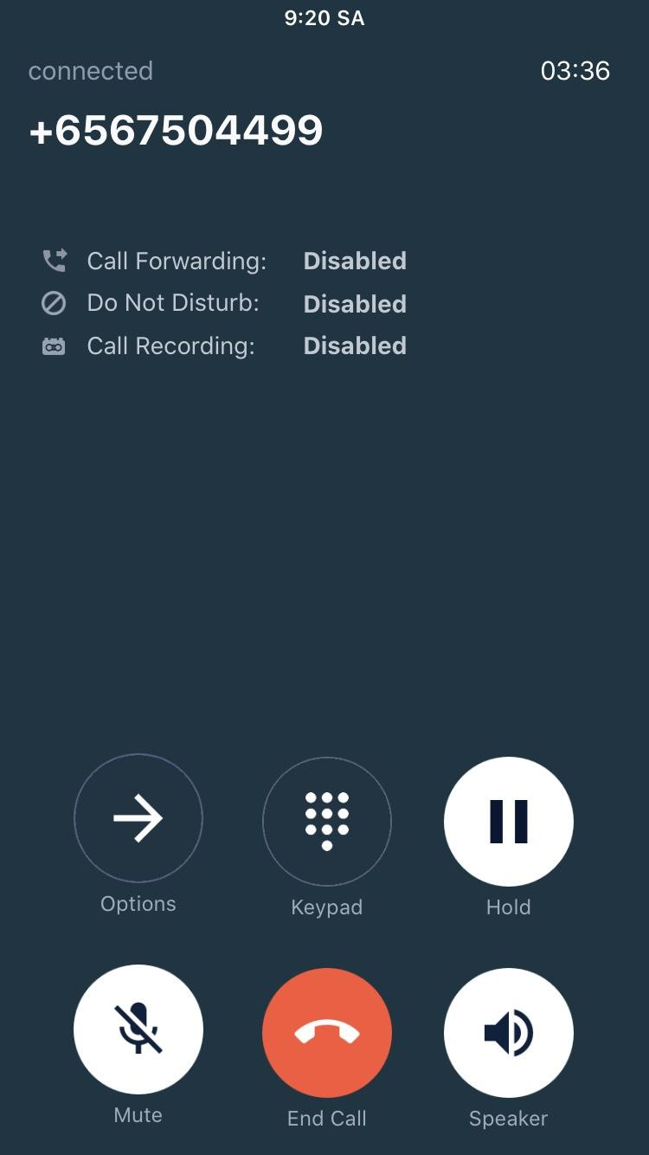
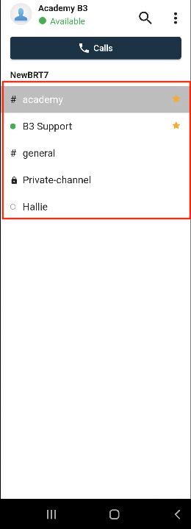
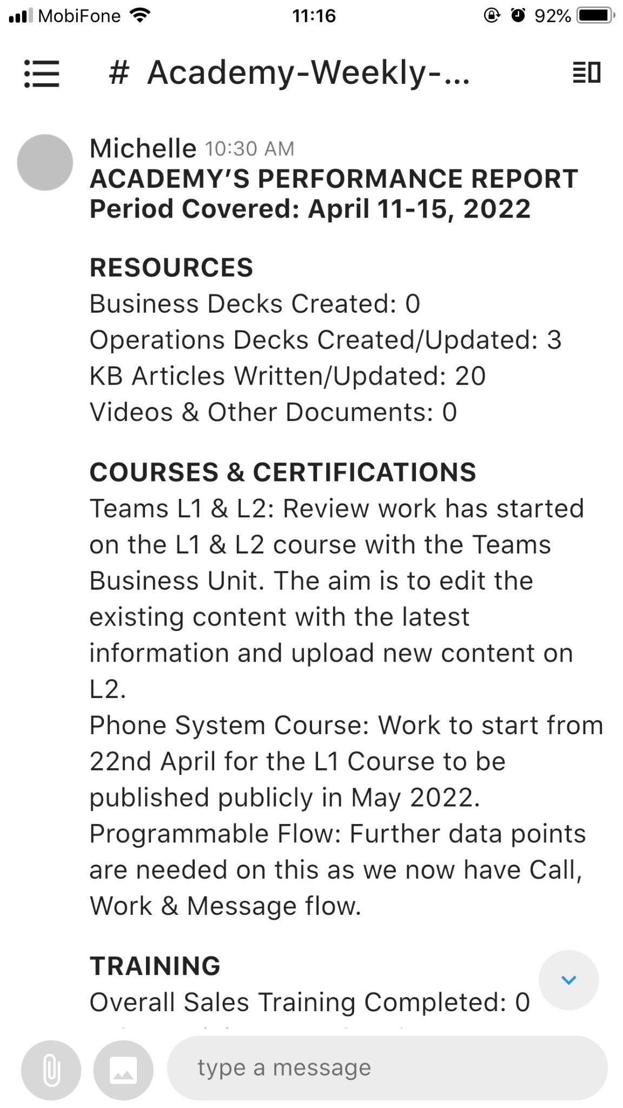
Mobile Application
Call
Chat

Slide 17
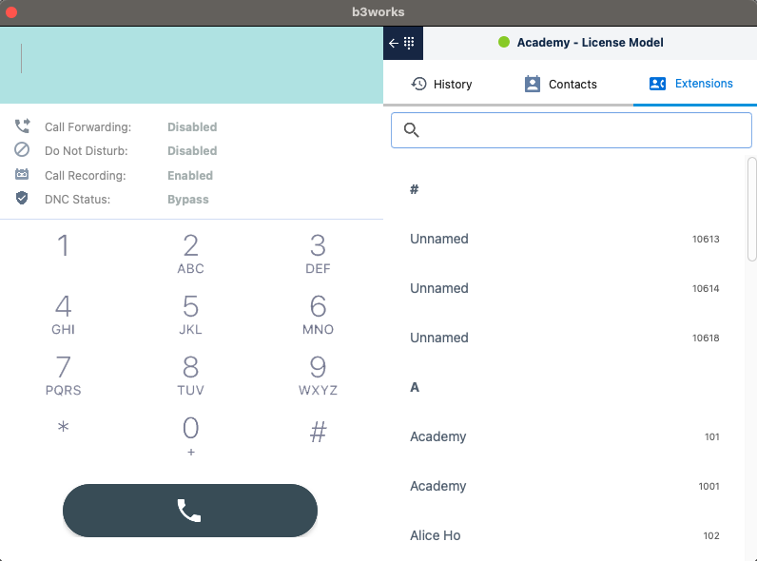
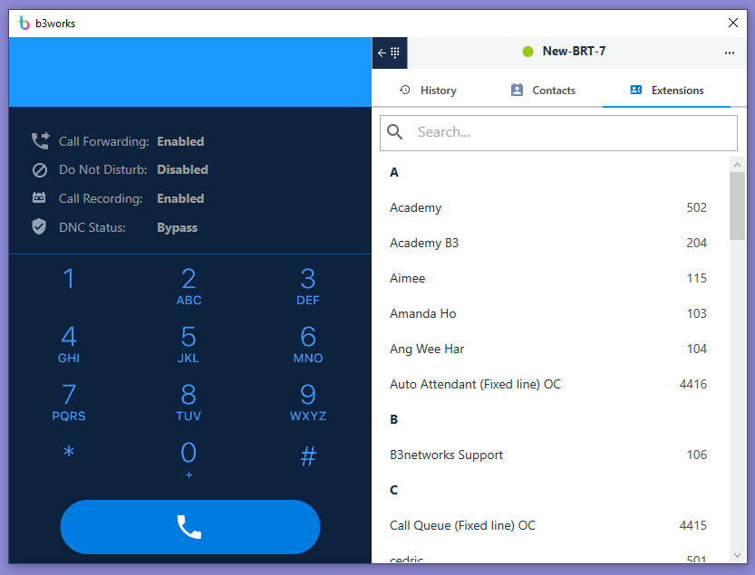
Desktop Application
Mac
Windows

Slide 18

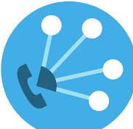




Success Stories
CPaaS User
Implemented to organization with over 2000 extension where the personnel is working remotely from office (multiple location) and home. The user is using CPaaS on a daily basis for making both external and internal incoming and outgoing calls.
Make/Receive Calls
Support multiple locations
Remote staff from home
Korea
Singapore
Thailand

Slide 19

Success Stories
An organization with over 600 users has implemented Phone System company wide. Users consists of various type of use devices including Mobile Application, and IP Phone. The IP Phone is used extensively for boss / secretary function whereby multiple boss is supported by one secretary.
Boss 1
Boss 2
Mobile App
Internal teams
Call Delegated
Boss’s number
External caller
Secretary
Desktop App/ WebPhone
IP Phone

