Slide 1

FASHION LIFE
PRESENTATION

Slide 2
CONTENTS
PART 01
PART 02
PART 03
PART 04
We hope that this template will return to you as a time, money and reputation.
We hope that this template will return to you as a time, money and reputation.
We hope that this template will return to you as a time, money and reputation.
We hope that this template will return to you as a time, money and reputation.

Slide 3

PART 01
CLICK TO ADD CAPTION TEXT

Slide 4

TITLE HERE
TITLE HERE
TITLE HERE
TITLE HERE
TITLE HERE
We hope that this template will return to you as a time, money and reputation.
We hope that this template will return to you as a time, money and reputation.
We hope that this template will return to you as a time, money and reputation.
We hope that this template will return to you as a time, money and reputation.
We use well-known development methodologies to create a customized approach for each of the projects. This allows us to achieve high quality outcomes and full transparency towards.

Slide 5

STEP HERE
We use well-known development methodologies to create a customized approach for each of the projects. This allows us to achieve high quality outcomes and full transparency towards. We use well-known development methodologies to create a customized approach for each of the projects. This allows us to achieve high quality outcomes and full transparency towards.
STEP HERE
A complex idea can be conveyed with just a single still image, namely making it possible to absorb large amounts of data quickly.
STEP HERE
A complex idea can be conveyed with just a single still image, namely making it possible to absorb large amounts of data quickly.

Slide 6

STAGE HERE
We use well-known development methodologies to create a customized approach for each of the projects. This allows us to achieve high quality outcomes and full transparency towards.
STAGE HERE
A complex idea can be conveyed with just a single still image, namely making it possible to absorb large amounts of data quickly.
STAGE HERE
A complex idea can be conveyed with just a single still image, namely making it possible to absorb large amounts of data quickly.

Slide 7

OPTION HERE
We hope that this template will return to you as a time, money and reputation.

Slide 8
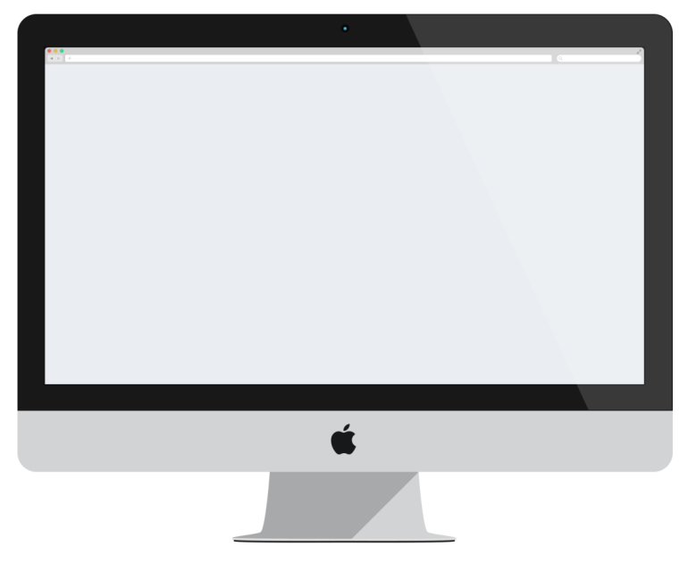

STEP HERE
We hope that this template will return to you as a time, money and reputation.
STEP HERE
STEP HERE
STEP HERE
STEP HERE

Slide 9
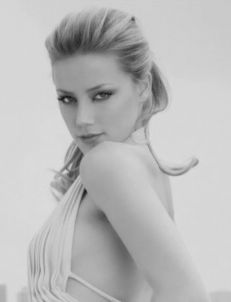
PART 02
CLICK TO ADD CAPTION TEXT

Slide 10

STAGE HERE
STAGE HERE
A complex idea can be conveyed with just a single still image, namely making it possible to absorb large amounts of data quickly.
STAGE
HERE
STAGE HERE
A complex idea can be conveyed with just a single still image, namely making it possible to absorb large amounts of data quickly.
STAGE HERE
A complex idea can be conveyed with just a single still image, namely making it possible to absorb large amounts of data quickly.

Slide 11

TITLE HERE
TITLE HERE
A complex idea can be conveyed with just a single still image, namely making it possible to absorb large amounts of data quickly.
TITLE HERE
A complex idea can be conveyed with just a single still image, namely making it possible to absorb large amounts of data quickly.
TITLE HERE
A complex idea can be conveyed with just a single still image, namely making it possible to absorb large amounts of data quickly.

Slide 12

单击此处添加标题
Apple Devices
Apple Devices
Apple Devices
STEP HERE
STEP HERE
STEP HERE
A complex idea can be conveyed with just a single still image, namely making it possible to absorb large amounts of data quickly.
A complex idea can be conveyed with just a single still image, namely making it possible to absorb large amounts of data quickly.
A complex idea can be conveyed with just a single still image, namely making it possible to absorb large amounts of data quickly.
Apple Devices
Apple Devices
Apple Devices
STEP HERE
STEP HERE
STEP HERE
A complex idea can be conveyed with just a single still image, namely making it possible to absorb large amounts of data quickly.
A complex idea can be conveyed with just a single still image, namely making it possible to absorb large amounts of data quickly.
A complex idea can be conveyed with just a single still image, namely making it possible to absorb large amounts of data quickly.

Slide 13


STAGE HERE

Slide 14

OPTION HERE
01
02
03
OPTION HERE
OPTION HERE
OPTION HERE
We hope that this template will return to you as a time, money and reputation.
We hope that this template will return to you as a time, money and reputation.
We hope that this template will return to you as a time, money and reputation.

Slide 15

PART 03
CLICK TO ADD CAPTION TEXT

Slide 16

TITLE HERE
TITLE HERE
TITLE HERE
A complex idea can be conveyed with just a single still image, namely making it possible to absorb large amounts of data quickly.
A complex idea can be conveyed with just a single still image, namely making it possible to absorb large amounts of data quickly.
TITLE HERE
TITLE HERE
A complex idea can be conveyed with just a single still image, namely making it possible to absorb large amounts of data quickly.
A complex idea can be conveyed with just a single still image, namely making it possible to absorb large amounts of data quickly.

Slide 17
STEP HERE
STEP HERE
A complex idea can be conveyed with just a single still image, namely making it possible to absorb large amounts of data quickly.
STEP HERE
A complex idea can be conveyed with just a single still image, namely making it possible to absorb large amounts of data quickly.
STEP HERE
A complex idea can be conveyed with just a single still image, namely making it possible to absorb large amounts of data quickly.
STEP HERE
A complex idea can be conveyed with just a single still image, namely making it possible to absorb large amounts of data quickly.

Slide 18

STAGE HERE
We hope that this template will return to you as a time, money and reputation.
We hope that this template will return to you as a time, money and reputation.
STAGE HERE
STAGE HERE
TWITTER
TWITTER
We hope that this template will return to you as a time, money and reputation.
We hope that this template will return to you as a time, money and reputation.
STAGE HERE
STAGE HERE
FACEBOOK
FACEBOOK

Slide 19

OPTION HERE
We use well-known development methodologies to create a customized approach for each of the projects. This allows us to achieve high quality outcomes and full transparency towards.

Slide 20


We use well-known development methodologies to create a customized approach for each of the projects. This allows us to achieve high quality outcomes and full transparency towards. We use well-known development methodologies to create a customized approach for each of the projects. This allows us to achieve high quality outcomes and full transparency towards.
TITLE HERE

Slide 21

PART 04
CLICK TO ADD CAPTION TEXT

Slide 22

STEP HERE
STEP HERE
STEP HERE
STEP HERE
STEP HERE
Marketing
Finances
Social Media
Entertainment

Slide 23

STAGE HERE
We use well-known development methodologies to create a customized approach for each of the projects. This allows us to achieve high quality outcomes and full transparency towards.

Slide 24

02
OPTION HERE
We hope that this template will return to you as a time, money and reputation.
01
03
OPTION HERE
OPTION HERE
We hope that this template will return to you as a time, money and reputation.
We hope that this template will return to you as a time, money and reputation.

Slide 25

TITLE HERE
We use well-known development methodologies to create a customized approach for each of the projects. This allows us to achieve high quality outcomes and full transparency towards.

Slide 26

THANK YOU!
Powered by GoogleSlides.org

