Slide 1
Evidence-Based GAP Analysis
Jack States

Slide 2

Implementation How do we make it work? Addressing all relevant variables so an intervention will be successfully adopted in a particular setting.
Two Elements of Implementation
Adoption
Sustainability
How do we make it work?

Slide 3
Definitions
Adoption “Getting a practice approved for use in education”. Formal authorization from critical stakeholders for the use of an intervention that has been determined to be both efficacious and effective.
Sustainability “Maintaining a practice beyond the implementation phase”. To make an impact an intervention must be durable and meet the test of time.
How do we make it work?

Slide 4
Implementation Issues
Practices established as efficacious and effective frequently fail to be implemented
Practices that are ineffective and even harmful are often implemented
Unintended consequences resulting from poorly planned implementation strategies frequently impede the successful implementation of evidence-based (EB) practices
How do we make it work?
Notes:
Direct Instruction: Demonstrated to be both efficacious as well as effective. - Issues of implementation
Research
Project Follow Through, completed in the 1970s. This was the largest educational study ever done, costing over $600 million, and covering 79,000 children in 180 communities.
Adoption & Sustainability flaws
Resistance to highly scripted curriculum

Slide 5
Obstacles to Successful Implementation
Insufficient research conducted in establishing the factors that influence implementation.
Going from research to practice forces increased complexity into the system. The introduction of scores of unanticipated variables frequently lead to failure.
Implementation “at-large” requires analysis & action at multiple levels of a system each with their own unique sets of contingencies.
How do we make it work?

Slide 6
Adoption Goals
Laws, policies, and regulations support evidence-based interventions
Network of evidence-based stakeholders is established
Researchers, politicians, implementers, and consumers adopt common criteria for evaluating best practices
Research on efficacious and effective methods for getting interventions adopted is available
Clearinghouse(s) to disseminate evidenced-based research easily accessible by decision-makers and consumers
Training in best methods for achieving adoption is widely available
How do we make it work?

Slide 7
Obstacles to Successful Adoption
General resistance to change
Policy Makers select practices for reasons other than being EB
Being re-elected (quick fixes)
Lobbyist influence
Avoidance of controversy
Fiscal constraints
Ideological or ethical conflicts
Insufficient planning by stakeholders
Inadequate infrastructure for distribution of EB studies
No Child Left Behind Conflicts with IDEA
Decision making in IDEA is decentralized - IEP
General Education decision making is centralized at State, School Board, and Principal level
How do we make it work?

Slide 8
ADOPTION Requirements
Motivation
The problem must be substantial and requires change
An efficacious and effective solution is available
The intervention is cost effective
Active support can reasonably be achieved by Decision Makers.
Politicians
Administrators
Practitioners
Consumers
How do we make it work?

Slide 9
ADOPTION Requirements
Infrastructure
Policies, laws, and/or regulations are aligned (minimally not hostile)
An Adoption Team with the skills to manage and lead an adoption campaign is formed
Resources
Fiscal Resources are accessible
Human Resources are available
Planning
An assessment of conditions completed
Written outcomes and benchmarks are developed
Written goals are developed
Written roles and responsibilities are created
How do we make it work?

Slide 10
ADOPTION Decision Points
Tools - Adoption Plan
Contingency Analysis (for each stakeholder faction)
Current Situation
Contingencies that support
Contingencies that suppress
New Practice
Contingencies that support
Contingencies that suppress
GAP Analysis
Cost Benefit Analysis
Public Relations Plan
How do we make it work?

Slide 11
Sustainability Goals
Active support of the organization(s) secured
Commitment from implementers and consumers is secured
Specific and objective outcomes are identified and commonly accepted
A reporting system to assess progress is operational
A written plan with goals, responsibilities, and timelines is developed with the input of all stakeholders. The goals and objectives include:
Specific strategies for overcoming obstacles
Goals to address the contingencies that support and threaten the intervention are incorporated
Personnel required to implement the intervention are actively recruited and hired
Training in best methods for implementation of the intervention is available
How do we make it work?

Slide 12
Obstacles to Successful Sustainability
General resistance to change
The cost of implementing exceeds benefits
Outcomes are not relevant to stakeholders
Practice is aversive to implementers (too much time, too much effort, etc.)
Inadequate planning paid to matching naturally occurring reinforcers with the new behavior
Leadership is ineffective
Turnover of person(s) advocating for the practice
Top down approach that doesn’t involve implementers and consumers in decisions
Insufficient funding
Feedback on the outcomes and process is infrequent and/or not maintained over time
Poorly trained personnel
Inadequate training
Turnover
How do we make it work?

Slide 13
SUSTAINABILITY Requirements
Motivation
Support from key stakeholders confirmed
Politicians
Administrators
Implementers
Groups affected by the practice
A contingency analysis favors the intervention
Measurable progress maintained
Goals and objectives are clearly defined for implementers
Feedback on performance provided to all stakeholders (frequently and timely)
How do we make it work?

Slide 14
Sustainability Requirements
Infrastructure
1. Policy and practices manual
Common Vision: a mission, purpose, and goals
Common Language: a means of describing its vision, actions, operations, and feedback.
Common Practices: defined actions, routines, procedures, or operations practiced members of the organization.
2. Initial and ongoing training
3. Data management systems that provide timely feedback to all stakeholders on performances against outcomes
4. Leadership Team
Resources
1. Fiscal Resources
Start-up funding
On-going funding
2. Human Resources
Active recruitment and timely hiring
Active performance management and supervision
How do we make it work?

Slide 15
Sustainability Requirements
Planning
1. Annual assessment of the results of performance
Outcome
Process
2. Annual Plan
Outcomes
Benchmarks
Goals
2. Systematic communication across levels of the organization
Politicians → ← Administrators, Implementer, and Consumers
Administrators → ←, Implementer, Consumers, and Politicians
Consumers → ←, Administrators, Implementer, and Politicians
How do we make it work?

Slide 16
Sustainability Requirements
Tools
1. Key indicator report (critical data that are mission critical)
2. Annual plan - Outcomes and Goals
Service plan
Operations plan
Public relations plan
Fiscal plan
3. Annual reports
4. Contingency analysis
5. Systems process analysis
How do we make it work?

Slide 17
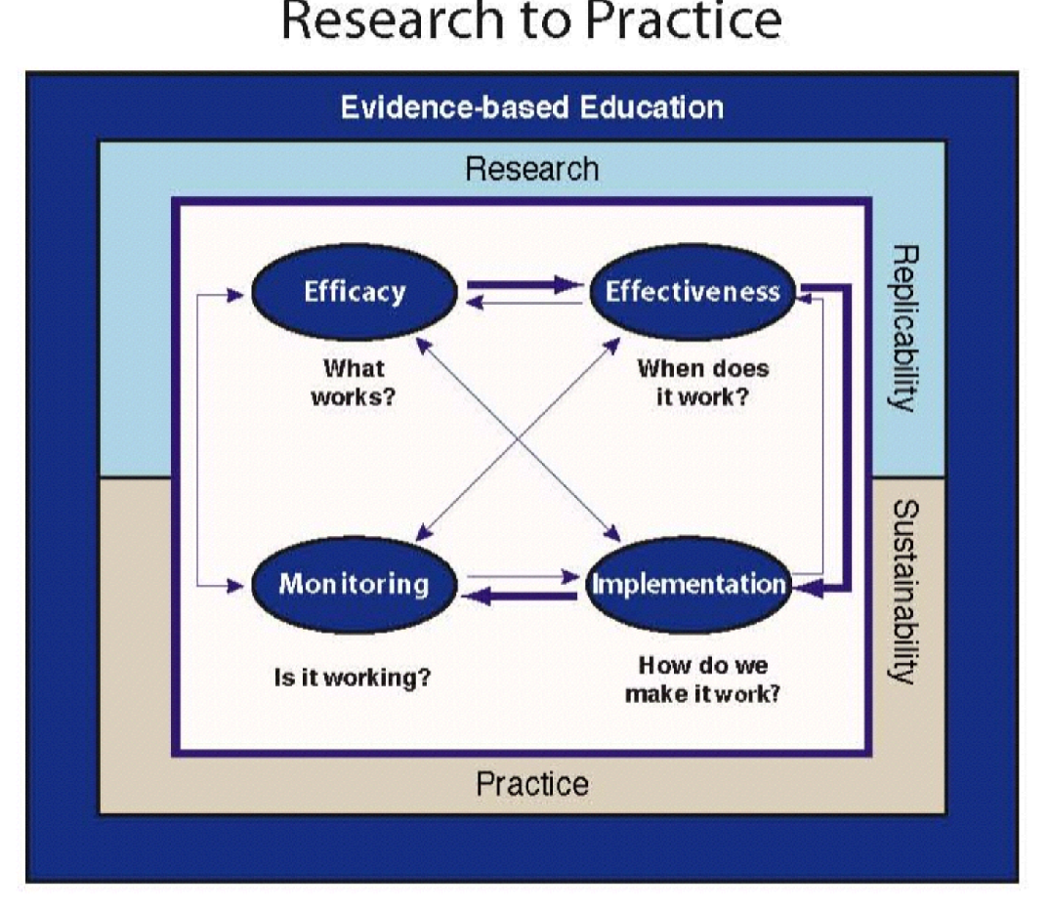
IMPLEMENTATION
How do we make it work?

