Slide 1






WILD ANIMAL
Free Template

Slide 2



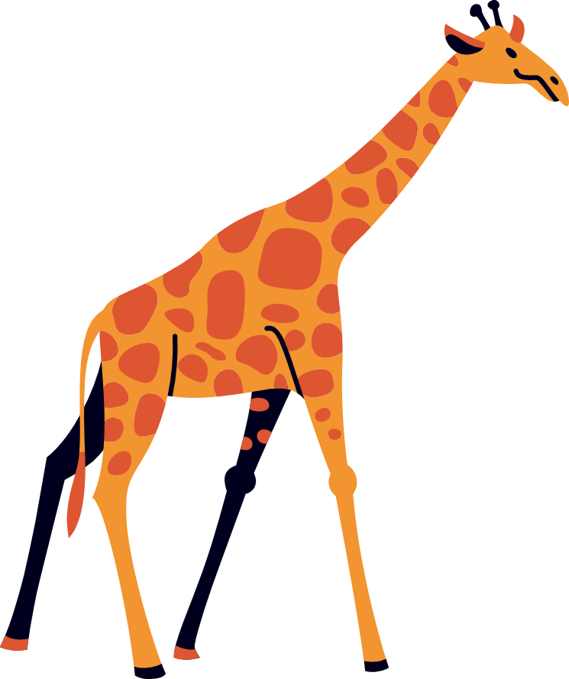

WELCOME
Welcome to the world of fantasy! Join us on a journey to explore the mystical creatures, enchanted lands, and magical wonders that exist beyond our reality. Discover the wonders and secrets of this exciting realm and unlock the power of imagination.

Slide 3





TABLE OF CONTENTS
01
INTRODUCTION
The Extraordinary Realm
02
ENCOUNTERS
Unicorn Sightings
03
WONDERS
Wishes Granted
04
MAGIC
Spellcasting

Slide 4

INTRODUCTION
The Fantasy Realm: Uncovering the Secrets of the Imagination and the Magic that Lies Within

Slide 5

THE REALM OF THE EXTRAORDINARY
Welcome to the Fantasy World, a realm of wonder and enchantment where anything is possible. Here, dragons breathe fire, unicorns prance through meadows, and rainbows shine brightly. This world is a place where wishes come true, where potions can be cursed and spells are cast. It's a place of treasure and adventure, where the impossible becomes possible. But the greatest treasure of all is the one that lies within.
The world of fantasy is a reflection of our deepest desires, our fondest dreams, and our wildest imaginations. It's a place where we can let go of the constraints of reality and explore the boundless possibilities of the human mind. In this introduction, we will delve into the mysteries of this realm, uncovering the magic and wonder that lies within. So come with us and let's embark on a journey through the Fantasy World.

Slide 6

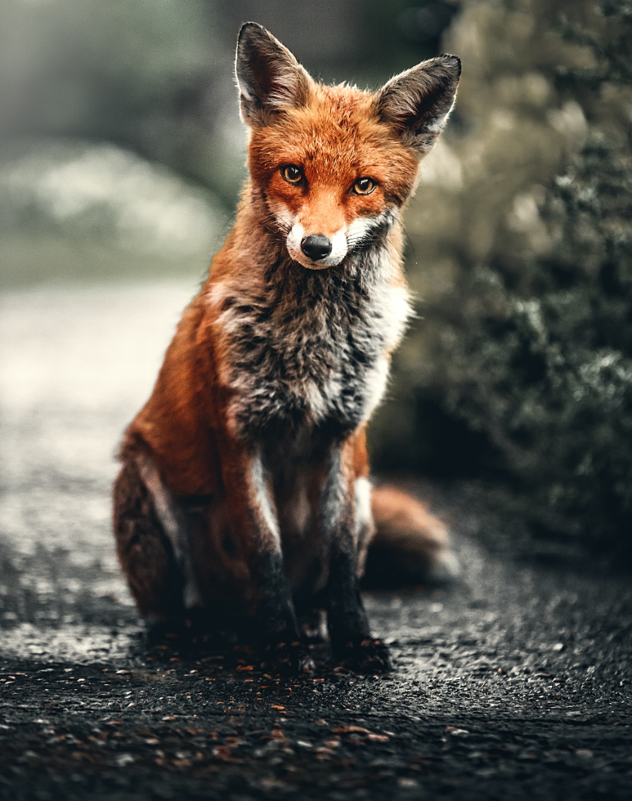







UNICORN SIGHTINGS
A record of the number of unicorns spotted in the fantasy realm and the beauty and mystery that surrounds these enchanting creatures.
DRAGON TAMING
A closer look at the art of taming dragons and the brave adventurers who dare to take on these fearsome creatures.

Slide 7

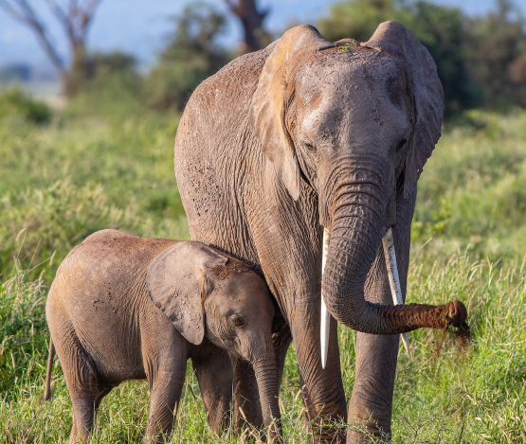
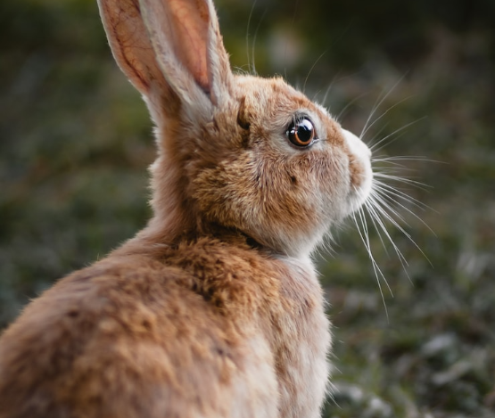
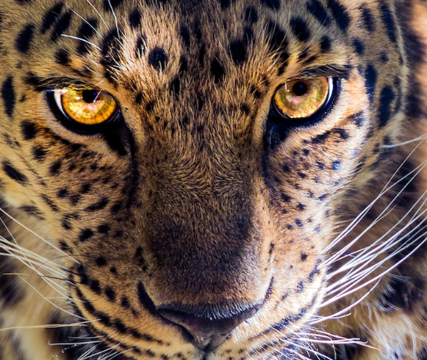


DRAGON TAMING
A closer look at the art of taming dragons and the brave adventurers who take on these creatures.
UNICORN SIGHTINGS
UNICORN SIGHTINGS
A record of the number of unicorns spotted in the fantasy realm and the beauty and mystery.
A record of the number of unicorns spotted in the fantasy realm and the beauty and mystery.
45%
67%
45%

Slide 8

FANTASY IS THE GATEWAY TO THE IMPOSSIBLE, THE LAND WHERE THE ORDINARY BECOMES EXTRAORDINARY, AND THE IMPOSSIBLE BECOMES POSSIBLE. IT IS THE REALM OF THE IMAGINATION, WHERE ANYTHING CAN HAPPEN AND EVERYTHING IS POSSIBLE.
THE DREAM WEAVER

Slide 9

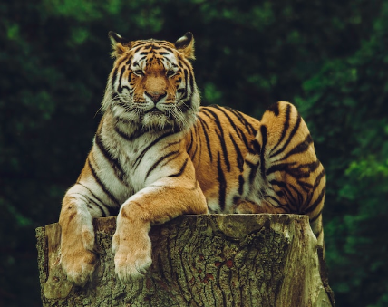
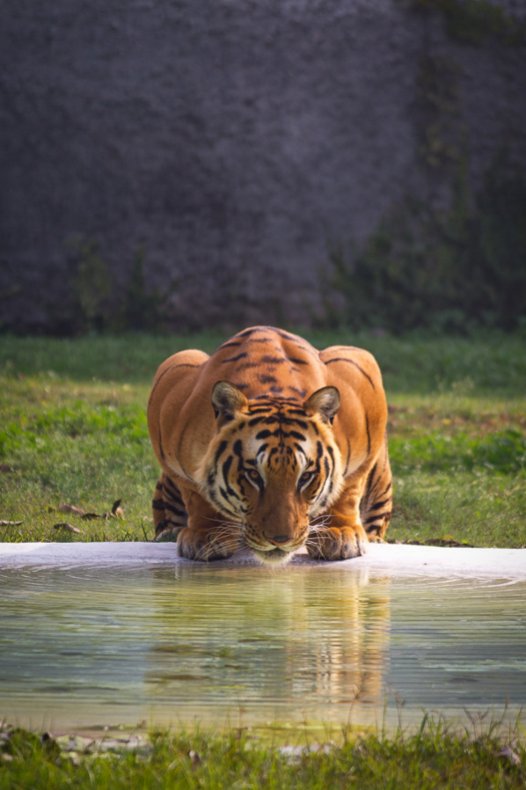
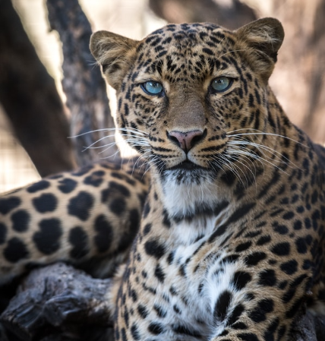

THE ART OF UNICORN SIGHTING
Tips and tricks for spotting the elusive unicorns in their natural habitat.
DRAGON TAMING TECHNIQUE
A guide to taming and caring for dragons in the realm of magic.

Slide 10






THE MAGIC OF DRAGONS: A RESEARCH
UNICORN SIGHTING
DRAGON TAMING
RAINBOW SEEING

Slide 11




PRICING PLAN
BASIC
ELITE
LEGENDARY
  Access to the entry-level dungeons.
  A limited number of quests and battles per month.
  Ability to form a small party with fellow adventurers.
  Access to the intermediate and advanced dungeons.
  A greater number of quests and battles
  Ability to form larger parties with fellow adventurers.
  Access to the most challenging dungeons and encounters.
  Unlimited quests and battles per month.
  The ability to form the largest parties with fellow adventurers.
$10/MONTH
$50/MONTH
$100/MONTH

Slide 12



S
W
ECLIPSE
OBTAIN
Rare event causes unpredictable magic.
Humans acquire Crystal
QUEST
FOUNDATION
Adventurers seek immortal artifact.
Shimmering City established
O
T
WAR
INVASION
Kingdoms clash in conflict.
Kingdom attacked by monsters.
TRANSFORMATION
BETRAYAL
Peasant discovers magical powers.
Queen's advisor revealed as spy.

Slide 13
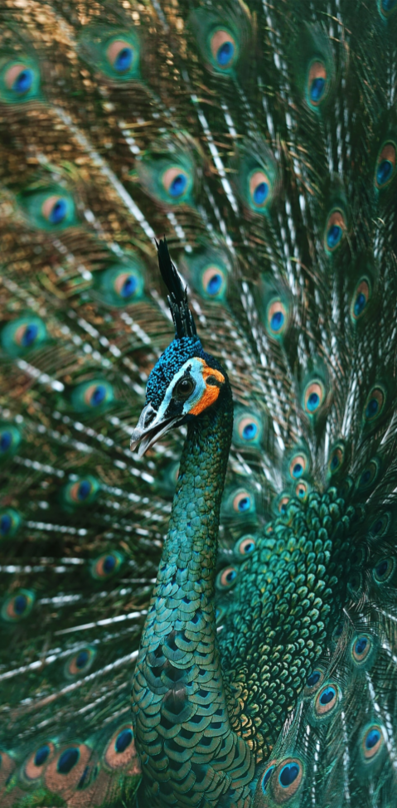
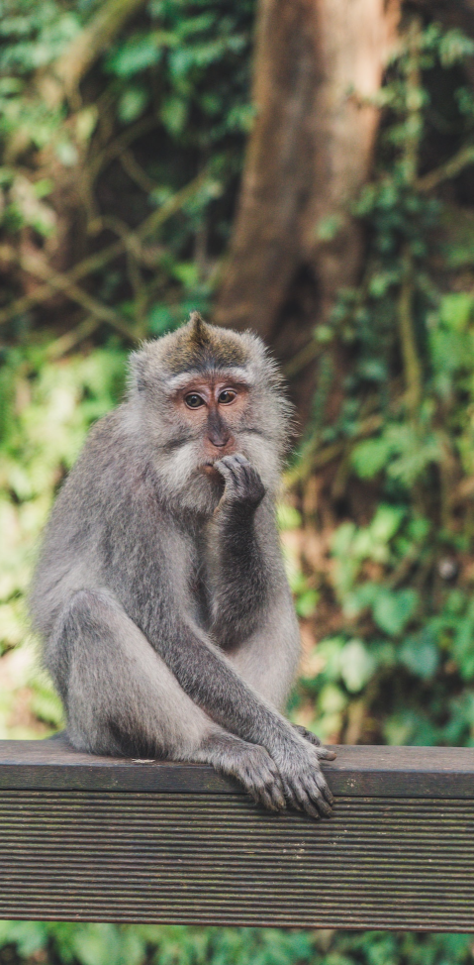
SOME DATA
75%
ENCHANTED CREATURES
possess the ability to cast spells.
60%
MAGIC-WIELDING INDIVIDUALS
practice the art of illusions.
90%
SPELLS CAST
are dark magic, foretelling danger.

Slide 14

234,567
Unicorn Sightings
A tally of the number of unicorns spotted in the fantasy realm.

Slide 15

233 COINS
85%
Treasure Found
Wished Granted
456 HOURS
535 KM
Duration of Spell Casting
Journey Distance

Slide 16





SOME GRAPH
100
90
80
70
60
50
34.574
40
30
Total
20
10
0
1
2
3
4
5
6
7
8

Slide 17

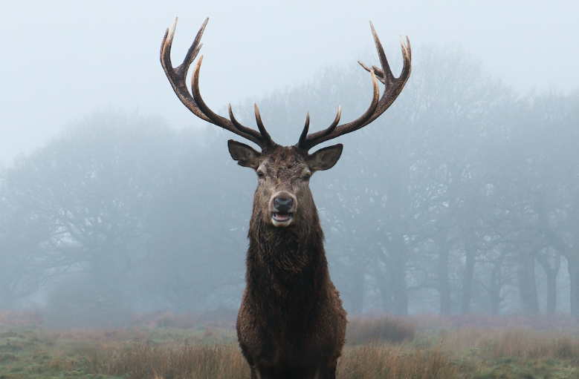
PORTAL TO ADVENTURE
A WEB APPLICATION
A web application designed for discovering the world of fantasy

Slide 18
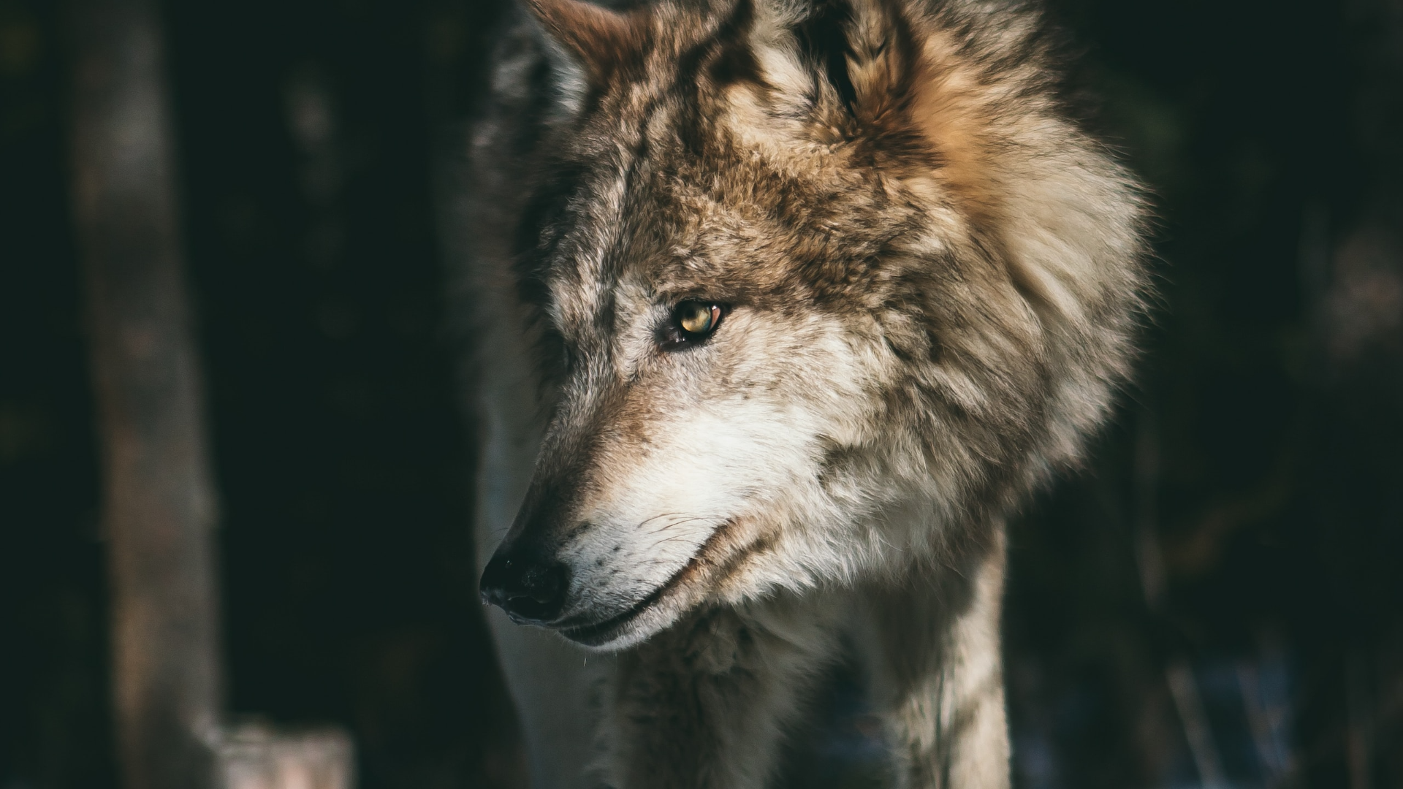
A MAGIC PICTURE

Slide 19
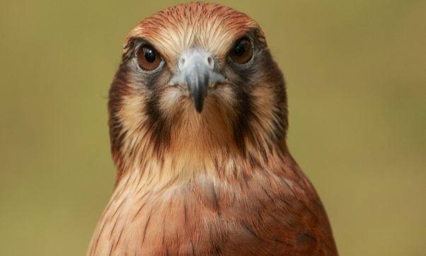
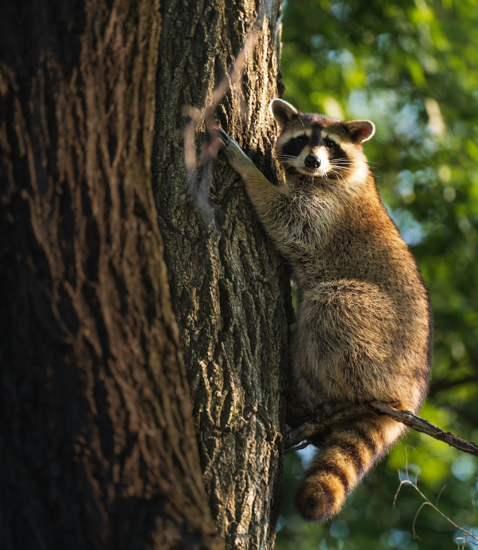
1
DISCOVER THE SECRETS
2
FIND YOUR OWN PATH
Explore the lush, vibrant forest and uncover the mysteries that lie within.
Choose your own path through the forest, and see where it takes you.
MEET THE CREATURES
UNCOVER THE MAGIC
3
4
Encounter the mythical creatures that call the forest home, from talking animals to fairies.
Learn about the powerful magic that pervades the forest and how it affects all who enter.

Slide 20









THE INFORMATION
SPELLCASTING
COMPETITION
A significant event in the history of the fantasy realm, in which the greatest spellcasters of the realm.
TREASURE
HUNT
A significant event in the history of the fantasy realm, in which a massive and awesome treasure hunt was organized.
GREAT
ADVENTURE
A notable year in the history of the fantasy realm, in which a large number of adventurers set out to explore.

Slide 21




OUR TEAM
ELDRUIN
LUNARIA
The Fire Mage
The Moon Priestess
ELEMENTALEN
ELDRUIN
The Guardian
The Fire Mage

Slide 22




THANK YOU FOR CHOOSING EATEMP
We offer free and high-quality slides templates for your presentations. We appreciate you choosing us and hope our templates have been helpful.
As a new website, we rely on your support to grow, so please help us by sharing our site with your friends and colleagues.
Credit | Image: Unsplash

