Slide 1

INDIA-CLIMATE

Slide 2
In this chapter we will study
Factors influence on climate of India
Seasons of India
Distribution of rainfall
Agriculture the gamble with monsoon

Slide 3
Tropical monsoon climate, because a greater part of India lies in a tropical zone and its climate is influenced by monsoon winds

Slide 4
Factors that influence on climate
Location
❖ Latitude
❖ Height from the sea level
❖ Distance from the sea
❖ Mountain ranges

Slide 5
❖ Direction of the winds
❖ Ocean currents
❖ Water bodies
❖ Relief features
❖ Monsoon winds

Slide 6
Climatic seasons
1. Summer season: March to May
2. South-west Monsoon season: June to Sept
3. Retreating monsoon season: October to Nov
4. Winter season: December to February

Slide 7
The winter season
❖ Annual rainfall is 2%
❖ During this season Jammu and Kashmir, Himachal Pradesh and the North Indian plains witness very low temperature.

Slide 8

Heavy snowfall occurs.
❖ South India, temperature is normal and the climate is very pleasant

Slide 9
The summer season
❖ Sun rays are perpendicular over the north hemisphere hence temperature is high in India
❖ Climatic condition is usually hot dry and sultry. Days are quite long
❖ The highest temperature records at 52 degree Celsius in Ganganagar

Slide 10
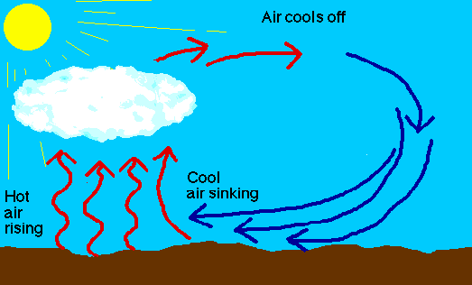
❖ Convectional rainfall takes place in some parts of India
❖ 10 % Rainfall takes place

Slide 11
Summer season rainfall is called……
❖ Andhis in Uttar Pradesh
❖ Kalabaisaki in West Bengal
❖ Mango Shower in Kerala
❖ Coffee blossom in Karnataka

Slide 12
The rainy season
❖ It is also called as South West monsoon season
❖ Since the temperature rises a low pressure area develop Central India high pressure creates over Indian Ocean
❖ Moisture Laden winds blow from southwest towards India 75% rainfall caused during this season

Slide 13
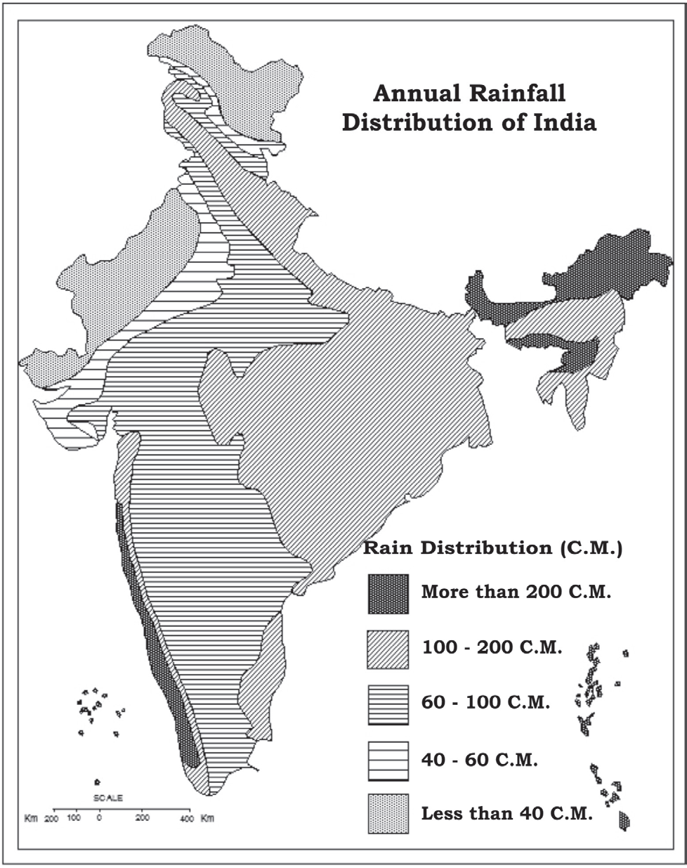

Low pressure
Moist laden winds blow from Arabian sea
Towards north east
high pressure

Slide 14
❖ there are two branches of Southwest monsoon season Arabian Sea branch and Bay of Bengal branch
❖ Heavy rainfall takes place on Western Ghat and decrease towards east

Slide 15
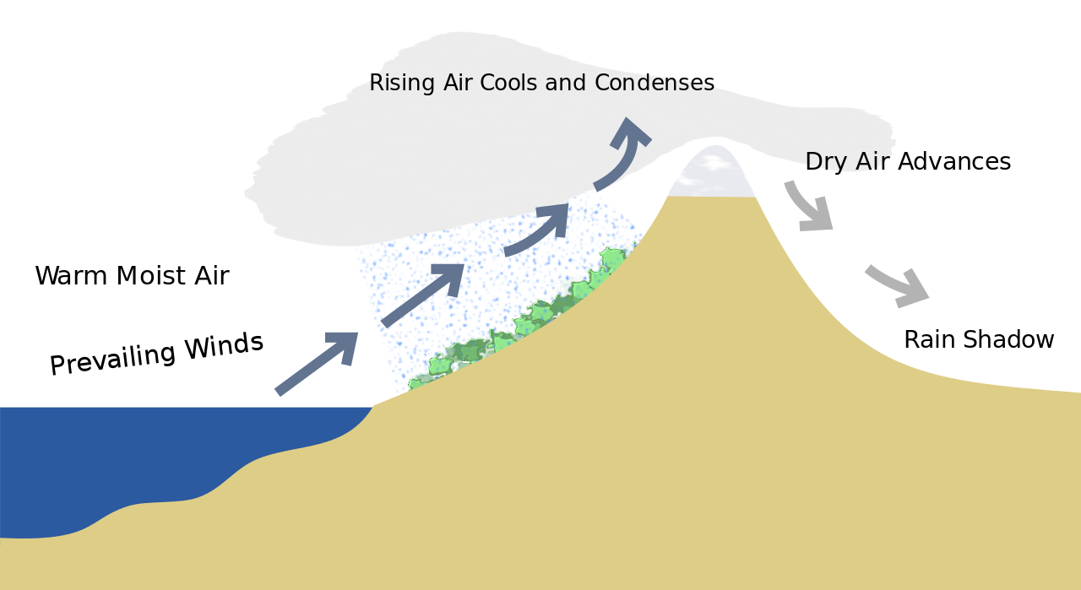
The eastern regions of the Western Ghats are called rain-shadow regions

Slide 16
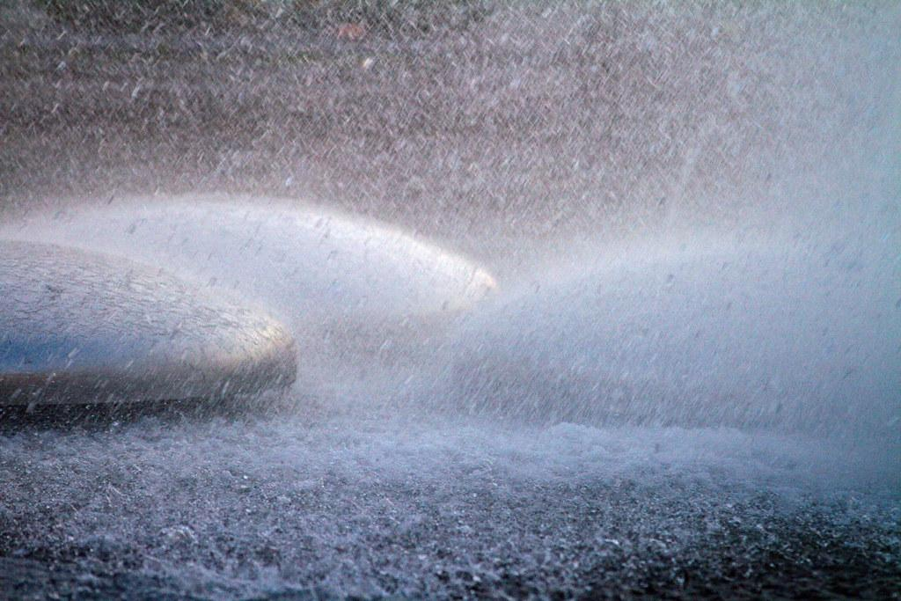
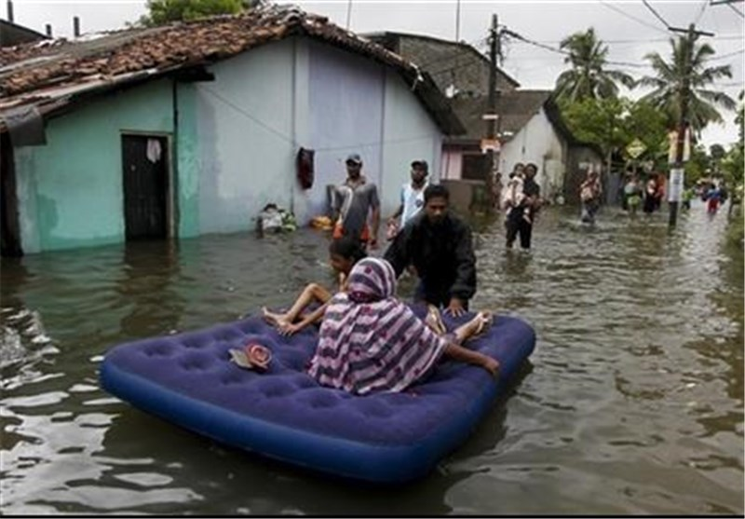
❖ Heavy rainfall takes place in Bengal branch. Mawsynram in Meghalaya foothills of Himalaya and Assam

Slide 17
The retreating monsoon season
❖ In early October due to decrease in temperature low pressure area replaced by high pressure area over land mass.
❖ A low pressure area developed over Bay of Bengal shore winds blow from north east direction to southwest

Slide 18
High pressure
The retreating monsoon season
Low pressure

Slide 19
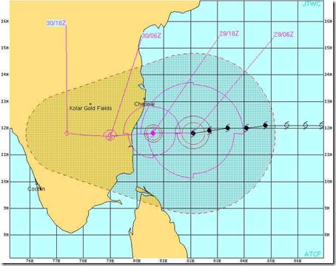
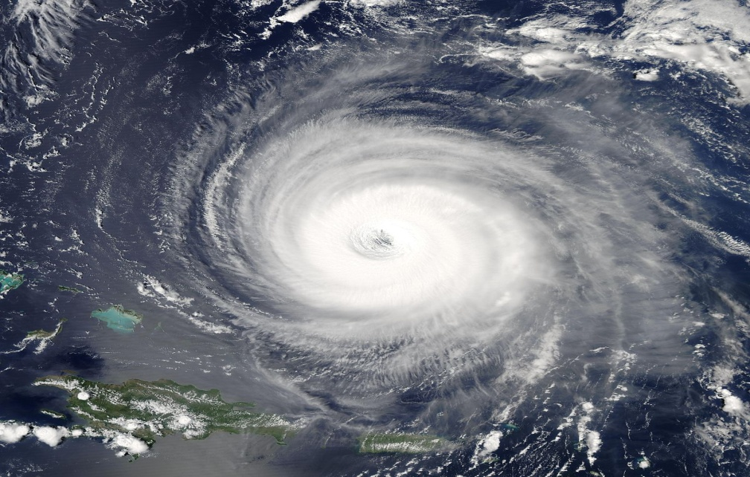
❖ It is a season of unsettled weather condition
❖ India receive 13 % rainfall
❖ Tropical cyclones frequently occur in the Bay of Bengal during this season

Slide 20
Distribution of rainfall
❖ The country’s average rainfall is 118 cms
Areas with low rainfall; less than 50 cm
Western Kutch Thar Desert Rajasthan Punjab Haryana and Gujarat. Royli in Jaisalmer district Rajasthan receives 8.3 CM rainfall

Slide 21
2. Medium rainfall 50 to 250 CM
Northern Punjab to Kanyakumari.areas between West and East Ghat . West peninsular India

Slide 22
3. Heavy rainfall: 250 cm more
Narrow belt in western Ghat , Jammu hills , Himachal Pradesh, Bihar, west Bengal , North east India . Mawsynram get highest rainfall in the country

Slide 23
Indian agriculture is a “gamble with the monsoons”
• Climatic condition of a country has a great influence on its economy
• monsoons control the agriculture of India which is the main occupation of Indians
• Failure of rainfall leads to drought
• When the monsoons are heavy there are floods they also cause to destruction to life and property.

Slide 24


Thank you
Prepared by:
Praveen Banakar

