Slide 1
Let’s Explore your Chromebook
By Kim Mattina
GTMS Technology Teacher
Google Certified Trainer

Slide 2
What is a Chromebook?
A Chromebook is a device that connects to the Internet and is designed to be used with a Google account.
A user can access all of the G Suite apps that are available on the school Google domain.

Slide 3
Why is it different?
It does not have a large hard drive so it is not meant to have programs installed on it.
It does not have a CD Drive.
It is lightweight and able to process and access information quickly.

Slide 4
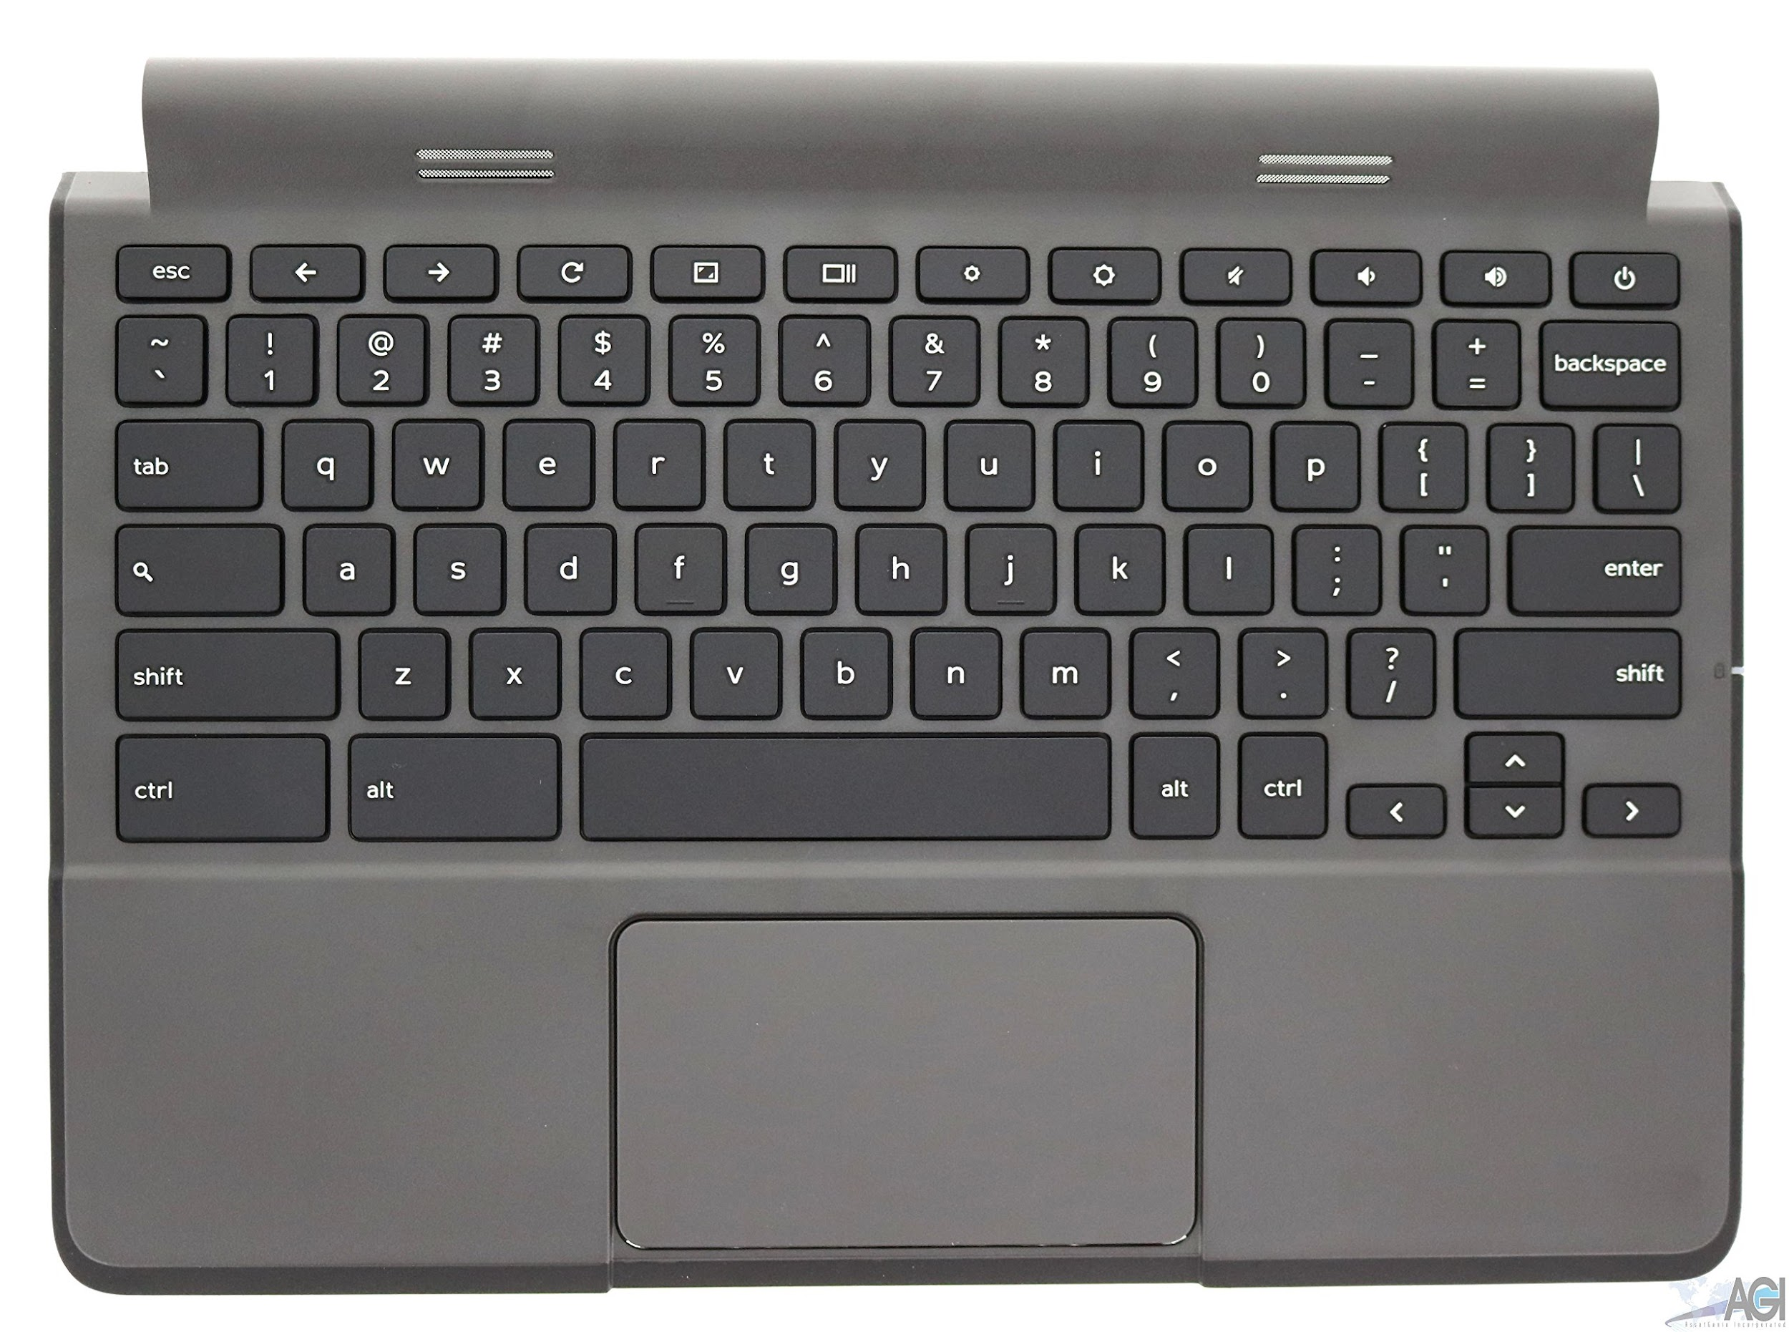
The Keyboard

Slide 5
Keyboard is Different!
There is no:
DELETE key
CAPS lock key
HOME and END keys
Get to know keyboard shortcuts.
Click this link to find more help with keyboard shortcuts

Slide 7
Common Keyboard Shortcuts
Press and hold down the CTRL key and the letter
COPY - CTRL + C
PASTE - CTRL + V
CUT - CTRL + X
Undo - CTRL + Z
Keyboard help - CTRL + ALT + ?

Slide 8


Keyboard Shortcuts
No DELETE Key - instead use:
ALT + Backspace - deletes a character ahead of the cursor
CTRL + Backspace - deletes a previous word
No CAPS LOCK key - instead use:
ALT + Search key
Toggle it again to disable it
+

Slide 9
Keyboard Shortcuts
No HOME Key - instead use:
ALT + Up Arrow
No END key - instead use:
ALT + Down arrow

Slide 10


Keyboard Shortcuts
Whole Screenshot
Partial Screenshot

Slide 11
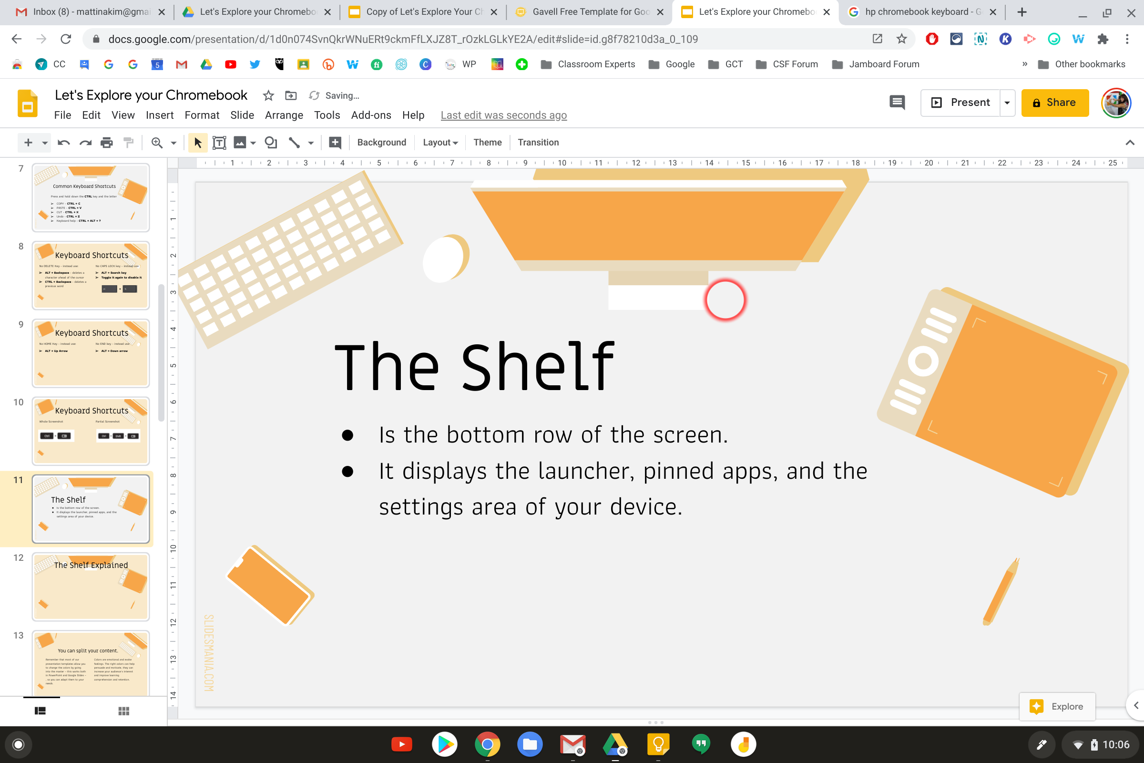
The Shelf
Is the bottom row of the screen.
It displays the launcher, any pinned apps, and the settings area of your device.
Pinned apps for quick access
Access your device settings, accessibility, and wifi network
This will open the apps launcher and display any apps that are installed in your account.

Slide 12
The Touchpad Shortcuts
There are no buttons on the touchpad! 😲
Instead you will need to know touchpad shortcuts to navigate your session on the Chromebook.

Slide 13
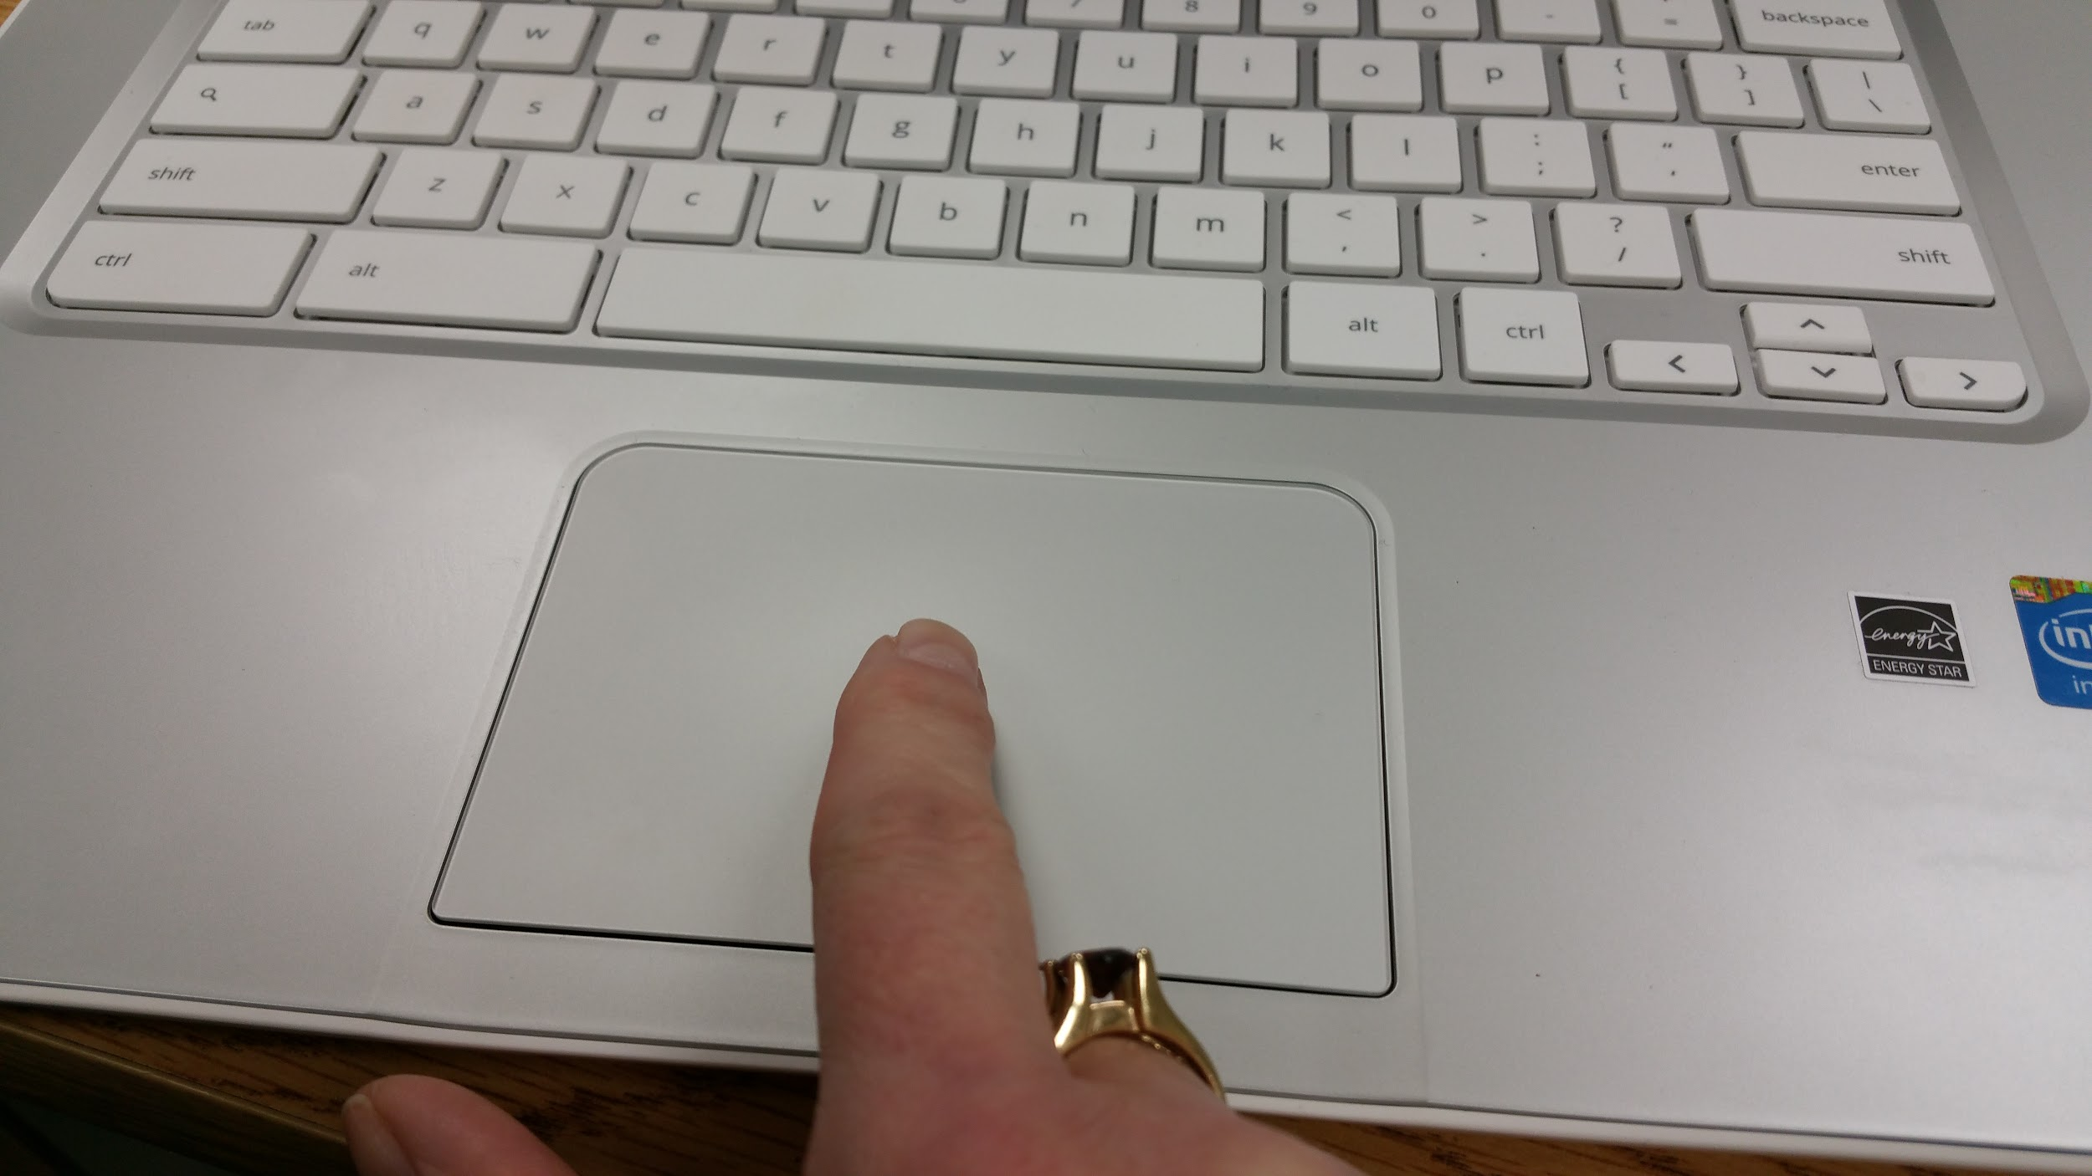
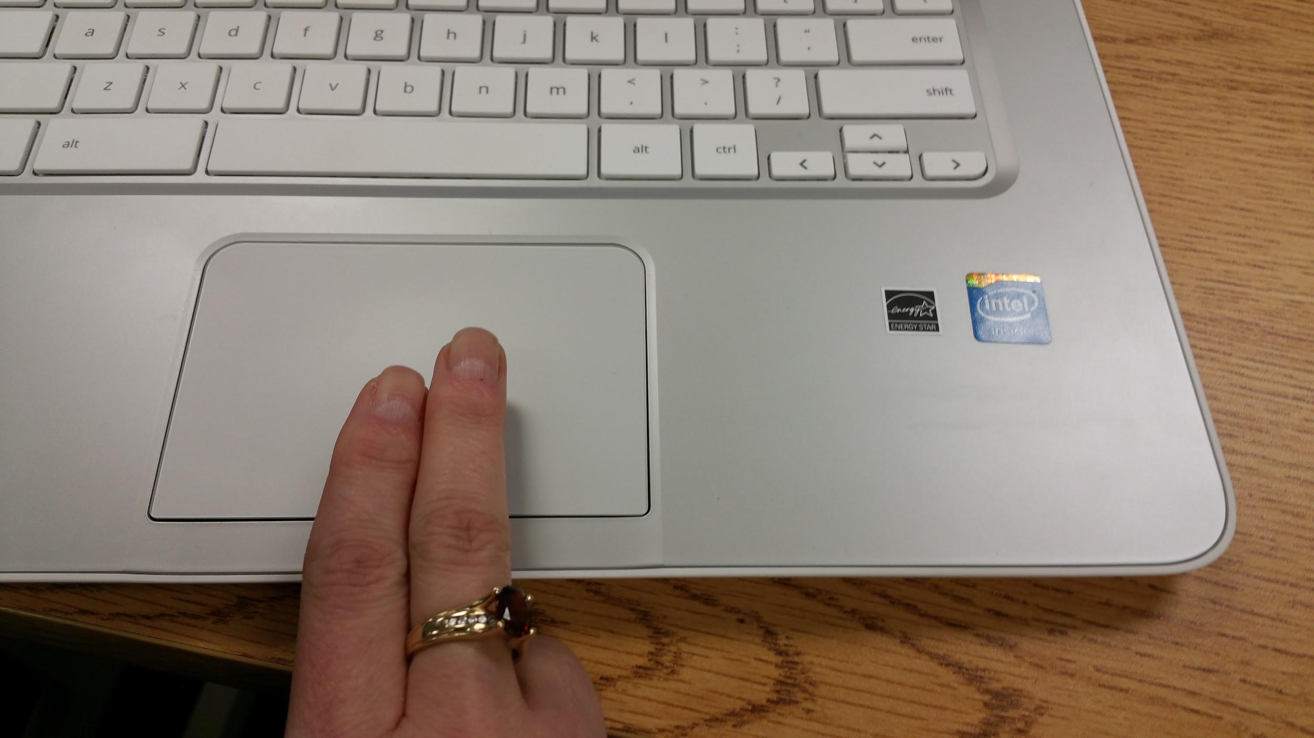
Touchpad Shortcuts
To Single Click - TAP the touchpad ONCE with ONE finger.
To RIGHT Click - TAP the touchpad ONCE with TWO fingers

Slide 14
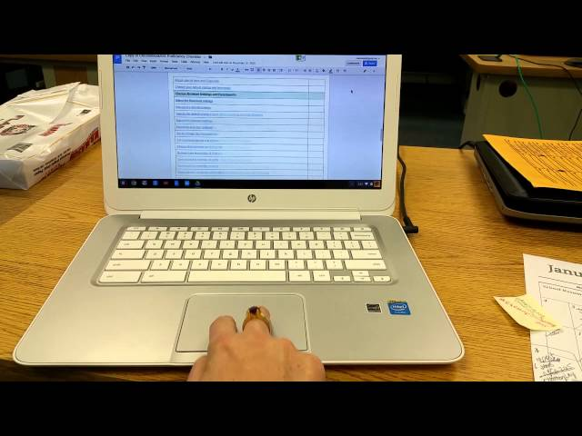
Scrolling!
Place TWO fingers on the touchpad and move them up and down to scroll vertically.
Place TWO fingers on the touchpad and move them left to right to scroll horizontally.

Slide 15
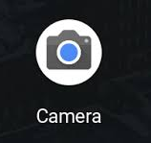
Activate the Camera App
On your Chromebook there is a built in camera that you can access to take pictures of your work or to create videos.
To access the camera, click on the LAUNCHER button at the bottom left corner
Follow the directions provided.

Slide 16

Chrome Web store and Extensions
A Chrome extension is a mini application that can be downloaded from the Chrome web store.
Once it is installed, the icons can be seen at the top right side of the browser.
Click here to access to the Chrome webstore

Slide 17
Thank you!

Slide 18
Credits
Presentation Template: SlidesMania
Images: Unsplash
Please keep this slide or mention us and the other resources used in the footer of a slide.

