Slide 1
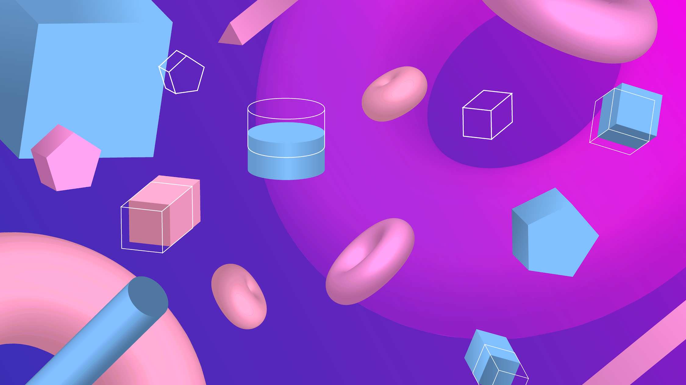
3D BACKGROUND
Here is where your presentation begins!

Slide 2

CONTENTS OF THIS TEMPLATE
Here’s what you’ll find in this PlantillasPowerPoint.org template:
  A slide structure based on a multi-purpose presentation, which you can easily adapt to your needs.
  An assortment of graphic resources that are suitable for use in the presentation can be found in the alternative resources slide.
  A thanks slide, which you must keep so that proper credits for our design are given.
  A resources slide, where you’ll find links to all the elements used in the template.
  Instructions for use.
  Final slides with:
  The fonts and colors used in the template.
  A selection of illustrations. You can also customize and animate them as you wish with the online editor. Visit Storyset to find more.
  More infographic resources, whose size and color can be edited.
  Sets of customizable icons of the following themes: general, business, avatar, creative process, education, help & support, medical, nature, performing arts, SEO & marketing, and teamwork.
  You can delete this slide when you’re done editing the presentation.

Slide 3

WHOA!
This can be the part of the presentation where you can introduce yourself, write your email…

Slide 4

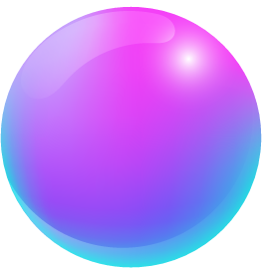

WHOA!
This can be the part of the presentation where you can introduce yourself, write your email…

Slide 5


“This is a quote, words full of wisdom that someone important said and can make the reader get inspired.”
—SOMEONE FAMOUS

Slide 6


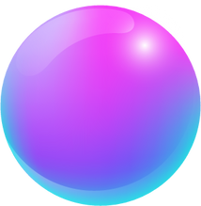


“This is a quote, words full of wisdom that someone important said and can make the reader get inspired.”
—SOMEONE FAMOUS

Slide 7

02
03
04
01
INTRODUCTION
PRESENTATION
ANALYSIS
CONCLUSION
Here you can describe the topic of the section
Here you can describe the topic of the section
Here you can describe the topic of the section
Here you can describe the topic of the section

Slide 8



01
INTRODUCTION
You can describe the topic of the section here
02
PRESENTATION
Here you can describe the topic of the section
03
ANALYSIS
Here you can describe the topic of the section

Slide 9



01
THIS IS A GREAT HEADLINE
You can enter a subtitle here if you need it

Slide 10
THE SLIDE TITLE GOES HERE!
Do you know what helps you make your point clear?
Lists like this one:
  They’re simple
  You can organize your ideas clearly
  You’ll never forget to buy milk!
  And the most important thing: the audience won’t miss the point of your presentation

Slide 11



FEATURES OF THE TOPIC
VENUS
JUPITER
  Venus has a beautiful name
  It’s the second planet from the Sun
  It’s terribly hot, even hotter than Mercury
  It’s atmosphere is extremely poisonous
  Jupiter is a gas giant
  It’s the biggest planet in the Solar System
  It's the fourth-brightest object
  It was named after the Roman god

Slide 12


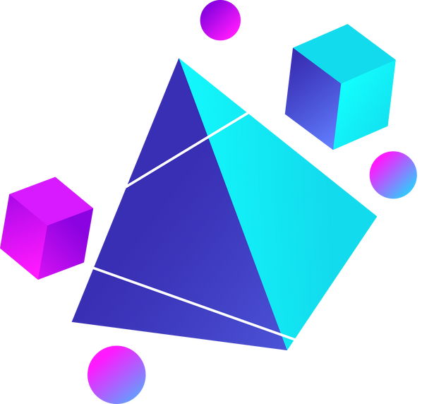
MAYBE YOU NEED TO DIVIDE THE CONTENT
JUPITER
VENUS
Jupiter is a gas giant, the biggest planet in the Solar System and the fourth-brightest object in the sky
Venus has a beautiful name and is the second planet from the Sun. It’s terribly hot, even hotter than Mercury

Slide 13
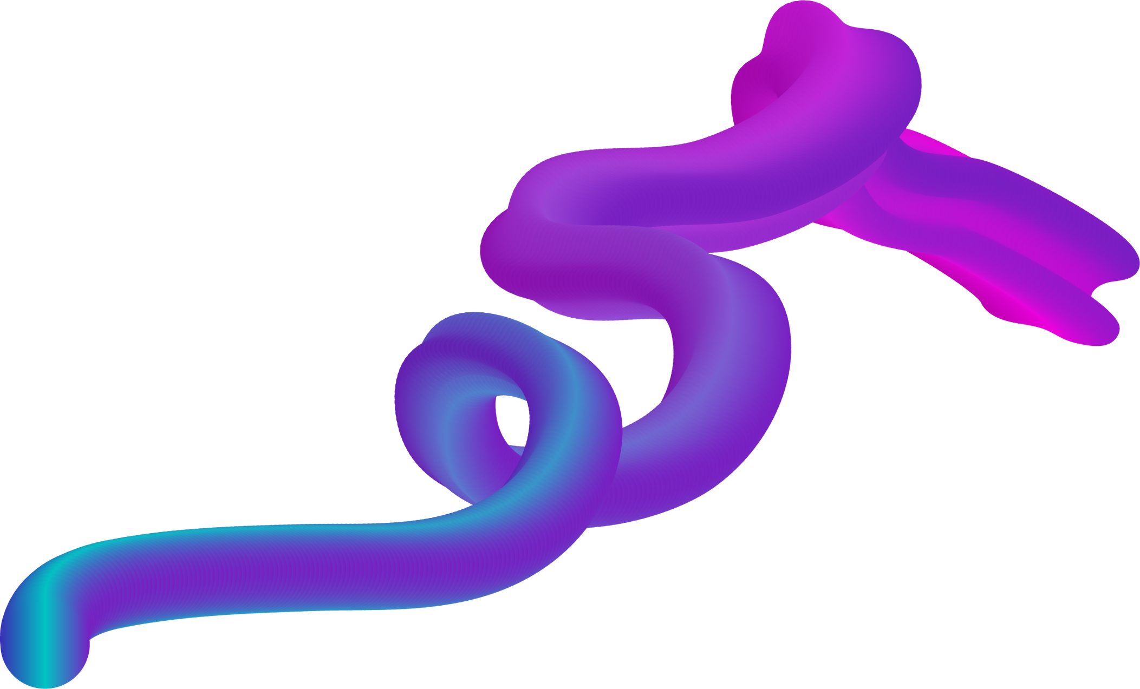

PERCENTAGES ABOUT THIS TOPIC
VENUS
MERCURY
Venus has a beautiful name and is the second planet
It’s the closest planet to the Sun in the Solar System
100%
100%
80%
70%
50%
10%
Mercury
Saturn
Venus
Neptune
Jupiter
Mars

Slide 14


YOU COULD USE THREE COLUMNS, WHY NOT?
MARS
JUPITER
SATURN
Despite being red, Mars is actually a cold place full of iron oxide dust
Jupiter is a gas giant and also the biggest planet in the entire Solar System
Saturn is a gas giant and is composed mostly of hydrogen and helium

Slide 15




THREE EXTRAS COLUMNS
MERCURY
VENUS
It’s the closest planet to the Sun and the smallest
Venus has a beautiful name and is the second planet
EARTH
Earth is the third planet from the Sun

Slide 16

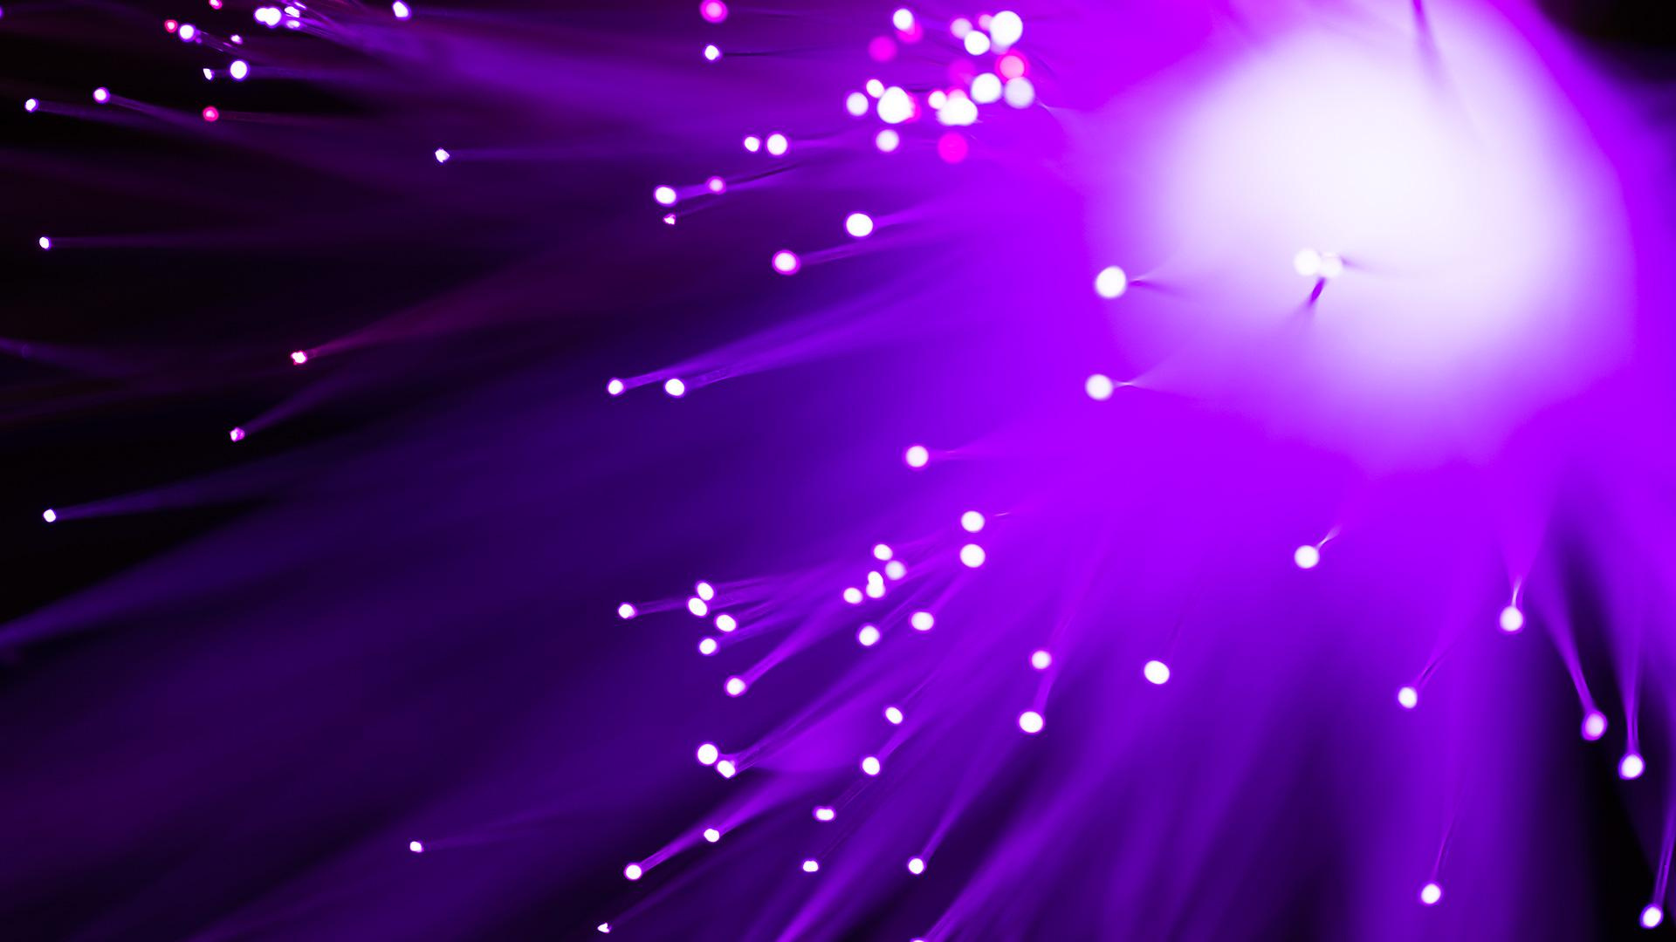
A PICTURE ALWAYS REINFORCES THE CONCEPT
Mercury is the closest planet to the Sun and the smallest one in the Solar System—it’s only a bit larger than the Moon. The planet’s name has nothing to do with the liquid metal, since Mercury was named after the Roman messenger god

Slide 17
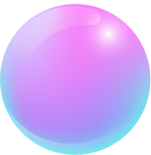
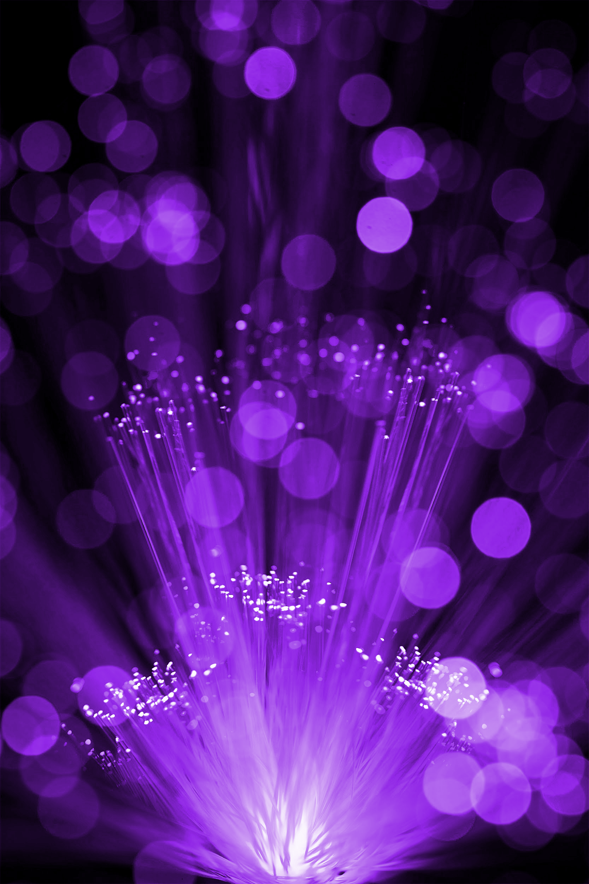
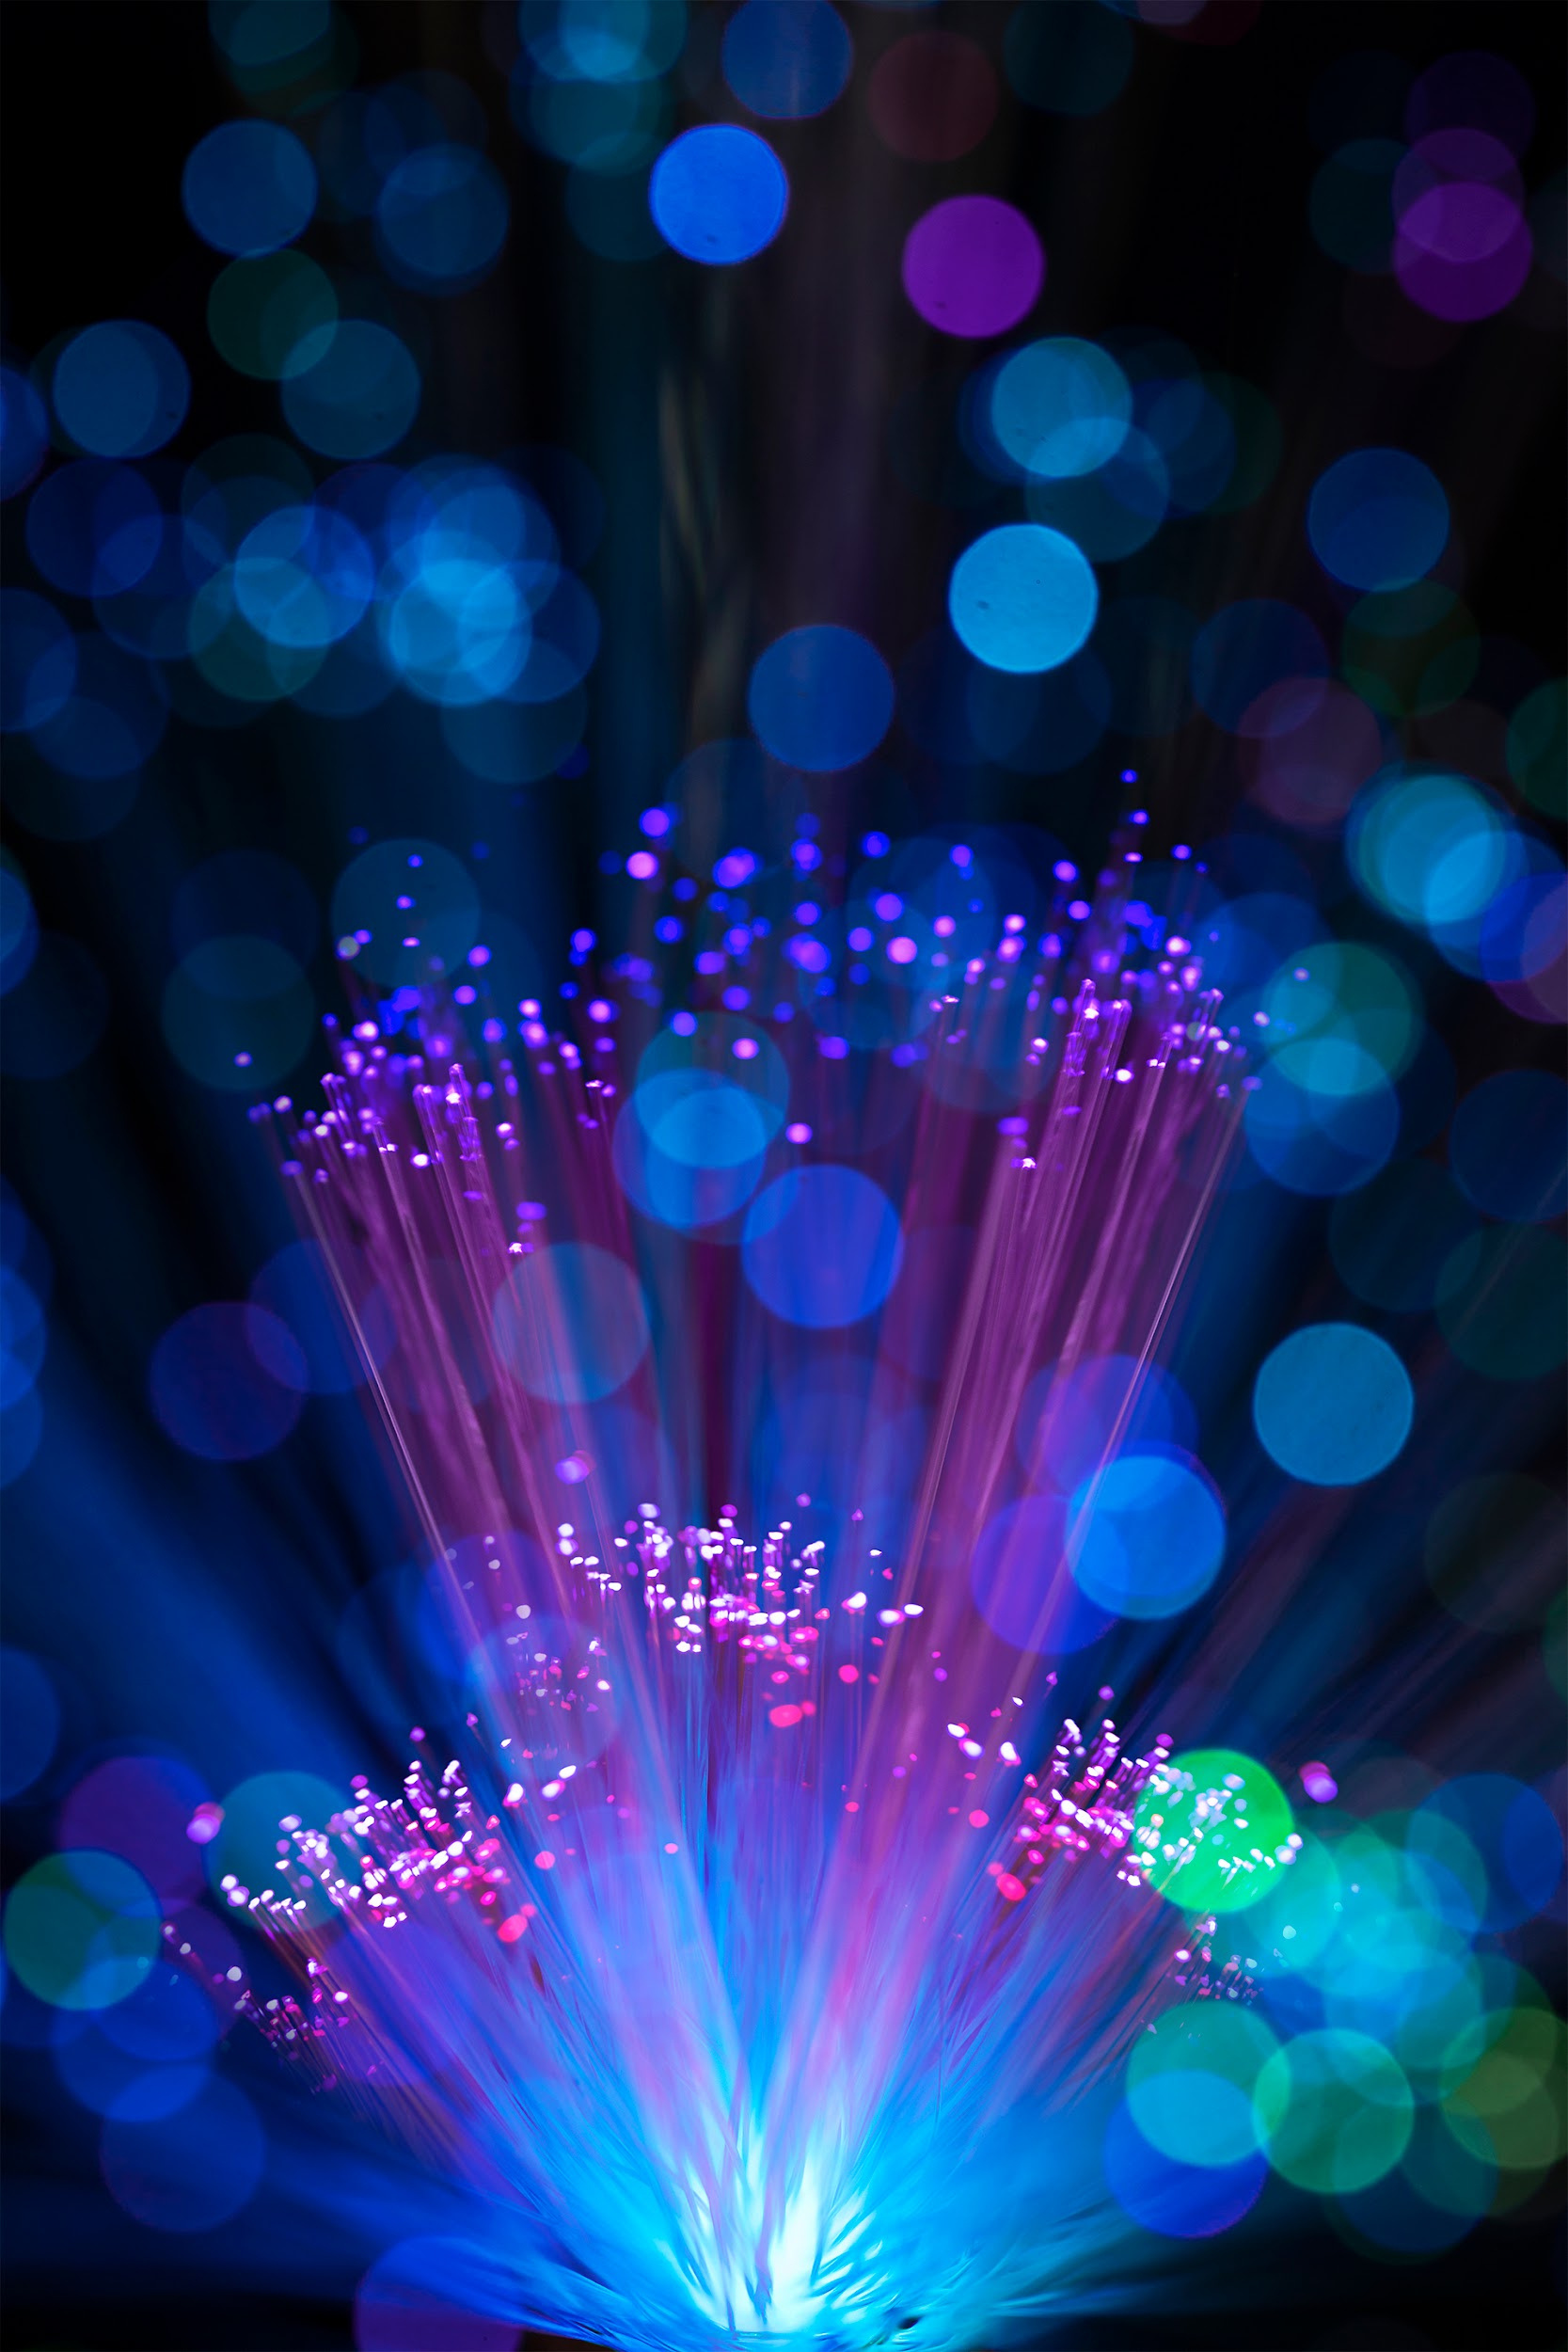

A PICTURE ALWAYS REINFORCES THE CONCEPT
Images reveal large amounts of data, so remember: use an image instead of a long text. Your audience will appreciate that

Slide 18
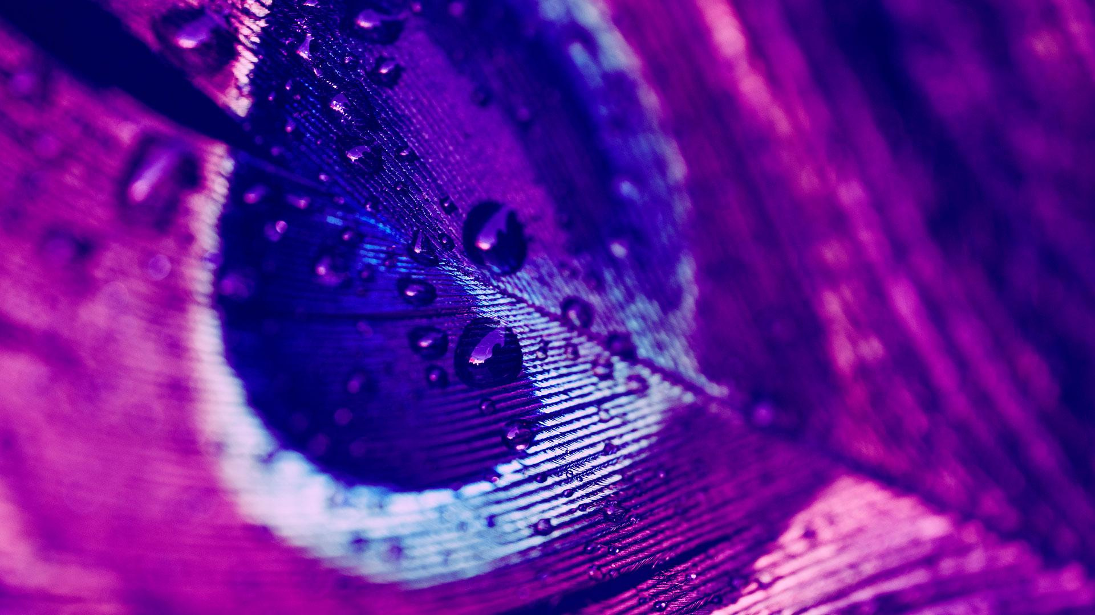
A PICTURE IS WORTH A THOUSAND WORDS

Slide 19
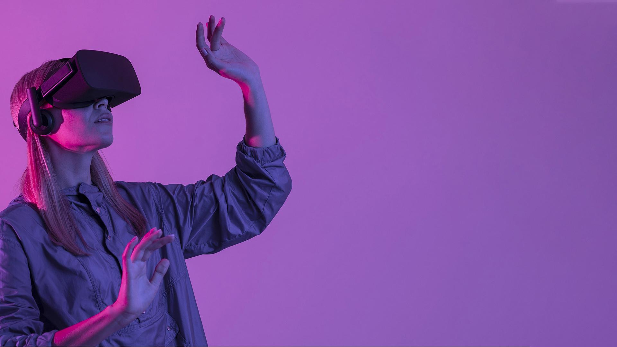
A PICTURE IS WORTH A THOUSAND WORDS

Slide 20

PERHAPS YOU NEED SEVERAL STEPS
01
02
03
VENUS
MARS
SATURN
Venus has a beautiful name and is the second planet from the Sun
Despite being red, Mars is actually a cold place full of iron oxide dust
Saturn is a gas giant composed mostly of hydrogen and helium

Slide 21

PERHAPS YOU NEED SEVERAL STEPS
SATURN
VENUS
01
02
Saturn is a gas giant and has several rings
Venus is the second planet from the Sun
MARS
EARTH
04
03
Despite being red, Mars is actually a cold place
Earth is the third planet from the Sun

Slide 22
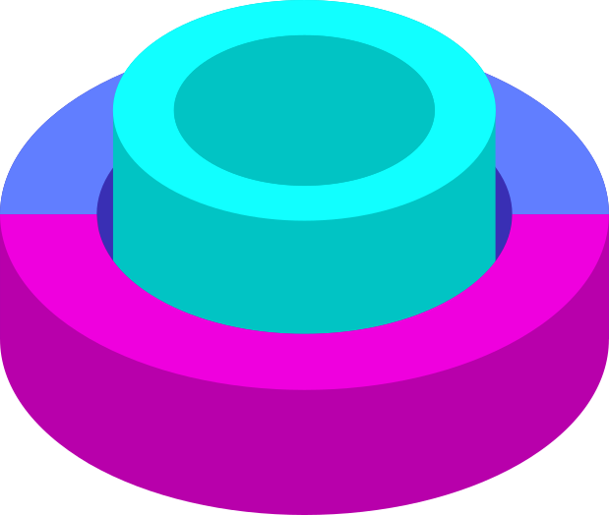
SOMETIMES, REVIEWING CONCEPTS IS A GOOD IDEA
01
MARS
Despite being red, Mars is actually very a cold
02
NEPTUNE
Neptune is the farthest planet from the Sun
03
THE SUN
The Sun is the star at the center of the Solar System

Slide 23

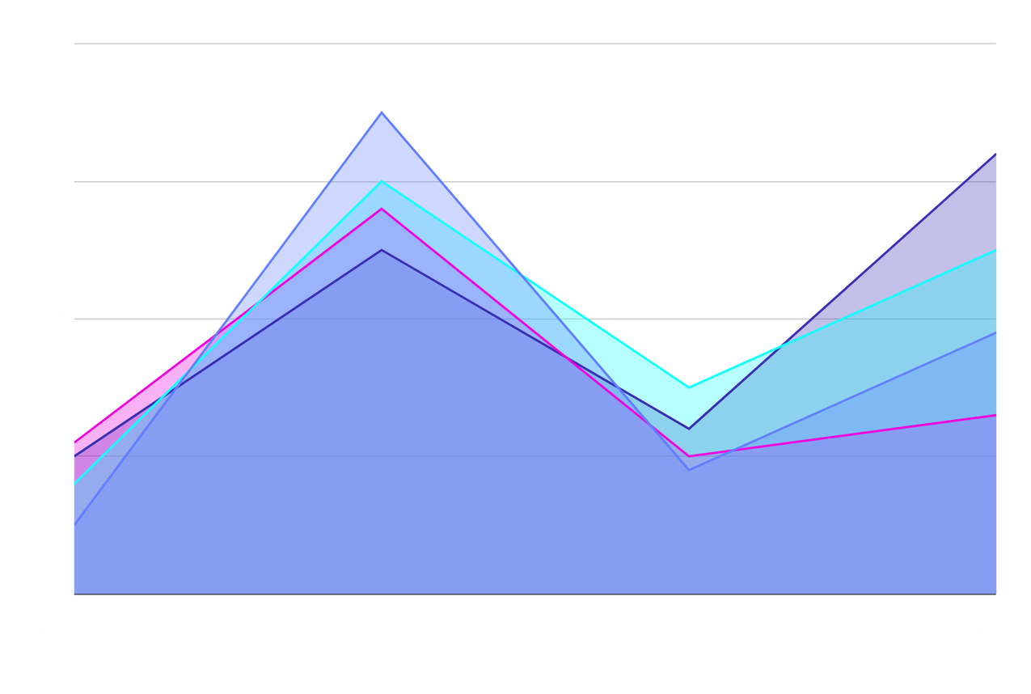
YOU CAN ADD YOUR GRAPH HERE
JUPITER
To modify this graph, click on it, follow the link, change the data and paste the resulting graph here!

Slide 24
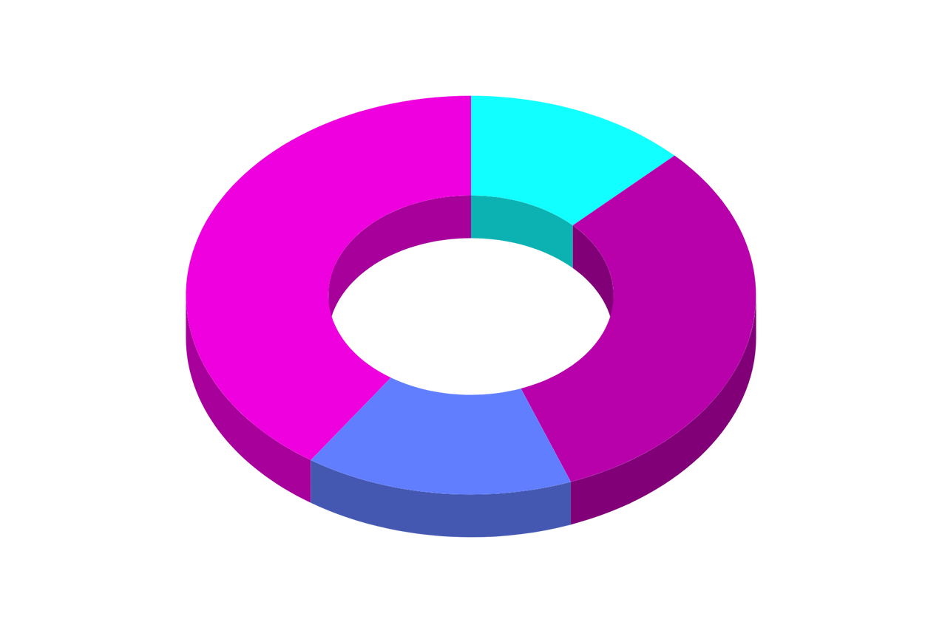
THIS IS A GRAPH
SATURN
13%
VENUS
Saturn is a huge gas giant in the Solar System
Venus is the second planet from the Sun
40%
32%
MARS
EARTH
15%
Despite being red, Mars is a cold place
Earth is the third planet from the Sun
To modify this graph, click on it, follow the link, change the data and paste the resulting graph here!

Slide 25

02
PRESENTATION
You can enter a subtitle here if you need it

Slide 26





INFOGRAPHICS MAKE YOUR IDEA UNDERSTANDABLE
80%
60%
40%
20%
VENUS
MARS
MERCURY
SATURN
Venus is the second planet from the Sun
Mars is a cold place full of iron oxide dust
Mercury is the closest planet to the Sun
Saturn is composed of hydrogen and helium

Slide 27




INFOGRAPHICS MAKE YOUR IDEA UNDERSTANDABLE
VENUS
MERCURY
MARS
JUPITER
Venus is the second planet from the Sun
Mercury is the closest planet to the Sun
Despite being red, Mars is a cold place
Jupiter is a gas giant and the biggest planet
20%
50%
45%
90%

Slide 28
THESE ARE PERCENTAGES
45%
30%
MARS
VENUS
Despite being red, Mars is actually a cold place
Venus is the second planet from the Sun
15%
10%
SATURN
MERCURY
Saturn is composed of hydrogen and helium
Mercury is the closest planet to the Sun

Slide 29

LET’S USE INFOGRAPHICS!
MERCURY
It’s the closest planet to the Sun and the smallest one in the Solar System
JUPITER
Jupiter is a gas giant and the biggest planet in the Solar System
NEPTUNE
It's also the fourth-largest object by diameter in the Solar System

Slide 30



THIS IS AN INFOGRAPHIC
VENUS
Venus has a beautiful name and is the second planet from the Sun. It’s terribly hot
MERCURY
It is the closest planet to the Sun and the smallest one in the Solar System

Slide 31
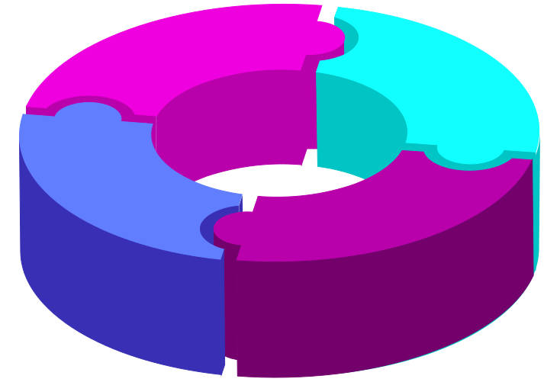
ANOTHER INFOGRAPHIC
THE SUN
VENUS
It’s the star at the center of the Solar System
Venus is the second planet from the Sun
SATURN
MERCURY
Saturn is composed of hydrogen and helium
Mercury is the closest planet to the Sun

Slide 32
03
ANALYSIS
Here you can describe the topic of the section

Slide 33
AND THE SAME GOES FOR TABLES
DAY 1 | DAY 2 | DAY 3
Mars | Saturn | Earth
Mercury | Jupiter | Ceres
Venus | Neptune | Pluto

Slide 34






AWARDS
 | 1ST AWARDS | 2ND AWARD | 3RD AWARD | 4TH AWARD | 5TH AWARD
2013
2016
2018
Neptune
Jupiter
Mercury

Slide 35
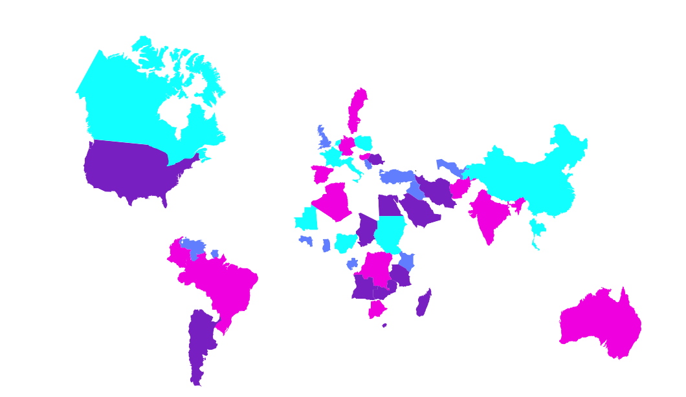
THIS IS A MAP
MERCURY
VENUS
MARS
JUPITER
SATURN
NEPTUNE
Neptune is the farthest planet from the Sun and the fourth-largest by diameter in the Solar System

Slide 36









REVIEWS
JOHN DOE
JAMES PATT
“ Mars is actually a very cold place”
“It has a nice name and is the second planet”
JENNA DOE
LENA JAMES
“Jupiter is a gas giant and the biggest planet”
“Earth is the third planet from the Sun”

Slide 37

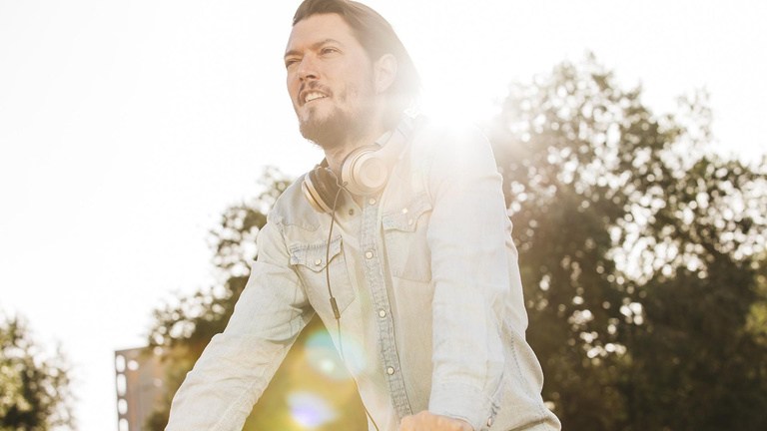

OUR TEAM
JOHN DOE
JANE PATTERSON
You can replace the image on the screen with your own
You can replace the image on the screen with your own

Slide 38





OUR TEAM
JOHN PATT
TIMMY JIMMY
MARK PATT
Here you can talk a bit about this person
Here you can talk a bit about this person
Here you can talk a bit about this person
JOHN DOE
JENNA ROE
Here you can talk a bit about this person
Here you can talk a bit about this person

Slide 39
HERE YOU HAVE FOUR COLUMNS
MERCURY
JUPITER
Mercury is the smallest planet in the Solar System
Jupiter is the biggest planet in the Solar System
VENUS
MARS
Venus is the second planet from the Sun
Despite being red, Mars is actually a cold place

Slide 40




YOU CAN DIVIDE THE INFORMATION IN FOUR COLUMNS
VENUS
MERCURY
Venus has a beautiful name and is the second planet
It is the closest planet to the Sun and the smallest
JUPITER
MARS
Jupiter is a gas giant and the biggest planet
It is actually a cold place. It's full of iron oxide dust

Slide 41
04
CONCLUSION
Here you can describe the topic of the section

Slide 42


A TIMELINE ALWAYS WORKS WELL
MARS
MERCURY
VENUS
NEPTUNE
Despite being red, Mars is actually a cold place
Mercury is the closest planet to the Sun
Venus is the second planet from the Sun
Neptune is the farthest planet from the Sun

Slide 43






THIS IS A TIMELINE!
MARS
SATURN
JUPITER
NEPTUNE
Despite being red, Mars is a cold place
Saturn is a gas giant and has several rings
It’s the biggest planet in the Solar System
Neptune is the farthest planet from the Sun

Slide 44
HOW ABOUT THESE PERCENTAGES?
MARS
60%
Despite being red, Mars is actually a cold place full of iron oxide dust
VENUS
70%
Venus has a beautiful name, but it’s terribly hot, even hotter than Mercury
NEPTUNE
50%
Neptune is the fourth-largest planet by diameter in the Solar System

Slide 45

TIMING
MARCH
01
02
03
04
05
06
07
09
It’s the biggest planet
08
09
10
11
12
13
14
17
It’s the ringed one
15
16
17
18
19
20
21
19
It’s the farthest planet
22
23
24
25
26
27
28
23
It’s the closest planet
29
30
01

Slide 46
DO YOU PREFER THESE OTHER PERCENTAGES?
90%
80%
70%
50%
70%
VENUS
EARTH
MERCURY
SATURN
Venus is the second planet from the Sun
Earth is the planet where we live on
Mercury is the closest planet to the Sun
Saturn is composed of hydrogen and helium

Slide 47
ANOTHER PERCENTAGES
127
MERCURY
It’s the closest planet to the Sun
234
JUPITER
Jupiter is a gas giant and the biggest
130
NEPTUNE
It's also the fourth-largest object
236
THE SUN
A
B
C
D
It’s the star at the center

Slide 48

4,498,317,465
Big numbers catch your audience’s attention

Slide 49



150
Big numbers catch your audience’s attention

Slide 50
333,000.00
earths is the Sun’s mass
24h 37m 23s
is Jupiter’s rotation period
386,000 km
distance between Earth and the Moon

Slide 51



10,000
15,000
Venus is the second planet from the Sun
Jupiter is the biggest planet of them all
5,000
2,000
It’s composed of hydrogen and helium
It’s the farthest planet from the Sun

Slide 52






REVIEWING CONCEPTS IS A GOOD IDEA
MARS
VENUS
MERCURY
Despite being red, Mars is actually a cold place
Venus is the second planet from the Sun
Mercury is the smallest planet in the Solar System
JUPITER
SATURN
NEPTUNE
Jupiter is the biggest planet in the Solar System
Saturn is composed mostly of hydrogen and helium
Neptune is the fourth-largest planet in the Solar System

Slide 53



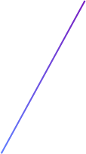


AWESOME WORDS

Slide 54



OUR SERVICES
$35
$60
$85
BASIC
PRO
PREMIUM
You can explain your product or your service
Characteristic
Characteristic
You can explain your product or your service
Characteristic
Characteristic
You can explain your product or your service
Characteristic
Characteristic

Slide 55







OUR SERVICES
BASIC
PREMIUM
It’s the closest planet to the Sun
It’s the biggest planet in the Solar System
$35
$95
PRO
EXTRA PREMIUM
Mars is actually a very cold place
It’s the farthest planet from the Sun
$50
$120

Slide 56
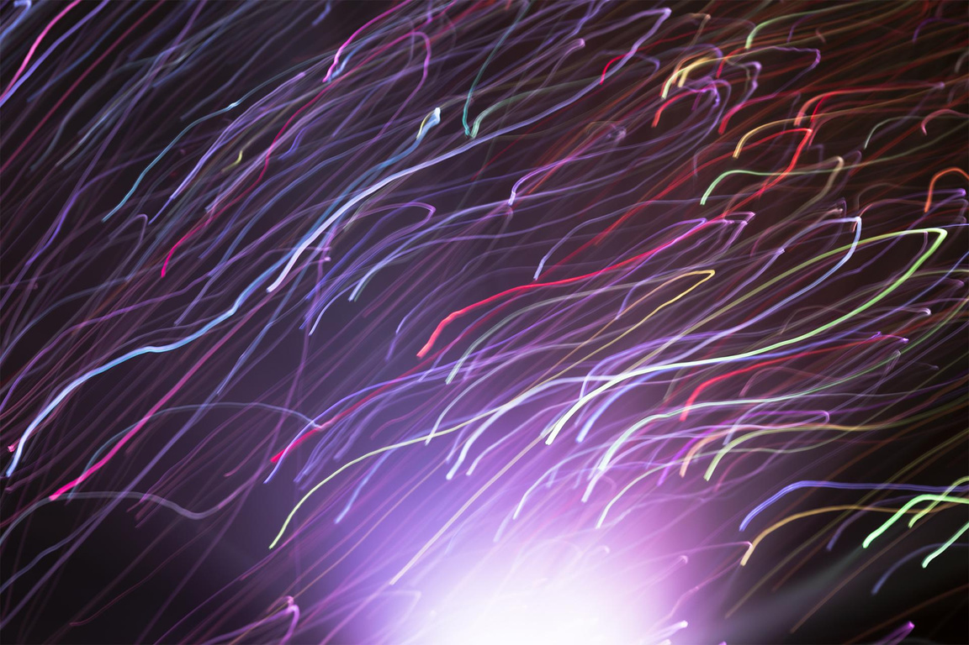
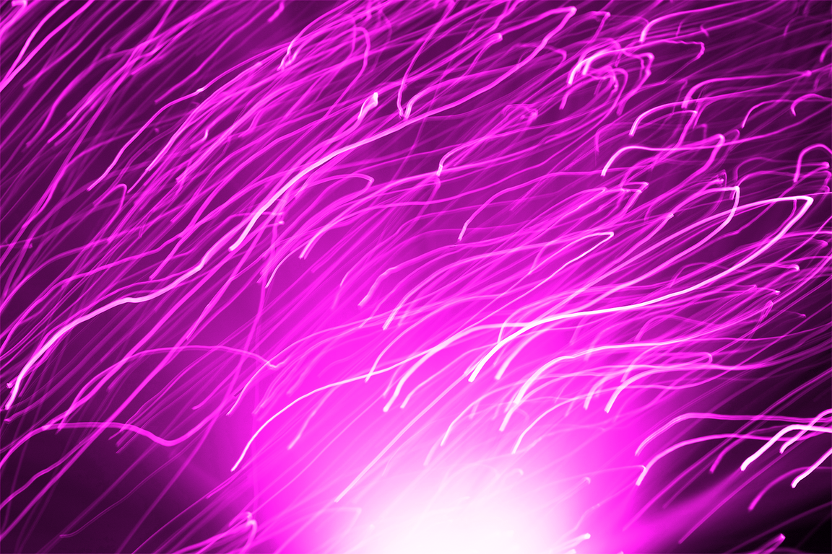

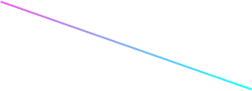

MULTIMEDIA
You can insert your multimedia content here

Slide 57



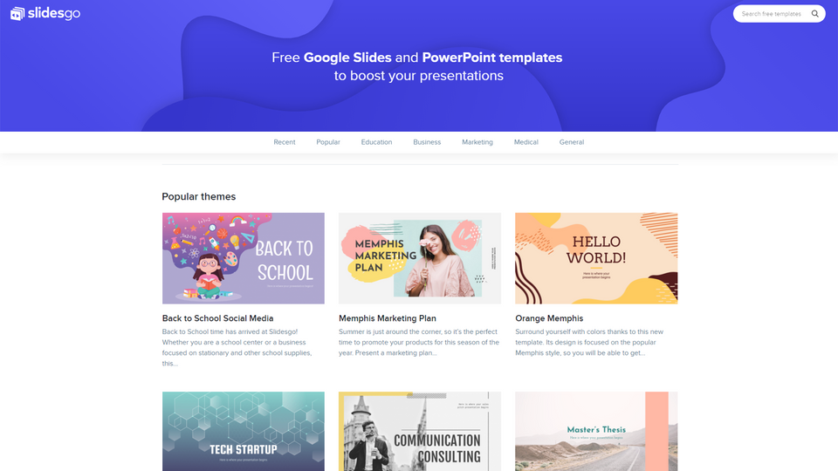
DESKTOP SOFTWARE
You can replace the image on the screen with your own work. Just delete this one, add yours and center it properly

Slide 58


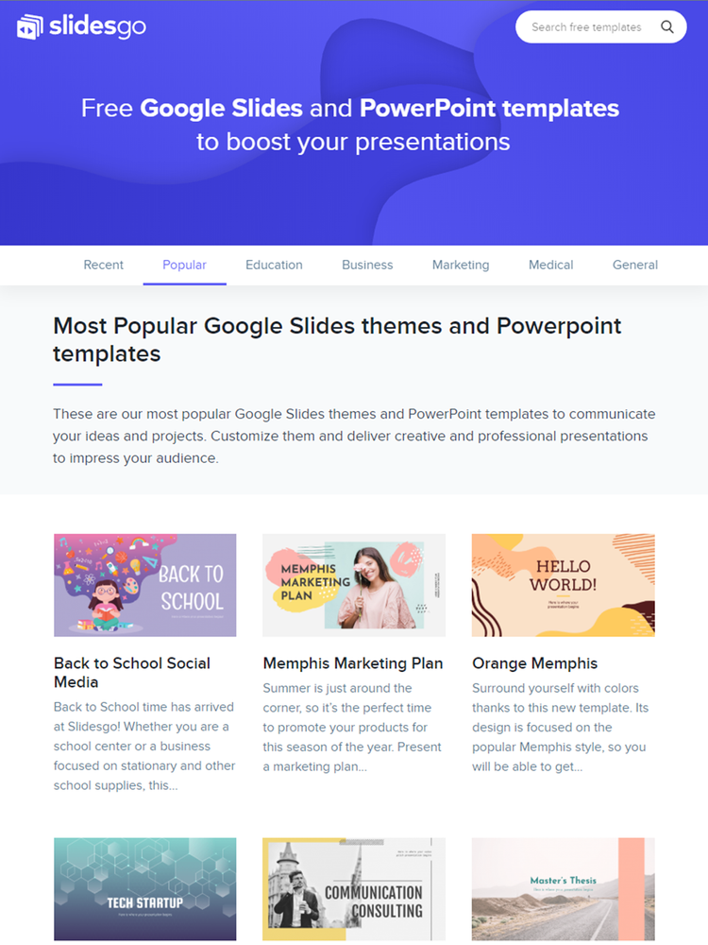
TABLET APP
You can replace the image on the screen with your own work. Just delete this one, add yours and center it properly

Slide 59

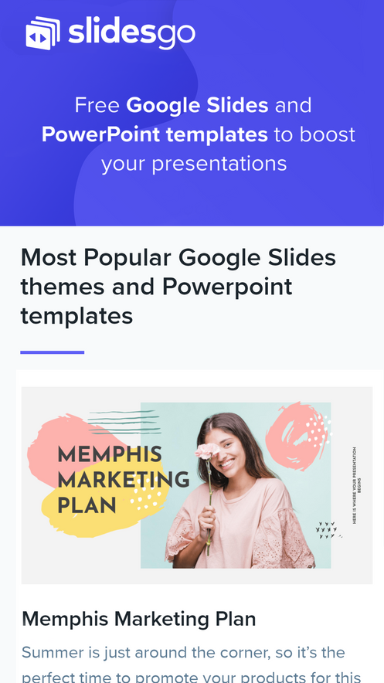
MOBILE WEB
You can replace the image on the screen with your own work. Just delete this one, add yours and center it properly

Slide 60
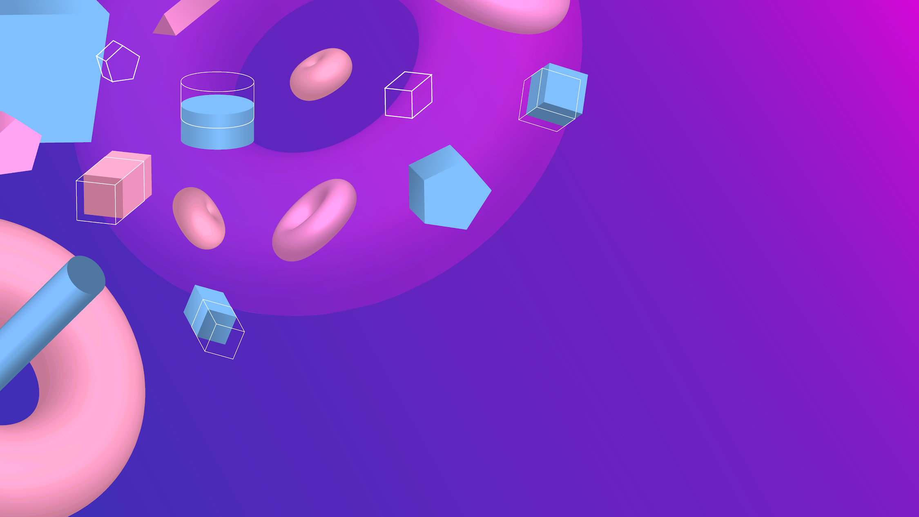

THANKS!
Do you have any questions?
youremail@freepik.com
+91 620 421 838
yourcompany.com
CREDITS: This presentation template was created by Slidesgo, including icons by Flaticon, and infographics & images by Freepik
Please keep this slide for attribution.

Slide 61
PACK ICON PREMIUM STARTUPS

Slide 62




ALTERNATIVE PREMIUM RESOURCES

Slide 63





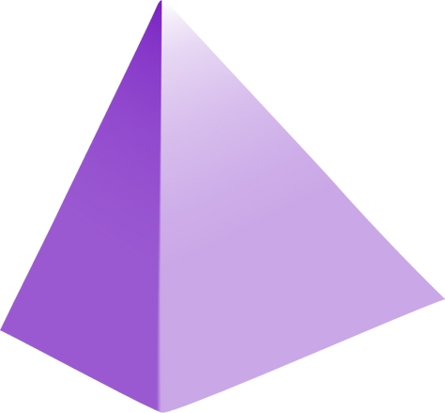

ALTERNATIVE PREMIUM RESOURCES

Slide 64



ALTERNATIVE INFOGRAPHICS

Slide 65

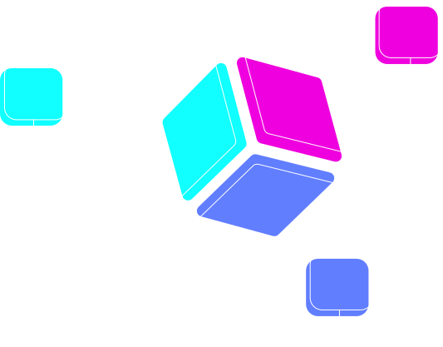
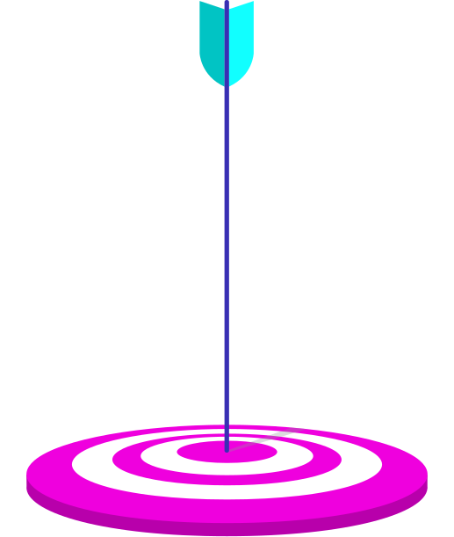



ALTERNATIVE INFOGRAPHICS

Slide 66
RESOURCES
VECTORS:
  3D geometric shapes background
  3D geometric shapes background 2
  Gradient 3D shapes background
  Abstract 3D shapes background
  3D geometric landing page with pyramids
  3D gradient geometric landing page template
  Floating geometric shapes brochure pack
  Floating polygonal shapes brochure set
  PHOTOS:
  Water droplets on vibrant blue and pink feather
  Violet fiber optics lights abstract background
  Portrait of cheerful young woman
  Young man riding a bike

Slide 67
PREMIUM RESOURCES
VECTORS
PHOTOS
  Colorful business timeline with flat design
  Floating 3d gradient polygons brochure collection
  Abstract background with dynamic shapes
  Fluid style background with memphis elements
  Colorful abstract background with memphis elements
  Business landing page template
  3d shapes background
  3d geometric shapes background
  Colorful fiber lights with defocused spots
  Woman wearing-virtual reality gadget medium shot
  Wavy abstract colorful fiber lights
ICONS
  Businessman
  Businesswoman
  Businessman
  Businessman
  Startups
  Businesswoman
  Medal
  Diploma
  Trophy

Slide 68
Fonts & colors used
This presentation has been made using the following fonts:
Cosmic Octo
(https://www.whatfontis.com/CR_Cosmic-Octo-Bold-otf-700.similar)
Abel
(https://fonts.google.com/specimen/Abel)
#11ffff
#ef00de
#781fc2
#617eff
#392fb4
#01c4c4
#b800ab

Slide 69

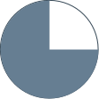



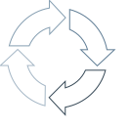








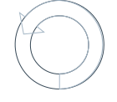








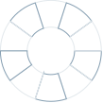

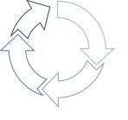

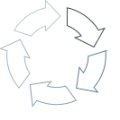






Use our editable graphic resources...
You can easily resize these resources without losing quality. To change the color, just ungroup the resource and click on the object you want to change. Then, click on the paint bucket and select the color you want. Don’t forget to group the resource again when you’re done.

Slide 70
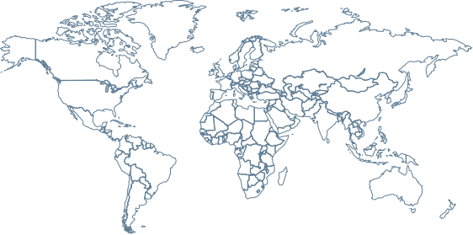
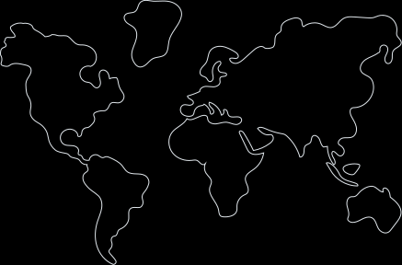
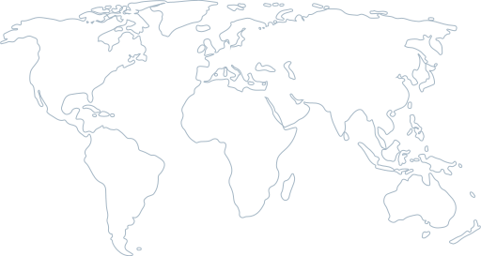
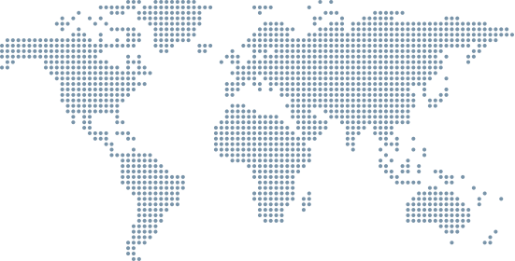
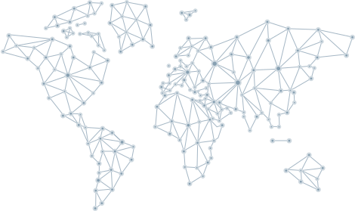
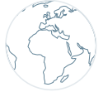
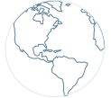







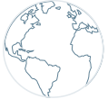
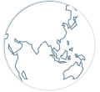





Slide 71
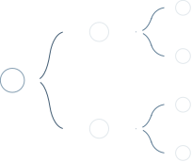



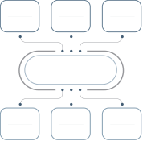




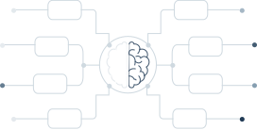
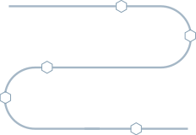



Slide 72
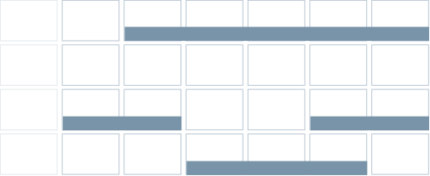
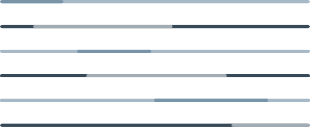
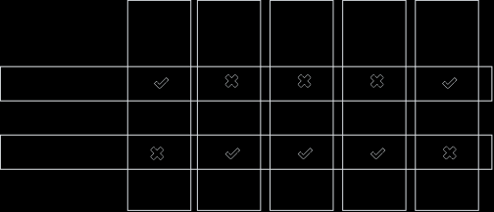

JANUARY
FEBRUARY
MARCH
APRIL
MAY
JUNE
PHASE 1
Task 1
Task 2
PHASE 2
Task 1
Task 2
JANUARY
FEBRUARY
MARCH
APRIL
PHASE 1
Task 1
Task 2

Slide 73

































Slide 74




















Slide 75



































































...and our sets of editable icons
You can resize these icons without losing quality.
You can change the stroke and fill color; just select the icon and click on the paint bucket/pen.
In Google Slides, you can also use Flaticon’s extension, allowing you to customize and add even more icons.

Slide 76





































































































Educational Icons
Medical Icons

Slide 77
















































































































Business Icons
Teamwork Icons

Slide 78










































































































Help & Support Icons
Avatar Icons

Slide 79





























































































Creative Process Icons
Performing Arts Icons

Slide 80





































































Nature Icons

Slide 81
























































































SEO & Marketing Icons

Slide 82
PLANTILLASPOWERPOINT.ORG

