Slide 1
Lofi Music Newsletter Infographics
x
Here is where this template begins

Slide 2
About lofi music newsletter infographics
This template contains an assortment of complementary infographic resources for the Lofi Music Newsletter presentation.
These infographics are adapted to the style of the aforementioned presentation, so you can insert them easily and have them completely integrated at once. You just need to do the following:
Select the element that you want to copy
Right-click and choose “Copy”
Go to the slide where you want the element to appear
Right-click and choose “Paste”

Slide 3

Lofi music newsletter infographics
X
A
Earth
Mercury
D
Earth is the third planet from the Sun
Mercury is the closest planet to the Sun
Jupiter
Mars
B
E
Jupiter is a gas giant and the biggest planet
Despite being red, Mars is a cold place
Neptune
Saturn
C
F
Neptune is far away from Earth
Saturn is composed of hydrogen and helium

Slide 4
Lofi music newsletter infographics
65%
50%
25%
75%
Jupiter
Mars
Mercury
Saturn
It’s the biggest planet in the Solar System
Mars is actually a very cold place
Mercury is the closest planet to the Sun
It’s composed of hydrogen and helium

Slide 5
Lofi music newsletter infographics
This week’s playlist |  | Artist | Day
1 | Mercury is a small planet | Algorithm Lee | Monday
2 | Venus is very hot | Charlie S. Ortiz | Tuesday
3 | We all live on Earth | The Human Tribe | Wednesday
4 | Mars is a red planet | Joel M. McAllister | Thursday
5 | Jupiter is a big planet | Sixth Aviator | Friday
6 | Saturn has rings | Charles C. Sheppard | Saturday
7 | Neptune is an ice giant | Rages Rating | Sunday

Slide 6
Lofi music newsletter infographics
Hip hop
Chillhop
40%
65%
Venus is the second planet from the Sun
Saturn is a gas giant and has several rings
Ambient
R&B
75%
50%
Despite being red, Mars is a cold place
Mercury is the closest planet to the Sun

Slide 7
Lofi music newsletter infographics
Song | Artist | Album | Duration | Year
Venus | Timmy Jimmy | The Moon | 5:32 | 2021
Jupiter | Jenna Doe | The Sun | 4:56 | 2019
Mercury | John Jameson | Neptune | 3:33 | 2018
Saturn | Sarah Bones | Ceres | 2:60 | 2022
Jupiter | Mary Wright | Pluto | 4:25 | 2020

Slide 8
Lofi music newsletter infographics
February
Total time: 10h56m Genre: Lofi Hip hop
Venus has a nice name
April
Playlist 2
Playlist 1
Playlist 3
Mercury is a small planet
Total time: 09h34m Genre: Lofi Trap
We all live on planet Earth
Total time: 10h30m Genre: Ambient
March

Slide 9
Lofi music newsletter infographics
May
Total time: 21h32m Genre: Lofi Rock
Venus has a nice name
July
Playlist 5
Playlist 4
Playlist 6
Mars is a very cold planet
Total time: 14h12m Genre: Electronic
We all live on planet Earth
Total time: 10h30m Genre: Ambient
June

Slide 10
Lofi music newsletter infographics
01
Song name
Artist name
07
Song name
Artist name
02
Song name
Artist name
08
Song name
Artist name
03
Song name
Artist name
09
Song name
Artist name
04
Song name
Artist name
10
Song name
Artist name
05
Song name
Artist name
11
Song name
Artist name
06
Song name
Artist name
12
Song name
Artist name

Slide 11
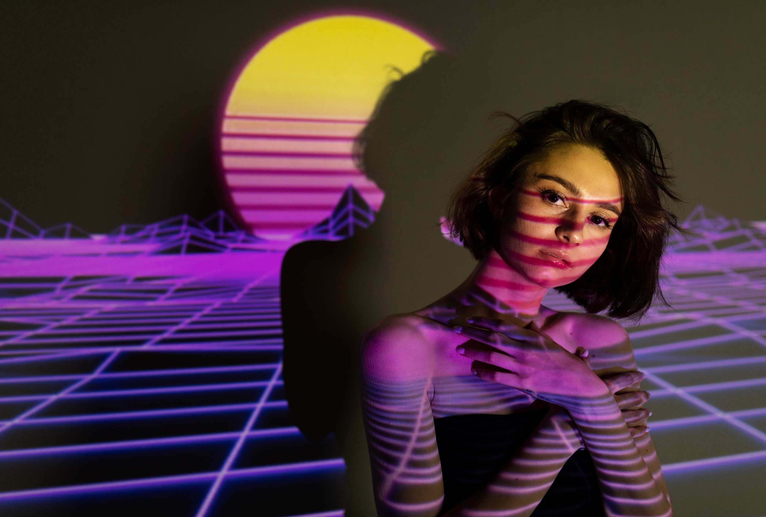
Lofi music newsletter infographics
X
Top artists
Strikers Commodores
Cake Phoenix
The Programs
Firelight
Top songs
Mercury is very small
Mars is a cold place
Venus has a nice game
Earth harbors life
Jupiter is a big planet
Saturn has rings
Pluto is dwarf planet
Minutes listened
Top genre
525.200
Hip hop

Slide 12
Lofi music newsletter infographics
Electronic
50%
Lofi Hip Hop
25%
Ambient
75%
Mercury is the closest planet to the Sun and the smallest one in the entire Solar System. This planet’s name has nothing to do with the liquid metal, since Mercury was named after the Roman messenger god. Despite being closer to the Sun than Venus, its temperatures aren't as terribly hot as that planet’s
Top
High
Low
Venus has a beautiful name and it’s the second planet from the Sun. Venus is terribly hot, even hotter than Mercury

Slide 13
Lofi music newsletter infographics
25%
Electronic
Venus has a beautiful name and is the second planet from the Sun
50%
Lofi Soul
Earth is the third planet from the Sun and the only one that harbors life in the System
75%
Lofi R&B
Despite being red, Mars is actually a cold place. It’s full of iron oxide dust

Slide 14
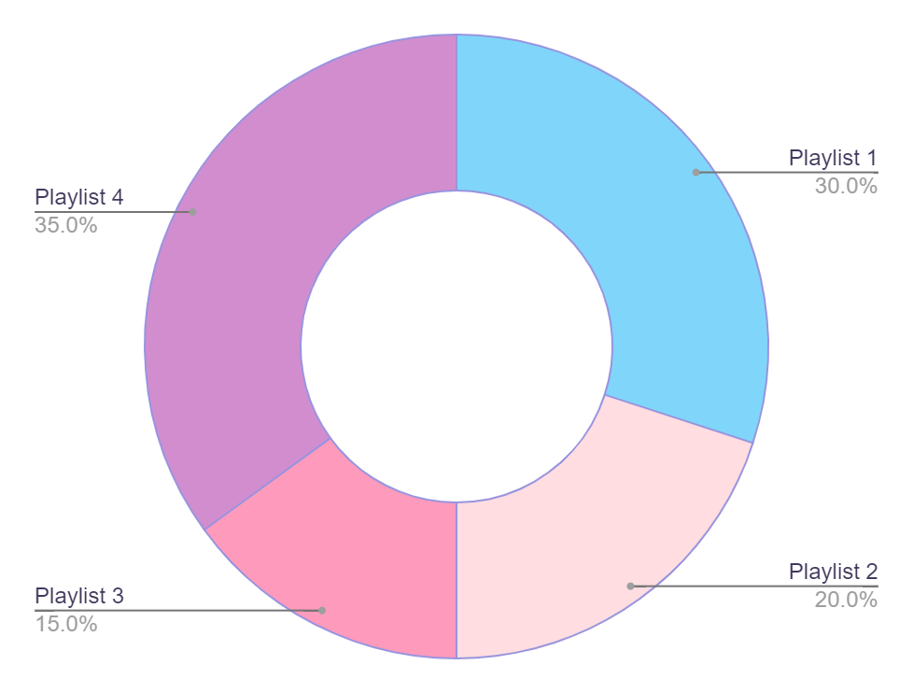
Lofi music newsletter infographics
01
02
Hip hop
Electronic
Despite being red, Mars is a cold place
Jupiter is the biggest planet of them all
04
03
Ambient
Lofi rock
Mercury is the closest planet to the Sun
Venus has a very beautiful name
Follow the link in the graph to modify its data and then paste the new one here. For more info, click here

Slide 15

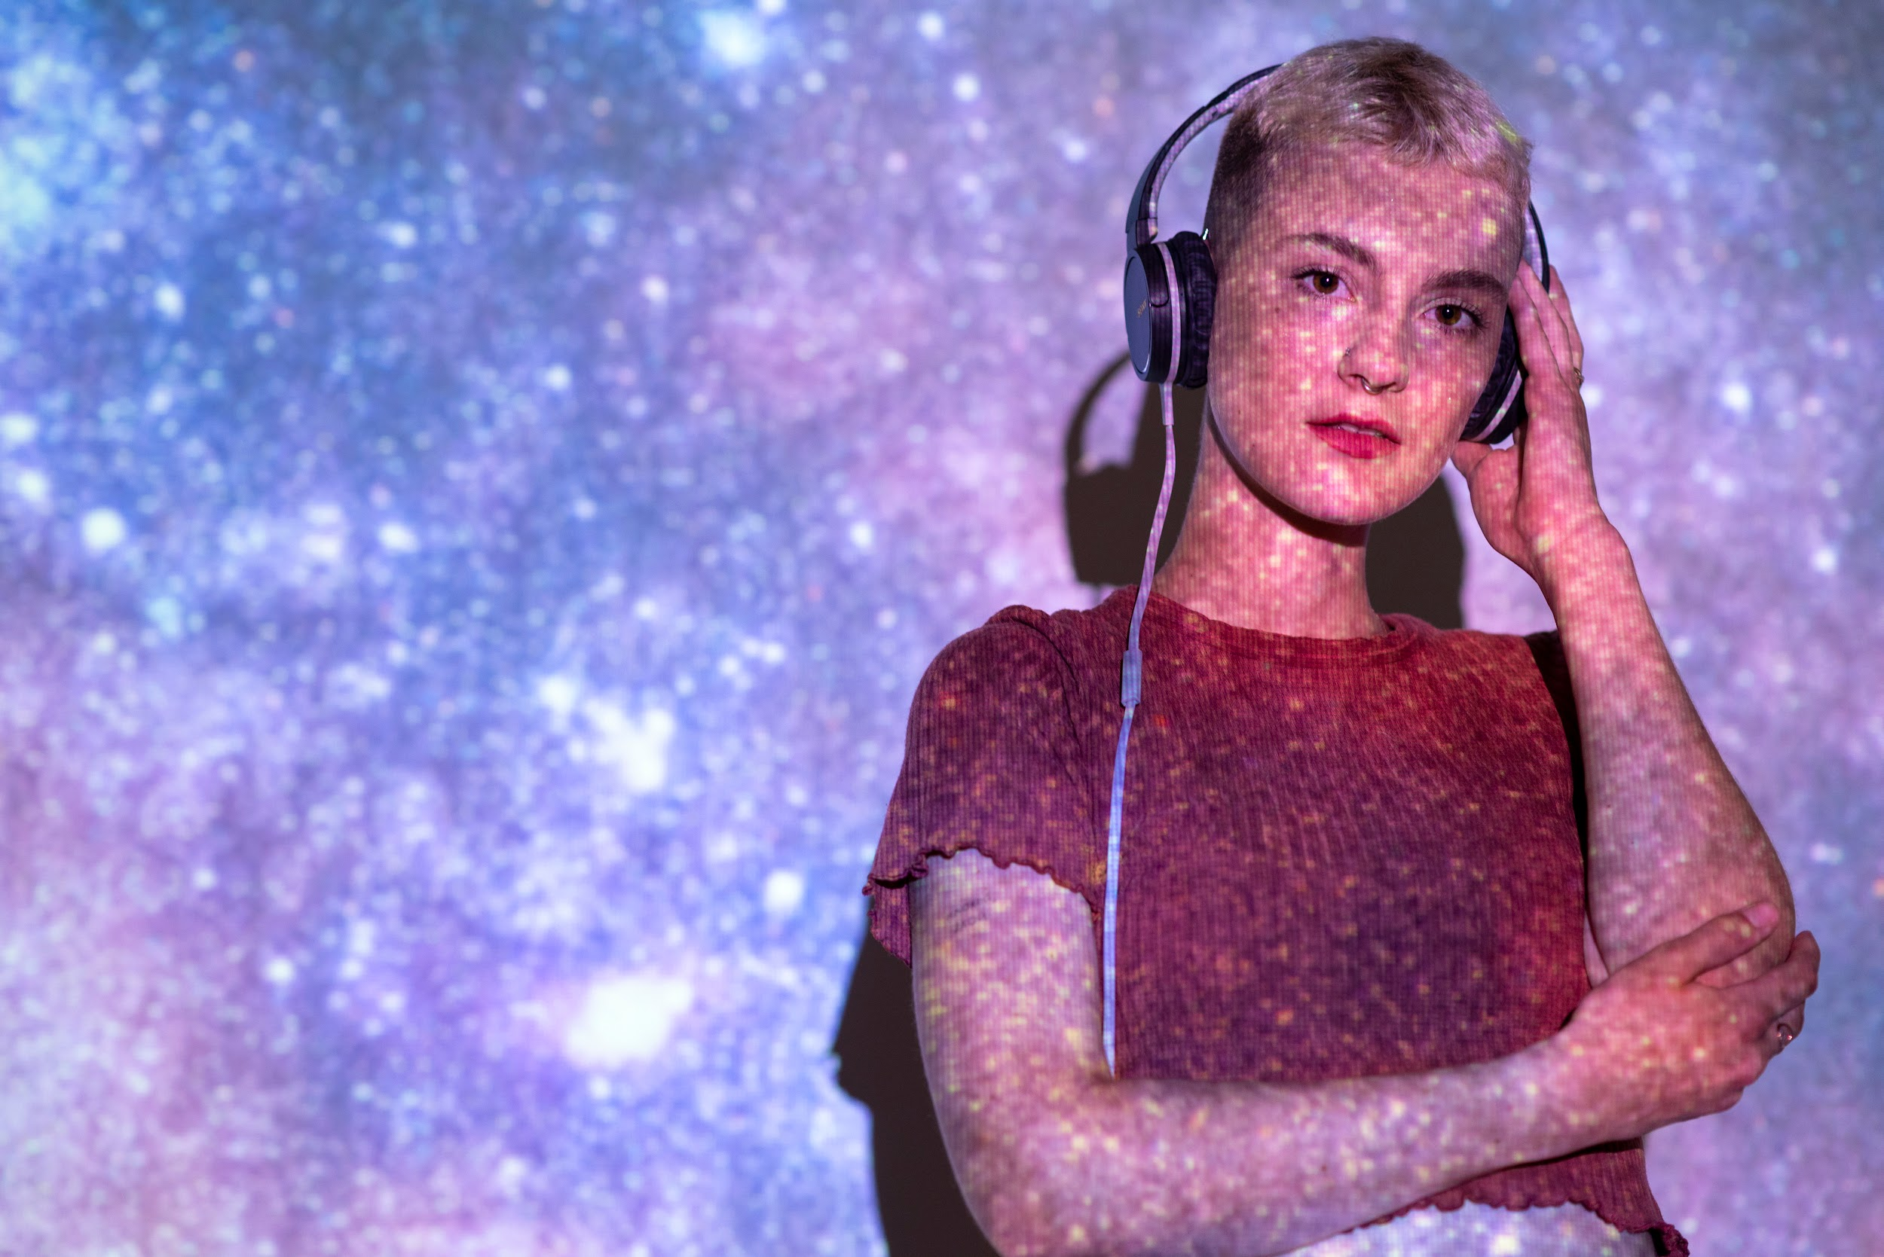

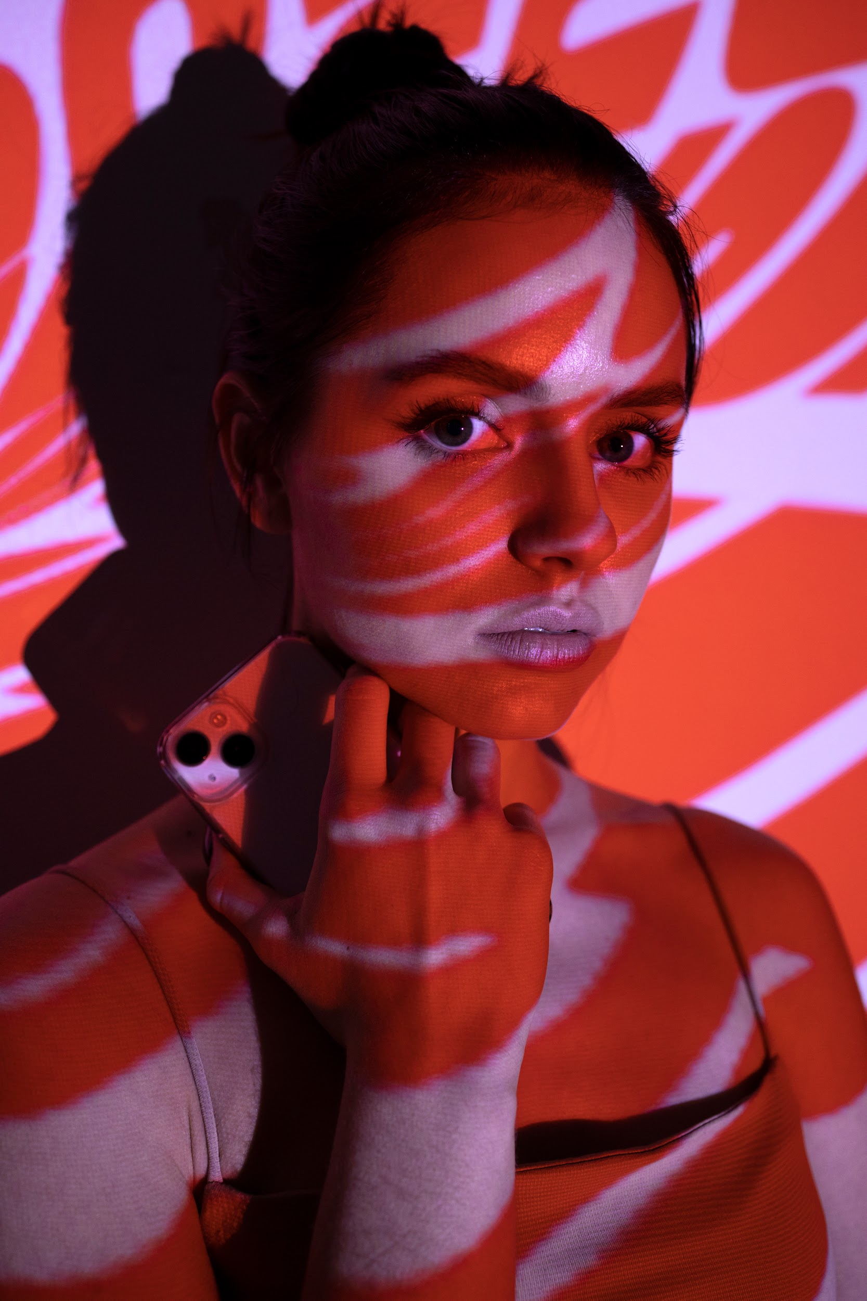
Lofi music newsletter infographics
October
November
December
January
X
X
X
X
Minutes listened
Minutes listened
Minutes listened
Minutes listened
22,230
15,628
16,468
12,550
Top genre
Top genre
Top genre
Top genre
Hip hop
Ambient
Soul
R&B

Slide 16
Lofi music newsletter infographics
Top 01
Saturn is a gas giant
Artist name
Top 02
Mars is a very cold place
Artist name
Top 03
Neptune is far away from us
Artist name
Top 04
Earth is the planet where we live
Artist name
Top 05
Venus is the second planet from the Sun
Artist name

Slide 17
Lofi music newsletter infographics
Playlist 1
Playlist 2
Playlist 3
Venus is terribly hot
Total time: 12h34m
Genre: Lofi Trap Artist: Timmy Jimmy
Mars is a very cold place
Total time: 15h40m
Genre: Lofi Hip Hop Artist: Reme James
We all live on planet Earth
Total time: 10h28m
Genre: Ambient Artist: Susan Cloe

Slide 18
Lofi music newsletter infographics
Basic
No | Download music
Yes | Listen to music
No | Ad-free
No | Skip all the songs
Standar
No | Download music
Yes | Listen to music
No | Ad-free
Yes | Skip all the songs
Premium
Yes | Download music
Yes | Listen to music
Yes | Ad-free
Yes | Skip all the songs
$5,80
$15,50
$25,80

Slide 19
Lofi music newsletter infographics
01
Top 4 songs
02
Mars is so red
Venus is so hot
X
Jane Clips
Genre: Hip Hop
Timmy Clips
Genre: R&B
03
04
Time played
Earth is blue
158
Jupiter is so big
Susan V.Bones
Genre: Ambient
George Yellow
Genre: Electronic Lofi
Top genre
R&B

Slide 20
Lofi music newsletter infographics
Fav Lofi songs
40%
Saturn is a gas giant and has several rings. It’s composed mostly of hydrogen and helium
Saturn has rings
Venus is hot
Mercury is small
Jupiter is big
The Sun is a star
Mars is red
Lofi trap
Jupiter is the biggest planet of them all
60%
Lofi hip hop
Venus is the second planet from the Sun

Slide 21
Lofi music newsletter infographics
01
02
03
Earth is blue
Venus is hot
Mars is so red
Charles Rib
Genre: Hip hop
Ware Palazzo
Genre: Lofi Electronic
Daniel Doe
Genre: Ambient
65%
50%
75%

Slide 22
Lofi music newsletter infographics
Album 1
Album 2
Album 3
Album 4
Enter a song
Enter a song
Enter a song
Enter a song
Enter a song
Enter a song
Enter a song
Enter a song
Enter a song
Enter a song
Enter a song
Enter a song
Enter a song
Enter a song
Enter a song
Enter a song
Enter a song
Enter a song
Enter a song
Enter a song
Enter a song
Enter a song
Enter a song
Enter a song
Enter a song
Enter a song
Enter a song
Enter a song
Enter a song
Enter a song
Enter a song
Enter a song
Enter a song
Enter a song
Enter a song
Enter a song
Enter a song
Enter a song
Enter a song
Enter a song
Enter a song
Enter a song
Enter a song
Enter a song
Enter a song
Enter a song
Enter a song
Enter a song

Slide 23
Lofi music newsletter infographics
Venus
4:35 min
2:46 min
Saturn
Venus is the second planet from the Sun
Saturn is a gas giant and has several rings
Mercury
3:11 min
3:25min
Mars
Mercury is the closest planet to the Sun
Despite being red, Mars is very cold
Jupiter
6:41 min
2:16 min
Earth
Jupiter is the biggest planet of them all
Earth is the third planet from the Sun

Slide 24
Lofi music newsletter infographics
Interests
Sports
Nature
Music
Theater
Style
Age
20-35
25%
60%
40%
Lofi rock
Lofi trap
36-45
40%
46-60
60%
Venus has a beautiful name and it’s the second planet from the Sun

Slide 25
Lofi music newsletter infographics
X
X
X
Playlist 1
Mars is a very cold place
Playlist 2
Venus is terribly hot
Playlist 3
Earth is where we all live on
X
X
X
Playlist 4
Jupiter is the biggest planet
Playlist 5
Saturn has several rings
Playlist 6
Mercury is the smallest planet

Slide 26

Lofi music newsletter infographics
#01
Jenna Doe
#05
Josh Marks
Song’s name
Song’s name
#02
Timmy Sam
#06
Katy Pop
Song’s name
Song’s name
#03
Susan Joe
#07
Mary Bin
Song’s name
Song’s name
#04
Rossan Lin
#08
Joe James
Song’s name
Song’s name

Slide 27
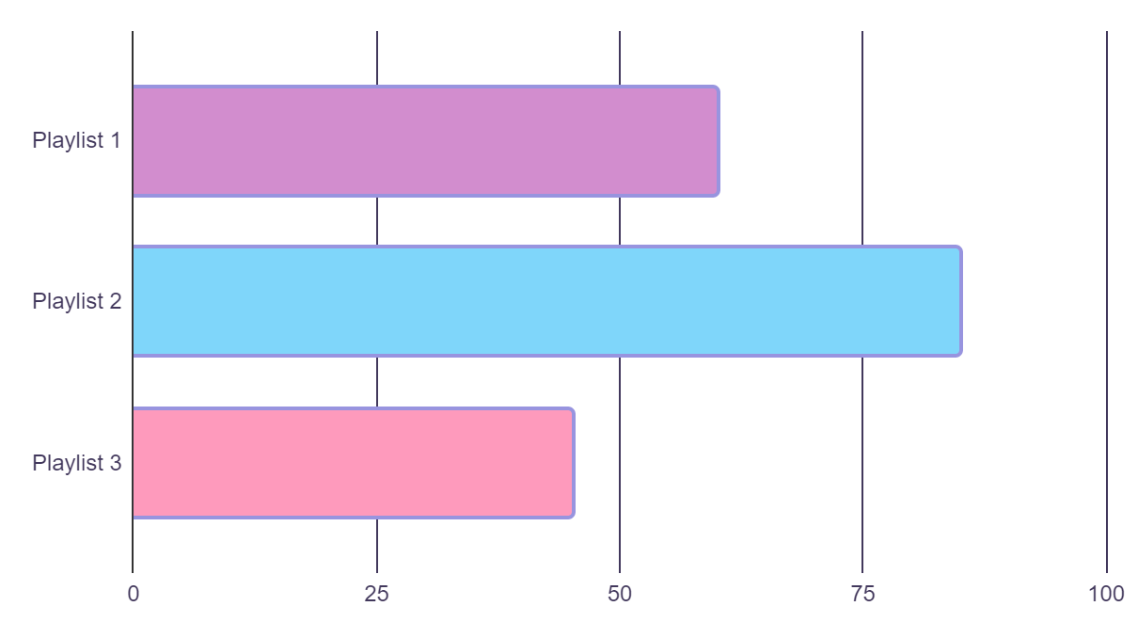
Lofi music newsletter infographics
Most listened playlists
60%
Despite being red, Mars is a cold place
85%
Mercury is the closest planet to the Sun
45%
Jupiter is the biggest planet of them all
Follow the link in the graph to modify its data and then paste the new one here. For more info, click here

Slide 28
Lofi music newsletter infographics
#1 | Write your song title here | 450
#2 | Write your song title here | 450
#3 | Write your song title here | 450
#4 | Write your song title here | 450
#5 | Write your song title here | 450
#6 | Write your song title here | 450
#7 | Write your song title here | 450
#8 | Write your song title here | 450
#9 | Write your song title here | 450
#10 | Write your song title here | 450
X
X

Slide 29
Lofi music newsletter infographics
Your most shared lyric this year
X
John A.
Follow
Like Share
Venus has a beautiful name and is the second planet from the Sun. It’s terribly hot, even hotter than Mercury, and its atmosphere is extremely poisonous. It’s the second-brightest natural object in the night sky after the Moon
2.8B | 75.5B
Streams | Hours
35.8 | 250
Listeners | Countries
X
Venus is hot
John A. James
Genre: Hip hop

Slide 30
Lofi music newsletter infographics
20XX | 20XX | 20XX | 20XX
Top Song | Top Song | Top Song | Top Song
Mars is cold | Venus is beautiful | Jupiter is big | Mercury is fine
Top song | Top song | Top song | Top song
Jenna James | Susan Doe | Adrian Hope | Helen Harper

Slide 31
Lofi music newsletter infographics
Month 1
Month 2
Month 3
Playlist 1
Mercury is a small planet
Total time: 09h34m Genre: Lofi Trap
Playlist 2
We all live on Planet Earth
Total time: 11h24m Genre: Lofi Hip Hop
Playlist 3
Mars is a very cold place
Total time: 10h46m Genre: Ambient

Slide 32
Lofi music newsletter infographics
#01
Chloe & Cloud
Mercury is the closest planet to the Sun and the smallest one in the Solar System
#02
Carlos Summer
Venus has a very beautiful name and is the second planet from the Sun. It’s a hot place
#03
Jenna Lyon
Despite being red, Mars is actually a cold place. It’s full of iron oxide dust

Slide 33
Instructions for use
If you have a free account, in order to use this template, you must credit Slidesgo in your final presentation. Please refer to the next slide to read the instructions for premium users.
As a Free user, you are allowed to:
- Modify this template.
- Use it for both personal and commercial projects.
You are not allowed to:
- Sublicense, sell or rent any of Slidesgo Content (or a modified version of Slidesgo Content).
- Distribute Slidesgo Content unless it has been expressly authorized by Slidesgo.
- Include Slidesgo Content in an online or offline database or file.
- Offer Slidesgo templates (or modified versions of Slidesgo templates) for download.
- Acquire the copyright of Slidesgo Content.
For more information about editing slides, please read our FAQs or visit our blog:
https://slidesgo.com/faqs and https://slidesgo.com/slidesgo-school

Slide 34
Instructions for use (premium users)
As a Premium user, you can use this template without attributing Slidesgo.
You are allowed to:
Modify this template.
Use it for both personal and commercial purposes.
Hide or delete the “Thanks” slide and the mention to Slidesgo in the credits.
Share this template in an editable format with people who are not part of your team.
You are not allowed to:
Sublicense, sell or rent this Slidesgo Template (or a modified version of this Slidesgo Template).
Distribute this Slidesgo Template (or a modified version of this Slidesgo Template) or include it in a database or in any other product or service that offers downloadable images, icons or presentations that may be subject to distribution or resale.
Use any of the elements that are part of this Slidesgo Template in an isolated and separated way from this Template.
Register any of the elements that are part of this template as a trademark or logo, or register it as a work in an intellectual property registry or similar.
For more information about editing slides, please read our FAQs or visit our blog:
https://slidesgo.com/faqs and https://slidesgo.com/slidesgo-school

Slide 35
Infographics
You can add and edit some infographics to your presentation to present your data in a visual way.
Choose your favourite infographic and insert it in your presentation using Ctrl C + Ctrl V or Cmd C + Cmd V in Mac.
Select one of the parts and ungroup it by right-clicking and choosing “Ungroup”.
Change the color by clicking on the paint bucket.
Then resize the element by clicking and dragging one of the square-shaped points of its bounding box (the cursor should look like a double-headed arrow). Remember to hold Shift while dragging to keep the proportions.
Group the elements again by selecting them, right-clicking and choosing “Group”.
Repeat the steps above with the other parts and when you’re done editing, copy the end result and paste it into your presentation.
Remember to choose the “Keep source formatting” option so that it keeps the design. For more info, please visit our blog.

