Slide 1
Dark Template

Slide 2
This is your presentation title
@username

Slide 3
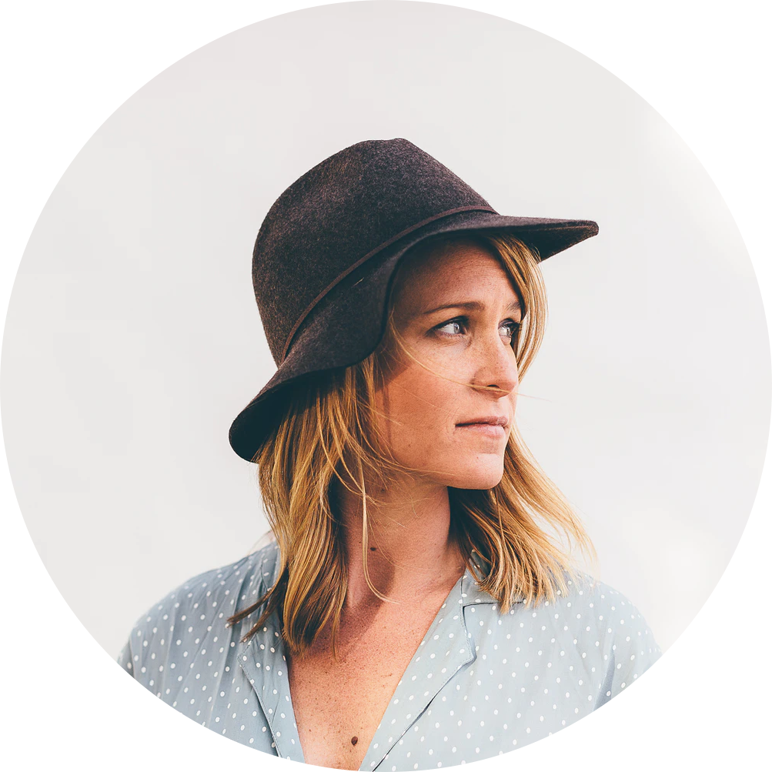
Hi, I’m Maggie Petterson

Slide 4
SUBTITLE
Slide title goes here
They are simple.
You can organize your ideas clearly
You’ll never forget to buy anything
They are simple.
You can organize your ideas clearly
You’ll never forget to buy anything

Slide 5

SUBTITLE
Slide title goes here
They are simple.
You can organize your ideas clearly
You’ll never forget to buy anything

Slide 6
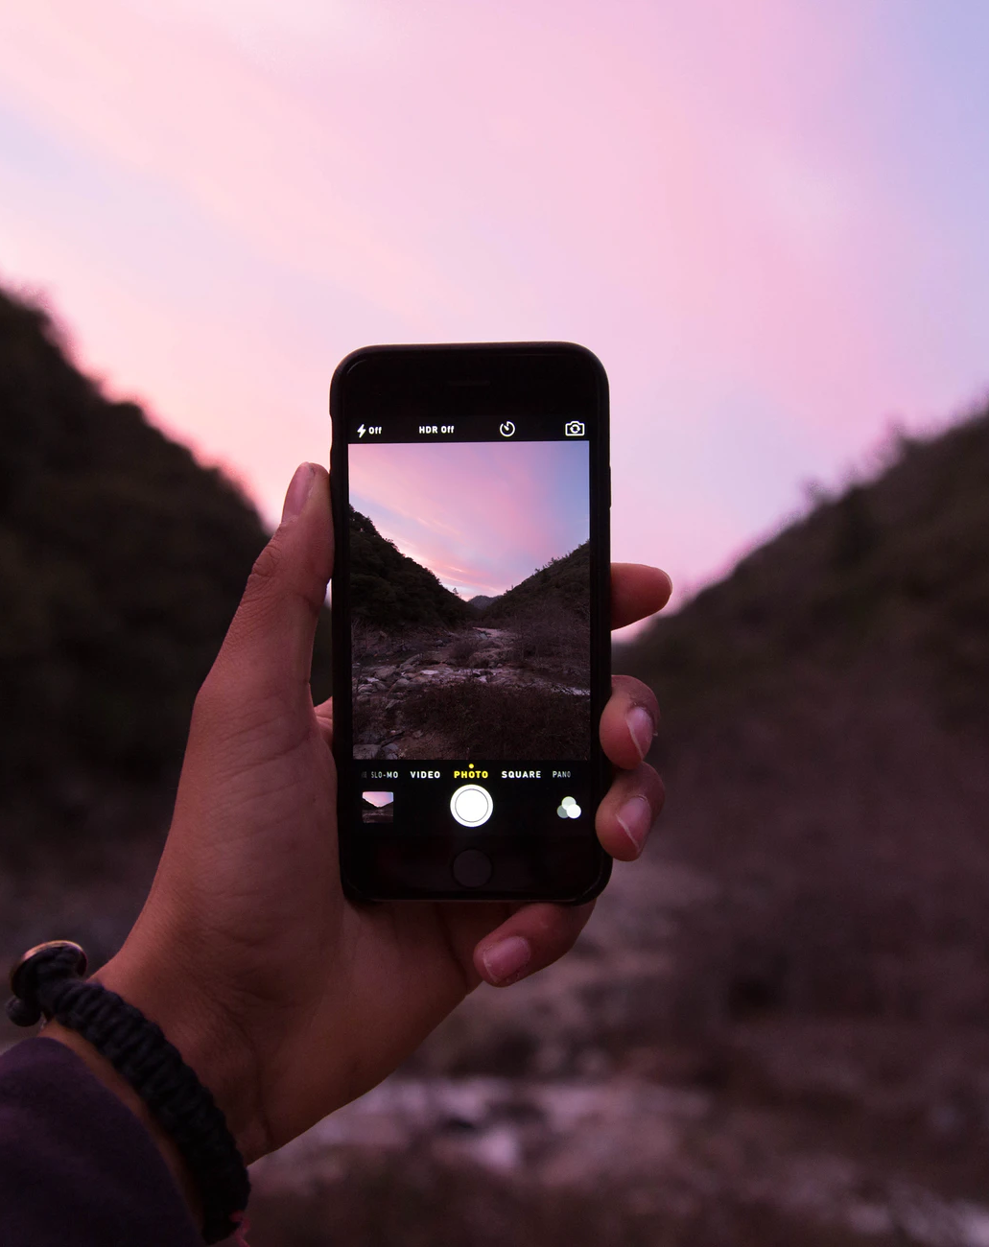
SUBTITLE
Slide title goes here
They are simple.
You can organize your ideas clearly
You’ll never forget to buy anything

Slide 7
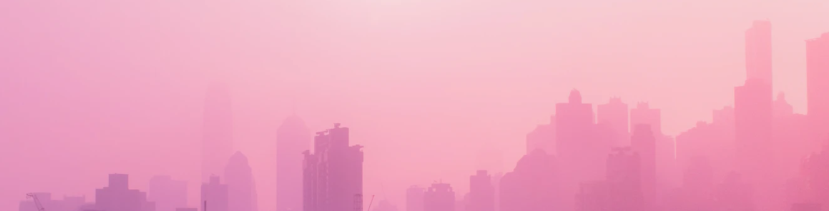
SUBTITLE
Slide title goes here

Slide 8

SUBTITLE
Slide title goes here
They are simple.
You can organize your ideas clearly
You’ll never forget to buy anything

Slide 9
SUBTITLE
Slide title goes here
 | Header 1 | Header 2 | Header 3 | Header 4 | Header
Option 1 | 100 | 200 | 300 | 400 | 500
Option 2 | 500 | 200 | 150 | 200 | 500
Option 3 | 800 | 900 | 1200 | 2000 | 400

Slide 10
Awesome words

Slide 11

Awesome words

Slide 12
01
VENUS
Venus has a beautiful name and is the second planet from the Sun. It’s terribly hotz

Slide 13
SUBTITLE
Slide title goes here
01
02
03
VENUS
Venus has a beautiful name and is the second planet from the Sun. It’s terribly hotz
MOON
The Moon is an astronomical body that orbits Earth as its only natural satellite.
MERCURY
Mercury is the closest planet to the Sun and the smallest one in our Solar System

Slide 14
01
02
VENUS
Venus has a beautiful name and is the second planet from the Sun. It’s terribly hotz
MOON
The Moon is an astronomical body that orbits Earth as its only natural satellite.
03
04
MERCURY
Mercury is the closest planet to the Sun and the smallest one in our Solar System
MARS
Mars is the fourth planet from the Sun and the second-smallest planet in the Solar System after Mercury.

Slide 16
4,498,300
Big numbers catch your audience’s attention

Slide 17
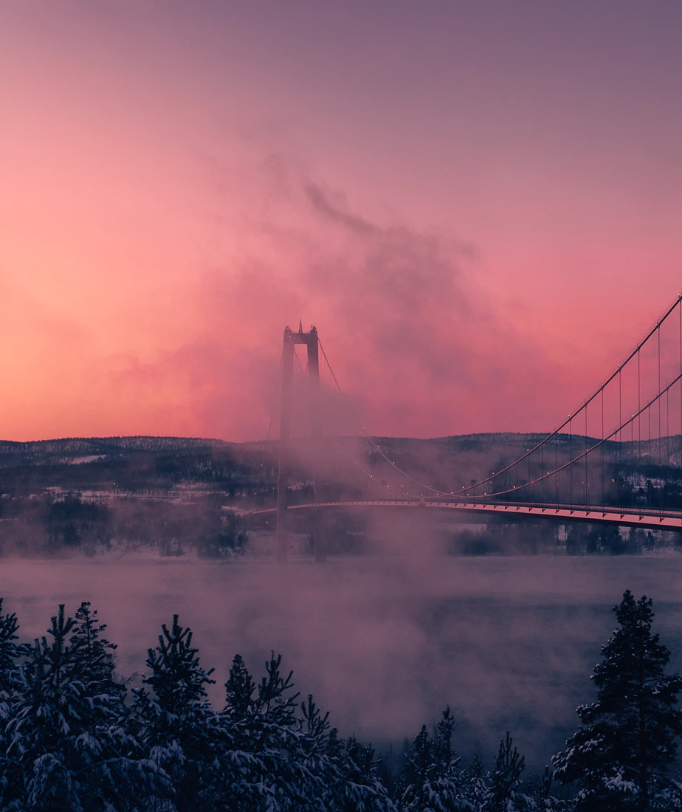
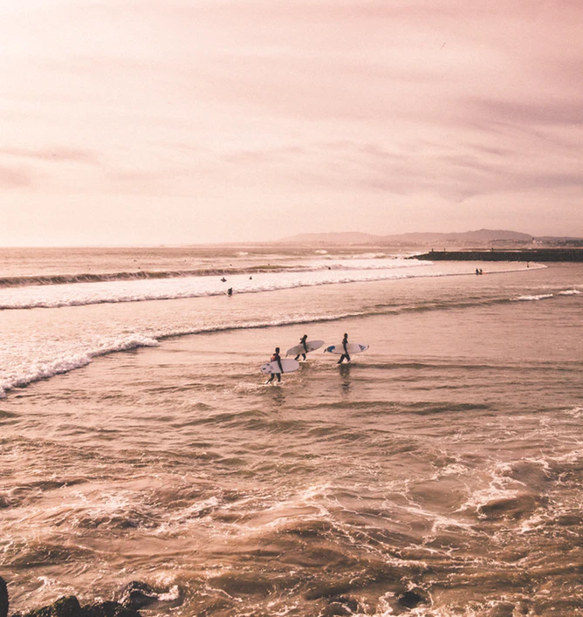

Slide 18
“
The life of inner peace, being harmonious and without stress, is the easiest type of existence
Norman Vincent Peale

Slide 19
Thanks!
@username

Slide 20
Light Template

Slide 21
This is your presentation title
@username

Slide 22
Hi, I’m Maggie Petterson

Slide 23
SUBTITLE
Slide title goes here
They are simple.
You can organize your ideas clearly
You’ll never forget to buy anything
They are simple.
You can organize your ideas clearly
You’ll never forget to buy anything

Slide 24
SUBTITLE
Slide title goes here
They are simple.
You can organize your ideas clearly
You’ll never forget to buy anything

Slide 25
SUBTITLE
Slide title goes here
They are simple.
You can organize your ideas clearly
You’ll never forget to buy anything

Slide 26
SUBTITLE
Slide title goes here

Slide 27
SUBTITLE
Slide title goes here
They are simple.
You can organize your ideas clearly
You’ll never forget to buy anything

Slide 28
SUBTITLE
Slide title goes here
 | Header 1 | Header 2 | Header 3 | Header 4 | Header
Option 1 | 100 | 200 | 300 | 400 | 500
Option 2 | 500 | 200 | 150 | 200 | 500
Option 3 | 800 | 900 | 1200 | 2000 | 400

Slide 29
Awesome words

Slide 30
Awesome words

Slide 31
01
VENUS
Venus has a beautiful name and is the second planet from the Sun. It’s terribly hotz

Slide 32
SUBTITLE
Slide title goes here
01
02
03
VENUS
Venus has a beautiful name and is the second planet from the Sun. It’s terribly hotz
MOON
The Moon is an astronomical body that orbits Earth as its only natural satellite.
MERCURY
Mercury is the closest planet to the Sun and the smallest one in our Solar System

Slide 33
01
02
VENUS
Venus has a beautiful name and is the second planet from the Sun. It’s terribly hotz
MOON
The Moon is an astronomical body that orbits Earth as its only natural satellite.
03
04
MERCURY
Mercury is the closest planet to the Sun and the smallest one in our Solar System
MARS
Mars is the fourth planet from the Sun and the second-smallest planet in the Solar System after Mercury.

Slide 35
4,498,300
Big numbers catch your audience’s attention

Slide 37
“
The life of inner peace, being harmonious and without stress, is the easiest type of existence
Norman Vincent Peale

Slide 38
Thanks!
@username

Slide 39
Pink Template

Slide 40
This is your presentation title
@username

Slide 41
Hi, I’m Maggie Petterson

Slide 42
SUBTITLE
Slide title goes here
They are simple.
You can organize your ideas clearly
You’ll never forget to buy anything
They are simple.
You can organize your ideas clearly
You’ll never forget to buy anything

Slide 43
SUBTITLE
Slide title goes here
They are simple.
You can organize your ideas clearly
You’ll never forget to buy anything

Slide 44
SUBTITLE
Slide title goes here
They are simple.
You can organize your ideas clearly
You’ll never forget to buy anything

Slide 45
SUBTITLE
Slide title goes here

Slide 46
SUBTITLE
Slide title goes here
They are simple.
You can organize your ideas clearly
You’ll never forget to buy anything

Slide 47
SUBTITLE
Slide title goes here
 | Header 1 | Header 2 | Header 3 | Header 4 | Header
Option 1 | 100 | 200 | 300 | 400 | 500
Option 2 | 500 | 200 | 150 | 200 | 500
Option 3 | 800 | 900 | 1200 | 2000 | 400

Slide 48
Awesome words

Slide 49
Awesome words

Slide 50
01
VENUS
Venus has a beautiful name and is the second planet from the Sun. It’s terribly hotz

Slide 51
SUBTITLE
Slide title goes here
01
02
03
VENUS
Venus has a beautiful name and is the second planet from the Sun. It’s terribly hotz
MOON
The Moon is an astronomical body that orbits Earth as its only natural satellite.
MERCURY
Mercury is the closest planet to the Sun and the smallest one in our Solar System

Slide 52
01
02
VENUS
Venus has a beautiful name and is the second planet from the Sun. It’s terribly hotz
MOON
The Moon is an astronomical body that orbits Earth as its only natural satellite.
03
04
MERCURY
Mercury is the closest planet to the Sun and the smallest one in our Solar System
MARS
Mars is the fourth planet from the Sun and the second-smallest planet in the Solar System after Mercury.

Slide 54
4,498,300
Big numbers catch your audience’s attention

Slide 56
“
The life of inner peace, being harmonious and without stress, is the easiest type of existence
Norman Vincent Peale

Slide 57
Thanks!
@username

