Slide 1
Understanding the Self in Anthropology
FREE PRESENTATION TEMPLATE

Slide 2
Welcome
Welcome to the world of fantasy! Join us on a journey to explore the mystical creatures, enchanted lands, and magical wonders that exist beyond our reality. Discover the wonders and secrets of this exciting realm and unlock the power of imagination.

Slide 3
Table of Contents
Introduction
Historical Context
01
02
Definition of the self and its cultural variations.
Development of the concept of the self in anthropology.
Cultural Variations
Body and Self
03
04
Variations in how different cultures conceive of the self and identity.
How the body is intertwined with the concept of self in different cultures.
Language and Self
Conclusion
05
06
How language affects our understanding of self and identity.
Summary of key points and implications.

Slide 4
Introduction
According to a study by Kuhn et al. (2010), the concept of the self is a central topic in anthropology, as it is linked to important questions about human nature and identity.

Slide 5
the self and its cultural variations
Cultural variations in the self are an important topic in anthropology. The way people experience and express their sense of self varies across cultures. Western cultures tend to emphasize an independent self, based on individualism and self-expression, while non-Western cultures tend to emphasize a relational self, based on interdependence and belonging to a larger social group.
The self and its cultural variations are important in anthropology. Cultural variations in the self can be observed in various domains, and understanding them is crucial for developing cross-cultural competence in multicultural contexts. Western cultures emphasize an independent self, while non-Western cultures emphasize a relational self based on interdependence.

Slide 6
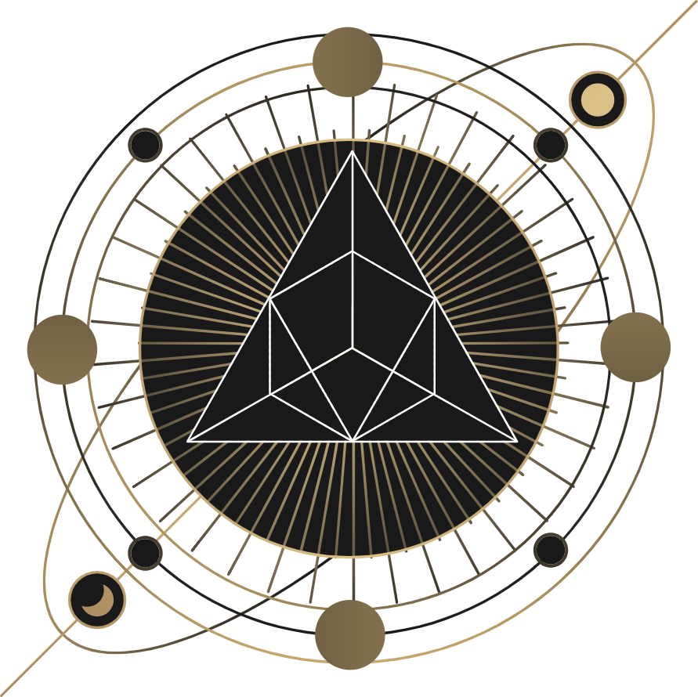
Historical Context
Anthropologists have studied the self over time, with early focus on non-Western societies. As cultural variations in human experience became recognized, the study of the self became central. Major theories like Freudian, Durkheimian, and Meadian have emerged, shaping how anthropologists approach the study of the self in different cultural contexts.

Slide 7
Major theories and perspectives
Freudian
Durkheimian
Self shaped by unconscious desires, id, ego, superego.
Self shaped by social norms, collective consciousness of society.
Meadian
Symbolic
Self shaped by social interaction, symbolic interaction between individuals and society.
Self shaped by symbols, language, constantly evolving through social interaction.

Slide 8
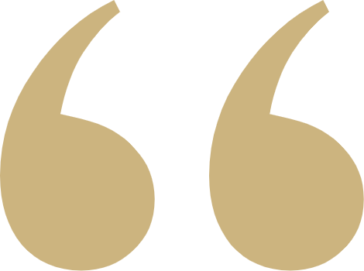
Each of us is a unique strand in the intricate web of life and here to make a contribution. What is not given, the meaning of life, is not something we can expect to receive from others but rather something we must create for ourselves.
Deepak Chopra

Slide 9
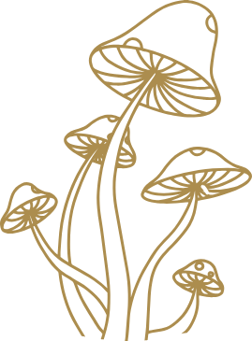
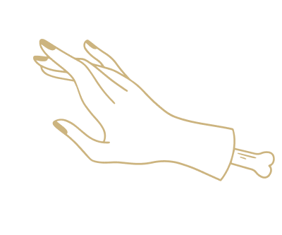
Psychological and Sociological Perspectives
Gender and the Self
Gender roles and expectations can shape the development and expression of the self.
Culture and the Self
The self is influenced by cultural values, beliefs, and practices.

Slide 10
The Three Components of Self-Concept
self-image
self-esteem
ideal self

Slide 11
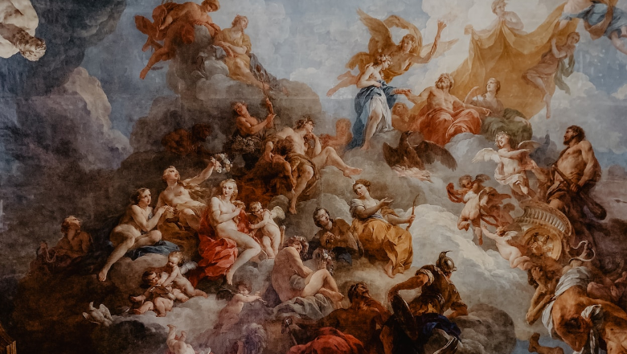
Cross-Cultural Perspectives
Collectivist cultures
Emphasize social roles and interconnectedness in defining the self
Individualist cultures
Cross-cultural perspectives challenge ethnocentric assumptions about the universality of Western conceptions of selfhood
Emphasize personal characteristics and achievements in defining the self

Slide 12
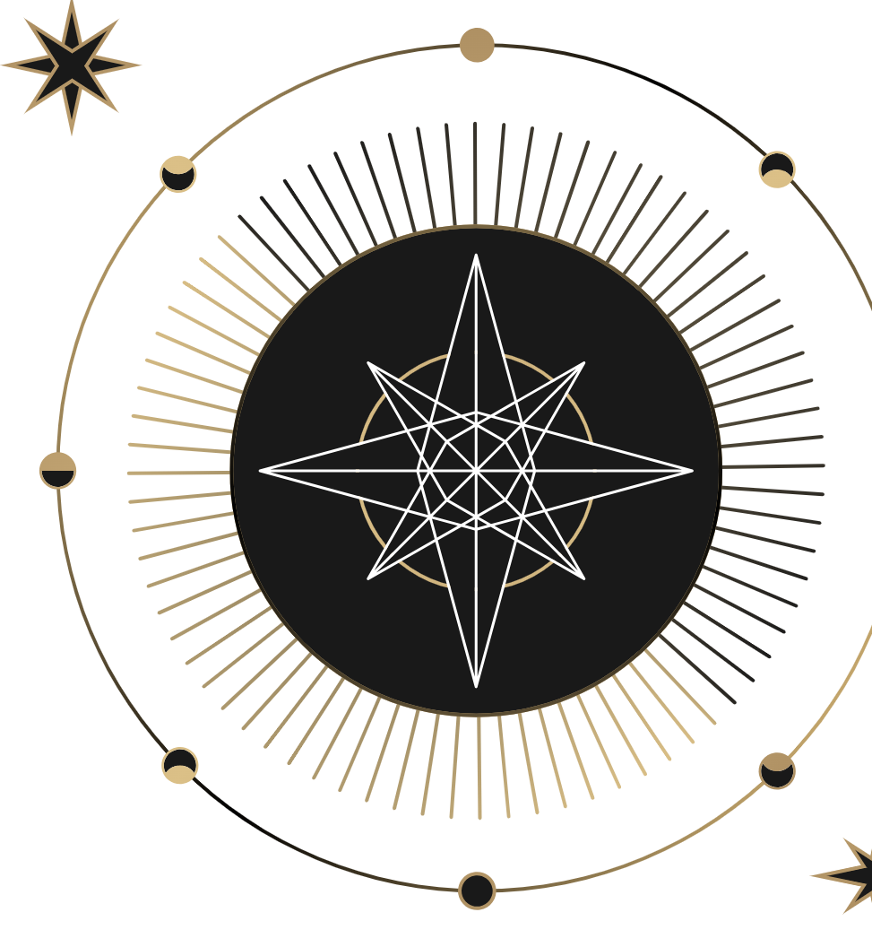
Cultural Variations
This section will focus on cultural variations in the self across different societies and communities. It will explore how cultural values, norms, and practices shape the way individuals understand and express their sense of self. We will also examine the implications of cultural variations for identity formation, interpersonal relationships, and mental health.

Slide 13
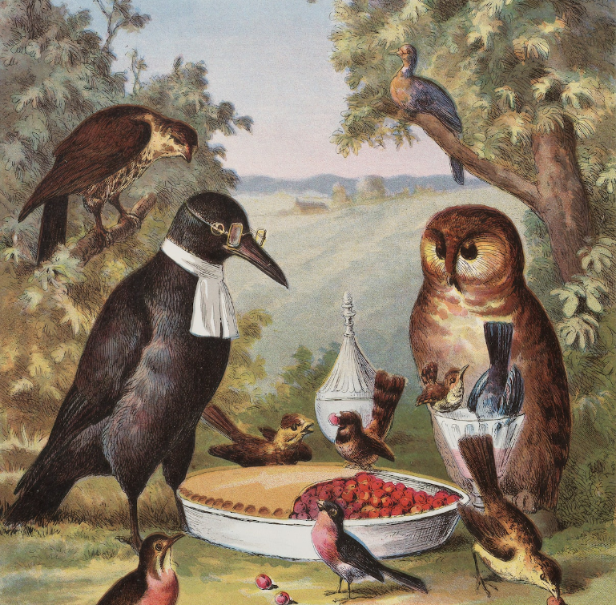
Collectivism cultures
Prioritize the needs and goals of the group over individual interests
Define the self in terms of social roles and relationships
Value harmony, cooperation, and conformity with the group
May prioritize family and community obligations over personal desires and goals
Communication is often indirect and relies on contextual cues
May have a present-oriented focus, valuing immediate satisfaction over long-term planning
Tend to have a higher power distance, accepting and respecting authority and hierarchy

Slide 14
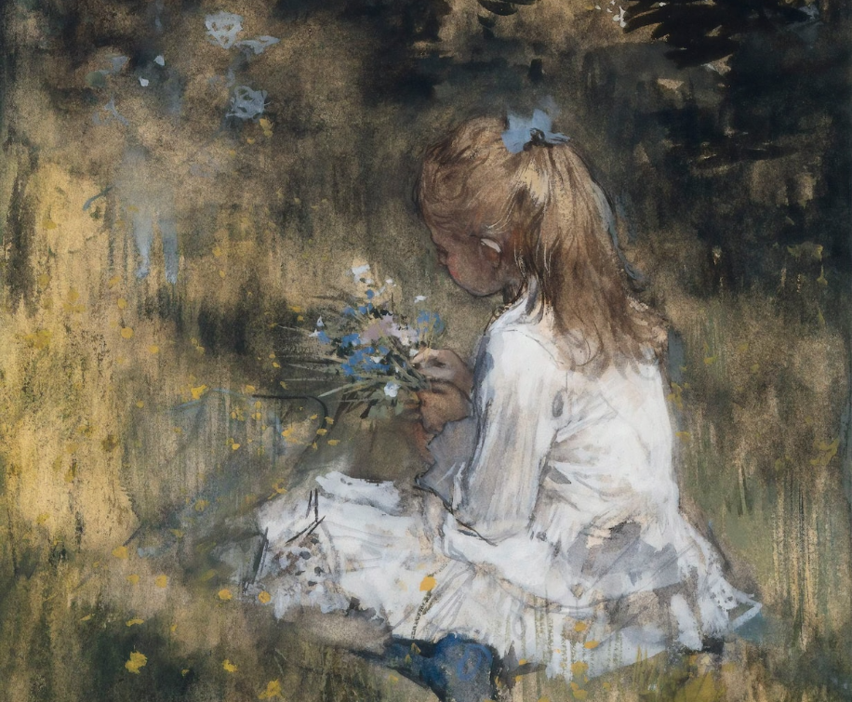
Individualistic cultures
Prioritize the needs and goals of the individual over the group
Define the self in terms of personal qualities and achievements
Value personal freedom, self-expression, and individual achievement
May prioritize personal goals and ambitions over family and community obligations
Communication is often direct and explicit
Tend to have a future-oriented focus, valuing planning and delayed gratification
Tend to have a lower power distance, valuing equality and questioning authority

Slide 15
Power Distance
below 40
A study by Smith et al. (2016) found that individuals from high power distance cultures (such as those from China and South Korea) tended to have a more collective and interdependent self-concept, while individuals from low power distance cultures (such as those from the United States and Australia) tended to have a more individualistic and independent self-concept.
Netherlands, Denmark, and Sweden
above 70
Malaysia, Mexico, and India

Slide 16
Body and Self
The body and self are intertwined in complex ways, with physical attributes, cultural values, and experiences all contributing to how individuals define themselves. Appearance, posture, and physical sensations can all shape the sense of self, and cultural norms and individual differences can influence how the body is perceived and valued.

Slide 17
Body Modification
Different cultures have different beliefs and values about the body and its role in shaping the sense of self
temple
transformation
shame

Slide 18
Illness and Disability
Self-Care
Engaging in self-care practices, such as physical exercise, healthy eating, and relaxation techniques, can improve physical and mental health outcomes.
Social Support
Treatment
Access to social support can improve physical and mental health outcomes and increase social connectedness and well-being for individuals with illness or disability.
Accessing medical treatment can significantly improve physical health outcomes and quality of life, but access may be limited by factors such as cost, location, or attitudes.

Slide 19
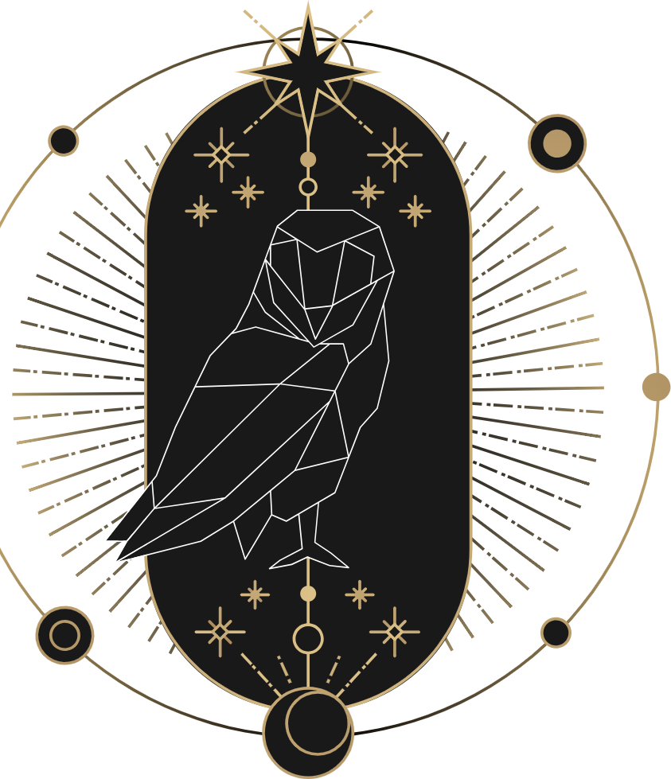
Language and Self
Language and self refers to the relationship between the way individuals use language and their sense of self, including the impact of language on self-concept, self-esteem, and identity. Language use varies across cultures and social contexts, influencing how individuals perceive themselves and how they are perceived by others.

Slide 20
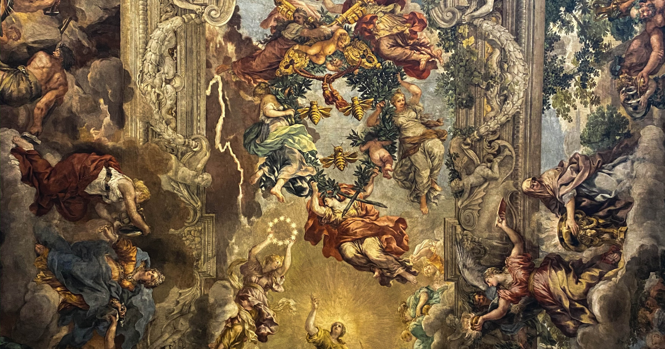
A Magic Picture

Slide 21
Linguistic Concepts Related to the Self
Linguistic Relativity
Linguistic Determinism
1
2
The idea that language influences our perceptions of reality, including our understanding of self and identity.
The idea that language determines our perceptions of reality and limits our ability to think outside of language.
Naming and Identity
Cultural Identity
3
4
The relationship between the names we are given and our sense of self, including how names can influence our perceptions.
The way language use varies across cultures, including the role of language in shaping cultural norms.

Slide 22
Indo-European
Spoken by over 3 billion people in Europe, South Asia, and the Americas.
Sino-Tibetan
Spoken by over 1.3 billion people, mainly in China and Southeast Asia.
Afro-Asiatic
Spoken by around 400 million people in North Africa and the Middle East.

Slide 23
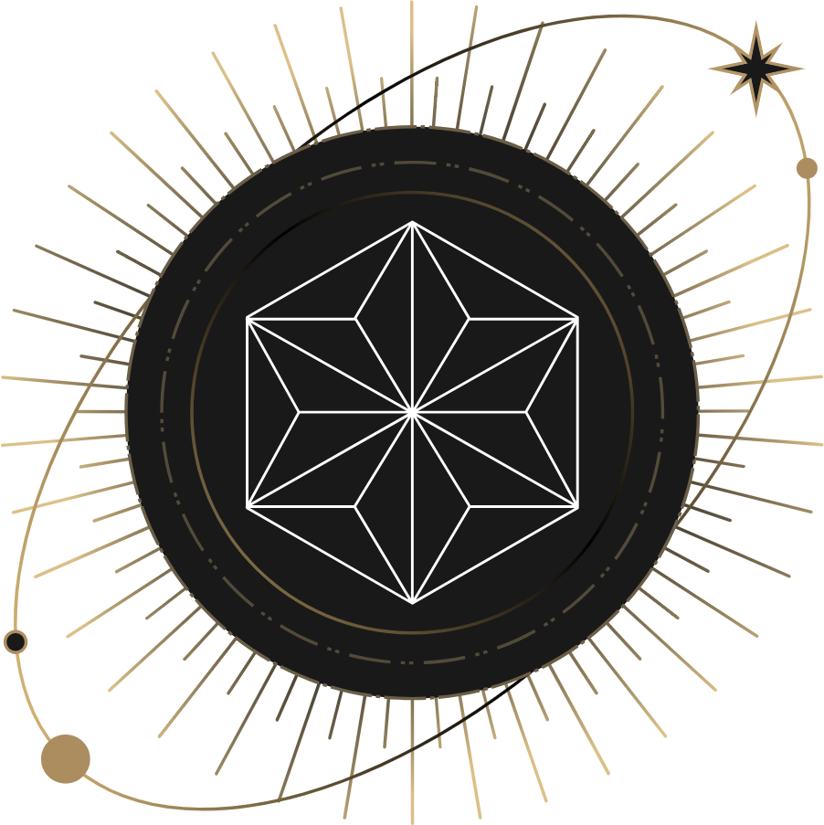
conclusion
Understanding the self in anthropology involves examining cultural variations in conceptions of self and identity, the role of power distance, the relationship between the body and self, the impact of illness and disability, and the influence of language.

Slide 24
Thank you for choosing EaTemp
We offer free and high-quality slides templates for your presentations. We appreciate you choosing us and hope our templates have been helpful.
As a new website, we rely on your support to grow, so please help us by sharing our site with your friends and colleagues.
eatemp._
@eatemp
eatempofficial
@eatemp.official

