Slide 1
SIP
- VOIP Service -
July, 2022

Slide 2

Table of Contents
Product Introduction
App Solutioning and Integrations
Use cases
User guide

Slide 3
Product Introduction

Slide 4
What is the SIP Application?
SIP App is a reliable trunking solution for better call quality at much lower call charges. The SIP Trunk supports Primary and Secondary SIP registrars. Customers can easily setup their VoIP line with options for automated DNC checking and Call Recording workflow into each and every call. They can also configure fully automated failover with shared caller ID, billing and usage history.
The SIP application is compatible to most IP Phone brands as well as traditional IP-PBX and PABX systems.

Slide 5
SIP Features
Unlimited channels for concurrent calls
Country whitelist, IP whitelist
SIP Encryption : Supports both TLS/SRTP
Connected device listing and dial plan setup
Backup line support for emergency situations
Compatibility with all SIP-enabled devices
Other apps integration (Global DNC, Call Recording)

Slide 6
App Solutioning and Integrations

Slide 7
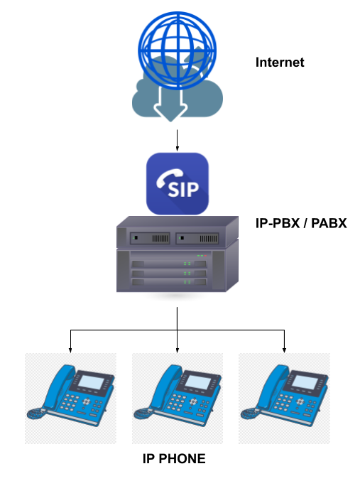
Traditional IP-PBX/PABX
In a traditional IP-PBX/PABX system, the SIP can be configured to provide the VoIP line used to make and receive calls through the connected IP Phones. IVR (auto-attendant), call distribution (to extensions), and other call flow requirements are configured in the IP-PBX system itself.
In addition, the SIP can also be integrated as a gateway to connect existing PSTN lines to IP-PBX/PABX systems.

Slide 8
Use Cases

Slide 9
Condominium/Residential Building
Solution:
SIP trunk integrated to building’s security system; Audio telephony system used for door access
Energy Solutions Provider
Solution:
Branch office telephony system integrated to MS Teams

Slide 10
User Overview

Slide 11
Account

Slide 12
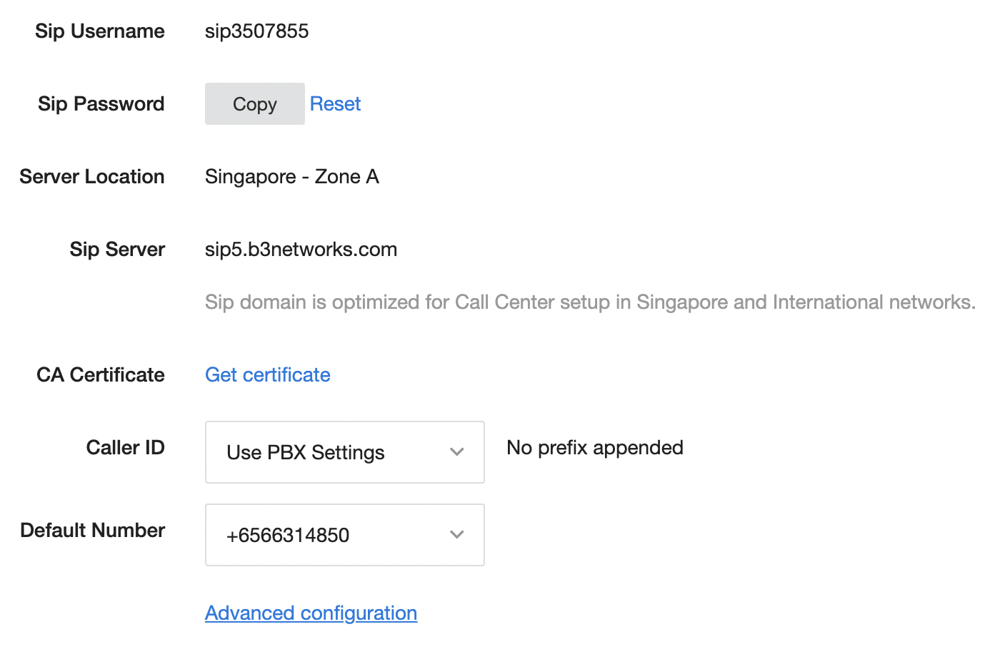
[Account] Setting Info: Account Info
SIP credentials: For provisioning
(Register, Make Calls)
Select option for Caller ID.
Specific numbers
Anonymous
SIP number*
PBX setting*
Set default number for caller*
*When client sends incorrect caller ID, this number will be used.

Slide 13
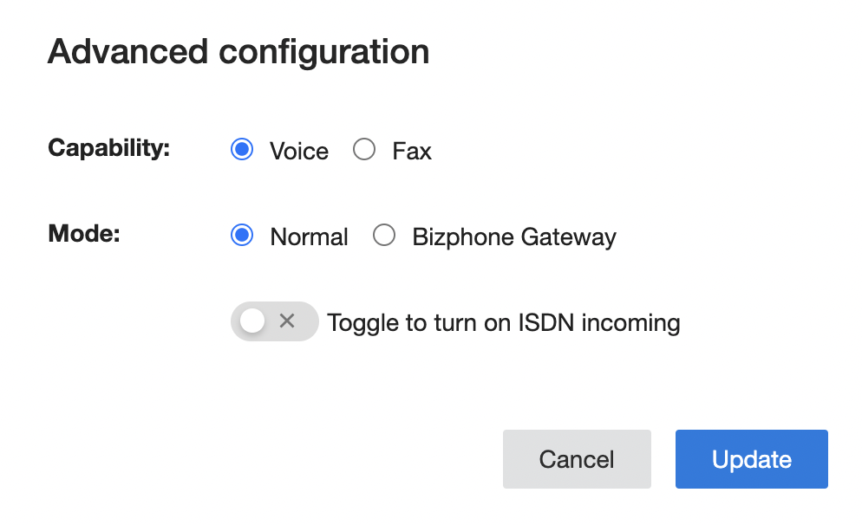
[Account] Setting Info: Account Info
Capability: Our SIP supports both Call and Fax services based on your needs.
  Call: this SIP account is registered on SIP-enabled devices for Call services.
  Fax: this SIP account is registered on SIP-enabled devices for FAX services.
Mode:
  Bizphone Gateway: this SIP account is integrated into Bizphone and is used as Bizphone Gateway.
  Normal: this SIP account is used for normal SIP-enabled devices.
ISDN: for ISDN customers only. If you have ISDN services and want to connect with our cloud services, please contact us for more information. For normal usage, please do not turn it on.

Slide 14
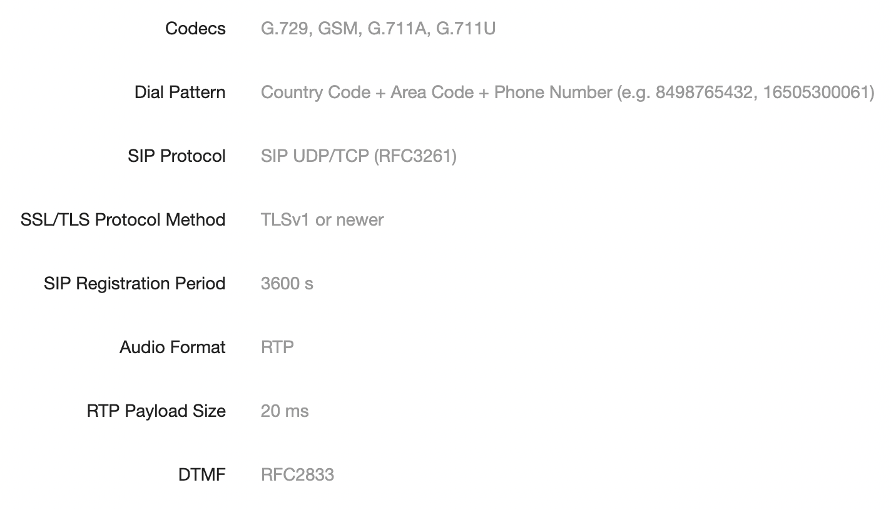
[Account] Setting Info: SIP Basic Configuration
Supported Codecs
How to dial a number/make a call
Transport protocol: TCP vs UDP
TCP gives more control
UDP lighter
TLS (secure)
DTMF mode supports only RFC2833. (IVR)

Slide 15
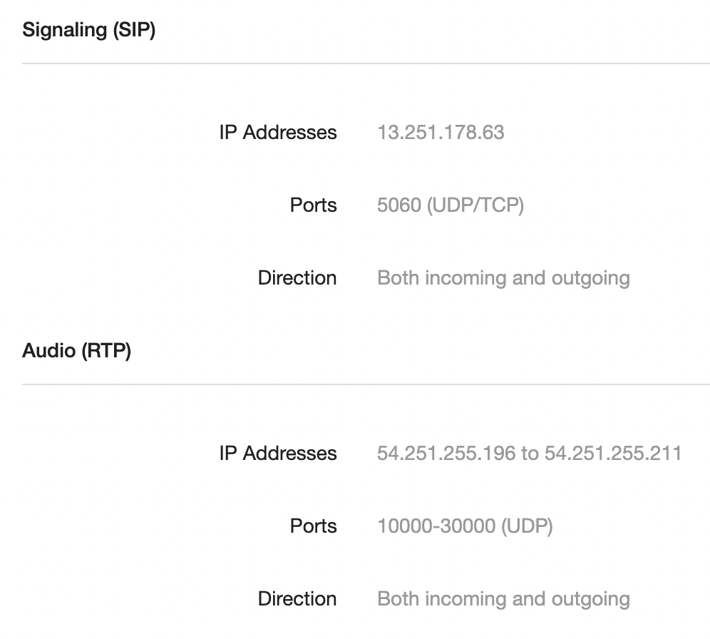
[Account] Setting Info: Firewall Configuration
FIREWALL is a network security system that monitors and controls the incoming and outgoing network traffic based on predetermined security rules
Voice call = Audio + Signaling
*Make sure Firewall allows traffic following the rules mentioned in the SIP App

Slide 16
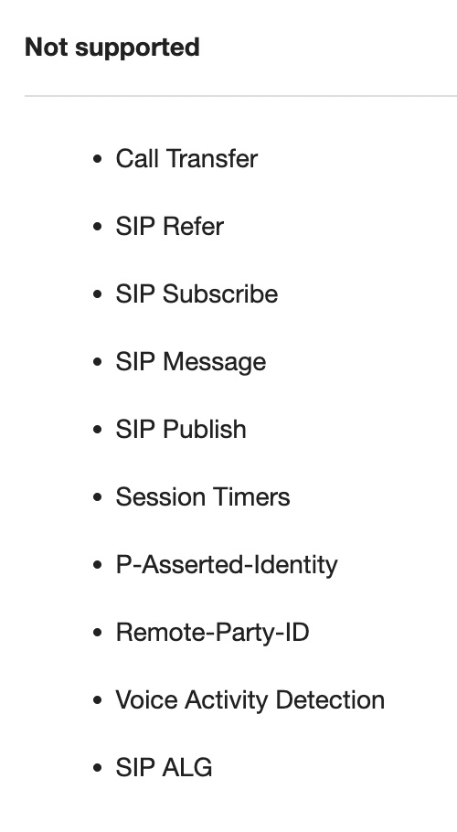
[Account] Setting Info: Not Supported
Call Transfer
SIP Refer
SIP Subscribe
SIP Message
SIP Publish
Session Timers
P-Asserted-Identity
Remote-Party-ID
Voice Activity Detection
SIP ALG

Slide 17
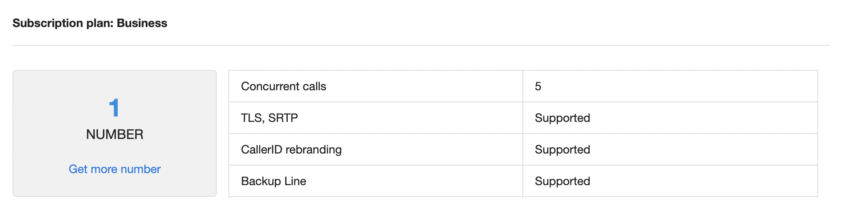
[Account] Subscription Info
SIP Plan
Click here to see which number(s) belong to this SIP account

Slide 18
Dial Plan

Slide 19
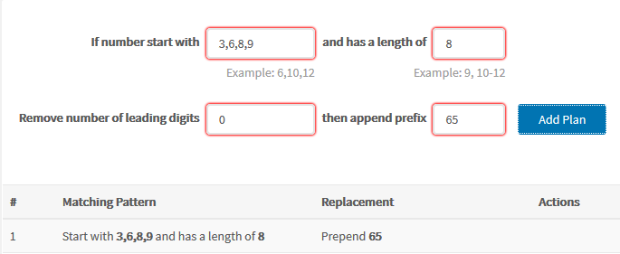
[Dial Plan]
Dial plan is the expected sequence of digits dialed by subscriber to access specific telephone networks for telephone calls.
Below is an example of a dial rule for local calls in Singapore. Normally, user must press 65XXXXXXXX to place a call. After the dial rule is applied, caller just needs to dial 8 digits if the leading digit is 3,6, 8 or 9.

Slide 20
Incoming Call Rule

Slide 21
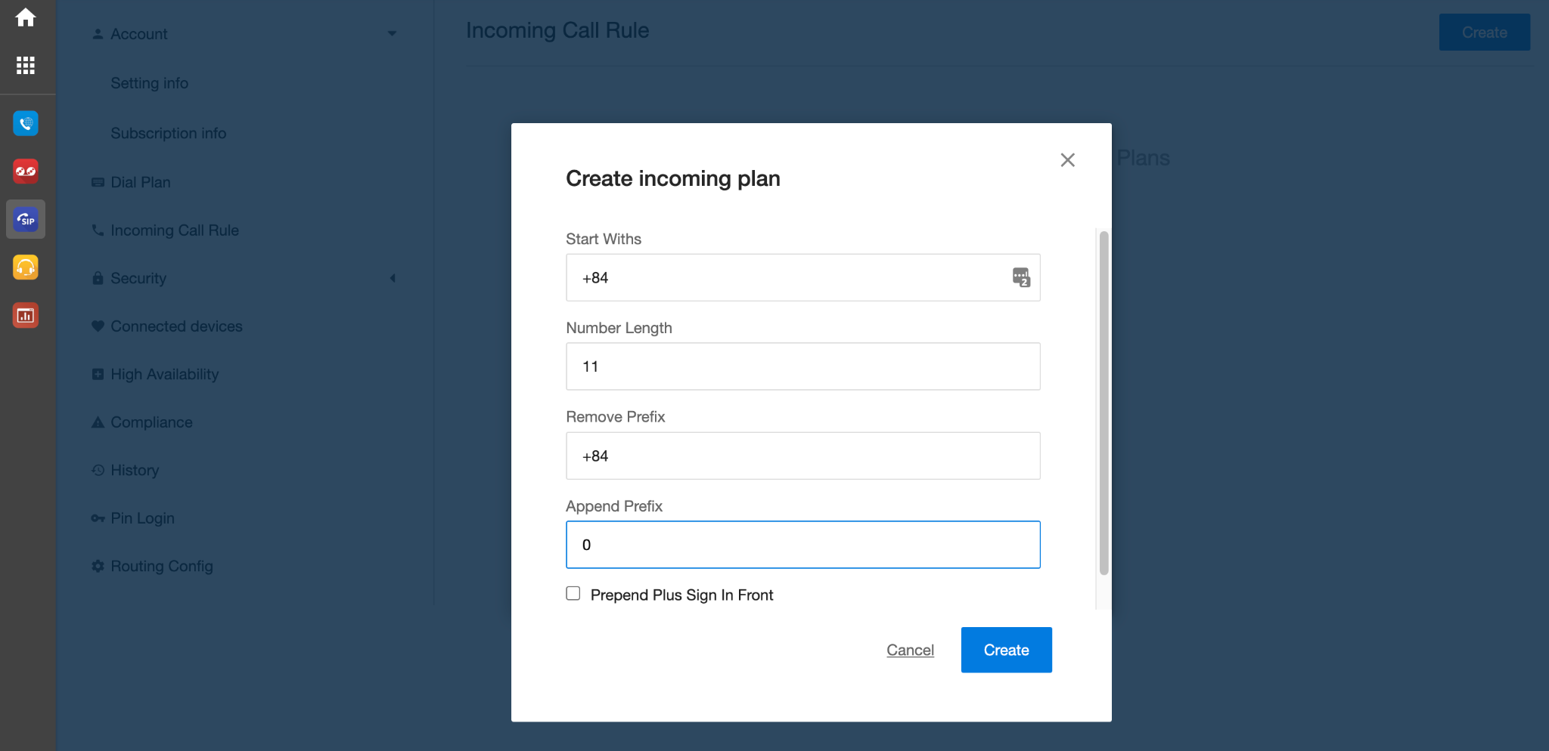
[Incoming Call Rule]
As a default, the system will display this standard Caller ID on the recipient's side when users make outgoing calls:
<country code> + <area code> + <destination>
However, this might let the recipients think it is a number calling overseas. Therefore, this Incoming Call Rule will help override how the recipients see the Caller ID.
To set the Incoming Call Rule, please follow the steps below:
Click on the Create button
Fill in the required fields:
  Start With
  Number Length
  Remove Prefix
  Append Prefix
  Prepend Plus (+) Sign in front
Create

Slide 22
Security

Slide 23
[Security]
Customer SIP devices
B3Networks
Destination
IP
Country Code
 | IP White List | Country White List
Direction | Outgoing | Outgoing
Based on Information | Device’s Source IP | Destination (Dialed Number)
Failure message | “The number you are calling is currently unavailable, please try again later” | “Destination country is blocked”

Slide 24
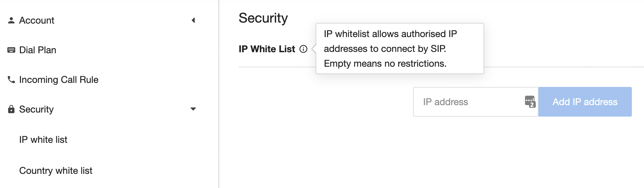
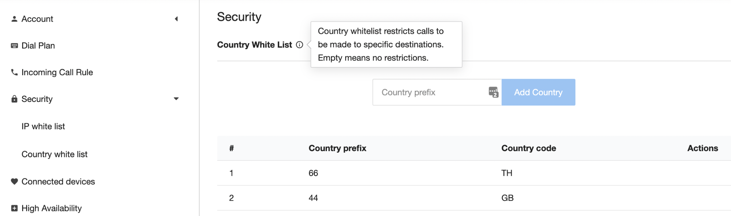
[Security]
IP address:
  Internet Protocol address is a numerical label assigned to each device participating in a computer network for communication.
  IPv4 Address: AAA.BBB.CCC.DDD (start 0.0.0.0 to 255.255.255.255)
  By Default SIP trunk allows all IP source.
Country code:
  Telephone dialing prefixes for the member countries of the International Telecommunication Union (ITU)
Example:
Vietnam +84
Singapore +65
USA/Canada +1
France +33
By Default SIP trunk allows all country codes.

Slide 25
Connected Devices

Slide 26
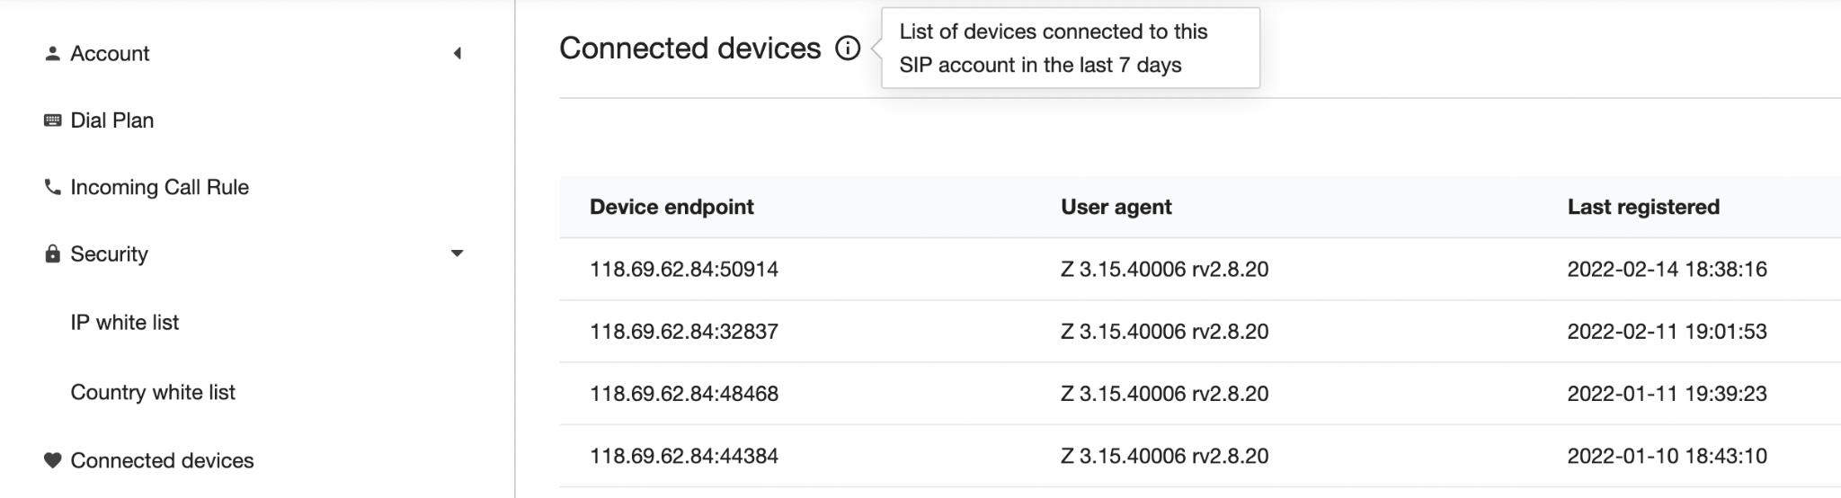
[Connected devices]
<IP Address>:<Port>
Device Type
Register Time

Slide 27
High Availability

Slide 28
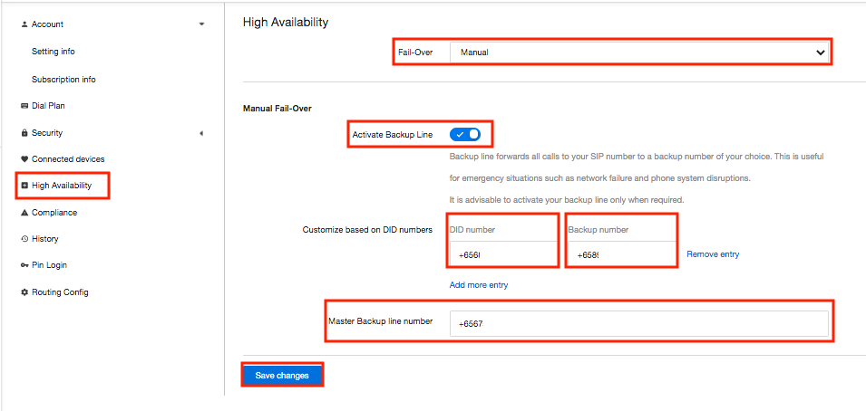
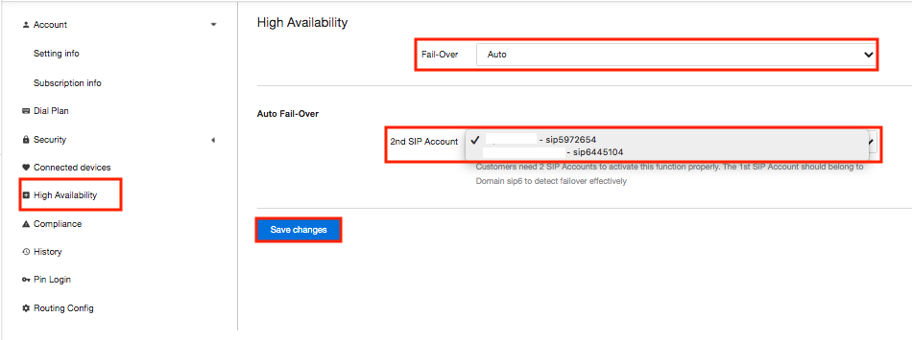
[High Availability]
This feature allows users to forward all the incoming calls of the SIP number to a backup number (e.g. a mobile number or a working landline number) or another SIP account.
Activate this feature only in emergencies such as Internet outage, PBX, IP Phone disruption.
There are 2 types of backup operation mode:
Manual Fail-Over:
For handling PBX downtime (Cloud PBX solution or Call Center Solution).
Forwarding all the incoming calls to internal or external numbers.
Auto Fail-Over:
For handling SIP downtime.
Forwarding all the incoming calls to the 2nd SIP Account.

Slide 29
Compliance

Slide 30
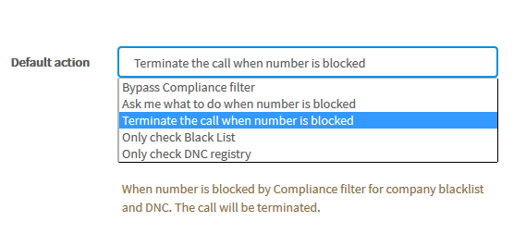
[Compliance]
This feature is used to define which action to be taken when calling to DNC numbers.
(Only appears when SIP has DNC addon license)

Slide 31
History

Slide 32
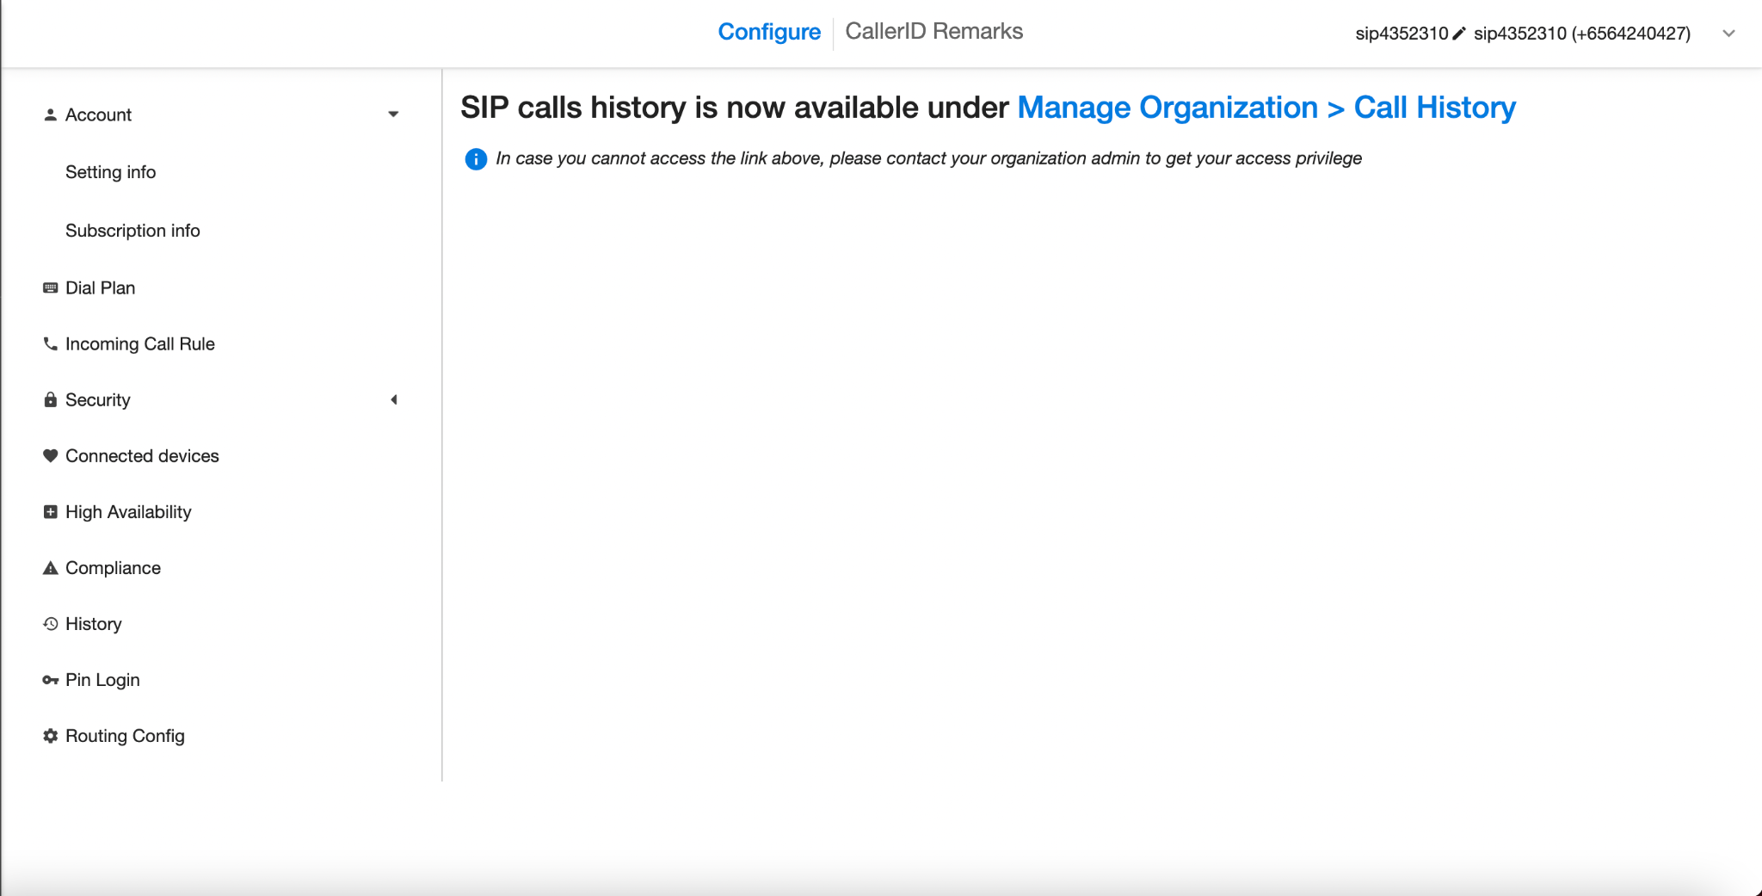
[Call History]
**User can only access the call history for SIP app using the Unified Call History.

Slide 33
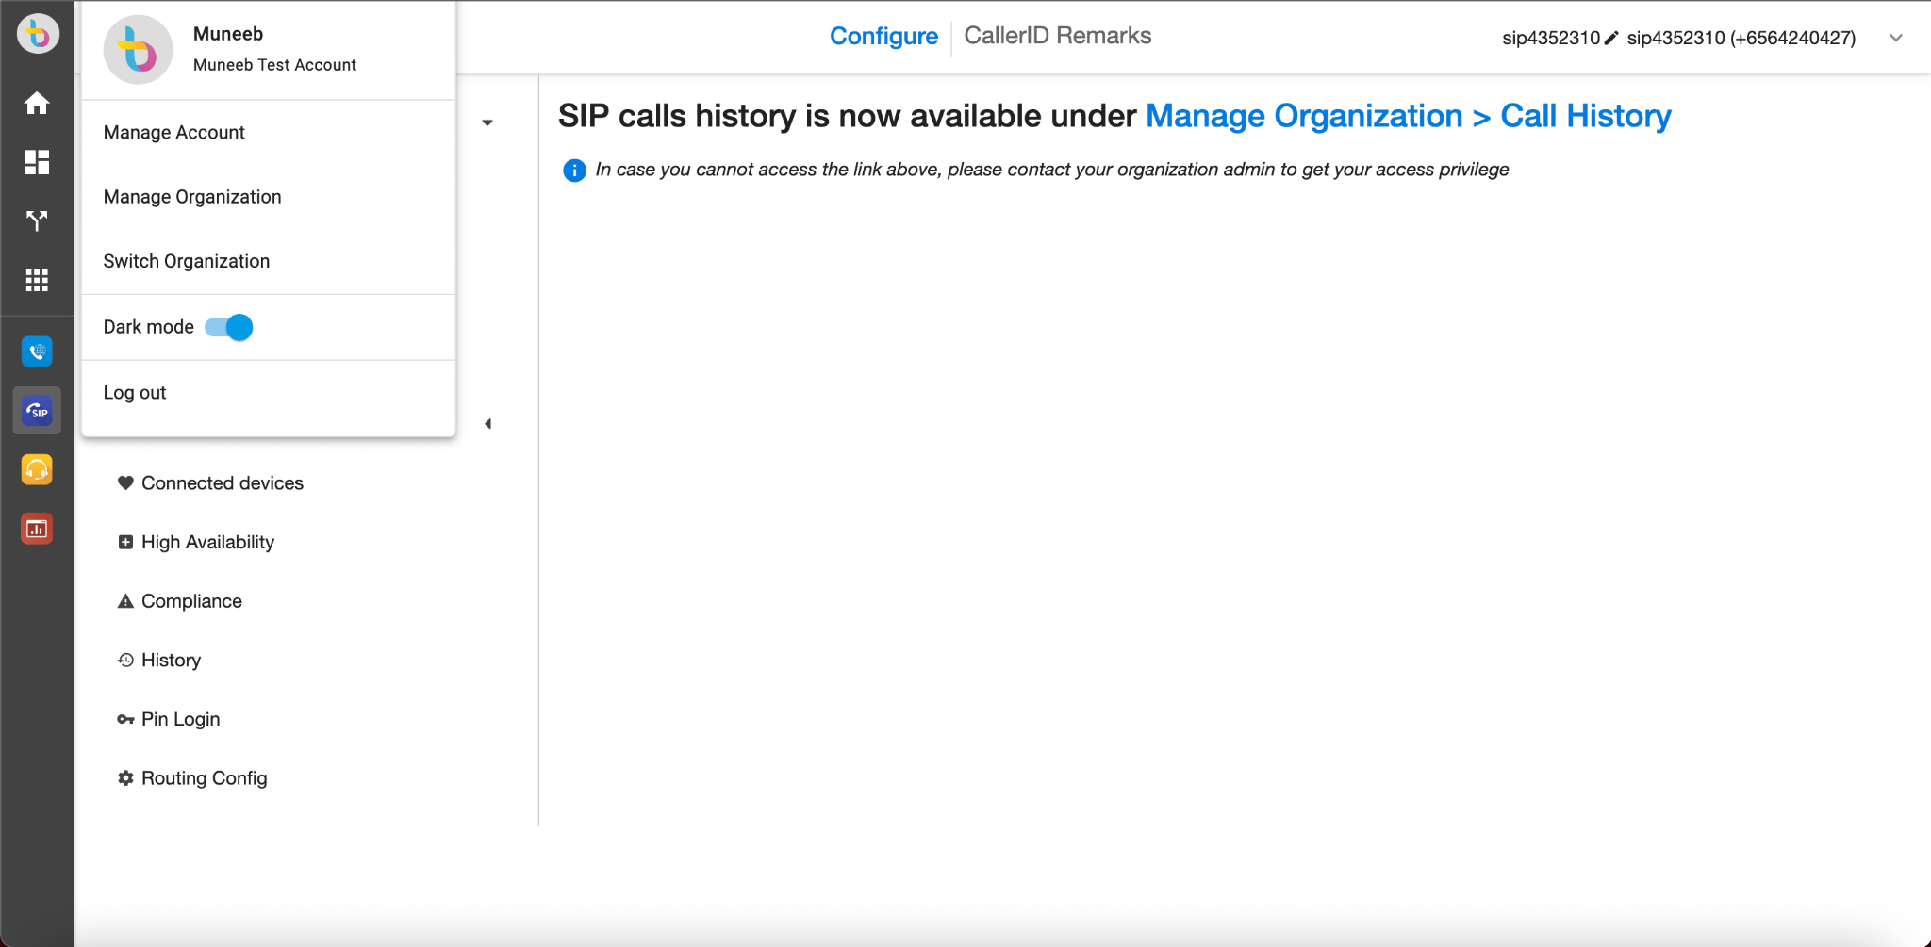
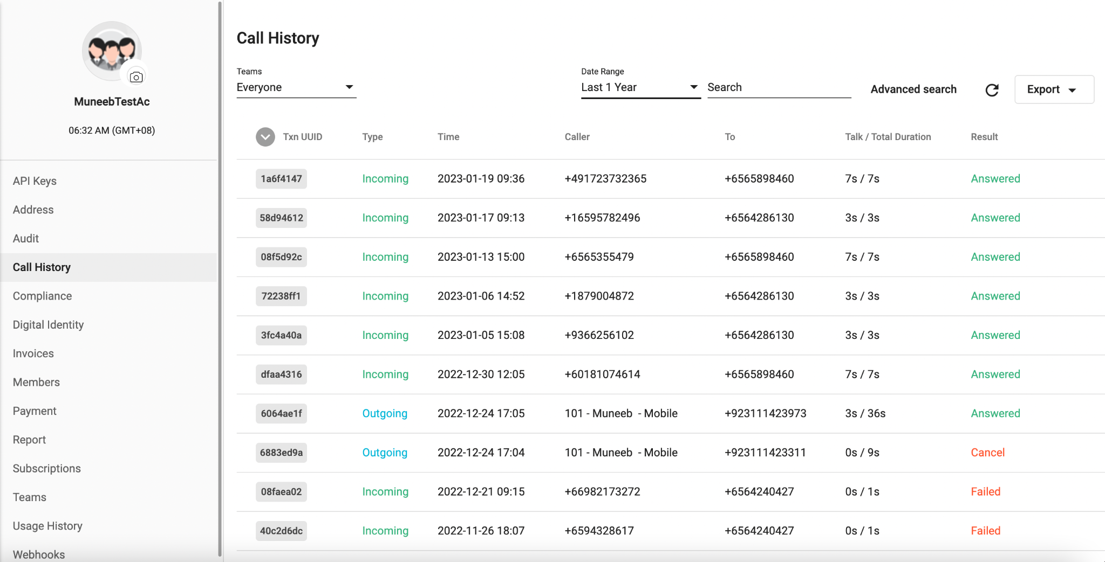
[Call History]
In order to access the call history:
Click on Top Left Profile Icon > Click Manage Organizations
Manage Organizations tab > Click on Call History

Slide 34
Pin Login

Slide 35
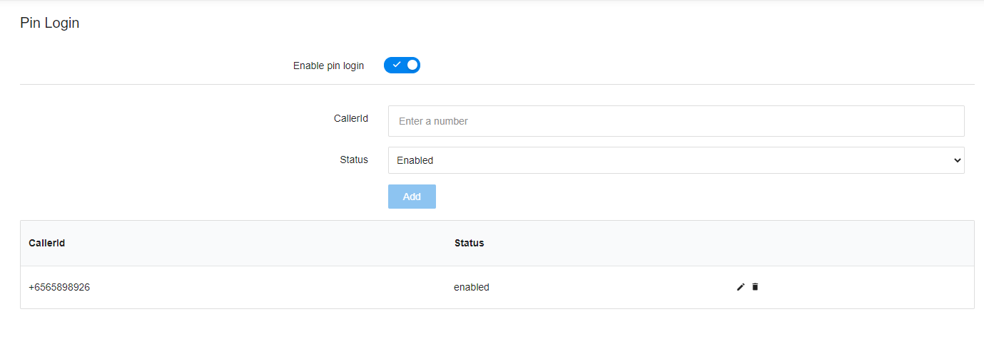
[PIN Login]
*Logging in with PIN before dialing would offer the user a trace to see who made a specific call.

Slide 36
Routing Config

Slide 37
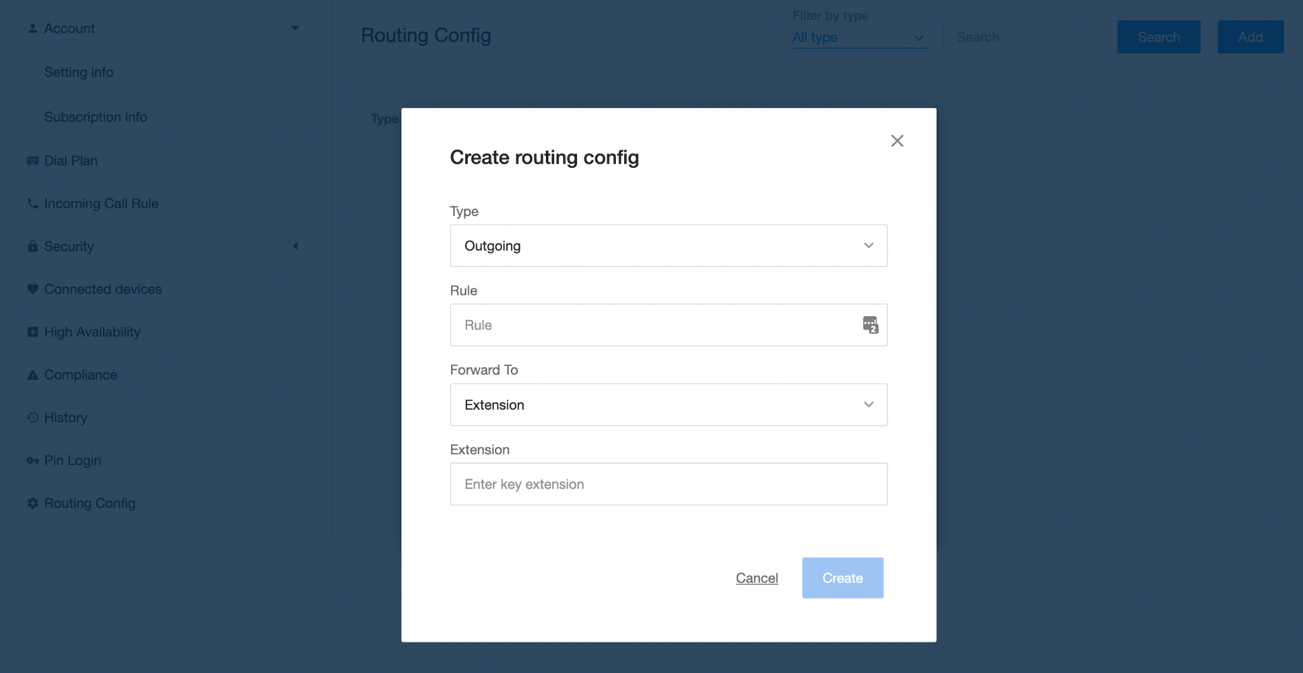
[Routing Config]
This is a SIP feature that allows user to route the calls to the numbers within their Organization.
To set a routing rule, please follow the steps below:
Click on the Add button
Fill in the required fields:
  Type:
    ISDN Incoming
    Outgoing
  Rule
  Forward To:
    SIP
    Extension
    Number
Create
Regular Expression
^ - indicates the beginning of a regular expression
( - indicates the beginning of a standard expression block - blocks are essential to define inner terms so they can be referenced by the variables $1, $2, $3, etc.;
) - closes the block;
[0-9] - matches one digit in the range from 0 to 9 (0,12, 3, 4, 5, 6, 7, 8, and 9), and as you also guessed, the [ ] pair of brackets encloses a range; other range examples: [1-9] matches 1 to 9
{8} - defines the number of occurrences for the previous expression,
$ - indicates the end of the regular expression
. - match any character
* - Matches zero or more consecutive characters
Visit this link for more information

