Slide 1




Types of transducer: thermistor
Active or Passive?
Passive
Analog or digital?
Analog (resistance)
Controller
Signal
Transducer
Excitation
$V_{X}$ (relative to ground)
+
$$R=f\left(T\right)$$
-
$V_{S}$ (relative to ground)
ground
$$T=f^{−1}\left(R\right)$$
Calibration – Campbell manual for
Model 107 thermistor probe

Slide 2
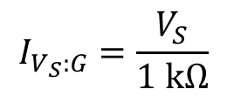
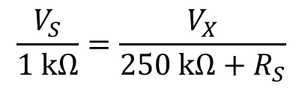
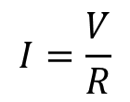




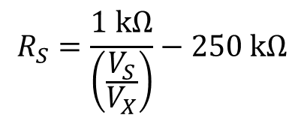
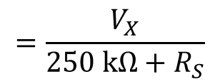
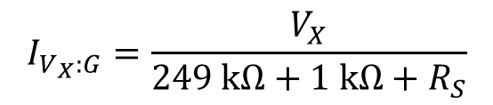
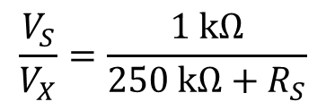
Measuring resistance with a half bridge
Ohm’s law: the electrical potential across a circuit element is the product of the current and resistance
$$I=\frac{V}{R}$$
$$I_{V_{S}:G}=\frac{V_{S}}{1 kΩ}$$
$$I_{V_{X}:G}=\frac{V_{X}}{249 kΩ+1 kΩ+R_{S}}$$
$$=\frac{V_{X}}{250 kΩ+R_{S}}$$
$$V=IR$$
Kirchhoff’s current law (continuity): Total current entering a junction must equal total current leaving a junction
$$\frac{V_{S}}{1 kΩ}=\frac{V_{X}}{250 kΩ+R_{S}}$$
$$\frac{V_{S}}{V_{X}}=\frac{1 kΩ}{250 kΩ+R_{S}}$$
$$R_{S}=\frac{1 kΩ}{\left(\frac{V_{S}}{V_{X}}\right)}−250 kΩ$$
$$I_{V_{S}:G}=I_{V_{X}:G}$$
$V_{X}$ (relative to ground)
$$R_{S}+249 kΩ=f\left(T\right)$$
$V_{S}$ (relative to ground)
ground
$$T=f^{−1}\left(R\right)$$
$1$kΩ
Calibration – Campbell manual for
Model 107 thermistor probe

Slide 3












Data loggers: thermistor example
$$TEMP−Red$$
$$SHIELD−Clear$$
$R_{S}+$ 249kΩ
$$EX TEMP−Green$$
$$SENSOR$$
Interface
$$V_{S}$$
$$V_{X}$$
$1$kΩ
$$DATALOGGER$$
$$SE TEMP−Red −SE$$
$$AG−White−Ground$$
$$EX TEMP−Green−VX$$
$$SHIELD−Clear−Ground$$
Controller
Input/Output
Keypad / Liquid Crystal Display (CR850)
Micro-Processor/-Controller
Power Supply
Memory

Slide 4
Transduction of information: thermistors
Demonstration
Thermistor in Campbell CS547A –
Temperature and Electrical Conductivity Probe
Making a ohm meter
Programming inference of temperature from a thermistor

