Slide 1
SMS Marketing
July 2022

Slide 2

Table of Contents
Features
Use cases
User guide

Slide 3
Introduction

Slide 4
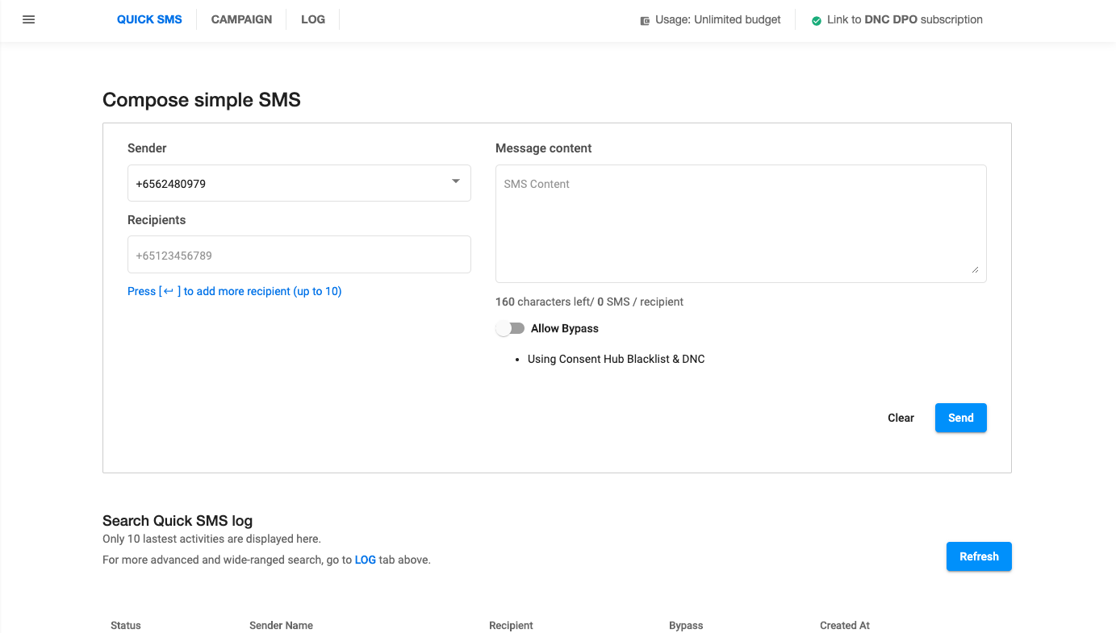
What is the SMS Marketing application?
A web application that is designed for businesses who need to send 1000’s of SMS to their customers as part of their marketing plans and campaigns.
Allowing users to send a Quick SMS, create a Campaign and have a view of all Quick SMS Logs.

Slide 5
Features
Sender name customization.
Merge tag to auto personalise your message.
Contact database to upload, add, edit, and manage.
Auto unsubscribe via web form to stay legally compliant.
Integrate with Global DNC to automatically filter out DNC numbers from the recipient list.

Slide 6
Use Cases

Slide 7
1. Real estate firm
Requirement/s:
Sending out SMS to existing subscribers in the company database with regards to a new property launch
Solution:
Setting up the SMS Marketing application and importing the list of users in a CSV format with their mobile phone numbers, first name and last name.
Post campaign report and with the number of users that may have unsubscribed from future SMS marketing messages
* DNC checks (Singapore only) may be added on if the campaign is targeted to the general public.

Slide 8
2. Spa and wellness business
Requirement/s:
Sending out SMS to users with the company name (ABC Wellness) to inform customers about their booking appointment.
Solution:
Setting up SMS Marketing allowing the company to send out “quick SMS” with the company name reflected as the SMS Sender Name / ID.

Slide 9
User Guide

Slide 10
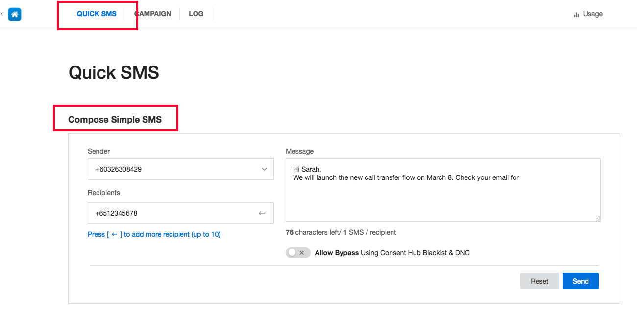
Sending out an Individual SMS
Go to Quick SMS
Select Sender ID
Add recipient's number
Compose SMS
Send

Slide 11
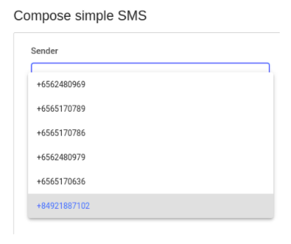
Sending out an Individual SMS - cont’d
Sender ID can be:
Your registered number
Applications’ numbers
Rebranding number/name

Slide 12
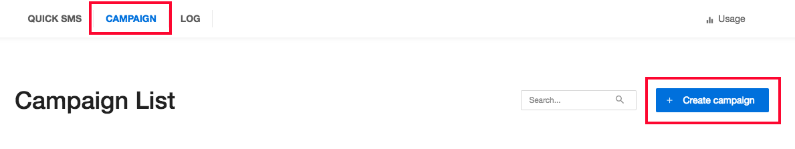
Sending out a SMS Campaign
Go to Campaign
Create campaign

Slide 13
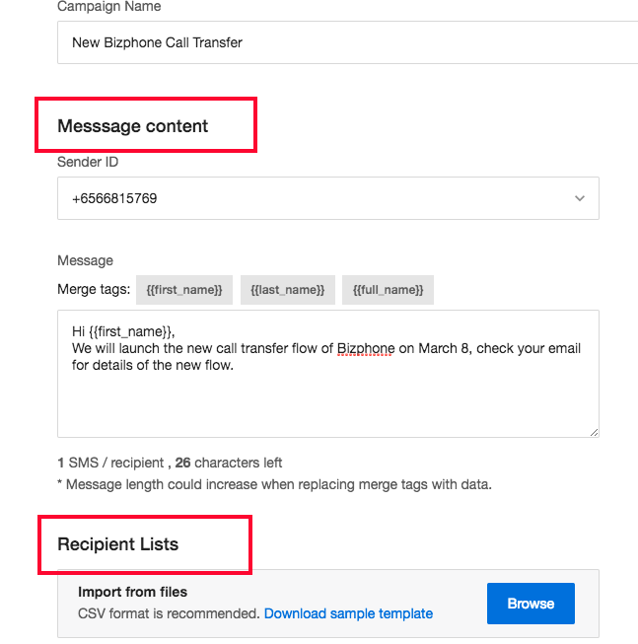
Sending out a SMS Campaign - cont’d
Choose Sender ID
Draft message content
Add Recipient List
You can use Merge tags to customize your SMS

Slide 14
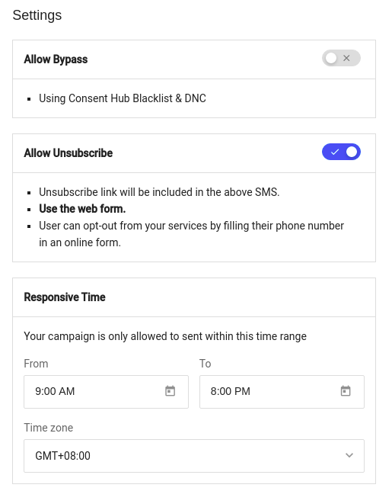
Sending out a SMS Campaign - cont’d
Allow Unsubscribe
Set up Responsive Time
  To allow your campaign to be only sent within a certain time range
SMS’s can be checked against Singapore’s DNC registry and internal whitelist/blacklist with DNC services.

Slide 15
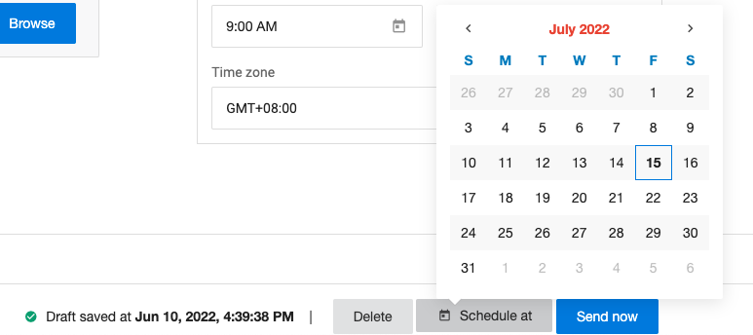
Sending out a SMS Campaign - cont’d
Send Now / Schedule At

Slide 16
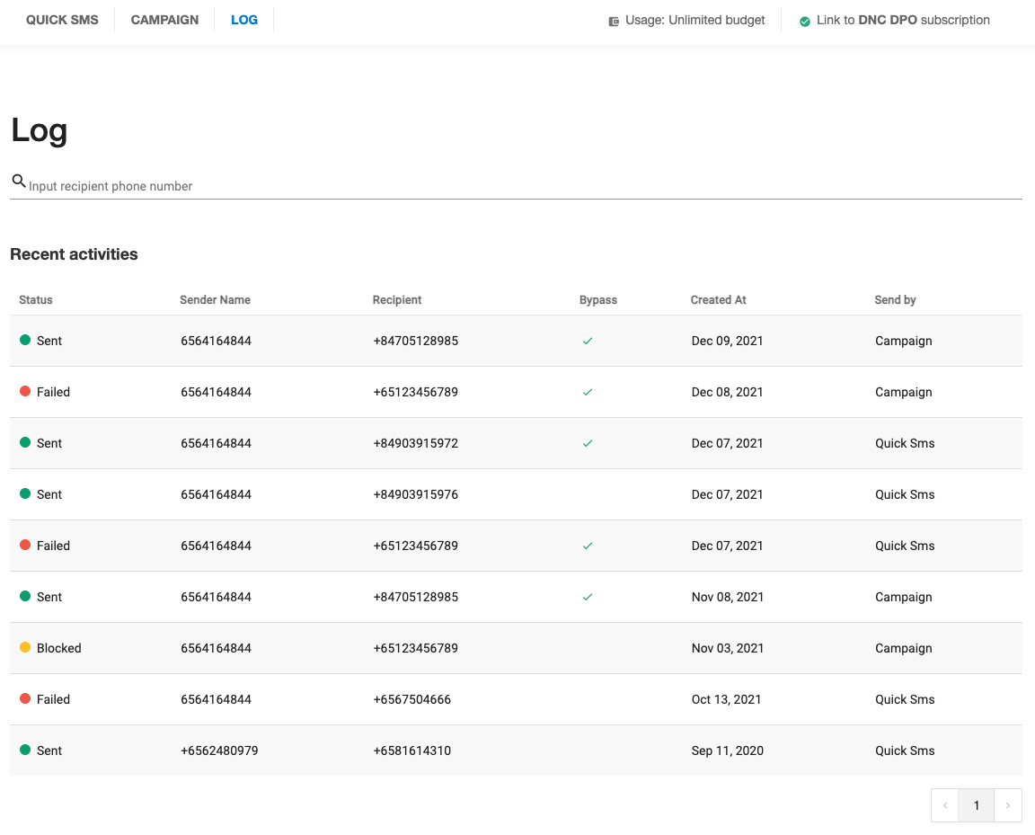
View SMS logs
Logs of all the SMSes with the status can be viewed in the log tab.

Slide 17
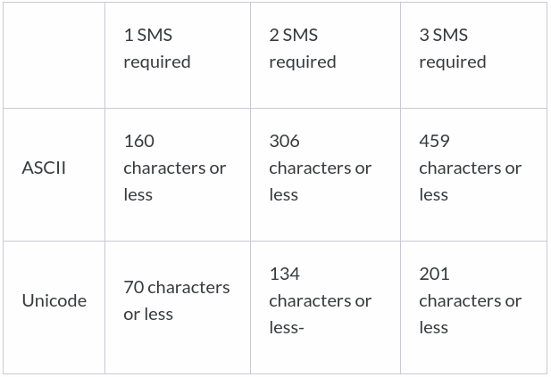
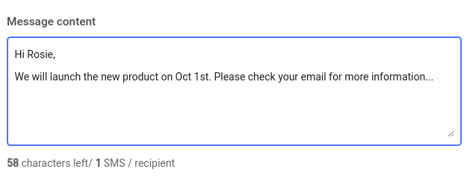
Message character limits and number of SMS required

