Slide 1


Table of Contents
1
Introduction
2
Background
3
Methodology
Introduce the fantasy world and its inhabitants.
Overview of the topic and why it is important
Research methods used to gather information.
2023
2023
Thesis Defenses
FREE PRESENTATION TEMPLATE
Thesis Defenses
Thesis Defenses
4
Findings
5
Discussion
6
Conclusion
The findings of the research.
Interpret the findings and explain what they mean.
Summarize the key findings and their implications.

Slide 2


Introduction
1
2023
2023
Table of Contents
1
Introduction
2
Background
3
Methodology
Introduce the fantasy world and its inhabitants.
Overview of the topic and why it is important
Research methods used to gather information.
4
Findings
5
Discussion
6
Conclusion
The findings of the research.
Interpret the findings and explain what they mean.
Summarize the key findings and their implications.
Thesis Defenses
Thesis Defenses
The Fantasy Realm: Uncovering the Secrets of the Imagination and the Magic that Lies Within

Slide 3

Magic has been a fundamental element of the fantasy genre since its inception, and its role in shaping the societies and politics of imaginary worlds is significant. Within these worlds, magic often serves as a metaphor for power, and its use by individuals and groups can have far-reaching consequences for the balance of power in society. In this paper, we explore the role of magic in the politics of the fantasy world and its impact.
2023
2023
1
Introduction
The Fantasy Realm: Uncovering the Secrets of the Imagination and the Magic that Lies Within
Thesis Defenses
Thesis Defenses
The world of fantasy is a reflection of our deepest desires, our fondest dreams, and our wildest imaginations. It's a place where we can let go of the constraints of reality and explore the boundless possibilities of the human mind. In this introduction, we will delve into the mysteries of this realm, uncovering the magic and wonder that lies within. So come with us and let's embark on a journey through the Fantasy World.

Slide 4


2023
2023
Fantasy is the gateway to the impossible, the land where the ordinary becomes extraordinary, and the impossible becomes possible. It is the realm of the imagination, where anything can happen and everything is possible.
Introduction
Magic has been a fundamental element of the fantasy genre since its inception, and its role in shaping the societies and politics of imaginary worlds is significant. Within these worlds, magic often serves as a metaphor for power, and its use by individuals and groups can have far-reaching consequences for the balance of power in society. In this paper, we explore the role of magic in the politics of the fantasy world and its impact.
The world of fantasy is a reflection of our deepest desires, our fondest dreams, and our wildest imaginations. It's a place where we can let go of the constraints of reality and explore the boundless possibilities of the human mind. In this introduction, we will delve into the mysteries of this realm, uncovering the magic and wonder that lies within. So come with us and let's embark on a journey through the Fantasy World.
Thesis Defenses
Thesis Defenses
Master Wizard Zoltar, The Politics of Magic in the Fantasy World.

Slide 5
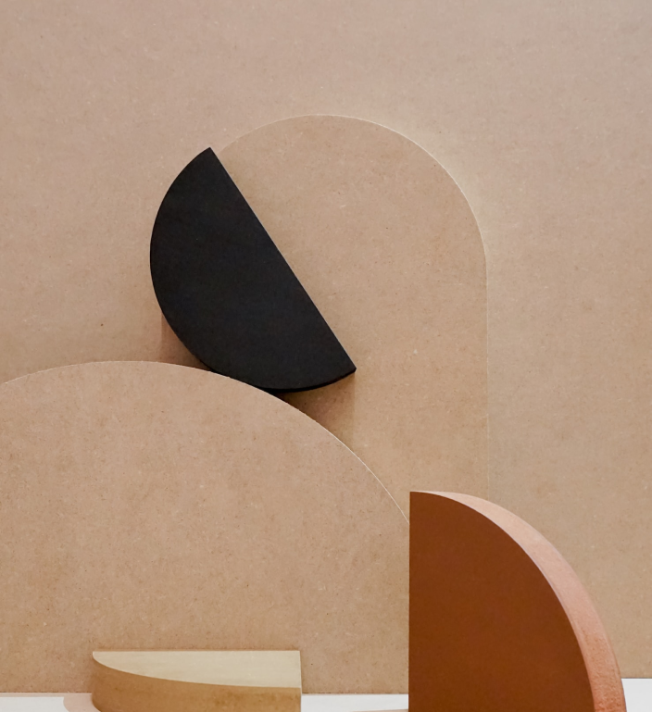


Background
2023
2023
Fantasy is the gateway to the impossible, the land where the ordinary becomes extraordinary, and the impossible becomes possible. It is the realm of the imagination, where anything can happen and everything is possible.
Power Imbalances
Not all individuals or groups in the fantasy world have equal access to magic.
Thesis Defenses
Ethical Questions
Thesis Defenses
Master Wizard Zoltar, The Politics of Magic in the Fantasy World.
The use of magic in politics raises important questions about the nature of power, ethics, and justice.

Slide 6

Definition of Key Terms
Dragons
Fire-breathing creatures that are often powerful and dangerous
Medieval-like Settings
Worlds with castles, knights, and feudal systems
Chosen One Trope
A hero chosen by destiny to save the world
Magic
An integral part of fantasy stories, can take many forms
The Best Curse
A curse that is unique, creative, and fits within the story
Unique Creatures
A variety of fantastical beings that inhabit the world
2023
2023
Background
Power Imbalances
Not all individuals or groups in the fantasy world have equal access to magic.
Ethical Questions
Thesis Defenses
Thesis Defenses
The use of magic in politics raises important questions about the nature of power, ethics, and justice.

Slide 7


Literature Review
Unicorn Sightings
This topic will explore the phenomenon of unicorn sightings in the fantasy world, including their cultural and symbolic significance, as well as the possible factors that contribute to their elusive nature.
2023
2023
Definition of Key Terms
Dragons
Fire-breathing creatures that are often powerful and dangerous
Medieval-like Settings
Worlds with castles, knights, and feudal systems
Chosen One Trope
A hero chosen by destiny to save the world
Magic
An integral part of fantasy stories, can take many forms
The Best Curse
A curse that is unique, creative, and fits within the story
Thesis Defenses
Thesis Defenses
Unique Creatures
A variety of fantastical beings that inhabit the world
Dragon Taming
The art of dragon taming in the fantasy world, including the different methods and techniques used by characters in popular fantasy literature, as well as the ethical implications of taming such powerful creatures.

Slide 8







Objectives
Dragon Taming
2023
2023
Literature Review
Unicorn Sighting
Unicorn Sightings
Dragon Taming
Spellcasting
This topic will explore the phenomenon of unicorn sightings in the fantasy world, including their cultural and symbolic significance, as well as the possible factors that contribute to their elusive nature.
The art of dragon taming in the fantasy world, including the different methods and techniques used by characters in popular fantasy literature, as well as the ethical implications of taming such powerful creatures.
Thesis Defenses
Thesis Defenses
Treasure Hunt

Slide 9





Methodology
2023
2023
Objectives
Research
his involves discussing the overall strategy and plan for conducting the research.
Unicorn Sighting
Dragon Taming
Data Analysis
This involves outlining the methods used to gather data, such as conducting interviews, surveys.
Thesis Defenses
Spellcasting
Treasure Hunt
Data Collection
This involves describing the process of analyzing the data, such as using thematic analysis or content analysis.
Comparision
This involves acknowledging any limitations to the research design or data collection methods.

Slide 10

Data Collection
2023
2023
Methodology
Research
Data Collection
his involves discussing the overall strategy and plan for conducting the research.
This involves describing the process of analyzing the data, such as using thematic analysis or content analysis.
Data Analysis
Comparision
This involves outlining the methods used to gather data, such as conducting interviews, surveys.
This involves acknowledging any limitations to the research design or data collection methods.
Thesis Defenses
Thesis Defenses
Item Name
Price
Enchanted Sword
500 Gold Coins
Spellbook of the Elders
700 Gold Coins
Staff of the Archmage
643 Gold Coins
Phoenix Feather Cloak
875 Gold Coins
Amulet of Invisibility
124 Gold Coins
Cursed Mirror
673 Gold Coins
Dragon's Hoard Chest
908 Gold Coins

Slide 11




Data Analysis
25%
100%
2023
2023
Data Collection
12
Item Name
Price
10
Enchanted Sword
500 Gold Coins
8
Spellbook of the Elders
700 Gold Coins
6
Staff of the Archmage
643 Gold Coins
Phoenix Feather Cloak
875 Gold Coins
4
Amulet of Invisibility
124 Gold Coins
2
Cursed Mirror
673 Gold Coins
Thesis Defenses
Thesis Defenses
0
Dragon's Hoard Chest
908 Gold Coins
2015
2016
2017
2018
2019
2020
2021

Slide 12
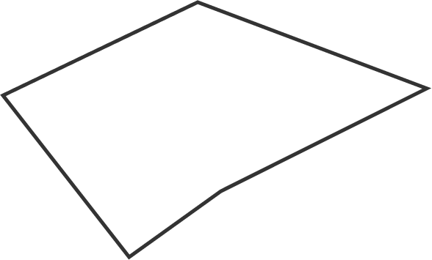
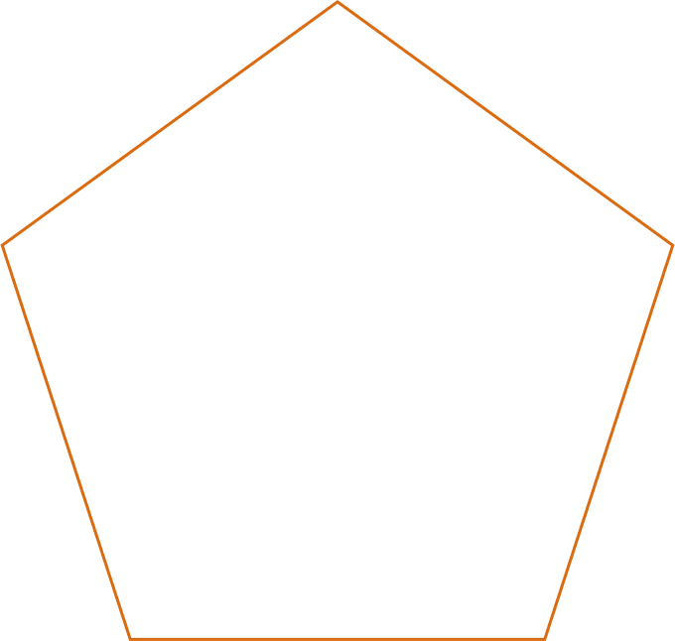
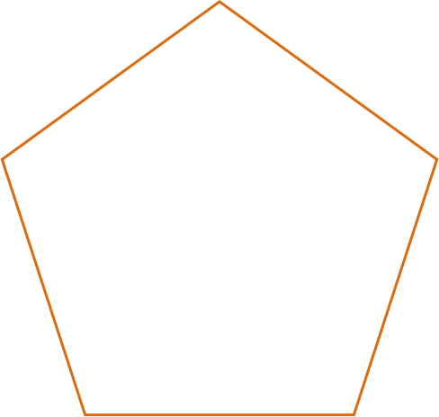
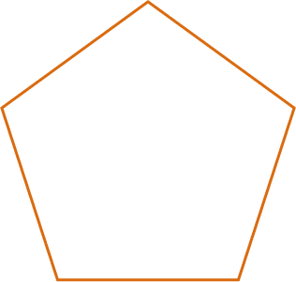
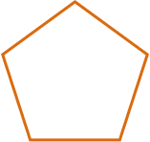
Findings
2023
2023
Data Analysis
100%
12
10
Adventure: 75%
8
6
25%
4
Mystery: 85%
Magic: 90%
Thesis Defenses
2
Thesis Defenses
The journey of self-discovery and the exploration of the human imagination are just as important as the creatures and wonders that populate this realm. Here, you can reflect on your deepest desires and fulfill your fondest dreams. The realm is a place where you can let go of the constraints of reality and explore the boundless possibilities of the mind.
0
2015
2016
2017
2018
2019
2020
2021
Danger: 50%
Wonder: 20%

Slide 13

Result Analysis
75%
Enchanted Creatures
possess the ability to cast spells.
2023
2023
Findings
Adventure: 75%
The journey of self-discovery and the exploration of the human imagination are just as important as the creatures and wonders that populate this realm. Here, you can reflect on your deepest desires and fulfill your fondest dreams. The realm is a place where you can let go of the constraints of reality and explore the boundless possibilities of the mind.
60%
Magic-Wielding Individuals
Mystery: 85%
Magic: 90%
practice the art of illusions.
Thesis Defenses
Thesis Defenses
Danger: 50%
Wonder: 20%
90%
Spells Cast
are dark magic, foretelling danger.

Slide 14





Unicorn Sightings
A record of the number of unicorns spotted in the fantasy realm and the beauty and mystery.
Result Analysis
2023
2023
Result Analysis
75%
Enchanted Creatures
possess the ability to cast spells.
60%
Magic-Wielding Individuals
practice the art of illusions.
90%
Spells Cast
are dark magic, foretelling danger.
Thesis Defenses
Thesis Defenses
Dragon Taming
A closer look at the art of taming dragons and the brave adventurers who dare to take on these fearsome creatures.

Slide 15

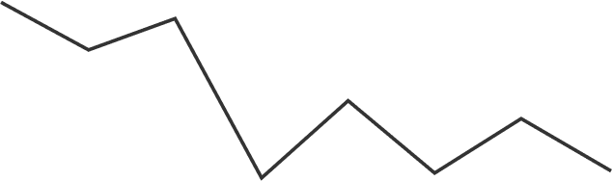
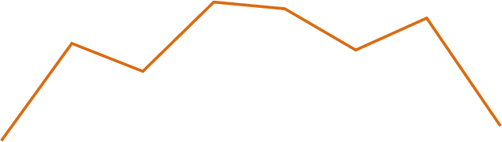


100
90
80
70
60
50
40
30
20
10
0
1
2
3
4
5
6
7
8
Treasure Found
A record of the amount of treasure found per month
Result Analysis
Spellcasting Progress
A record of the number of spells cast per year
2023
Result Analysis
2023
Unicorn Sightings
A record of the number of unicorns spotted in the fantasy realm and the beauty and mystery.
Dragon Taming
Thesis Defenses
A closer look at the art of taming dragons and the brave adventurers who dare to take on these fearsome creatures.
Thesis Defenses
34.574
Total

Slide 16


Discussion
2023
Result Analysis
2023
1
Discover the secrets
100
Explore the lush, vibrant forest and uncover the mysteries that lie within.
90
80
70
60
50
34.574
40
Total
30
20
10
0
1
2
3
4
5
6
7
8
2
Find your own path
Thesis Defenses
Spellcasting Progress
Treasure Found
Thesis Defenses
Choose your own path through the forest, and see where it takes you.
A record of the number of spells cast per year
A record of the amount of treasure found per month
Meet the creatures
3
Encounter the mythical creatures that call the forest home, from talking animals to mischievous fairies.

Slide 17

Discussion
2023
Discussion
2023
Taming Dragons and Sighting Unicorns: A Guide to the Realm of Magic and Adventure
1
Discover the secrets
Explore the lush, vibrant forest and uncover the mysteries that lie within.
In the Realm of Magic and Adventure, dragons are no longer fearsome beasts to be feared. They can be tamed and even become loyal companions to those brave enough to venture into the unknown. Similarly, unicorns, long considered to be mythical creatures, can now be sighted in this fantastical realm. The world is filled with endless possibilities and endless adventures.
2
Find your own path
Choose your own path through the forest, and see where it takes you.
Meet the creatures
3
Encounter the mythical creatures that call the forest home, from talking animals to mischievous fairies.
Thesis Defenses
Thesis Defenses

Slide 18



Unicorn Sightings
47.1%
Taming Dragons and Sighting Unicorns: A Guide to the Realm of Magic and Adventure
2023
Discussion
2023
In the Realm of Magic and Adventure, dragons are no longer fearsome beasts to be feared. They can be tamed and even become loyal companions to those brave enough to venture into the unknown. Similarly, unicorns, long considered to be mythical creatures, can now be sighted in this fantastical realm. The world is filled with endless possibilities and endless adventures.
Thesis Defenses
Thesis Defenses
Dragon Taming
15.6%
Conclusion

Slide 19
Conclusion
The Elves: A Glimpse into Their World
Elegant inhabitants of enchanted forests, known for their mastery of magic and their close connection to nature. They possess an innate sense of harmony and balance, making them protectors of the natural world.
2023
Conclusion
2023
Dragon Taming
Unicorn Sightings
15.6%
47.1%
Thesis Defenses
Thesis Defenses
  Elves are mythical beings often depicted as magical and mysterious creatures in fantasy literature.
  Studying elves in fantasy literature is important to understand the cultural and symbolic significance of the elf archetype.
  The objective of this thesis is to provide a deeper insight into the world of elves in fantasy literature.
  Elves have been a part of mythology and folklore in various cultures, such as Norse mythology and Celtic folklore.

Slide 20

Thank You
2023
2023
Conclusion
The Elves: A Glimpse into Their World
  Elves are mythical beings often depicted as magical and mysterious creatures in fantasy literature.
  Studying elves in fantasy literature is important to understand the cultural and symbolic significance of the elf archetype.
  The objective of this thesis is to provide a deeper insight into the world of elves in fantasy literature.
  Elves have been a part of mythology and folklore in various cultures, such as Norse mythology and Celtic folklore.
Elegant inhabitants of enchanted forests, known for their mastery of magic and their close connection to nature. They possess an innate sense of harmony and balance, making them protectors of the natural world.
Thesis Defenses
Thesis Defenses

Slide 21






Thank you for choosing EaTemp
2023
2023
Thank You
Thesis Defenses
Thesis Defenses
We offer free and high-quality slides templates for your presentations. We appreciate you choosing us and hope our templates have been helpful.
As a new website, we rely on your support to grow, so please help us by sharing our site with your friends and colleagues.
eatemp._
@eatemp
eatempofficial
@eatemp.official

Slide 22
2023
2023
Thank you for choosing EaTemp
We offer free and high-quality slides templates for your presentations. We appreciate you choosing us and hope our templates have been helpful.
As a new website, we rely on your support to grow, so please help us by sharing our site with your friends and colleagues.
eatemp._
@eatemp
Thesis Defenses
Thesis Defenses
eatempofficial
@eatemp.official

