Slide 1
ROMAN COLISEUM
Free Template
Here is where your presentation begins

Slide 2
Table of contents
01.
02.
03.
History of ancient Rome
Types of constructions
Recognized architects
You can describe the topic of the section here
You can describe the topic of the section here
You can describe the topic of the section here

Slide 3
Whoa!
This can be the part of the presentation where you introduce yourself, write your email…

Slide 4
01.
History of ancient Rome
You can enter a subtitle here if you need it

Slide 5
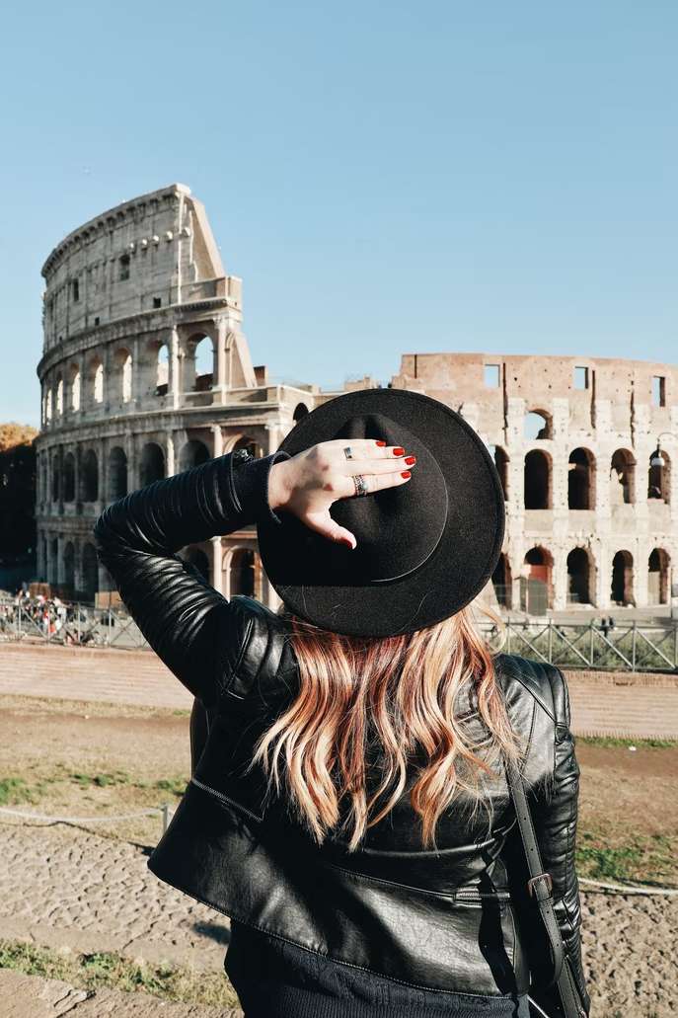
Roman architecture
You can give a brief description of the topic you want to talk about here. For example, if you want to talk about Mercury, you can say that it’s the smallest planet in the entire Solar System

Slide 6
509 BC
503
Roman architecture emerges in
with the establishment of the Roman Republic
The years that this empire lasted were
Roman Empire existed for five centuries

Slide 7
The stages of the Roman Empire
The High Empire
The Lower Empire
From 27 BC to 305 AD
From 305 AD to 476 AD
Venus is the second planet from the Sun
Saturn is a gas giant and has several rings

Slide 8
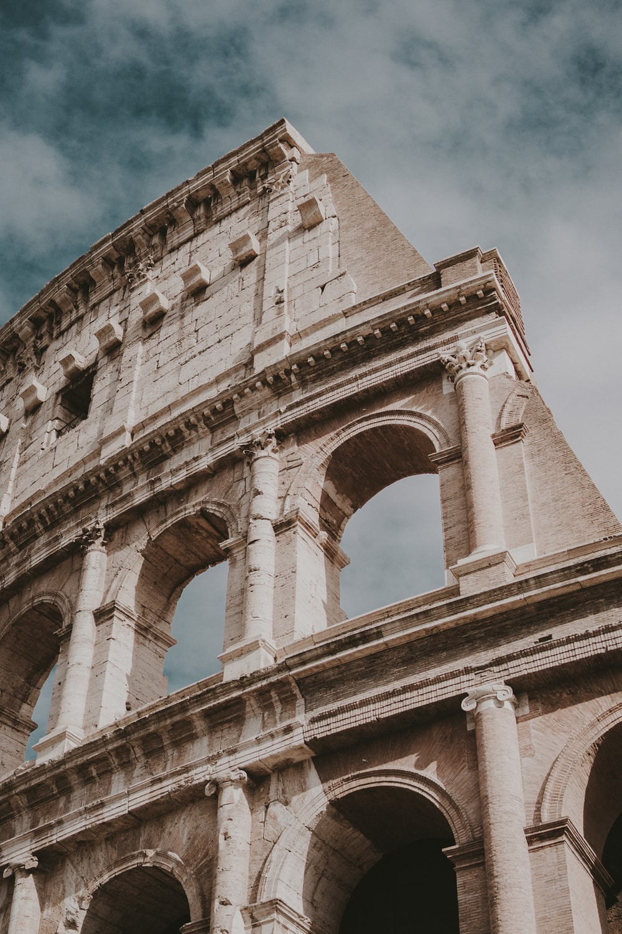
Characteristics of architecture
Do you know what helps you make your point clear?
Lists like this one:
They’re simple
You can organize your ideas clearly
You’ll never forget to buy milk!
And the most important thing: the audience won’t miss the point of your presentation. Let’s use lists!

Slide 9
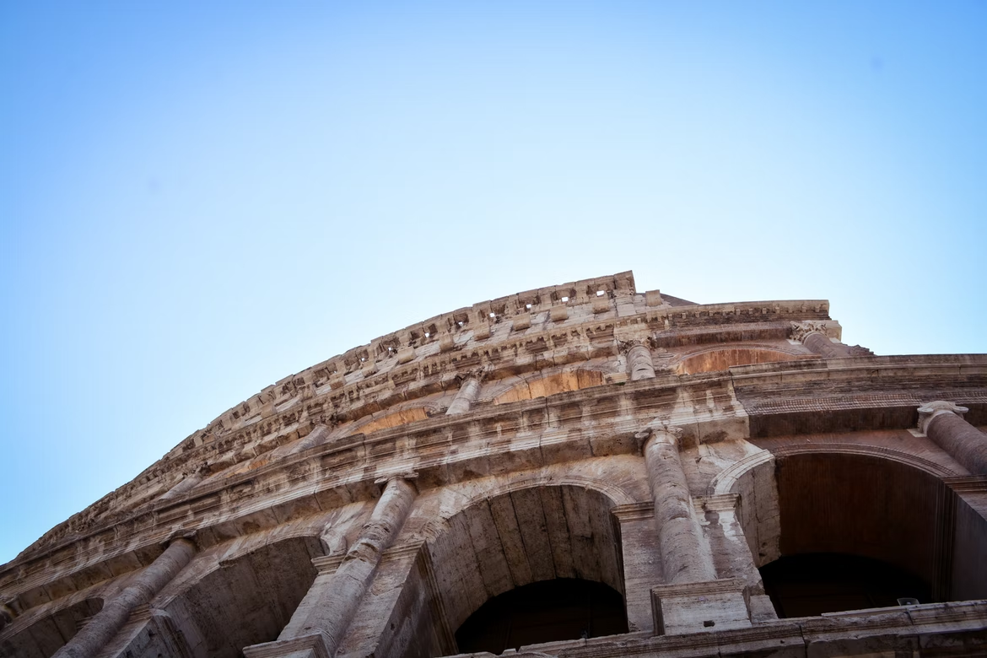
150,000
Big numbers catch your audience’s attention

Slide 10
Architectural boom
54
Venus is the second planet from the Sun
Between the years
Mars is full of iron oxide dust
The time between the reigns of Nero to Constantine I
Saturn is a gas giant and has several rings
337

Slide 11
Places with the most architectural influence
Mercury
Mercury is a small planet
Venus
Mars
Venus has a very toxic atmosphere
Mars is full of iron oxide dust

Slide 12
Urban design
Jupiter is a gas giant and the biggest planet in the Solar System. It's the fourth-brightest object in the night sky. It was named after the Roman god of the skies and lightning

Slide 13
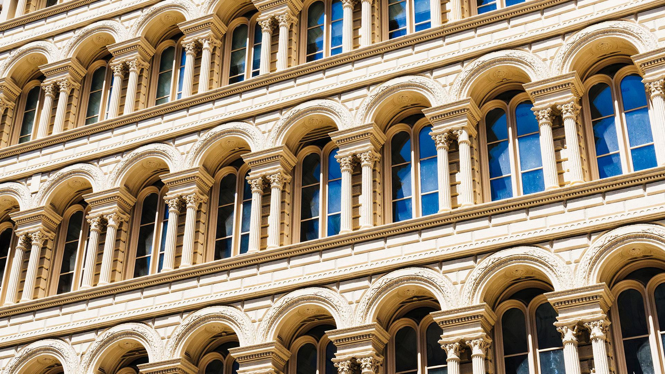
A picture is worth a thousand words

Slide 14
Influence of architecture in the world
Despite being red, Mars is actually a cold place. It's full of iron oxide dust, which gives the planet its reddish cast
Areas the
lowest presence
Areas with the greatest presence

Slide 15
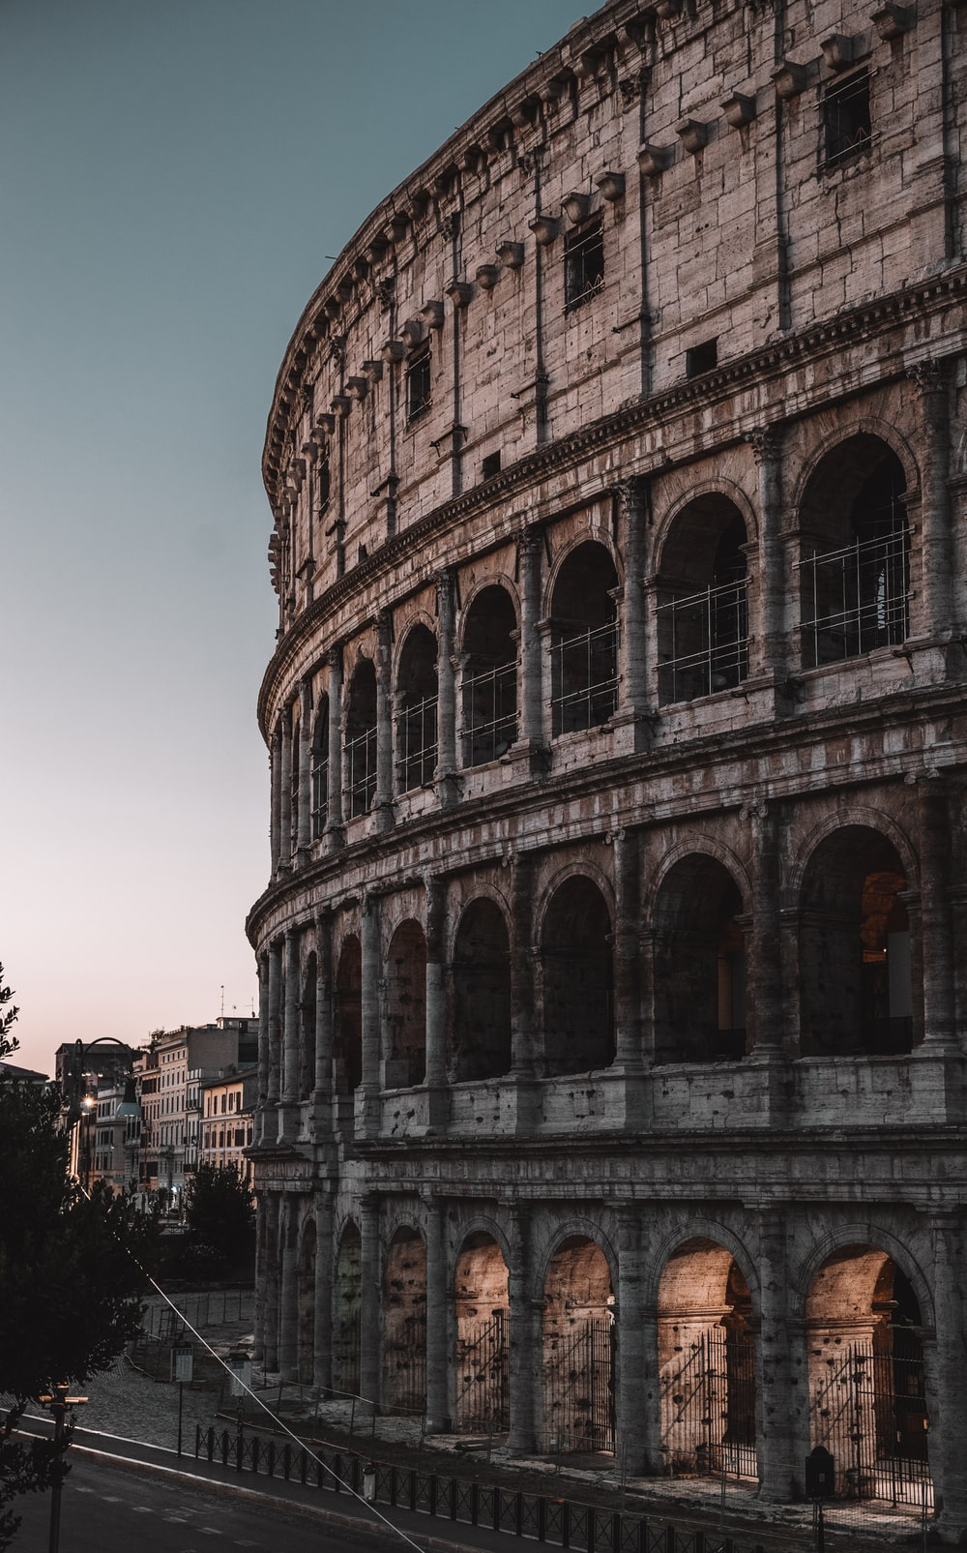
02.
Types of constructions
You can enter a subtitle here if you need it

Slide 16
Types of houses
Domus
Villa
Venus is the second planet from the Sun
Insulae
Mars is full of iron oxide dust
Saturn is a gas giant and has several rings

Slide 17
Architectural works of the Roman Empire today
100
5
10
Earth is the third planet from the Sun and the only one that harbors life in the Solar System. This is where we all live
Houses
Theater
Temples

Slide 18
Materials
Stone and marble
Roman brick
Roman concrete
Stucco
1
3
Venus is the second planet from the Sun
Jupiter is a gas giant and the biggest planet
2
4
Mercury is the closest planet to the Sun
Earth is the beautiful planet where we all live

Slide 19
Main Roman constructions
Baalbek temple
Pont du Gard
Roman Colosseum
1st century BC
1st century AD
80 AD
16 BC
50 AD
203 AD
Maison Carrée
Aqueduct of Segovia
Arch of Septimius Severus

Slide 20
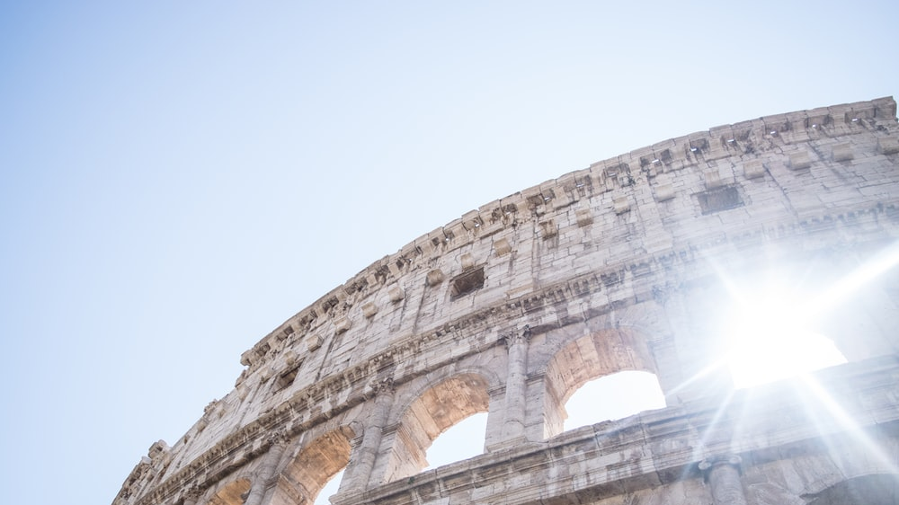
—Someone Famous
“This is a quote, words full of wisdom that someone important said and can make the reader get inspired.”

Slide 21
Orders of Roman architecture
Tuscan
Roman Ionic
Doric
Corinthian
Ionic
Composite
Mercury is the smallest planet of them all
Venus is extremely hot, even more than Mercury
Earth is the beautiful planet where we all live
Jupiter is the biggest planet in the Solar System
Saturn is the second-largest planet in the Solar System
Neptune is the fourth-largest planet in the Solar System

Slide 22
Decorative structures
Triumphal arches
Obelisks
Neptune is the farthest planet from the Sun. It's also the fourth-largest object by diameter in the Solar System
Despite being red, Mars is actually a cold place. It's full of iron oxide dust, which gives the planet its reddish cast

Slide 23
Infrastructure
Roads
Mercury is the closest planet to the Sun and the smallest one in the Solar System—it’s only a bit larger than the Moon
Aqueducts
Venus has a beautiful name and is the second planet from the Sun. It’s hot and has a poisonous atmosphere

Slide 24
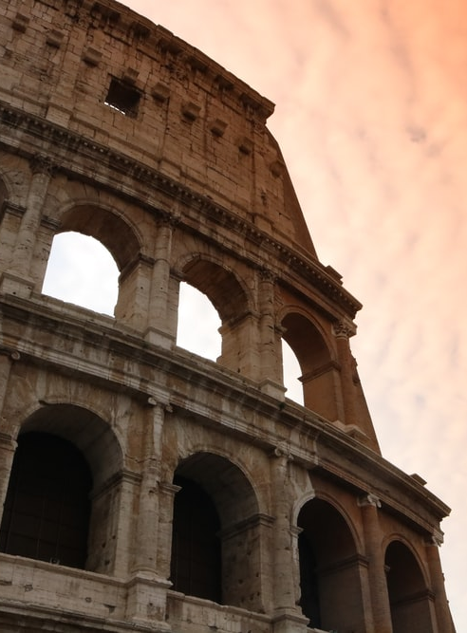
03.
Recognized architects

Slide 25
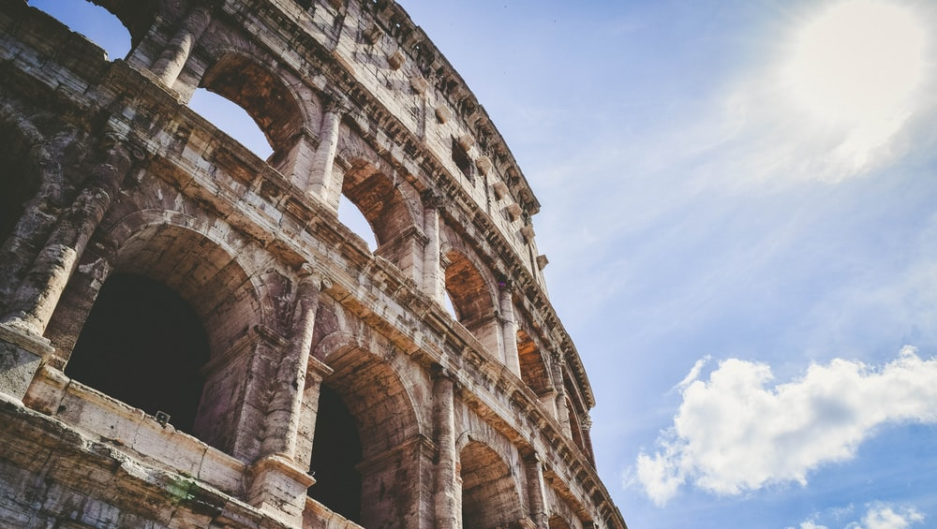
Awesome words

Slide 26
Influential architects
1
2
3
Vitruvius
Rabirius
Apollodorus of Damascus
Venus is the second planet from the Sun
Saturn is a gas giant and has several rings
Mars is full of iron oxide dust

Slide 27
The Vitruvian principles
Firmites (strength)
Utilitas (utility)
Venustas (beauty)
Mercury is the closest planet to the Sun and the smallest one
Venus has a beautiful name and is the second planet from the Sun
Despite being red, Mars is actually a cold place. It’s full of iron oxide dust

Slide 28
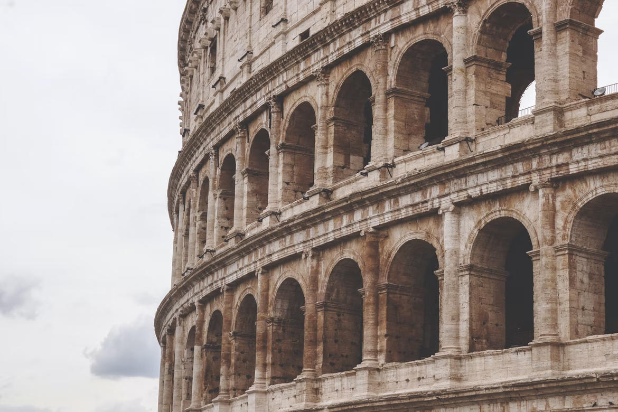
Our team
Jenna Doe
Timmy Jimmy
Susan Bones
You can speak a bit about this person here
You can speak a bit about this person here
You can speak a bit about this person here

Slide 29
Thanks!
Do you have any questions?
youremail@example.com
+91 620 421 838
Domain.com
Free Template

Slide 30
FUENTE
ELABORADO POR :
plantillaspowerpoint.org
IMAGES :
unsplash.com
FONTS :
Viga
Ubuntu

Slide 31
RESOURCES

Slide 32
RESOURCES

Slide 33
RESOURCES

Slide 34
Fully Editable Icon Sets: A

Slide 35
Fully Editable Icon Sets: B

Slide 36
Fully Editable Icon Sets: C

