Slide 1

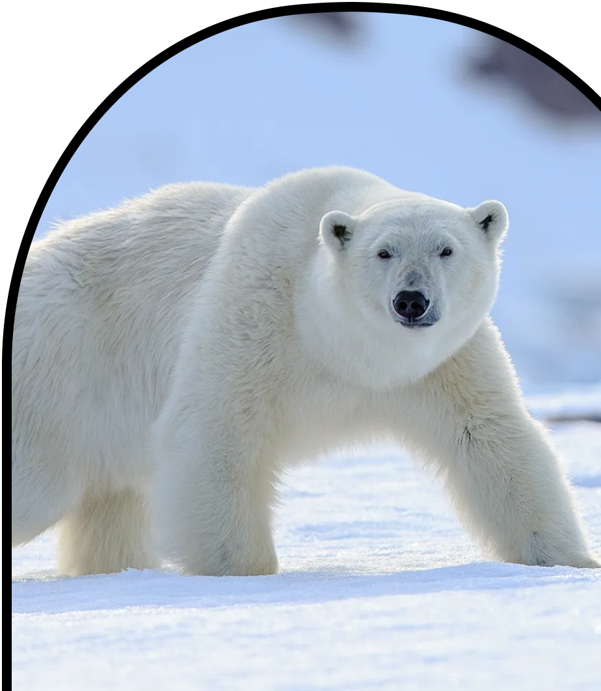
Anchor Layer Teacher Guide
A curriculum companion for Anchor Layer users
Grade 1
Animal Traits & Survival
Unit Web Link • Pacing Guides • Other Units

Slide 2
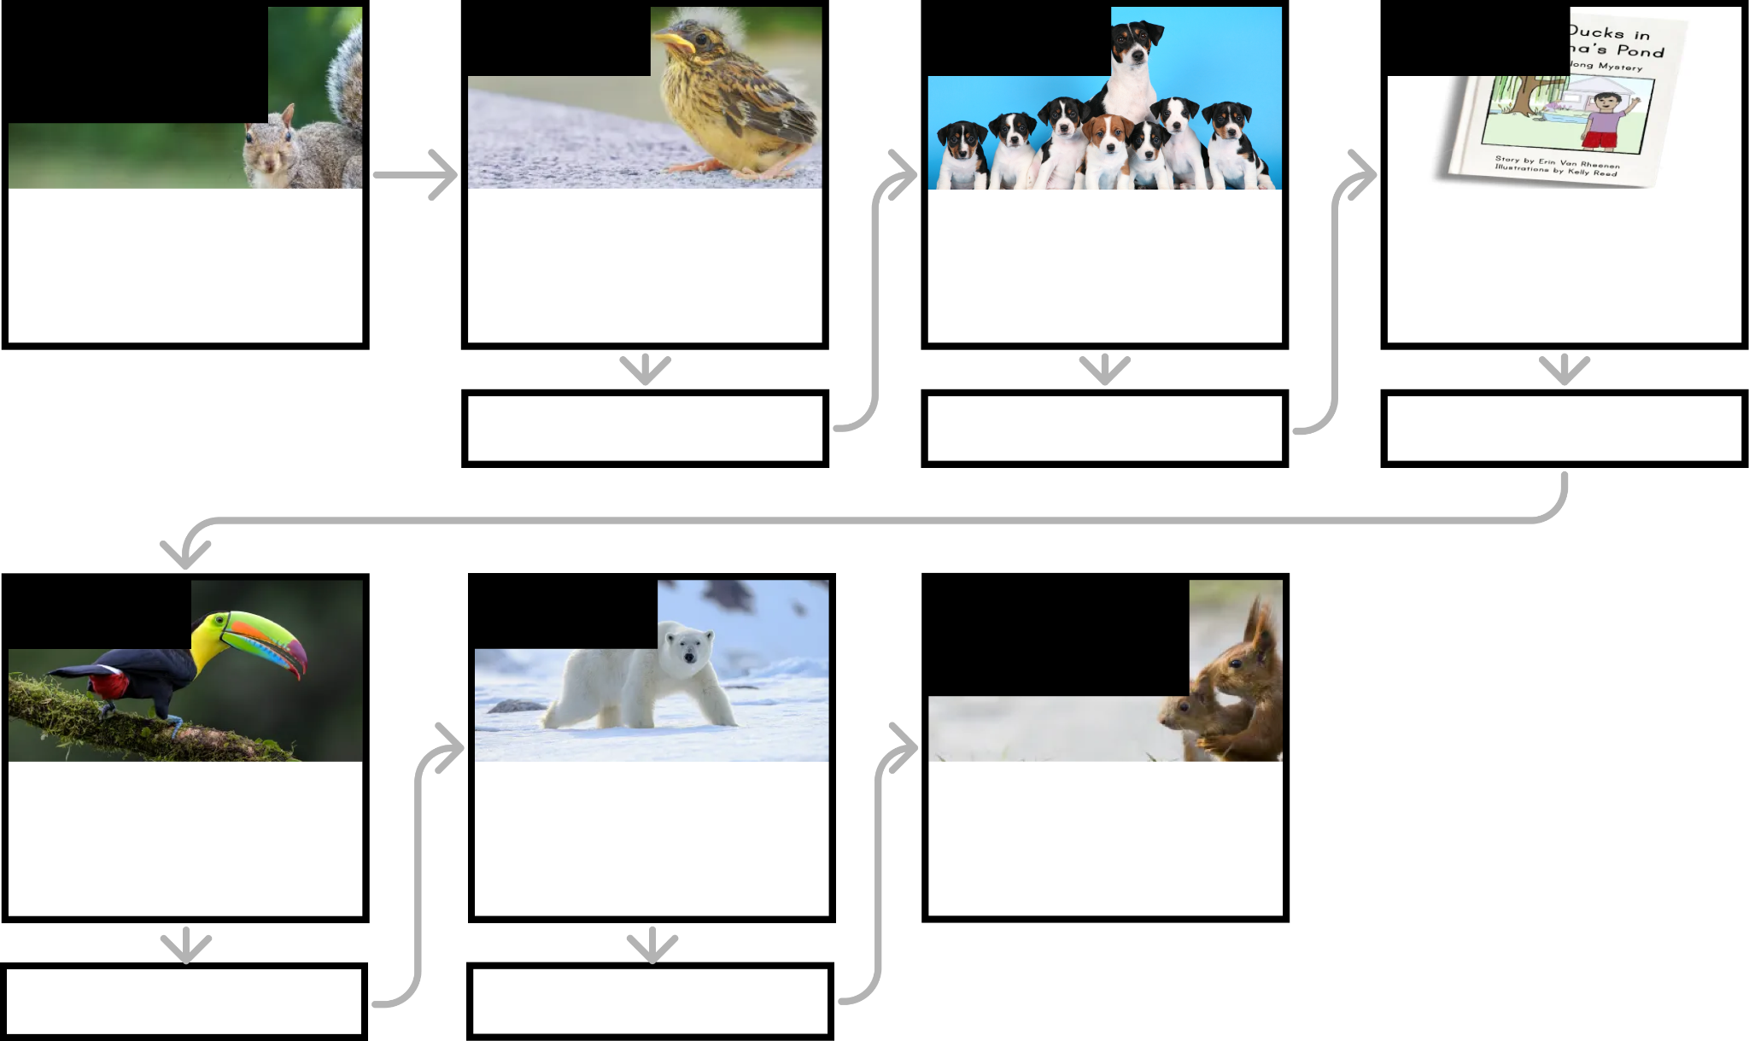
Animal Traits & Survival • Grade 1
Anchor Layer Teacher Guide
Unit Summary
In this unit, students explore the traits of adult and baby animals! Students make observations of parent animals and their offspring, determining how they are similar and different. They explore certain behaviors that help offspring survive. Students also investigate how the traits of animals are essential for their growth and survival.
Performance Expectations | Science & Engineering Practices | Disciplinary Core Ideas | Crosscutting Concepts
• 1-LS1-1. Use materials to design a solution to a human problem by mimicking how plants and/or animals use their external parts to help them survive, grow, and meet their needs. • 1-LS1-2. Read texts and use media to determine patterns in behavior of parents and offspring that help offspring survive. • 1-LS3-1. Make observations to construct an evidence-based account that young plants and animals are like, but not exactly like, their parents. | • Constructing Explanations and Designing Solutions • Developing and Using Models • Planning and Carrying Out Investigations • Analyzing and Interpreting Data • Obtaining, Evaluating, and Communicating Information • Engaging in Argument from Evidence | • LS3.A: Inheritance of Traits • LS3.B: Variation of Traits • LS1.A: Structure and Function • LS1.B: Growth and Development of Organisms | • Structure and function • Patterns
Anchor Phenomenon
Lesson 1
Lesson 2
Lesson 3
Animal Structures and Behaviors
Squirrel Secrets
Parent & Offspring Traits
How can you help a lost baby animal find its parents?
Offspring Trait Variation
Can you predict what an animal’s babies will look like?
Animal Behavior & Offspring Survival
Why do baby ducks follow their mother?
Anchor Connection
Anchor Connection
Anchor Connection
Lesson 4
Lesson 5
Performance Task
Animal Structures & Survival
Why do birds have beaks?
Camouflage & Animal Survival
Why are polar bears white?
Animal Behavior and Survival
How do animals take care of their babies?
Anchor Connection
Anchor Connection
‹#›

Slide 3
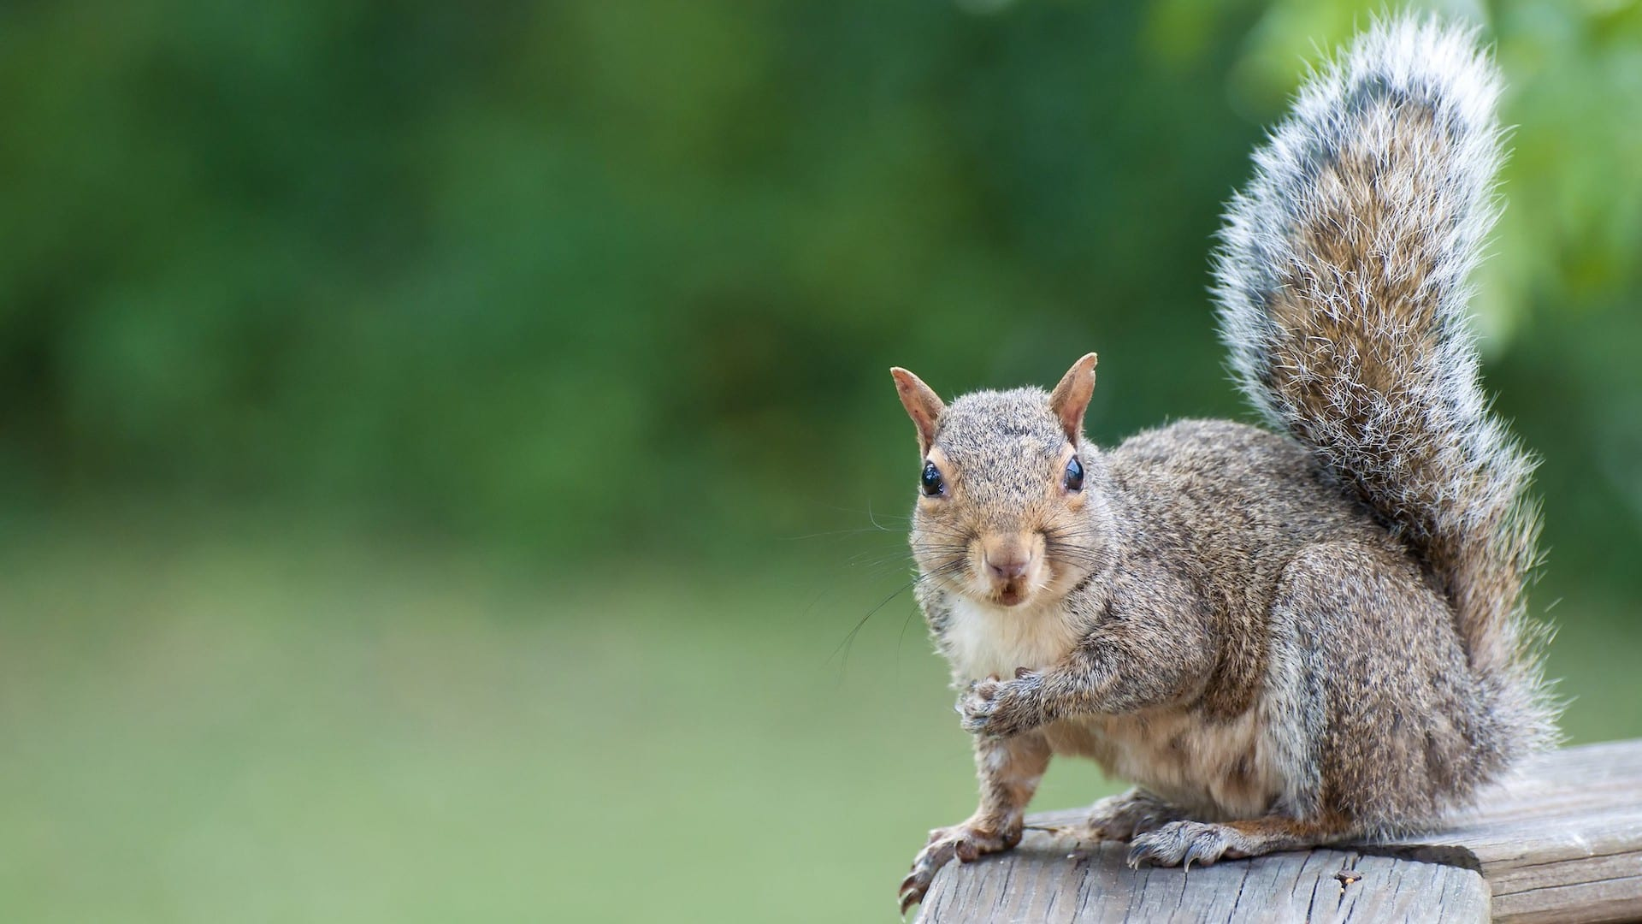
Animal Traits & Survival • Grade 1
Anchor Layer Teacher Guide
Anchor Phenomenon Background
How can squirrels live in such a huge range of places on Earth?
Squirrels are truly amazing animals. Some types of squirrels can be found living in trees, while others can be found living underground. Some squirrels live in hot deserts, while other squirrels live in snowy forests. But squirrels are relatively small animals, who don’t have large teeth, or claws, or wings, or other obvious adaptations that would allow them to be successful in many different places. What is it about squirrels that makes them so successful?
Squirrels have a few adaptations that take care of their most basic needs of food, safety from predators, and shelter.
One of the most well-known squirrel behaviors is the tendency to save food. In fact, the word “squirrel” can be used as a verb to describe the process of saving things for later. When squirrels have access to more food than they can consume at one time, they will save the food for later.
Some squirrels do this by placing the food inside of their dens, while other squirrels will scatter the food in shallow holes around the area in which they live. They can then rely on this stored food during other times of year when they may not have any other food source.
Squirrels do multiple things to remain safe from predators. Their coloration tends to blend in well with their surroundings, and if a predator does spot them, they are fast both on the ground and in the trees. Adult female squirrels also go to great lengths to care for their young. This includes doing things such as carrying their young in their mouth if they need to quickly move them to a new place.
Squirrels also build a variety of shelters for themselves, ranging from building large nests called dreys in the tops of trees, to occupying hollow cavities within tree trunks and logs, to digging large burrows underground. These shelters provide a place to rest, raise young, store food, and/or survive harsh weather conditions.
‹#›

Slide 4
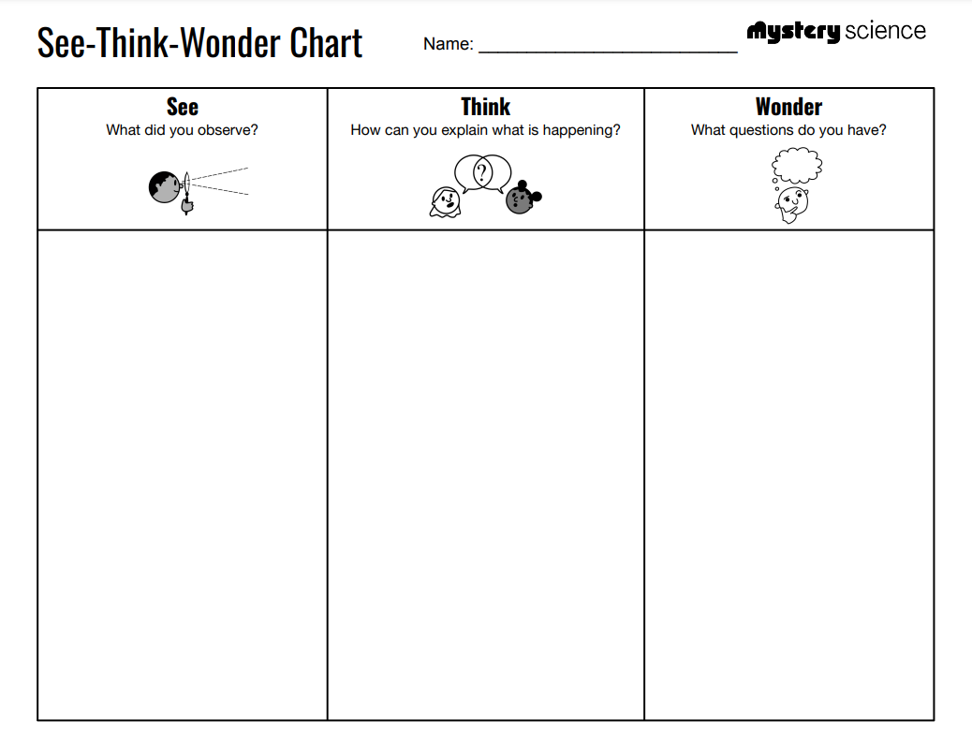
Animal Traits & Survival • Grade 1
Anchor Layer Teacher Guide
Anchor Phenomenon: Squirrel Secrets
Animal Structures and Behaviors
Anchor Phenomenon Overview
Note: This lesson is part of this unit’s Anchor Layer. If you have the Anchor Layer turned on, we recommend teaching all lessons in the remainder of this unit in order.
The anchor phenomenon for this unit is the amazing fact that squirrels are found living across a huge range of habitats around the world. Squirrels have special body structures and behaviors that help them accomplish this.
During the introduction, students generate observations and questions about the phenomenon and create a list of possible explanations for the phenomenon. Students will use these initial ideas to track how their understanding grows throughout the unit.
Anchor Phenomenon 15 mins
Guided Inquiry 15 mins
Student Work Samples & Notes
Students will gather clues during and after each lesson in this unit to help them improve their understanding and explanations. It is important to encourage students to recognize that even if they don't know the perfect answer yet, they are going to learn a lot throughout the unit and will have an opportunity to revisit the phenomenon over time.
Squirrels with stuffed cheeks
Squirrels running with food in their mouth
Squirrels holding food but not eating it
I think the squirrels hold the food to make it softer and easier to eat
I think the squirrels don’t want to eat the food, they just collect it
I think the squirrel is scared and running away, but will eat it later
What do the squirrels do with the food?
Why don’t the squirrels just eat?
Do squirrels eat other food?
‹#›

Slide 5
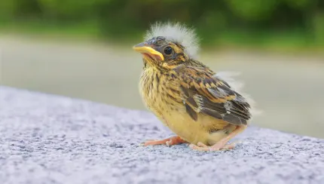
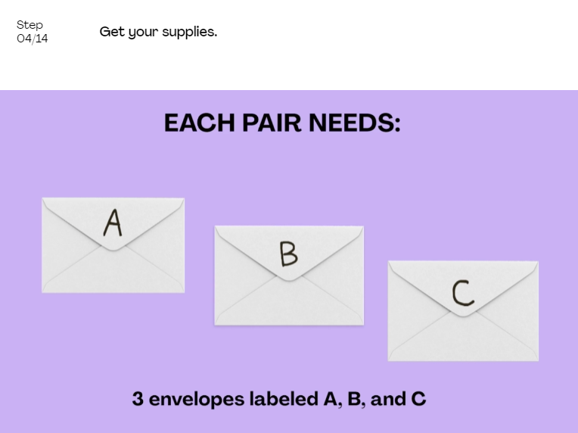
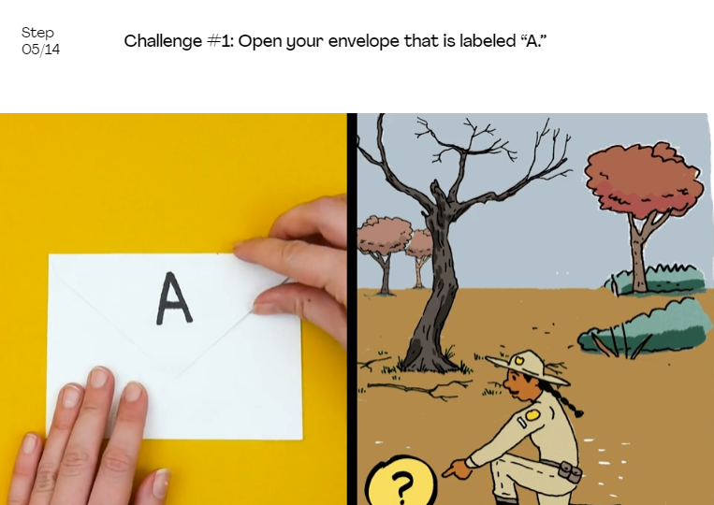
Animal Traits & Survival • Grade 1
Anchor Layer Teacher Guide
Lesson 1: How can you help a lost baby animal find its parents?
Parent & Offspring Traits (pg 1 of 2)
Overview
In this lesson, students make observations of baby animals and their parents, gathering evidence that they look similar because they share many of the same traits.
In the activity, Baby Bird Rescue, students help identify lost baby birds based on observations of their specific traits.
Anchor Connection on Next Page
Exploration 16 mins
Hands-On Activity 30 mins
Wrap-Up 4 mins
Anchor Connection 10 mins
Assessment 20 mins
Activity Notes
We suggest preparing the Bird Cards and Envelopes for the Baby Bird Rescue activity in advance.
We suggest students work in pairs.
‹#›

Slide 6
Animal Traits & Survival • Grade 1
Anchor Layer Teacher Guide
Lesson 1: How can you help a lost baby animal find its parents?
Parent & Offspring Traits (pg 2 of 2)
Anchor Connection
In this lesson, students observed the traits of various types of animals. Some types of squirrels have a very interesting trait: cheek pouches. They use these cheek pouches to carry food. They will see in the next lesson that squirrels carry food so that they can hide it and save it for later.
Students revisit the See-Think-Wonder chart that they worked on during the Anchor Phenomenon. They should understand that parent animals pass their traits to their young. This is true for birds and squirrels.
Connecting Storyline Question
How do squirrel traits help them survive?
Exploration 16 mins
Hands-On Activity 30 mins
Wrap-Up 4 mins
Anchor Connection 10 mins
Assessment 20 mins
‹#›

Slide 7

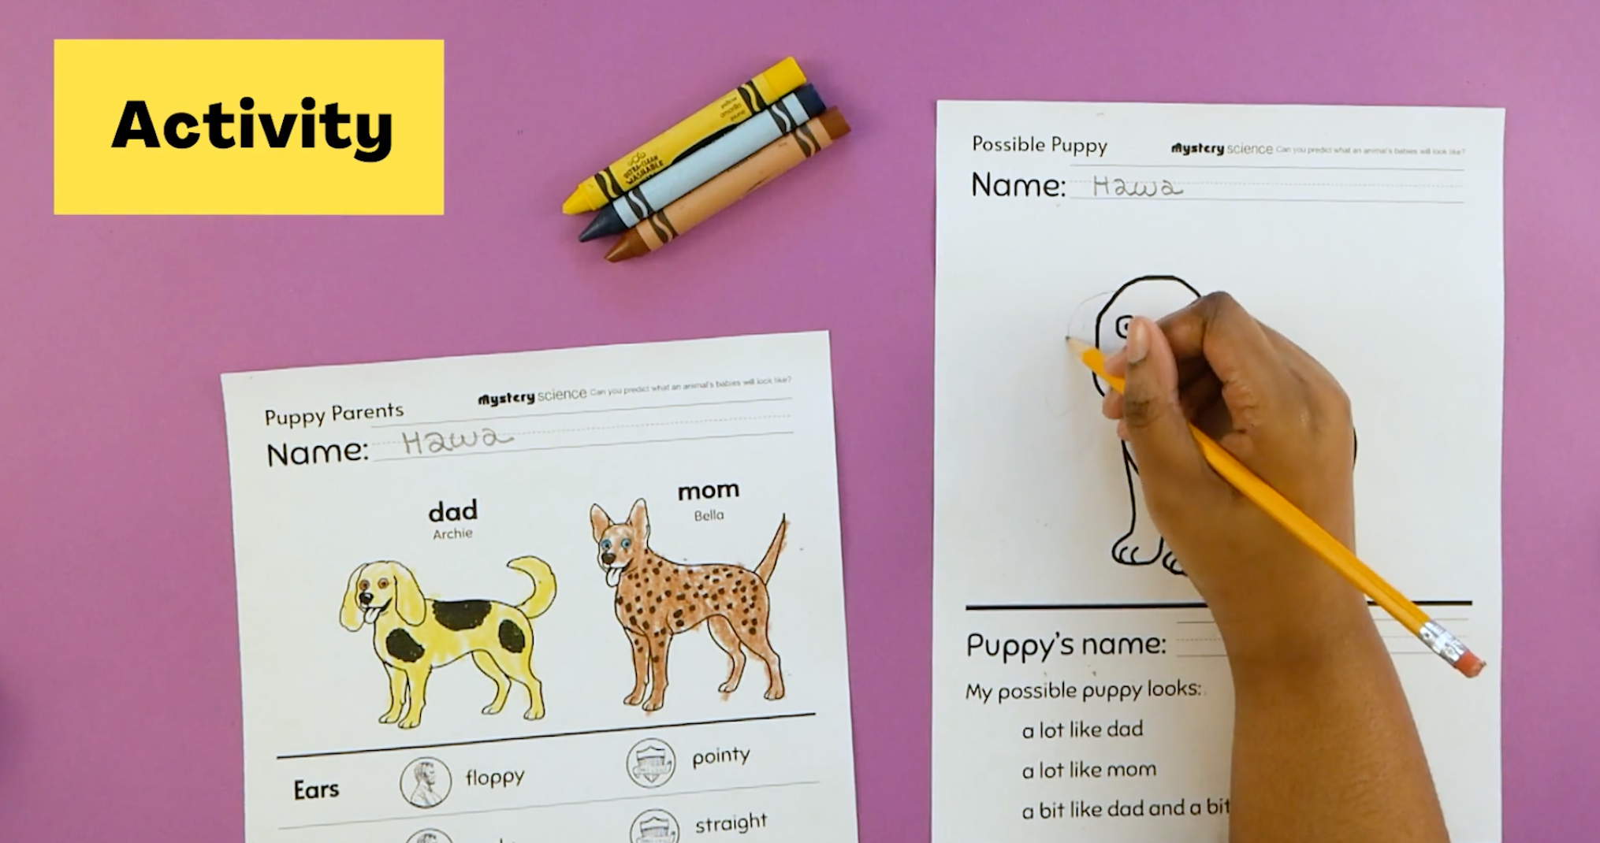
Animal Traits & Survival • Grade 1
Anchor Layer Teacher Guide
Lesson 2: Can you predict what an animal’s babies will look like?
Offspring Trait Variation
Overview
In this lesson, students gather evidence that animal offspring look like, but not exactly like, their parents.
In the activity, Possible Puppies, students play a game that models how puppies look similar to their parents, but each puppy can vary in many ways.
Exploration 10 mins
Hands-On Activity 30 mins
Wrap-Up 15 mins
Anchor Connection 20 mins
Assessment 20 mins
Activity Notes
We suggest students work in pairs.
Anchor Connection
Physical characteristics are passed down from parents to offspring in many
animals, and this is true for squirrels as well. The behaviors of squirrels are
passed down in the same way that physical characteristics are. This includes where they tend to live, depending on if there are tree-dwelling or ground-dwelling.
Students revisit both See-Think-Wonder charts that they worked on during the unit. They should understand that young animals look similar to their parents. However, they don’t just look similar—they also act similarly.
Connecting Storyline Question
How do animals take care of their babies?
‹#›

Slide 8
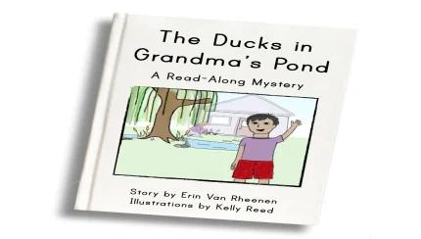
Animal Traits & Survival • Grade 1
Anchor Layer Teacher Guide
Lesson 3: Why do baby ducks follow their mother?
Animal Behavior & Offspring Survival
Overview
In this Read-Along lesson, Juan Carlos visits his grandmother who has a backyard full of ducks.
The lesson includes a short exercise where students get moving by acting like ducks. If you want to extend the lesson, you can try this optional activity, What’s Going On?, where students watch videos and discover ways that animal parents help their offspring.
Anchor Connection
In this lesson, students made observations of how mother ducks care for their young. In the Anchor Connection, students make the same observations for mother squirrels and their young.
Students complete a new See-Think-Wonder chart. They should understand that While young squirrels can walk and climb, mother squirrels can carry their babies in their mouths in order to move them quickly to safety.
Connecting Storyline Question
How do squirrels stay safe from other animals?
Digital Book (W/Audio) 25 mins
Hands-On Activity 20 mins
Anchor Connection 20 mins
Assessment 20 mins
Activity Notes
There is no prep for the optional activity. Here are some discussion questions you may use after viewing the videos:
What are the big birds doing? Why are they doing that?
What is the big cat doing? Why is she doing that?
These are shrews, animals about the size of a mouse. How do the babies make sure they don’t lose their mother?
This is an opossum and her babies. Why are the babies riding on their mother’s back?
‹#›

Slide 9
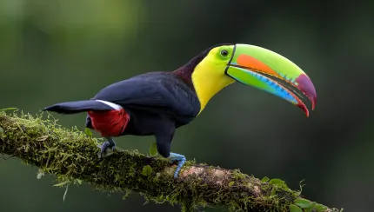
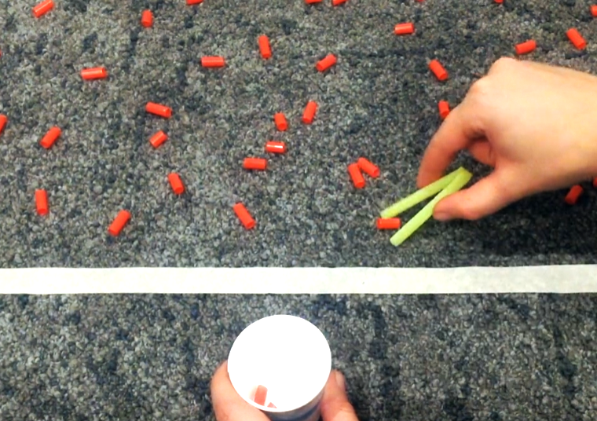
Animal Traits & Survival • Grade 1
Anchor Layer Teacher Guide
Lesson 4: Why do birds have beaks (pg 1 of 2)
Animal Structures & Survival
Lesson Overview
In this lesson, students carry out an investigation to determine the relationship between the shape of different bird beaks and the food each bird eats.
In the activity, Find the Best Beak, students experiment with long pointy beaks that are great for picking up seeds and wide flat beaks that are good for scooping. They discover that different beaks are best for different kinds of food.
Anchor Connection on Next Page
Exploration 16 mins
Hands-On Activity 25 mins
Wrap-Up 5 mins
Anchor Connection 20 mins
Assessment 20 mins
Activity Notes
We suggest students work in groups of four.
This activity works best on a low pile carpet. If your classroom has a smooth floor (such as linoleum), you’ll need a bath towel to serve as the work area for each group of 4 students.
We suggest making “beaks” and setting up stations in advance. See the lesson page for more detailed prep instructions.
‹#›

Slide 10
Animal Traits & Survival • Grade 1
Anchor Layer Teacher Guide
Lesson 4: Why do birds have beaks (pg 2 of 2)
Animal Structures & Survival
Anchor Connection
In this lesson, students developed an understanding of the importance of
specialized bird mouths. Squirrel mouths are specialized as well. Specifically, their mouths are very good at carrying food. In the case of chipmunks and other ground squirrels, their cheeks are actually large pouches that can be packed with food. Squirrels use their mouths to carry excess food to places where they can store it and eat it later
Students revisit the See-Think-Wonder chart that they worked on during the Anchor Phenomenon. They should understand that birds are not the only animals with specialized mouths. Squirrels have special mouths that help them carry food and save it for later.
Connecting Storyline Question
How do squirrels keep from being seen?
Exploration 16 mins
Hands-On Activity 25 mins
Wrap-Up 5 mins
Anchor Connection 20 mins
Assessment 20 mins
‹#›

Slide 11
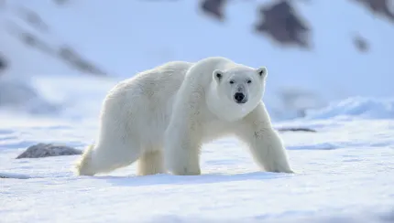
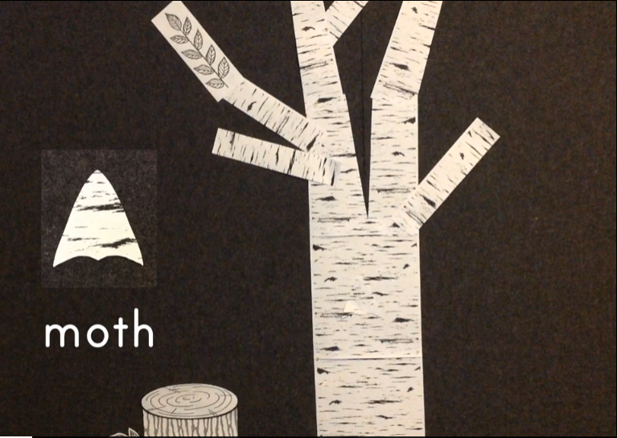
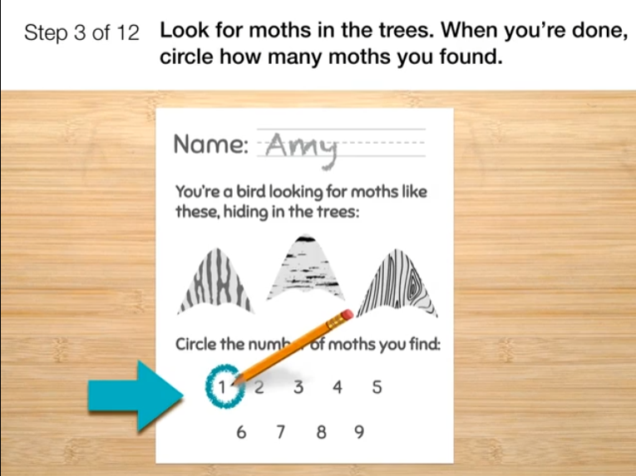
Animal Traits & Survival • Grade 1
Anchor Layer Teacher Guide
Lesson 5: Why are polar bears white? (pg 1 of 2)
Camouflage & Animal Survival
Overview
In this lesson, students make observations to construct an explanation of why camouflage is helpful to animals.
In the activity, Moth Hide and Seek, students test their ability to spot camouflage moths, and then design a camouflage pattern for a moth of their own and hide it in the classroom!
Anchor Connection on Next Page
Exploration 17 mins
Hands-On Activity 25 mins
Wrap-Up 8 mins
Anchor Connection 30 mins
Assessment 20 mins
Activity Notes
We suggest preparing your classroom forest before class. Each tree takes a wall space measuring about 32" wide by 55" tall (about the size of a door).
You are going to hide paper moths for your students to find, and then your students will hide moths for you to find. See the lesson page for more detailed prep instructions.
‹#›

Slide 12
Animal Traits & Survival • Grade 1
Anchor Layer Teacher Guide
Lesson 5: Why are polar bears white? (pg 2 of 2)
Camouflage & Animal Survival
Anchor Connection
Camouflage is an important characteristic that helps many living things. Squirrels are no exception. By blending in with their environment, squirrels improve their chances of surviving.
Students will create their own chipmunk camouflage designs, just as they did during the lesson itself with moths. They should understand that squirrels are camouflaged in many different environments. This helps them stay safe.
Connecting Storyline Question
What are all of the things that squirrels do to take care of their babies?
Exploration 17 mins
Hands-On Activity 25 mins
Wrap-Up 8 mins
Anchor Connection 30 mins
Assessment 20 mins
‹#›

Slide 13
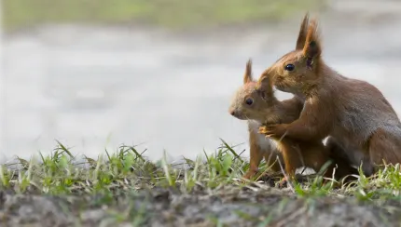
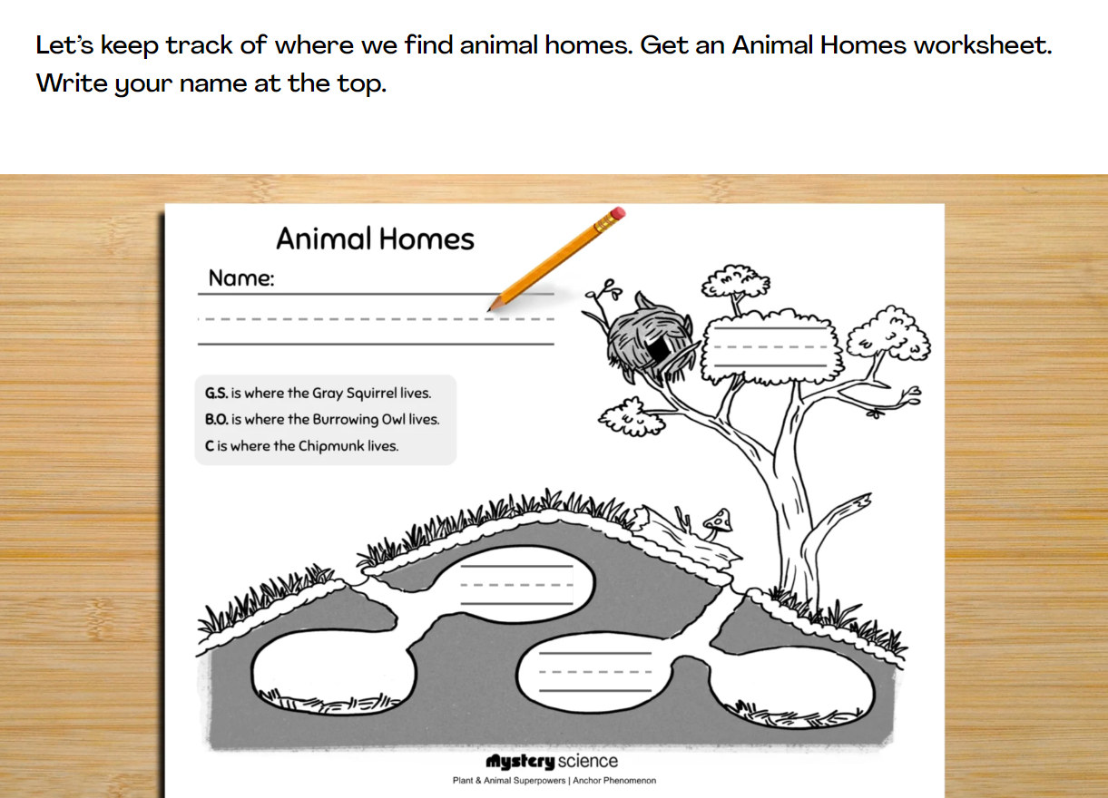
Animal Traits & Survival • Grade 1
Anchor Layer Teacher Guide
Performance Task: Placeholder
Placeholder
Overview
In this performance task, students will observe and interpret the behavior of different animals to see how they care for their offspring.
After a review of the unit, students will visit the homes of three different animals and see what they do to take care of themselves and their offspring. They will see that some animals can make their homes in very different and surprising places, but they share some behaviors in common with one another.
Unit Review 10 mins
Hands-On Activity 35 mins
Performance Task Notes
Students can work as a class, in small groups, or individually. Each student will need one copy of the Animal Homes worksheet.
Crosscutting Concepts
Patterns: There are many, many different types of animals that live in many, many different types of habitats. By identifying patterns in behaviors, we can develop an understanding of how animals are able to survive and thrive in such a wide range of environments
‹#›

