Slide 1
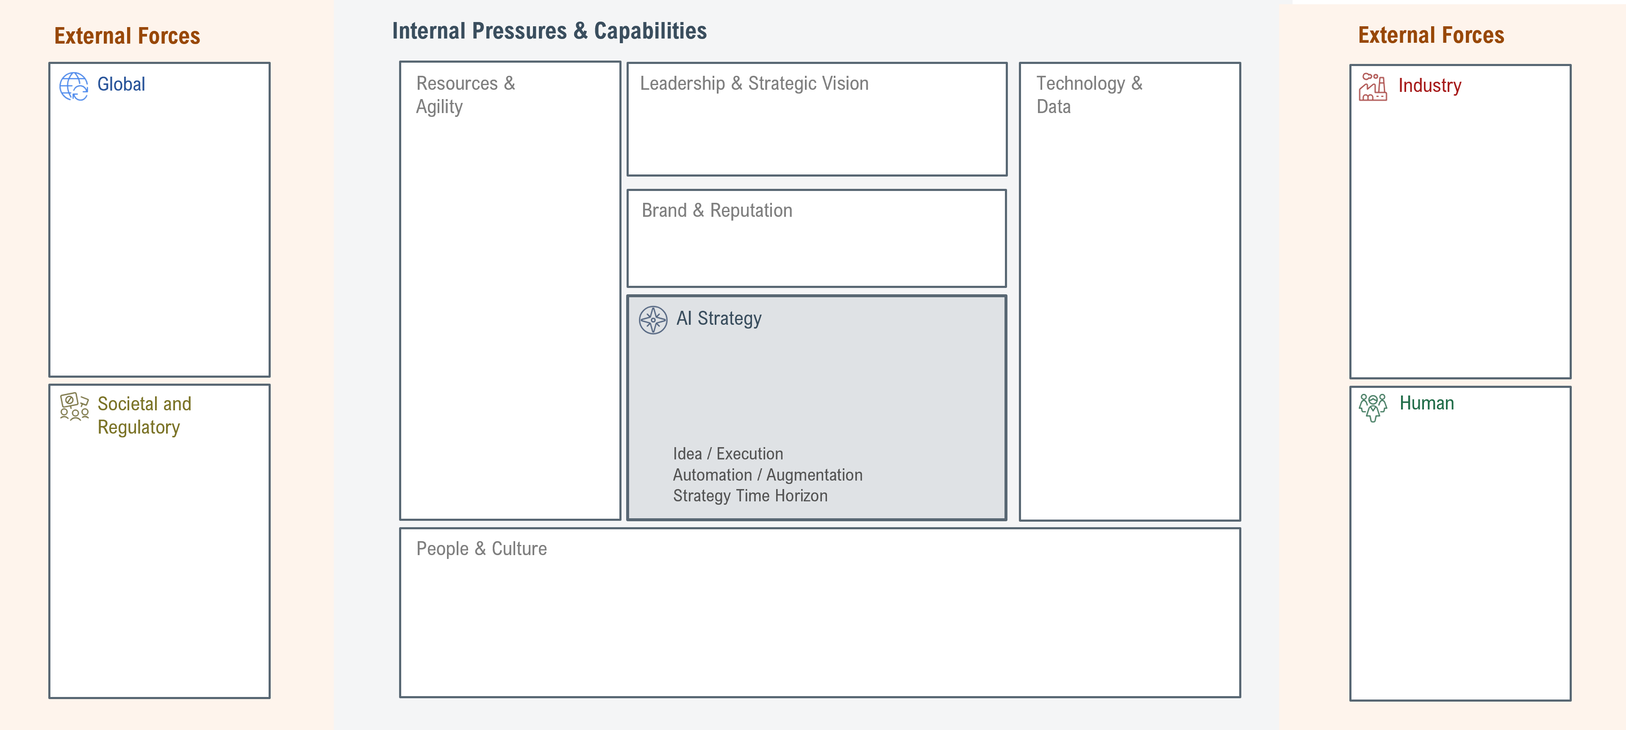
Technological & economic competition
Strategic assets & IP
Regional differences
Laws & standards
Why do you do what you do? Does your strategy enhance this?
Can you describe your strategy in terms of the 3 dimensions below?
Technological advances
Speed, efficiency & scalability
Increased experimentation
Customer preferences
Why do you do what you do? Does your strategy enhance this?
Can you describe your strategy in terms of the 3 dimensions below?
Technology outpacing regulation
Adoption with compliance
Regulatory, consumer, employee groups
AI literacy & skills
Human desires & goals
Employment & income needs
Workforce & labor supply

