Slide 1
CHARCOAL STYLE
Powerpoint Template
www.freepptbackgrounds.net

Slide 2
CONTENTS
1
2
3
4
Briefing
Evaluation
Workshops
Design

Slide 3
1
PART 01
BRIEFING

Slide 4
Briefing
Culture
Estate
Energy
Culture
Estate
Energy
Get a modern PowerPoint Presentation that is beautifully designed.
I hope and I believe that this Template will your Time, Money and Reputation.
I hope and I believe that this Template will your Time, Money and Reputation.

Slide 5
Briefing
Our
Vision
We use well-known development methodologies
Click on the button
under the
Values
Mission
Click on the button
under the
We use well-known development methodologies

Slide 6
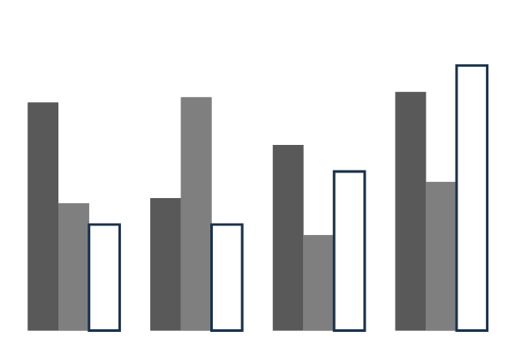
Briefing
About us
This allows us to achieve high quality outcomes and full transparency towards.
Forum
We press play on your digital story. Using conceptual, digital design
Services
We press play on your digital story. Using conceptual, digital design
Timeline
This allows us to achieve high quality outcomes and full transparency towards.

Slide 7
Briefing
Annual Meeting
Future
Simple & Smooth, exactly how purchasing experiences should be.
Moving from creative ideas to solid strategy and execution
What we do?
Pricing
Moving from creative ideas to solid strategy and execution
Simple & Smooth, exactly how purchasing experiences should be.

Slide 8
Briefing
1
Transport
Your audience relate and absorb information on different sensory levels.
Suggest
The user can demonstrate on a projector or computer, or print the presentation and make it into a film to be used in a
2
Conferences
3
Your audience relate and absorb information on different sensory levels.

Slide 9
2
PART 02
EVALUATION

Slide 10




Evaluation
The user can make a presentation
The user can demonstrate on a projector or
The user can make a presentation
The user can demonstrate on a projector or

Slide 11




Evaluation
Share
Success
It is a very sad thing that nowadays there is so little useless information.
Enter the comprehensive description of the above chart here
Skills
Split
Enter the comprehensive description of the above chart here
It is a very sad thing that nowadays there is so little useless information.

Slide 12
Evaluation
Lanage
Send
We certainly do not forget you as soon as you forget us. It is, perhaps, our fate rather than our merit.
It is a very sad thing that nowadays there is so little useless information.
01
02
Schedule
03
04
Signature
It is a very sad thing that nowadays there is so little useless information.
We certainly do not forget you as soon as you forget us. It is, perhaps, our fate rather than our merit.

Slide 13
Evaluation
1
The time is now, the place is here. Stay in the present. You can do nothing to change the past, and the future will never come exactly as you
2
I believe that people would be alive today if there were a death penalty. Nancy Reagan
3
4
The time is now, the place is here. Stay in the present. You can do nothing to change the past, and the
I believe that people would be alive today if there were a death penalty. Nancy Reagan

Slide 14
3
PART 03
WORKSHOPS

Slide 15
Workshops
Lower
Approve
Bill
Add
Occupation
Advise
Agenda
Accept
Apply

Slide 16
Workshops
1
I feel very strongly that change is good because it stirs up
3
5
A large income is the best recipe for happiness I ever
Woe be to him that reads but one book.
A large income is the best recipe for happiness I ever
I feel very strongly that change is good because it stirs up
2
4
Woe be to him that reads but one book.
6

Slide 17
Workshops
Calculate
Be an encourager, the world has enough critics already.
Cancel
Buy
Budget

Slide 18
Workshops
Fund
Certification
Date
Fix
Choose
Decide

Slide 19
Workshops
Hearing
Growth
Goal
God sometimes removes people from your life to protect you. Do not run after them.
Education is the most powerful weapon which you can use to change the world.
Always give your best never worry for results.

Slide 20
4
PART 04
DESIGN

Slide 21
Design
Improve
Industry
Install
Increase
Inform

Slide 22
Design
Woe be to him that reads but one book.
Be an encourager, the world has enough critics already.
Always give your best never worry for results.
Education is the most powerful weapon which you can use

Slide 23
Design
Join
Inventory
Take calculated risks. That is quite different from being rash.
Be not afraid of going slowly, be afraid only of standing still
Instructions
Invoice
A torn jacket is soon mended; but hard words bruise the heart of a child.
To see what is in front of one's nose needs a constant struggle.

Slide 24
THANK YOU !
Charcoal Style Presentation
www.freepptbackgrounds.net

