Slide 1
Collaborating to Accelerate Care Transformation, Learning Health Systems, and Realizing Your Goals
Jerome A. Osheroff, MD, FACP, FACMI
TMIT Consulting, LLC;
Lead, Accelerating Care Transformation (ACT) Initiative
ACT Initiative
Version of 4/8/26

Slide 2
Deck aim/outline
Aim
Stimulate discussion about joint activities to speed progress to your and ACT care transformation goals
Outline
Outreach executive summary
Your strategic initiatives and challenges
Accelerating Care Transformation (ACT) Initiative overview
Fostering discussion and brainstorming about synergies

Slide 3
Outreach executive summary
All healthcare and public health stakeholders face major challenges to achieving desired outcomes (e.g., around health, costs, revenue, experience)
  Health and care processes are complex and variable, making it difficult to improve at scale
The Accelerating Care Transformation (ACT) initiative builds on 2 decades of successful public and private efforts to reengineer care delivery and improve outcomes
  ACT uses a common framework for analyzing and enhancing health and care-related workflows across improvement targets and cross-stakeholder collaborations to reduce transformation barriers
Are there ACT synergies with your care transformation goals and capabilities that could support your efforts and speed progress toward ‘Best care for everyone, everywhere’?
  For example, ways you could leverage ACT frameworks, methods, tools, and collaborations in achieving your goals – while also amplifying ACT’s value, sustainability and scalability

Slide 4
Your strategic initiatives and challenges
What essential business drivers and needs are you facing and how are you addressing these?
  The answer tees up opportunities for mutually beneficial ACT collaborations

Slide 5
ACT Context, Origin, Foundations

Slide 6
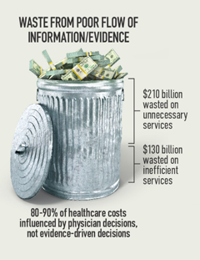
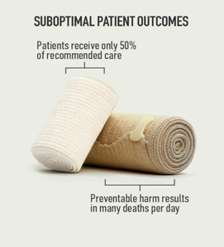
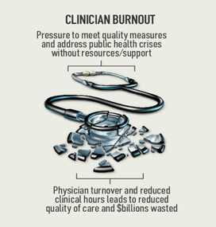
ACT context: widespread, pressing healthcare challenges
These Groups (Stakeholders):
Patients
Health Systems
Care Teams
Payers
Governments
Product / Service Suppliers (e.g., Health IT, Drugs / Devices, Quality Improvement)
Are Facing These Challenges:
Health Outcomes (e.g., quality, safety)
Costs
Revenue
Experience (e.g., satisfaction, burnout, access to care, equity)
Images credit: ACTS
Common Underlying Theme:
Care delivery processes often not efficient or effective in achieving goals for patients, others
Process complexity and variation makes it difficult to improve processes at scale

Slide 7
Examples of specific challenges
Less than ideal achievement of care goals
  Poor control of chronic disease with resulting preventable illness/costs
Care for aging population with increasing utilization in timely and patient-centered manner given limited resources
  Need more efficient strategies for managing chronic illness (including addressing root causes) than current encounter-driven approach
Increasing evidence, knowledge, guidance, and misinformation that relates to delivering effective care efficiently
Increasing demands for measuring care processes and outcomes causing increasing stress on providers – taking time away from valuable care for documentation, exacerbating burnout
Not using resources efficiently – e.g., people not working at the top of their qualifications

Slide 8
Why we’re here - a root cause
* e.g., in 2018, US spent $194B on health/medical R&D
** e.g., US has worse health outcomes of developed countries and spends the most
What We Know*
What We Do**
No organization or country has figured out how robustly create this ‘virtuous cycle’!

Slide 9
What this means for you/us
We’re not (and for decades haven’t been) getting the best care!
60%
Guideline- aligned care
30%
Low value care / waste
10%
Harmful Care
Braithwaite, J. et al. BMC Medicine, 2020. The three numbers you need to know about healthcare: the 60-30-10 Challenge [assertion supported by other studies]

Slide 10
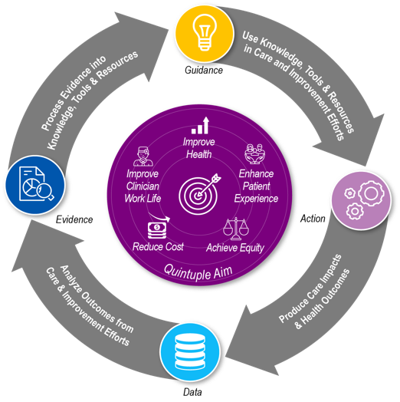

Emerging solution consensus: need learning health systems to achieve Quintuple Aim…
*Quintuple Aim
•Optimize Health
•Reduce Costs
•Satisfy Patients
•Support Care Teams
•Achieve Equity
Healthcare We Need*
Healthcare Today
Image credits: Osheroff/ACTS/freepik

Slide 11
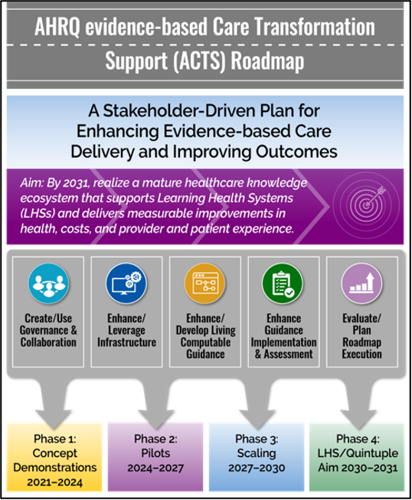

ACT origins
US Agency for Healthcare Research and Quality – commissioned Roadmap 2018-21:
Roadmap Presented to US Secretary of Health and Human Services, 2006:
Link to article
Both Roadmaps:
Steering Committee
Coordinate efforts
Priority Targets
Test -> Spread
ACT is Stakeholder-driven initiative to execute
COVID!!!
Source: Osheroff et. al., AHRQ evidence-based Care Transformation Support (ACTS) initiative

Slide 12
Accelerating Care Transformation (ACT) Initiative [Launched November 2023*]
Vision
Best healthcare for everyone, everywhere
Mission
Support progress toward organizational, national, and global Learning Health Systems that reliably and measurably improve outcomes (e.g., Quadruple / Quintuple Aim)
Approach:
Help organizations apply and enhance over time proven care transformation / workflow re-engineering methods & tools
Drive/fund initial efforts through mutually beneficial in-kind contributions and paid engagements with ACT Steering Committee members and collaborators.
Make ACT sustainable, scalable via evolution to a non-profit, ultimately a Public Private Partnership
Collaborators
Diverse clinical, public health, and health informatics leads, including CMO, CMIO, HL7 board chair, Quality Improvement/LHS experts, others
*Slides from Launch Summit, attended by over 70 stakeholders, are here.

Slide 13
ACT Steering Committee* (seed members)
Jerome A. Osheroff, MD, FACP, FACMI Founder, ACT (Steering Committee Chair); Principal, TMIT Consulting, LLC
Carol E. Ash, D.O., MHCDS, MBA, FACHE Pulmonary/Sleep Medicine Physician, Deborah Heart and Lung Center; Care Transformation Lecturer and National Health News Consultant; Former Chief Medical Officer, RWJ University Hospital Rahway
Theresa Cullen, MD, MS Public Health Director, Pima County Health Dept.
Patricia Gagliano, MD Vice President, Health Care Quality Improvement, IPRO
Ben Hamlin, DrPH, FAMIA Director of Digital Health, IPRO
Sue Lacey Bryant, MSc Visiting Professor, Manchester Metropolitan U, UK; Former Chief Knowledge Officer, NHS England
Michael Meier, MD, MPH HRO Coach; Principal, Winsight Consulting, LLC
Bilikis Oladimeji, MD, MMCi, CPHIMS Founder, SheriBell Global, LLC
J. Marc Overhage, MD, PhD Overhage Group, NCQA Board Member (former CHIO, Elevance Health)
Josh Rubin, JD, MBA, MPH, MPP Founding President and CEO, Learning Health Community; Program Officer for Learning Health System Initiatives, Department of Learning Health Sciences University of Michigan Medical School
Julia Skapik, MD, MPH, FAMIA Board Vice Chair, HL7 International
Frank Sonnenberg, MD, FACP, FACMI Professor Emeritus, Rutgers Robert Wood Johnson Medical School
Retired CMIO, RWJBarnabas Health Medical Group
Janice Tufte Patient Partner, Hassanah Consulting
*EARLY DRAFT spreadsheet with strategic focus and ACT-related wants and offers for Steering Committee members and Collaborators (to cultivate synergies) is here

Slide 14
ACT builds on 2 decades of leadership, collaboration
2005
National Clinical Decision Support Roadmap, CDS 5 Rights: Roadmap requested by ONC, presented to HHS Secretary, called for steps ACT now taking (e.g., Steering Committee/targets/scale); both provide foundation for ACT methods, tools, collaborations
2011
Workflow Reengineering Worksheets (WRWs) and Methods: early use within and across organizations via the CDS Collaborative for Performance Improvement (initially funded by CHCF)
HIMSS Guide to improving Outcomes with CDS (2e): further guidance on using WRWs, getting CDS 5 Rights right; still widely used/cited
2016
HRSA-Sponsored guide to care transformation using WRWs: Publicly available and frequently accessed (>57,000 views)
2018
AHRQ ACTS Initiative: 3 year, multi-stakeholder effort developed detailed future vision, 10-year roadmap and execution concept demo for supporting Learning Health Systems in broadly realizing the Quintuple Aim; called for steps ACT now taking
2021
LHS Collaborative: Launched to execute ACTS Roadmap immediately after AHRQ’s funding ended; created target-focused learning communities with public / private support, e.g., on Pain/Opioids (summative webinar slides, recording)
2023
ACT Initiative: Builds on / replaces LHS Collaborative; launch summit attended by 70+ stakeholders; approach = use WRW-related methods/ tools / collaborations to execute Roadmaps above; delivering value diverse and growing public/private sector orgs
2012
2019
Stakeholder-driven Action Plan for Improving Pain Management, Opioid Use, OUD Treatment with CDS; 51 individuals from diverse stakeholder groups developed plan and began taking steps to execute it.
ACT Differentiators: Proven, scalable approach to workflow reengineering and robust cross-stakeholder collaboration to accelerate care transformation

Slide 15
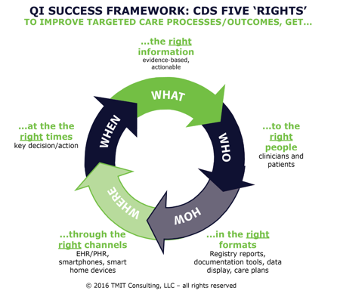
Foundations for ACT methods / tools:
Clinical Decision Support 5 Rights
CDS 5 Rights (2006)
Broadly useful framework for improving care processes and outcomes; springboard for reengineering worksheets / methods
Recommended by CMS as a best practice for health IT-enabled quality improvement
Widely cited and used in CDS / care transformation efforts; question on informatics board exams

Slide 16

Foundations for ACT methods / tools:
HIMSS guidebooks on improving outcomes
3 HIMSS Bestsellers, Books of the Year
Latest published in 2012, still widely used and cited
Sponsored by AHRQ; 5 co-publishers
Workflow Reengineering Worksheets to address CDS 5 Rights effectively
Tasks and Key Lessons from each chapter, worksheet list

Slide 17
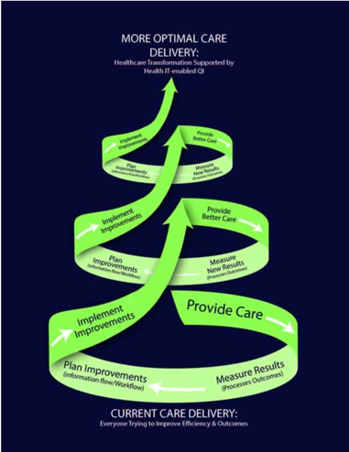
Foundations for ACT methods / tools:
US Gov’t guidance on care transformation
Guide to Improving Care Processes and Outcomes
Builds on content in last HIMSS guidebook
US Gov’t funded web resource (HRSA, 2016)
Over 57,000 views
Provides additional Workflow Reengineering Worksheets and guidance

Slide 18
Foundations for ACT methods / tools:
Care transformation learning community
Clinical Decision Support Collaborative for Performance Improvement
Getting better faster, togetherSM
2011-2019
Seeded with funding from California Healthcare Foundation (2011-13; final report here)
Engaged many provider organizations and other stakeholders
Drove collaborative efforts to refine and use Workflow Reengineering Worksheets to improve care and quality processes and outcomes
Results from CHCF-funded work and many other public and private-funded efforts to use worksheets outlined here.

Slide 19
ACT Approach

Slide 20
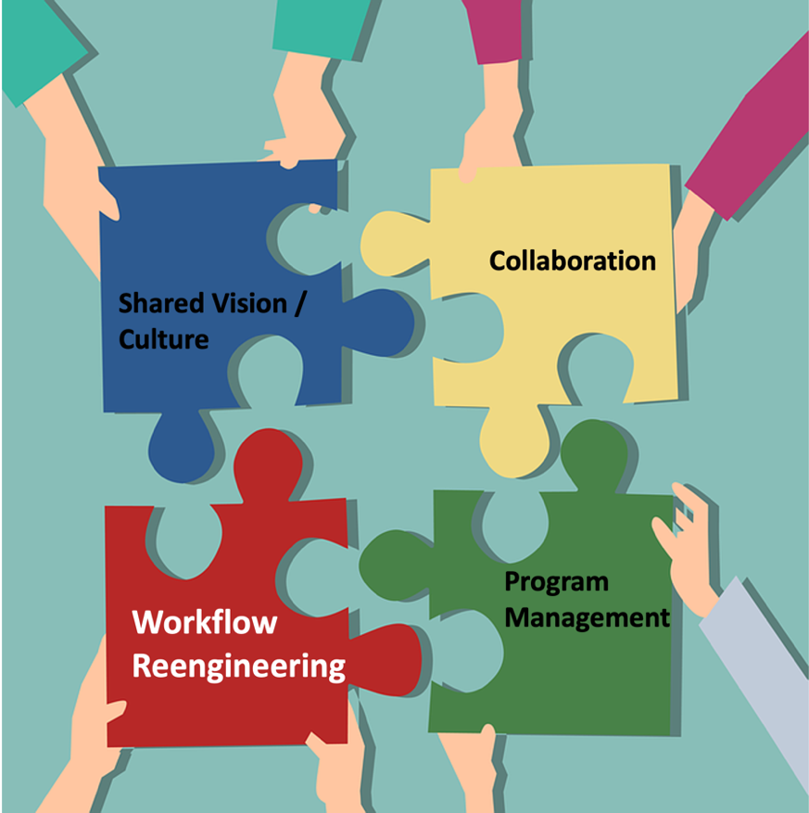
ACT supports activities needed to improve outcomes and strengthen Learning Health Systems
ACT’s ‘Special Sauce’ is a proven framework, methodology, and toolset for reengineering workflows
This underpins, augments, and integrates all ACT care transformation support activities

Slide 21
ACT support: implement, refine, scale care transformation & LHSs while strengthening partners’ business performance
Optimal Health for Individuals and Populations in ‘Transformation Test Kitchens’
Public Health
Payers / Health Plans
Evidence / Guidance Orgs
Quality Improvement Initiatives
Standard Development Organizations
Drug / Device Manufacturers
Gov’t Agencies
Measure Providers
Health IT / EHR suppliers
Health Systems
Community-based Organizations
ACT-fostered Collaborations
Leverage Proven Workflow Reengineering Approaches (Transformation Playbooks)

Slide 22
Transformation activities ACT supports (via Transformation Playbooks, facilitation, collaborations)
Shared Vision / Culture
  Build/ Document/ Leverage Stakeholder Consensus: what we’re doing; why; how
  Project Charter Template, Culture Playbook
Project and Program Management
  Robustly manage individual improvement projects and synergies across efforts
  E.g., Guidance/tools from HIMSS improving outcomes Guidebook [Osheroff 2012]
Workflow Reengineering Frameworks, Methods, and Tools
  Analyze and improve target-related workflow / information flow
  Workflow Reengineering Worksheets (WRWs)
Collaboration
  Enhance and leverage innovation through robust cross-fertilization, e.g., ‘Puzzle Piece’ spreadsheet,
  Collaboration Whiteboards, Transformation Initiative Catalog (intake form, results);
  ACT Response to CMS RFI on the Health Technology Ecosystem

Slide 23
ACT Cornerstones:
Workflow Reengineering Framework, Worksheets, and Related Tools

Slide 24
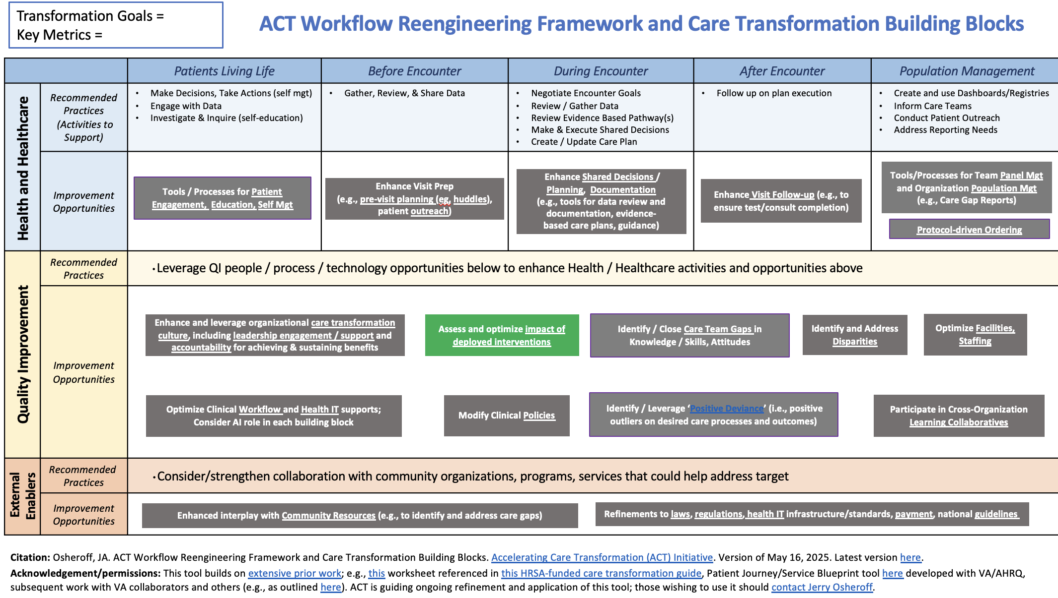
Cross-cutting framework for workflow reengineering
This framework underlies ACT Tools
It helps:
Visualize and leverage complex ecosystems driving outcomes
Identify opportunities to improve actions and outcomes
Foster collaborations within / across internal and external stakeholders
[Infographic source is here]

Slide 25
Workflow Reengineering Worksheets (WRWs) – A cornerstone of the Transformation Playbooks
Culmination of 2 decades of collaborative work outlined above
Have been applied and delivered value to efforts on many targets in many settings
Earlier development/use supported by US Gov’t agencies (e.g., VA, AHRQ, CMS, ONC, CDC, HRSA, IHS), private sector
Sampling of User Feedback Quotes from Studies using WRW-related tools:
  We were able to add steps in the places that made the most impact, but the least extra work for the staff
  Mapping out current workflows and potential enhancements was most beneficial and applicable to other QI efforts
  We plan on utilizing [WRW] as we continue to work on our hypertension control and expand into other chronic diseases
  [WRW] helped us outline our potential enhancements that we needed to work on and help us define roles and responsibilities related to hypertension identification and management. From the Medical Assistants [MA] to the Quality Improvement team in the back end [WRW helped us to work] efficiently together to recall and monitor our hypertensive patients.
  The [WRW] helped me [have] a clear template to follow which allowed me to make sure I touched on critical areas
  The worksheets help us as a team make sure nothing was overlooked

Slide 26
Four steps in using Workflow Reengineering Worksheets to improve care processes and outcomes
Document improvement goals
  Consider target, current performance, and success measures
Ensure stakeholders consider the different performance drivers and opportunities to achieve improvement goals
  As per the ACT Care Transformation / Workflow Reengineering Framework
Use Workflow Reengineering Worksheet tables
  Review best practices, analyse current state, brainstorm future state
Implement improvements; enhance workflow and results

Slide 27
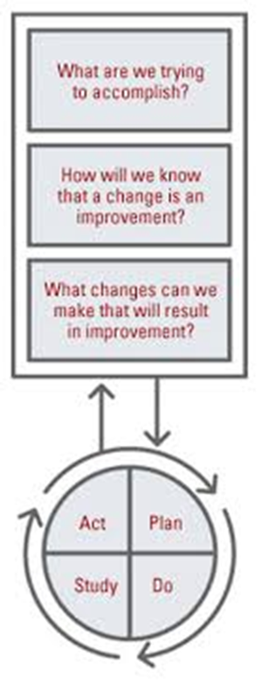
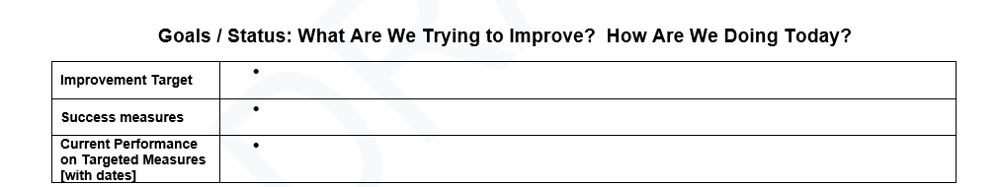
Step 1: What are we trying to improve?
Document goals, current performance, and success measures
Corresponding Steps in IHI / Model for Improvement:

Slide 28
Step 2: Ensure stakeholders consider performance drivers / opportunities to achieve goals

Slide 29
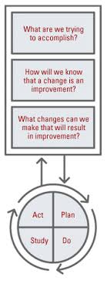
Step 3: The heart of the analysis work:
Using the Workflow Reengineering Worksheet tables, document:
What is best practice?
What is the current state?
What changes can we make to improve outcomes?
Corresponding Step in IHI / Model for Improvement:

Slide 30
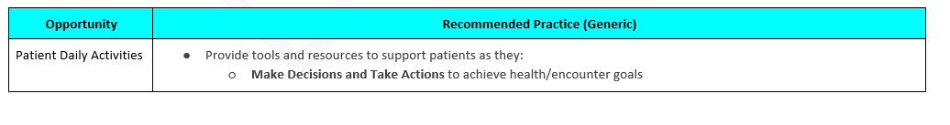
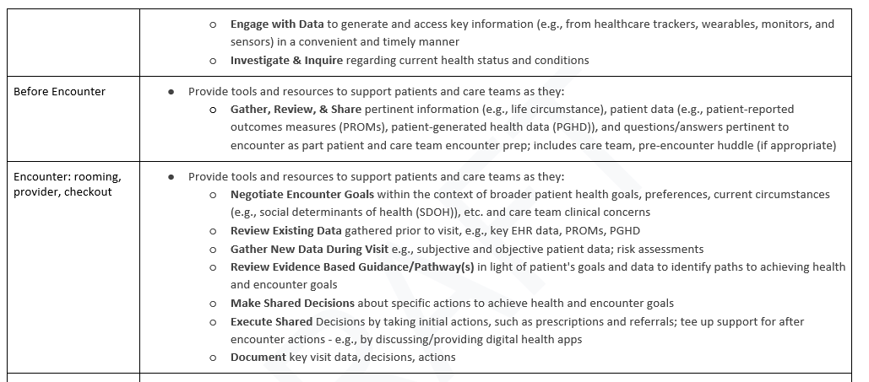
What is recommended practice for the target?
An excerpt from the generic template

Slide 31
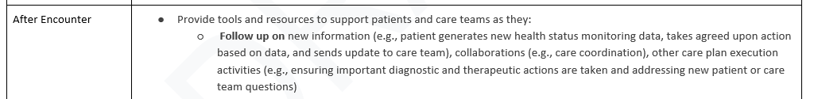
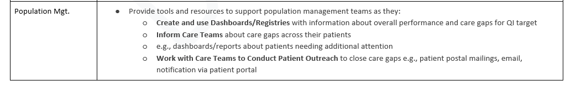
What is recommended practice?
Continuation of the excerpt from the generic template

Slide 32

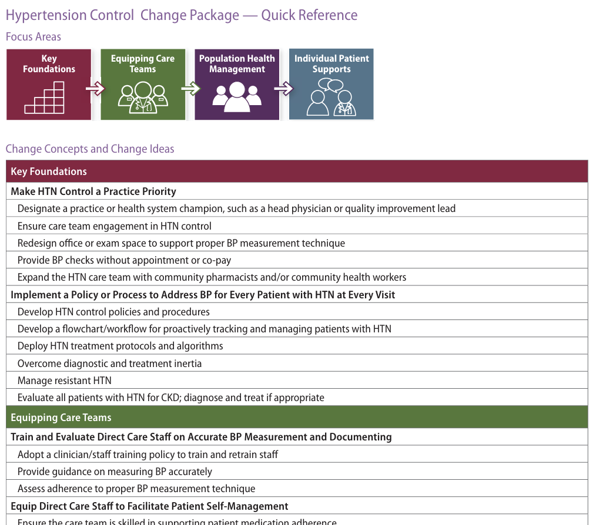
Target-specific change packages with ‘recommended practice’
Based on the ACT framework can be leveraged or created
Addressing best practice in practice
Access this US CDC tool here
Other ACT Framework-based change packages have been developed for VTE prophylaxis, colorectal cancer screening, SMBP, Diabetes

Slide 33
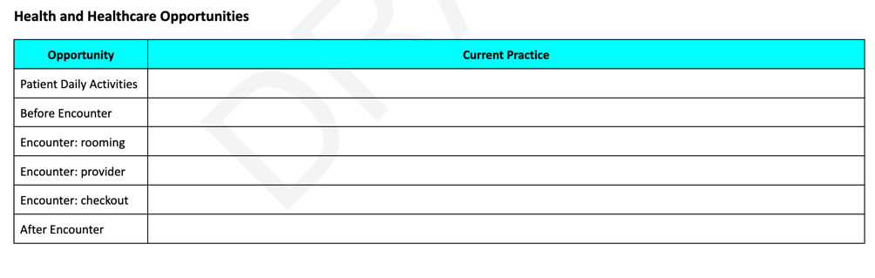
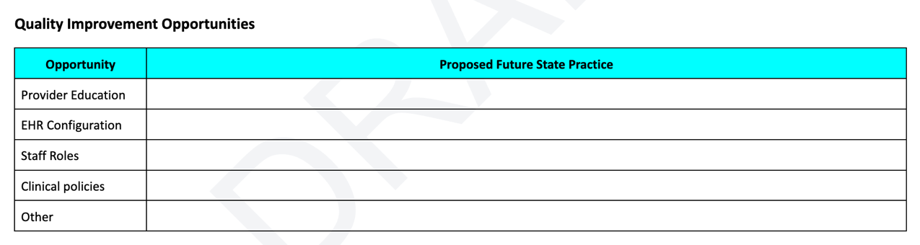
Excerpts of tables from Workflow Reengineering Worksheet for documenting current and future state
What is happening now?
Current Processes Documentation
What changes can we make to improve outcomes?
Potential Future State Documentation

Slide 34
Step 4: Implement improvements; enhance workflow
Use future state worksheets with teams and stakeholders to prioritize, design, implement, and evaluate high-impact changes to current workflows and information flows
Apply standard Quality Improvement approaches such as PDSA cycles as appropriate
Corresponding Steps in IHI / Model for Improvement:

Slide 35
Project Description Template for cultivating synergies across initiatives / organizations
What problems/opportunities are we focusing on addressing?
How are we phasing our approach to these problems?
What are the specific goals we are trying to achieve and what measures will we use to track progress toward these goals/in these phases?
What is our strategy for getting to goals? (including use of WRWs)
How will the initiative be managed?
Where are we in this outcome improvement process? What are our Next Steps?
What risks/challenges/concerns are we facing and what are mitigation plans?
Template is used in public and private sector ACT collaborator organizations

Slide 36
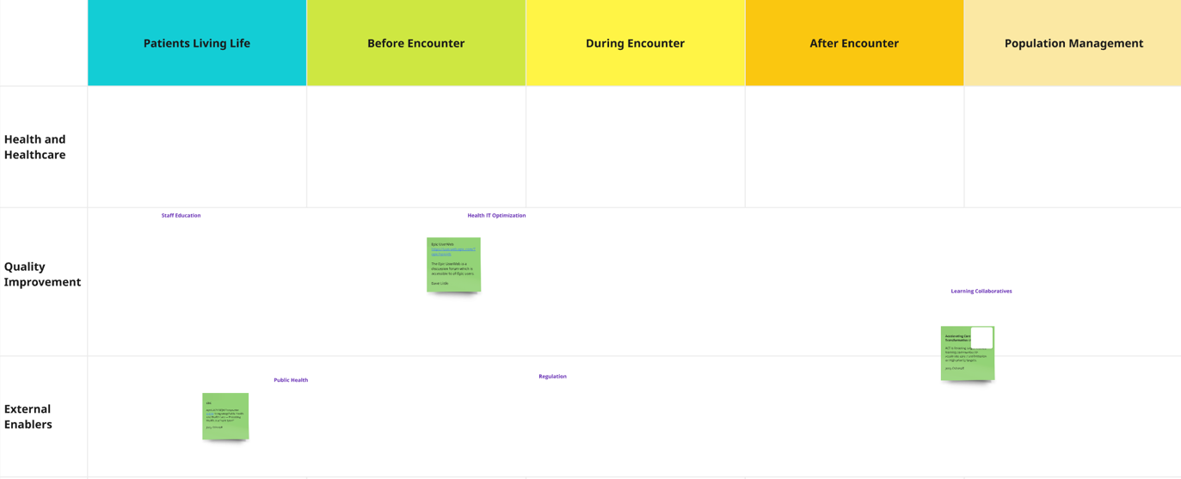
Collaboration Whiteboard: Reengineering framework fosters collaboration across stakeholder groups / initiatives
Surface / spread ‘positive deviance’, crowdsource solutions within / across improvement efforts; can be used with ACT Initiative Catalog (screenshot on next slide; intake form, results), ACT Network

Slide 37
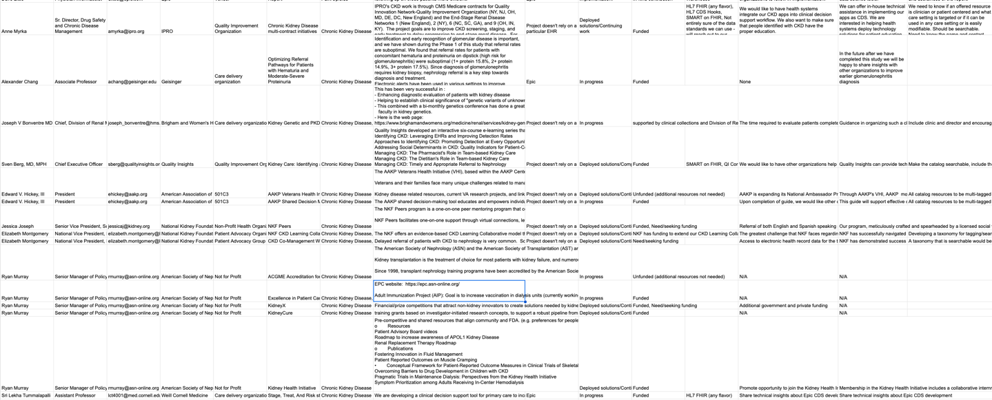
ACT Care Transformation Initiative Catalog
Data Fields:
Sampling of ~30 entries so far (limited outreach; 16 for CKD; full results here)

Slide 38
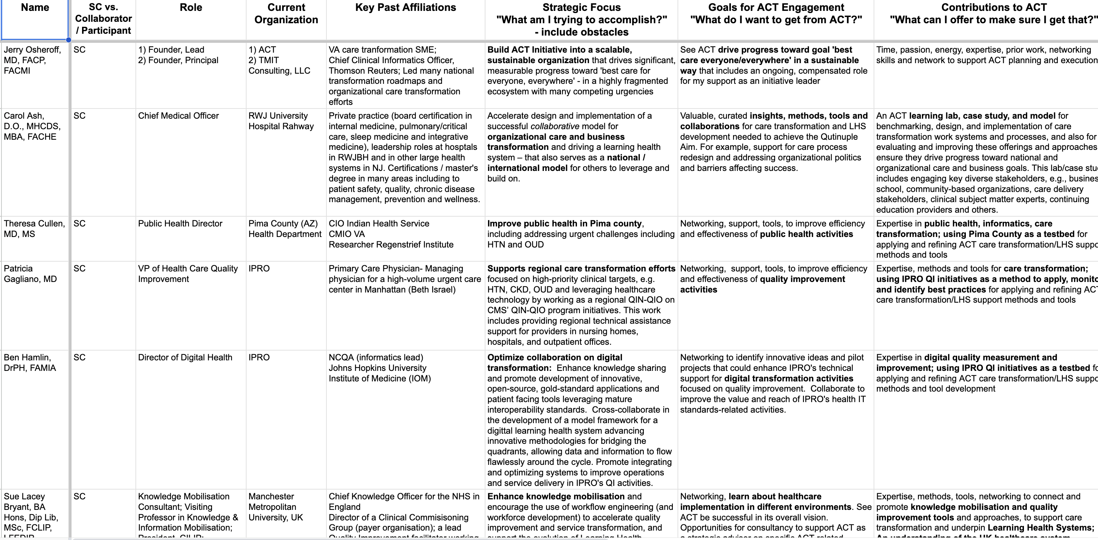
ACT ‘Network’ – Identify and connect key transformation ‘people/puzzle pieces’
Excerpt from ACT Networking spreadsheet here; complements ACT Initiative Catalog (intake form, results)

Slide 39
Applying ACT Workflow Reengineering frameworks, methods, tool, collaborations
ACT-enabled Workflow Reengineering | Within Improvement Target | Across Improvement Targets
Within Organization | Targeted Transformation Strategy | Enterprise Transformation Approach
Across Organizations | Learning Communities for Improvement Target | Ecosystem Enhancement

Slide 40
ACT Collaborations and Partnerships

Slide 41
ACT Strategic Roadmap
From Current State to Global Impact
Test Kitchen Cycle
Current State
Identify &
engage
Formalize
collaboration
Destination
• 2 early-stage test kitchens:
- Pima County, Arizona
- Northeast - Mid-Atlantic
CMS QIN-QIO
•Emerging playbooks
•Committed SC, stakeholders
Best healthcare for
everyone, everywhere
Global PPP (coordinated
multi-national initiative)
oversees sustainable
ACT operations
Success attracts
new test kitchens
Adapt
playbook
Share proof
points & learnings
Execute &
measure
Learnings refine playbook & tools
Current test kitchen status: formalizing agreements & adapting playbook
Foundation supporting all ACT activities
SC & Stakeholder
Engagement
Strategic
Partnerships
Playbook & Tools
Development
Sustainability
Mechanisms
Weekly SC meetings
Stakeholder communications
Mailing list refinement and use
LinkedIn presence
HL7 collaboration (Quality Accelerator, CardX, others)
Others in development
Core playbook
Custom adaptations
WRW templates
Collaboration agreements
Funded engagements
Path to nonprofit
Path to PPP

Slide 42
‘Test Kitchens’ for implementing, refining, scaling ACT value proposition
Pima County Health Department
Goals: Learning Public Health System / Public Health 4.0
Initial Targets = HTN, Overdose/MOUD, Syphilis/DoxyPEP
IPRO CMS 13th SOW
Goals: Improve provider performance on targeted measures
Initial Targets: HTN, CKD, Overdose, others
Will leverage and build on the ACT LHS Learning Community
RWJ University Hospital Rahway Quality Poster (recent prior work)
ACT-supported work on care/ business transformation, HTN control, whole person care
Poster/initiative being shared by The Joint Commission as an exemplary approach
Other ACT-supported ‘test kitchens’ are being cultivated to foster, enhance and cross-fertilize needed healthcare/public health transformation work and results

Slide 43
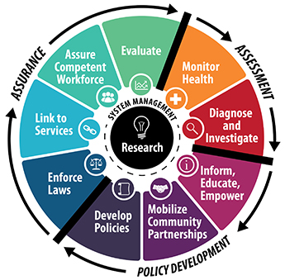
Improving health in Pima County: proposed approach
With ACT support, PCHD uses its data and convening capabilities to identify opportunities and coordinate / support efforts to measurably improve health processes & outcomes – in a sustainable and scalable manner
Syphilis
Key Numbers: Total cases, number of maternal cases, number of newborns, mothers getting prenatal care, number screened, number identified, number treated effectively
Initial Targets of Interest:
HTN
Key Numbers: CV death, HTN prevalence, Uncontrolled HTN, hypertension HIPS
OUD
Key Numbers: near misses, overdose deaths, MOUD/OUD - PCHD-initiated/ other initiated
Public Health:
PCHD, AZ DHS, Regional
Health Systems
Payers / Health Plans: AC Medicaid/MCOs, Commercial, Medicare, Uninsured
Supports/Enablers
ACT Initiative
Community Partners (e.g., for behavioral health)
NACHC for FQHC support
Drug/device suppliers
Statues / Regulations
Care Programs/Processes:
Screen for/recognize unmet clinical/SDOH needs
Provide interim support (e.g., medications)
Link patients to care resources: Transitions of Care and more definitive long term support (PCP, etc.)
Care Programs/Processes:
Care Programs/Processes:
Medicaid support for screening (e.g., syphilis)
Commercial: outreach to networks about programs
10 Essential PH Services

Slide 44
Other care transformation/LHS initiatives in various stages of leveraging ACT offerings
Hypertension Control
  Exploring support for national initiatives in US and abroad
Chronic Kidney Disease
  US Veterans Administration heavily leveraging ACT enablers; exploring cross-fertilizing with other organizations (see catalog)
Pain/Opioids (see Pain/Opioid LHS Learning Community [POLLC] overview, summative webinar slides, recording)
  Exploring POLLC 2.0 – address OUD in a region
  OUD efforts in Pima County, AZ
  Colorectal cancer screening, other primary care targets in healthcare safety net
  HealthEfficient using WRW-related tools to improve care/outcomes
  Sickle Cell Disease – National Association of Sickle Cell Centers
  Care gap and documentation tools in Pfizer-funded effort
  VTE Prophylaxis/Traumatic Brain Injury
  WRWs to spread innovations in AHRQ-funded CDS effort
Multiple Chronic Conditions / Whole Person Care
  Exploring with various organizations opportunity to leverage ACT workflow reengineering methods/tools and collaborations

Slide 45

Sample ACT collaboration opportunities
Quality Improvement / Care Transformation / LHS / High Reliability / Informatics Education
Do WRW PDSA to test if these methods/tools augment a current target-focused strategic effort and accelerate progress toward clinical and business goals; scale successful results
Explore if WRWs and related ACT offerings can foster cross fertilization across targets within your organization and with other organizations; e.g., by forming or leveraging learning communities
Leverage ACT collaborations / methods / tools (e.g., WRWs, Collaboration Whiteboards, Transformation Initiative Catalog), to create or enhance target-focused learning communities
Leverage ACT collaborations with key stakeholder groups – e.g., HL7, EHR vendors, federal agencies, quality improvement organizations, public health, payers, measure developers – to support local efforts
Leverage ACT activities as a ‘learning lab’ for trainees / learners (ACT has provided semester practicum experiences for 3 informatics master’s students and an MD/PhD student)
Engage with Steering Committee to drive efforts to enhance the healthcare ecosystem in which you, your partners, and others operate
Image credit: freepik

Slide 46
Ways to leverage ACT in your work
Support for Organizations
ACT can enhance an organization’s new or existing care transformation / LHS initiatives:
Analysis/Recommendations: e.g., leveraging WRWs to ‘get the CDS/LHS 5 rights’ right, improving stakeholder engagement and shared vision, improving program management efficiency
Facilitation: e.g., work directly with program participants in the organization to support program activities (using WRWs, program charters, monitoring / refining program activities)
Training: e.g., on using WRWs to analyze and improve workflows and targeted outcomes
Networking: Engage others from the Steering Committee and network of ACT collaborators
Support for Cross-organization Initiatives
ACT is fostering cross-organization initiatives to improve targeted outcomes in a scalable manner:
Developing / Enhancing Learning Communities: e.g., using WRWs/Whiteboard to support target-focused efforts within participating health systems and spread successful approaches among them.
Care / Business Transformation Pilots: E.g., as in an emerging proposal for a multi-stakeholder, scalable effort to improve selected clinical and business measures
Overarching Public-Private Partnership: E.g., as called for in ACTS Roadmap
Engagement Model:
Today
Business relationships with ACT– affiliated organizations
Being Considered
ACT non-profit
Long Term Goal
National / Global Public Private Partnership

Slide 47

Brainstorm
Where are synergies between Your Priorities and ACT? E.g.,
  What are potential win-win-wins we could address?
What follow-on activities we might undertake jointly? E.g.,
  Knowledge exchange – deeper dive / show and tell on respective methods, tools, collaborators
  Scalable Pilot - Identify potential clinical targets / settings for accelerating care transformation, engage potential collaborators, combine respective approaches to care process reengineering, achieve targeted outcomes (pre-determined KPIs), develop / implement plan for scaling benefits
Image credit: freepik

Slide 48
Appendix Slides

Slide 49
Future Vision from ACTS that ACT is Driving Progress Toward

Slide 50
Imagine a world where…
ACT Initiative

Slide 51
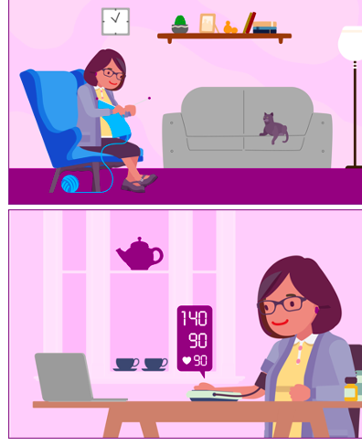
Future patient experience
Focus = Patient Health Goals
Driven by patient needs / values
Empowered for self management
Coordinated, proactive
Images credit: ACTS
51

Slide 52
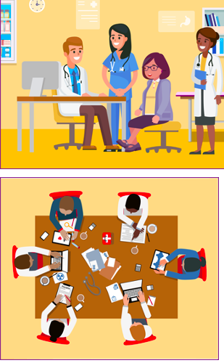
Future care team experience
Professional Joy Restored
Workflows are efficient, effective, well-supported
Appropriate decisions / actions evidence-informed, easier
Everyone working at ‘top of license’
Images credit: ACTS
52

Slide 53

Future Care Delivery Organization Experience
Clinical and Business Goals Realized
Excellent care / equity / reliability
Continuous learning and improvement
Resilience: margins, pandemics, staff shortages / burnout
Image credit: freepik

Slide 54

Future society experience
Global Learning Health System
Promote wellness
Support everyone achieving health goals
Use healthcare resources efficiently
Image credit: freepik

Slide 55
Additional Information on ACT Precurors and Foundations

Slide 56
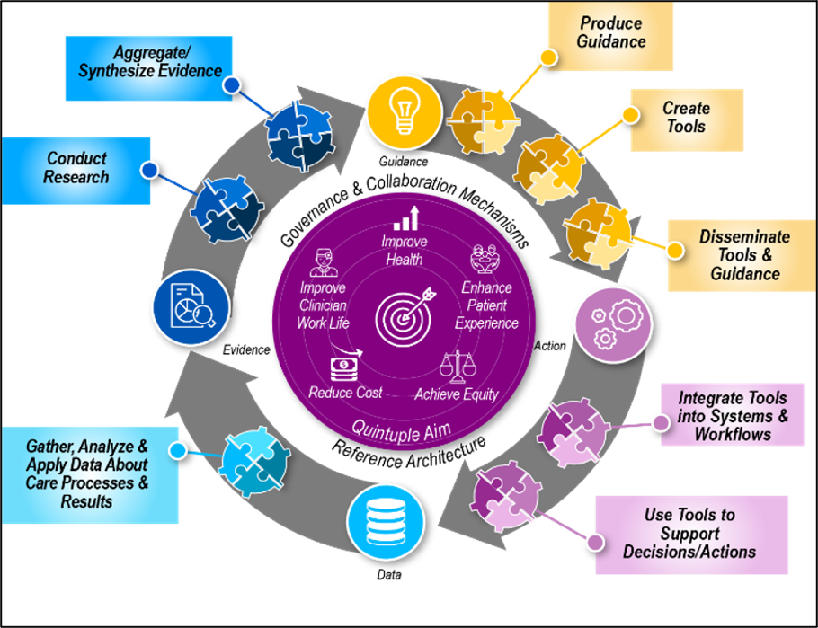
ACTS future vision requires efficient flow around LHS cycle
Need comprehensive, coordinated approach to ensure cycle improves care delivery / outcomes
  Address all stakeholders, targets, tooling
  break down silos
All participants produce, consume cycle components
  goal = make exchanges more efficient/effective to produce desired results
Source: Osheroff et. al., AHRQ evidence-based Care Transformation Support (ACTS) initiative

Slide 57
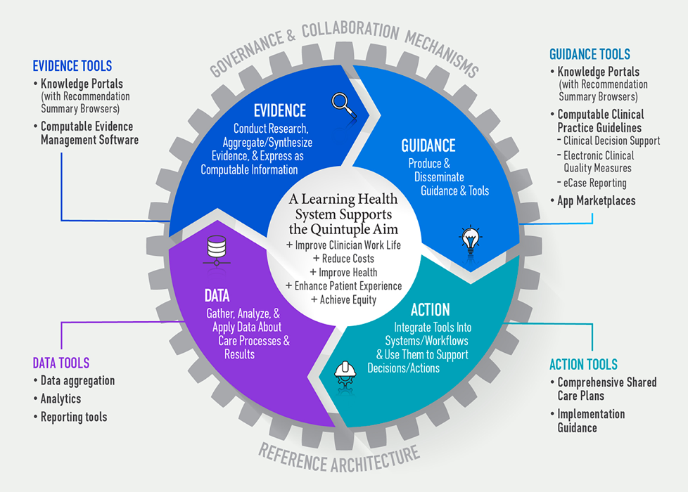
Knowledge ecosystem tooling needed to optimize LHS flow, outcomes
Better tools / strategies needed to improve flow
  Leverage FHIR and other standards
Deep dive on tooling here in ACTS Concept Demo (see section, “Key Knowledge Ecosystem Tool Sets”)
Source: Osheroff et. al., AHRQ evidence-based Care Transformation Support (ACTS) initiative

Slide 58
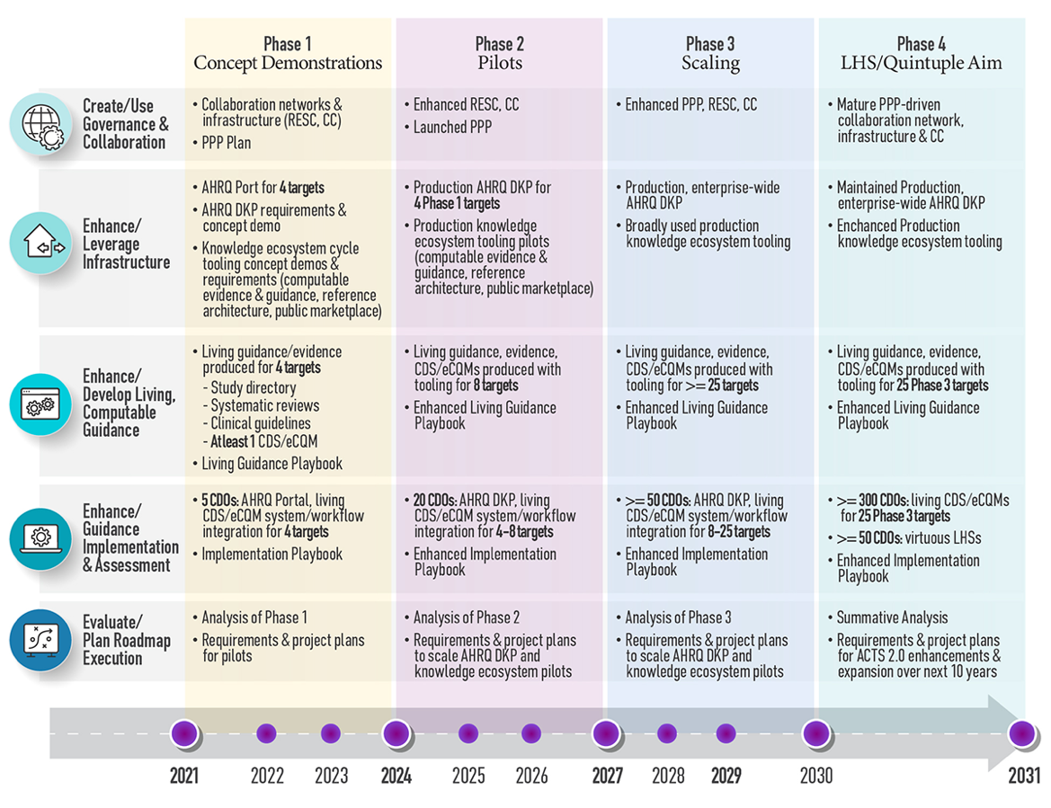
ACTS 10-year roadmap: activities
*RESC = Roadmap Execution Steering Committee; CC = Coordinating Center; PPP = Public Private Partnership; DKP = Digital Knowledge Platform
Source: Osheroff et. al., AHRQ evidence-based Care Transformation Support (ACTS) initiative

Slide 59
Stakeholder engagement towards future vision
Slide from 10/2021 ACTS presentation; support letters to collaborate on executing ACTS Roadmap
Forty-one organizations provided support letters indicating plans to collaborate and align efforts / investments to achieve the Future Vision.
Federal Agencies: 1
VHA (Nebeker)
Care Delivery Organizations: 8
VCU/ACORN (Krist)
UM Health Fairview (Melton-Meaux/Tignanelli)
U Chicago Medicine (Umscheid),
Rutgers RWJBarnabas Health (Sonnenberg)
MUSC (Lenert)
Hennepin Healthcare (Pandita)
AACHC-CVN (Frick)
VUMC (Johnson)
Professional Societies/Accrediting Bodies/Institutes: 7
American Medical Association (Rakotz)
AMIA (Dykes)
ACMQ (Casey)
ACCME (Singer)
NCQA (Barr)
RTI (Richardson)
ACP (Qaseem)
Health IT Vendors/Initiatives: 11
Epic (Little)
Cognitive Medical Systems (Burke/Bormel)
Health Catalyst (Rimmasch)
Apervita (Middleton)
U Mich/MCBK (Friedman/Richesson/Flynn)
Logica Health (Hu
EBM on FHIR/COKA/Computable Publishing (Alper)
BPM+ Health (Rubin)
HL7 (Jaffe)
PICOPortal (Agai)
ZeaMed (Bondugula)
Patient Advocates: 4
Hassanah Consulting (Tufte)
Rosie Bartel (Bartel)
Society for Participatory Medicine (Hennings)
Maureen Smith (Smith)
Clinical Evidence/Guidance Organizations: 10
Cochrane (Soares-Weiser)
COVID-END (Grimshaw)
GIN (Harrow)
JBI (Jordan)
Epistemonikos (Rada)
MAGIC Evidence Ecosystem Foundation (Vandvik/Brandt)
McMaster University (Iorio)
University of MN EPC, School of Public Health, Division of Health Policy and Management (Butler/Beebe)
Brown University EPC – SRDR (Saldanha)
Penn Medicine Center for Evidence-based Practice (Mull)
59

Slide 60
Additional Information about ACT Offerings

Slide 61
Support ACT provides to drive care transformation/LHSs [Earlier DRAFT]]
Support Type | Description | Resources | Examples / Use Cases
Networking with CT/LHS opinion leaders and implementers | Provide access to diverse thought leaders on the ACT SC (and beyond) who are focused on broadly accelerating care transformation | ACT’s Stakeholder Initiative Catalog (intake form, results) Needs/offerings of SC | - Peer support among SC members and beyond - SC support for HTN/NJ and CKD/VA efforts
Set up/enhance target-focused learning communities | Help stakeholders form or enhance learning communities that bring together those seeking to accelerate target-focused care transformation e.g. help them get peer support and SME input leverage methods/tools for CDO care processes improvement etc. (see bullet above / this table) for cross-organization sharing and learning leverage standards to deploy interventions | ACT Care Transformation Collaboration Whiteboard Engagement with leading EHR vendors and patient partners Develop/leverage target-focused change packages [planned slides from Julia/Maria about standards considerations for CT/LHS] | Pain/Opioid LHS Learning Community ACT Collaboration with HL7, especially HL7’s LHS WG and explorations to leverage Accelerators, CardX, etc. see examples of change packages and projects to apply them
Support CDO’s target-focused CT/LHS efforts | Help CDOs and their partners apply tools and methods, e.g. to gain stakeholder engagement on care transformation efforts analyze current workflows in light of recommended practices to define consensus future state workflows that will deliver desired results Iimplement and evaluate care process changes and achieve desired results | Workflow Reengineering Worksheets Engagement with leading EHR vendors and patient partners Project Pitch Deck Template Assess care Gaps [planned slides from Julia/Maria about standards considerations for CT/LHS] | Rutgers/RWJBH HTN Control Initiative CKD Care Transformation at VA Extensive prior work to apply HSB-related tools to reengineer care delivery ACT Care Gap Report Poster; Epic Care Gap Report for Pain/Opioid Care
Notes:
Help CDOs and their partners apply tools and methods (that have been used as outlined above) to gain stakeholder engagement on care transformation efforts, analyze current workflows in light of recommended practices to define consensus future state workflows that will deliver desired results, and otherwise support these efforts
Help stakeholders (e.g., specialty societies, government agencies, foundations) form or enhance learning communities that bring together those seeking to accelerate target-focused care transformation in various ways - e.g., help them get peer support and SME input, leverage methods/tools for CDO care processes improvement etc. (see bullet above/this table) for cross-organization sharing and learning, leverage standards to deploy interventions, etc.
provide access to diverse thought leaders on the ACT SC (and beyond) who are focused on broadly accelerating care transformation

Slide 62
ACT enablers [earlier draft]
Enabler | Description
Health Service Blueprint (HSB)-related tools | • e.g., in HSB framework; playing key role in VA’s CKD care transformation efforts, POLLC efforts; and work on HTN and other targets
Learning Communities, supported by ACT’s Stakeholders Initiative Catalog (intake form, results) and ACT Collaboration Whiteboard Template | •The Pain-Opioid LHS Learning Community (overview, summative webinar) is a foundation for target-focused learning communities ACT aims to foster, including leveraging other ACT enablers within and across these learning communities •initial catalog version has >30 entries entries; VA shared catalog entry form with CKD stakeholders and many of the entries focus on that target •POLLC started using Collaboration Whiteboard before pausing to identify partners for regional performance improvement efforts; whiteboard use is under consideration for use by the Kidney Interagency Coordinating Committee and could be an engine for cross-fertilizing efforts above on care transformation across organizations.
Engagement with leading EHR vendors (Epic, Oracle Health) | •physician informaticists with Epic and Oracle Health have played key roles in ACT-related learning communities (POLLC and SCD-TCIP) - e.g., developing Care Gap Reports and related tools to make the appropriate decision/action easier (ACT Care Gap Report Poster, MCBK NA/2024). Through their engagement, ACT aims to foster platform-independent solutions that don’t require customized development for each target and EHR; ? populate care transformation building blocks with how to leverage EHRs to address transformation.
Collaboration with HL7, especially HL7’s LHS WG | •ACT is supporting HL7’s LHS WG efforts to create a Domain Analysis Model that will help make information flow around the LHS cycle more computable and interoperable, which will be required to optimally advance care transformation/LHS efforts •HL7’s board chair and other active HL7 members are members of the ACT steering committee and are cultivating synergies between ACT activities and HL7’s standards development and implementation efforts
Strong ACT Steering Committee engagement from leading patient partners/advisors | •e.g., drivers for the recent Patient, Family, and Care Partner Advisor Living Toolkit and the Patient, Family and Caregiver Engagement portion of the ACTS LHS Concept Demonstration ensuring that ACT activities are strongly patient-focused and leverage best practices for patient participation in all LHS cycle-related activities
Work to Identify Care Gaps within and across targets | •e.g., see this ACT poster on ACT-related care gap report efforts presented at the MCBK North America chapter meeting 2/26/24
Exploring ways to leverage NHS change work | NHS Change Model; Leading Large Scale Change

Slide 63
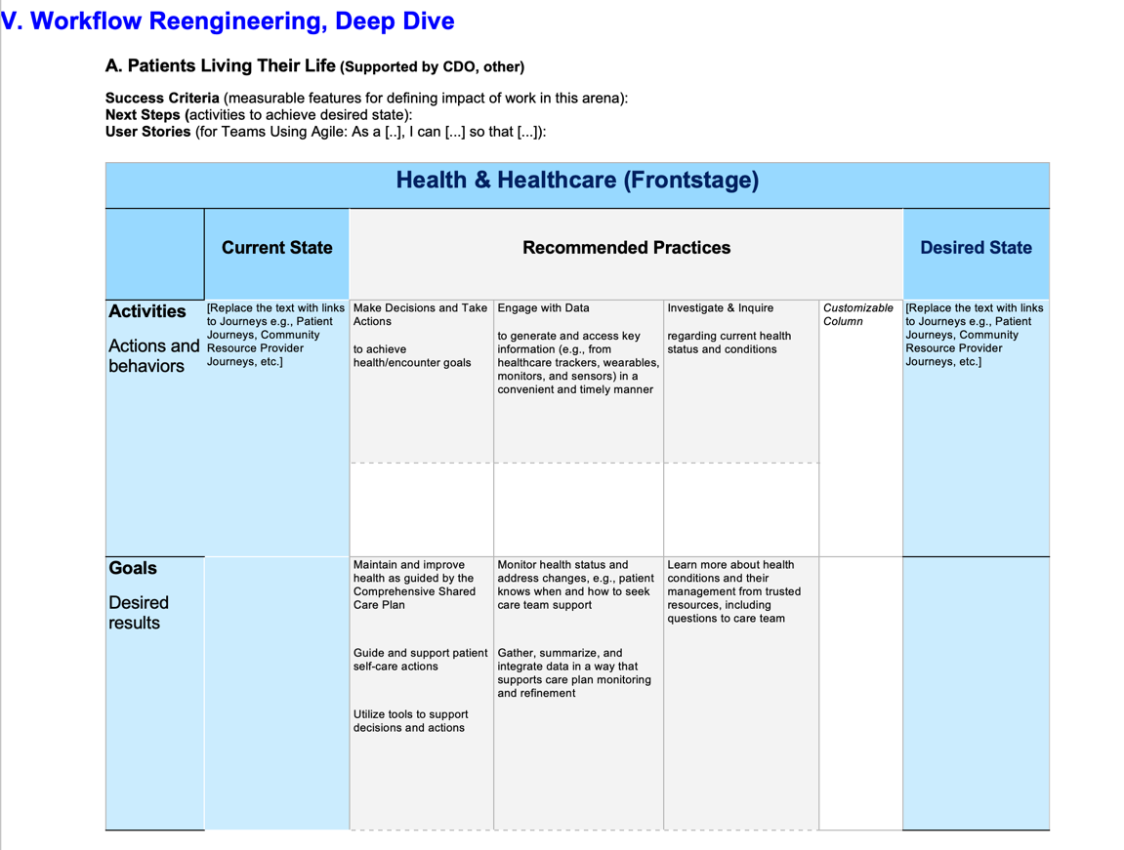
Workflow Reengineering Worksheet component: Deep dive into desired future state, driven by current state, recommended practice
Small excerpt from one portion of an extensive Workflow Reengineering Worksheet Tool

