Slide 1

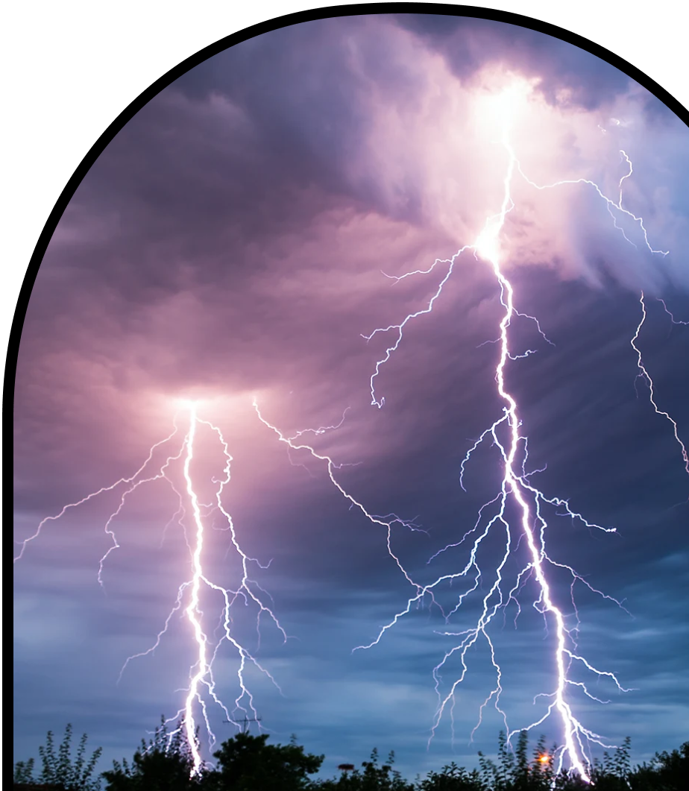
Anchor Layer Teacher Guide
A curriculum companion for Anchor Layer users
Grade 3
Weather & Climate
Unit Web Link • Pacing Guide • Other Units

Slide 2
Weather & Climate • Grade 3
Anchor Layer Teacher Guide
Unit Summary
In this unit, students explore weather and climate patterns. They make predictions about the weather through careful observations of the clouds, wind, temperature, and precipitation. Students also learn to differentiate between weather and climate and use models to reveal global climate patterns. They use this information to design solutions that reduce the impacts of severe weather events like windstorms. Assessments
Performance Expectations | Science & Engineering Practices | Disciplinary Core Ideas | Crosscutting Concepts
• 3-ESS2-1. Represent data in tables and graphical displays to describe typical weather conditions expected during a particular season. • 3-ESS2-2. Obtain and combine information to describe climates in different regions of the world. • 3-ESS3-1. Make a claim about the merit of a design solution that reduces the impacts of a weather-related hazard. • 3-5-ETS1-1. Define a simple design problem reflecting a need or a want that includes specified criteria for success and constraints on materials, time, or cost. • 3-5-ETS1-2. Generate and compare multiple possible solutions to a problem based on how well each is likely to meet the criteria and constraints of the problem. • 3-5-ETS1-3. Plan and carry out fair tests in which variables are controlled and failure points are considered to identify aspects of a model or prototype that can be improved. | • Planning and Carrying Out Investigations • Developing and Using Models • Analyzing and Interpreting Data • Obtaining, Evaluating, and Communicating Information • Asking Questions and Defining Problems • Constructing Explanations and Designing Solutions | • ESS2.D: Weather and Climate • ESS3.B: Natural Hazards • ETS1.A: Defining and Delimiting Engineering Problems • ETS1.B: Developing Possible Solutions • ETS1.C: Optimizing the Design Solution | • Structure and Function • Stability and Change • Cause and Effect • Patterns
Weather & Climate Lesson Flow on Next Page
‹#›

Slide 3
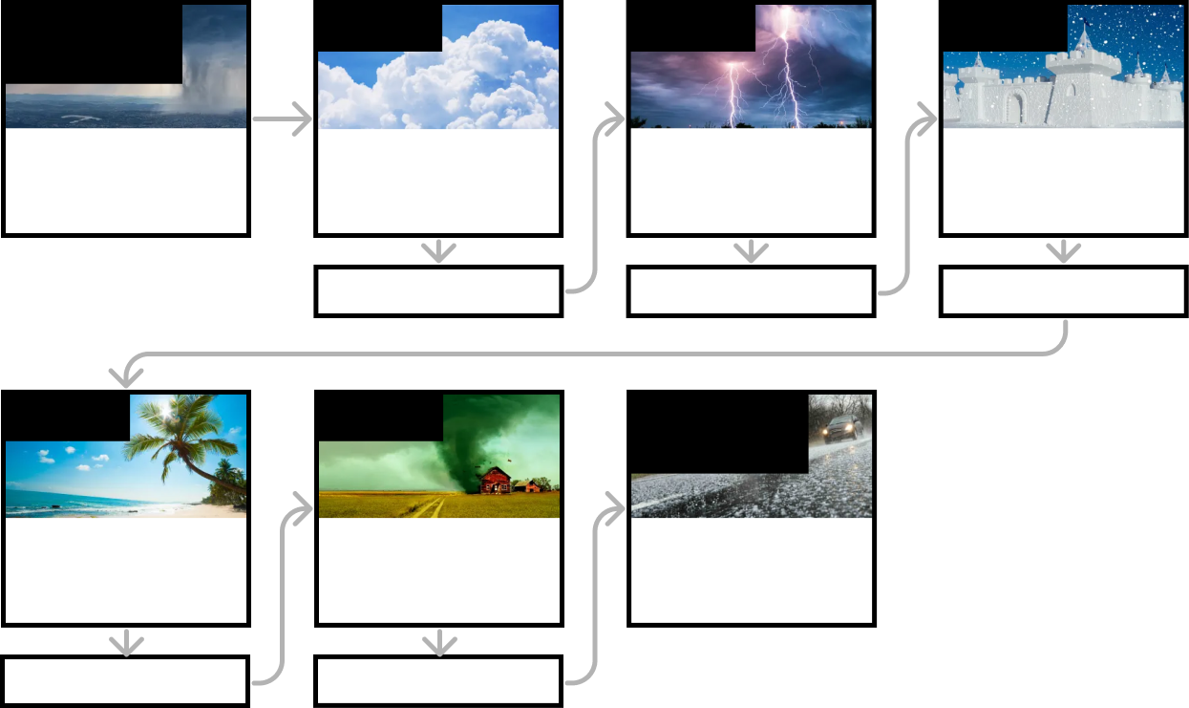
Weather & Climate • Grade 3
Anchor Layer Teacher Guide
Weather & Climate Lesson Flow
Anchor Phenomenon
Lesson 1
Lesson 2
Lesson 3
Weather System Modeling
Summer Ice Storm
Water Cycle & States of Matter
Where do clouds come from?
Local Weather Patterns & Weather Prediction
How can we predict when it's going to storm?
Seasonal Weather Patterns
Where’s the best place to build a snow fort?
Anchor Connection
Anchor Connection
Anchor Connection
Lesson 4
Lesson 5
Performance Task
Climate & Global Weather Patterns
Why are some places always hot?
Natural Hazards & Engineering How can you keep a house from blowing away in a windstorm?
Weather and Climate
Can we predict when it’s going to hail?
Anchor Connection
Anchor Connection
‹#›

Slide 4
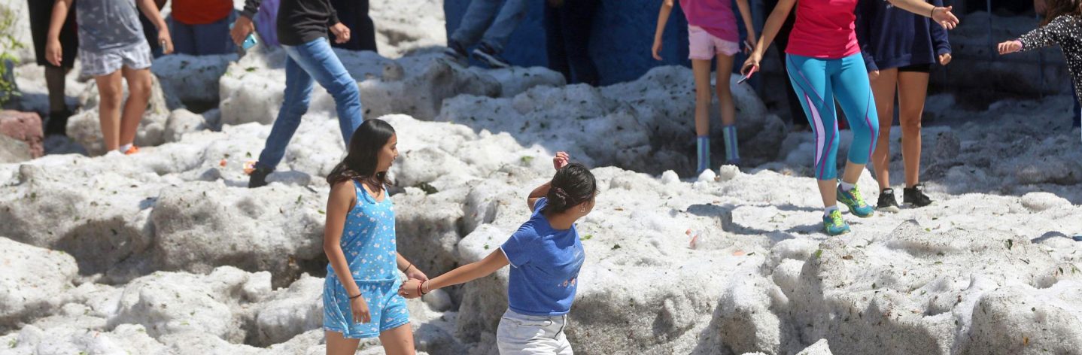
Weather & Climate • Grade 3
Anchor Layer Teacher Guide
Anchor Phenomenon Background
How can an ice storm happen during hot summer weather?
We live on the ground at the bottom of the atmosphere. The main idea at the center of this Anchor Layer is that the weather and climate conditions at the bottom of the atmosphere (where we live) can be very, very different than the conditions higher up. We wouldn’t expect there to be huge amounts of extremely cold air and icy water high above us when we’re on the warm ground, but that’s exactly what leads to hailstorms!
Imagine it’s the end of winter, after months of cold. The atmosphere is likely to be cold from the ground all the way up. When spring begins, the increasing intensity of sunlight causes the ground to warm up. The warming ground warms the air at the bottom of the atmosphere, but the air just a bit higher is still cold. This leads to the formation of warm, humid air at ground level with cold air immediately above it.
The warmer air will tend to rise and carry water vapor along with it.
As warm, humid air rises higher in the sky, it will cool down. The water vapor being carried upward will condense and form clouds and eventually large water droplets. If those water droplets cool even further, they will freeze and form hailstones!
Over time, the flow of warm air from the bottom of the atmosphere to the top will slowly warm the upper atmosphere, which decreases the likelihood of forming icy hailstones in late summer and fall. As temperatures begin to drop again at the beginning of winter, the entire atmosphere cools off from bottom to top. This makes it more likely for water vapor to freeze directly from a gas into a solid, which is how snowflakes are formed.
‹#›

Slide 5
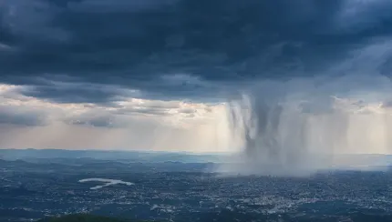
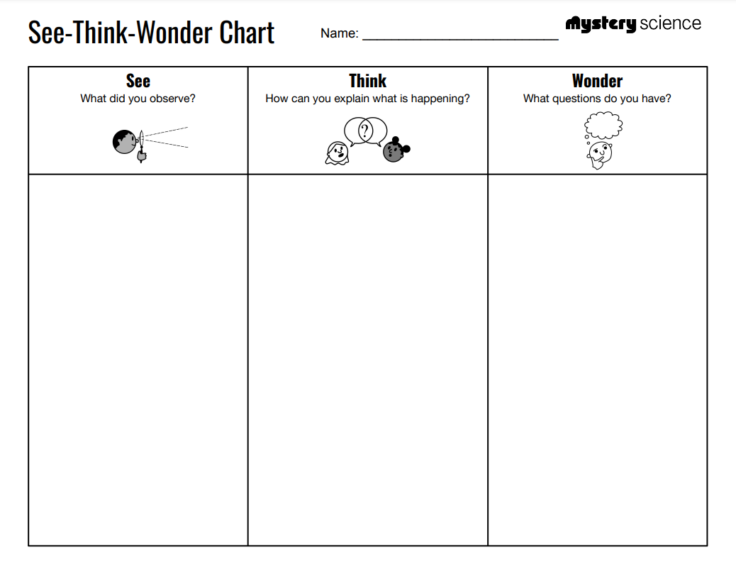
Weather & Climate • Grade 3
Anchor Layer Teacher Guide
Anchor Phenomenon: Summer Ice Storm
Weather System Modeling
Anchor Phenomenon Lesson Overview
Note: This lesson is part of this unit’s Anchor Layer. If you have the Anchor Layer turned on, we recommend teaching all lessons in the remainder of this unit in order.
The anchor phenomenon for this unit is an icy hailstorm that happens during warm summer weather. In the activity, Summer Ice Storm, students generate observations and questions about the phenomenon and create an initial explanation of how it happened. Students will use these initial ideas to track how their understanding grows throughout the unit.
Anchor Phenomenon 15 mins
Guided Inquiry 20 mins
Hands-On Activity 20 mins
Wrap-Up 2 mins
Student Work Samples & Notes
Students will gather clues during and after each lesson to help them improve their explanation. It is important to encourage students to recognize that even if they don't know the perfect answer yet, they are going to learn a lot throughout the unit and will have an opportunity to change or add to their first explanation.
Lots of hail on the ground
People walking on the hail
People dressed in clothes for warm weather
Sunshine
Cars buried in hail
Hail could be just like
snow or frozen rain
Maybe it wasn’t actually hot everywhere… it could
be cold nearby
How can hail fall when it is hot out?
Why did hail fall?
Why didn’t this happen in winter?
Can this happen
where I live?
‹#›

Slide 6

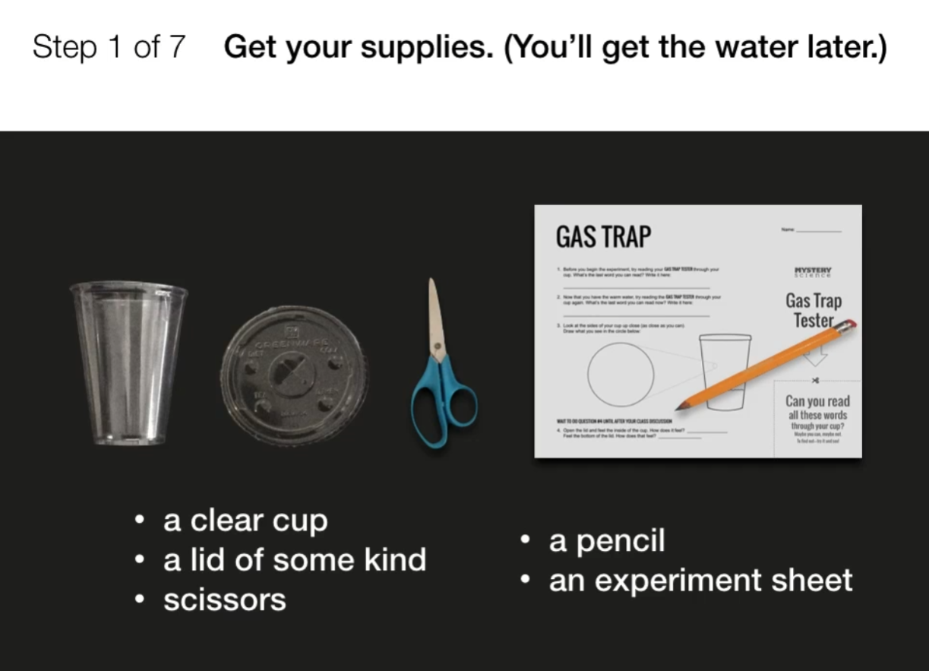
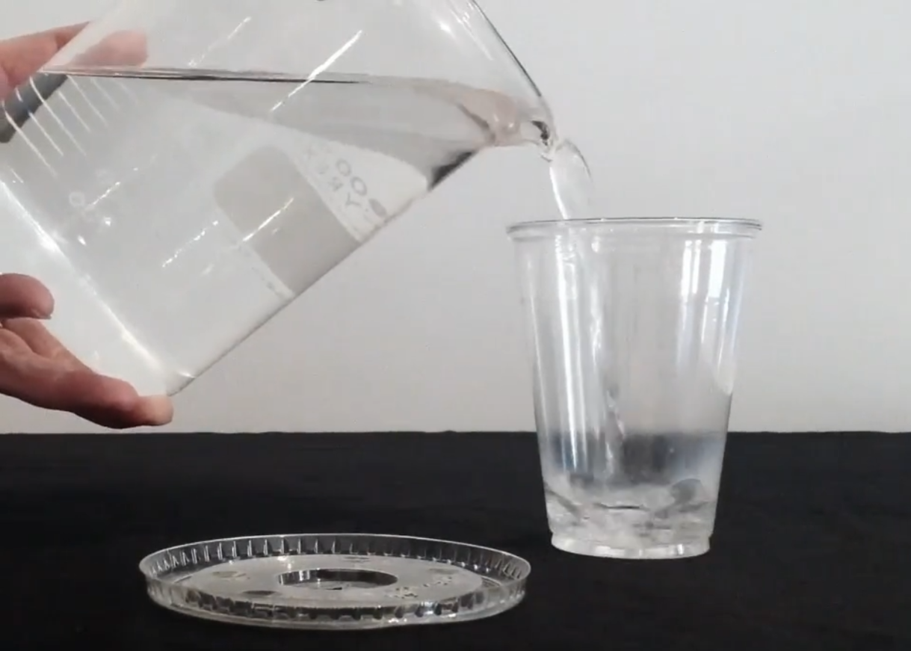
Weather & Climate • Grade 3
Anchor Layer Teacher Guide
Lesson 1: Where do clouds come from? (pg 1 of 2)
Water Cycle & States of Matter
Overview
In this lesson, students examine clues about how clouds look and feel to discover what they’re made of and how they form.
In the activity, Gas Trap, students add hot water to clear cups to observe evaporation firsthand. They observe the condensation of the water vapor on the sides of the cup. They use this model to understand how clouds are formed.
Anchor Connection on Next Page
Exploration 16 mins
Hands-On Activity 30 mins
Wrap-Up 4 mins
Anchor Connection 25 mins
Assessment 20 mins
Activity Notes
You will need access to hot water for this activity.
Each student will need about 1/4 cup of hot water. Hot water from the tap is hot enough -- in other words, water you can touch without it feeling uncomfortably hot. If you don’t have a sink in your classroom, fill a few bottles with hot water and bring them to the classroom. Keep the water hot by putting the bottles in a cooler or wrapping them in a towel.
We recommend having one container of hot water for each group of 4 students. For each group, you may want to appoint responsible students to help you pour water.
‹#›

Slide 7
Weather & Climate • Grade 3
Anchor Layer Teacher Guide
Lesson 1: Where do clouds come from? (pg 2 of 2)
Water Cycle & States of Matter
Anchor Connection
Warm water evaporates more readily than cold water does.
If there is hot weather somewhere that has water at ground level, that water will be more likely to evaporate. That water vapor can then form clouds and a wide range of types of precipitation.
The amount of water at ground level can be very different than the amount of water in the sky.
Students revisit the explanation and/or drawing that they worked on during the Anchor Phenomenon. They should understand that warm temperatures at ground level causes water to evaporate. This leads to water in the air in the form of clouds.
Students can revise their explanation and/or drawing by adding:
That water on the ground evaporates & becomes water gas in the air
That clouds are made of water
Connecting Storyline Question
How can clouds form ice during hot weather?
Exploration 16 mins
Hands-On Activity 30 mins
Wrap-Up 4 mins
Anchor Connection 25 mins
Assessment 20 mins
‹#›

Slide 8
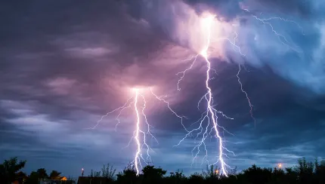
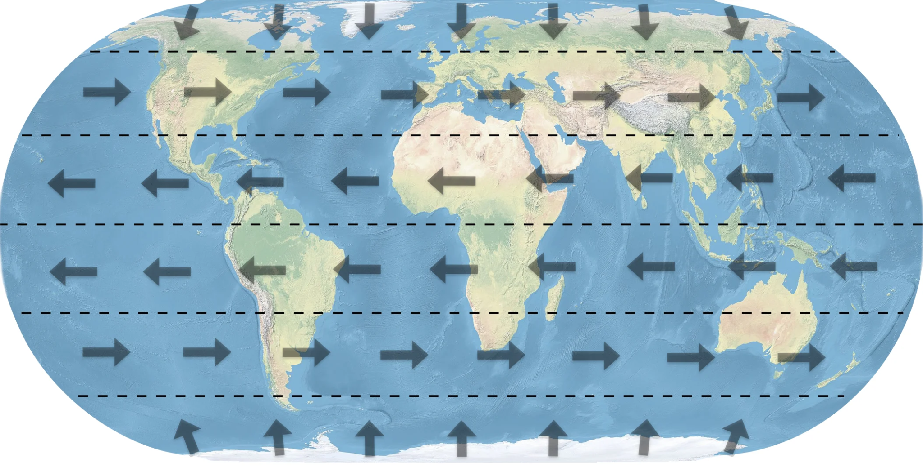
Weather & Climate • Grade 3
Anchor Layer Teacher Guide
Lesson 2: How can we predict when it's going to storm?
Local Weather Patterns & Weather Prediction (pg 1 of 2)
Overview
In this lesson, students learn how to make predictions about the weather by observing clouds and their changes.
In the activity, Storm Spotter's Guide, students create a small book to record their notes, identify different types of clouds, and think about wind direction to figure out if a storm is heading their way.
Anchor Connection on Next Page
Exploration 30 mins
Hands-On Activity 30 mins
Anchor Connection 25 mins
Assessment 20 mins
Activity Notes
We suggest students work in pairs. Before beginning, figure out which direction weather is coming from. The wind blows the clouds around. To see what clouds (and possible storms) are coming your way, you need to look into the wind.
On the world map below,, arrows show which way the prevailing winds blow in different parts of the world. In the continental United States, winds blow from west to east — so we look to the West to see the weather that’s coming our way. Which way does the wind blow where you live?
Once you know which direction you want to look, label your classroom walls North, East, South, and West. Find a landmark that will help your students remember which way to look. (Here in San Francisco, we look toward the ocean, which is to our west.)
‹#›

Slide 9
Weather & Climate • Grade 3
Anchor Layer Teacher Guide
Lesson 2: How can we predict when it's going to storm?
Local Weather Patterns & Weather Prediction (pg 2 of 2)
Anchor Connection
The temperature at ground level can be hot or cold, but as you go higher and higher in the sky it becomes colder and colder.
If you’ve ever seen bits of frost on the window of an airplane, you’ve seen this effect. The temperature on the ground can be very different than the temperature in the sky.
Students revisit the explanation and/or drawing that they worked on during the Anchor Phenomenon. They should understand that the tallest clouds tend to cause storms. The tops of those tall storm clouds are very high in the sky, where it is very cold.
Students can revise their explanation and/or drawing by:
Adding details about the temperature difference between the ground and high in the sky
Drawing and labeling the clouds as cumulonimbus
Connecting Storyline Question
How cold does it have to be for water to freeze into ice?
Exploration 30 mins
Hands-On Activity 30 mins
Anchor Connection 25 mins
Assessment 20 mins
‹#›

Slide 10
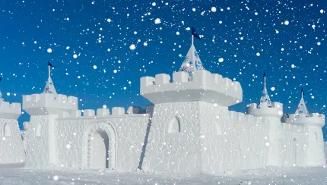
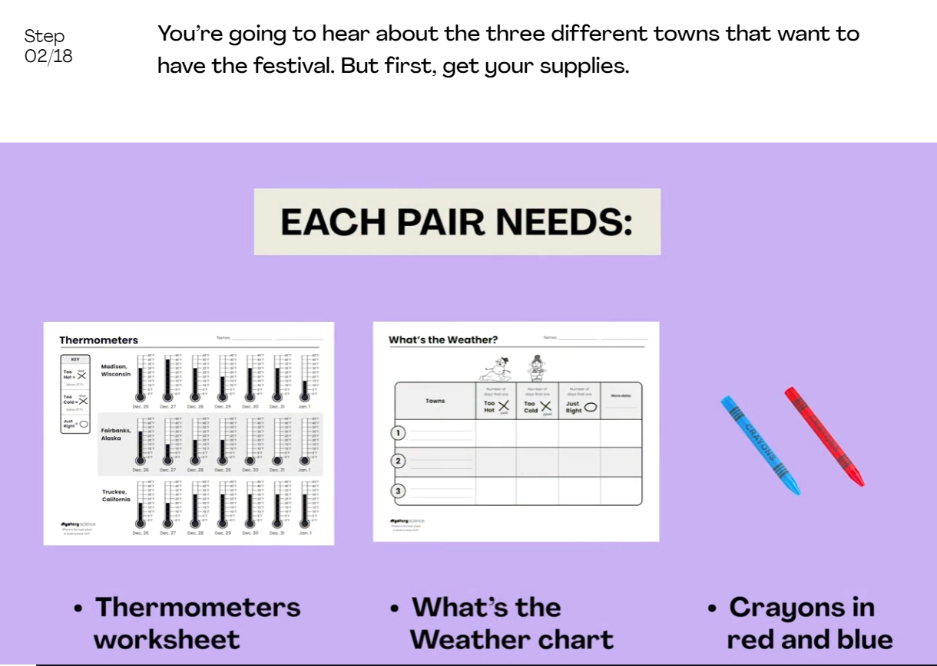
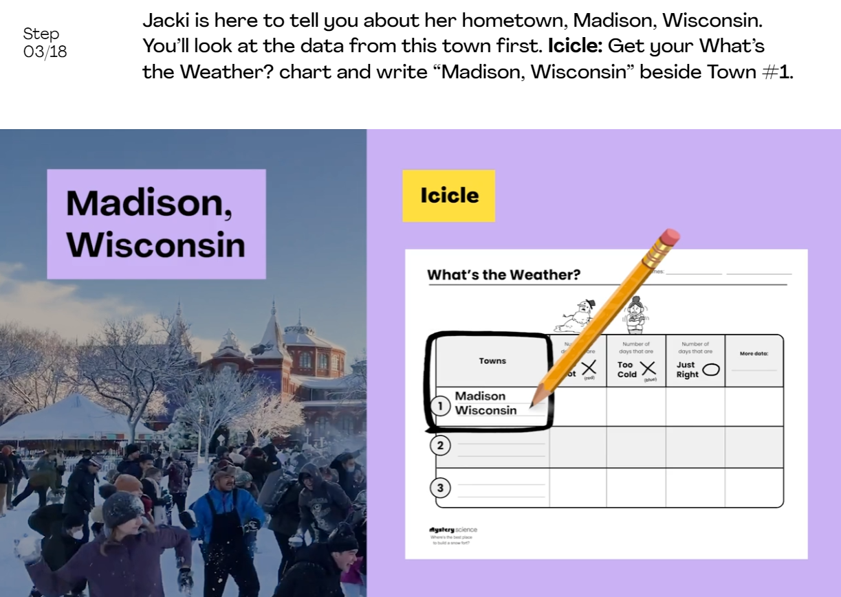
Weather & Climate • Grade 3
Anchor Layer Teacher Guide
Lesson 3: Where’s the best place to build a snow fort?
Seasonal Weather Patterns (part 1 of 2)
Overview
In this lesson, students explore seasonal weather conditions across different regions. They investigate how weather patterns can be used to make predictions about future weather.
In the activity, Snow Fort Weather, students organize daily temperature data from three snowy towns into a table so that they can compare weather conditions and predict which town is most likely to have the best weather for a snow fort festival next year.
Anchor Connection on Next Page
Exploration 20 mins
Hands-On Activity 30 mins
Wrap-Up 10 mins
Anchor Connection 15 mins
Assessment 20 mins
Activity Notes
We suggest students work in pairs.
In this lesson, we discuss both the Celsius scale and Fahrenheit scale for measuring temperature.
We mainly focus on Fahrenheit because students in the United States are more familiar with this temperature scale. We have Celsius worksheets available for the activity if you would like to use that temperature scale instead.
‹#›

Slide 11
Weather & Climate • Grade 3
Anchor Layer Teacher Guide
Lesson 3: Where’s the best place to build a snow fort?
Seasonal Weather Patterns (part 2 of 2)
Anchor Connection
The fact that water freezes when it falls below 32° Fahrenheit, and melts when it is above 32° Fahrenheit allows us to predict whether we will get liquid water or frozen ice.
Students revisit the explanation and/or drawing that they worked on during the Anchor Phenomenon. They should understand that the tops of the tallest clouds are cold enough to freeze water into ice, even when it is hot on the ground. This is where hailstones form.
Students can revise their explanation and/or drawing by:
Adding that water freezes below 32° Fahrenheit and melts above that temperature
Connecting Storyline Question
Is it always cold high up in the sky?
Exploration 20 mins
Hands-On Activity 30 mins
Wrap-Up 10 mins
Anchor Connection 15 mins
Assessment 20 mins
‹#›

Slide 12

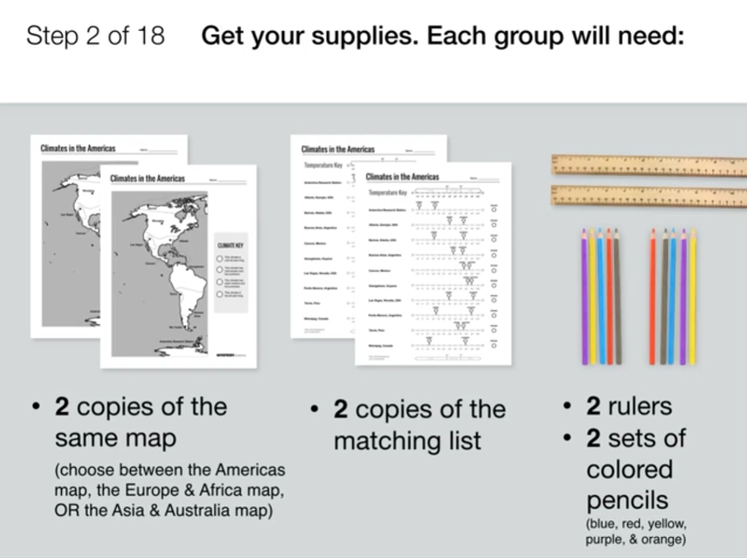
Weather & Climate • Grade 3
Anchor Layer Teacher Guide
Lesson 4: Why are some places always hot? (pg 1 of 2)
Climate & Global Weather Patterns
Overview
In this lesson, students are introduced to the concept of “climate” and explore the world’s five major climates.
In the activity, Climate Decoder, students color one part of a world map to figure out the different climates of that region. Students then combine maps and search for global climate patterns.
Anchor Connection on Next Page
Exploration 8 mins
Hands-On Activity 30 mins
Wrap-Up 17 mins
Anchor Connection 25 mins
Assessment 20 mins
Activity Notes
We suggest students work in pairs.
Once your students are paired up, divide your class into three groups. Decide which group will be in charge of which map (Americas map, Europe & Africa map, and Asia & Australia map). At the end of the activity, groups will combine their maps to make a full world climate map.
‹#›

Slide 13
Weather & Climate • Grade 3
Anchor Layer Teacher Guide
Lesson 4: Why are some places always hot? (pg 2 of 2)
Climate & Global Weather Patterns
Anchor Connection
The climate map for the top of the tallest clouds is almost the opposite of the climate map on the ground. The tops of the tallest clouds are coldest over the equator, and hottest over the poles. This is the opposite of the pattern that is present at ground level.
The climate on the ground is very different than the climate in the sky.
Students revisit the explanation and/or drawing that they worked on during the Anchor Phenomenon. They should understand that the long term climate high in the air is very different than the climate on the ground. On the ground it can be hot or cold; but; high in the air, it is always freezing cold.
Note: Give students a copy of the final sheet so they can neatly record everything they’ve learned.
Students can revise their explanation and/or drawing by:
Coloring in the “Sky Climate Map” on their sheet.
Neatly showing the key information from the earlier lessons about:
  Water evaporating from the ground and eventually forming clouds in the sky
  The temperature on the ground and in the sky
  The name and appearance of the type of clouds that cause these storms
Connecting Storyline Question
How can we help people prevent damage from hailstorms?
Exploration 8 mins
Hands-On Activity 30 mins
Wrap-Up 17 mins
Anchor Connection 25 mins
Assessment 20 mins
‹#›

Slide 14
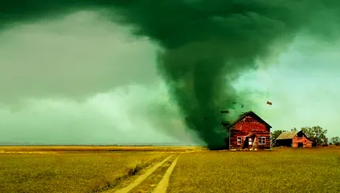
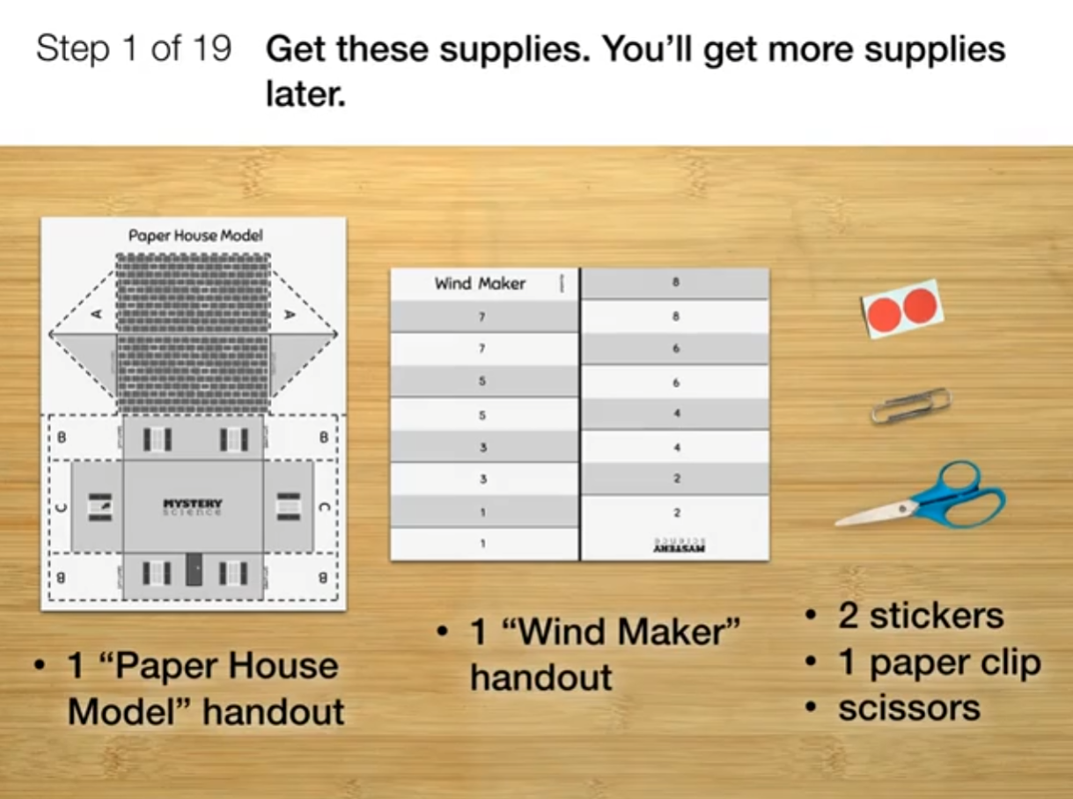
Weather & Climate • Grade 3
Anchor Layer Teacher Guide
Lesson 5: How can you keep a house from blowing away in a windstorm?
Natural Hazards & Engineering (pg 1 of 2)
Overview
In this lesson, students explore the effects of natural hazards, such as tornadoes, hurricanes, and dust storms.
In the activity, Design a Windproof House, students build paper house models. Then, using limited materials, students design multiple solutions that will make their houses sturdy enough to survive a wind storm, and compare the merits of their solutions.
Anchor Connection on Next Page
Exploration 18 mins
Hands-On Activity 35 mins
Wrap-Up 2 mins
Anchor Connection 30 mins
Assessment 20 mins
Activity Notes
We suggest students work in pairs.
Students first need one paper clip and two dot stickers to build their paper house model.
For the second part of the activity, each pair will need a blank sheet of paper, six toothpicks, four paper clips, and two dot stickers to design a solution that prevents their house from blowing over in the wind. You may want to separate the supplies for these two parts of the activity for ease of classroom distribution.
‹#›

Slide 15
Weather & Climate • Grade 3
Anchor Layer Teacher Guide
Lesson 5: How can you keep a house from blowing away in a windstorm?
Natural Hazards & Engineering (pg 2 of 2)
Anchor Connection
Another aspect of understanding weather is learning how to reduce the negative impact of harmful weather, such as droughts, floods, hurricanes, tornadoes, and hail storms.
Hailstorms cause nearly $10 billion in damage each year in the United States alone, and nearly $1 billion of that damage is to cars and trucks.
Students should understand that weather affects people around the world. The more we understand severe weather, such as hailstorms, the more we can help keep people safe.
Students will not update the Summer Ice Storm sheets that they had been updating up to this point. Instead, they will record their design plan for a device that will protect cars and trucks from hail damage. This design will be referenced in the Performance Task at the end of the unit.
Connecting Storyline Question
How can we use our knowledge of weather to help people be safe?
Exploration 18 mins
Hands-On Activity 35 mins
Wrap-Up 2 mins
Anchor Connection 30 mins
Assessment 20 mins
‹#›

Slide 16
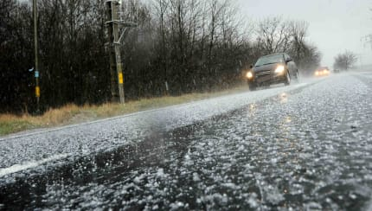
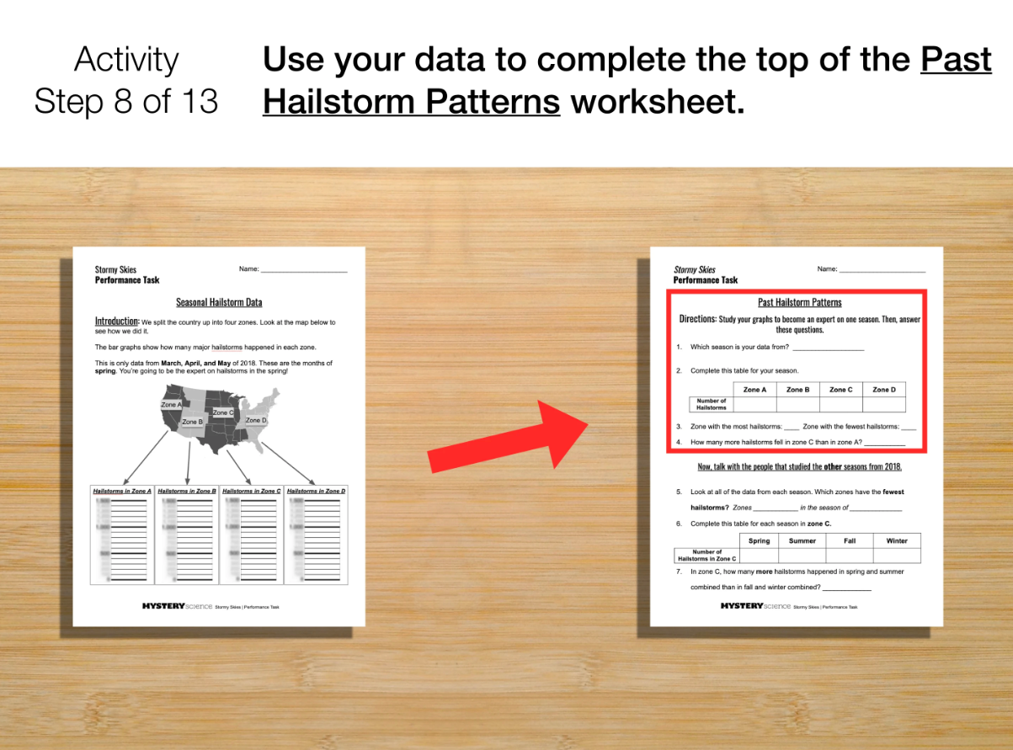
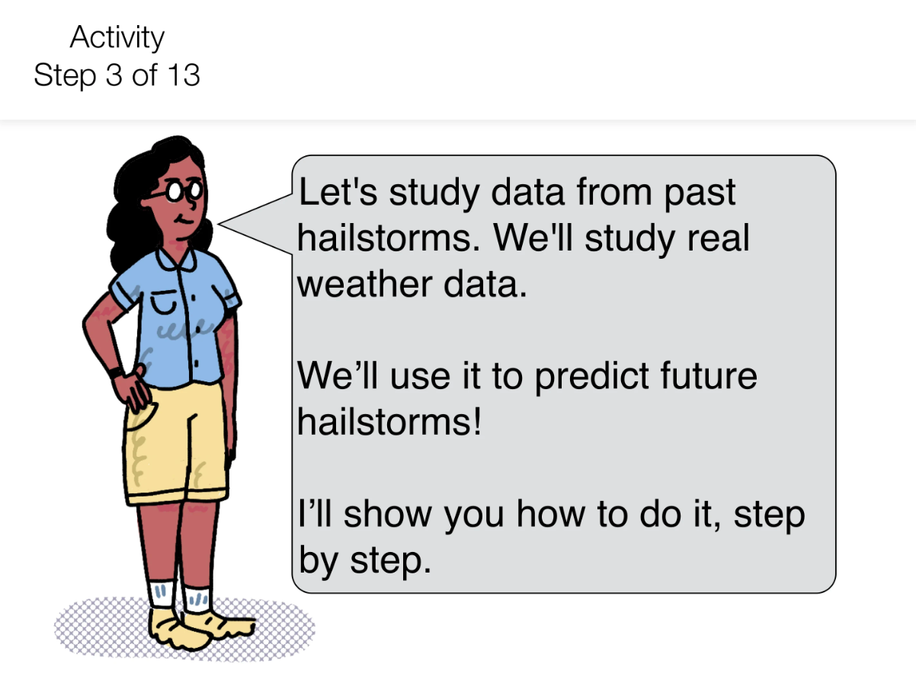
Weather & Climate • Grade 3
Anchor Layer Teacher Guide
Performance Task: Can we predict when it’s going to hail?
Weather and Climate (pg 1 of 2)
Overview
In this performance task, students study real NOAA weather data on severe hailstorms in order to make a forecast about future hailstorm events.
If you have time to extend the performance task, we recommend having your students create a poster showcasing what they've done in this Anchor Layer. The poster can be broken into three sections: an explanation of how hail storms happen during warm weather, a description of their design for something that will protect cars and trucks from hailstorm damage, and a forecast of when and where that device is most likely to be needed.
Crosscutting Concepts on the Next Page
Unit Review 30 mins
Hands-On Activity 60 mins
Performance Task Notes
We recommend having students work in groups of between two and four. If students worked in groups to design something that will protect cars and trucks from hail damage after Mystery 4, they can continue to work in those same groups for this activity.
If students work in a group of four, each student will be responsible for data from a single season. If groups have fewer than four students, each student may need to study data from more than one season. This will likely increase the length of the activity, so plan accordingly.
‹#›

Slide 17
Weather & Climate • Grade 3
Anchor Layer Teacher Guide
Performance Task: Can we predict when it’s going to hail?
Weather and Climate (pg 2 of 2)
Unit Review 30 mins
Hands-On Activity 60 mins
Crosscutting Concepts
Cause and Effect: Cause and effect relationships are used to explain surprising phenomena such as a summer hailstorm. Hailstorms are a result of multiple causes, such as a huge temperature difference from the bottom to the top of the atmosphere.
Systems and System Models: This is a great opportunity to reinforce the crosscutting concept of systems and system models. A system is a group of related parts that interact with one another. All weather systems involve varying interactions between the air, water, and/or land. Many of the processes are driven by differences of temperature.
‹#›

