Slide 1
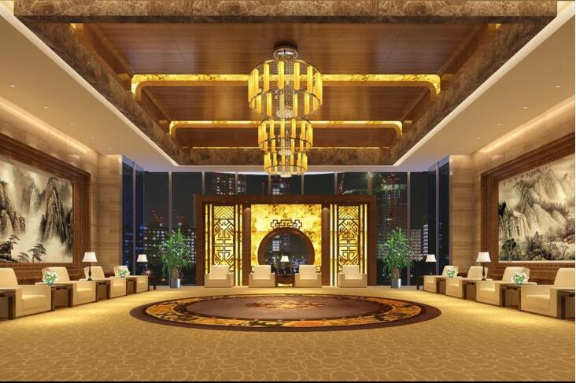
INTERIOR ARCHITECH
Powerpoint Template
www.freepptbackgrounds.net

Slide 2
CONTENTS
Future
Timeline
Services
Forum

Slide 3
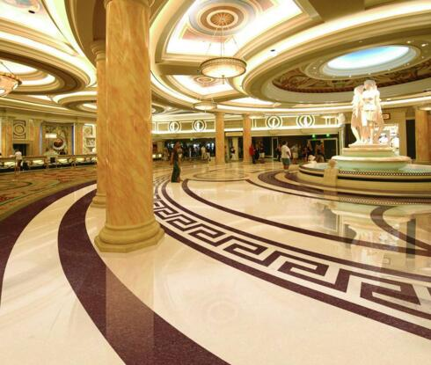
FUTURE

Slide 4
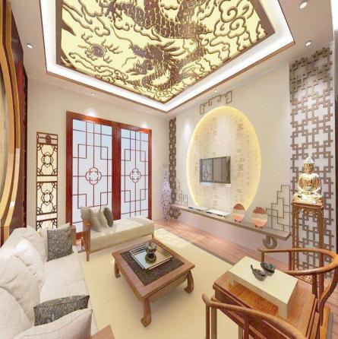



Future
Signature
I hope and I believe that this Template will your Time
Split
Insert the title of your subtitle here
Share
Skills
A complex idea can be conveyed with just a single still image
Show and explain your web, app or software projects using these gadget templates

Slide 5

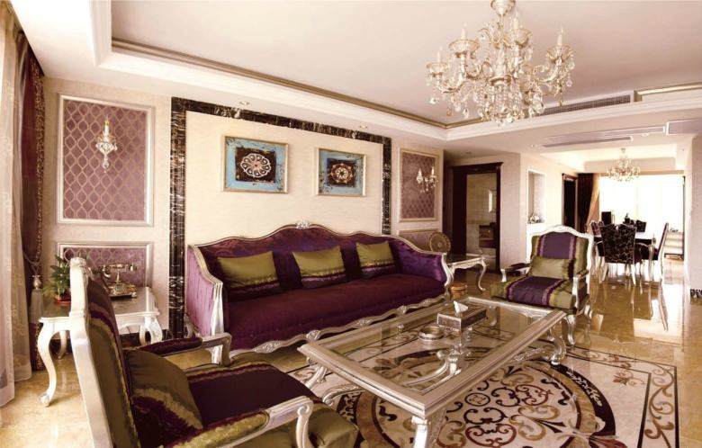

Easy to change colors, photos and Text. Get a modern PowerPoint Presentation that is beautifully designed.
Easy to change colors, photos and Text. Get a modern PowerPoint Presentation that is beautifully designed.
Far far away, behind the word mountains, far from the countries Vokalia and Consonantia, there live the blind texts.

Slide 6

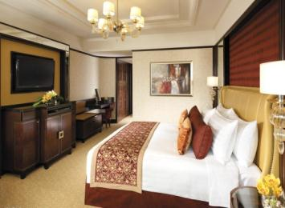


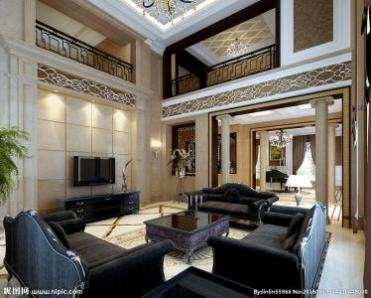

Future
What we do?
You will get a copy of this document on your Google Drive and will be able to edit, add or delete slides. You have to be signed in to your Google account.

Slide 7


Future
Annual
1
You have to be signed in to your Google account.
Meeting
2
You will get a copy of this document on your Google Drive and will be
3
Conferences
You will get a copy of this document on your Google Drive and will be
Transport
4
You have to be signed in to your Google account.

Slide 8
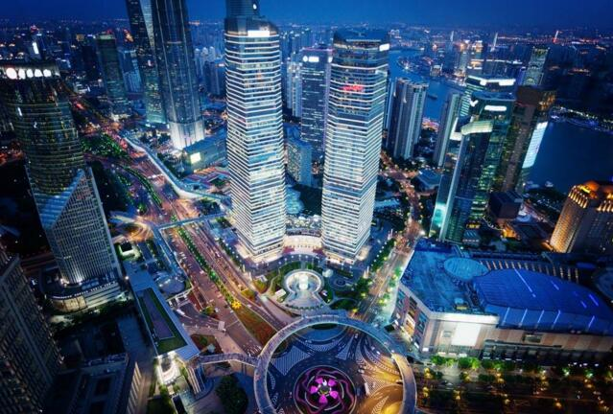
TIMELINE

Slide 9
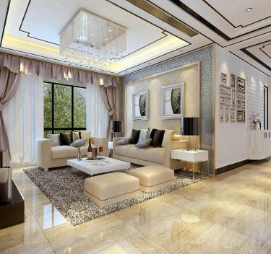
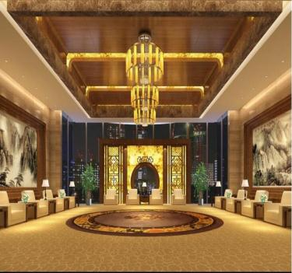
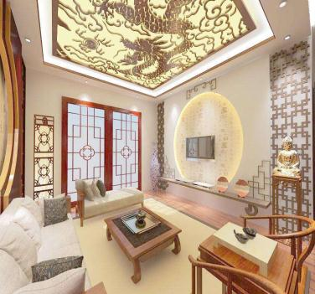


Timeline
Suggest
You will get a copy of this document on your Google Drive and will be able to edit, add or delete slides.
“
Click on the button under the presentation preview that says

Slide 10
Timeline
Share
Success
Is the color of gold, butter and ripe lemons. In the spectrum of visible light,
We use well-known development methodologies to create
Skills
Split
We use well-known development methodologies to create
Is the color of gold, butter and ripe lemons. In the spectrum of visible light,

Slide 11
Timeline
Lanage
01
02
Signature
Using conceptual, digital design, we work with you to build experiences that feel 'right' for your users.
We press play on your digital story.
Schedule
Send
We press play on your digital story. We press play on your digital story.
03
04
Using conceptual, digital design, we work with you to build experiences that feel 'right' for your users.

Slide 12

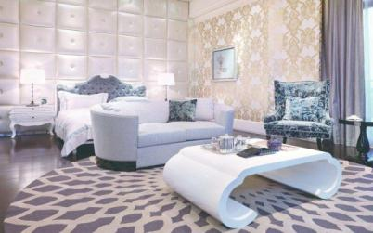

Timeline
Using conceptual, digital design, we work with you to build experiences that feel 'right' for your users.
Accept
Occupation
Lower
Moving from creative ideas to solid strategy and execution, we help your target market resonate fully with your
Simple & Smooth, exactly how purchasing experiences should be. We align with your users
Moving from creative ideas to solid strategy and execution, we help your target market resonate fully with your

Slide 13




Timeline
Add
Approve
Apply
Agenda
Advise
The user can make a presentation on a projector or computer
The user can demonstrate on a projector or computer, or print the presentation and
The user can make a presentation on a projector or computer
The user can demonstrate on a projector or computer, or print the presentation and

Slide 14
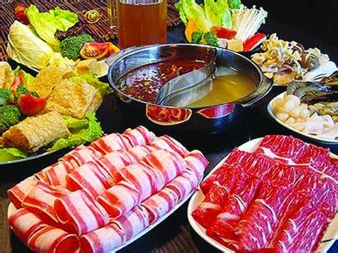
SERVICES

Slide 15



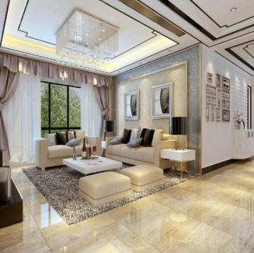
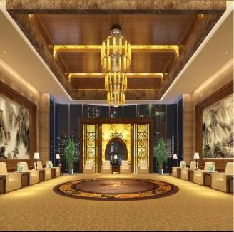
Services
Bill
Authorize
The user can make a presentation on a projector or computer, or print out the presentation to make a film. The user can make a presentation on a projector or computer, and can also make a presentation. You can also print out the presentation to make a film
The user can make a presentation on a projector or computer, or print out the presentation to make a film. The user can make a presentation on a projector or computer, and can also make a presentation. You can also print out the presentation to make a film

Slide 16
Services
Enter the comprehensive description of the above chart here
The user can make a presentation on a projector or computer
Enter the comprehensive description of the above chart here
Calculate
Budget
Cancel
Buy
Brand
The user can make a presentation on a projector or computer
The user can make a presentation on a projector or computer

Slide 17
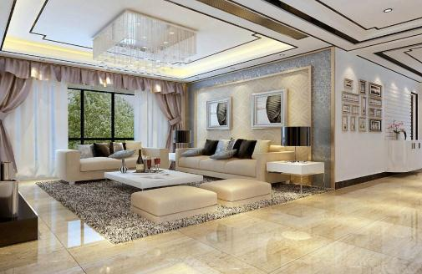


Services
We certainly do not forget you as soon as you forget us. It is, perhaps, our fate rather than our merit. We cannot help ourselves.
Comparison
Commission
Certification
Choose
Comparison
Commission
Certification
Choose
We certainly do not forget you as soon as you forget us.
It is a very sad thing that nowadays there is so little useless information. Oscar Wilde
We certainly do not forget you as soon as you forget us.
It is a very sad thing that nowadays there is so little useless information. Oscar Wilde

Slide 18


Services
We certainly do not forget you as soon as you forget us. It is, perhaps, our fate rather than our merit. We cannot help ourselves.
1
Complete
2
Complain
3
Competition
I believe that people would be alive today if there were a death penalty.
The time is now, the place is here. Stay in the present.
I believe that people would be alive today if there were a death penalty.

Slide 19



Services
Confirm
Customer
Deadline
Date
The time is now, the place is here. Stay in the present. You can do nothing to change the past, and the future will never come exactly as you plan or hope for. Dan Millman
Convince

Slide 20

FORUM

Slide 21

Forum
I feel very strongly that change is good because it stirs up the system. Ann Richards
Genius hath electric power which earth can never tame. Lydia M. Child
Decision
Decide

Slide 22
Forum
01
Description
02
Department
03
Deliver
You can do nothing to change the past, and the future will never come exactly as you plan or hope for.
The time is now, the place is here. Stay in the present.
Education is the most powerful weapon which you can use to change the world
A large income is the best recipe for happiness I ever heard of. Mansfield Park A large income is the best recipe for happiness I ever heard of. Mansfield Park

Slide 23

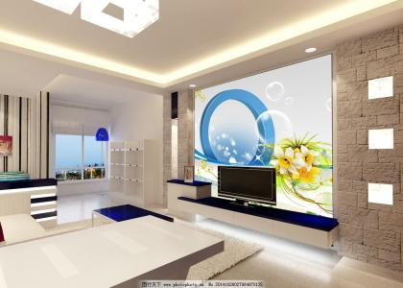
Forum
Develop
Be an encourager, the world has enough critics already. Always give your best never worry for results.

Slide 24
Forum
Employ
Dispatch
God sometimes removes people from your life to protect you. Do not run after them.
Education is the most powerful weapon which you can use to change the world
Education
Dismiss
Always give your best never worry for results.
Always give your best never worry for results.
标题
Distribute
Difference
Education is the most powerful weapon which you can use to change the world
God sometimes removes people from your life to protect you. Do not run after them.

Slide 25


Forum
Always give your best never worry for results.
Be an encourager, the world has enough critics already.
Be an encourager, the world has enough critics already.
Education is the most powerful weapon which you can use to change the world.
Always give your best never worry for results.

Slide 26
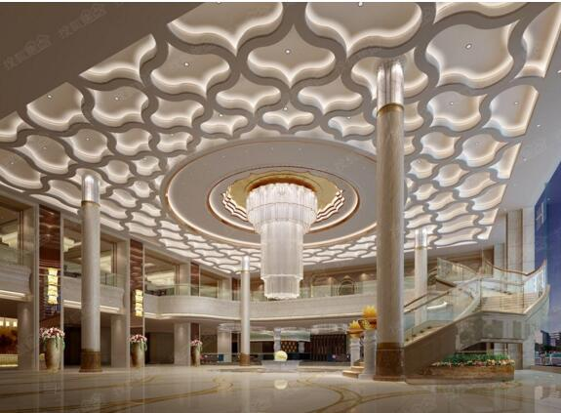
THANK YOU !
Interior Architect Powerpoint Template
www.freepptbackgrounds.net

