Slide 1


FREEDOM MOVEMENT

Slide 2
In this chapter we will study
India national congress
Gandhi era
Moderates and radicals
Revolutionaries
Important leaders of freedom movement
Tribal and formers protest
Division of India

Slide 3
Rise of nationalism
Local Kings fought against British Kings guided by their political goals since they fought against foreign occupation it is a beginning of nationalism
● Expansion of communication, Road ,education, journalism ,cultural Association witnessed the beginning of nationalism

Slide 4
The British government declared provision of better amenities to Indians.
● In the subsequent developments, the aristocratic new generation who learnt English, started fighting for their rights in a constitutional manner. This led to the establishment of Indian National Congress.

Slide 5
Indian National Congress
People of India were getting prepared to face new challenges. Towards this end, many organizations were established
● Various associations established like the Hindu Mela ,Pune public Sabha, Indian Association
● During the reign of Lord lytton Vernacular Press Act passed to curb independence of press

Slide 6
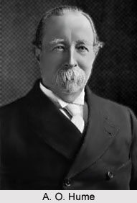
The British realized the growing strength of the Congress and started implementing its ‘Divide and Rule’ policy. They separated Hindus and Muslims through their manipulative techniques.
● Indian National Congress established in 1885 at Bombay
● It was founded by AO Hume, a retired British Civil Servant.

Slide 7
It discuss various issues of public importance
● WC Banerjee was the first President of INC
● It placed the problems of people before British government and changed the direction of Indian political history

Slide 8
Differences surfaced in the Indian National Congress. Based on the plan of action, beliefs and type of struggle adopted by them, they were identified as moderates and extremists

Slide 9
Moderates: 1885 to 1905 the age of moderates
The leaders are WC Banerjee MG Ranade Surendranath Banerjee Dadabhai naoroji and Gokhale
● They have faith in British rule
● They used to table that demands within constitutional framework through prayer and request

Slide 10
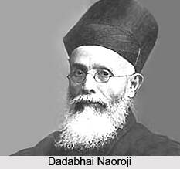
Organized public meetings discussions demanded to cut down military expenditure industrial development, good education and eradication of poverty
● Drain of resources of India to England through statistics- Drain theory by Dadabhai naoroji
● Moderate period is called liberal nationalism

Slide 11
Extremists (1906 - 1920)
One group of Congress members who became unhappy with the mild attitude of the moderates called them ‘political beggars’. Those who criticized the moderate thinking and propagated extremist ideas were known as Extremists.
● Aurobindo Ghosh, Bal Gangadhar Tilak, Lala Lajpat Rai, and Bipin Chandra Pal are the leaders

Slide 12
Division of Bengal
Bengal was centre of anti British protests and anti British sentiment
● Viceroy Lord Karjan introduced dividing Bengal to control anti-british protests
● Since Bengal had more concentration of Muslims and Hindus, In 1905 British divided Bengal into East and West. East was Muslim dominated while West was dominated by Hindus

Slide 13
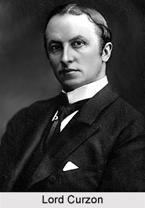
The division of Bengal resulted in widespread protest.
● Swadeshi movement called for a ban on western goods and the organizations supporting the import of European items.
They encouraged the people to use Indian goods. Finally government withdrew it in 1911

Slide 14
Bal Gangadhar Tilak:
He declared Swaraj is my birthright attended complete freedom is the aim of radicals
● They are organised people by employing religious celebrations like Ganesha Chaturthi Shivaji jayanti Durga celebrations
● They started preparing the common people for freedom struggle

Slide 15
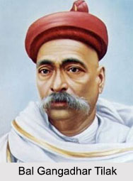
He published Kesari and Maratha newspapers and influence on common people
● He wrote the book Gita Rahasya in prison it fueled freedom fever

Slide 16
Revolutionaries:
They dreams of complete freedom and believed in violent method used guns and bombs to achieve goal
● engaged in collection of money, arms and training of people.
● Established secret association for armed struggle that is Lotus and Dagger in England, Gadha in USA, Abhinav Bharathi in India, Anushilana Samiti in India.

Slide 17
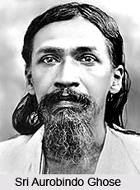
Aurobindo Ghosh, VD Savarkar,Rajguru, Khudiram Bose,Bhagat Singh, Chandrashekar,Madam Cama are some leaders
Many of the radicals later became revolutionaries that is Aurobindo Ghosh

Slide 18
Gaidin Liu
The Christian missionary and the power of the British was taking control of the whole of north-east India.
Jadonang of the Naga tribe, an youngster built a youth's army to fight against the British.
Gaidin Liu, an young lady collected ladies of North-eastern India and joined Jadonang to fight the British.
She joined the Herakka religious movement along with Jadonang

Slide 19
British Government Imprisoned Jadonang at silcher jail and later hanged him to death on 29th August 1931.
Gaidin Liu took charge of the army and let the movement against the British.
She fought on the lines of Guerilla warfare. The entire villages of North-east co-operated
She was in jail from 1932 Oct 12th till India became free. Haralu was awarded with Kaiser - E - Hind by the British.

Slide 20
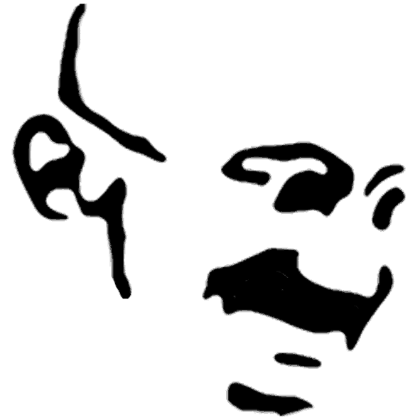
GANDHI ERA
❖ The British who were ruling South Africa, practiced apartheid and discriminated mainly against Africans and Indians.
❖ People, who were employed in low-paid jobs, were not allowed to travel on trains along with the white people and could not eat along with them. The British treated them mercilessly.

Slide 21
❖ Gandhiji brought together the people who were discriminated against, and carried out agitations and protests against the British in a peaceful, non-violent manner.
❖ The success that he got to his movement against the British in South Africa inspired Gandhiji to do the same in India and achieve freedom from the British

Slide 22
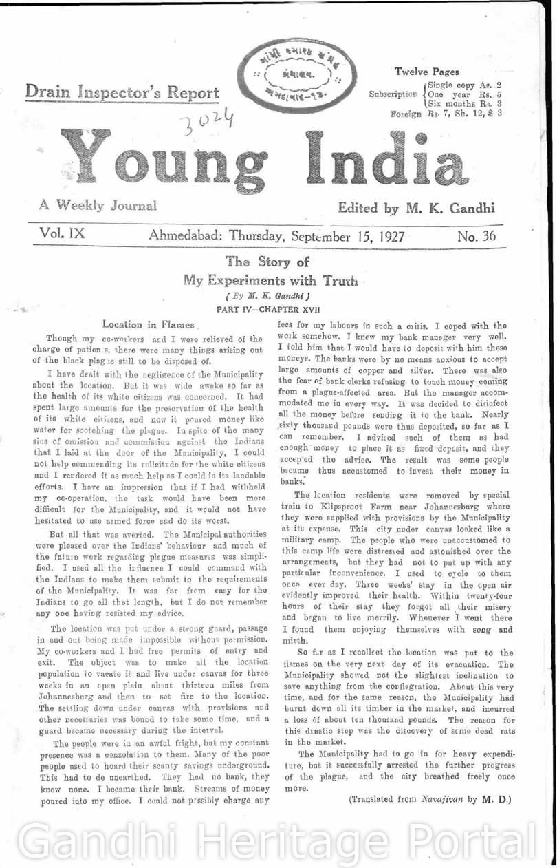
❖ Gandhiji made use of indirect protests, non-violence and satyagraha as the main instruments for the freedom struggle.
❖ He wrote about his principles in the newspaper ‘Young India’. Satyagraha was his main political weapon

Slide 23
Jallianwala Bagh massacre
Background:
● Rowlatt Act 1919 implementation
● They could arrest any person without reason
● MK Gandhi formed Satyagraha Sabha to oppose Rowlatt Act
● He called a hartal protest the act hence many leaders were arrested

Slide 24
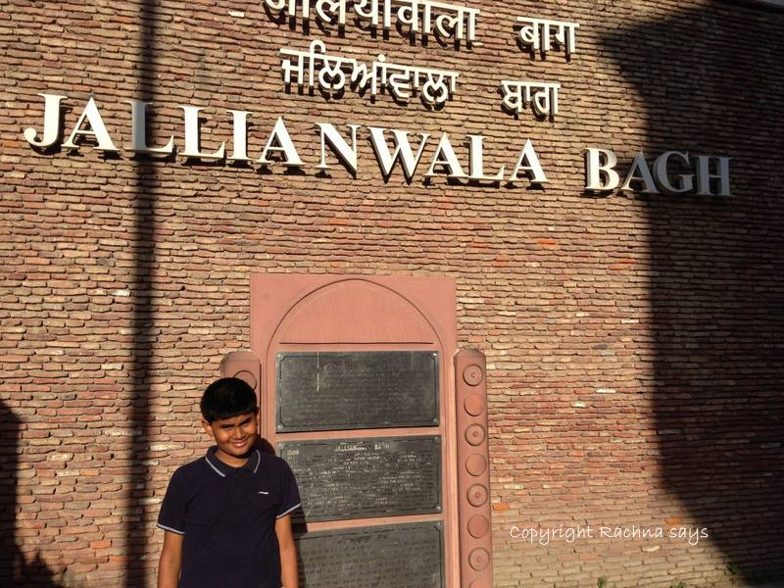
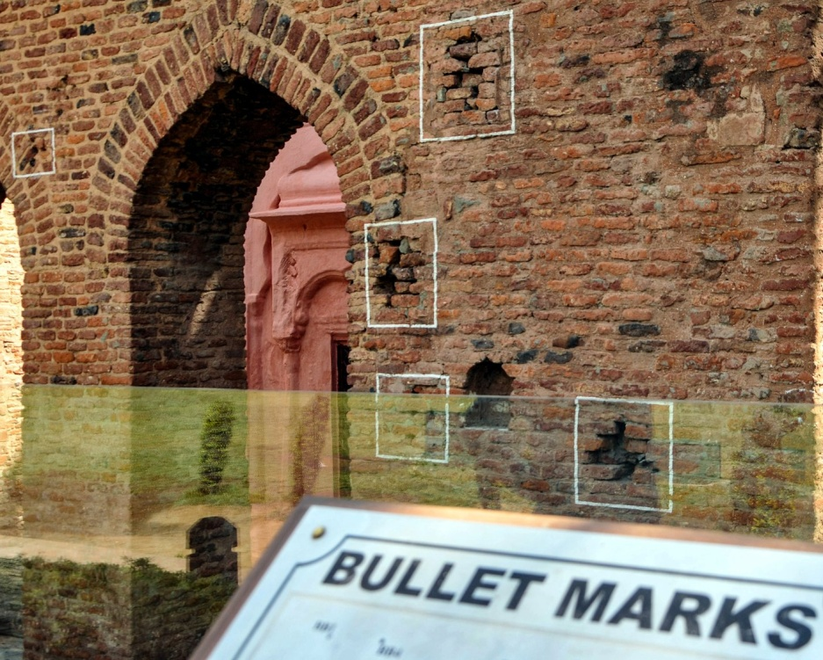
Massacre held on April 13,1919 Amritsar Punjab
● Killed 380 people. General Dyer who was associated with this incident
● later Rabindranath Tagore returned knighthood award to the British

Slide 25
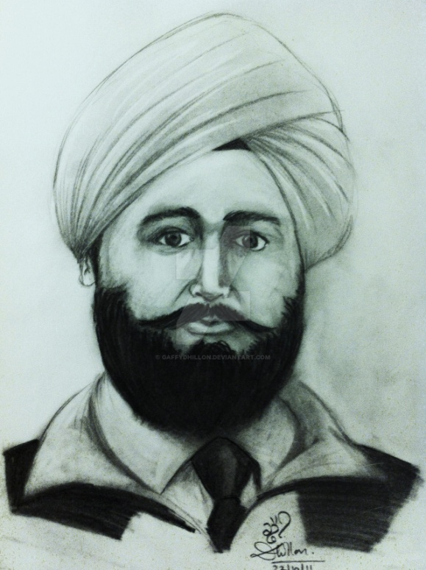
This was the reason for non cooperation movement.
● The government appointed Hunter Commission to conduct an enquiry into the Jallianwallah Bagh tragedy, but it was of no consequence.
● Later Udham Singh killed General Dyer

Slide 26
Khilafat movement
The Turkish Emperors of the Ottoman Empire were Muslim Khalifs. Due to this, the hatred against the British grew in the minds of Indian Muslims.
● Ali brothers started the Khilafat movement in India in order to support the Turks

Slide 27
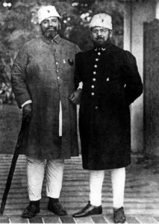
Gandhiji believed that only if Hindus and Muslims fought together against the British, the British would leave the country.
In this context, he felt that participation of Muslims in the Congress was vital. Hence, Gandhiji declared his support to the Khilafat movement

Slide 28
Non cooperation movement
Main programs
● Boycotting schools colleges and courts
● Boycotting elections to regional legislative bodies held according to 1919 act
● Returning all honour and medals
● nominated members to the local bodies resigning from their membership
● Boycotting all government functions
● Boycotting all foreign goods.

Slide 29
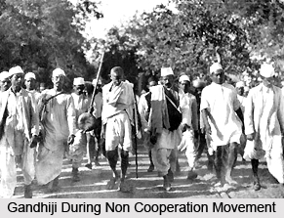
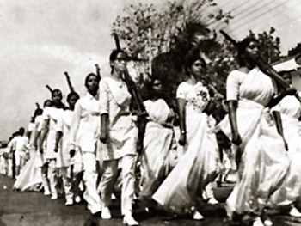
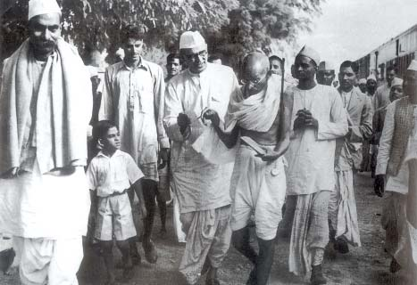

Slide 30
Senior lawyers like Deshbandhu Chittaranjan Das Motilal Nehru Rajendra Prasad left their legal practice
● Students boycotted schools and colleges
● Congress boycott elections for regional bodies
● Ravindranath Tagore returned knighthood
● During this period, there was a stiff opposition to the visit of the British Prince. There were widespread agitations against the visit throughout the country.

Slide 31
Chori choura incident
● February 5th 1922 a group of around 3000 farmers assembled in front of the police station
● There was a protest against the police officer
● the police started shooting from inside, the enraged people fired the police station
● 22 policemen died. Gandhiji realized this happened due to lack of preparation and morality among people

Slide 32
● He withdrew the non cooperation movement on February 12 1922
● Gandhiji was arrested on March 10 1922 holding Gandhi responsible for all the violent uprisings
● He was released two years later on the grounds of ill health.

Slide 33
Swaraj Party
The withdrawal of non cooperation movement disheartened many congressmen
● Swaraj party was found in 1923 by Motilal Nehru and CR Das
● Through this party, they wanted to enter the legislative assembly and oppose the policies of the British from within

Slide 34
Belgaum Conference held in 1924, Gandhiji approved of the plan of the Swaraj Party and accepted it as a part of the Congress plan. Thus Swaraj Party became a part of the Congress

Slide 35
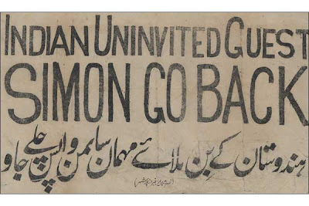
Simon commission
British government appointed the Simon Commission in 1927 to study the effects of Indian government act 1919
● It arrived in India on February 3rd 1928
● This commission did not have a single Indian as the member

Slide 36
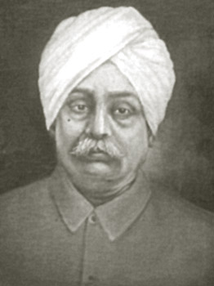
Treating it as an insult to India, the Congress boycotted the Simon Commission.
● It was witness divide so protest with slogans Simon go back organised in different places
● Lala Lajpat Rai was died during Lathi charge in Lahore . It intensified National freedom struggle

Slide 37
Poorna Swaraj
In the year 1929, under the president ship of Jawaharlal Nehru, a Congress Session was held in Lahore. During this conference, the Congress declared that ‘Purna Swaraj’ was their aim.
On January 26, 1930, the Congress celebrated Independence day all over the country and supported the Lahore declaration

Slide 38
Civil disobedience movement
● Civil disobedience movement, submitted a Charter of 11 demands to Viceroy Irwin.
● He had conveyed that if these demands were not met, he would start Civil Disobedience movement.
● One of the demands was abolition of tax imposed on salt. But Irwin did not consider Gandhiji’s demands
● The Congress met at Sabarmati ashram and pass resolution to hold civil disobedience under the leadership of MK Gandhi

Slide 39
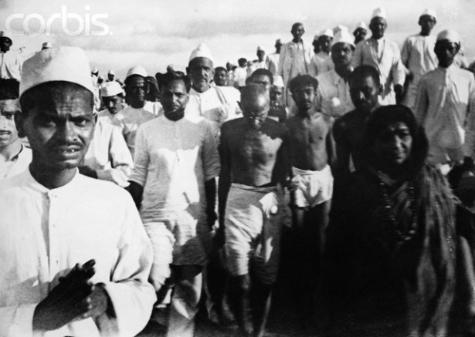
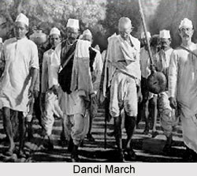
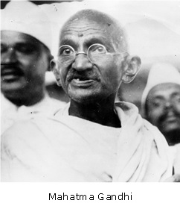
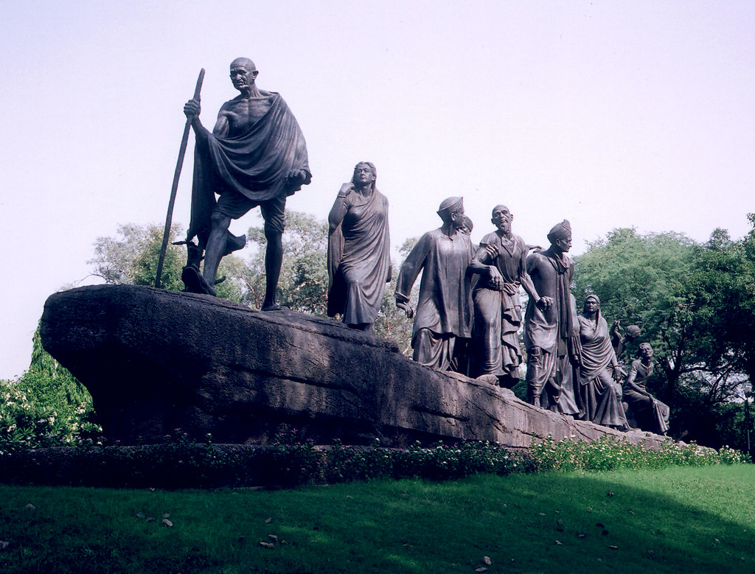

Slide 40
● They walk with followers upto Dandi. 375 km on foot.
he broke the law by holding a fistful salt without paying the tax with the British had levied on salt..
● Thousands of people participated in the Salt Satyagraha. Many leaders like Vijayalakshmi pandit, Kamala Nehru, Vallabhbhai Patel, Rajagopalachari Rajendra Prasad and many others.
● This event in history is popular as ‘Dandi March’.

Slide 41
First Round table conference
First Round table conference held in London in 1930. Representation was given to untouchable community
● In order to facilitate the participation of leaders the in present leaders were released from prison
● This conference approved dominion status responsible Government and religious representation

Slide 42
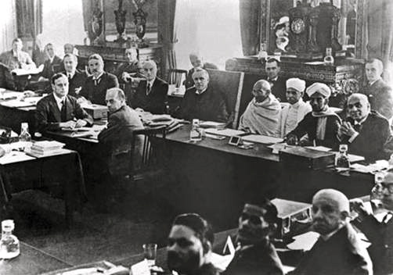
the Indian National Congress did not participate in the first Round table conference
● As a result of Gandhi Irwin pact Congress stopped the civil disobedience movement and agreed to participate in the second round table conference

Slide 43
Second round table conference
Ambedkar passed for a separate electoral constituency for untouchables
● This was opposed by Gandhi and resulted in ideological difference between them
● British government announced its decision to provide separate electoral constituencies for the untouchable and it implemented communal award in 1932

Slide 44
● Mahatma Gandhi opposed this communal award and started fasting unto death.
● According to the Poona pact between Gandhi and Ambedkar few constituencies were reserved for untouchables among general constituencies

Slide 45
Third round table conference
the Congress did not participate in the conference
● The British government brought in Government of India Act 1935. The act provided for federal structure at the centre and regional autonomy
● as a result of the Congress and Muslim league participate in the election and the Congress gain majority and form the government

Slide 46
The viceroy unilaterally declared India's war against Germany the Congress walked out of the cabinet opposing this decision then Stratford Cripps was sent to India to mediate.

Slide 47
Quit India 1942
The Stratford Cripps commission proposed some suggestions in front of Indians like dominion status to India for the formation of new constitution
● The proposals were opposed by Congress and called for quit India Movement
● Gandhi gave call to the fellow Indians to Do or die
● Many leaders of Congress were arrested and imprisoned.

Slide 48
● a non Congress organisation took the lead in this moment. Jayaprakash Narayan provided leadership to this movement and he was the leader of socialist wing.
● the train, factory workers and call for the support of common people and collected the money
● Efforts were made outside the border of India Subhas Chandra Bose really commendable in this direction

Slide 49
after the election of 1937 Muslim league was kept out of government formation
Congress walked out of the government in 1939 opposing the unilateral decision of viceroy to participate in World War II
Muslim celebrated this walkout as Vimukti Divas hence Muslim league did not participate in quit India Movement but they proposed for the Division of India.

Slide 50
Farmers and workers protest
● These associations were influenced by congress some were influenced by Marxist ideology
● Many farmers rebelled against British planters and zamindars
● They opposed the Indigo cropping in Champaran district
● They protested against land tax
● Congress try to organize the farmers as a part of national freedom struggle

Slide 51
● Gandhi's influence was visible in activities in Champaran and Kheda
● formers of Tebhaga, Bulbar and other places revolted against British and zamindars
● Many of the protests were organised under the banner of Kisan Sabha which was influenced by leftist
● In Telangana farmers protest against the zamindars and Nizam's Razaks

Slide 52
The farmers of Bengal rose against zamindars
● in Maharashtra farmers protest against low wages for them

Slide 53
Worker struggle started in Kolkata in 1827
● Railway workers held protest in railway stations and raised slogans against British officer
● printers union in Kolkata and cotton mill workers of Bombay created National awareness
● A labour union was founded in Madras

Slide 54
The Tribal revolts
the tax and forest policies implemented during British administration was the reason for tribal revolts
● Revolt of Santhala, khola, Munda and halagali bedaru important
● The revolt of santhals is an important in India the people of this tribe are present in hilly areas of Bengal
● With the implementation of permanent zamindari system these people became landless

Slide 55
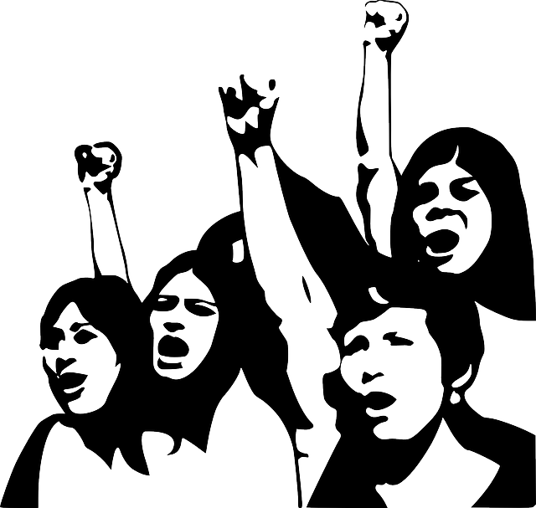
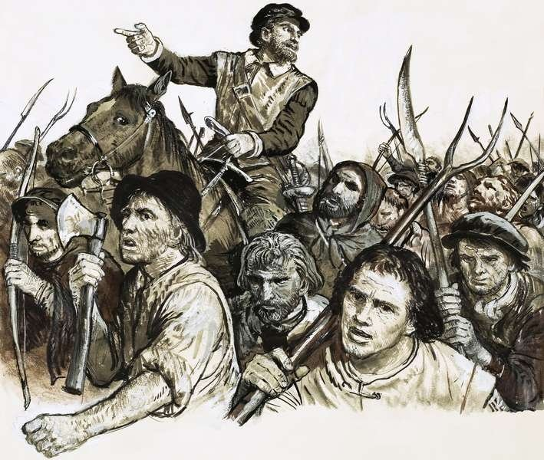

Slide 56
The land developed by them was taken over by the zamindars
● Zamindars and money lenders became the exploiters
● the upset Santhal has made secretly and decided to loot the zamindars and money lenders
● The revolt was in Bharatpur and Rajmahal areas

Slide 57
The tribal people killed their enemies and Frightened money lenders and zamindars fled from these areas
● It became an inspiration for many revolts in future

Slide 58
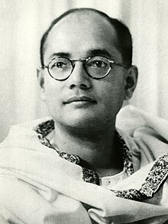
Subhash Chandra Bose
● Subhash Chandra Bose was from Cuttack of Orissa
● He had secured 4th rank in the Indian civil services exam and he refused posting and became part of the national freedom struggle
● He became popularly as Netaji
● He told many cities like Vienna, Rome, Istanbul and other cities, rallied the where Indian settled
● In1934 Subhash Chandra Bose and Jawaharlal Nehru founded the Congress socialist party

Slide 59
● Bose became the President of haripura convention of Indian National Congress
● In 1939 Subhas Chandra Bose got selected as President of Indian National Congress
● He quit Congress and founded forward bloc
● Subhas Chandra Bose opposed the British war preparation and also the participation of British India in the war

Slide 60
● the British government arrested Subhas Chandra Bose and put him under house arrest
● Subhash Chandra Bose escaped from house arrest and reached Germany
● He organised the prisoners of War from India and broadcast and his speeches over Azad Hind radio
● Bose joined hands with Ras Behari Bose to explode the possibility of seeking the help of Japan

Slide 61
● He was calling his military wing as Indian National army and he called for Delhi chalo
● He said give me your blood I will get you Indian independence
● Captain Lakshmi Sehgal became the commander of Jhansi regiment
● They started their armed struggle on Burma border
● Subhas Chandra Bose died in an airplane crash

Slide 62
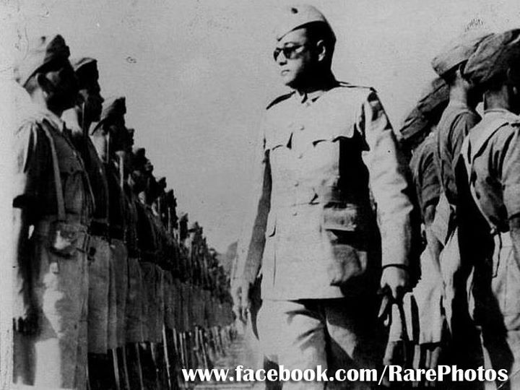
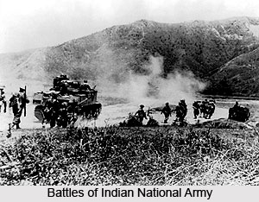
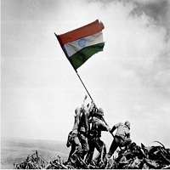

Slide 63
Dr.B.R Ambedkar.
● He believed that political freedom without social freedom was meaningless .
● He introduced the concept of India not only as a political entity but whole system
● He organised Mahad tank and Kalaram temple movement
● He participated in all the three round table conference

Slide 64
● He demand for separate electoral constituency for untouchables
● Was Diwan to Baroda Maharaj and member of Bombay legislative council
● He founded Bahishkruta Hitakarini Saba and Swatantra karmika party
● He published periodicals Prabuddha Bharata , janatha , mookanayaka

Slide 65
Ambedkar was elected as chairman of Drafting committee
● He became the first Law minister of Independent India
● India govt honored him for life time achievement civil award Bharata Ratna posthumously

Slide 66
Jawaharlal Nehru
● He can be seen as the architect of industrialization and modern India
● Nehru became instrumental in the integration of India ,The home minister of his cabinet Vallabhbhai Patel the iron man of India successful in bringing all princely states of India together

Slide 67
also laid foundation for the diverse culture of India by implementing language based reorganization of states policy
● firmly believe that only complete industrialization can bring development
● He sought to develop India through five year plans

Slide 68
● the foundation for mastering atomic energy under the leadership of Homi Jehangir Bhabha
● Advocated non alignment movement stay away from power politics
● Implemented panchsheel principles signing with Chinese President
● Developed infrastructure and heavy industries through five year plans.

Slide 69
The partition of India
● Indian National Congress at the vision of free independent United India but Mohammad Ali zinna putting pressure for an independent Pakistan
● Jinna declared that Hindus and Muslims cannot make one nation
● The cabinet committee to have discussion on giving self rule rights to India

Slide 70
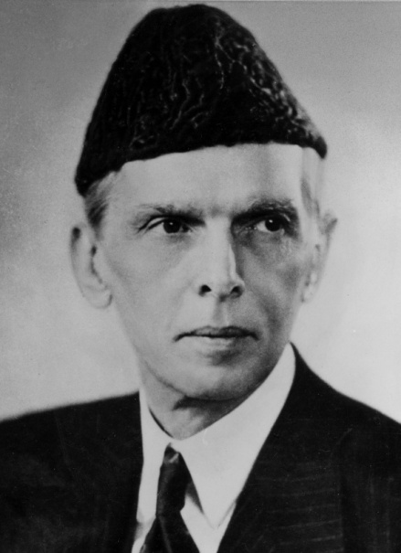
it recommended for federal form of Government and suggested to form an interim government
● the Muslim league called for Direct action day on August 16 1946
● as a result communal clashes took place in various parts of the country Muslim league did not participate in the constituent assembly

Slide 71
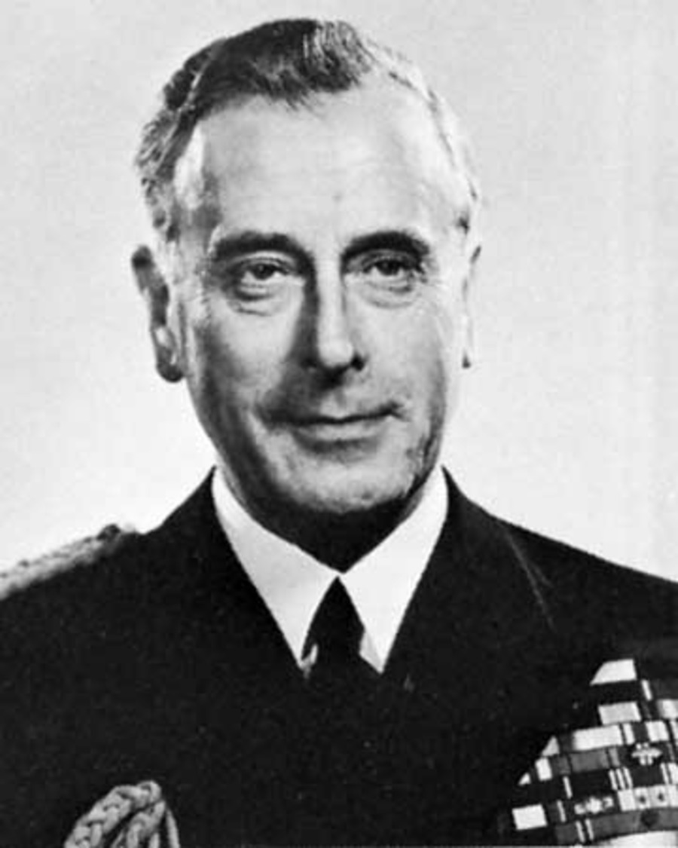
● British government sent Lord Mountbatten as viceroy to India to complete the process of handing over of the power
● In 1946 Mountbatten had discussion with Gandhiji and Muhammad Ali Jinnah
● In July 1947 the bill of India independence to the shape of an act

Slide 72
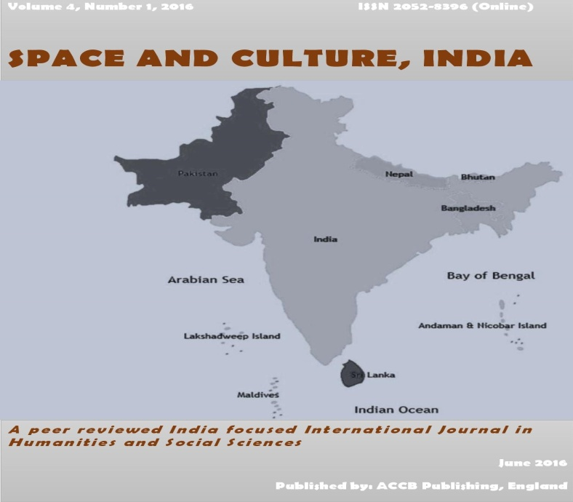
● August 15th 1947 to new nation India and Pakistan was born
● the Radcliffe Brown commission mark the boundaries between two Nations
● Jawaharlal Nehru took oath as the first prime minister of India.

Slide 73

Thank you
Prepared by:
Praveen Banakar

