Slide 1
Professional Growth and Evaluation Process
Professional Growth and Evaluation Series
Notes:
Rick

Slide 2
Presenters
Secondary
Rick Anthony, Assistant Superintendent Educator Support and Development
Rob McDaniel, Director New Administrator Support
Elementary
Katy Timothy, Associate Director, Human Resources
Jon Adams, Director Leadership and Improvement
Notes:
Presenter - Rick
Time - 1 Min

Slide 3
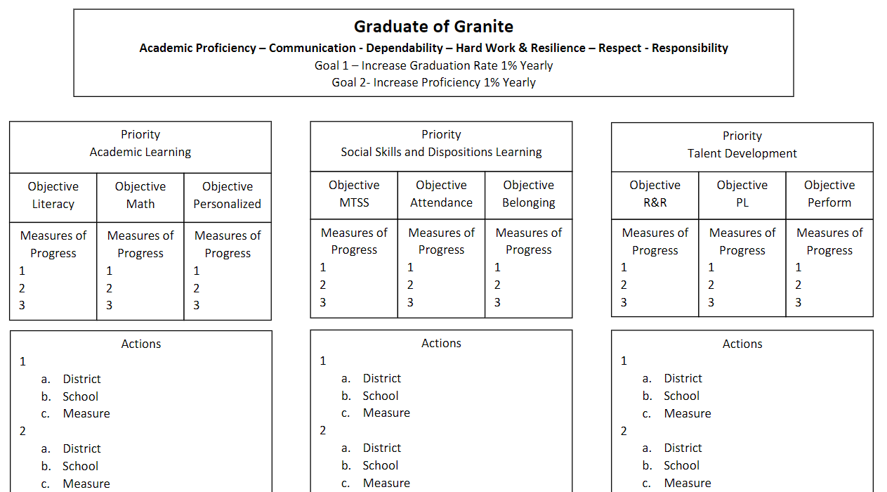
Notes:
Presenter - Rick
Time - 1 Min
Connect to the Strategic Plan

Slide 4
Objectives
Participants will gain an understanding of the process used for Professional Growth and Evaluation (PG&E) in Granite School District.
Notes:
Presenter - Rick
Time - 1 Min

Slide 5
Why the presentation on PG&E Logistics?
Increase clarity and congruence
Incorporate projected adjustments from Utah State Board of Education Rules
Reflect a capacity building approach
Review adjustments to multiple measures used in providing feedback
Notes:
Presenter - Rick
Time - 5 Min
Replacing Rater Reliability
No longer Summative and Formative
Veteran Principals - the reality is our new approach will be more time consuming for some. It is worth it.

Slide 6
Fall
NOTIFICATION AND ORIENTATION
Provide an orientation on evaluation in a faculty meeting no later than 20 days after school begins.
Inform the teacher(s) about the evaluation process at least 15 days prior to the first evaluation by -
Giving the teacher a copy of the standards
Reviewing the standards and allowing for questions/concerns
Explaining the multiple measures used by the evaluator
Securing the teacher’s verification of the notification requirement
Notes:
Teachers sign sheet after being trained on PG&E
We recommend you do this during the afternoon for PG&E in the first week back before students attend.
Provide a link to the Educator Standards at the end of this document If so, do you want the color coded ones with red, yellow, and green, or just the gray?
Principal Presentation on PG&E - Do these things.

Slide 7
Activity - Notification and Orientation
Discuss how you have seen this done or how you have done it at your school. Include what you need to change.
5 Minutes to discuss.
5 Minute share out ideas.
Notes:
Presenter - Rob
Time - 10 min

Slide 8
Fall
SELF ASSESSMENT - Frontline Platform Entry
GOAL SETTING - Frontline Platform Entry
SUPERVISOR REVIEW AND COMMENT - Frontline Platform Entry
Due by September 30th
Notes:
Presenter - Rob
Time - 2 min
No change from past practice

Slide 9
Fall
SUPERVISOR CONSIDERATION OF MULTIPLE MEASURES
CLASSROOM OBSERVATION - Frontline Platform Entry (Fall and Spring)
Date
Notes
Standard(s) identified as strengths
Standard(s) identified as areas for growth
LESSON DESIGN REVIEW - Frontline Platform Entry (Fall)
Date
Notes
OTHER FRONTLINE OBSERVATIONS- Additional Frontline Classroom Observation and Lesson Design Forms can be requested from Katy as you have been able to do in the past
OTHER OBSERVATIONS - Can be made in the following locations and documented elsewhere:
PLC, General Interactions, Etc.
Notes:
Presenter - Rick
Time - 2 min
GEA - sees corrective action or directives put into the notes. That is separate - corrective action.
Perhaps we should have them brainstorm where other observations could occur as another group activity?

Slide 10
Multiple Measures
The answer to all of the questions wanting specifics -
Like the answer “it depends”
Ours is -
Supervisor must feel comfortable they have the information needed for the feedback generated.
Notes:
Presenter - Rick
Time - 3 min
There will be a lot of questions wanting us to breakdown specifics in amount of time, what is measured, etc. This slide for explaining we have a balanced approach to evaluation. We are not too specific and not too holistic. We try to avoid the pitfalls of being too much one way or another.

Slide 11
What is Feedback?
Feedback is an interactive, dialogic process. It uses shared evidence and questioning to transform a learner’s current level of practice to a higher level of excellence by developing and advancing individual knowledge about pedagogy.
Notes:
Presenter - Rick
Time - 2 min
Coaching Techniques and Feedback PL Slide Deck

Slide 12
Notes:
Presenter - Rick
Time - 2 min
When we talk about feedback, we use the word “generated” rather than “given” because the reflective side of feedback is not “given” it is ideally generated by the learner.

Slide 13
Activity - Feedback
Supervisor must feel comfortable they have the information needed for the feedback generated.
5 Minutes to discuss how you are understanding what this means.
5 Minute share out.
Notes:
Presenter - Rick
Time - 10 min

Slide 14
Classroom Observation
REQUIRED FOR BOTH PROVISIONAL AND CAREER
New form - more open - slide upcoming
Supervisor must feel comfortable they have the information needed for the feedback generated
Debrief with the individual
Provisional Deadline-Due November 15th
Career Educators-Due December 22nd (End of Fall Semester)
Notes:
Presenter - Rob
Time - 2 min
Big question is how long must you be in the classroom? The answer is “the supervisor must feel comfortable they have the information needed for the feedback generated”
If you feel you need more than one fall Classroom Observation, Katy Timothy in HR can open one for you.
Observation PL Slide Deck

Slide 15
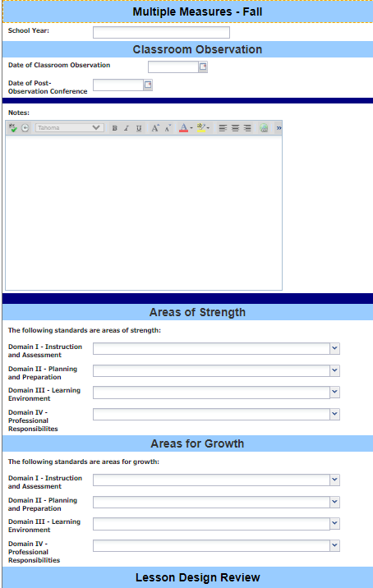
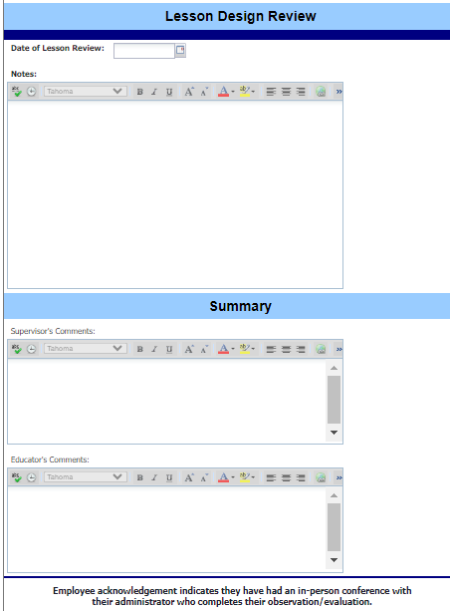
Fall Multiple Measures Form
Notes:
Presenter - Rob
Time - 2 min
This is the Fall Multiple Measures Form that will be used to conduct the Classroom Observation and the Lesson Design Review.

Slide 16
Lesson Design Review
REQUIRED FOR PROVISIONAL AND CAREER
Flexibility in modality of submission -
Written
Verbally Shared/Demonstrated
PLC Collaboration
Link to Canvas, Google Classroom
Supervisor must feel comfortable they have the information needed to support the feedback generated
Debrief with individual
Notes:
Presenter - Rob
Time - 2 min
Lesson Design PL Slide Deck

Slide 17
Notes:
Presenter - Rob
Time - 1 min
Lesson Design PL Slide Deck

Slide 18
Activity - Lesson Design Review
Flexibility in modality of submission
Supervisor must feel comfortable they have the information needed for the feedback generated.
5 Minutes to discuss how you are understanding what these mean.
5 Minute share out.
Notes:
Presenter - Rob
Time - 10 min

Slide 19
Fall Multiple Measures Form
Notes:
Presenter - Rob
Time - 2 min
This is the Fall Multiple Measures Form that will be used to conduct the Classroom Observation and the Lesson Design Review.

Slide 20
Other General Observations
BOTH PROVISIONAL AND CAREER
Flexibility in -
Length of time
Place
Number of times
Supervisor must feel comfortable they have the information needed for the feedback generated in the evaluation
No entry into Frontline other than incorporated into the evaluation of individuals on standards
Debrief on each of these is not required
Notes:
Presenter - Rick
Time - 3 min

Slide 21
Fall
PROVISIONAL ONLY - EVALUATION
Supervisor rating on educator standards - Frontline platform entry
Has performance been satisfactory yes/no - Frontline platform entry
Debrief
Due by November 15th
CAREER
Reminder - debrief on Classroom Observation and Lesson Design
Due by December 22nd
Notes:
Presenter - Rick
Time - 2 min

Slide 22
Winter
FRONTLINE PLATFORM ENTRY
MID YEAR REVIEW OF PROGRESS ON GOALS
SUPERVISOR REVIEW AND COMMENTS
Due by January 31st
Notes:
Presenter - Rick
Time - 1 min
No change from what is currently expected at the middle of the year.

Slide 23
Spring
SUPERVISOR CONSIDERATION OF MULTIPLE MEASURES
Classroom Observation - Frontline Platform Entry
Date
Notes
Standard(s) identified as strengths
Standard(s) identified as areas for growth
Other Observations - No Frontline Platform Entry
PLC, Etc.
Notes:
Presenter - Rick
Time - 1 min

Slide 24
Spring Continued
SUPERVISOR CONSIDERATION OF MULTIPLE MEASURES
Stakeholder Feedback Reflection - Frontline Platform Entry
Date
Notes
Student Growth Reflection - Frontline Platform Entry
Date
Notes
Supervisor must feel comfortable they have the information needed for the feedback generated.
Notes:
Presenter - Rick
Time - 2 min
Student Growth and Stakeholder Feedback PL Slide Deck

Slide 25
Classroom Observation
REQUIRED IN SPRING FOR BOTH PROVISIONAL AND CAREER
Supervisor must feel comfortable they have the information needed for the feedback generated.
Debrief with the individual.
Provisional Deadline-Due March 15th
Career Educators-Due May 15th
Notes:
Presenter - Rick
Time - 1 min

Slide 26
Other Observations
REQUIRED IN SPRING FOR BOTH PROVISIONAL AND CAREER
Flexibility in -
Length of time
Place
Number of times
Supervisor must feel comfortable they have the information needed for the feedback generated.
Notes:
Presenter - Rick
Time - 1 min
Consider moving this slide to be after

Slide 27
Stakeholder Feedback Reflection
REQUIRED IN SPRING FOR BOTH PROVISIONAL AND CAREER
Flexibility in modality -
Written
Verbally Shared
Entered into Frontline End of Year Summary Field(s) Reflection
Supervisor must feel comfortable they have the information needed for the feedback generated.
Notes:
Presenter - Rick
Time - 2 min
No debrief required

Slide 28
Student Growth Reflection
REQUIRED IN SPRING FOR BOTH PROVISIONAL AND CAREER
Flexibility in modality -
Written
Verbally Shared
Entered into Frontline End of Year Summary Field(s) Reflection
Flexibility in growth data used -
Classroom assessment
Common formative assessment
Interim (Acadience, Reading Growth Measure, Benchmarks)
Summative (WIDA, AP, RISE) from a prior year
Supervisor must feel comfortable they have the information needed for the feedback generated.
Notes:
Presenter - Rick
Time - 3 min

Slide 29
Activity - Stakeholder/Student Growth Reflection
Flexibility in modality of submission
Supervisor must feel comfortable they have the information needed for the feedback generated.
5 Minutes to discuss how you are understanding what these mean.
5 Minute share out.
Notes:
Presenter - Rick
Time - 10 min

Slide 30
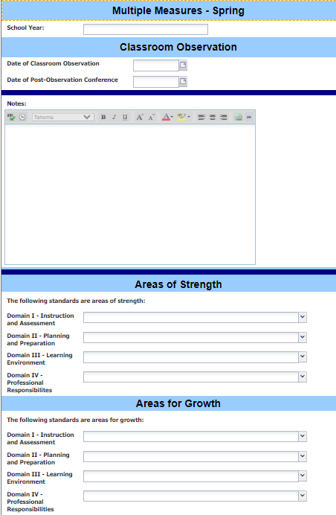
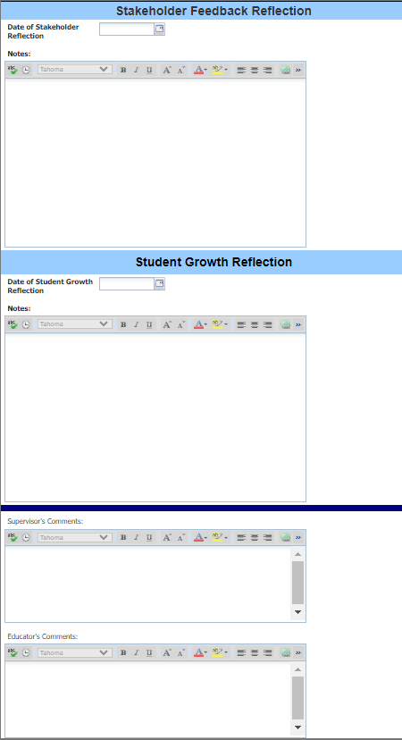
Spring Multiple Measures Form
Notes:
Presenter - Rick
Time - 2 min
This is the Multiple Measure Spring Form that will be used to conduct the Spring Classroom Observation, Stakeholder Feedback Reflection, and the Student Growth Reflection.

Slide 31
Spring
Supervisor rating
EVALUATION
Provisional - has performance been satisfactory yes/no - Frontline platform entry
Question is asked in both the Fall and Spring
Provisional - continued employment yes/no - Frontline platform entry
Question is asked in the Spring only
Supervisor rating on educator standards - Frontline platform entry
Career - has performance been satisfactory yes/no - Frontline platform entry
The question regarding continued employment has been removed
Supervisor rating on educator standards - Frontline platform entry
Debrief
Provisional Deadline-Due March 15th
Career Educators-Due May 15th
Notes:
Presenter - Rob
Time - 3 min
There is no longer formative and summative.
No longer do we have Year End Formative Assessment. Provisional teachers receive an evaluation in fall and spring. Career teachers receive an evaluation in spring.
If No is marked, it shouldn’t come as a surprise

Slide 32
Spring
FRONTLINE PLATFORM ENTRY
END OF YEAR REFLECTION ON GOALS
SUPERVISOR REVIEW AND COMMENTS
Due May 15th
Notes:
Presenter - Rob
Time - 2 min
We won’t be able to push the May 15th deadline back this year because school is out for summer on May 24th.

Slide 33
Thank You

