Slide 1
Big Ideas in Data-Driven Decision Making at a Systems Level
William David Tilly III, Ph.D.
Heartland AEA 11
Johnston, IA
April 23, 2009

Slide 2
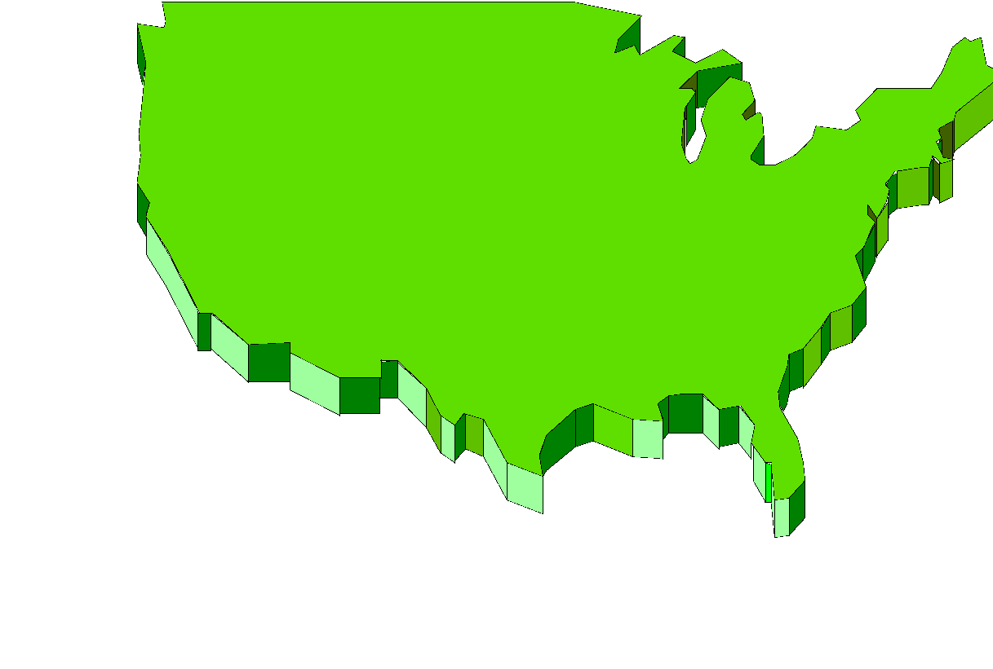
Where is Iowa?
IOWA

Slide 3
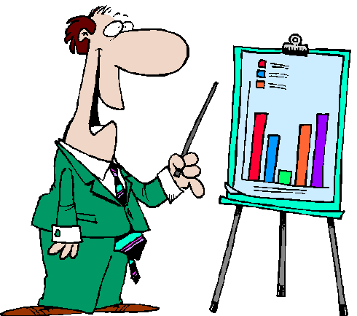
Introduction

Slide 4

Presentation Objectives
To identify some big ideas of systems level data based decision making.
To Illustrate one system’s framework and processes for data based decision making
To identify some mistakes and challenges encountered over the years

Slide 5

The Importance of Big Ideas
Zig Engelmann frequently reminds us to attend to the “Big Ideas” of what we’re teaching
This presentation is about some of the big ideas of systems implementation and measurement in Data Based Decision Making

Slide 6

Big Ideas From This Presentation
Thinking that drives student-level DBDM also drives systems level DBDM
To do systems-level DBDM you need a system…
At a minimum ask:
  Did we pick the right strategies? (match)
  Did we implement the strategies with fidelity? (integrity)
  Are the children learning? (outcome)

Slide 7
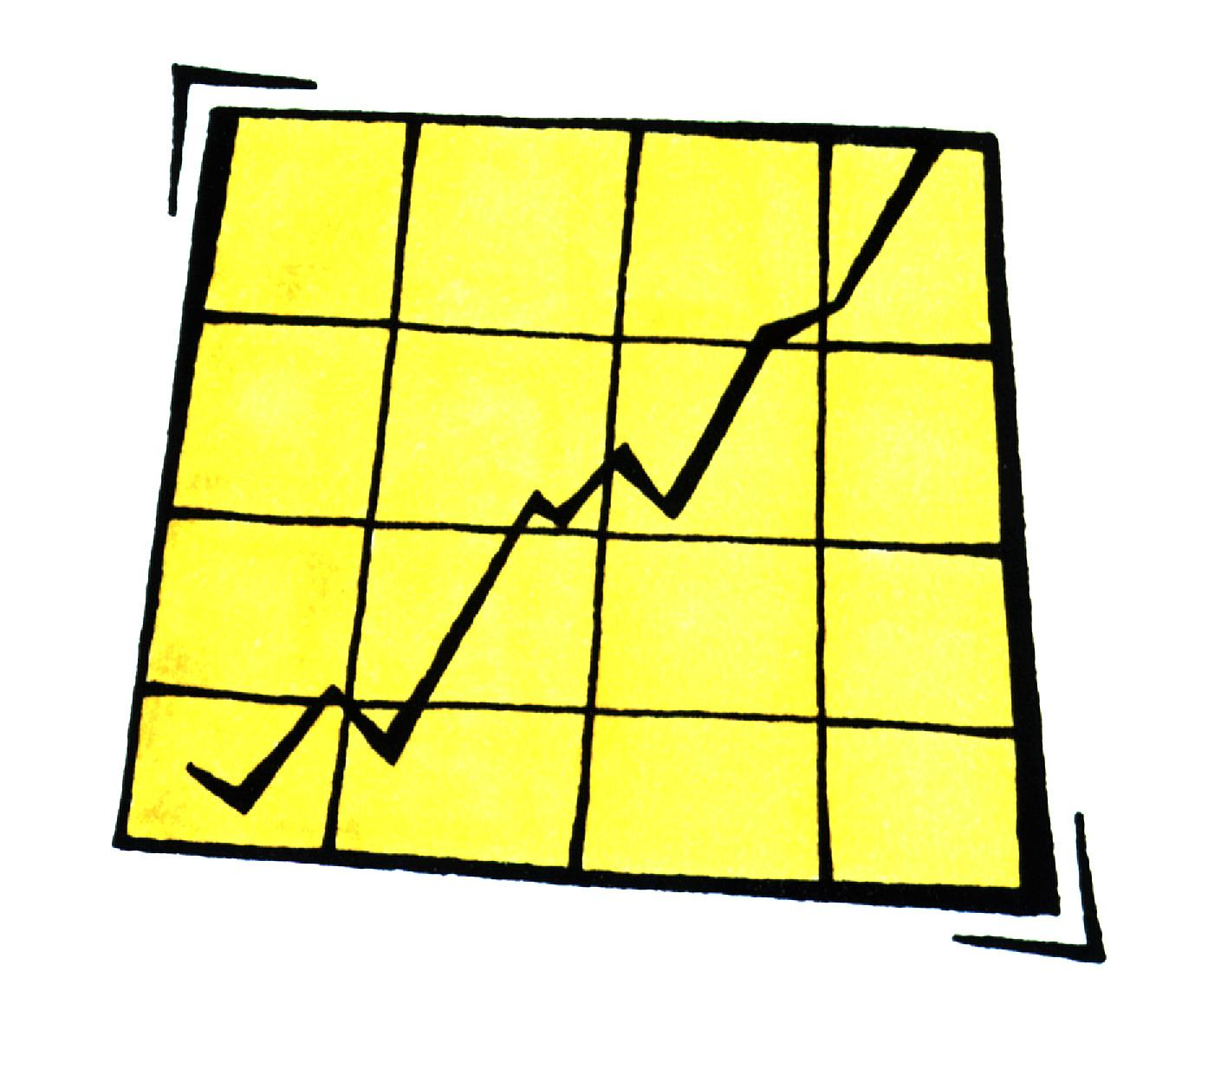
The Overarching Big Idea in Systems That Drives DBDM in Schools Is:
What percent of your XXXX students are proficient in:
  Reading
  Math
  Science
  Social Studies
  ……..

Slide 8

Finally We Know
With Data…
  Who is not proficient
  In what areas are they not proficient
  How far below proficiency are they
  And a whole lot more

Slide 9

What Systems Generally Don’t Know Is
Why aren’t these student’s proficient?
What options are there to catch them up?
If we implement these options, are they working?
And, when and for whom do we need to change options/strategies?

Slide 10
The Purpose of Systems Level DBDM
Maximizing results for all students
Dan Reschly’s outcomes criterion (1980, 1988) “the value of human services…should be determined by client outcomes”
Reschly, D. J. (1980). School psychologists and assessment in the future. Professional Psychology, 11, 841-848.
Reschly, D. J. (1988). Special education reform: School psychology revolution. School Psychology Review, 17, 459-475.

Slide 11
Which Means…
Taking on the whole system at once…
PIECEMEAL CHANGE
will always disappear
Bill Spady, 1992

Slide 12

Acknowledgements
The content and kudos for much of the content in this presentation go to Jim Stumme, Randy Allison, Sharon Kurns, Alecia Rahn-Blakeslee, Dan Reschly, Kristi Upah, Jeff Grimes and the Supervisors’ team at Heartland Area Education Agency
And literally 1000s of Iowa teachers and administrators

Slide 13

Quote
We have witnessed over the last 30 years numerous attempts at planned educational change. The benefits have not nearly equaled the costs, and all too often, the situation has seemed to worsen. We have, however, gained clearer and clearer insights over this period about the do’s and don’ts of bringing about change….One of the most promising features of this new knowledge about change is that successful examples of innovation are based on what might be most accurately labeled “organized common sense.” (Fullan, 1991, p. xi-xii)
Fullan, M. G. (1991). The new meaning of educational change. New York, NY : Teachers College Press.

Slide 14
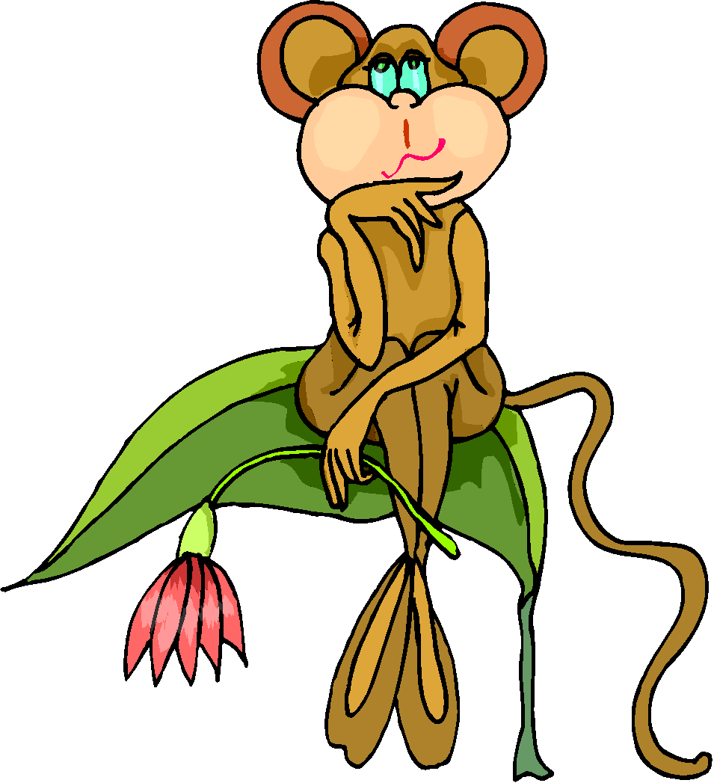
Big Idea #1
Thinking that drives student-level data based decision making also drives systems level data based decision making
  They are driven by a common framework
  They are driven by a decision making logic.

Slide 15

Big Idea #2
To do systems level data based decision making about evidence-based practice (EBP) you need 3 things
  A System Framework – to organize EBP
  Decision Making Processes– Knowing what questions to ask at a systems level and how to answer them
  Data Gathering Strategies Built In – Getting critical data

Slide 16

First Component:
A System
Getting an orderly system
We went through a series of iterations
  ReAim (1986-1989)
  RSDS (1989-1994)
  HELP (1999-2004)
  RtI, PBS (2004-present)
All same focus,
never strayed

Slide 17
Historical System Framework
Special Education
Sea of Ineligibility
General Education

Slide 18
Our Early Framework
Level IV
IEP
Consideration
Level III
Consultation With
Extended Problem
Solving Team
Look Familiar?
Level II
Amount of Resources
Needed to Solve Problem
Consultation with
Other Resources
Level I
Consultation
Between
Teachers-Parents
INTENSITY OF PROBLEM

Slide 19
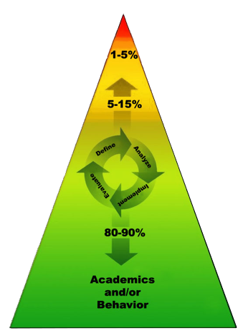
Our Later Framework
Academic Systems
Behavioral Systems
Tier III: Comprehensive/Intensive Interventions ( Few Students)
Students who need Individualized Interventions
Tier III: Intensive Interventions
(Few Students)
Students who need Individual Intervention
Tier II: Strategic Interventions (Some Students)
Students who need more support in addition to the core curriculum
Tier II: Targeted Interventions (Some Students)
Students who need more support in addition to school-wide positive behavior program
Tier I: Core Curriculum
(All students)
Tier I: Universal Interventions
(All students; all settings)
Notes:
‹#›
Don’t think of Tier I Kids, Tier II Kids, Tier III Kids…think of different levels of intensity that are needed for the students to get success

Slide 20
Our Decision
Making Process
• Define the Problem
(Screening and Diagnostic Assessments)
What is the problem and why is it happening?
• Develop a Plan
(Goal Setting and Planning)
• Evaluate
(Progress Monitoring
Assessment)
What are we going to do?
Did our plan work?
• Implement Plan
(Treatment Integrity)
Carry out the intervention

Slide 21
What These Structures Provide
The framework
  Organizes resources for efficient delivery
  Explicitly matches resource deployment to need
  Allows for prevention, not just reaction
The decision making process
  Provides decision making guidance
  Requires data-based decision making
  When done well, is self correcting

Slide 22
ALL THIS IS FOUNDATIONAL TO GOOD SYSTEMS LEVEL DATA BASED DECISION MAKING

Slide 23
Second and Third Components – Decision Making and Data
We frame DBDM as the process of using data to answer questions
Parsimony is key
We can measure anything, but we can’t measure everything. Therefore, we have to be careful.
Just because you can, you have to ask “should you?”
Remember: The Big Ideas

Slide 24
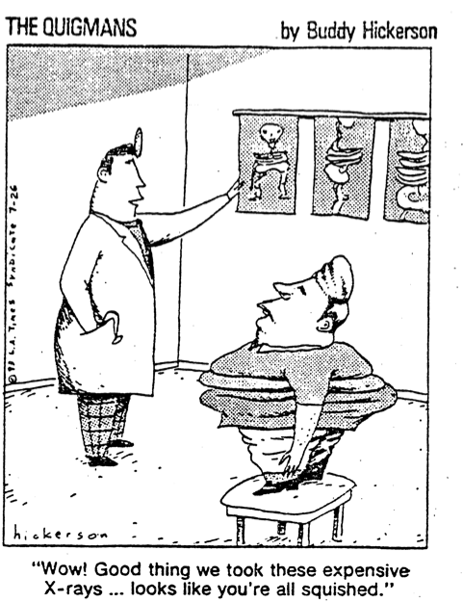
We have limited resources in practice for measurement. We need to spend them wisely.

Slide 25
Big Idea #3: Three Key Systems-Level DBDM Questions
Did we pick the right strategies? (match)
Did we implement the strategies with fidelity? (integrity)
Are the children learning? (outcome)
• Define the Problem
(Screening and Diagnostic Assessments)
What is the problem and why is it happening?
• Evaluate
• Develop a Plan
(Goal Setting and Planning)
Did our plan work?
What are we going to do?
• Implement Plan
(Treatment Integrity)
Carry out the intervention

Slide 26
Types of Data Collected to Answer Each Question
Did we pick the right strategies? (match) | Did we implement the strategies with fidelity? (integrity) | Are the children learning? (outcome)
Implementation with fidelity of problem identification and problem analysis steps | Checklists of steps implemented | Progress monitoring data
Documentation that strategies implemented have research supporting effectiveness | Permanent products generated by implementation of strategy | Benchmark data (when available)
Documentation that strategies are logically and empirically linked to identified areas of need | Direct observation | Outcome data (esp. state accountability criterion measures)

Slide 27
Framework Plus Decisions: Creates This Matrix
 | Few | Some | All
Did we pick the right strategies?
Did we implement the strategies with fidelity (integrity)?
Are the children learning?
• Define the Problem
(Screening and Diagnostic Assessments)
• Define the Problem
(Screening and Diagnostic Assessments)
• Define the Problem
(Screening and Diagnostic Assessments)
What is the problem and why is it happening?
What is the problem and why is it happening?
What is the problem and why is it happening?
• Evaluate
(Progress Monitoring
Assessment)
• Develop a Plan
(Goal Setting and Planning)
• Evaluate
(Progress Monitoring
Assessment)
• Develop a Plan
(Goal Setting and Planning)
• Evaluate
(Progress Monitoring
Assessment)
• Develop a Plan
(Goal Setting and Planning)
Did our plan work?
What are we going to do?
Did our plan work?
What are we going to do?
Did our plan work?
What are we going to do?
• Implement Plan
(Treatment Integrity)
Carry out the intervention
• Implement Plan
(Treatment Integrity)
Carry out the intervention
• Implement Plan
(Treatment Integrity)
Carry out the intervention

Slide 28
Start With All
 | Few | Some | All
Did we pick the right strategies (match)?
Did we implement the strategies with fidelity (integrity)?
Are the children learning (outcome)? |  |  | >=80% proficiency on State outcome (RMS)
Yes

Slide 29
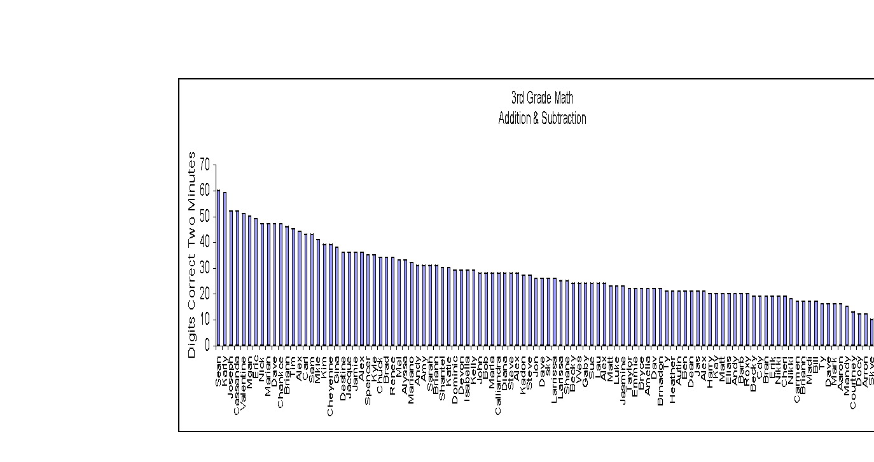
Example
Third Grade Mathematics Outcome Data (or
a proxy for same)
About 81% Meeting minimum proficiency
100
80
60
40
20
This format was borrowed originally from Drs. Amanda VanDerHeyden and Joe Witt,
project STEEP.

Slide 30
Start With All
 | Few | Some | All
Did we pick the right strategies (match)?
Did we implement the strategies with fidelity (integrity)?
Are the children learning (outcome)? |  |  | >=80% proficiency on State outcome (RMS)
No Further
Analysis
Yes

Slide 31
When This Looks Good
• Define the Problem
(Screening and Diagnostic Assessments)
What is the problem and why is it happening?
• Evaluate
(Progress Monitoring
Assessment)
• Develop a Plan
(Goal Setting and Planning)
Did our plan work?
What are we going to do?
We can safely assume
something good is happening
here
• Implement Plan
(Treatment Integrity)
Carry out the intervention

Slide 32
Start With All
 | Few | Some | All
Did we pick the right strategies (match)?
Did we implement the strategies with fidelity (integrity)?
Are the children learning (outcome)? |  |  | >=80% proficiency on State outcome (RMS)
No

Slide 33
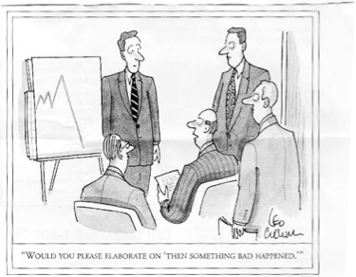
Would you please elaborate on “then something really bad happened.”

Slide 34
Analysis of C&I in Relation to Research-Based Criterion and Implementation Evaluation
Evaluating a Core Reading Program Grades K-3: A Critical Elements Analysis (Match)
Planning and Evaluation Tool for Effective School-wide Reading Programs – Revised (PET-R) – (Fidelity)
Edward J. Kame’enui, Ph.D.
Deborah C. Simmons, Ph.D.

Slide 35
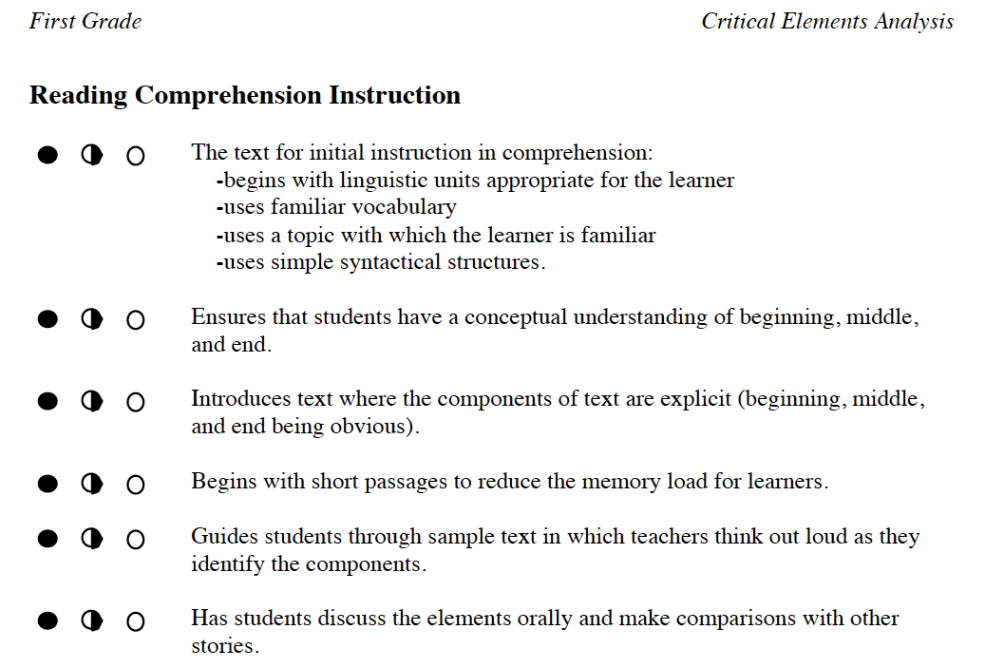
Evaluating a Core Reading Program Grades K-3: A Critical Elements Analysis
(Match)
Kame’enui & Simmons, 2003,
http://reading.uoregon.edu/appendices/con_guide_3.1.03.pdf

Slide 36
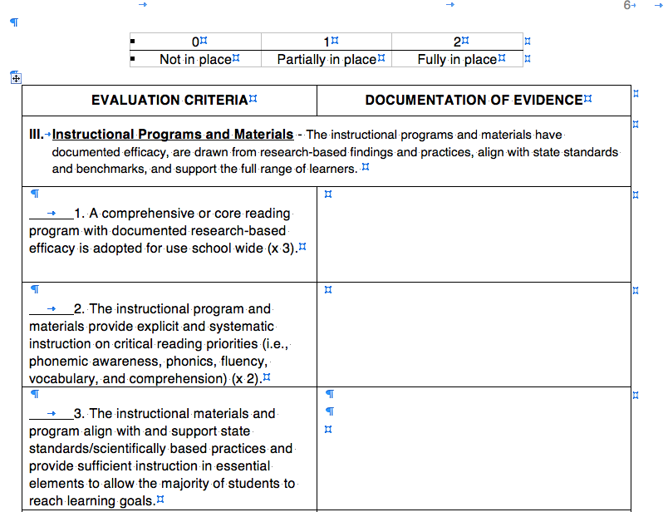


PET-R (Excerpt)
(Fidelity)
Kame’enui and Simmons, http://www.aea11.k12.ia.us:16080/idm/day3_elem.html

Slide 37
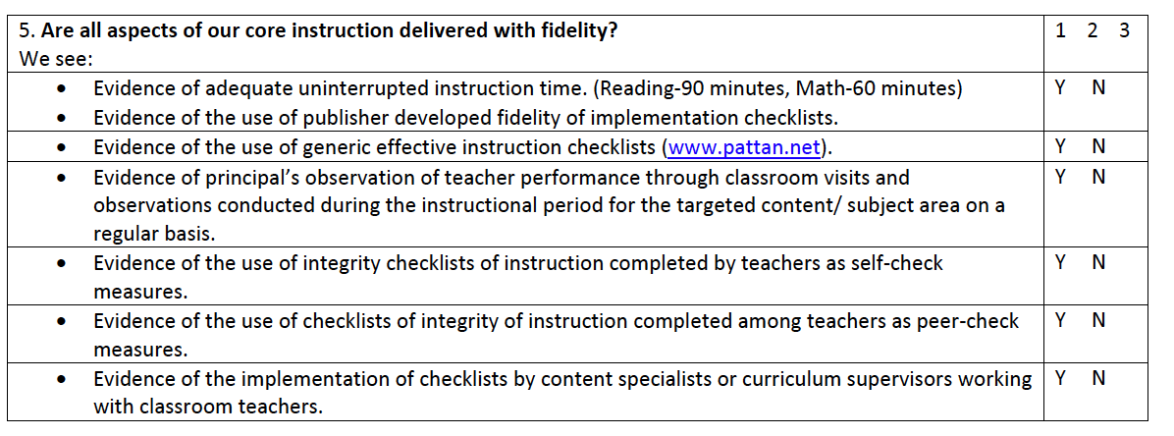

Core Program Review – Fidelity Checklist
Excerpted from PA RtI initiative, www.pattan.net,
http://www.pattan.k12.pa.us/files/Handouts09/CorePrograms033009b.pdf

Slide 38
Use Dx Data To Plan Changes
Changes are made
  Structures
  Processes
Consistent with data from assessments
Effectiveness of changes is monitored over time with Universal Screening Data percents
And ultimately system accountability data

Slide 39
In Other Words
And measure this
• Define the Problem
(Screening and Diagnostic Assessments)
What is the problem and why is it happening?
• Evaluate
• Develop a Plan
(Goal Setting and Planning)
Did our plan work?
What are we going to do?
We go back through this
• Implement Plan
(Treatment Integrity)
Carry out the intervention

Slide 40
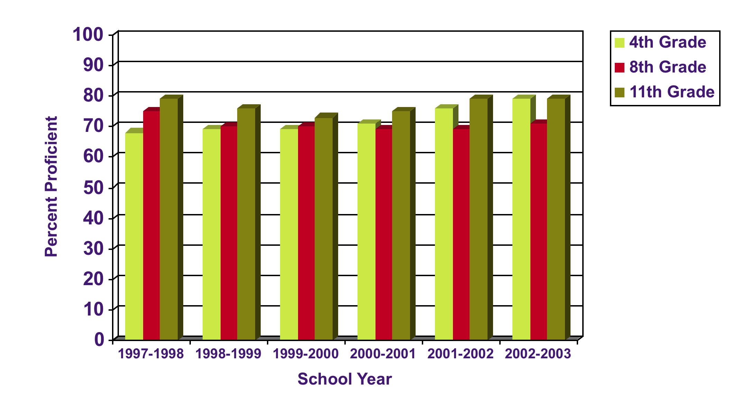
Iowa Test of Basic Skills Percent Proficient – Reading Comprehension Subtest
n approx. = 9000 per grade level
Note: Data include all public and non-public accredited schools in AEA 11 (including Des Moines)

Slide 41
Next Work With “Some”
Supplemental Instruction
Two possibilities
  Generic Standard Treatment Protocol
  Customized Standard Treatment Protocol
Assume for this discussion, supplemental services are in place in a school

Slide 42
Next Work With “Some”
 | Few | Some | All
Did we pick the right strategies (match)?
Did we implement the strategies with fidelity (integrity)?
Are the children learning (outcome)? |  | >=66% of supplemental students making acceptable progress
Yes

Slide 43
Working With “Some”
When This Looks Good
• Define the Problem
(Screening and Diagnostic Assessments)
HOWEVER!!!!
What is the problem and why is it happening?
• Evaluate
(Progress Monitoring
Assessment)
• Develop a Plan
(Goal Setting and Planning)
Did our plan work?
What are we going to do?
We can safely assume
something good is happening
here
• Implement Plan
(Treatment Integrity)
Carry out the intervention

Slide 44
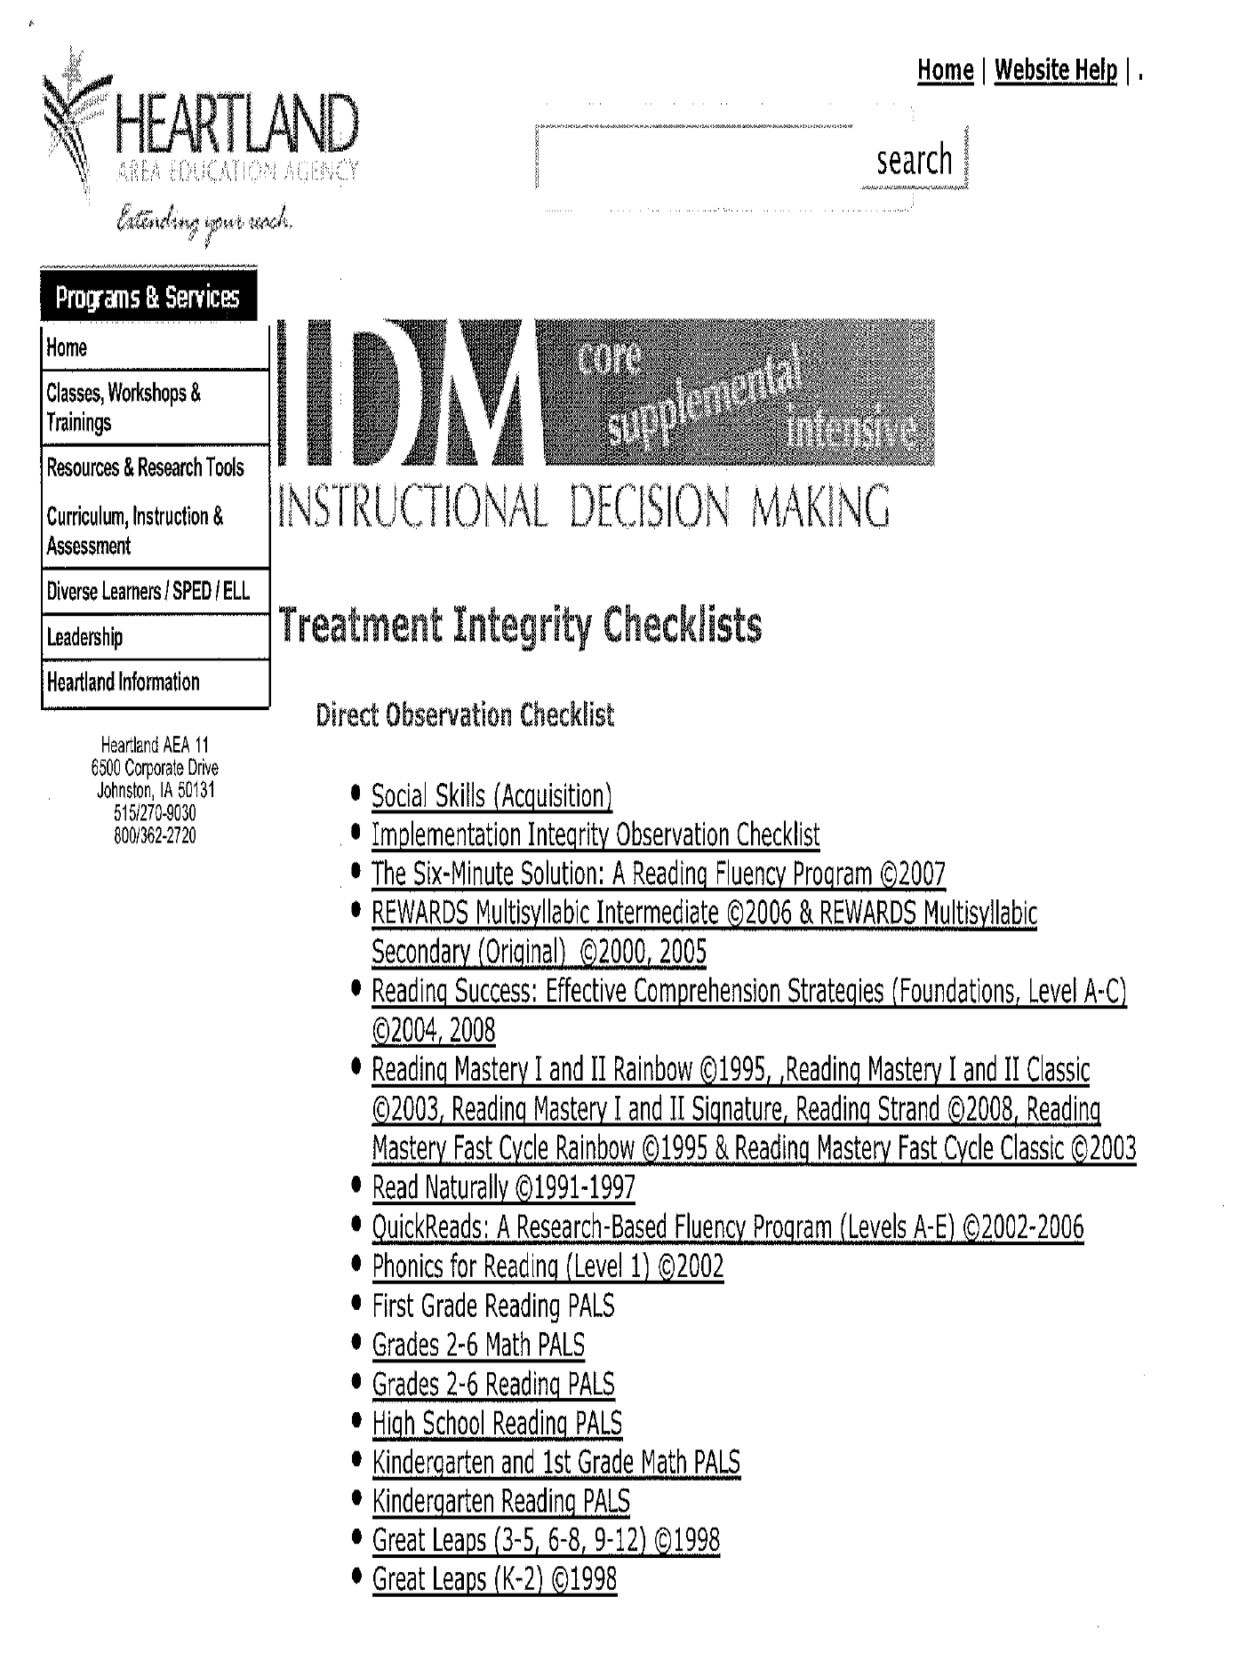
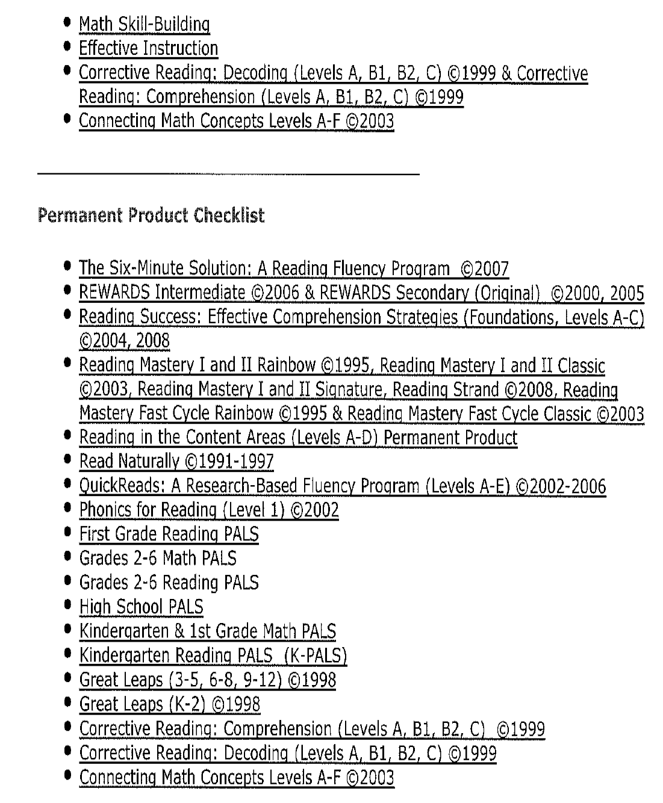
Tx Integrity Checks For Supplemental Services
(Tier 2 Fidelity)
All Available at: http://www.aea11.k12.ia.us:16080/idm/checkists.html

Slide 45
Next Work With “Some”
 | Few | Some | All
Did we pick the right strategies (match)?
Did we implement the strategies with fidelity (integrity)?
Are the children learning (outcome)? |  | >=66% of supplemental students making acceptable progress
No

Slide 46
Working With “Some”
When This Doesn’t Look Good
• Define the Problem
(Screening and Diagnostic Assessments)
What is the problem and why is it happening?
• Evaluate
(Progress Monitoring
Assessment)
• Develop a Plan
(Goal Setting and Planning)
Did our plan work?
What are we going to do?
We go back through
this process
• Implement Plan
(Treatment Integrity)
Carry out the intervention

Slide 47
Important Point About EBP
(Tier 2 Match)
Even the best evidence-based strategies/programs/interventions are doomed to fail if they are applied to the wrong problems
Having decision rules that clarify what students will get for supplemental instruction is critical.

Slide 48
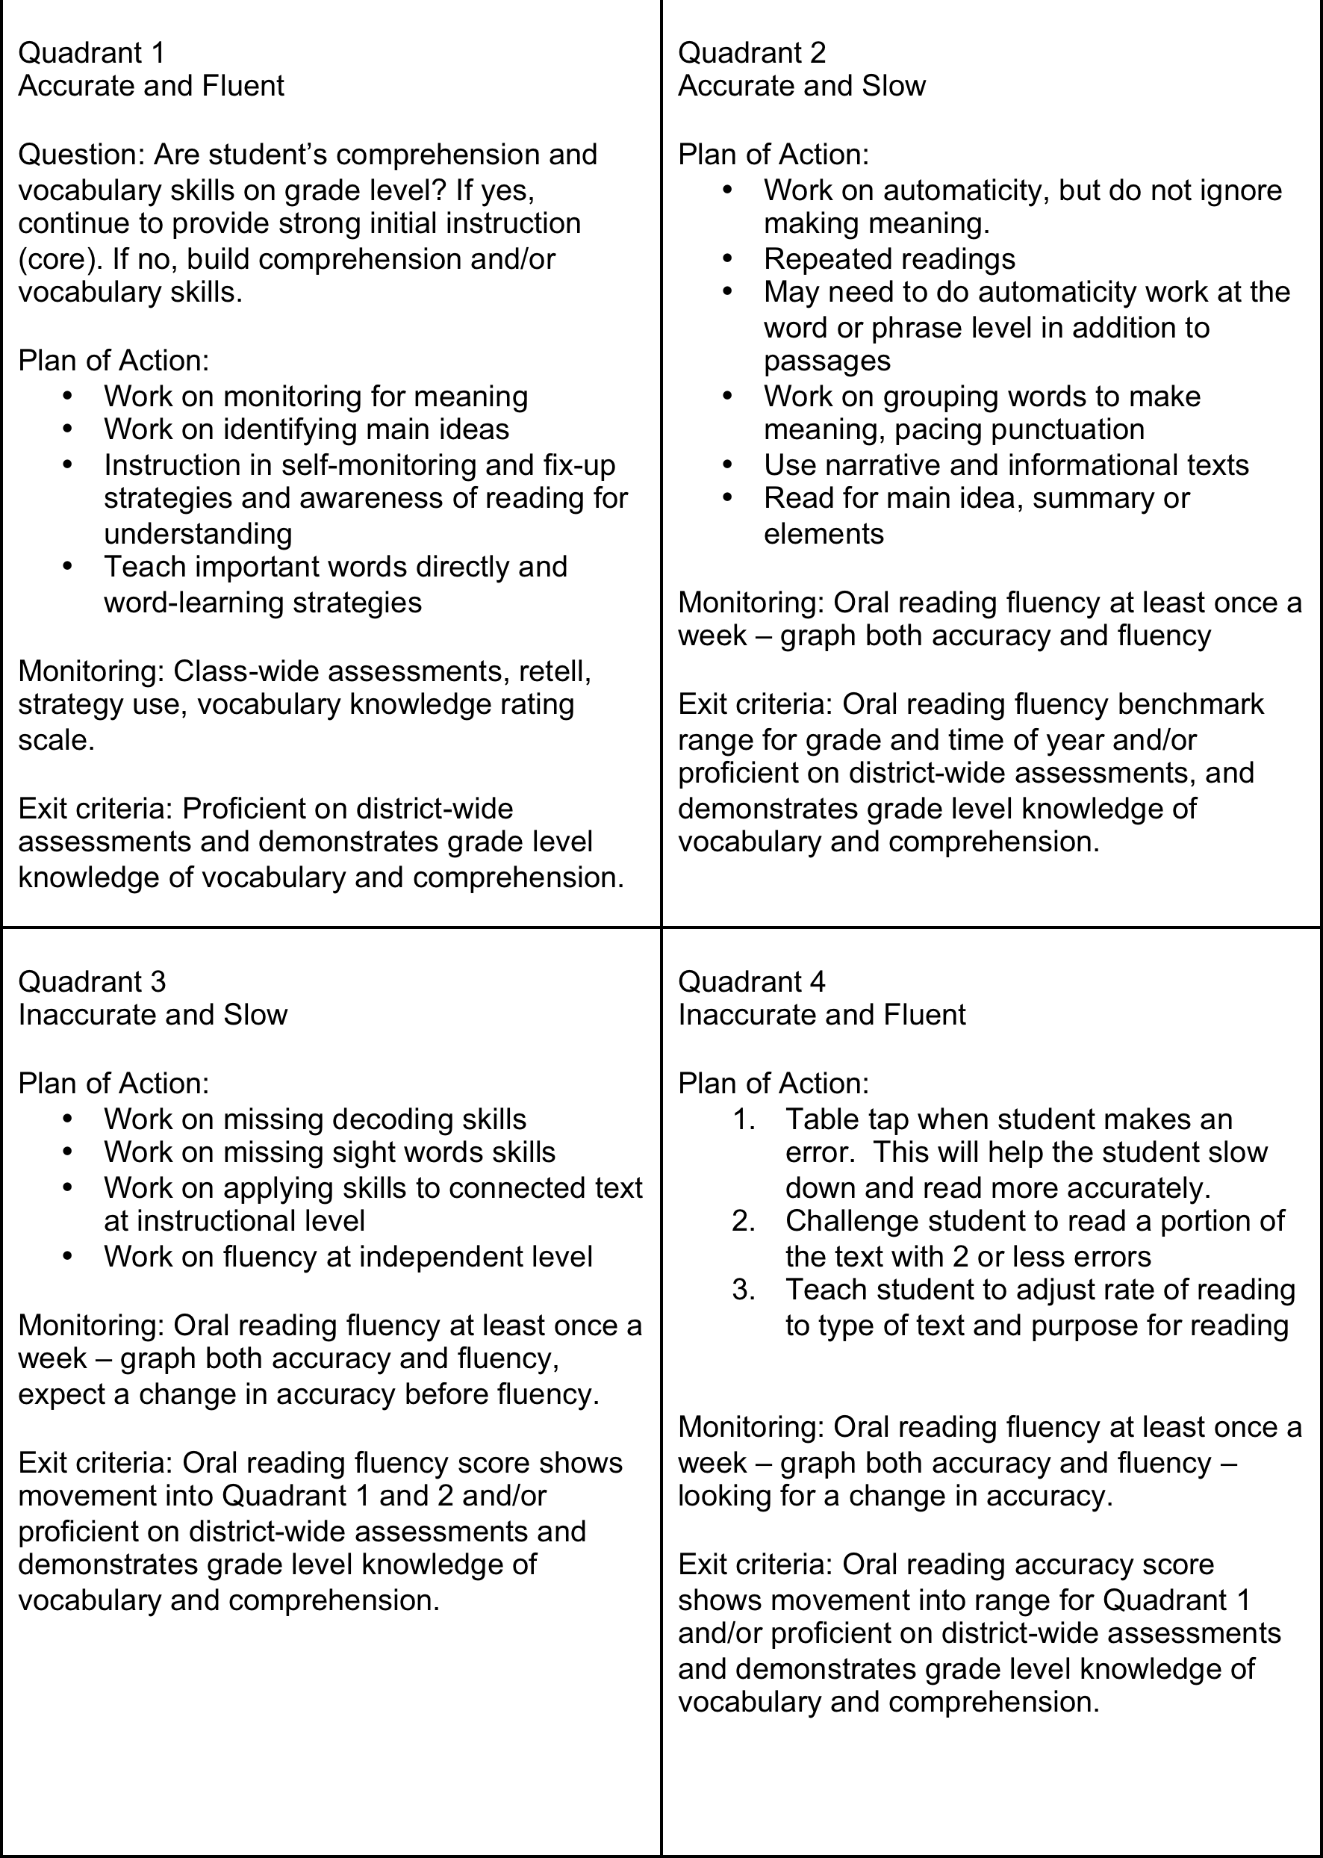
(Tier 2 Match)
Four Box Method for grouping
students for supplemental
Reading instruction

Slide 49
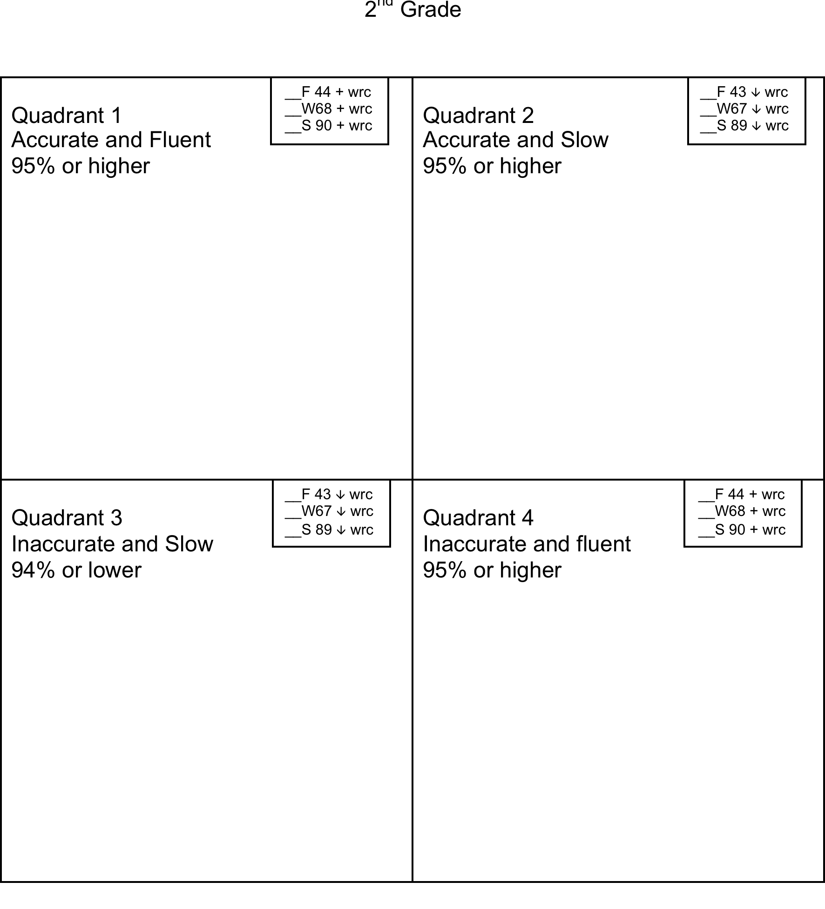
(Tier 2 Match)
Clear criteria and decision rules for placing students in supplemental instruction

Slide 50
Critical RtI Assumption
Implementing a systems wide data based decision making system means catching kids up
Meaning, teaching more in less time

Slide 51
If you teach the same curriculum, to all students, at the same time, at the same rate, using the same materials, with the same instructional methods, with the same expectations for performance and grade on a curve you have fertile ground for growing special education.
Gary Germann, 2003

Slide 52
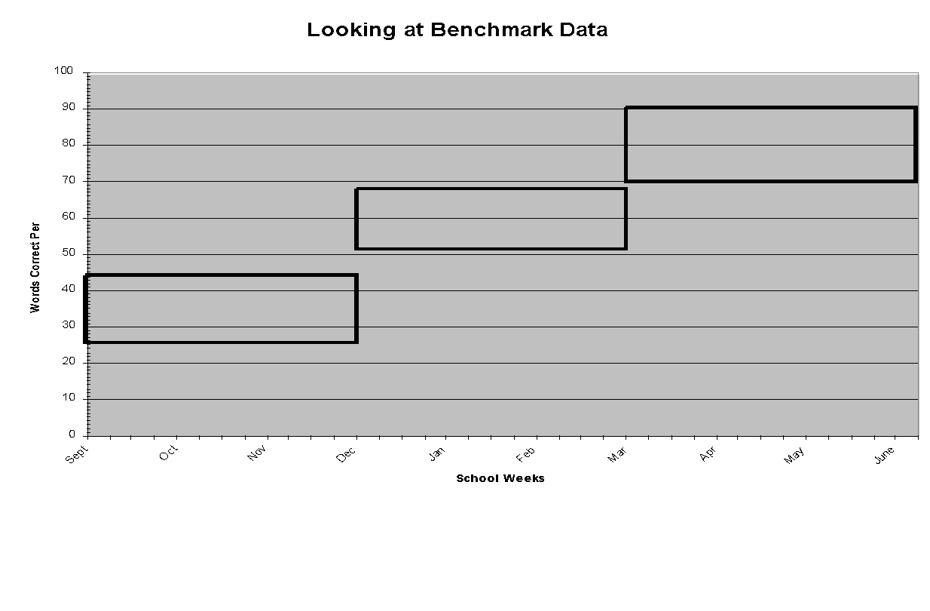
For Student in Interventions – Acceptable Progress Means Catching Up
Benchmark is Top of Box
Some Risk is inside the box
At Risk is Below the box

Slide 53
Poor RtI
100
90
80
Goal
70
60
50
40
Trendline =.07 WCPM
Aimline
30
20
10
M M M M M M M M M M M M M M M M M M M M M M M M M M M M M M
Nov
Dec
Jan
Feb
Mar
Apr
May
Jun
Poor RtI

Slide 54
Better RtI
100
Baseline
1
90
Trendline =.54 WCPM
80
Goal
70
60
Trendline =1.93 WCPM
50
40
Trendline =.07 WCPM
30
20
10
M M M M M M M M M M M M M M M M M M M M M M M M M M M M M M
Nov
Dec
Jan
Feb
Mar
Apr
May
Jun
Better, RtI

Slide 55
Summary: Tier 2 Outcome Data
% of students catching up (progress monitoring)
% of students moving from needing supplemental back to core alone (meeting all screening criteria)

Slide 56
Last Work With “Few” – Individual Intensive
Refer to Frank Gresham’s presentation
For us, systematic, intensive problem solving
Only make a few points

Slide 57

For Intensive, Fidelity and Match
Addressed through integrity of problem solving process
Must specify the behaviors you want professionals to do
Must have a way of ensuring the integrity of the decision making is ensured

Slide 58
Next Work With “Few”
 | Few | Some | All
Did we pick the right strategies (match)?
Did we implement the strategies with fidelity (integrity)?
Are the children learning (outcome)? | % of student population receiving intensive services <=?% (5-10) % of students with positive RtI (catching up - benchmarks and outcome data)

Slide 59
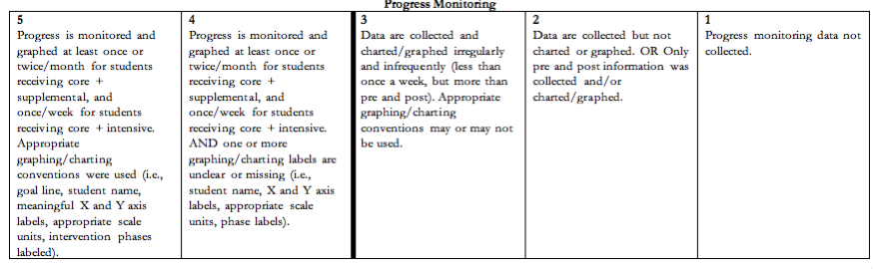
Performance Profile
Acceptable
Unacceptable
Notes:
Give participants time to read the 5, 4, and 3 and note the differences between acceptable and unacceptable work.

Slide 60
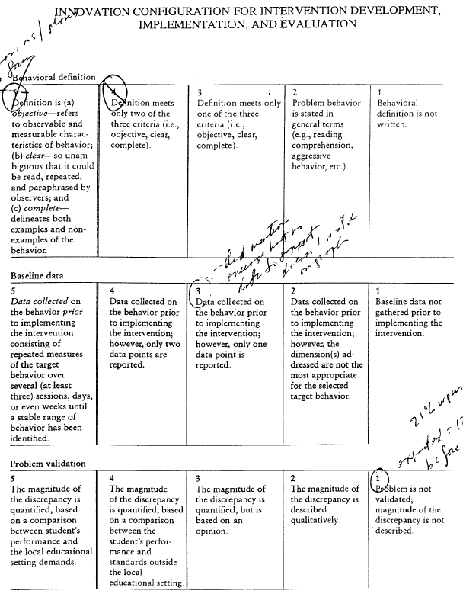
Shorter Performance Profile

Slide 61
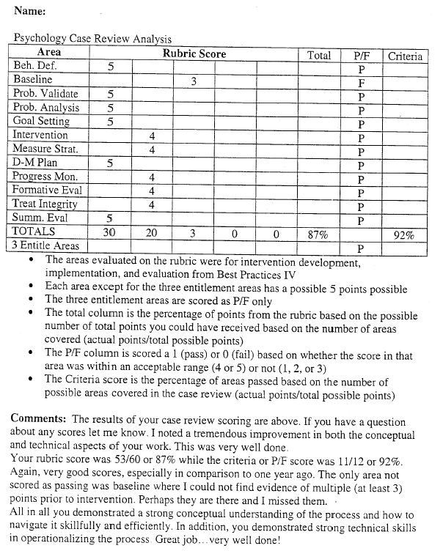
Summary of Performance Profile

Slide 62
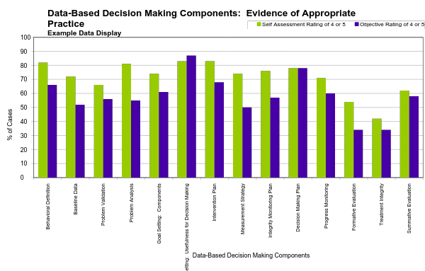

Slide 63


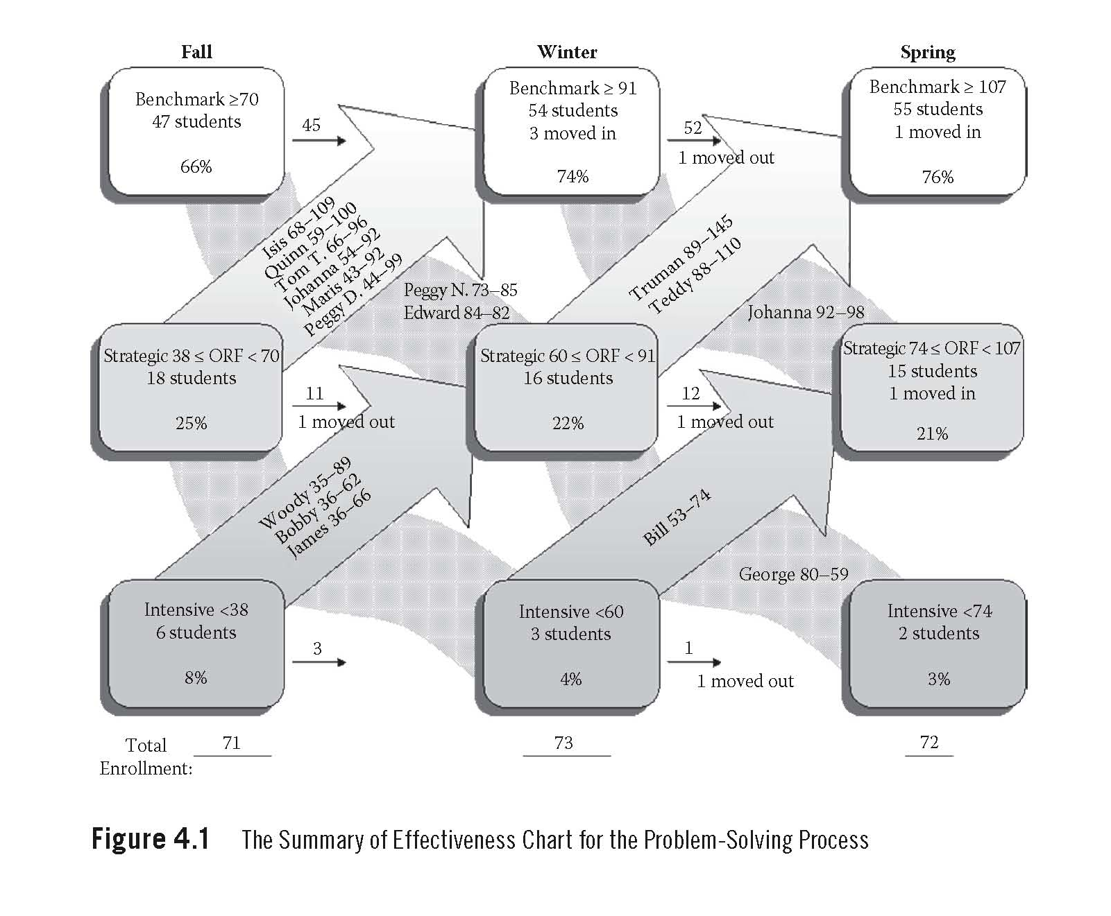
Summary of Effectiveness - Outcomes
Original concept by Ben Ditkowsky,
http://measuredeffects.com/index.php?id=9
From Burns and Gibbons, 2007

Slide 64

Take Away Lessons (AKA – Some of Our More Bonehead Moments)
Don’t just measure student outcomes (you must have systems diagnostic data)
You must have a high tolerance for ambiguity
Trying to measure too much
Not involving the whole system in your measurement and especially the questions we’re answering (social consequences, Messick)

Slide 65
Challenges
Polymorphous Philosophies across disciplines
System-level skills and commitment to data based decision making
Decisions in search of data
Human behavior not under stimulus control of data
Measuring too many things
Lack of a single data system to bring everything together
Overcomplicating things

