Slide 1
Treatment Integrity: A Wicked Problem and Some Solutions
Ronnie Detrich
Wing Institute

Slide 2
Goals for Today
Make the case that treatment integrity monitoring is a necessary part of service delivery.
Describe dimensions of treatment integrity.
Suggest methods for increasing treatment integrity.
Place treatment integrity within systems framework.

Slide 3
What is a Wicked Problem?
Technical problems: can be complicated but there is common agreement about the nature of the problem and how to best solve it.
Wicked problems: No agreement on what the problem is and how to solve it. Solutions often require changing multiple aspects of system.
Notes:
Messy, devious, and fight back when you try to solve them.

Slide 4
“A job is worth doing, it is worth doing right”
(Every parent everywhere)

Slide 5
A Bit of Wisdom
“Students do not benefit from interventions they do not experience.” (Dean Fixsen)

Slide 6
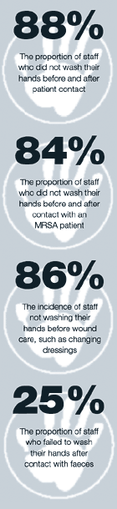

We Have Met the Enemy and it is Us Us
2,000,000 people infected annually in hospital.
90,0000 die from these infections.
Hand washing consistently halts spread of infection.
Hospital personnel wash hands only 33%-50% of the time they should.

Slide 7
Current State of Treatment Integrity in Education

Slide 8
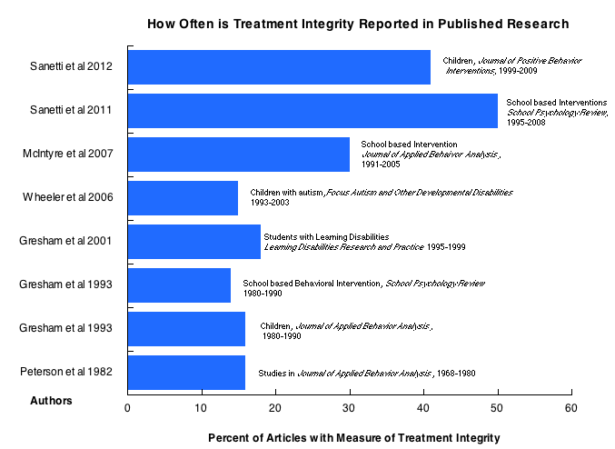

Slide 9
Treatment Integrity in Practice
Survey of school psychologists (Cochrane & Laux, 2008)
97% agreed that it was key factor to consider.
11% reported monitoring with individual cases.
1.9% reported monitoring for group/team consultation.

Slide 10
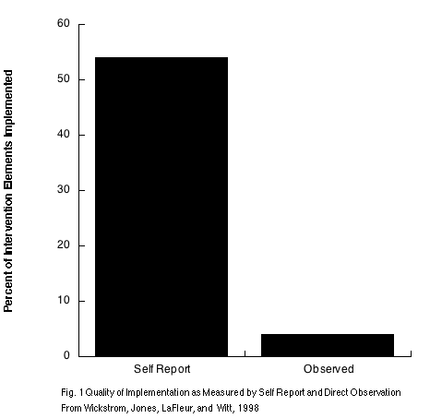

Slide 11
Evidence-based Practice in Education
NCLB and IDEIA increased interest in scientifically supported practices.
Much greater emphasis on identifying practices that meet evidentiary standards.
Less attention to how well those interventions are implemented.
Effectiveness studies routinely do not achieve same magnitude of effect as efficacy studies of same intervention.
Lack of treatment integrity often accounts for the differences.
Notes:
As we move from research under optimum conditions to research about effects of an intervention under usual care conditions often obtain much smaller outcomes.

Slide 12
Probability of Benefit
Empirically Supported?
Yes
No
High
Benefit
likely
Benefit unlikely
Treatment Integrity
Low
Benefit unlikely
Benefit
unlikely
Notes:
Function of Service is to produce benefit. Probability of benefit falls on a continuum of likely to not likely. This figure depicts the probability of benefit as Intervention and Treatment Integrity interact.
Figure makes clear that both Empirically Supported Interventions and Treatment Integrity are necessary but neither is sufficient.

Slide 13
Probability of Benefit
Empirically Supported?
Yes
No
High
Benefit
likely
Benefit unlikely
Treatment Integrity
Low
Benefit unlikely
Benefit
unlikely
Notes:
Both are necessary neither is sufficient

Slide 14
Treatment Integrity as Ethical Responsibility
Fiduciary
Act solely for the benefit of the other party
Assure that the taxpayers are receiving the greatest possible return on their investment
Carries the weight of ethical conduct
Notes:
Call to action-failure to implement with integrity=wasting students time. Too many instructional casualties. Students not succeeding lose motivation-many drop out.

Slide 15
Evidence-based Practice as a Framework for Decision Making

Slide 16
Logic Chain
Data-based decision making at heart of evidence-based practice.
The impact of evidence-based education depends on the effectiveness of specific interventions.
The effectiveness of interventions is a function of the integrity with which they are implemented.
The quality of decisions about effects of an intervention is directly linked to the quality of implementation.

Slide 17
Logic Chain
Student progress data tells us about the effects of the intervention.
If we know about adequacy of treatment integrity then can make decisions:
Adequacy of intervention
Adequacy of implementation
If implementation is inadequate then focus should be on improving implementation.
If implementation is adequate then focus should be on changing intervention so student can succeed.

Slide 18
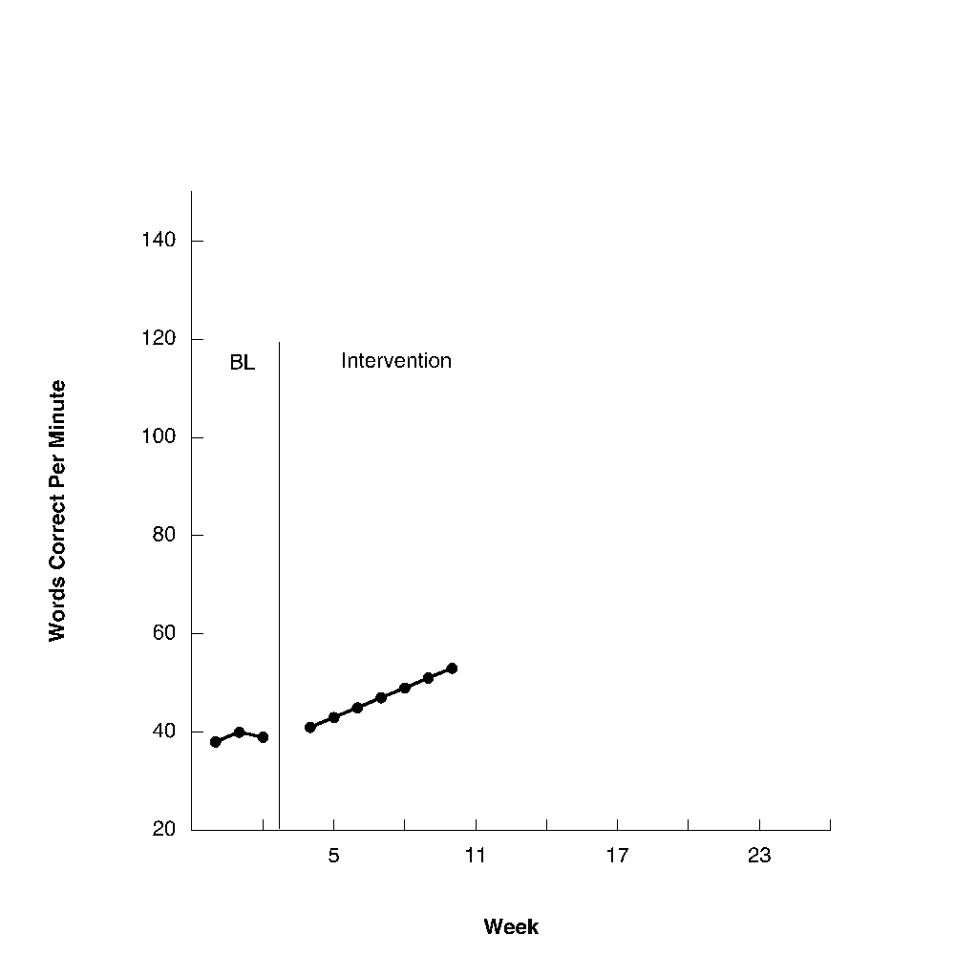
Data-based Decision Making and Treatment Integrity
Grade Level Standard
Aim Line
Trend Line

Slide 19


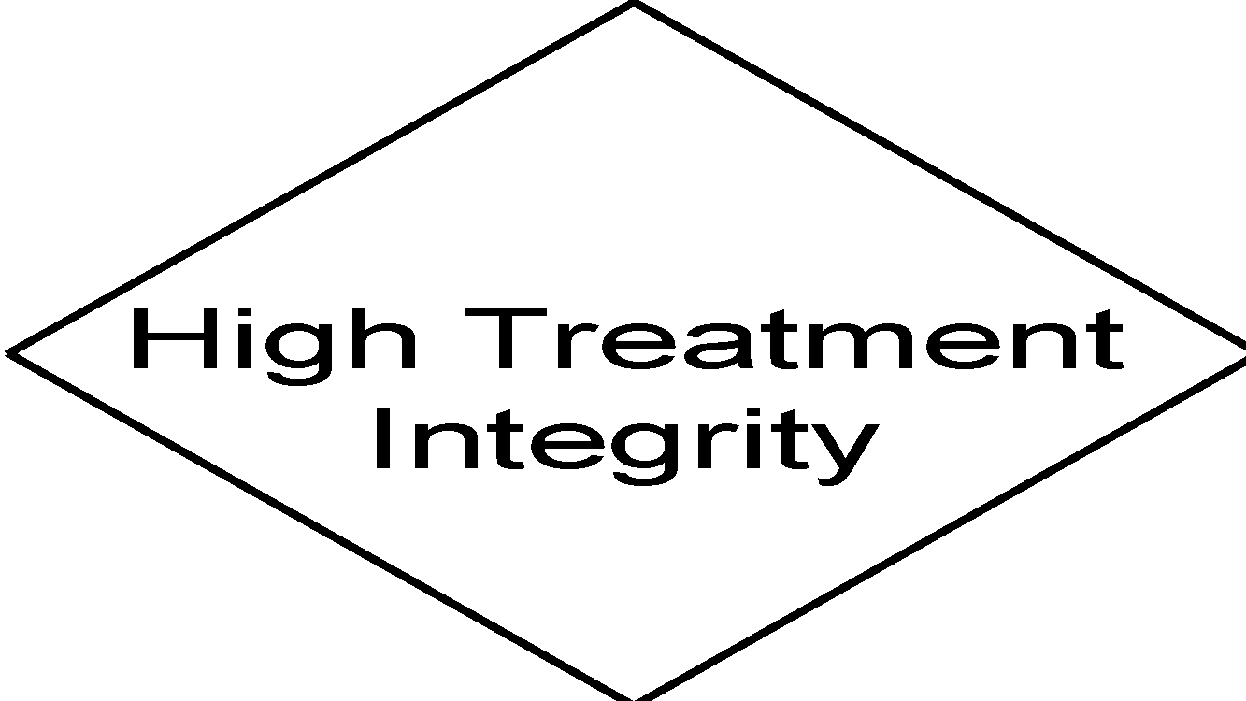
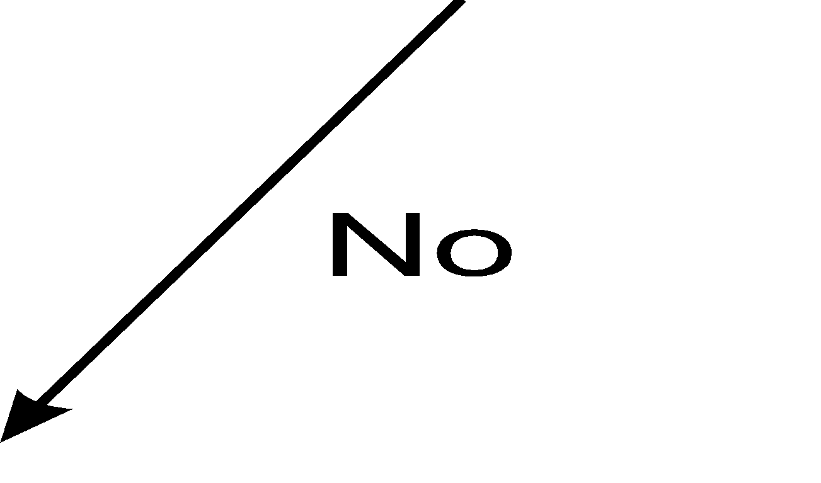




Slide 20
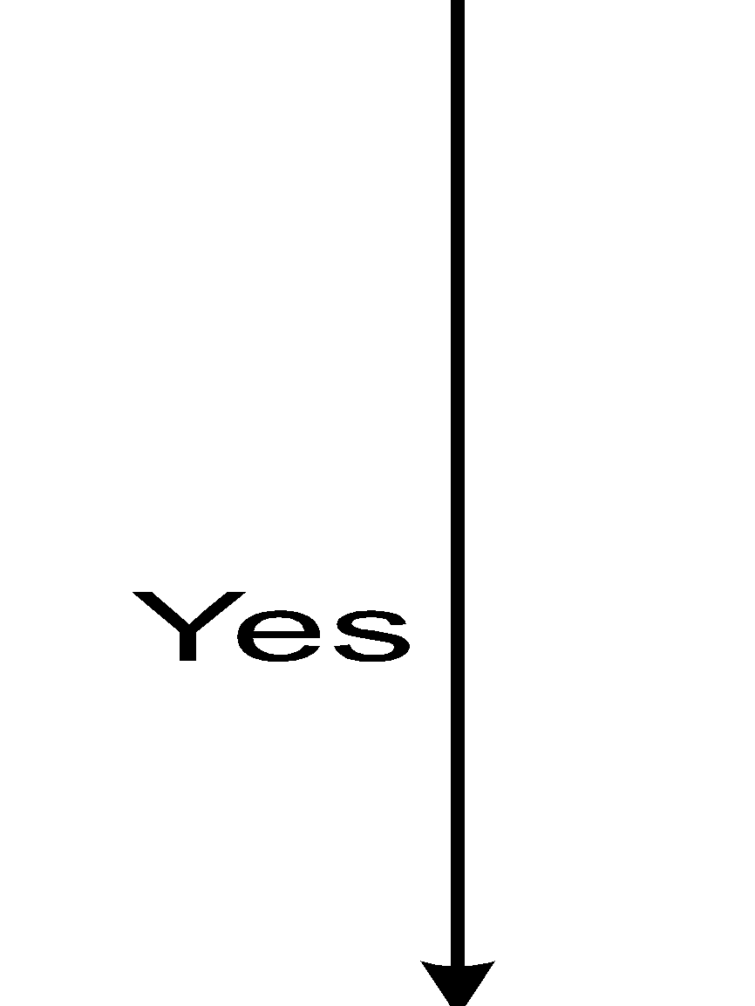

Slide 21

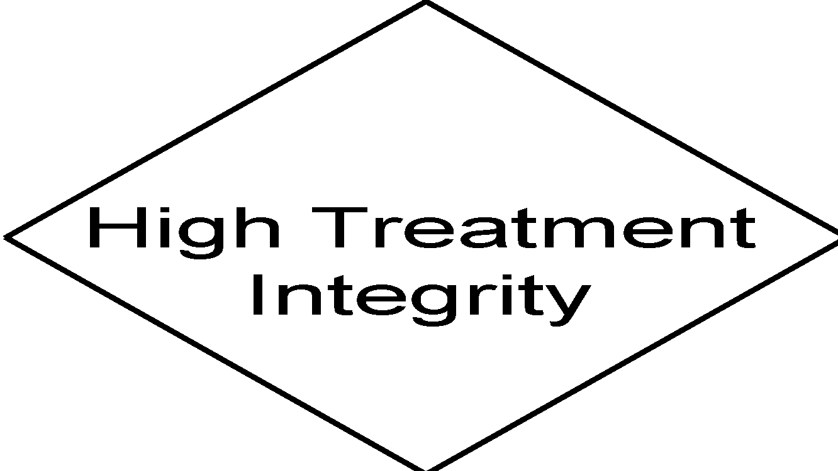



Slide 22






Slide 23



Slide 24




Slide 25
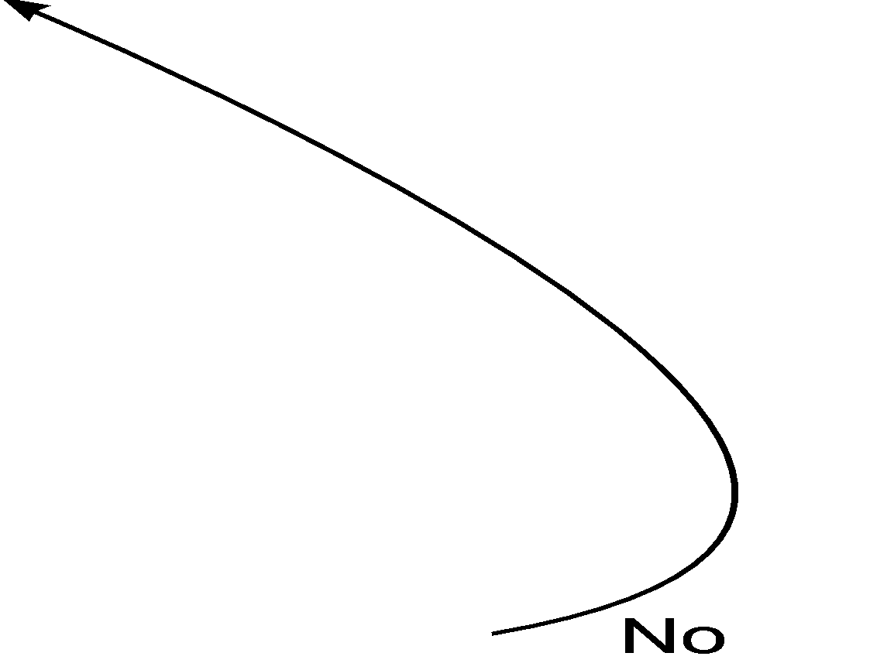

Slide 28
The Challenge of Treatment Integrity in Practice Settings
Interventions always have costs:
Resources
Time
Money
Monitoring treatment integrity has costs.
Resources
Time
Money
Resources are not likely to be added so reallocating existing resources is necessary.

Slide 29
The Challenge of Treatment Integrity in Practice Settings
Do we take resources from intervention to support monitoring treatment integrity?
Failing to assure high quality implementation likely results in a waste of resources because effects of intervention are minimized.
Services with no outcomes =
activity without accomplishment

Slide 30
Definition of Treatment Integrity

Slide 31
Definition of Treatment Integrity
Intervention implemented as planned
(Gresham, Gansle, Noell, Cohen, & Rosenblum, 1993;
Moncher & Prinz, 1991;
Yeaton & Sechrest, 1981).

Slide 32
Dimensions of Treatment Integrity (Dane & Schneider, 1998)
Exposure (Dosage): the extent to which participants are exposed to the intervention as prescribed.
Curricula usually prescribe frequency and duration of exposure that is necessary for benefit.
Ex: 3/week for 30 minutes/session.
Failing to satisfy either can impact student benefit.
Ex: 1/week for 30 minutes or 3 times/week for 10 minutes each time.

Slide 33
Dimensions of Treatment Integrity (Dane & Schneider, 1998)
Adherence: the extent to which the components of an intervention are delivered as prescribed.
Most commonly measured dimension.
It is necessary but not sufficient to produce benefits.
Adherence with low dosage not likely to produce positive outcomes.

Slide 34
Dimensions of Treatment Integrity (Dane & Schneider, 1998)
Quality of delivery: qualitative measure of how well the intervention is implemented.
Importance has been acknowledged for years.
Have not developed good measures or how to influence it.
Possible measures through social validity methods:
Enthusiasm
Sincerity
Variations in inflection and content of speech.

Slide 35
Dimensions of Treatment Integrity (Dane & Schneider, 1998)
Responsiveness of Participants: a measure of participants response to sessions. Includes indicators such as levels of participation and enthusiasm.
It is possible to have very high exposure and adherence and have very low participation.
Improper placement in curriculum.
Boring from student’s perspective.
Not socially valid intervention.

Slide 36
Assessment with Resource Constraints
Difficult to assess all dimensions of integrity at same time.
Some require fewer resources to assess than others.
Exposure easier than adherence.
Sequential assessment of dimensions allows intervention only where necessary.

Slide 37

PoPoor Outcomes?
Outcomes
Assess Treatment Integrity
Exposure Adequate?
No
Increase Exposure
ID Obstacles
Better Outcomes?
Yes
Yes
No
Adherence Adequate?
No
Increase Adherence
Obstacles
Can’t do/won’t do
Better Outcomes?
Yes
Yes
No
Quality of delivery?
No
Increase Coaching
Video Modeling
Yes
No
Better Outcomes?
Yes
Student Responsiveness?
No
Increase social validity
Assess Consumers
Better Outcomes?
Yes
Yes
No
Change Intervention
Continue Intervention

Slide 38
Variables Influencing Treatment Integrity

Slide 39
Variables Influencing Treatment Integrity
Effort

Slide 40
Hand Washing Protocol
Remove watch, rings, other jewelry.
Wet hands in warm tap water.
Dispense soap and lather all surfaces including the lower arm for the full duration recommended by the manufacturer (15-30 seconds).
Rinse off for 30 seconds.
Dry completely with clean, disposable towel.
Use towel to turn the tap off.
Repeat after any new contact with a patient.

Slide 41
Variables Influencing Treatment Integrity
Broader cultural rules
Reinforcement=bribery
Spare the rod, spoil the child
Trust your judgment
Discount the consequences
Negative outcomes:
Later
Negative outcomes impact someone else
No direct causal link can be proven

Slide 42
Variables Influencing Treatment Integrity
Organizational
Systems that are perceived by teachers to be supportive and provide strong leadership have higher levels of integrity.
Personal characteristics
Burnout: Inverse relation between measures of teacher burnout and treatment integrity.
Personal efficacy: Positive correlation between measures of personal efficacy and treatment integrity.

Slide 43
Variables that Influence Treatment Integrity
Characteristics of Intervention
Complexity of intervention.
Perceived effectiveness.
Acceptability.
Contextual fit.
Necessary resources available.

Slide 44
Assessing Treatment Integrity

Slide 45
Direct Observation
Gold standard
Resource intensive
May result in reactivity
inflating scores.

Slide 46
Permanent Products
Uses products of intervention to determine if steps of intervention were completed.
Pages completed
Stickers given
Primarily used as a measure of adherence.
Generally results in lower estimates of integrity than direct observation.
May result in different decisions about implementation and outcomes than direct observation data.
Not viable for interventions that do not have permanent products.

Slide 47
Teacher Self Report
Teacher rate their own implementation.
Relatively low effort and resource friendly.
Teacher ratings tend to overestimate accuracy of implementation ( Wickstrom, Jones, Lafleaur, & Witt, 1998).
Teachers rated integrity at 54% accurate.
Direct observation= 4%.
Integrity may be increased by rating immediately following intervention session.
Integrity may be improved by having teacher score video tape.
It may be possible to teach teachers to rate more accurately (see self-evaluation literature).

Slide 48
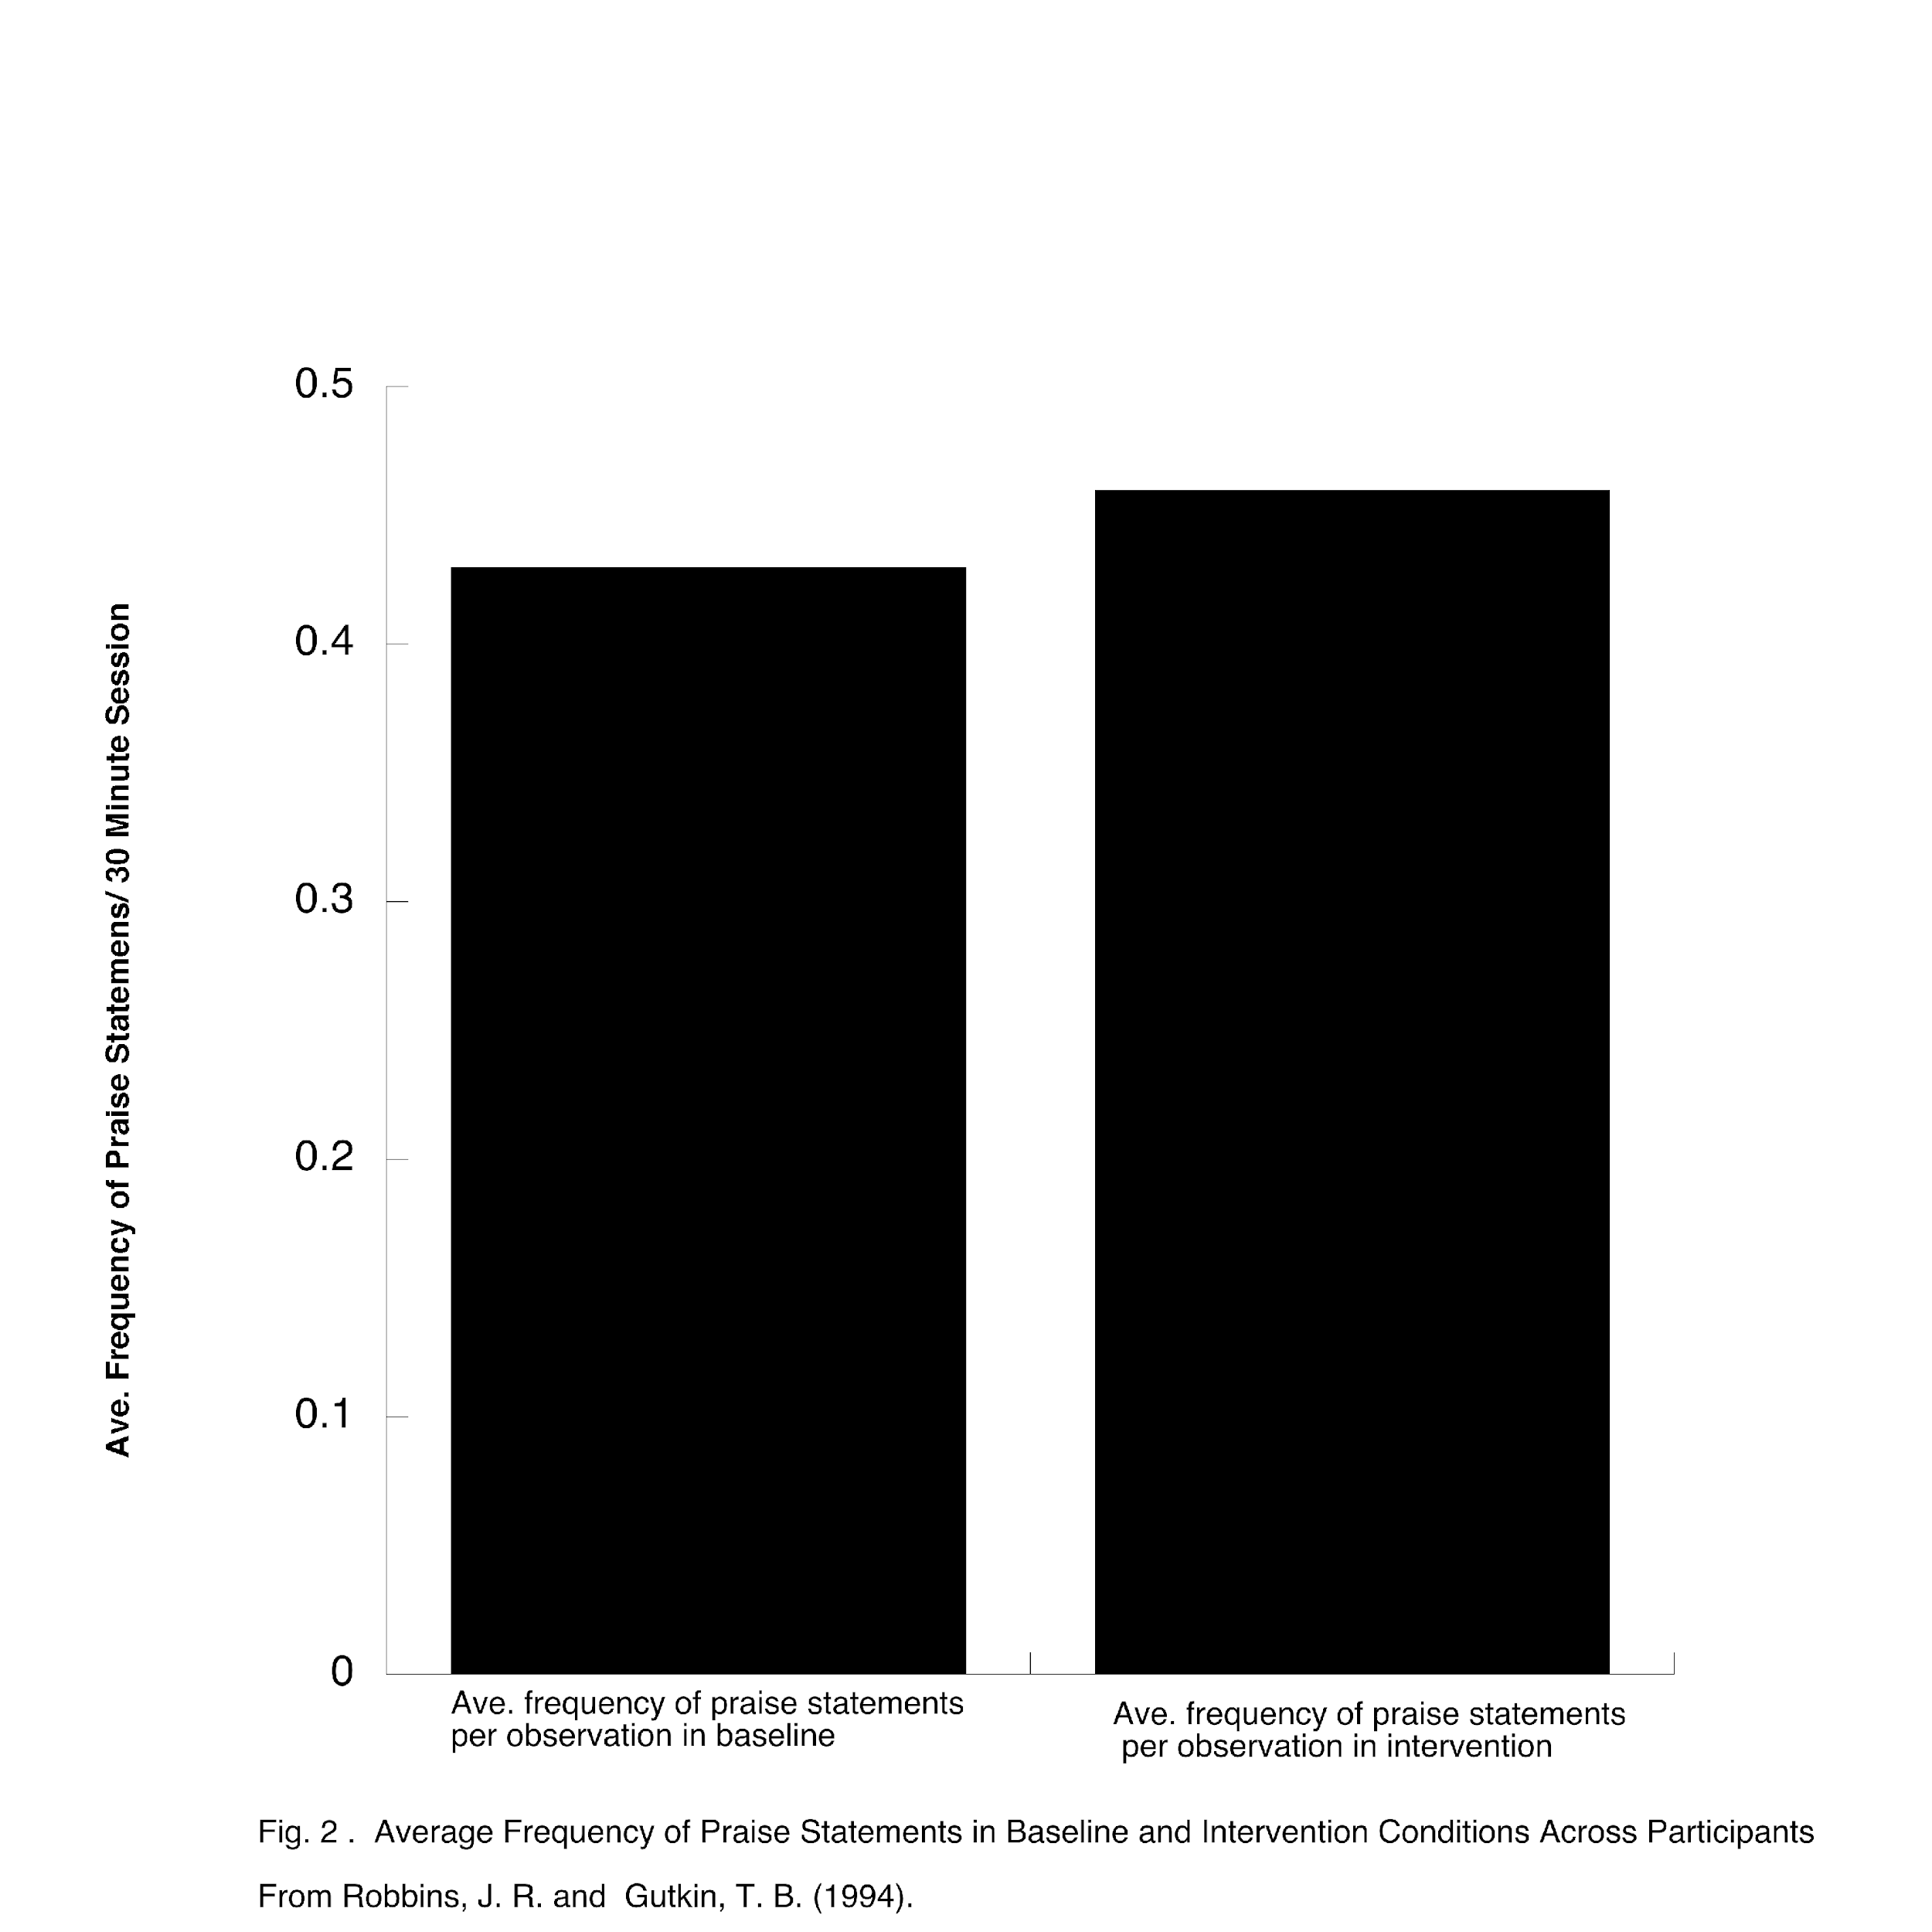
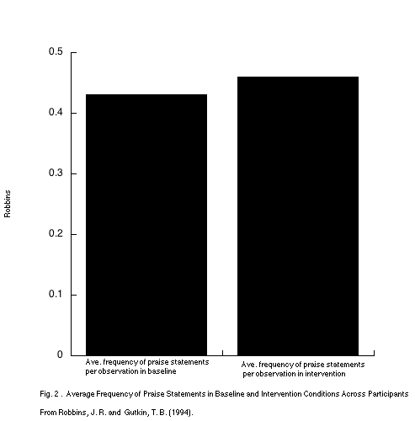

Slide 49
Increasing Treatment Integrity

Slide 50
Two Lines of Treatment Integrity Research
Effects on students
Methods for increasing and maintaining staff behavior

Slide 51
What Do We Know About Treatment Integrity and Student Behavior?
Different levels of integrity result in different levels of student behavior.
(Wilder, Atwell, & Wine, 2006)
High integrity followed by declines in integrity has limited disruptive effect on student behavior.
(Northup, Fisher, Kahng, Harrel, & Kurtz, 1997)
Low levels of integrity followed by increases in integrity do not produce the same level of student response as when integrity high from the beginning.
(Groskreutz,, Groskreutz, & Higbee, 2011)

Slide 52
What Do We Know About Treatment Integrity and Student Behavior?
Implications
Make sure that integrity is high at the beginning of intervention.
It is better to start with high levels of integrity and let it decline than to start with low integrity and try to increase it.
Maximizes impact of intervention.

Slide 53
What We Know About Adult Behavior
Integrity highly variable within and across staff.
Integrity likely to decline quickly without active intervention.

Slide 54
Why So Low?
Training alone is not sufficient to assure high integrity.

Slide 55
Not All Training is Equal
 | OUTCOMES
 | (% of Participants who demonstrate knowledge, demonstrate new skills in a training setting, and use new skills in the classroom)
TRAINING COMPONENTS | Knowledge | Skill Demonstration | Use in the Classroom
Theory and Discussion | 10% | 5% | 0%
... + | 30% | 5% | 0%
... + | 60% | 5% | 5%
…+ | 95% | 95% | 95%
Demonstration in
Training
Practice & Feedback in Training
Coaching in Classroom
Joyce and Showers, 2002

Slide 56
Two Alternatives
Let it happen
Make it Happen
Implement and hope.
Long history with little to show for it.
Requires efficient and effective approaches.
Effective ways to increase integrity only beginning to emerge.
Most of the research is at level of individual support plans.
It is necessary to find ways to scale to larger units.

Slide 57
Performance Feedback
Feedback is most common approach.
Feedback can be given in a variety of ways.
Face to face (tell)
Email (tell)
Graphed (show)
Tell + show feedback more effective than either alone.

Slide 58
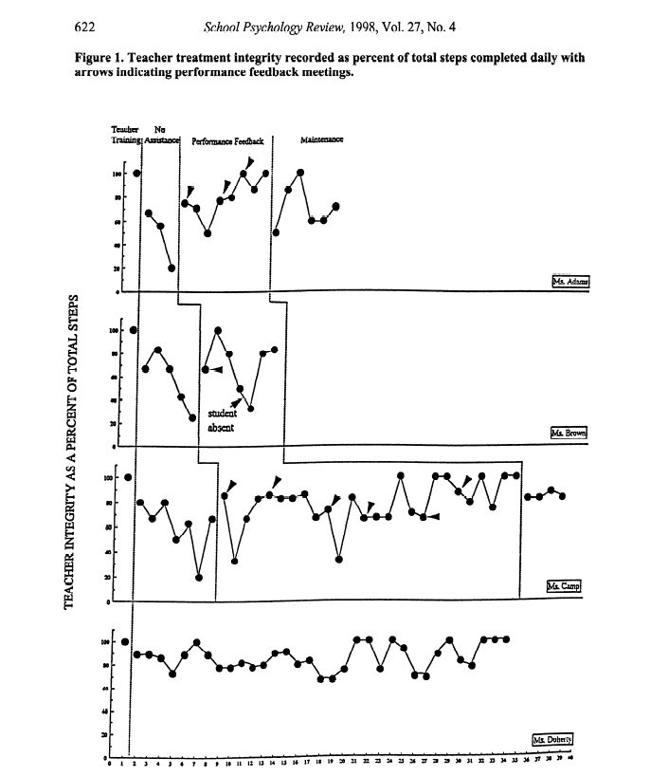
Mortenson & Witt, 1998

Slide 59
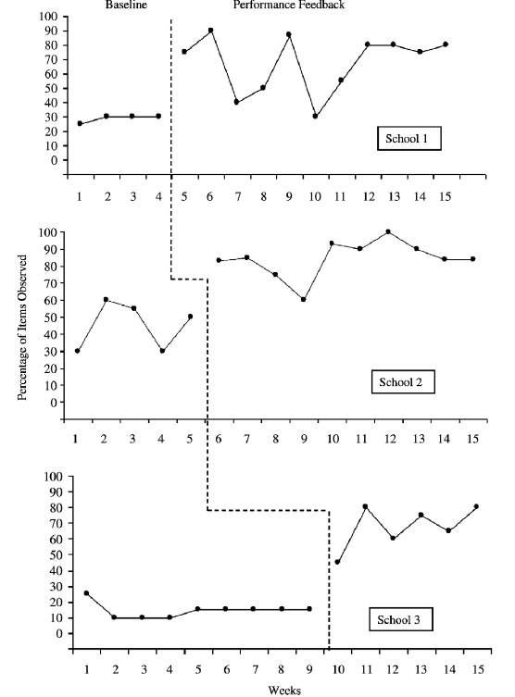

Slide 60
Effective Performance Feedback
More frequent the feedback the better the effects (Jones, Wickstrom, & Friman, 1997; Mortensen & Witt, 1998).
Daily better than weekly.
Immediate better than delayed.
Immediate more preferred than delayed.

Slide 61
Limitations of Performance Feedback
Usually requires direct observation.
May be too resource intensive to implement at large scale.
Would require significant restructuring to implement effectively.
Often has low acceptability ratings.
Nested in culture of feedback.
Non-evaluative-nothing ends up in personnel file.

Slide 62
Coaching
Similar to performance feedback.
Coach in classroom demonstrating, prompting, and giving feedback.
Limitations:
Resource intensive
Coaching requires specific skill set.
Not everyone can be effective coach.
Characteristics of effective coaching
Coach perceived as credible.
Focus on problem solving
Mutually agreed on goals.

Slide 63
Self Monitoring
Most often used to monitor adherence.
Discrete events (specific praise, opportunities to respond).
Accuracy may be improved by:
Rating immediately following instructional period.
Rating over shorter periods of time.
Reviewing video recordings.
Notes:
Add what we know about making self monitoring work
Delete methods for recording.

Slide 64
Quizzes
Quizzes (Detrich et al., unpublished)
Staff quizzed weekly on elements of multi-component individualized behavior support plans.
Given feedback on quiz but no feedback on actual implementation of support plan.
4 versions of the quiz. One question per element of the plan (student preferences, antecedent interventions, teaching replacement behavior, responding to misbehavior).

Slide 65
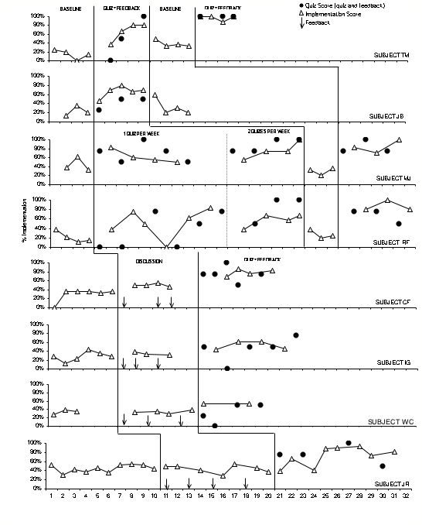

Slide 66
Quizzes
Advantages:
Easier to implement than performance feedback.
May be easy to implement at scale when standard protocols are utilized.
Limitations:
Does not produce maintenance effects in the absence of quizzes.

Slide 67
Matching Interventions to Context
Several authors have suggested good contextual fit between intervention and classroom may increase integrity (Albin, et al, 1998, Detrich, 1999, Riley-Tillman & Chafoulaes, 2003).
Change as little of the classroom routine as possible.
Build upon existing resources in classroom.

Slide 68
Allowing Implementers to Choose Intervention Elements
Often interventions are developed in top down approach.
Not all implementers equally able to implement all elements of an intervention.
Allowing choice from empirically-supported elements increased treatment integrity.
(Anderson & Daly)

Slide 69
Using Resources Wisely

Slide 70
It Takes a System

Slide 71
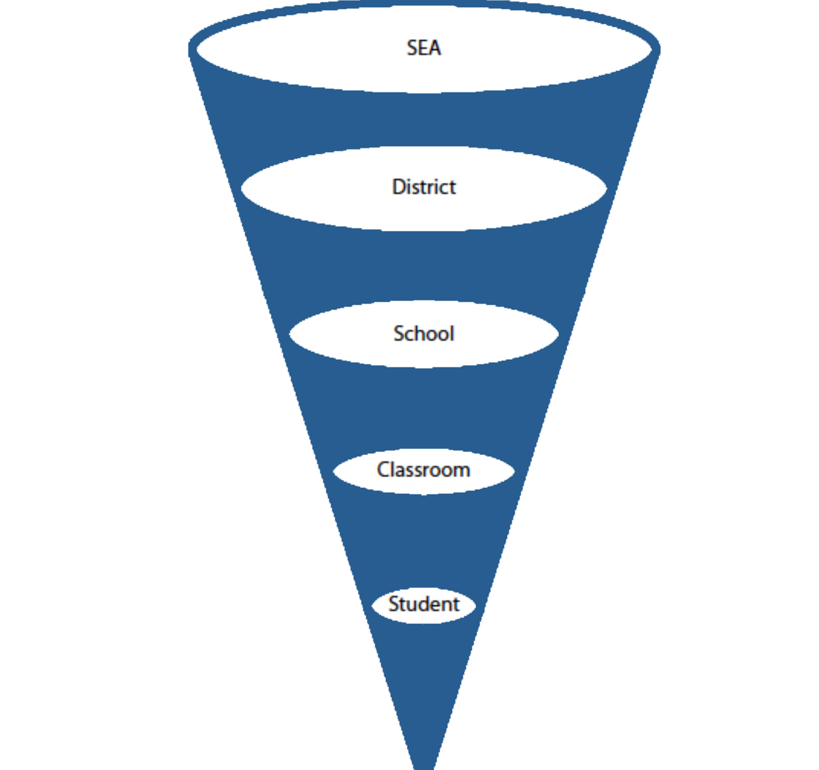


Notes:
Implementation is not just the responsibility of the classroom teacher. It is everyone’s responsibility.

Slide 72
Multi-tiered System of Support for Implementers
Not all implementers require same level of support to implement with integrity.
Provide only the support necessary to achieve effective implementation.

Slide 73



A Prevention Model for Evidence-based Education
Academic Systems
Behavioral Systems
Intensive, Individual Interventions
Individual Students
Assessment-based
High Intensity
Intensive, Individual Interventions
Individual Students
Assessment-based
Intense, durable procedures
1-5%
1-5%
Targeted Group Interventions
Some students (at-risk)
High efficiency
Rapid response
5-10%
5-10%
Targeted Group Interventions
Some students (at-risk)
High efficiency
Rapid response
Universal Interventions
All students
Preventive, proactive
80-90%
80-90%
Universal Interventions
All settings, all students
Preventive, proactive

Slide 74
Work Still to Do

Slide 75
Unresolved Issues
How much integrity is enough?
What is best way to assess different dimensions.
Adoption or adaptation?
Must we implement exactly as prescribed or can we adjust to fit local circumstances?

Slide 76
Unresolved Issues
What does this mean for treatment integrity?
Are adaptations systematic?
If so, then we can assess integrity.
What parts of program can we adapt without doing harm to effectiveness?
Core elements?
If adapted is program still research-based?
If teachers allowed to adapt then program more acceptable.
Teachers made better adaptation of reading programs if they were well grounded in principles. (Klingner, Vaughn, Hughes, & Arguellas, 1999).

Slide 77
Closing Thoughts
Assuring high levels of treatment integrity is an ethical responsibility.
High levels of treatment integrity necessary to benefit from empirically supported interventions.
There are emerging practices for increasing treatment integrity.
Improving treatment integrity requires efforts at all levels of the system.
Treatment integrity is everyone’s business

Slide 78
Thank you Copies may be obtained at winginstitute.org

