Slide 1
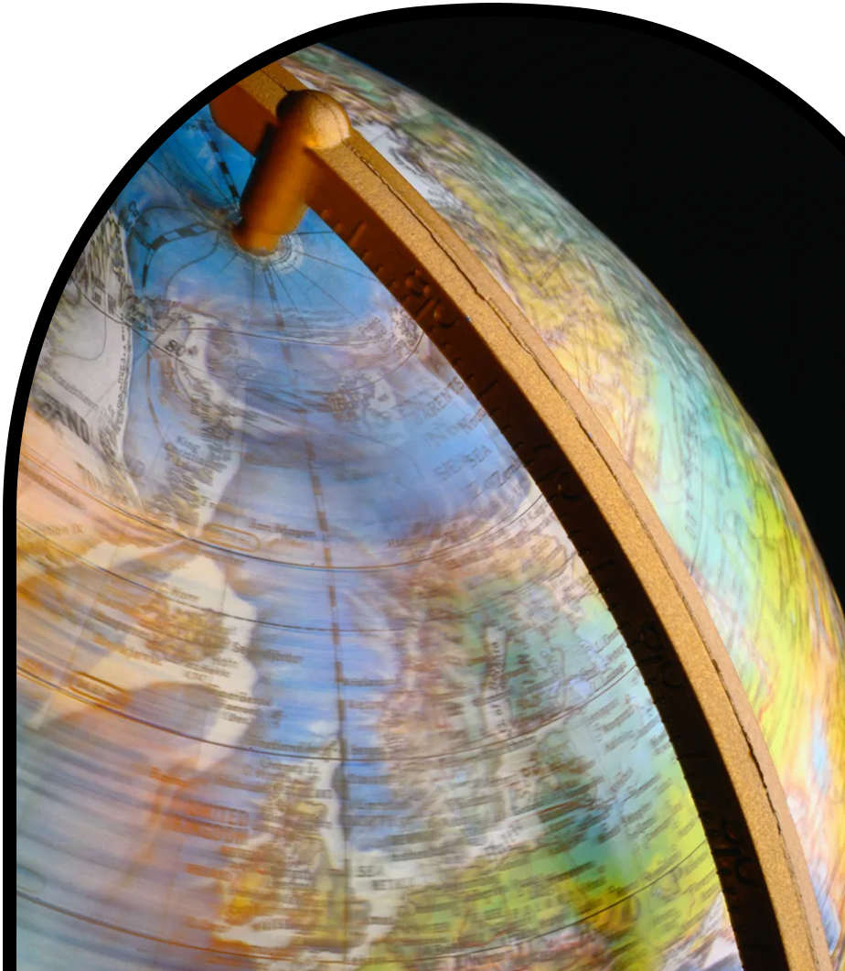
Anchor Layer Teacher Guide
A curriculum companion for Anchor Layer users
Grade 5
Earth & Space Patterns
Unit Web Link • Pacing Guide • Other Units

Slide 2
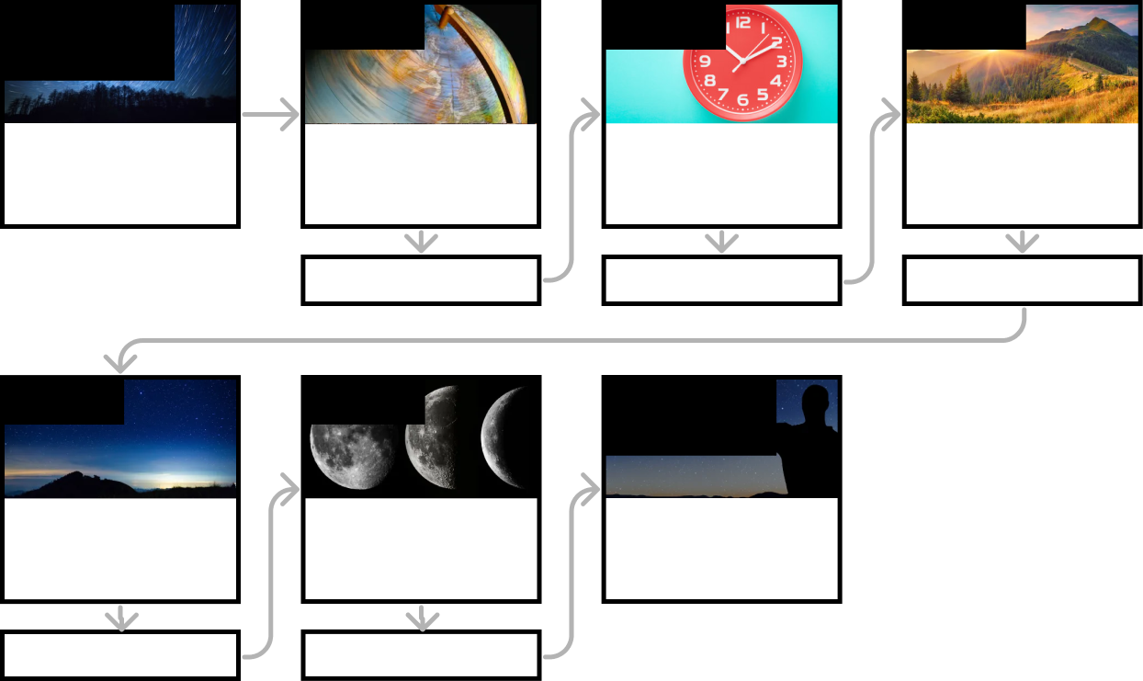
Earth & Space Patterns • Grade 5
Anchor Layer Teacher Guide
Unit Summary
In this unit, students explore patterns of the Earth, Sun, Moon, and stars. They investigate how shadows change throughout the day, how the Sun's position changes throughout the year, and how stars change throughout the seasons. They also create Earth, Sun, and Moon models to explore Moon patterns. Assessments
Performance Expectations | Science & Engineering Practices | Disciplinary Core Ideas | Crosscutting Concepts
• 5-ESS1-2. Represent data in graphical displays to reveal patterns of daily changes in length and direction of shadows, day and night, and the seasonal appearance of some stars in the night sky. | • Developing and Using Models • Using Mathematics and Computational Thinking • Planning and Carrying Out Investigations • Analyzing and Interpreting Data • Engaging in Argument from Evidence • Constructing Explanations and Designing Solutions | • ESS1.B: Earth and the Solar System | • Cause and Effect • Patterns
Anchor Phenomenon
Lesson 1
Lesson 2
Lesson 3
Sky Patterns & Modeling
Star Trails
Day, Night, & Earth’s Rotation
How fast does the Earth spin?
Earth’s Rotations & Daily Shadow Patterns
Who set the first clock?
Seasonal Changes & Shadow Length
How can the Sun tell you the season?
Anchor Connection
Anchor Connection
Anchor Connection
Lesson 4
Lesson 5
Performance Task
Seasonal Patterns & Earth’s Orbit
Why do the stars change with the seasons?
Moon Phases & Lunar Cycle
Why does the Moon change shape?
Night Sky
How can you tell time at night?
Anchor Connection
Anchor Connection
‹#›

Slide 3
Earth & Space Patterns • Grade 5
Anchor Layer Teacher Guide
Anchor Phenomenon Background
What causes the patterns found in star trails?
Why circles?
The Earth’s rotation makes the stars appear to move each night, even though they are stationary and we are on a rotating Earth! In the Northern Hemisphere, star trails make concentric circles, almost centering on the North Star. If you look to the side and spin around, you can see why this is. When you spin, pictures on the walls go in and out of view. But if you look straight up, you can always see the ceiling as you spin around. The Earth’s axis, the imaginary line around which the planet spins, points north. Looking north is like looking up when you are standing on your feet and spinning.
Time and the Stars
Star trails are just one example of how what we see in the sky reveals the movements of our solar system — patterns that people have used for thousands of years to keep track of the time of day and the time of year.
In this unit, you’ll see many other examples. The period from sunrise to sunrise — the time it takes for the Earth to complete one rotation — is the length of a day.
A sundial uses shadows cast by the Sun to divide that day into hours. The Sun’s path changes with the seasons, which is why your sundial includes an adjustment for the time of year. Seasons are also marked by changes in the constellations that can be seen in the night sky, which provides evidence that the Earth orbits the Sun. The Moon’s phases helped set the length of the month. The clocks and calendars that we use each day reflect the movements in the sky.
The Big Picture
Thinking about astronomy and time can lead you to think about other ways to keep track of time here on Earth. You can use a sundial to mark time during the day, but how could you keep track of time at night?
This may also lead to interesting discussions about time-keeping on other planets, where the day and year are different from those on Earth. What challenges would you face if you wanted to keep track of time on Mars, where the day is a little longer than ours, but the year is almost twice as long?
‹#›

Slide 4
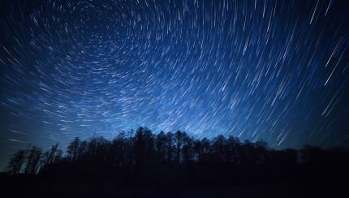
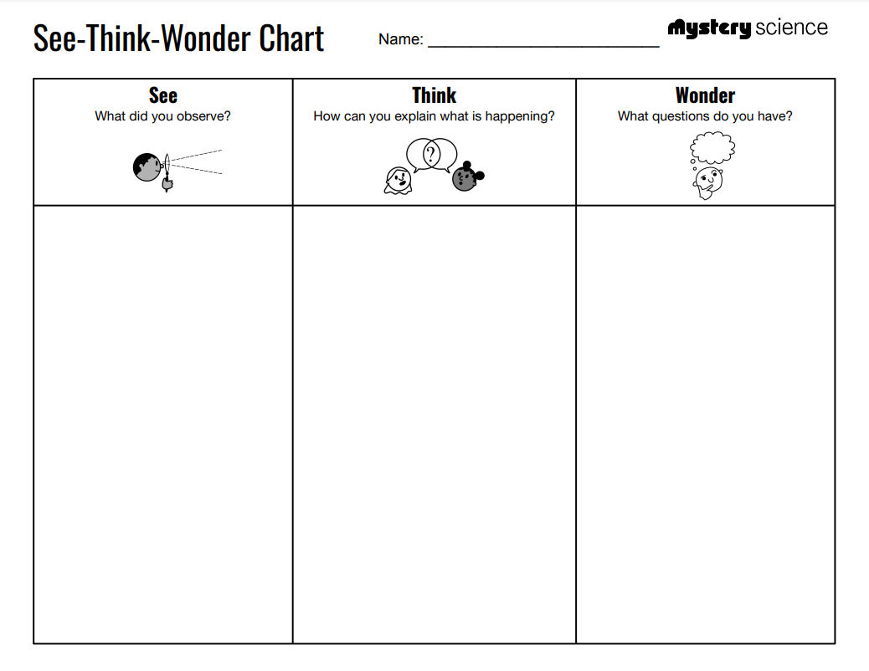
Earth & Space Patterns • Grade 5
Anchor Layer Teacher Guide
Anchor Phenomenon: Star Trails
Sky Patterns & Modeling
Anchor Phenomenon Lesson Overview
Note: This lesson is part of this unit’s Anchor Layer. If you have the Anchor Layer turned on, we recommend teaching all lessons in the remainder of this unit in order.
The anchor phenomenon for this unit is star trails that appear in long-exposure photographs. Students generate observations and questions about the phenomenon and create an initial model to explain what causes these patterns to form.
Anchor Phenomenon 13 mins
Guided Inquiry 30 mins
Hands-On Activity 30 mins
Wrap-Up 2 mins
Student Work Samples & Notes
It is important to encourage students to recognize that even if they don't know the full answer yet, they are going to learn a lot throughout the unit to help them explain the phenomenon and that they'll have an opportunity to change or add to their first model.
There are streaks of light instead of individual stars.
The streaks are in the pattern of circles.
The circles seem to move around one dot in the center of the sky.
You can see the entire path of the circles in the middle, but not on the outside.
Some streaks are brighter than others.
The bright streaks might be moving stars.
The camera’s shutter was open for 25 minutes so it captured the movement of the stars. It is similar to a blurry photo when the subject moves in it.
The Earth is rotating slowly but the stars are staying still.
How would the pattern change depending on how long the camera’s shutter stayed open?
Why can’t we see streaks with our eyes?
Do stars change positions in the sky?
Do other objects (Sun, Moon, planets) in the sky make trails like this?
‹#›

Slide 5
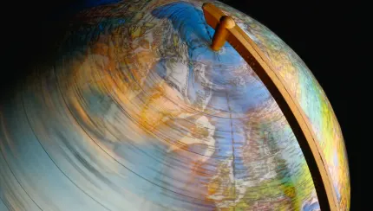
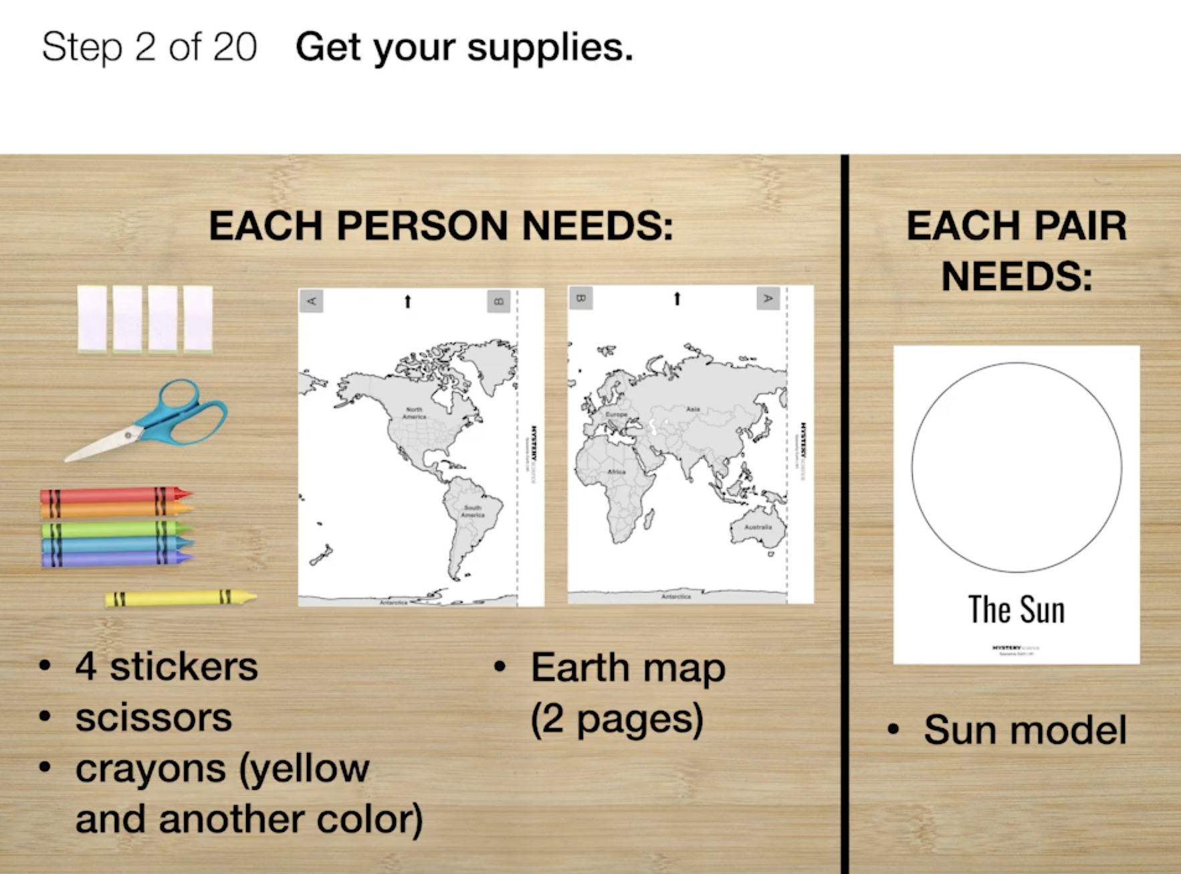
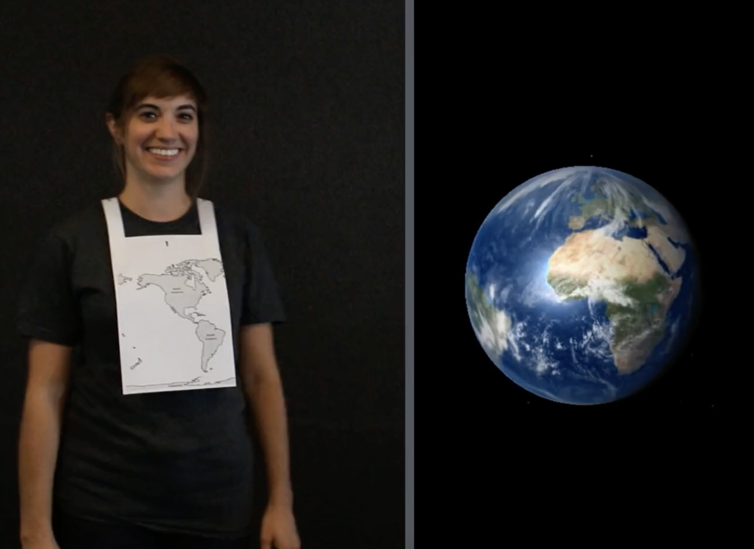
Earth & Space Patterns • Grade 5
Anchor Layer Teacher Guide
Lesson 1: How fast does the Earth spin? (pg 1 of 2)
Day, Night, & Earth’s Rotation
Overview
In this lesson, students come to understand that the setting Sun isn’t moving, the Earth is spinning.
In the activity, Spinning Earth, students use their bodies as a kinesthetic model of the Earth to understand how the speed of the Earth’s spin affects the length of a day.
Exploration 15 mins
Hands-On Activity 30 mins
Wrap-Up 5 mins
Anchor Connection 30 mins
Assessment 25 mins
Activity Notes
We suggest students work in pairs.
All students will be standing up and spinning in place throughout the activity with a place to view their paper Sun model.
We find that placing the Sun model on a desk and standing about a foot behind the desk works well.
If you have a lamp or bright light, you can also use this as a model for the Sun. Just remind students NOT to look directly at the bulb.
Anchor Connection on Next Page
‹#›

Slide 6
Earth & Space Patterns • Grade 5
Anchor Layer Teacher Guide
Lesson 1: How fast does the Earth spin? (pg 2 of 2)
Day, Night, & Earth’s Rotation
Anchor Connection
It certainly looks as though many objects move in the sky and it certainly feels as though we are not moving here on Earth. However, we have a great deal of evidence that the opposite is true! The Earth is constantly rotating.
The Earth completes one rotation roughly every 24 hours. This causes the Sun to appear to move across the sky, even though it is actually the Earth that is rotating.
Students revisit the explanation and/or drawings that they worked on during the Anchor Phenomenon. They should understand that the Earth is rotating, and that rotation is what causes the Sun to appear to move in the sky. The Sun doesn’t move—we do!
Students can update their explanations and/or drawings by:
Adding sunlight shining toward the Earth (can be done with rays or
shading)
Shading the side of the Earth facing away from the Sun to show that side as being in darkness/nighttime
Adding a curved arrow to show the tilted spin of the Earth
Connecting Storyline Question
Why do the stars appear to move in the same pattern as the Sun?
Exploration 15 mins
Hands-On Activity 30 mins
Wrap-Up 5 mins
Anchor Connection 30 mins
Assessment 25 mins
‹#›

Slide 7
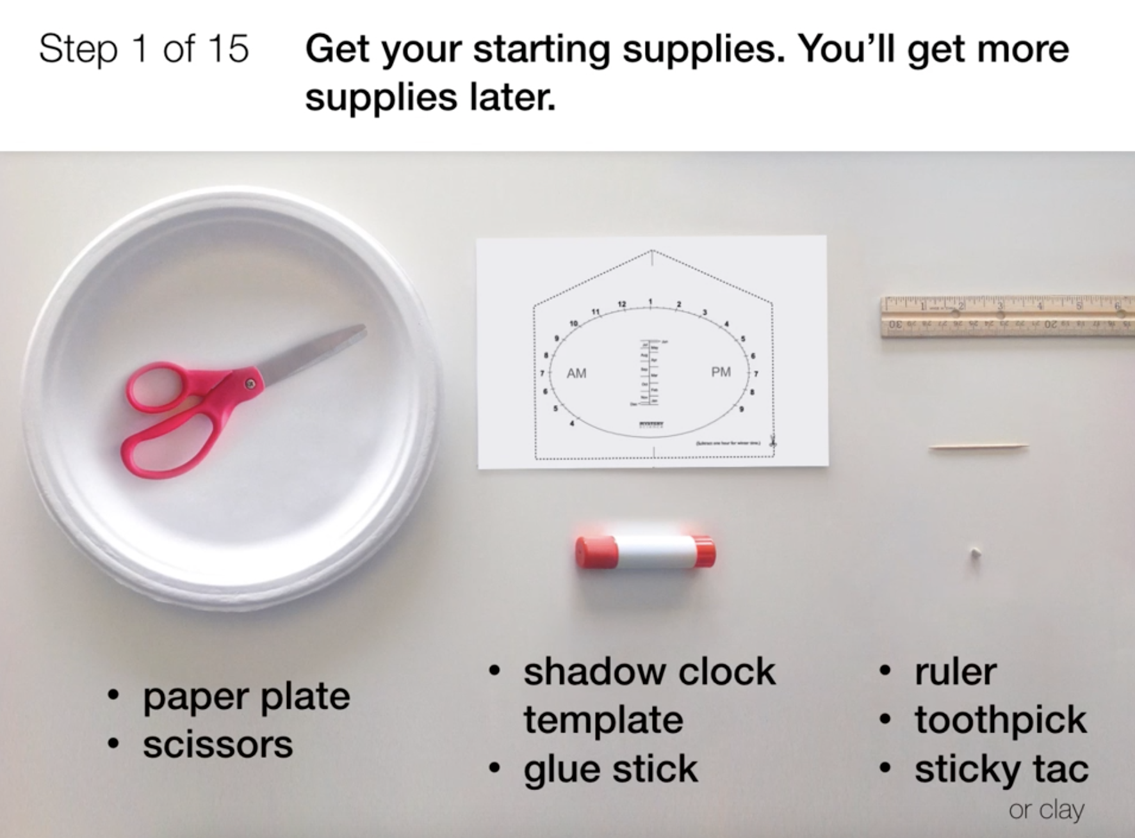
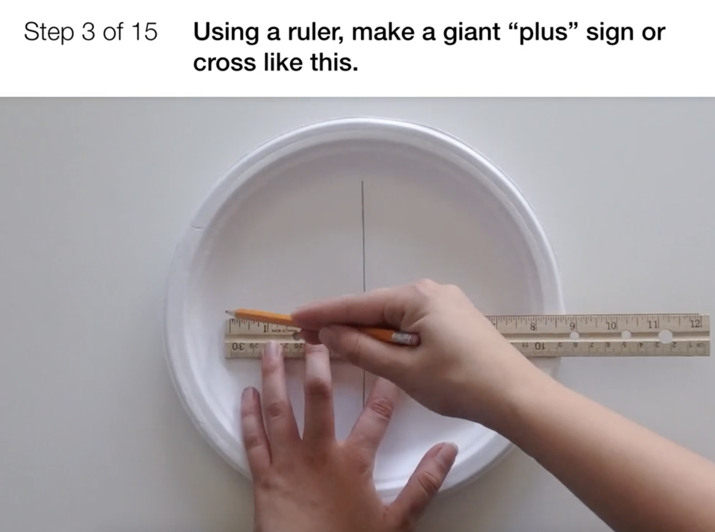
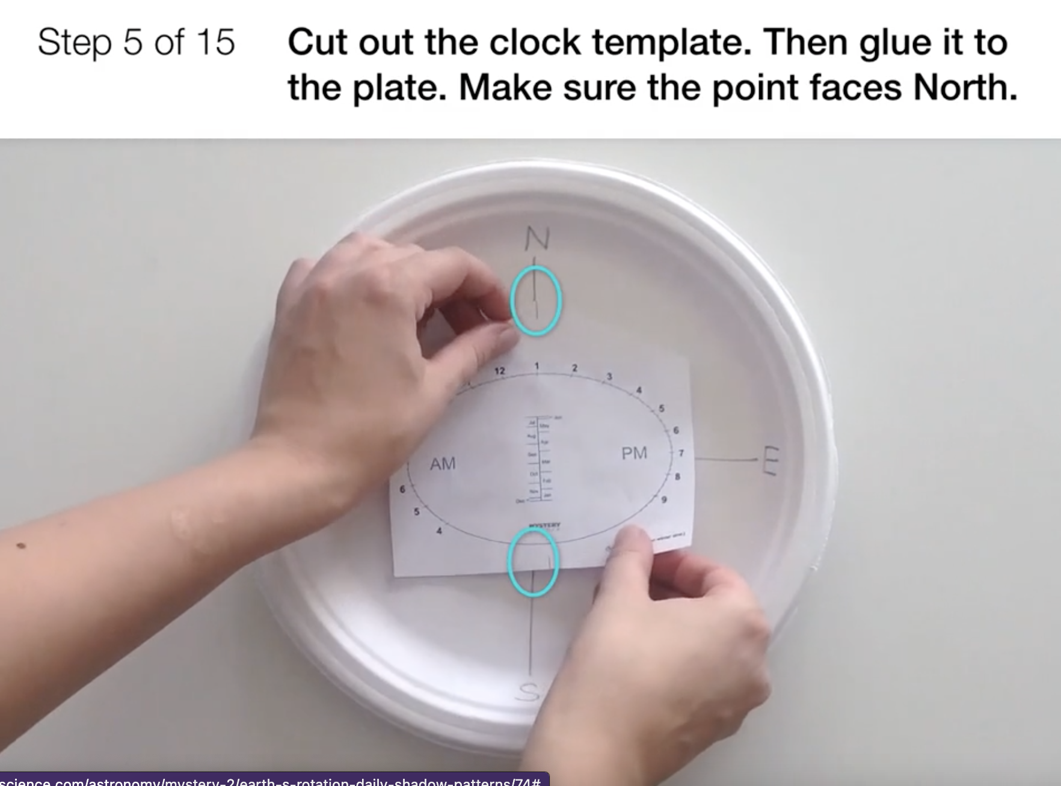
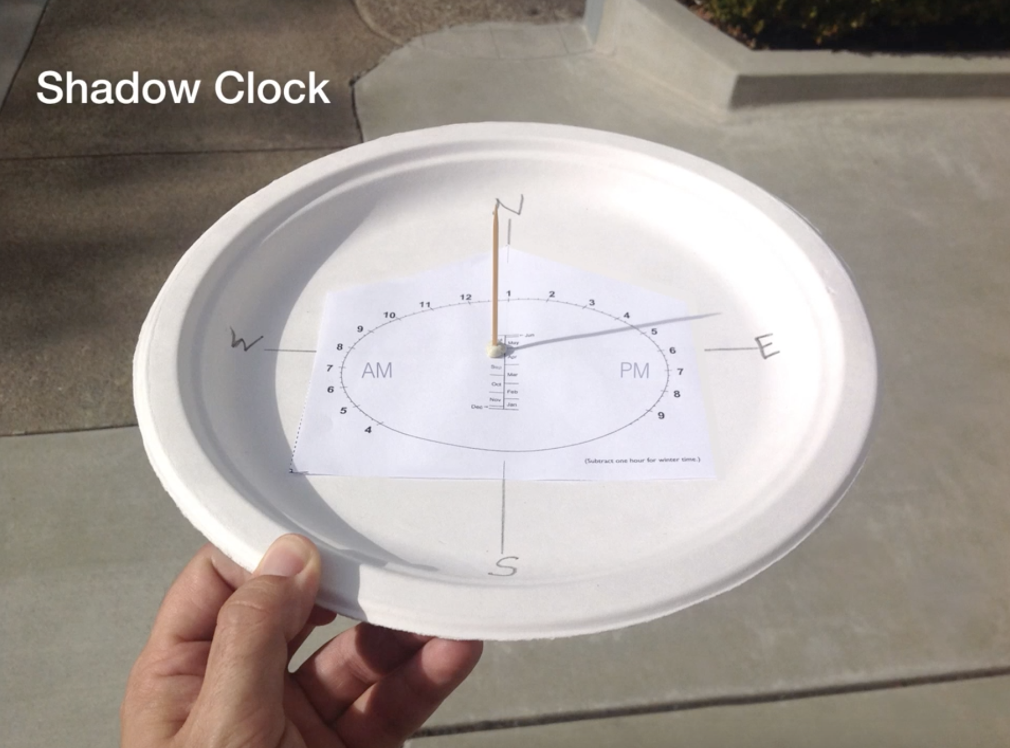
Earth & Space Patterns • Grade 5
Anchor Layer Teacher Guide
Lesson 2: Who set the first clock? (pg 1 of 2)
Earth’s Rotations & Daily Shadow Patterns
Overview
In this lesson, students will learn why our ancestors divided the day into hours and how clocks measure the Sun’s apparent movement.
In the activity, Make a Shadow Clock, students make their own sundials. First, students use flashlights indoors to understand how the position of the light affects the time shown on the clock. Then, students take their shadow clocks outside to see how the position of the Sun can tell them the time of day.
Exploration 20 mins
Hands-On Activity 25 mins
Anchor Connection 30 mins
Assessment 25 mins
Activity Notes
We suggest students work in pairs. Each Shadow Clock printout has two templates on it. Once you print these out, cut each in half so that each student will have one. Label classroom walls with cardinal directions — North, South, East, West. When students are experimenting in the classroom, they need to orient their Shadow Clocks so the arrow points North.
The main activity is completed indoors, but we recommend that students test their Shadow Clocks outside on a sunny day. They’ll need to orient their Shadow Clock with the arrow pointing North. We recommend that you sketch several compass roses on the ground in chalk to serve as workstations. The easiest way to find exact North when you are outside is to use a Shadow Clock. Turn the shadow clock to match the current time. Now the compass rose you made on the Shadow Clock will be properly oriented.
A magnetic compass, whether an old-fashioned kind or those available on many smartphones (such as iPhone’s compass app), actually points toward the Earth’s magnetic North Pole, which is slightly off from the geographic North Pole, depending on where you are. It may cause some error, depending on your location.
Anchor Connection on Next Page
‹#›

Slide 8
Earth & Space Patterns • Grade 5
Anchor Layer Teacher Guide
Lesson 2: Who set the first clock? (pg 2 of 2)
Earth’s Rotations & Daily Shadow Patterns
Anchor Connection
The stars appear to move across the sky at night for the same reason the Sun does during the day: the Earth is constantly rotating. Most stars appear to rise in the east and set in the west, just like the Sun does. Some stars stay visible throughout the night, though. They don’t appear to rise and set at all. They appear to just move in circles.
Students revisit the explanation and/or drawings that they worked on during the Anchor Phenomenon. They should understand that just like the Sun, the stars appear to rise in the east and set in the west due to the Earth’s rotation. The stars don’t move—we do!
Students can update their explanations and/or drawings by:
Labeling which directions are East and West in the view looking North
Adding that the stars rise in the East and set in the West, just like the Sun
Writing any thoughts about how stars might be used to tell time at night
Writing any new thoughts they have that might explain why the star trails look the way that they do
Connecting Storyline Question
Do the stars always appear to move the same way the Sun does?
Exploration 20 mins
Hands-On Activity 25 mins
Anchor Connection 30 mins
Assessment 25 mins
‹#›

Slide 9
Earth & Space Patterns • Grade 5
Anchor Layer Teacher Guide
Lesson 3: How can the Sun tell you the season? (pg 1 of 2)
Seasonal Changes & Shadow Length
Overview
In this lesson, students discover how the Sun’s path changes with the seasons.
In the visual activity, Guess the Season, students figure out the season of the year by studying a photo. Students come to realize that they can use the time of day and length of shadows to figure out the season in each photo.
Exploration 20 mins
Hands-On Activity 25 mins
Anchor Connection 30 mins
Assessment 25 mins
Activity Notes
This activity does not require supplies.
Each photo has an obvious clue related to the season — like ripe pumpkins for autumn or snow for winter. Students will recognize those clues immediately.
But each photo also includes the time it was taken. Using the time and the Sun’s position, students can figure out the season using astronomical clues — like the length of the day (long in summer, short in winter) or the time of sunrise (early in summer, late in winter).
In the class discussion that follows each photo, you may need to prompt students to notice the time on the photo and think about what the time says about the season. Reviewing the questions and answers before class will help you prepare to facilitate class discussion.
Anchor Connection on Next Page
‹#›

Slide 10
Earth & Space Patterns • Grade 5
Anchor Layer Teacher Guide
Lesson 3: How can the Sun tell you the season? (pg 2 of 2)
Seasonal Changes & Shadow Length
Anchor Connection
The Sun appears to travel in a higher path in the summer, making the days longer and the nights shorter because sunrise happens earlier and sunset happens later. In the winter, the Sun appears to follow a lower path, leading to fewer hours of sunlight because it rises and sets later. Shadow clocks can account for the different paths the Sun follows by changing where the pointer in the center is placed.
Students revisit the explanation and/or drawings that they worked on during the Anchor Phenomenon. They should understand that during the Summer, the length of time that the Sun is visible each day is longer and the length of time the stars are visible each night is shorter. The opposite is true in the winter.
Students can update their explanations and/or drawings by:
Adding any ideas they have about how the stars could be used to determine when it’s the middle of the night
Note: Students might not necessarily add much to their worksheet at the end of this lesson. Use this time to reinforce that the Earth is rotating and the stars are stationary in the “View of the Earth from space” on their worksheet. Ask them to think about how us being on a rotating Earth might cause the stars to appear to move in the “View of the night sky from Earth,” even though the stars are staying still.
Connecting Storyline Question
Do the stars change from season to season? If so, why? If not, why not?
Exploration 20 mins
Hands-On Activity 25 mins
Anchor Connection 30 mins
Assessment 25 mins
‹#›

Slide 11
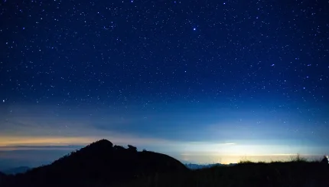
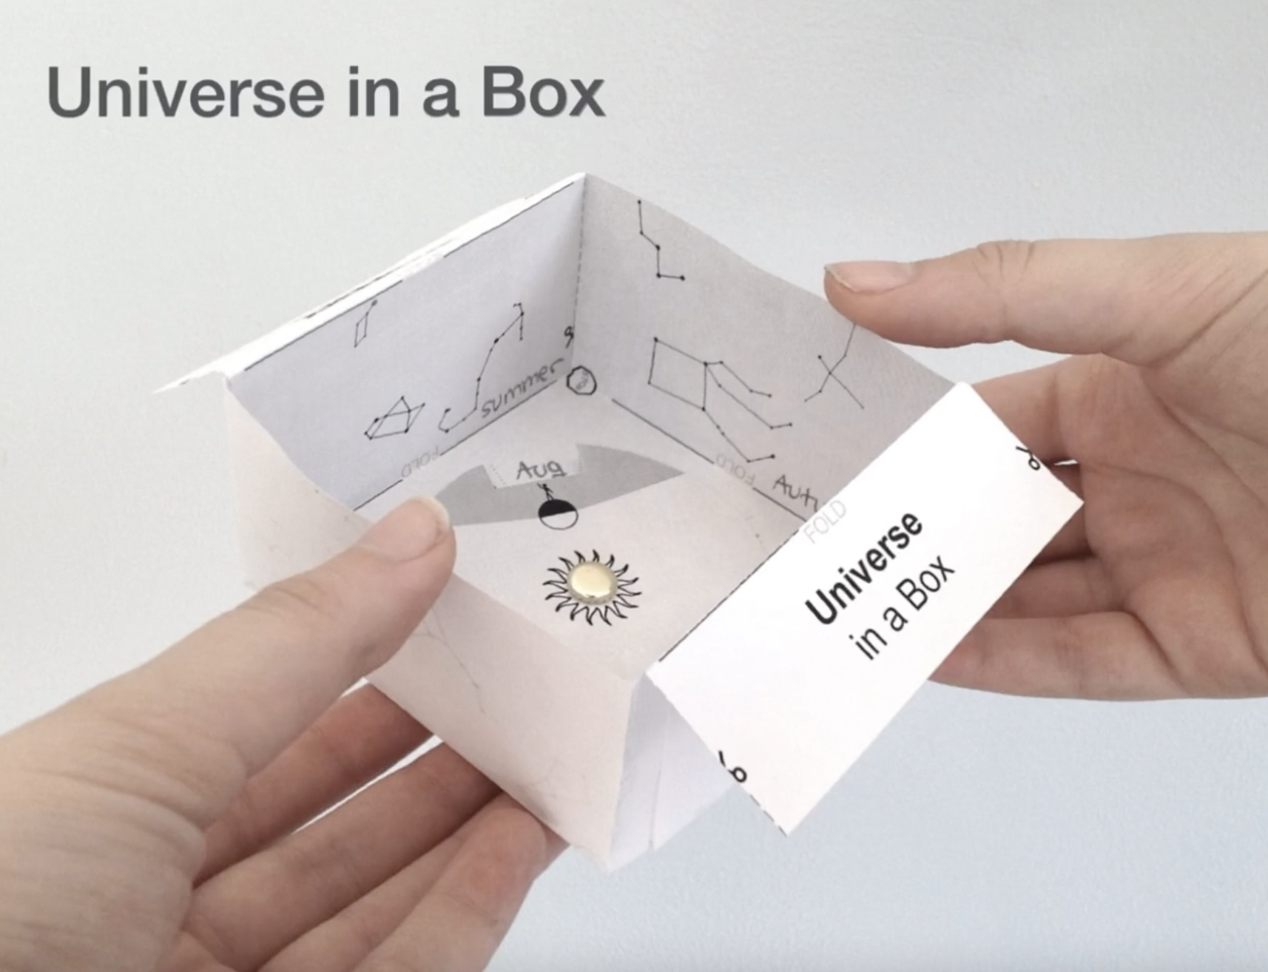
Earth & Space Patterns • Grade 5
Anchor Layer Teacher Guide
Lesson 4: Why do the stars change with the seasons?
Seasonal Patterns & Earth’s Orbit (pg 1 of 2)
Overview
In this lesson, students will be introduced to the Earth’s orbital movement around the Sun, as a means of seeing why the constellations change.
In the activity, Universe-in-a-Box, students make a paper model that helps them visualize the Earth’s yearly orbit around the Sun. They use this model to understand why some constellations are only visible during part of the year.
Anchor Connection
If you stand up and spin, pictures on the walls go in and out of view, but if you look up, you can always see the ceiling. This is similar to what happens when we look at the North Star. Imagine that the North Star is on the ceiling above the axis that the Earth spins around, and the stars around the Earth in other directions come in and out of view. Note: We suggest offering students a new worksheet at this point, but you should feel free to give students a new sheet (or not) at any point throughout this unit.
Students revisit the explanation and/or drawings that they worked on during the Anchor Phenomenon. They should understand that while many stars do change from season to season, the stars near the North Star don’t. This is because the North Pole is aimed very close to the North Star, and this part of the night sky is visible throughout the year.
Exploration 20 mins
Hands-On Activity 25 mins
Anchor Connection 30 mins
Assessment 25 mins
Activity Notes
This activity requires a printable, scissors, and fasteners. You do not need to prep the supplies before class.
Anchor Connection Notes Continued on Next Page
‹#›

Slide 12
Earth & Space Patterns • Grade 5
Anchor Layer Teacher Guide
Lesson 4: Why do the stars change with the seasons?
Seasonal Patterns & Earth’s Orbit (pg 2 of 2)
Anchor Connection Notes Continued
Students can update their explanations and/or drawings by:
Connecting the stars that make up the Big and Little Dippers and labeling the North Star
Showing that stars (and the constellations they make up) appear to rise in the East and set in the West
Explaining that stars appear to form trails in the sky because we are on a rotating Earth, and stars only appear to spin around the North Star because our own rotation is centered around an imaginary line pointed close to that star
Connecting Storyline Question
Is there anything else in the sky that we can use to tell time? What about the Moon?
Exploration 20 mins
Hands-On Activity 25 mins
Anchor Connection 30 mins
Assessment 25 mins
‹#›

Slide 13
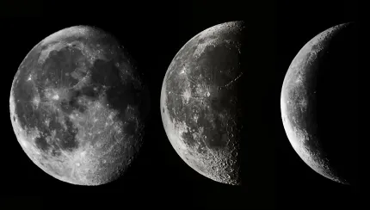
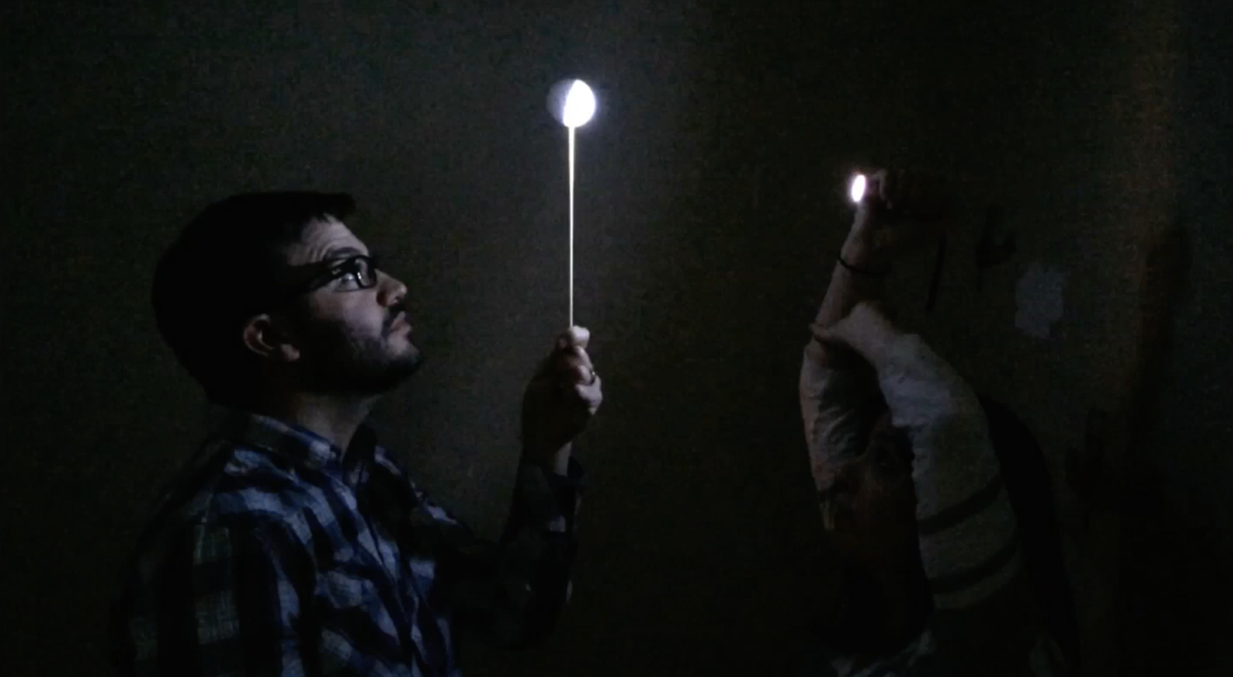
Earth & Space Patterns • Grade 5
Anchor Layer Teacher Guide
Lesson 5: Why does the Moon change shape? (pg 1 of 2)
Moon Phases & Lunar Cycle
Overview
This lesson explores why the Moon seems to change shape (phases) over the course of a month.
In the activity, Model the Moon's Phases, students use a styrofoam ball as a model of the Moon and a flashlight as a model of the Sun to gain a better understanding of how the interactions between the Sun and Moon are responsible for the Moon’s phases.
Exploration 13 mins
Hands-On Activity 25 mins
Wrap-Up 7 mins
Anchor Connection 30 mins
Assessment 25 mins
Activity Notes
We suggest students work in pairs.
It is important to get your room as dark as possible! It's worth taking the time to black out your windows and even tape curtains to eliminate cracks of light. Also, the brighter your flashlights, the better the demonstration. The flashlights we link to are particularly bright and inexpensive.
Anchor Connection on Next Page
‹#›

Slide 14
Earth & Space Patterns • Grade 5
Anchor Layer Teacher Guide
Lesson 5: Why does the Moon change shape? (pg 2 of 2)
Moon Phases & Lunar Cycle
Anchor Connection
A full Moon can be used to tell the time at night because it will always be directly opposite the Sun from our perspective. Full Moons rise when the Sun sets, set when the Sun rises, and are at the highest point in the sky in the middle of the night--exactly opposite the Sun! When the Moon is in other phases, it is not opposite the Sun in the Sky, so we see it as partially in shadow.
Students revisit the explanation and/or drawings that they worked on during the Anchor Phenomenon. They should understand that the full Moon rises at sunset and sets at sunrise. Just as the Sun is always highest in the sky in the middle of the day, the Moon is always highest in the sky in the middle of the night.
Students can update their explanations and/or drawings by:
Shading the Moon just like they shaded the Earth after lesson 1
Describing what they would see if they were standing on the dark side of the Earth in the second view of their worksheet (they would see a half-illuminated Moon)
Connecting Storyline Question
We’ve talked about the Sun, the Moon, and the stars. Can I see other planets in the sky?
Exploration 13 mins
Hands-On Activity 25 mins
Wrap-Up 7 mins
Anchor Connection 30 mins
Assessment 25 mins
‹#›

Slide 15
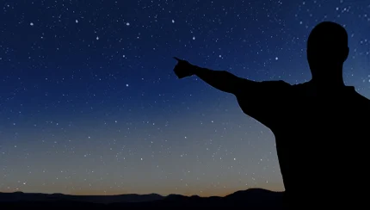
Earth & Space Patterns • Grade 5
Anchor Layer Teacher Guide
Performance Task: How can you tell time at night?
Night Sky
Overview
In the Performance Task, students use engineering design principles to invent a clock that uses patterns in the night sky. They evaluate possible patterns, suggest multiple ways to measure time with those patterns, and describe their final design and how it works.
Unit Review 20 mins
Hands-On Activity 40 mins
Performance Task Notes
Print one Time-Keeper Challenge for each person.
Crosscutting Concepts
Cause and Effect: Observed patterns in the movement of objects in space prompt questions about the causes underlying them.
Engineering Design: Building on observations and scientific knowledge, students propose and evaluate possible solutions to a problem.
‹#›

