Slide 1


Mystery Science Alignment with Missouri Science Standards
Mystery Science is a hands-on curriculum that aligns with the Missouri Learning Standards for Science (2016).
Mystery Science’s units of study contain:
Hands-on, easy-prep activities with EVERY lesson
Engaging, real-world investigative phenomena
Thoughtful discussions to build background knowledge
Lesson & unit assessments to evaluate comprehension
Curated, cross-curricular extensions
Mystery Science also offers the Anchor Layer, which enriches the unit with an anchor phenomenon, incorporates anchor connections after each lesson, & concludes the unit with a performance task.
Updated 06/14/2025

Slide 2
Missouri Standards Alignment
Table of Contents
Kindergarten
Life Science Animal Needs Plant Needs Earth & Space Science Weather Patterns Physical Science Sunlight & Warmth Light, Sound, & Communication Pushes & Pulls | Page 3 Page 5 Page 6
1st Grade
Life Science Animal Traits & Survival Plant Traits & Survival Earth & Space Science Day Patterns Night Patterns Severe Weather Physical Science Light, Sound, & Communication | Page 9 Page 11 Page 14
2nd Grade
Life Science Plant Growth & Interactions Earth & Space Science Erosion & Earth’s Surface Physical Science Material Properties | Page 15 Page 16 Page 18
3rd Grade
Life Science Animal Biodiversity Fossil & Changing Environments Life Cycles Heredity, Survival, & Selection Earth & Space Science Weather & Climate Physical Science States of Matter Forces, Motion, & Magnets | Page 20 Page 24 Page 25
4th Grade
Life Science Human Body, Vision, & The Brain Animal & Plant Adaptations Earth & Space Science Earth’s Features & Processes Physical Science Forces, Motion, & Magnets Energy & Energy Transfer Electricity, Light, & Heat Sound, Waves, & Communication | Page 26 Page 28 Page 29
5th Grade
Life Science Human Body, Vision, & The Brain Ecosystems & The Food Web Earth & Space Science Water Cycle & Earth’s Systems Earth & Space Patterns Stars & Planets Physical Science Chemical Reactions & Properties of Matter | Page 33 Page 36 Page 39
www.mysteryscience.com/docs/missouri

Slide 3

Missouri Standards Alignment
Kindergarten - Life Science
Animal Needs Animal Secrets)
 | Topic & Guiding Question | Student Objectives | Missouri Learning Standards for Science 2016
Lesson 1 | Animal Needs: Food Why do woodpeckers peck wood? | Students obtain information through virtual observations of different animal behaviors. They use this evidence to explain that one of the basic needs of animals is food. | K.LS1.C.1 Use observations to describe patterns of what plants and animals (including humans) need to survive.
Lesson 2 | Animal Needs: Shelter Read-Along Where do animals live? | Students obtain information through media about how different animal homes are built. They use this evidence to explain that animals need shelter. | K.ESS3.A.1 Use a model to represent the relationship between the needs of different plants and animals (including humans) and the places they live.
Lesson 3 | Animal Needs: Safety How can you find animals in the woods? | Students obtain information through virtual observations of different animal behaviors. They use this evidence to explain that one of the basic needs of animals is shelter. | K.LS1.C.1 Use observations to describe patterns of what plants and animals (including humans) need to survive.
Lesson 4 | Animals & Changing the Environment Read-Along How do animals make their homes in the forest? | Students take a nature walk to look for evidence of animal homes. | K.ESS2.E.1 With prompting and support, construct an argument using evidence for how plants and animals (including but not limited to humans) can change the environment to meet their needs.
Lesson 1
Lesson 2
Lesson 3
Lesson 4
www.mysteryscience.com/docs/missouri

Slide 4
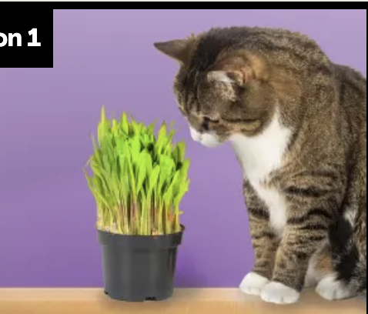
Missouri Standards Alignment
Kindergarten - Life Science
Plant Needs (Plant Secrets)
 | Topic & Guiding Question | Student Objectives | Missouri Learning Standards for Science 2016
Lesson 5 | Living & Nonliving Are plants alive? | Students make observations of plants in order to identify their needs and that they are, in fact, living things. | K.LS1.C.1 Use observations to describe patterns of what plants and animals (including humans) need to survive.
Lesson 6 | Plant Needs: Water & Light How do plants and trees grow? | Students investigate to determine the basic needs of plants. They observe to identify ways young plants resemble the parent plant and how the plant changes as it proceeds through its life cycle. | K.LS1.C.1 Use observations to describe patterns of what plants and animals (including humans) need to survive.
Lesson 7 | Human Impacts on the Environment Read-Along Why would you want an old log in your backyard? | Students obtain evidence of living organisms by virtually keeping watch of a log and the living things that visit it. | K.ESS3.C.1 Communicate solutions that will reduce the impact of humans on the land, water, air, and/or other living things in the local environment.
Lesson 1
Lesson 2
Lesson 3
www.mysteryscience.com/docs/missouri

Slide 5

Missouri Standards Alignment
Kindergarten - Earth & Space Science
Weather Patterns (Circle of Seasons)
 | Topic & Guiding Question | Student Objectives | Missouri Learning Standards for Science 2016
 | Daily Weather Patterns Read-Along How do you know what to wear for the weather? | Students track the weather daily and analyze the data by collecting, recording, and sharing their observations to observe patterns of weather changing throughout the day and from day-to-day. | K.ESS1.D.1 Use and share observations of local weather conditions to describe patterns over time.
 | Seasonal Weather Patterns What will the weather be like on your birthday? | Students evaluate information in a series of unnamed drawings of each season. They use these clues to identify characteristics of each season and describe the yearly cyclical pattern. | K.ESS1.D.1 Use and share observations of local weather conditions to describe patterns over time.
 | Animals Changing Their Environment Why do birds lay eggs in the spring? | Students identify the reasons why birds lay eggs in the spring. Then, they develop a bird nest model and use this model as evidence for how animals can change the environment to meet their needs. | K.ESS2.E.1 With prompting and support, construct an argument using evidence for how plants and animals (including but not limited to humans) can change the environment to meet their needs.
Lesson 1
Lesson 2
Lesson 3
www.mysteryscience.com/docs/missouri

Slide 6

Missouri Standards Alignment
Kindergarten - Physical Science
Sunlight & Warmth (Sunny Skies)
 | Topic & Guiding Question | Student Objectives | Missouri Learning Standards for Science 2016
 | Sunlight, Heat, & Earth’s Surface Read-Along How could you walk barefoot across hot pavement without burning your feet? | Students make observations of the pavement heating up after being warmed by the Sun. Then, they design a solution to build a shade structure that can reduce the warming effect of sunlight. | K.PS3.A.1 Make observations to determine the effect of sunlight on Earth’s surface. K.PS3.B.1 With prompting and support, use tools and materials to design and build a structure that will reduce the warming effect of sunlight on an area.
 | Sunlight, Warming, & Engineering How could you warm up a frozen playground? | Students carry out an investigation to test which materials can redirect the light and heat of sunlight. (*This lesson has students increase the warming effect of sunlight on an area.) | K.PS3.A.1 Make observations to determine the effect of sunlight on Earth’s surface. K.PS3.B.1 With prompting and support, use tools and materials to design and build a structure that will reduce the warming effect of sunlight on an area. K.ETS1.A.1 Ask questions, make observations, and gather information about a situation people want to change to define a simple problem that can be solved through the development of a new or improved object or tool. K.ETS1.B.1 Develop a simple sketch, drawing, or physical model to illustrate how the shape of an object helps it function as needed to solve a given problem.
 | Sunlight & Warmth Why does it get cold in winter? | Students construct an explanation for why marshmallows melt in one car and not in another car. Then, they conduct a virtual investigation to determine that the warmth of the Sun is the cause of the melted marshmallows. | K.PS3.A.1 Make observations to determine the effect of sunlight on Earth’s surface. K.PS3.B.1 With prompting and support, use tools and materials to design and build a structure that will reduce the warming effect of sunlight on an area. K.ESS1.B.1 Make observations during different seasons to relate the amount of daylight to the time of year.
Lesson 1
Lesson 2
Lesson 3
www.mysteryscience.com/docs/missouri

Slide 7

Missouri Standards Alignment
Kindergarten - Physical Science
Missouri Standards Alignment
Kindergarten - Life Science
This unit is found under 1st Grade on our site, but we recommend teaching some lessons in Kindergarten if you are following Missouri Standards.
Light, Sound, & Communication (Lights & Sounds)
 | Topic & Guiding Question | Student Objectives | Missouri Learning Standards for Science 2016
 | Light, Materials, Transparent & Opaque What if there were no windows? | Students investigate the properties of different materials that they can and cannot see through. Then they create a stained glass window using tissue paper to explore how materials interact with light. | K.PS1.A.1 Make qualitative observations of the physical properties of objects (i.e. size, shape, color, mass).
 | Light & Illumination Read-Along Can you see in the dark? | Students look inside a completely dark box to determine if they can see the shape of the object inside. They allow more light into the box to illuminate the object and allow them to see it. Students use their observations explain that objects need light to be seen. | K.PS1.A.1 Make qualitative observations of the physical properties of objects (i.e. size, shape, color, mass).
Lesson 3
Lesson 4
www.mysteryscience.com/docs/missouri

Slide 8

Missouri Standards Alignment
Kindergarten - Physical Science
Pushes & Pulls (Force Olympics)
 | Topic & Guiding Question | Student Objectives | Missouri Learning Standards for Science 2016
 | Pushes & Pulls What’s the biggest excavator? | Students observe different machines and use those observations as evidence for why machines make work easier. | Foundational for K.PS2.A.1 Plan and conduct an investigation to compare the effects of different strengths or different directions of pushes and pulls on the motion of an object.
 | Pushes, Pulls, & “Work Words” Read-Along Why do builders need so many big machines? | Students observe construction equipment being used in different ways to move objects. | Foundational for K.PS2.A.1 Plan and conduct an investigation to compare the effects of different strengths or different directions of pushes and pulls on the motion of an object.
 | Motion, Speed, & Strength How can you knock down a wall made of concrete? | Students carry out an investigation to determine how far back they should pull a model wrecking ball to knock down a wall, but not the houses behind it. | K.PS2.A.1 Plan and conduct an investigation to compare the effects of different strengths or different directions of pushes and pulls on the motion of an object.
 | Speed & Direction of Force Read-Along How can you knock down the most bowling pins? | Students play a game of bumper bowling to observe the way that objects can move in straight lines, zigzags, and back and forth. | K.PS2.A.1 Plan and conduct an investigation to compare the effects of different strengths or different directions of pushes and pulls on the motion of an object.
 | Direction of Motion & Engineering How can we protect a mountain town from falling rocks? | Students conduct an investigation of how to protect a town from a falling boulder. They design a solution to safely guide the direction of the boulder away from the town. | K.PS2.A.2 Describe ways to change the motion of an object (i.e. how to cause an object to go slower, go fast, go farther, change direction, stop). K.ETS1.C.1 Analyze data from tests of two objects designed to solve the same problem to compare the strengths and weaknesses of how each performs.
 | Forces & Engineering Read-Along How could you invent a trap? | Students define a problem they would like to solve and then design a solution using what they know about the locations of objects and how they can move. | K.PS2.A.2 Describe ways to change the motion of an object (i.e. how to cause an object to go slower, go fast, go farther, change direction, stop).
Lesson 1
Lesson 2
Lesson 3
Lesson 4
Lesson 5
Lesson 6
www.mysteryscience.com/docs/missouri

Slide 9
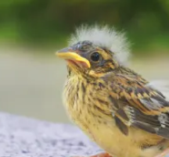


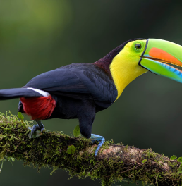
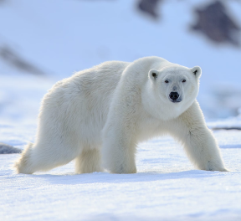
Missouri Standards Alignment
1st Grade - Life Science
✔ Animal Traits & Survival (Animal Superpowers)
 | Topic & Guiding Question | Student Objectives | Missouri Learning Standards for Science 2016
 | Parent & Offspring Traits How can you help a lost baby animal find its parents? | Students observe the traits of adult and baby animals in order to construct an explanation that most young animals are like, but not exactly like, their parents. | 1.LS3.A.1 Make observations to construct an evidence based account that young plants and animals are like, but not exactly like, their parents.
 | ✨New!✨ Offspring Trait Variation Can you predict what an animal’s babies will look like? | Students observe the traits of parent and baby animals to construct an explanation that offspring look similar to their parents, but can also vary in many ways. They predict what a puppy might look like based on the traits of the parent dogs. | 1.LS3.A.1 Make observations to construct an evidence based account that young plants and animals are like, but not exactly like, their parents.
 | Animal Behavior & Offspring Survival Read-Along Why do baby ducks follow their mother? | Students obtain information about the behaviors of animal parents that help their offspring survive. | 1.LS3.A.1 Make observations to construct an evidence based account that young plants and animals are like, but not exactly like, their parents.
 | Animal Structures & Survival Why do birds have beaks? | Students investigate how different bird beaks are well suited for eating different kinds of food. They explain which beak would help a particular bird survive in a particular environment. | 1.LS1.A.1 Use materials to design a solution to a human problem by mimicking how plants and/or animals use their external parts to help them survive, grow, and meet their needs.
 | Camouflage & Animal Survival Why are polar bears white? | Students use observations of animal parents and their offspring to construct an explanation about young plants and animals being similar, but not identical, to their parents. | 1.LS1.A.1 Use materials to design a solution to a human problem by mimicking how plants and/or animals use their external parts to help them survive, grow, and meet their needs.
Lesson 1
Lesson 2
Lesson 3
Lesson 4
Lesson 5
✨ New Lesson
✔ Unit Restructured for the 2025-2026 School Year
www.mysteryscience.com/docs/missouri

Slide 10
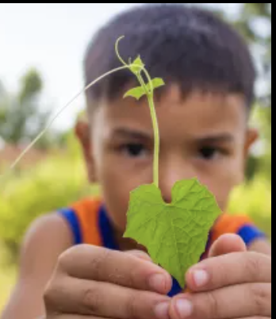

Missouri Standards Alignment
1st Grade - Life Science
Plant Traits & Survival (Plant Superpowers)
 | Topic & Guiding Question | Student Objectives | Missouri Learning Standards for Science 2016
 | Plant Traits & Offspring What will a baby plant look like when it grows up? | Students observe seedlings and adult plants and use their observations to identify the pattern that young plants are similar to their parent plants. | 1.LS3.A.1 Make observations to construct an evidence based account that young plants and animals are like, but not exactly like, their parents.
 | Plant Survival & Engineering Why don’t trees blow down in the wind? | Students learn how plants respond to light. They conduct an investigation to compare how the parts of a plant respond to light. | 1.LS1.A.1 Use materials to design a solution to a human problem by mimicking how plants and/or animals use their external parts to help them survive, grow, and meet their needs. 1.ETS1.A.1 Ask questions, make observations, and gather information about a situation people want to change to define a simple problem that can be solved through the development of a new or improved object or tool. 1.ETS1.B.1 Develop a simple sketch, drawing, or physical model to illustrate how the shape of an object helps it function as needed to solve a given problem.
 | Plant Movement & Survival Read-Along What do sunflowers do when you’re not looking? | Students learn how plants respond to light. They conduct an investigation to compare how the parts of a plant respond to light. | 1.LS1.A.1 Use materials to design a solution to a human problem by mimicking how plants and/or animals use their external parts to help them survive, grow, and meet their needs.
Lesson 1
Lesson 2
Lesson 3
Lesson 1
Lesson 2
Lesson 3
www.mysteryscience.com/docs/missouri

Slide 11

Missouri Standards Alignment
1st Grade - Earth & Space Science
Day Patterns (Sun & Shadows)
 | Topic & Guiding Question | Student Objectives | Missouri Learning Standards for Science 2016
Lesson 1 | Sun, Shadows, & Daily Patterns Could a statue’s shadow move? | Students observe how shadows change as time passes, or as the Sun moves across the sky. They analyze how to move a light source to change the shape and direction of shadows, constructing an explanation of what causes a shadow to move. | 1.ESS1.A.1 Describe the presence of the Sun, Moon, and stars in the sky over time. 1.ESS1.A.2 Use observations of the Sun, Moon, and stars to describe patterns that can be predicted.
Lesson 2 | Sun, Shadows, & Daily Patterns Read-Along What does your shadow do when you’re not looking? | Students conduct an investigation to gather information about how their shadow changes throughout the day. | 1.ESS1.A.1 Describe the presence of the Sun, Moon, and stars in the sky over time. 1.ESS1.A.2 Use observations of the Sun, Moon, and stars to describe patterns that can be predicted.
Lesson 3 | Sun & Daily Patterns How can the Sun help you if you’re lost? | Students develop a Sun Finder, a model of the Sun’s movement across the sky. They use this model to reason about how the Sun can help guide them during the day. | 1.ESS1.A.1 Describe the presence of the Sun, Moon, and stars in the sky over time. 1.ESS1.A.2 Use observations of the Sun, Moon, and stars to describe patterns that can be predicted.
Lesson 4 | Daylight & Seasonal Patterns Read-Along Why do you have to go to bed early in the summer? | Students obtain information about the seasonal patterns of sunrise and sunset. | 1.ESS1.A.2 Use observations of the Sun, Moon, and stars to describe patterns that can be predicted.
Lesson 1
Lesson 2
Lesson 3
Lesson 4
www.mysteryscience.com/docs/missouri

Slide 12

Missouri Standards Alignment
1st Grade - Earth & Space Science
Night Patterns (Moon & Stars)
 | Topic & Guiding Question | Student Objectives | Missouri Learning Standards for Science 2016
Lesson 1 | Moon Phases & Patterns When can you see the full moon? | Students record observations of the Moon’s shape using a series of photos collected over the course of four weeks. Using this information, students discover that the Moon follows a cyclical pattern, which they can use to predict when a full moon will appear. | 1.ESS1.A.1 Describe the presence of the Sun, Moon, and stars in the sky over time. 1.ESS1.A.2 Use observations of the Sun, Moon, and stars to describe patterns that can be predicted.
Lesson 2 | Stars & Daily Patterns Why do stars come out at night? | Students develop and use a model of the Big Dipper in the night sky. After conducting a simple investigation, students construct an explanation for why stars are only visible in the night sky. | 1.ESS1.A.1 Describe the presence of the Sun, Moon, and stars in the sky over time. 1.ESS1.A.2 Use observations of the Sun, Moon, and stars to describe patterns that can be predicted.
Lesson 3 | Stars & Seasonal Patterns Read-Along How can stars help you if you get lost? | Students observe that groups of stars in the sky form a pattern: constellations. Even though the Big Dipper changes its spot in the sky in different seasons, it always points to the North Star. | 1.ESS1.A.1 Describe the presence of the Sun, Moon, and stars in the sky over time.
Lesson 5
Lesson 6
Lesson 7
www.mysteryscience.com/docs/missouri

Slide 13

Missouri Standards Alignment
Kindergarten - Physical Science
Missouri Standards Alignment
1st Grade - Earth & Space Science
This unit is found under Kindergarten on our site, but we recommend teaching some lessons in 1st Grade if you are following Missouri Standards.
Severe Weather (Wild Weather)
 | Topic & Guiding Question | Student Objectives | Missouri Learning Standards for Science 2016
 | Severe Weather & Preparation Read-Along How can you get ready for a big storm? | Students obtain information of different types of severe weather to observe and describe how the weather changes during these events and what students can do to prepare and stay safe. | 1.ESS2.D.1 Identify patterns indicating relationships between observed weather data and weather phenomena (e.g. temperature and types of precipitation, clouds and amount of precipitation).
 | Wind & Storms Have you ever watched a storm? | Students create a simple tool that allows them to observe how hard the wind is blowing. They use this tool to observe weather changes and describe the pattern of faster wind speeds right before a storm. | 1.ESS2.D.1 Identify patterns indicating relationships between observed weather data and weather phenomena (e.g. temperature and types of precipitation, clouds and amount of precipitation).
 | Weather Conditions How many different kinds of weather are there? | Students obtain information through observations of the weather. They communicate the information by acting as weather watchers and creating drawings of the weather conditions. | 1.ESS2.D.1 Identify patterns indicating relationships between observed weather data and weather phenomena (e.g. temperature and types of precipitation, clouds and amount of precipitation).
Lesson 1
Lesson 2
Lesson 3
www.mysteryscience.com/docs/missouri

Slide 14
Missouri Standards Alignment
1st Grade - Physical Science
Light, Sound, & Communication (Lights & Sounds)
 | Topic & Guiding Question | Student Objectives | Missouri Learning Standards for Science 2016
 | Sounds & Vibrations How do they make silly sounds in cartoons? | Students explore how to make different sounds with everyday objects. They construct an explanation that objects vibrate when they make a sound, and if the vibration stops, the sound stops. | 1.PS4.A.1 Plan and conduct investigations to provide evidence that vibrating materials can make sound and that sound can make materials vibrate.
 | Sounds & Vibrations Read-Along Where do sounds come from? | Students create three different sound makers and construct an explanation about where the vibrations are happening in each sound experiment. | 1.PS4.A.1 Plan and conduct investigations to provide evidence that vibrating materials can make sound and that sound can make materials vibrate.
 | Light, Communication, & Engineering How could you send a secret message to someone far away? | Students are presented with the problem that they need to send a message at night, without using noise. They design a solution to create a color-coded message system and communicate with light signals. | 1.PS4.C.1 Use tools and materials to design and build a device that uses light or sound to solve the problem of communicating over a distance. 1.ETS1.C.1 Analyze data from tests of two objects designed to solve the same problem to compare the strengths and weaknesses of how each performs.
 | Lights, Sounds, & Communication Read-Along How do boats find their way in the fog? | Students obtain information about light and sound signals. They analyze different sounds with eyes closed to determine which type of sound they hear. | 1.PS4.C.1 Use tools and materials to design and build a device that uses light or sound to solve the problem of communicating over a distance.
Lesson 1
Lesson 2
Lesson 5
Lesson 6
Missouri Specific Standard: 1.PS3.A.1 Identify the source of energy that causes an increase in the temperature of an object (e.g. sun, stove, flame, light bulb).
www.mysteryscience.com/docs/missouri

Slide 15

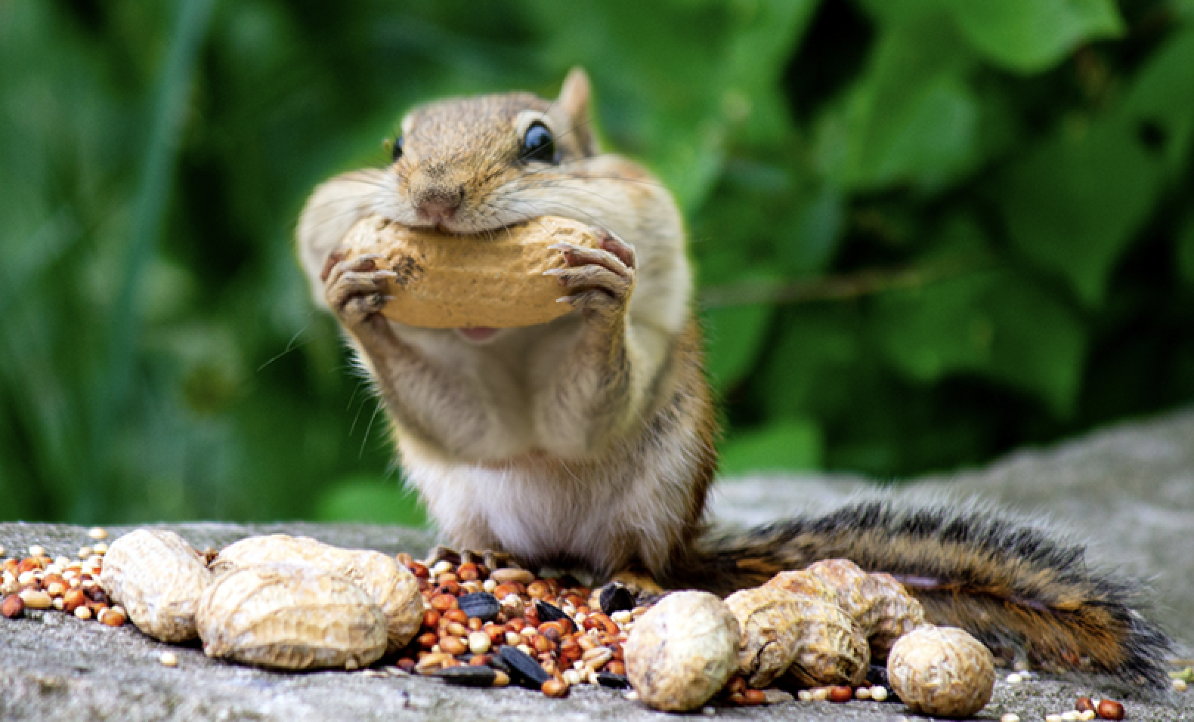
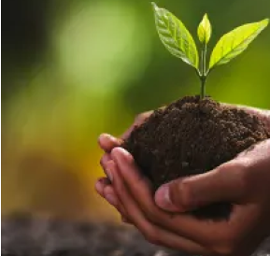
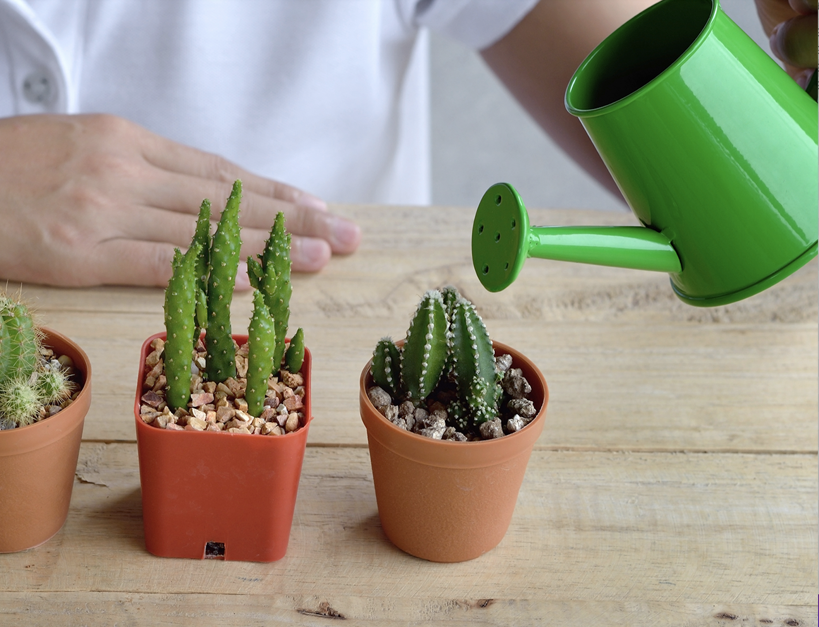
Missouri Standards Alignment
2nd Grade - Life Science
Plant Growth & Interactions (Plant Adventures)
 | Topic & Guiding Question | Student Objectives | Missouri Learning Standards for Science 2016
 | Seed Dispersal How did a tree travel halfway around the world? | Students develop physical models of seed structures. They observe how structure affects the seed’s function in dispersing away from the tree. | Foundational for 2.LS2.A.2 Develop a simple model that mimics the function of an animal in dispersing seeds or pollinating plants. 2.ETS1.B.1 Develop a simple sketch, drawing, or physical model to illustrate how the shape of an object helps it function as needed to solve a given problem.
 | Animal Seed Dispersal Why do seeds have so many different shapes? | Students develop a model of a furry animal and then use it to test how far seed models with different structures can travel. | 2.LS2.A.2 Develop a simple model that mimics the function of an animal in dispersing seeds or pollinating plants.
 | Water, Sunlight, & Plant Growth Could a plant survive without light? | Students conduct an investigation to determine that plants need water and light to grow. | 2.LS2.A.1 Plan and conduct investigations on the growth of plants when growing conditions are altered (e.g., dark vs. light, water vs. no water).
 | Plant Needs & Habitats How much water should you give a plant? | Students plan and conduct a series of virtual experiments in order to determine how much water and sunlight a set of mystery plants need in order to stay healthy and survive. | 2.LS2.A.1 Plan and conduct investigations on the growth of plants when growing conditions are altered (e.g., dark vs. light, water vs. no water).
Lesson 1
Lesson 2
Lesson 3
Lesson 4
www.mysteryscience.com/docs/missouri

Slide 16
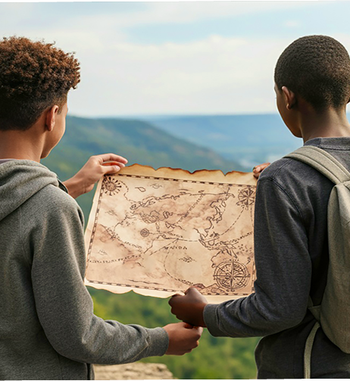
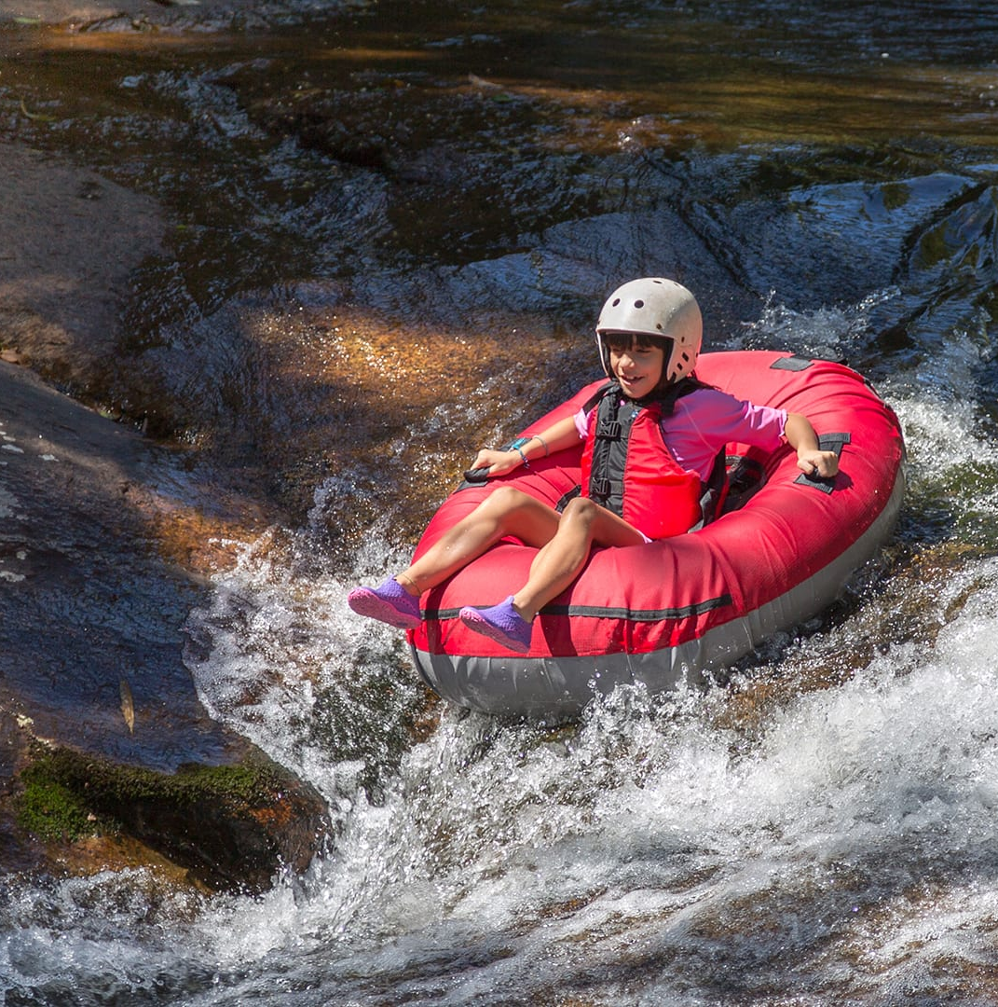
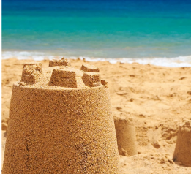
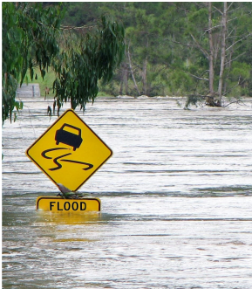
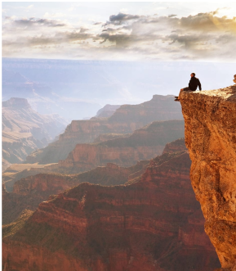
Missouri Standards Alignment
2nd Grade - Earth & Space Science
Erosion & Earth’s Surface (Work of Water) • Page 1 of 2
 | Topic & Guiding Question | Student Objectives | Missouri Learning Standards for Science 2016
 | ✨New!✨ Mapping Landforms & Bodies of Water Where’s the best place to hide a treasure? | Students develop a model (a map) of different landforms and bodies of water in a given location based on the shape of each feature. | 2.ESS2.B.1 Develop a model to represent the shapes and kinds of land and bodies of water in an area.
 | Mapping: Mountains & Rivers If you floated down a river, where would you end up? | Students develop a model of the Earth’s surface and use it to discover an important principle about how rivers work: rivers flow downhill, from high places to low places. | 2.ESS2.B.1 Develop a model to represent the shapes and kinds of land and bodies of water in an area. 2.ESS2.C.1 Obtain information to identify where water is found on Earth and that it can be solid or liquid.
 | Rocks, Sand, & Erosion Why is there sand at the beach? | Students investigate the effects of rocks tumbling in a river. Based on their observations, they construct an explanation for why rocks on the top of mountains are much bigger than the sand at the beach. | 2.ESS2.B.1 Develop a model to represent the shapes and kinds of land and bodies of water in an area.
 | Mapping & Severe Weather Where do flash floods happen? | Students use a model (i.e. a map) to examine the different factors, including the shapes and kinds of land, that contribute to flash floods. They use this to predict where flash floods are most likely to happen. | 2.ESS2.B.1 Develop a model to represent the shapes and kinds of land and bodies of water in an area. 2.ESS1.C.1 Use information from several sources to provide evidence that Earth events can occur quickly or slowly.
 | Erosion, Earth’s Surface, & Landforms What’s strong enough to make a canyon? | Students create a model landform and investigate how some Earth events can occur quickly, while others occur slowly. | 2.ESS1.C.1 Use information from several sources to provide evidence that Earth events can occur quickly or slowly.
Continued on next page
Lesson 1
Lesson 2
Lesson 3
Lesson 4
Lesson 5
✨ New Lesson
www.mysteryscience.com/docs/missouri

Slide 17
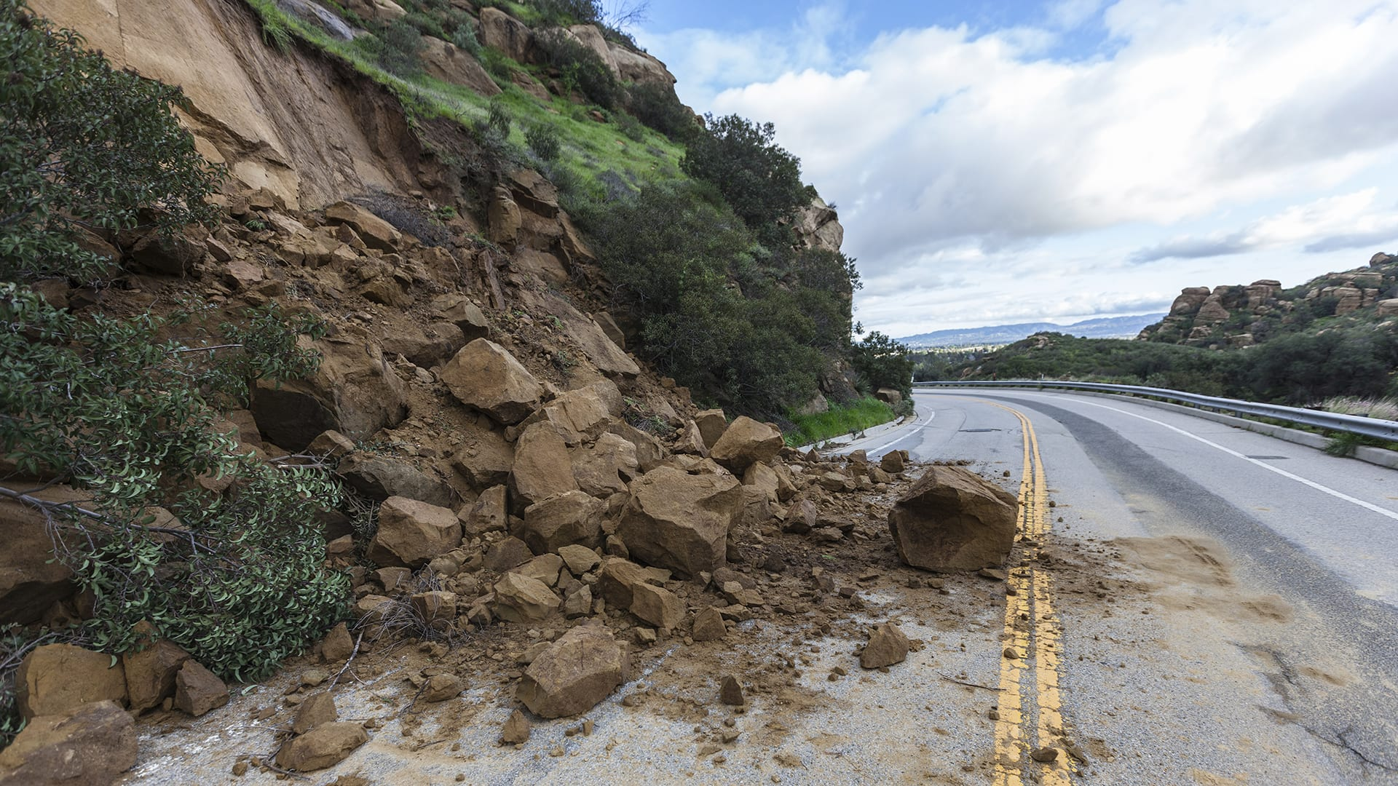
Missouri Standards Alignment
2nd Grade - Earth & Space Science
Erosion & Earth’s Surface (Work of Water) • Page 2 of 2
 | Topic & Guiding Question | Student Objectives | Missouri Learning Standards for Science 2016
 | Erosion & Engineering How can you stop a landslide? | Students compare multiple solutions for preventing erosion. | 2.ESS2.A.1 Compare multiple solutions designed to slow or prevent wind or water from changing the shape of the land. 2.ETS1.A.1 Ask questions, make observations, and gather information about a situation people want to change to define a simple problem that can be solved through the development of a new or improved object or tool. 2.ETS1.C.1 Analyze data from tests of two objects designed to solve the same problem to compare the strengths and weaknesses of how each performs.
Lesson 6
Missouri Specific Standard: 2.PS2.A.1 Analyze data to determine how the motion of an object changed by an applied force or the mass of an object.
Missouri Specific Standard: 2.PS4.A.1 Plan and conduct investigations to provide evidence that changes in vibration create changes in sound.
www.mysteryscience.com/docs/missouri

Slide 18
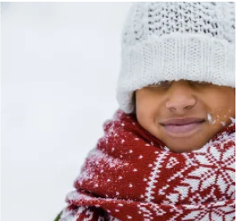
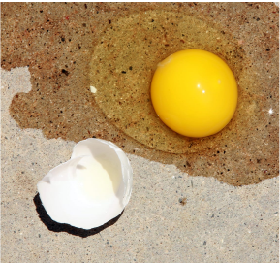

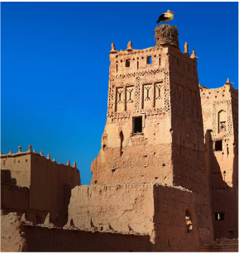
Missouri Standards Alignment
2nd Grade - Physical Science
✔ Material Properties (Material Magic)
 | Topic & Guiding Question | Student Objectives | Missouri Learning Standards for Science 2016
 | Material Properties & Engineering Why do we wear clothes? | Students investigate different material properties, such as flexibility and absorbency, and use those properties to design and build a hat that protects them from the sun. | 2.PS1.A.1 Plan and conduct an investigation to describe and classify different kinds of materials by their observable properties. 2.PS1.A.2 Analyze data obtained from testing different materials to determine which materials have the properties that are best suited for an intended purpose.
 | Classify Materials: Insulators & Conductors Can you really fry an egg on a hot sidewalk? | Students conduct an investigation of conductors and insulators in order to determine which are best suited for allowing people to handle hot items. | 2.PS1.A.2 Analyze data obtained from testing different materials to determine which materials have the properties that are best suited for an intended purpose.
 | Material Building Blocks & Engineering Could you build a house out of paper? | Students construct an evidence- based account of how a structure built of paper can be disassembled and rebuilt in new ways. | 2.PS1.A.2 Analyze data obtained from testing different materials to determine which materials have the properties that are best suited for an intended purpose. 2.ETS1.C.1 Analyze data from tests of two objects designed to solve the same problem to compare the strengths and weaknesses of how each performs.
 | Soil Properties How do you build a city out of mud? | Students conduct an investigation where they examine three different soil models. They use this information to determine which type of soil has the properties that will result in the best mud that can be used to build a house. | 2.PS1.A.1 Plan and conduct an investigation to describe and classify different kinds of materials by their observable properties. 2.PS1.A.2 Analyze data obtained from testing different materials to determine which materials have the properties that are best suited for an intended purpose.
Lesson 1
Lesson 2
Lesson 3
Lesson 4
✔ Unit Restructured for the 2025-2026 School Year
www.mysteryscience.com/docs/missouri

Slide 19

Missouri Standards Alignment
Kindergarten - Physical Science
Missouri Standards Alignment
3rd Grade - Life Science
This unit is found under 2nd Grade on our site, but we recommend teaching some lessons in 3rd Grade if you are following Missouri Standards.
Animal Biodiversity & Habitat (Animal Adventures)
 | Topic & Guiding Question | Student Objectives | Missouri Learning Standards for Science 2016
Lesson 1 | Biodiversity & Classification How many different kinds of animals are there? | Students observe the traits of different animals and use that information to organize them into groups based on their characteristics. | Foundational for 3.LS3.C.1 Construct an argument with evidence that in a particular ecosystem some organisms – based on structural adaptations or behaviors – can survive well, and some cannot survive at all.
Lesson 2 | Habitat Diversity Why would a wild animal visit a playground? | Students observe animals, plants, and the physical characteristics of two different habitats. They collect and analyze data to compare the biodiversity between the two habitats. | Foundational for 3.LS3.C.1 Construct an argument with evidence that in a particular ecosystem some organisms – based on structural adaptations or behaviors – can survive well, and some cannot survive at all.
Lesson 3 | Biodiversity, Habitats, & Species Why do frogs say “ribbit”? | Students identify frogs based on their unique calls and use that information to determine the level of frog species diversity within multiple habitats. | Foundational for 3.LS3.C.1 Construct an argument with evidence that in a particular ecosystem some organisms – based on structural adaptations or behaviors – can survive well, and some cannot survive at all.
Lesson 4 | Biodiversity & Engineering How could you get more birds to visit a bird feeder? | Students investigate which kinds of birds are likely to visit a bird feeder based on what they eat and design and build a prototype bird feeder that attracts a specific type of bird. | Foundational for 3.LS3.C.1 Construct an argument with evidence that in a particular ecosystem some organisms – based on structural adaptations or behaviors – can survive well, and some cannot survive at all.
Lesson 1
Lesson 2
Lesson 3
Lesson 4
www.mysteryscience.com/docs/missouri

Slide 20

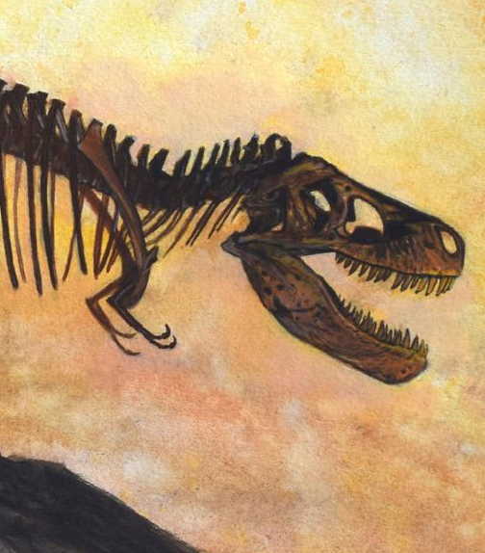
Missouri Standards Alignment
3rd Grade - Life Science
Fossils & Changing Environments (Animals Through Time)
 | Topic & Guiding Question | Student Objectives | Missouri Learning Standards for Science 2016
 | Habitats, Fossils, & Environments Over Time Where can you find whales in a desert? | Students explore the idea that the rock under our feet sometimes contains fossils, and investigate how these fossils reveal changes in habitats through time. | 3.LS3.C.1 Construct an argument with evidence that in a particular ecosystem some organisms – based on structural adaptations or behaviors – can survive well, and some cannot survive at all.
 | Fossil Evidence & Dinosaurs How do we know what dinosaurs looked like? | Students learn how we can infer what the outside of an animal looked like by using clues about their skeleton. | 3.LS3.C.1 Construct an argument with evidence that in a particular ecosystem some organisms – based on structural adaptations or behaviors – can survive well, and some cannot survive at all.
 | Trace Fossil Evidence & Animal Movement Can you outrun a dinosaur? | Students learn how fossilized animal tracks can tell us a great deal about the animals that left them. | 3.LS3.C.1 Construct an argument with evidence that in a particular ecosystem some organisms – based on structural adaptations or behaviors – can survive well, and some cannot survive at all.
Lesson 1
Lesson 2
Lesson 3
www.mysteryscience.com/docs/missouri

Slide 21
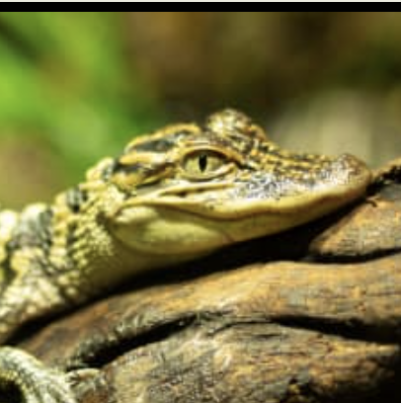


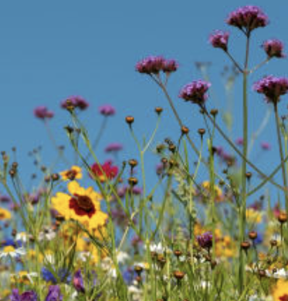
Missouri Standards Alignment
3rd Grade - Life Science
Life Cycles (Circle of Life)
 | Topic & Guiding Question | Student Objectives | Missouri Learning Standards for Science 2016
 | Animal Life Cycles How is your life like an alligator’s life? | Students create models of several different animal life cycles and compare them to one another. They use these models to discover the pattern that all animals are born, grow, can have babies, and eventually die. | 3.LS1.B.1 Develop a model to compare and contrast observations on the life cycle of different plants and animals.
 | Environmental Change & Engineering What’s the best way to get rid of mosquitoes? | Students obtain and evaluate information about mosquitoes from different sources. They analyze and interpret information about the mosquito life cycle to reduce the number of mosquitoes that live in a certain area. | 3.LS3.D.1 Make a claim about the merit of a solution to a problem caused when the environment changes and the types of plants and animals that live there may change. 3.ETS1.A.1 Define a simple design problem reflecting a need or a want that includes specified criteria for success and constraints on materials, time, or cost.
 | Pollination & Plant Reproduction Why do plants grow flowers? | Students model the structure and function of flower parts that are responsible for creating seeds. | 3.LS1.B.1 Develop a model to compare and contrast observations on the life cycle of different plants and animals.
 | Fruit, Seeds, & Plant Reproduction Why do plants give us fruit? | Students explore the function of fruits in plants and practice classification. | 3.LS1.B.1 Develop a model to compare and contrast observations on the life cycle of different plants and animals.
 | Plant Life Cycles Why are there so many different kinds of flowers? | Students play a game that models the stages of the plant life cycle. After playing the game students use the model to show how changes to one part of the life cycle affect all other stages. | 3.LS1.B.1 Develop a model to compare and contrast observations on the life cycle of different plants and animals.
Lesson 1
Lesson 2
Lesson 3 Lesson 4 Lesson 5
www.mysteryscience.com/docs/missouri

Slide 22
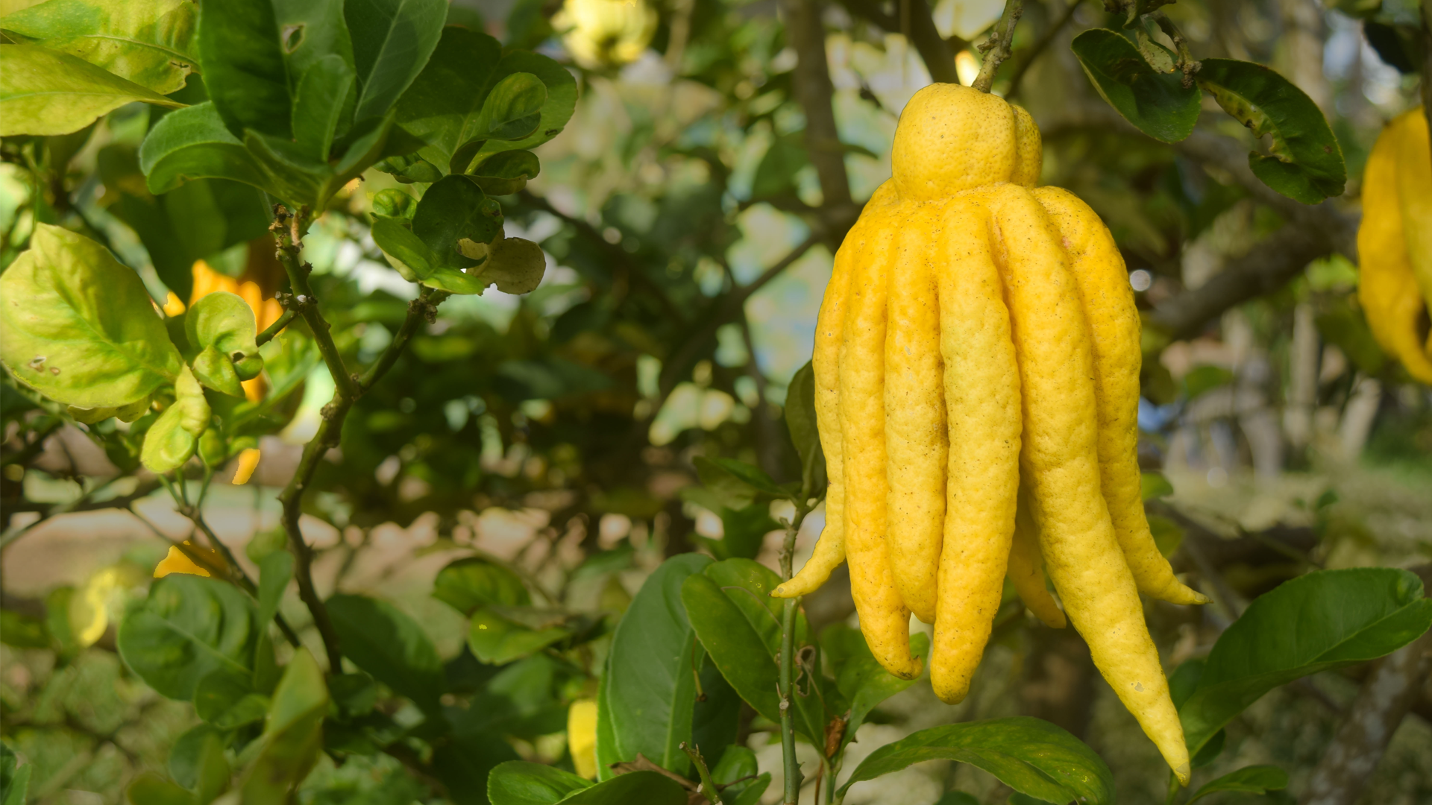
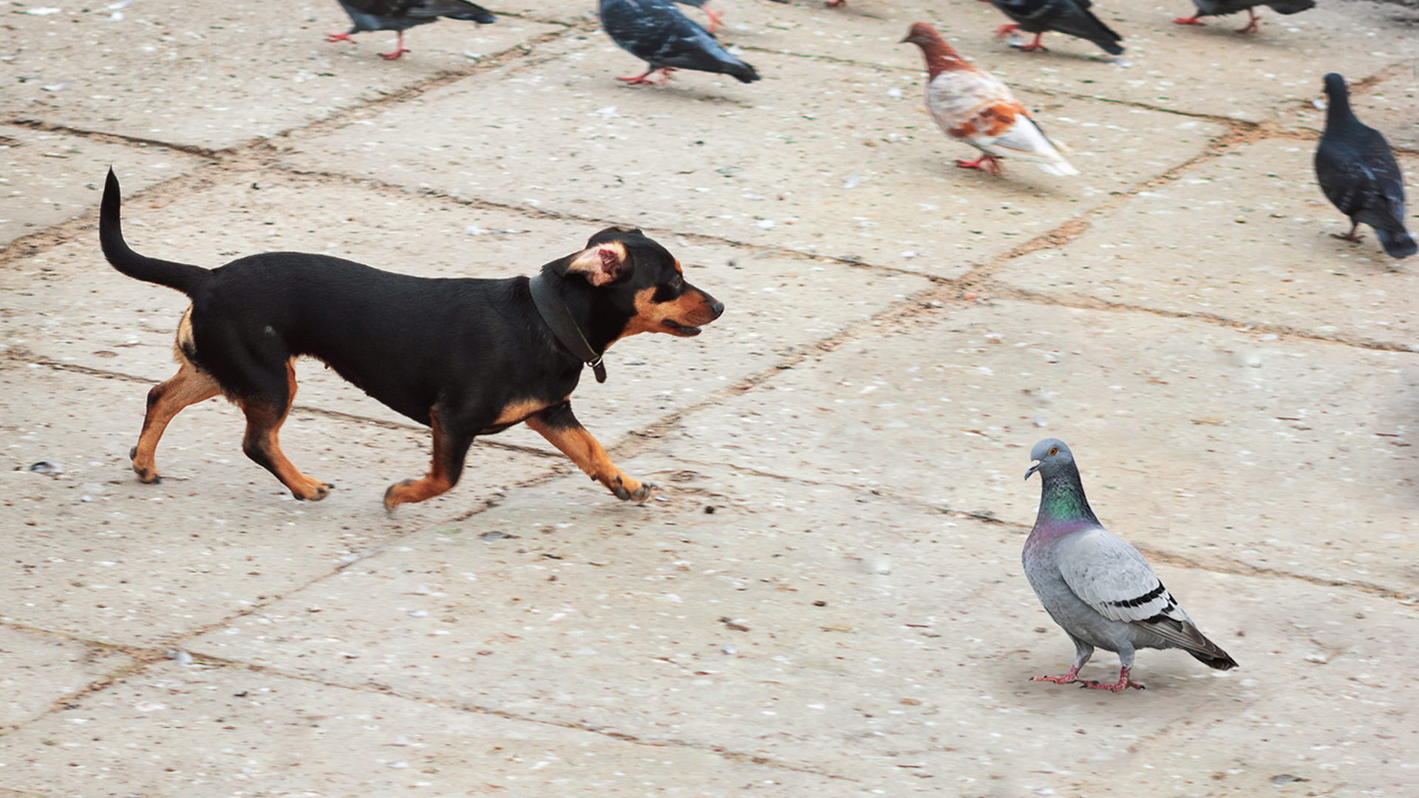
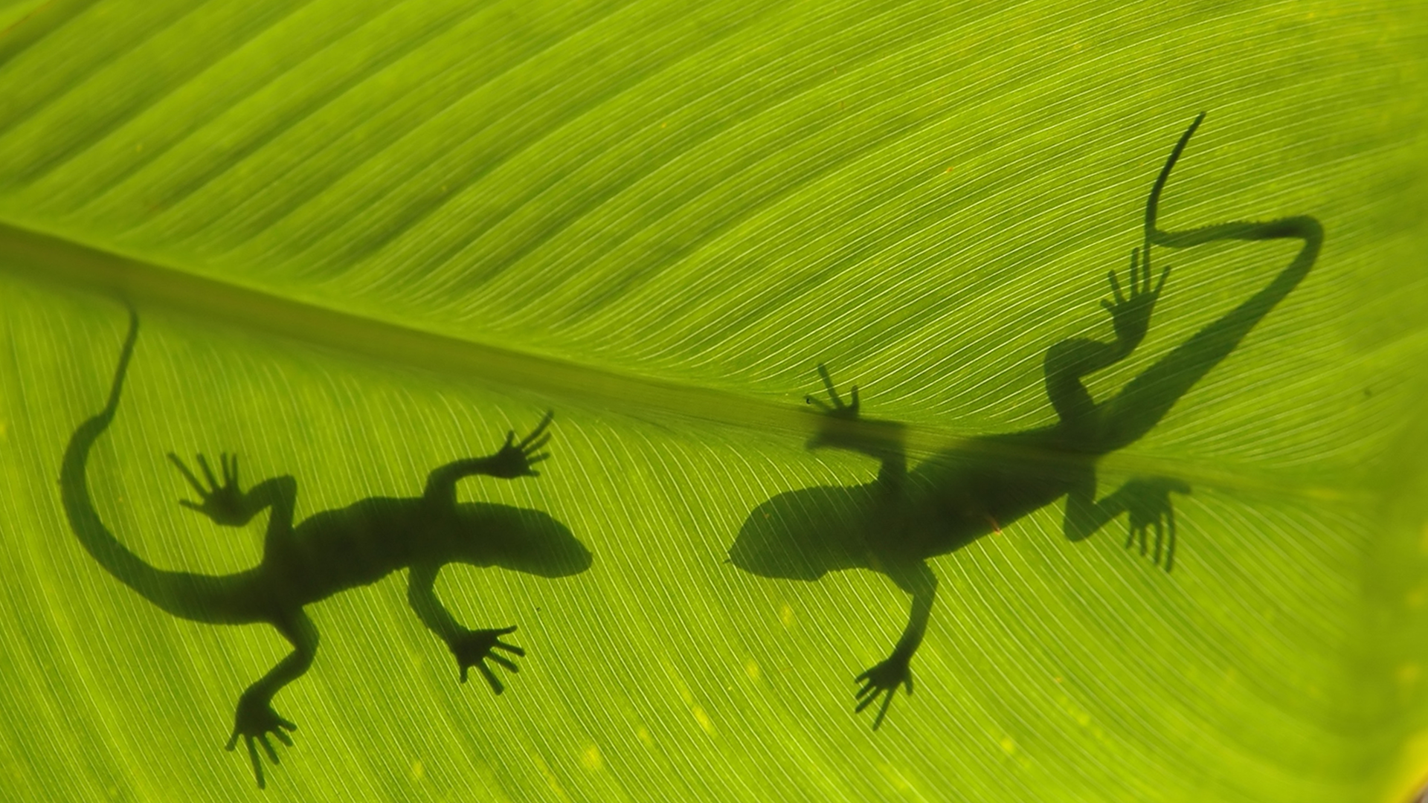
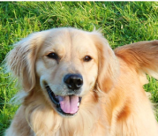
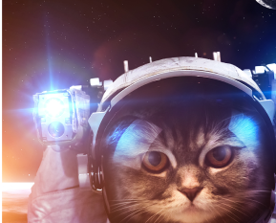
Missouri Standards Alignment
3rd Grade - Life Science
Heredity, Survival, & Selection (Fates of Traits)
 | Topic & Guiding Question | Student Objectives | Missouri Learning Standards for Science 2016
 | Traits & Inheritance How do you identify a mysterious fruit? | Students examine plant traits and use that information as evidence to help them identify an unknown fruit. They look for similarities and differences in the leaves, flowers, and fruits of plants to sort them into groups and identify patterns of inheritance. | 3.LS3.A.1 Construct scientific arguments to support claims that some characteristics of organisms are inherited from parents and some are influenced by the environment.
 | Trait Variation, Inheritance, & Artificial Selection What do dogs and pigeons have in common? | Students analyze trait similarities and differences among parent, offspring, and sibling pigeons. They interpret this data to discover that the variation and inheritance of traits creates a pattern that explains why we see such extreme traits in artificially selected animal breeds. | 3.LS3.A.1 Construct scientific arguments to support claims that some characteristics of organisms are inherited from parents and some are influenced by the environment.
 | Trait Variation, Survival, & Natural Selection How could a lizard’s toes help it survive? | Students compare the structures of lizards that live on an island. They simulate multiple generations of these lizards, and analyze and interpret the data to understand how these structures aid in their survival. | 3.LS3.A.1 Construct scientific arguments to support claims that some characteristics of organisms are inherited from parents and some are influenced by the environment. 3.LS3.B.1 Use evidence to construct an explanation for how the variation in characteristics among individuals of the same species may provide advantages in surviving and finding mates. 3.LS3.C.1 Construct an argument with evidence that in a particular ecosystem some organisms – based on structural adaptations or behaviors – can survive well, and some cannot survive at all.
 | Animal Groups & Survival Why do dogs wag their tails? | Students observe animals that live in groups in order to obtain, evaluate, and communicate information about animal social behavior. Students use evidence to show how animals form groups to help them survive. | 3.LS3.A.1 Construct scientific arguments to support claims that some characteristics of organisms are inherited from parents and some are influenced by the environment.
 | Traits & Environmental Variation How long can people (and animals) survive in outer space? | Students measure and compare their own physical traits (arm strength, balance, and height) and analyze the information to construct an explanation for how the environment can influence traits. | 3.LS3.A.1 Construct scientific arguments to support claims that some characteristics of organisms are inherited from parents and some are influenced by the environment.
Lesson 1
Lesson 2
Lesson 3
Lesson 4
Lesson 5
www.mysteryscience.com/docs/missouri

Slide 23

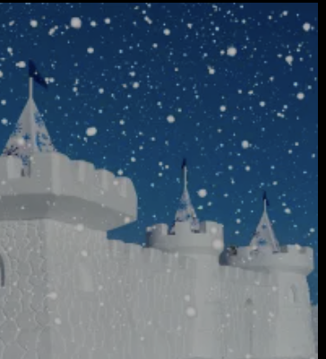
Missouri Standards Alignment
3rd Grade - Earth & Space Science
Weather & Climate (Stormy Skies)
 | Topic & Guiding Question | Student Objectives | Missouri Learning Standards for Science 2016
Lesson 1 | Water Cycle & States of Matter Where do clouds come from? | Students obtain and combine information that water can change from liquid to gas, but that it is always made of tiny drops. Clouds are made of water that has evaporated. | 3.PS1.A.1 Predict and investigate that water can change from a liquid to a solid (freeze), and back again (melt), or from a liquid to a gas (evaporation), and back again (condensation) as the result of temperature changes.
Lesson 2 | Local Weather Patterns & Weather Prediction How can we predict when it’s going to storm? | Students make observations of clouds and develop a tool to make predictions about what kind of weather might happen next. | 3.ESS2.D.1 Represent data in tables and graphical displays to describe typical weather conditions expected during a particular season.
Lesson 3 | Seasonal Weather Patterns Where’s the best place to build a snow fort? | Students gather winter temperature data from three different towns. They represent the data in a table to compare the weather and decide which town is the best candidate to host a snow fort festival in future years. | 3.ESS2.D.1 Represent data in tables and graphical displays to describe typical weather conditions expected during a particular season.
Lesson 4 | Climate & Global Weather Patterns Why are some places always hot? | Students obtain and combine information to describe the different climate regions of the world. | 3.ESS2.D.2 Obtain and combine information to describe climates in different regions of the world.
 | Natural Hazards & Engineering How can you keep a house from blowing away in a windstorm? | Students design and build solutions that reduce the hazards associated with strong winds that could damage buildings. | 3.ESS3.B.1 Make a claim about the merit of an existing design solution (e.g. levies, tornado shelters, sea walls, etc.) that reduces the impacts of a weather-related hazard. 3.ETS1.A.1 Define a simple design problem reflecting a need or a want that includes specified criteria for success and constraints on materials, time, or cost.
Lesson 1
Lesson 2
Lesson 3
Lesson 4
Lesson 5
www.mysteryscience.com/docs/missouri

Slide 24
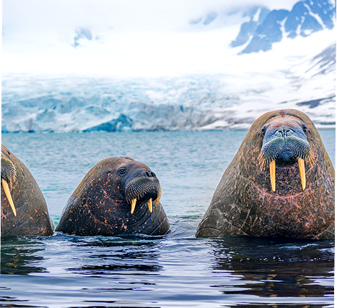

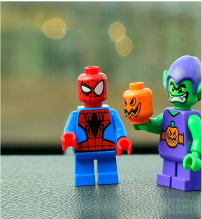
Missouri Standards Alignment
Kindergarten - Physical Science
Missouri Standards Alignment
3rd Grade - Physical Science
This unit is found under 2nd Grade on our site, but we recommend teaching some lessons in 3rd Grade if you are following Missouri Standards.
⭐ States of Matter (States of Matter)
 | Topic & Guiding Question | Student Objectives | Missouri Learning Standards for Science 2016
 | ✨New!✨ Liquid Water & Solid Ice Where do animals find the water they need? | Students obtain information about the liquid water and solid ice that different animals utilize for their survival in the Arctic. | Foundational for 3.PS1.B.1 Construct an argument with evidence that some changes caused by heating or cooling can be reversed and some cannot.
 | ✨New!✨ Reversible & Irreversible Changes How is an ice cube like a crayon? | Students observe the properties of different materials after being heated up and then cooled down. They use these observations to support the explanation that some changes are reversible and others are not. | 3.PS1.B.1 Construct an argument with evidence that some changes caused by heating or cooling can be reversed and some cannot.
 | Heating, Cooling, & States of Matter Why are so many toys made out of plastic? | Student conduct an investigation of different materials in order to determine which are most and least easily melted. | 3.PS1.B.1 Construct an argument with evidence that some changes caused by heating or cooling can be reversed and some cannot.
Lesson 1
Lesson 2
Lesson 3
✨ New Unit or Lesson
www.mysteryscience.com/docs/missouri

Slide 25

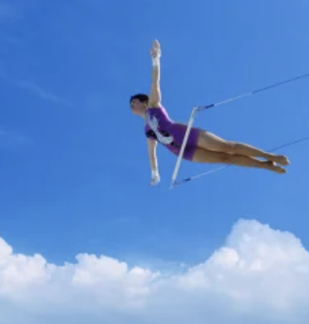
Missouri Standards Alignment
3rd Grade - Physical Science
Forces, Motion, & Magnets (Invisible Forces)
 | Topic & Guiding Question | Student Objectives | Missouri Learning Standards for Science 2016
 | Balanced & Unbalanced Forces How could you win a tug-of-war against a bunch of adults? | Students develop a mental model of the nature of forces and motion and use that model to explain the behavior of an elastic jumper. | 4.PS2.A.2 Plan and conduct an investigation to provide evidence of the effects of balanced and unbalanced forces on the motion of an object.
 | Balanced Forces & Engineering What makes bridges so strong? | Students develop and design a bridge to be as strong as possible while working with limited materials. | 4.PS2.A.2 Plan and conduct an investigation to provide evidence of the effects of balanced and unbalanced forces on the motion of an object.
 | Pattern of Motion, Gravity, & Friction How high can you swing on a flying trapeze? | Students make observations and measurements of a trapeze model. Then, using that information they predict the motion of a real trapeze. | 4.PS2.A.1 Make observations and/or measurements of an object’s motion to provide evidence that a pattern can be used to predict future motion. 4.PS2.B.1 Plan and conduct a fair test to compare and contrast the forces (measured by a spring scale in Newtons) required to overcome friction when an object moves over different surfaces (i.e. rough/smooth).
 | Magnets & Forces What can magnets do? | Students investigate the properties of magnets and the fact that they exert forces that act at a distance. | 3.PS2.B.1 Plan and conduct investigations to determine the cause and effect relationships of electric or magnetic interactions between two objects not in contact with each other.
 | Magnets & Engineering How can you unlock a door using a magnet? | Students investigate magnetic attraction and repulsion, and design a magnetic lock in the hands-on activity. | 3.PS2.B.1 Plan and conduct investigations to determine the cause and effect relationships of electric or magnetic interactions between two objects not in contact with each other. 3.ETS1.B.1 Generate and compare multiple solutions to a problem based on how well each is likely to meet the criteria and constraints of the problem. 3.ETS1.C.1 Plan and carry out fair tests in which variables are controlled and failure points are considered to identify aspects of a model or prototype that can be improved.
Lesson 1
Lesson 2
Lesson 3
Lesson 4
Lesson 5
We recommend teaching this in 4th grade if following Missouri Standards.
We recommend teaching this in 4th grade if following Missouri Standards.
We recommend teaching this in 4th grade if following Missouri Standards.
www.mysteryscience.com/docs/missouri

Slide 26

Missouri Standards Alignment
4th Grade - Life Science
Human Body, Vision, & The Brain (Human Machine)
 | Topic & Guiding Question | Student Objectives | Missouri Learning Standards for Science 2016
 | Muscles & Skeleton Why do your biceps bulge? | Students construct a model of the human hand to explain how muscles pull on bones to create movement. | 4.LS1.A.1 Construct an argument that plants and animals have internal and external structures that function to support survival, growth, behavior, and plant reproduction.
 | Light, Eyes, & Vision What do people who are blind see? | Students develop a working model of an eye. They use the model to reason about how light reflects off an object and into the eye, helping an organism process information from the environment. | 5.PS4.A.1 Develop a model to describe that objects can be seen only when light is reflected off them or when they produce their own light.
 | Structure & Function of Eyes How can some animals see in the dark? | Students use their eye model to discover that the pupil controls the amount of light let into the eye. In the dark, pupils get larger to let in more light. | 5.PS4.A.1 Develop a model to describe that objects can be seen only when light is reflected off them or when they produce their own light.
 | Brain, Nerves, & Information Processing How does your brain control your body? | Students investigate how their own brain works by testing their reflexes. They discover that the brain receives information from the senses, processes the information, and sends signals to the muscles to enable movement. | 4.LS1.D.1 Use a model to describe that animals receive different types of information through their senses, process the information in their brain, and respond to the information in different ways.
Lesson 1
Lesson 2
Lesson 3
Lesson 4
We recommend teaching this in 5th grade if following Missouri Standards.
We recommend teaching this in 5th grade if following Missouri Standards.
www.mysteryscience.com/docs/missouri

Slide 27
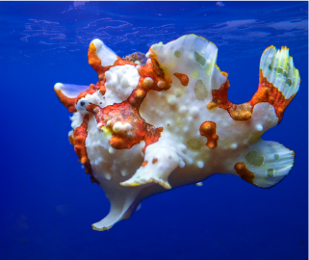
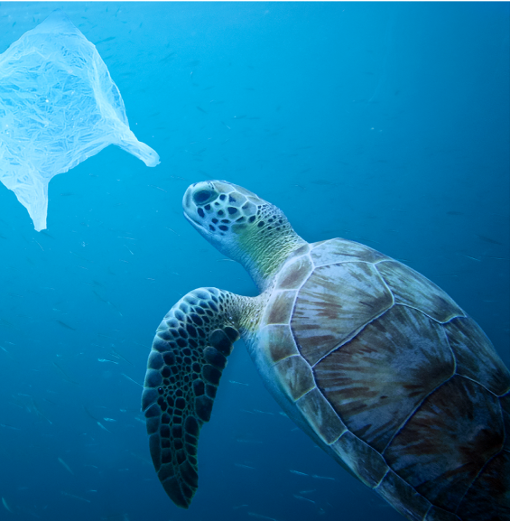
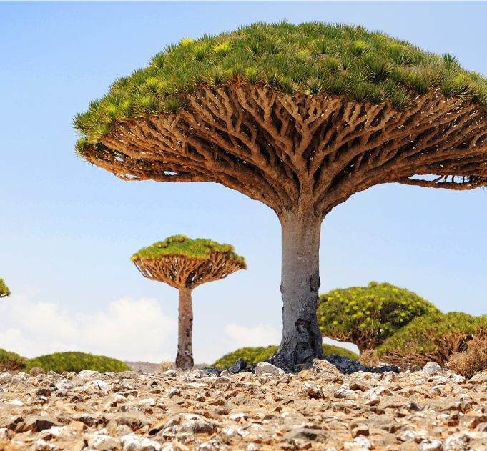
Missouri Standards Alignment
4th Grade - Life Science
Animal & Plant Adaptations (Animal & Plant Adaptations)
 | Topic & Guiding Question | Student Objectives | Missouri Learning Standards for Science 2016
 | Animal Adaptations Why do some sea creatures look so strange? | Students make observations of underwater animals in order to collect evidence that external structures serve specific functions. They use their observations to construct an argument that an animal’s structures work together as part of a system to support their growth and survival. | 4.LS1.A.1 Construct an argument that plants and animals have internal and external structures that function to support survival, growth, behavior, and plant reproduction.
 | Learned Behavior & Instinct Why would a sea turtle eat a plastic bag? | Students use models to understand how an animal’s senses, brain, and memories all work together as a system to influence their behavior and support their survival. | 4.LS1.D.1 Use a model to describe that animals receive different types of information through their senses, process the information in their brain, and respond to the information in different ways.
 | Plant Adaptations Why don’t the same trees grow everywhere? | Students use models of roots and branches to explore their functions and then construct an argument about how these structures must work together in order to support the survival of trees in the unique environment of the frozen taiga. | 4.LS1.A.1 Construct an argument that plants and animals have internal and external structures that function to support survival, growth, behavior, and plant reproduction.
Lesson 1
Lesson 2
Lesson 3
www.mysteryscience.com/docs/missouri

Slide 28

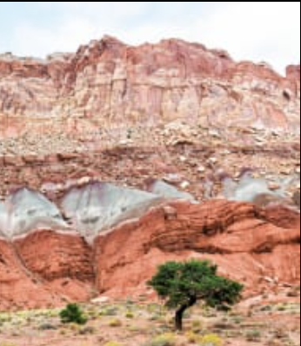
Missouri Standards Alignment
4th Grade - Earth & Space Science
Earth’s Features & Processes (The Birth of Rocks)
 | Topic & Guiding Question | Student Objectives | Missouri Learning Standards for Science 2016
Lesson 1 | Volcanoes & Patterns of Earth’s Features Could a volcano pop up where you live? | Students use coordinates to develop a map of volcanoes to discover a pattern of where volcanoes exist on Earth. Students identify the pattern of volcanoes in the “Ring of Fire.” | 4.ESS2.B.1 Analyze and interpret data from maps to describe patterns of Earth’s features.
Lesson 2 | Volcanoes & Rock Cycle Why do some volcanoes explode? | Students investigate the properties of thin and thick lava by attempting to create air bubbles. Students realize that thick lava will cause a volcano to explode, while thin lava will not. | 4.ESS2.A.1 Plan and conduct scientific investigations or simulations to provide evidence how natural processes (e.g. weathering and erosion) shape Earth’s surfaces.
Lesson 3 | Weathering & Erosion Will a mountain last forever? | Students make observations of the effects of weathering to discover that rocks will become rounded and break into small pieces when they tumble down a mountain. | 4.ESS2.A.1 Plan and conduct scientific investigations or simulations to provide evidence how natural processes (e.g. weathering and erosion) shape Earth’s surfaces.
Lesson 4 | Sedimentary Rock & Fossils What did your town look like 100 million years ago? | Students create a model canyon and use the pattern of fossils found in each rock layer to support the explanation that the landscape has changed many times over millions of years. | 4.ESS1.C.1 Identify evidence from patterns in rock formations and fossils in rock layers to support an explanation for changes in a landscape over time.
 | Erosion, Natural Hazards, & Engineering How could you survive a landslide? | Students generate multiple possible solutions to protect homes from a landslide. Students realize that there are many causes for the erosion that causes rocks to fall in landslides. | 4.ESS3.A.1 Generate and compare multiple solutions to reduce the impact of natural Earth processes on humans. 4.ETS1.B.1 Generate and compare multiple solutions to a problem based on how well each is likely to meet the criteria and constraints of the problem.
Lesson 1
Lesson 2
Lesson 3
Lesson 4
Lesson 5
www.mysteryscience.com/docs/missouri

Slide 29
Missouri Standards Alignment
4th Grade - Physical Science
This unit is found under 3rd grade on our site, but we recommend teaching some of its lessons in 4th grade if you are following Missouri Standards.
Forces, Motion, & Magnets (Invisible Forces)
 | Topic & Guiding Question | Student Objectives | Missouri Learning Standards for Science 2016
 | Balanced & Unbalanced Forces How could you win a tug-of-war against a bunch of adults? | Students develop a mental model of the nature of forces and motion and use that model to explain the behavior of an elastic jumper. | 4.PS2.A.2 Plan and conduct an investigation to provide evidence of the effects of balanced and unbalanced forces on the motion of an object.
 | Balanced Forces & Engineering What makes bridges so strong? | Students develop and design a bridge to be as strong as possible while working with limited materials. | 4.PS2.A.2 Plan and conduct an investigation to provide evidence of the effects of balanced and unbalanced forces on the motion of an object. 4.ETS1.B.1 Generate and compare multiple solutions to a problem based on how well each is likely to meet the criteria and constraints of the problem.
 | Pattern of Motion, Gravity, & Friction How high can you swing on a flying trapeze? | Students make observations and measurements of a trapeze model. Then, using that information they predict the motion of a real trapeze. | 4.PS2.A.1 Make observations and/or measurements of an object’s motion to provide evidence that a pattern can be used to predict future motion. 4.PS2.B.1 Plan and conduct a fair test to compare and contrast the forces (measured by a spring scale in Newtons) required to overcome friction when an object moves over different surfaces (i.e. rough/smooth).
 | Magnets & Forces What can magnets do? | Students investigate the properties of magnets and the fact that they exert forces that act at a distance. | 3.PS2.B.1 Plan and conduct investigations to determine the cause and effect relationships of electric or magnetic interactions between two objects not in contact with each other.
 | Magnets & Engineering How can you unlock a door using a magnet? | Students investigate magnetic attraction and repulsion, and design a magnetic lock in the hands-on activity. | 3.PS2.B.1 Plan and conduct investigations to determine the cause and effect relationships of electric or magnetic interactions between two objects not in contact with each other.
Lesson 1
Lesson 2
Lesson 3
Lesson 4
Lesson 5
We recommend teaching this in 3rd grade if following Missouri Standards.
We recommend teaching this in 3rd grade if following Missouri Standards.
www.mysteryscience.com/docs/missouri

Slide 30

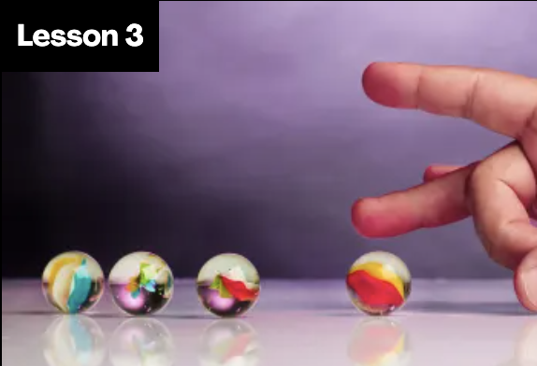

Missouri Standards Alignment
4th Grade - Physical Science
Energy & Energy Transfer (Energizing Everything)
 | Topic & Guiding Question | Student Objectives | Missouri Learning Standards for Science 2016
 | Speed & Energy How is your body similar to a car? | Students learn about stored energy and about the relationship between motion and energy. Students build models of an amusement park ride and discover how energy can be stored in materials. Stored energy can be converted to speed. | 4.PS3.A.1 Use evidence to construct an explanation relating the speed of an object to the energy of that object.
 | Gravitational Energy, Speed, & Collisions What makes roller coasters go so fast? | Students build a model of a roller coaster and carry out an investigation using marbles. Students learn that lifting an object up stores energy in the object. When the object falls, that stored energy is released. They realize that energy is transferred when objects collide. | 4.PS3.A.1 Use evidence to construct an explanation relating the speed of an object to the energy of that object. 4.PS2.B.2 Predict how changes in either the amount of force applied to an object or the mass of the object affects the motion (speed and direction) of the object.
 | Collisions & Energy Transfer How can marbles save the world? | Students investigate how energy transfers when objects collide. In the activity, Bumper Jumper, students ask questions and make predictions about how far a marble will launch over a jump after colliding with other objects. | 4.PS2.B.2 Predict how changes in either the amount of force applied to an object or the mass of the object affects the motion (speed and direction) of the object.
 | Energy Transfer & Engineering Could you knock down a building using only dominoes? | Students experiment with ways to store and release energy, creating the beginning of a chain reaction machine with a lever and a ramp. Students figure out that a domino standing on end is storing energy, only requiring a small amount of energy (a tiny push) to release the stored energy. | 4.PS3.C.1 Use models to explain that simple machines change the amount of effort force and/or direction of force.
 | Energy Transfer & Engineering Can you build a chain reaction machine? | Students continue to build a chain reaction machine — identifying a goal, brainstorming and testing multiple ideas, and determining an optimal solution. The chain reaction machine uses multiple components to transfer energy from one part to the next. | 4.PS3.C.1 Use models to explain that simple machines change the amount of effort force and/or direction of force.
Lesson 1
Lesson 2
Lesson 3
Lesson 4 Lesson 5
www.mysteryscience.com/docs/missouri

Slide 31

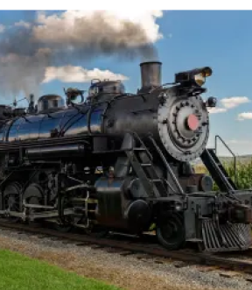
Missouri Standards Alignment
4th Grade - Physical Science
Electricity, Light, & Heat (Electricity, Light & Heat)
 | Topic & Guiding Question | Student Objectives | Missouri Learning Standards for Science 2016
 | Renewable Energy & Natural Resources What’s the best way to light up a city? | Students evaluate the advantages and disadvantages of wind, water, and solar energy to power a town. Students obtain and evaluate information about the needs of each source of energy and analyze and interpret data about the town’s resources. | 4.PS3.B.2 Apply scientific ideas to design, test, and refine a device that converts energy from one form to another.
 | Electrical Energy What if there were no electricity? | Students design a flashlight with an on/off switch, using batteries, flights, and tin foil. Students figure out that electricity can be transformed to other forms of energy, such as movement, light, and heat. | 4.PS3.B.2 Apply scientific ideas to design, test, and refine a device that converts energy from one form to another. 4.ETS1.B.1 Generate and compare multiple solutions to a problem based on how well each is likely to meet the criteria and constraints of the problem.
 | Heat Energy & Energy Transfer How long did it take to travel across the country before cars and planes? | Students build a paper spinner and conduct an investigation to explain how heat makes things move. Students realize that heat energy can be transformed into motion energy using a turbine. | 4.PS3.B.1 Provide evidence to construct an explanation of an energy transformation (e.g. temperature change, light, sound, motion, and magnetic effects).
Lesson 1
Lesson 2
Lesson 3
www.mysteryscience.com/docs/missouri

Slide 32


Missouri Standards Alignment
4th Grade - Physical Science
Sound, Waves, & Communication (Waves of Sound)
 | Topic & Guiding Question | Student Objectives | Missouri Learning Standards for Science 2016
 | Pattern Transfer & Technology How do you send a secret code? | Students explore how digital devices encode complex information. Students generate their own codes in order to transfer information across the classroom. Then, they compare their codes and evaluate which worked best given the criteria and constraints. | 4.PS4.A.1 Develop a model of waves to describe patterns in terms of amplitude or wavelength and that waves can cause objects to move.
 | Sound, Vibration, & Engineering How far can a whisper travel? | Students investigate sound energy using paper cup telephones. Students figure out that sound is a vibration that can travel through a medium. | 4.PS4.A.1 Develop a model of waves to describe patterns in terms of amplitude or wavelength and that waves can cause objects to move. 4.ETS1.C.1 Plan and carry out fair tests in which variables are controlled and failure points are considered to identify aspects of a model or prototype that can be improved.
 | Sound & Vibrations What would happen if you screamed in outer space? | Students construct a model of sound vibrations to explain how air is a medium that sound vibrations travel through. | 4.PS4.A.1 Develop a model of waves to describe patterns in terms of amplitude or wavelength and that waves can cause objects to move.
 | Sound Waves & Wavelength Why are some sounds high and some sounds low? | Students make observations of vibrations and sound waves to discover that high pitch sounds vibrate faster and have short wavelengths and low pitch sounds vibrate slower and have long wavelengths. | 4.PS4.A.1 Develop a model of waves to describe patterns in terms of amplitude or wavelength and that waves can cause objects to move.
Lesson 1
Lesson 2
Lesson 3 Lesson 4
Lesson 1
Lesson 2
Lesson 3
www.mysteryscience.com/docs/missouri

Slide 33
Missouri Standards Alignment
5th Grade - Life Science
This unit is found under 4th grade on our site, but we recommend teaching all of its lessons in 5th grade if you are following Missouri Standards.
Human Body, Vision, & The Brain (Human Machine)
 | Topic & Guiding Question | Student Objectives | Missouri Learning Standards for Science 2016
 | Muscles & Skeleton Why do your biceps bulge? | Students construct a model of the human hand to explain how muscles pull on bones to create movement. | 4.LS1.A.1 Construct an argument that plants and animals have internal and external structures that function to support survival, growth, behavior, and plant reproduction.
 | Light, Eyes, & Vision What do people who are blind see? | Students develop a working model of an eye. They use the model to reason about how light reflects off an object and into the eye, helping an organism process information from the environment. | 5.PS4.A.1 Develop a model to describe that objects can be seen only when light is reflected off them or when they produce their own light.
 | Structure & Function of Eyes How can some animals see in the dark? | Students use their eye model to discover that the pupil controls the amount of light let into the eye. In the dark, pupils get larger to let in more light. | 5.PS4.A.1 Develop a model to describe that objects can be seen only when light is reflected off them or when they produce their own light.
 | Brain, Nerves, & Information Processing How does your brain control your body? | Students investigate how their own brain works by testing their reflexes. They discover that the brain receives information from the senses, processes the information, and sends signals to the muscles to enable movement. | 4.LS1.D.1 Use a model to describe that animals receive different types of information through their senses, process the information in their brain, and respond to the information in different ways.
Lesson 1
Lesson 2
Lesson 3
Lesson 4
We recommend teaching this in 4th grade if following Missouri Standards.
We recommend teaching this in 4th grade if following Missouri Standards.
Missouri Specific Standard: 5.LS1.A.1 Compare and contrast the major organs/organ systems (e.g. support, reproductive, digestive, transport/circulatory, excretory, response) that perform similar functions for animals belonging to different vertebrate classes.
www.mysteryscience.com/docs/missouri

Slide 34
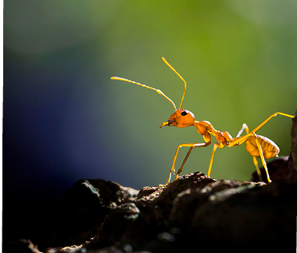
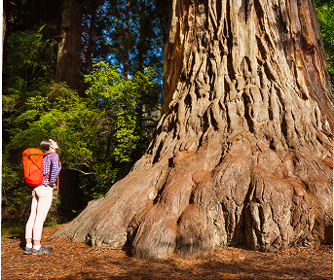
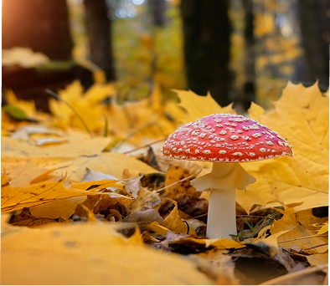
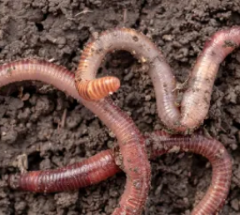
Missouri Standards Alignment
5th Grade - Life Science
Ecosystems & The Food Web (Web of Life)• Page 1 of 2
 | Topic & Guiding Question | Student Objectives | Missouri Learning Standards for Science 2016
 | ✨New!✨ Food Chains & Matter Flow What if all the ants disappeared? | Students construct models of food chains by linking cards discovering that different interrelationships exist between organisms. | 5.LS2.B.1 Develop a model to describe the movement of matter among plants, animals, decomposers, and the environment.
 | ✨New!✨ Plant Growth & Matter How does a tiny seed become one of the heaviest trees on Earth? | Students gather evidence through a series of virtual experiments to construct an argument that plants use mostly air and water as the materials for their growth. | 5.LS1.C.1 Support an argument that plants get the materials (i.e. carbon dioxide, water, sunlight) they need for growth chiefly from air and water.
 | ✨New!✨ Decomposers & Matter Flow Where do fallen leaves go? | Students conduct an investigation to gain an understanding of the important role that decomposers play in recycling matter from dead leaves back into the environment. | 5.LS2.B.1 Develop a model to describe the movement of matter among plants, animals, decomposers, and the environment.
 | Decomposers & Soil Nutrients Do worms really eat dirt? | Students make observations of worms to realize that worms act as decomposers to eat dead matter in an ecosystem and cycle nutrients into the soil. | 5.LS2.B.1 Develop a model to describe the movement of matter among plants, animals, decomposers, and the environment.
Lesson 1
Lesson 2
Lesson 3
Lesson 4
Continued on next page
✨ New Lesson
www.mysteryscience.com/docs/missouri

Slide 35

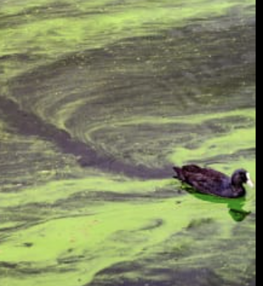
Missouri Standards Alignment
5th Grade - Life Science
Ecosystems & The Food Web (Web of Life)• Page 2 of 2
 | Topic & Guiding Question | Student Objectives | Missouri Learning Standards for Science 2016
 | Ecosystems & Matter Cycle Why do you have to clean a fish tank but not a pond? | Students develop a model of a pond ecosystem and realize that interrelationships exist between decomposers, plants, and animals. Students discover that each organism must be in balance for the pond ecosystem to function. | 5.LS2.B.1 Develop a model to describe the movement of matter among plants, animals, decomposers, and the environment.
 | Protecting Environments How can we protect Earth’s environments? | In this lesson, students learn about what happens in unbalanced ecosystems and how that can lead to an overabundance of algae and harmful algal blooms. In the activity, Bloom Busters, students play a game in which they obtain and combine science ideas in order to help a community respond to and prevent harmful algal blooms. | 5.ESS3.C.1 Obtain and combine information about ways individual communities use science ideas to protect the Earth’s resources and environment.
 | Food Webs & Flow of Energy Why did the dinosaurs go extinct? | Students develop a model of a dinosaur food web. Students realize that blocking the sun’s energy would have disastrous effects on the organisms that rely on this energy in the food web and cause the extinction of some entire species. | 5.PS3.D.1 Use models to describe that energy stored in food (used for body repair, growth, motion, and to maintain body warmth) was once energy from the sun.
Lesson 5 Lesson 6
Lesson 7
www.mysteryscience.com/docs/missouri

Slide 36

Missouri Standards Alignment
5th Grade - Earth & Space Science
Water Cycle & Earth’s Systems (Watery Planet)
 | Topic & Guiding Question | Student Objectives | Missouri Learning Standards for Science 2016
Lesson 1 | Hydrosphere & Water Distribution How much water is in the world? | Students analyze and interpret data from world maps to determine the relative amounts of fresh, salt, and frozen water. Students figure out that while the Earth has a lot of water, most of Earth’s water is not fresh or accessible. | 5.ESS2.C.1 Describe and graph the amounts and percentages of water and fresh water in various reservoirs to provide evidence about the distribution of water on Earth.
Lesson 2 | Mixtures & Solutions How much salt is in the ocean? | Students create a model ocean to observe how salt seems to completely vanish when dissolved in water. Students measure and graph quantities to provide evidence that the salt is still in the solution, even though we can’t see it. | 5.PS1.A.2 Measure and graph quantities to provide evidence that regardless of the type of change that occurs when heating, cooling, or mixing substances, the total weight of matter is conserved. 5.PS1.B.1 Plan and conduct investigations to separate the components of a mixture/solution by their physical properties (ie. sorting, filtration, magnets, screening).
Lesson 3 | Groundwater as a Natural Resource When you turn on the faucet, where does the water come from? | Students learn most people get fresh water from underground sources. Students determine the best place to settle a town by considering features of the landscape & the characteristics of the plants that thrive there. | 5.ESS2.A.1 Describe a model using an example to describe ways the geosphere, biosphere, hydrosphere, and/or atmosphere interact.
Lesson 4 | Water Cycle Can we make it rain? | Students create a model of the ocean and sky to investigate how temperature influences evaporation and condensation. Students figure out that higher ocean temperatures lead to more evaporation, thus leading to more rain. | 5.ESS2.A.1 Describe a model using an example to describe ways the geosphere, biosphere, hydrosphere, and/or atmosphere interact.
 | Natural Disasters & Engineering How can you save a town from a hurricane? | Students define the problem that a town needs protection from flooding. They design solutions using different types of flood protection. They realize flooding is caused by severe rainfall generated by hurricanes. Hurricanes are created where ocean temperatures are warm. | 5.ETS1.A.1 Define a simple design problem reflecting a need or a want that includes specified criteria for success and constraints on materials, time, or cost. 5.ETS1.B.1 Generate and compare multiple solutions to a problem based on how well each is likely to meet the criteria and constraints of the problem.
Lesson 1
Lesson 2
Lesson 3
Lesson 4
Lesson 5
Missouri Specific Standard: 5.ETS1.C.1 Plan and carry out fair tests in which variables are controlled and failure points are considered to identify aspects of a model or prototype that can be improved.
www.mysteryscience.com/docs/missouri

Slide 37
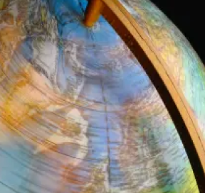

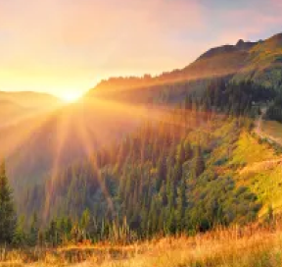
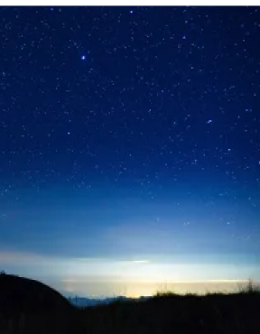
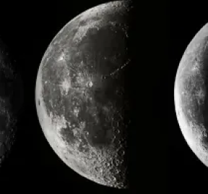
Missouri Standards Alignment
5th Grade - Earth & Space Science
Earth & Space Patterns (Spaceship Earth)
 | Topic & Guiding Question | Student Objectives | Missouri Learning Standards for Science 2016
 | Day, Night, & Earth’s Rotation How fast does the Earth spin? | Students model the rotation of the Earth and investigate why the Sun looks like it’s moving across the sky. Using evidence they gathered in the investigation, students build a model that explains how the Earth’s rotation around its own axis causes the Sun to appear to rise and set. | 5.ESS1.B.2 Represent data in graphical displays to reveal patterns of daily changes in length and direction of shadows, day and night, and the seasonal appearance of some stars in the night sky.
 | Earth’s Rotation & Daily Shadow Patterns Who set the first clock? | Students make a shadow clock (sundial) and investigate how the direction and length of shadows change with the position of the light shining on the sundial. Students realize that the Sun’s position in the sky can be used to tell the time of day. | 5.ESS1.B.2 Represent data in graphical displays to reveal patterns of daily changes in length and direction of shadows, day and night, and the seasonal appearance of some stars in the night sky.
 | Seasonal Changes & Shadow Length How can the Sun tell you the season? | Students examine photos taken at different times of year and figure out the time of year that each photo was taken. Students discover that the Sun’s path changes with the seasons, as does the time of sunrise and sunset. The Sun is always highest in the sky at noon, but that height changes with the season. | 5.ESS1.B.1 Make observations during different seasons to relate the amount of daylight to the time of year.
 | Seasonal Patterns & Earth’s Orbit Why do the stars change with the seasons? | Students build a model of the universe and use it to explain why different stars are visible at different times of year. Using evidence from this model, students make an argument that supports the claim that the Earth orbits the Sun. | 5.ESS1.B.2 Represent data in graphical displays to reveal patterns of daily changes in length and direction of shadows, day and night, and the seasonal appearance of some stars in the night sky.
 | Moon Phases, Lunar Cycle Why does the Moon change shape? | Students use a physical model of the Sun and Moon to investigate how the Moon’s phase relates to its position relative to the Sun. Students notice that the Moon’s phases repeat in a predictable pattern. | 5.ESS1.B.2 Represent data in graphical displays to reveal patterns of daily changes in length and direction of shadows, day and night, and the seasonal appearance of some stars in the night sky.
Lesson 1
Lesson 2
Lesson 3
Lesson 4
Lesson 5
www.mysteryscience.com/docs/missouri

Slide 38
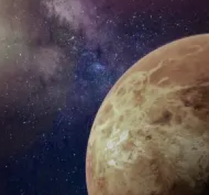
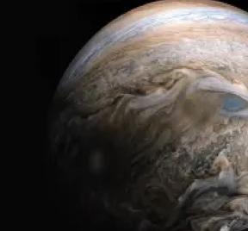
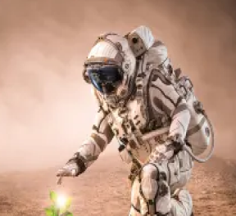
Missouri Standards Alignment
5th Grade - Earth & Space Science
Stars & Planets (Stars & Planets)
 | Topic & Guiding Question | Student Objectives | Missouri Learning Standards for Science 2016
 | Solar System & Sun Brightness How can the Sun help us explore other planets? | Students gather evidence to support an argument that the apparent brightness of the Sun is dependent upon an observer’s distance from the Sun. They construct a model of the solar system and gather observations of the Sun’s apparent brightness from each planet within their model. | 5.ESS1.A.1 Support an argument that relative distances from Earth affects the apparent brightness of the sun compared to other stars.
 | Gravity Why is gravity different on other planets? | Using mathematics and computational thinking, students calculate how high they could jump on planets and moons that have stronger or weaker gravity than Earth. Students analyze and interpret this data to construct an explanation for why the amount of gravity is different on other planets. | 5.PS2.B.1 Support an argument that the gravitational force exerted by Earth on objects is directed towards the planet’s center.
 | Star Brightness & Habitable Planets Could there be life on other planets? | Sun with the right amount of light and heat for life to exist. Students evaluate other solar systems, comparing their stars to our Sun. Based on their analysis, students plan a space mission to a planet with conditions similar to those on Earth. | 5.ESS1.A.1 Support an argument that relative distances from Earth affects the apparent brightness of the sun compared to other stars.
Lesson 1
Lesson 2
Lesson 3
www.mysteryscience.com/docs/missouri

Slide 39

Missouri Standards Alignment
5th Grade - Physical Science
Chemical Reactions & Properties of Matter (Chemical Magic)
 | Topic & Guiding Question | Student Objectives | Missouri Learning Standards for Science 2016
 | Conservation of Matter Are magic potions real? | Students observe that a salt and vinegar solution will turn a dull penny shiny again indicating that substances can change other substances. | Foundational for 5.PS1.A.1 Develop a model to describe that matter is made of particles too small to be seen. Foundational for 5.PS1.A.2 Measure and graph quantities to provide evidence that regardless of the type of change that occurs when heating, cooling, or mixing substances, the total weight of matter is conserved.
 | Dissolving & Particulate Nature of Matter Could you transform something worthless into gold? | Students coat a steel nail in copper by placing it into the solution that dissolved bits of the penny. Students realize that substances can change to become particles too small to be seen, but they still exist. | Foundational for 5.PS1.A.1 Develop a model to describe that matter is made of particles too small to be seen. Foundational for 5.PS1.A.2 Measure and graph quantities to provide evidence that regardless of the type of change that occurs when heating, cooling, or mixing substances, the total weight of matter is conserved.
 | Properties of Matter: Acids What would happen if you drank a glass of acid? | Students figure out that acids are very reactive substances. Students investigate reactions between different substances to determine how known acids react with other materials. | 5.PS1.B.2 Conduct an investigation to determine whether the combining of two or more substances results in new substances.
 | Chemical Reactions What do fireworks, rubber, and Silly Putty have in common? | Students combine different substances together to discover that chemical reactions can create new substances. | 5.PS1.B.2 Conduct an investigation to determine whether the combining of two or more substances results in new substances.
 | Gases & Particle Models Why do some things explode? | Students investigate and model the reaction between baking soda and vinegar. They figure out that gases are made of particles too small to be seen. | 5.PS1.A.1 Develop a model to describe that matter is made of particles too small to be seen.
Lesson 1
Lesson 2
Lesson 3
Lesson 4
Lesson 5
www.mysteryscience.com/docs/missouri

