Slide 1


Health Education: Home Injury Prevention
Johns Hopkins Center for Injury Research and Policy
Diné College

Slide 2
How this lecture fits into the course
This lecture builds on discussions in a Health Education course by focusing on an intervention developed using the Health Belief Model. The intervention includes educational materials for child injury prevention in the home setting.

Slide 3
Part 1: Learning Objectives
In this lecture you will learn an introduction to injury prevention:
Define injury
Describe how injury compares with other leading causes of death
Describe injury epidemiology for both intentional and unintentional injuries.
Notes:
Define injury and/or violence and describe the concepts of intentionality and mechanism as they relate to injury and/or violence.
Describe how injury and/or violence compare with other leading causes of morbidity and mortality and with regard to burdens on the population (e.g. incidence, cost, years of potential life lost, etc.)
Explain how injuries and/or violence are preventable.
Describe the disparity in the risks of injury and/or violence (e.g. differences by age, gender, race, ethnicity, education, location, access to economic resources, access to health care services, sexual orientation, creed, community norms, and the environment).
Describe the influence of a variety of factors (including age, gender, race, ethnicity, education, access to economic resources, sexual orientation, creed, community norms, access to health care services, and the environment) on injury and/or violence prevention.

Slide 4
What are the public health issues you have discussed so far in your studies?
Notes:
Ask everyone to respond immediately in the chat to the prompt “What are the public health issues that you have discussed so far in your studies?” This works because it is rapid and shows the diversity of experiences all at once.
Comment on the variety of responses, or that hopefully the variety of responses will be increased through the introduction of Injury Prevention and Home Injury Prevention issues in today’s lesson.

Slide 5

Part 1: Injury 101
Play Recorded Lecture

Slide 6
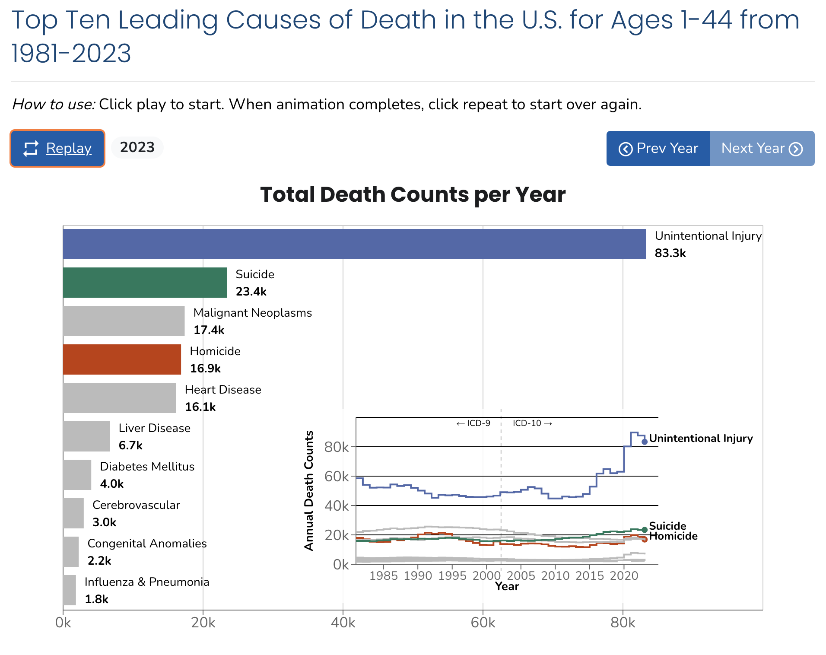
Link to animation: https://wisqars.cdc.gov/animated-leading-causes/
Notes:
Optional activity if there is time. Description in Facilitator Guide.

Slide 7
Part 2: Health Education for Home Injury Prevention Learning Objectives
After this lecture, you will be able to:
NEED OBJECTIVES.
Notes currently on slide: Overall, this lecture describes an example of methods of
instruction for home injury in health education.
– add lecture slide with modality

Slide 8
Part 2: Health Education for Home Injury Prevention
Play Recorded Lecture

Slide 9

DISCUSSION QUESTIONS
What connections did you see in
this lecture to your current coursework?
If you were to design health
education materials, which
modality or method of instruction
would you use? ​
From your perspective, what
structural barriers do you think may
be driving home injury risks?
Notes:
If the class will be going into different break out rooms, post the questions in the chat before initiating the breakout rooms. Inform the facilitators the time allowed and if there will be a person to give a summary of the small group discussion.

