Slide 1
Microsoft Teams
- End User Guide -
April, 2023

Slide 2
Table of Contents
MS Teams Call Flow
MS Teams User Guide

Slide 3
MS Teams Call Flows

Slide 4



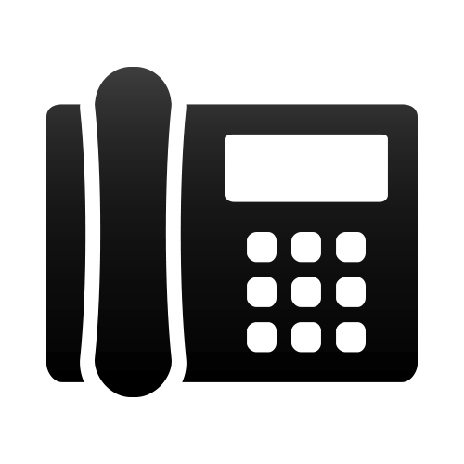

User Experience
MS Teams Application
Phone Number
Incoming, Outgoing Calls to external numbers
Laptop / Desktop
IP Phone
Smart Phone

Slide 5
MS Teams Basic User Guide

Slide 6
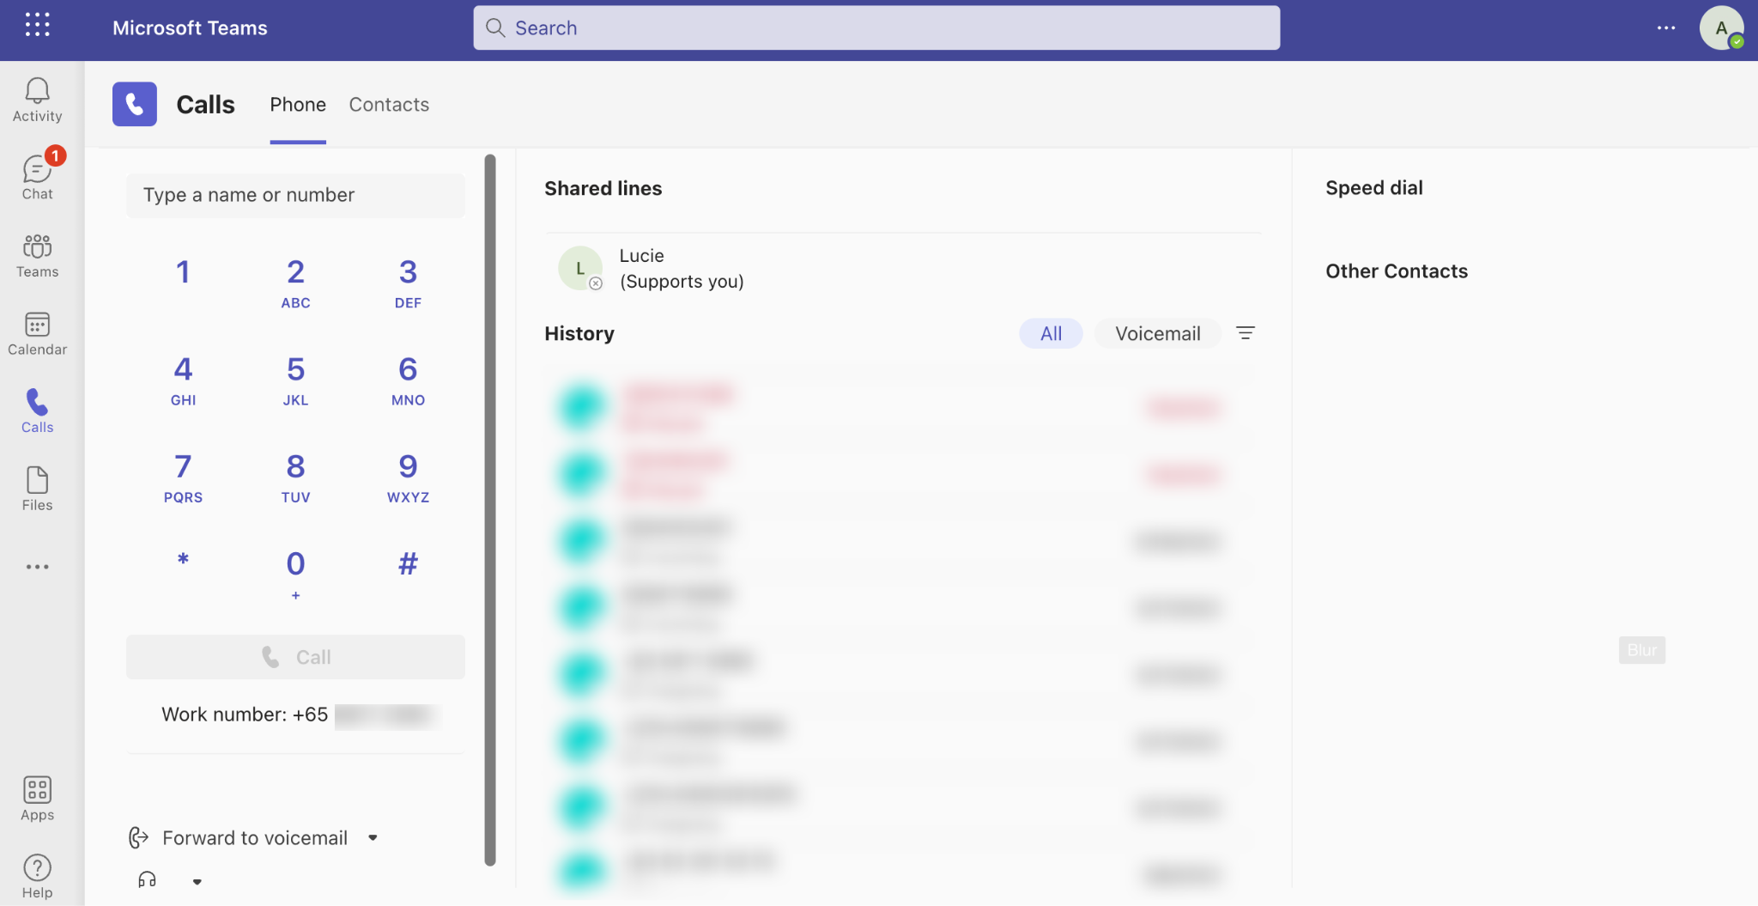
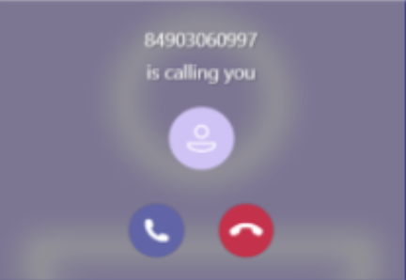
1. MS Teams User Interface
Outbound calls to normal phone numbers
MS Teams Outgoing Call
  Login your MS Teams account > Go to Calls > Dial a Number > Enter contact > Call
MS Teams Incoming Call
  On both Web, Mobile and Desktop App, users will see an incoming call notification. Click on the Green Call button to pick up the incoming call.
Receive inbound calls from your mobile or fixed line numbers on MS Teams Apps

Slide 7
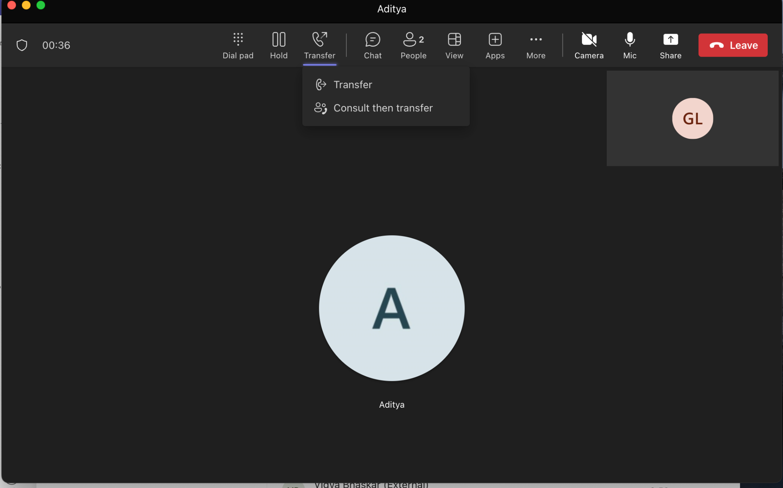
2. MS Teams Call Transfer
During an active call, users will have these options available:
  Direct Transfer - allows users to transfer the call blindly.
  Consult then Transfer - using MS Teams Directory on desktop or mobile, user can either use the chat box or do a warm transfer to converse with the transfer destination first. After which, the transferer can click on the Transfer button to complete the call, or go back to the caller if declined.

Slide 8
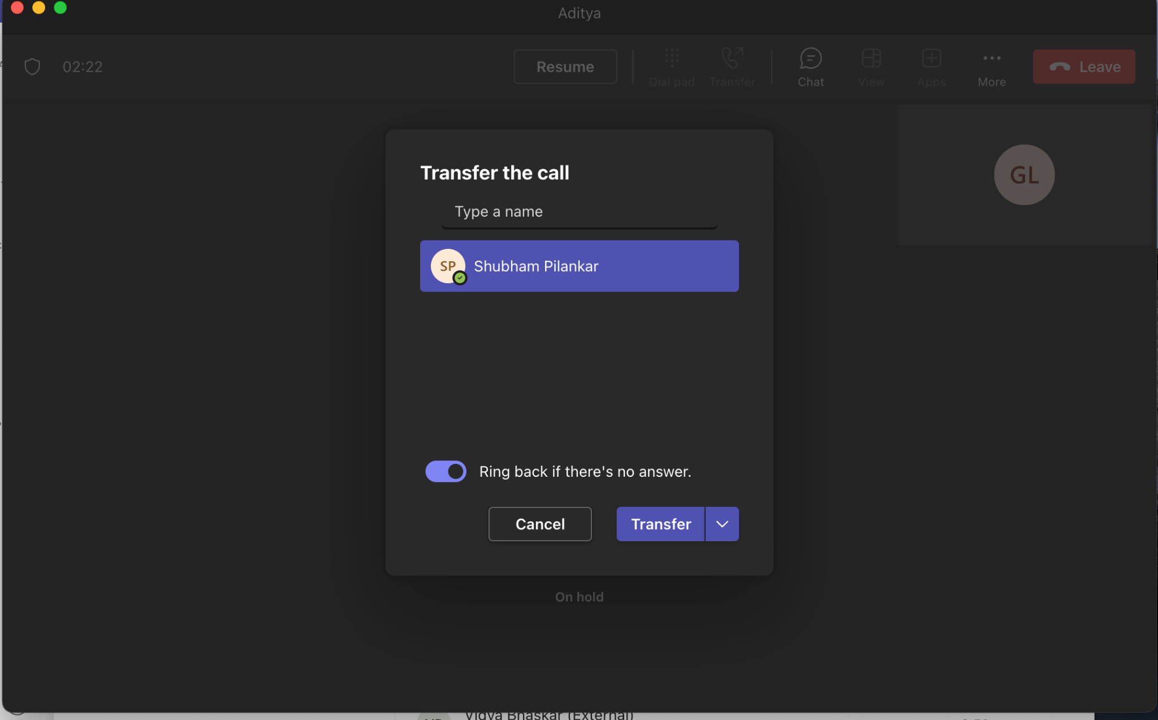
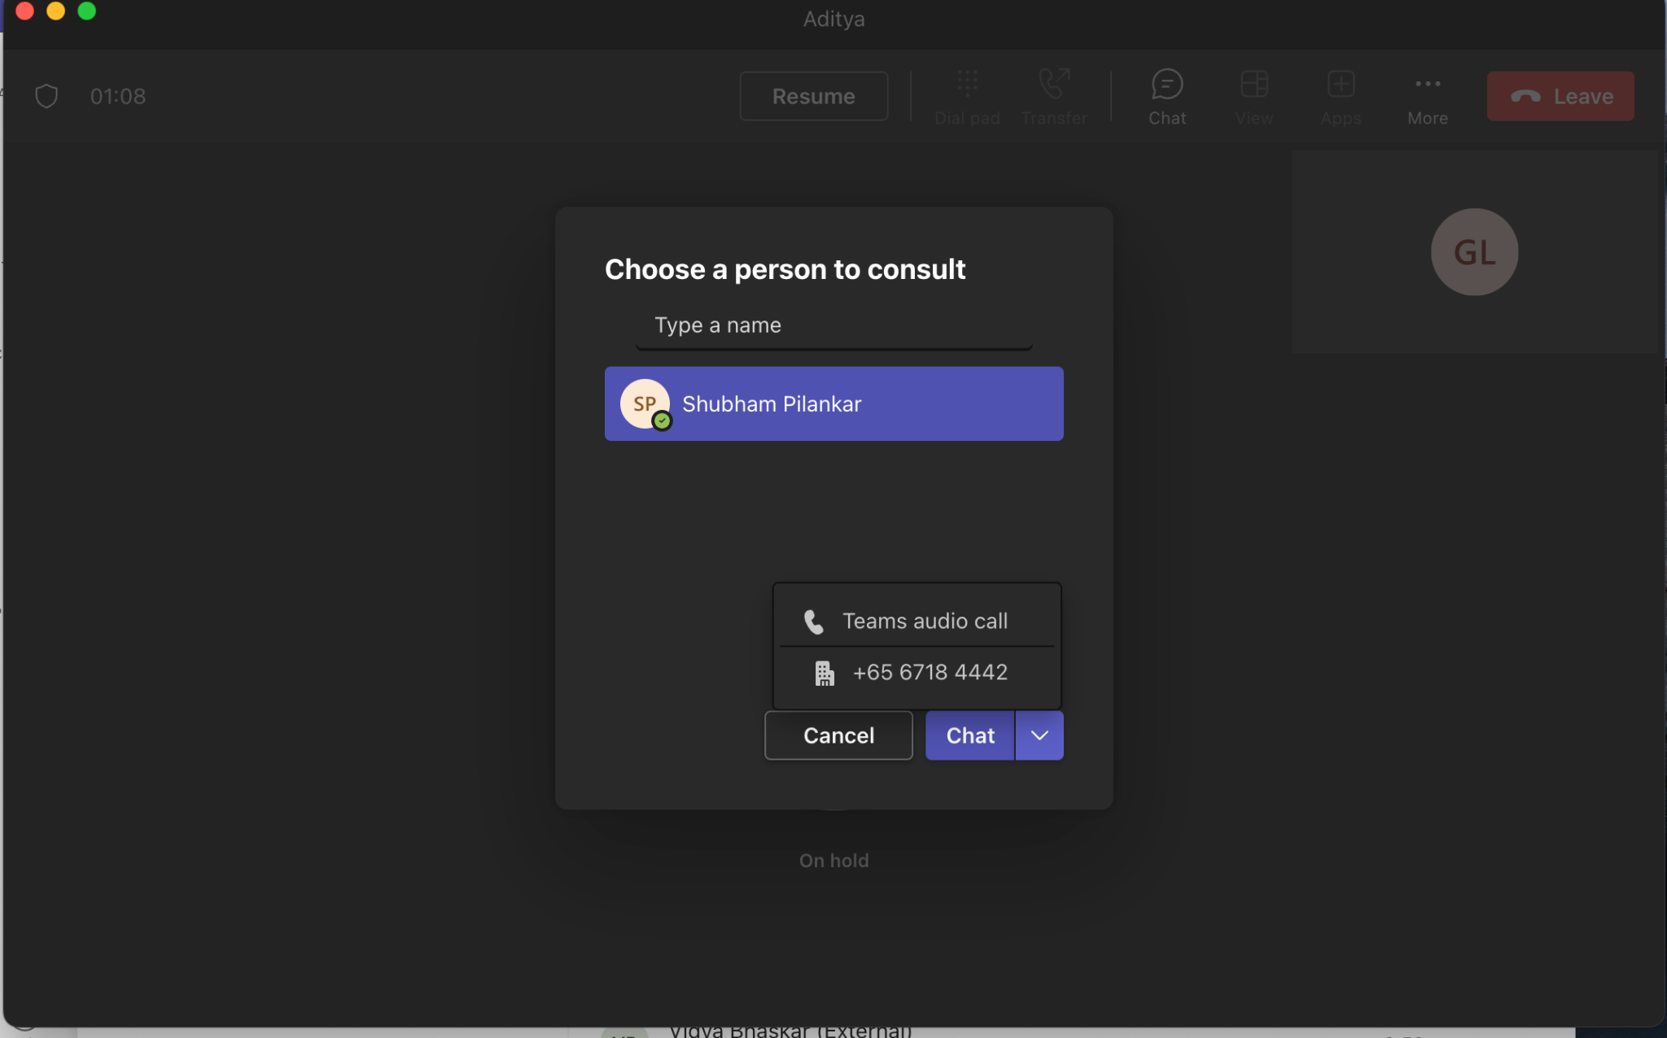
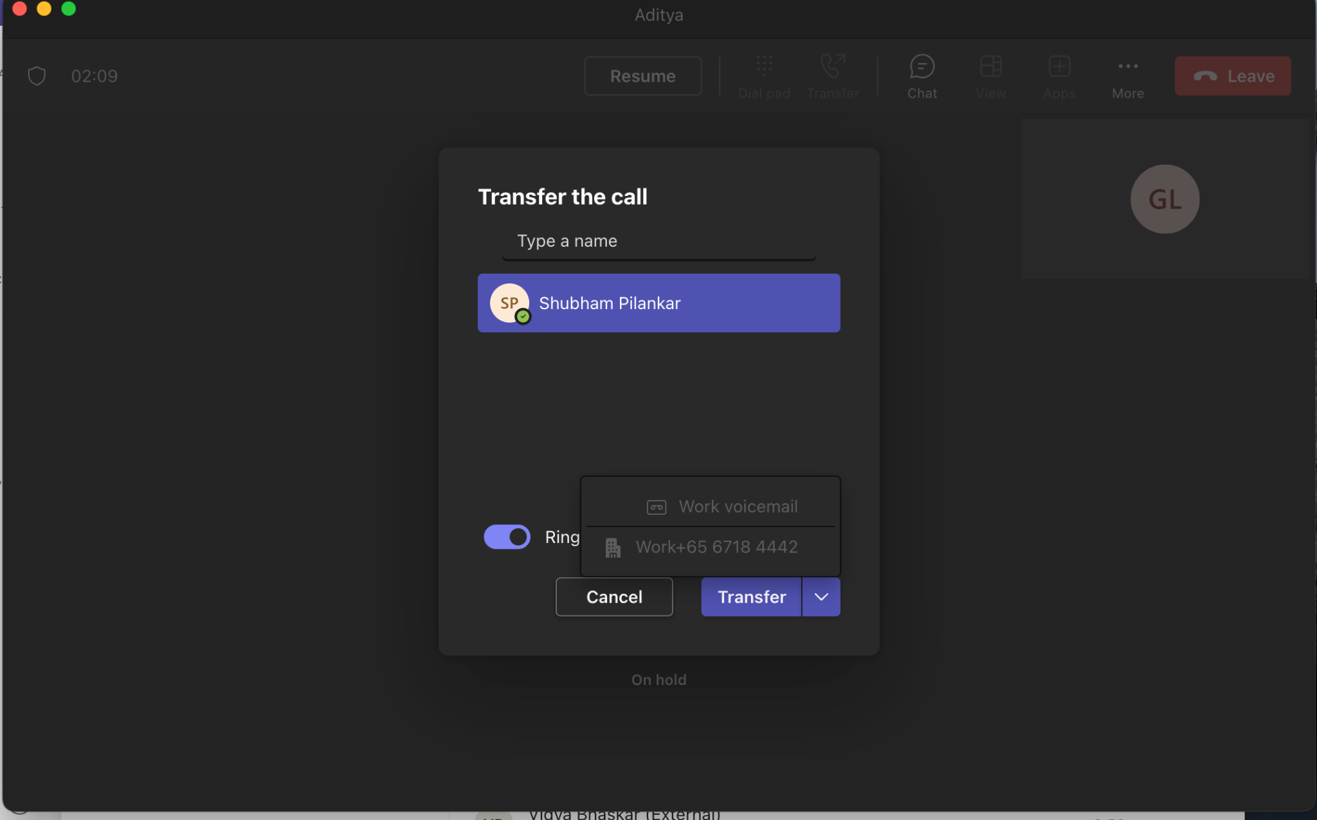
2. MS Teams Call Transfer - Desktop View
Direct Transfer
Consult then Transfer

Slide 9
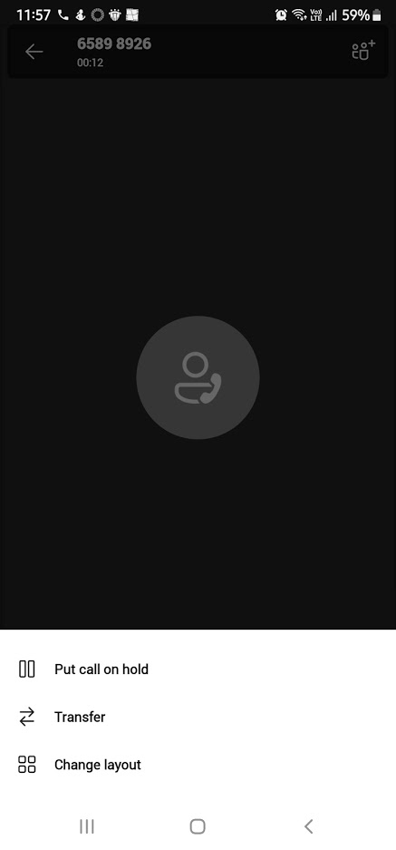
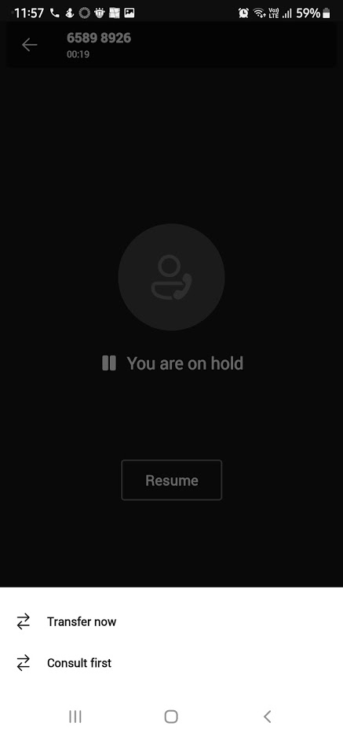
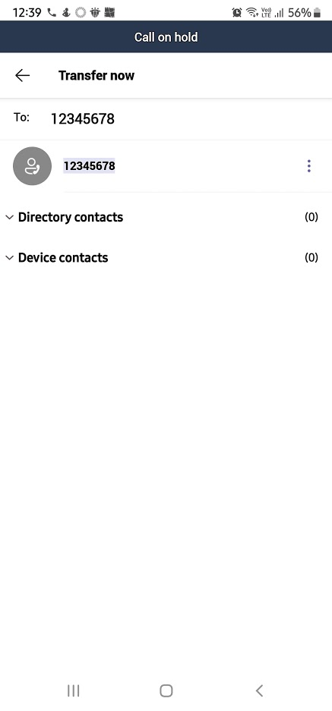
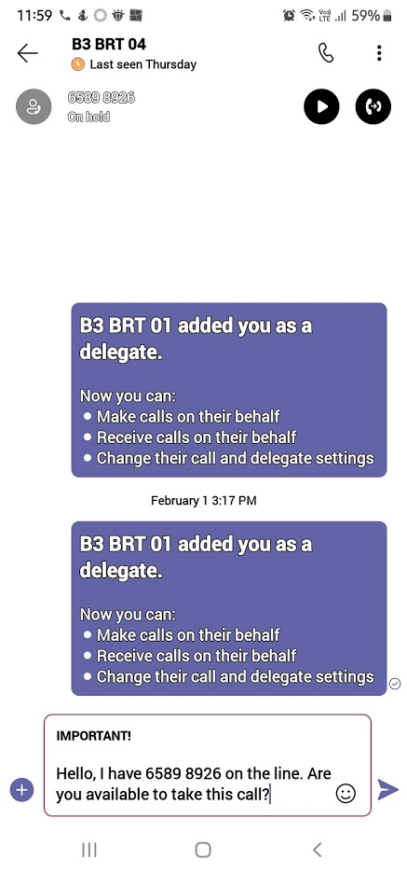
2. MS Teams Call Transfer - Mobile App View
Transfer Now
Consult First (Chat)

Slide 10
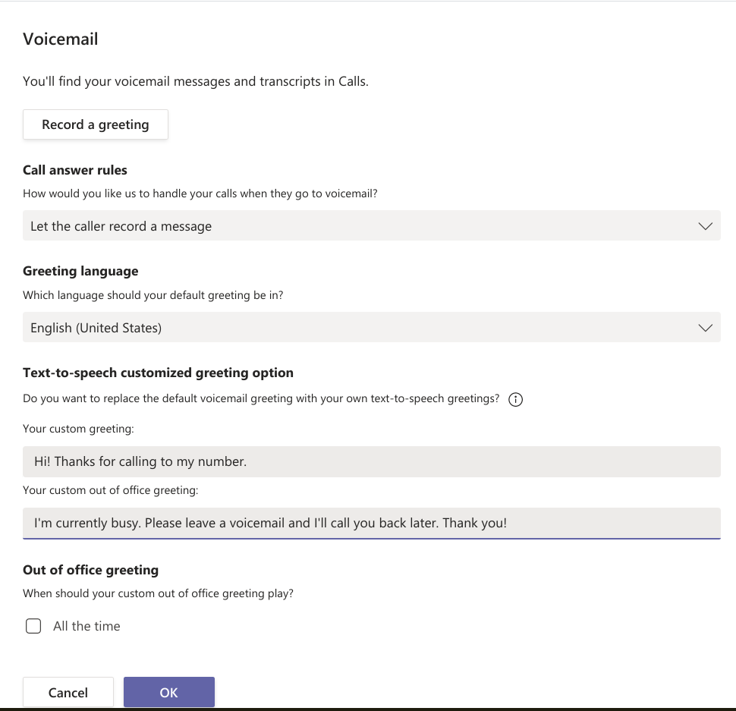
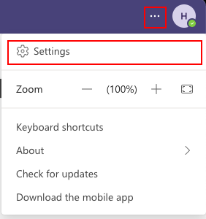
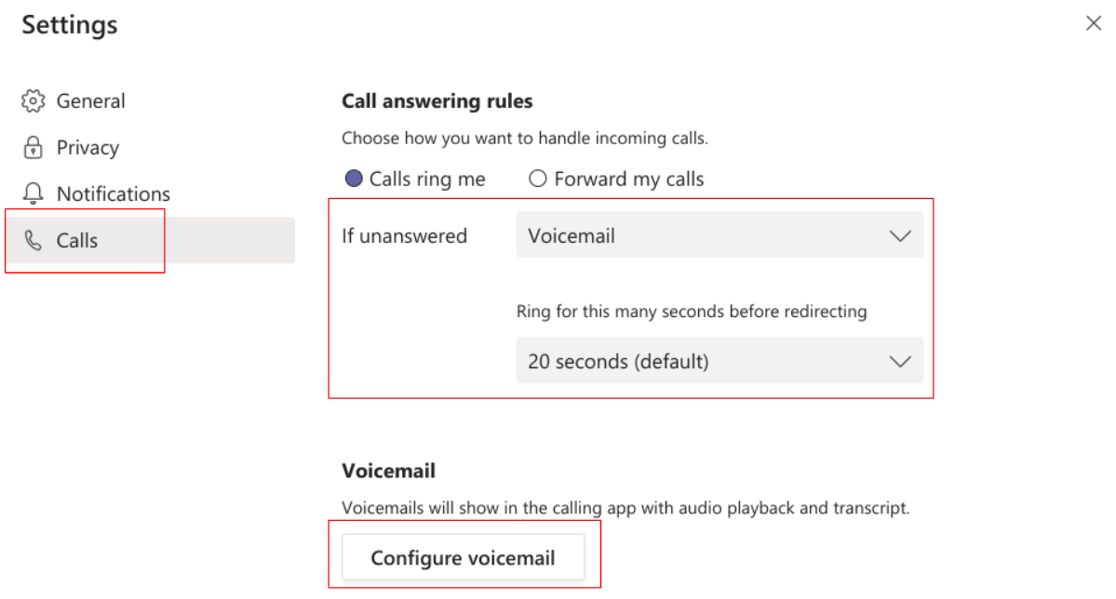
3. MS Teams Voicemail
To configure:
Login your MS Teams account on Desktop > Go to Settings > Calls
Click on Configure voicemail > configure your own settings > OK
By default, Teams will play your voicemail greeting and allow the caller to record a message. You have some other options, though:
Let the caller record a message.
Let the caller record a message or be transferred to someone else.
End the call without playing your greeting.
Play your greeting and end the call.
Transfer the call to someone else.

Slide 11
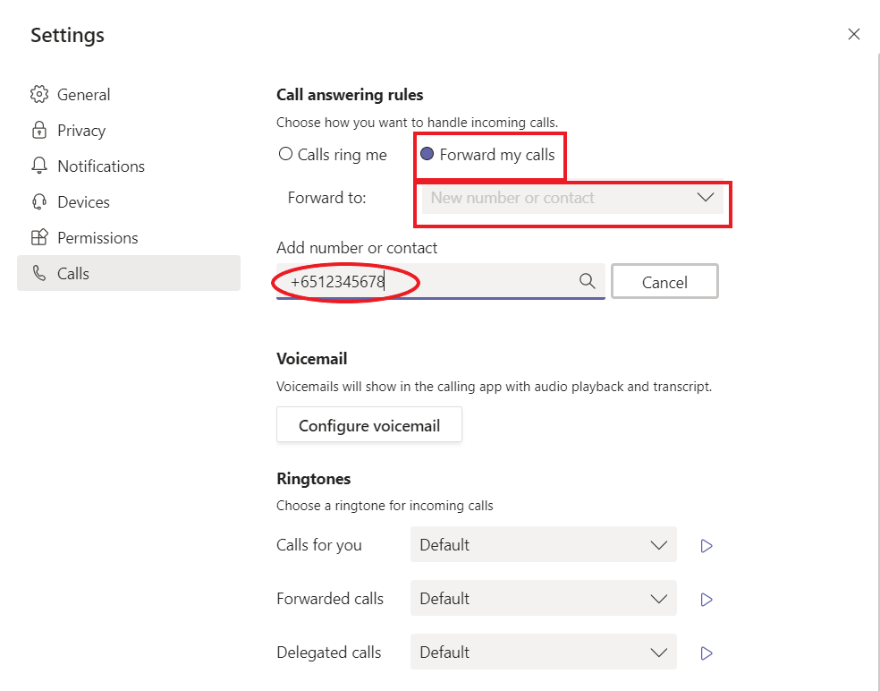
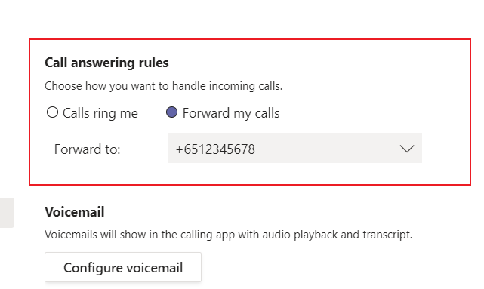
4. MS Teams Call Forwarding
Login your MS Teams account > Go to Settings
Go to Calls > Call answering rules > Forward my calls
Choose forward call to New number or contact > add the forwarding number > Enter

Slide 12
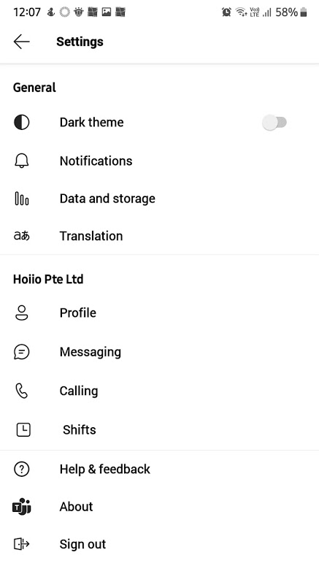
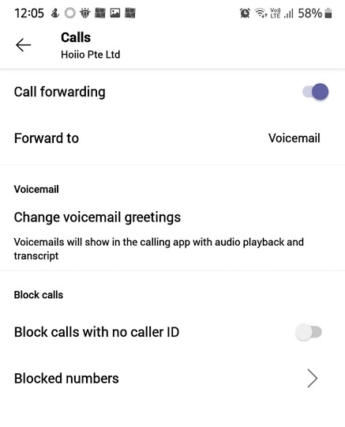
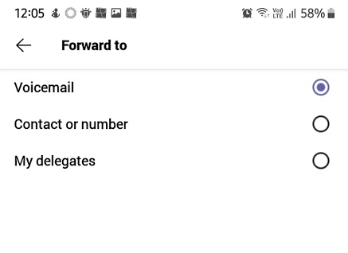
4. MS Teams Call Forwarding - Mobile App View

Slide 13
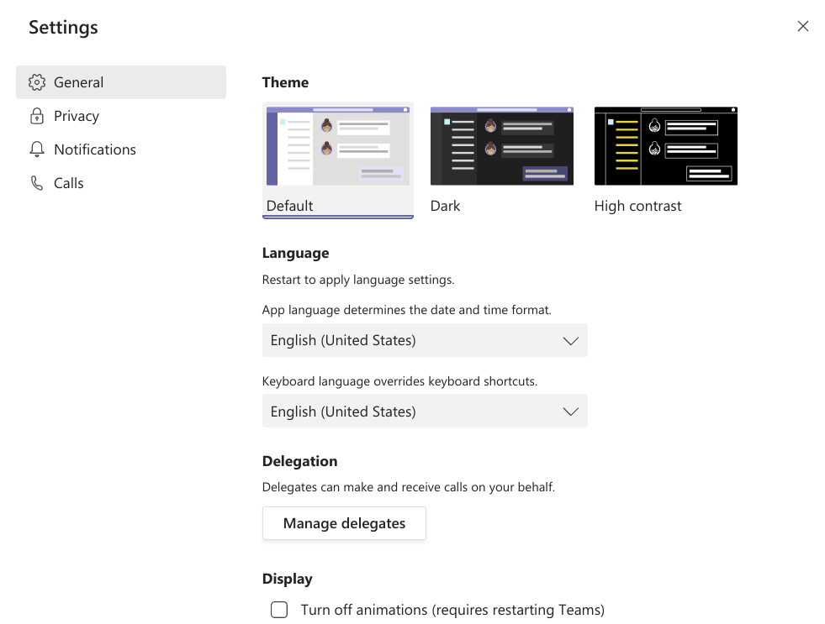
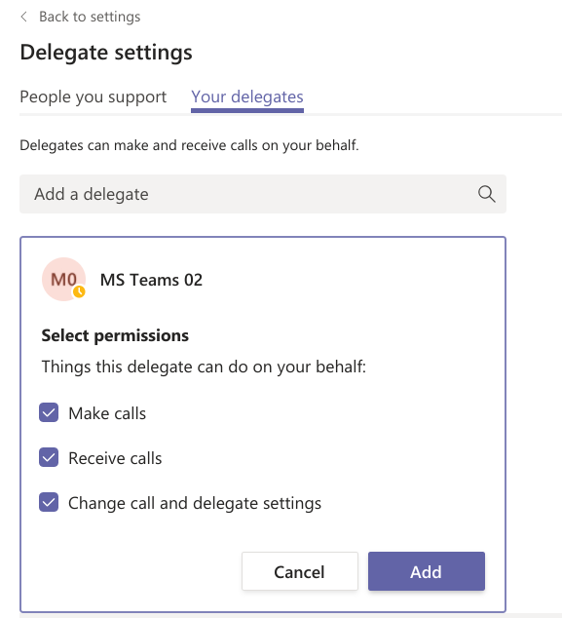
5. MS Teams Delegation
Login your MS Teams account > Go to Settings
Go to General > Delegation > Manage Delegates > Your delegates
Search your delegates > Add

Slide 14
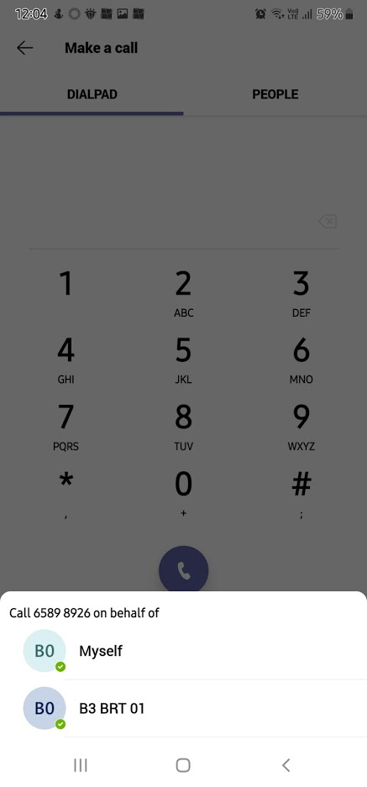
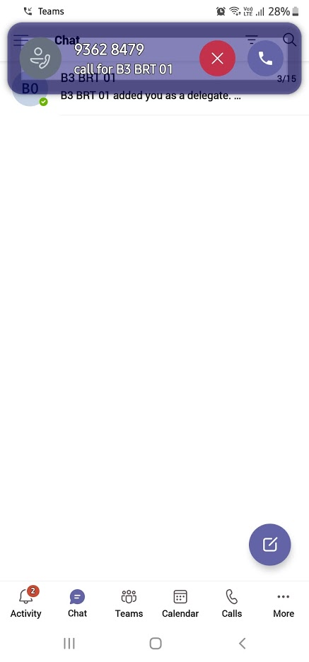
MS Teams Delegation is mainly used in a Boss/Secretary use case or the like. When a user is assigned as a Delegate, they can:
Make calls on behalf of the people they support. When the Delegate makes a call on their behalf, the recipient will see the corresponding number/Caller ID of the “Boss”.
Receive calls for/on behalf of the supported User. The “Boss” can either forward ALL calls to the delegate or ring both users simultaneously when a call comes in.
5. MS Teams Delegation (Cont’d)
Mobile App View (Outgoing Call)
Mobile App View (Outgoing Call)

Slide 15
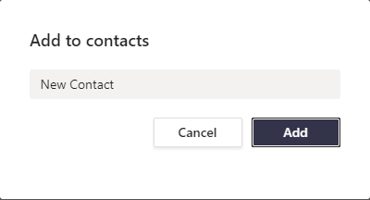
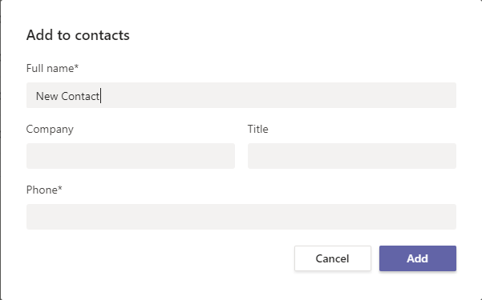
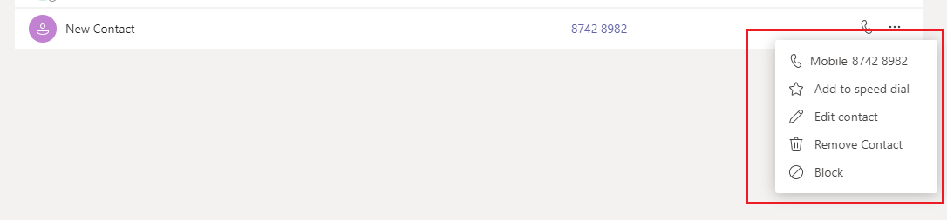
6. MS Teams Contacts (Directory)
Login your MS Teams account on Desktop > Go to Calls > Add Contacts
On Desktop, Users are able to manually add New Contacts. On Mobile App, Users can allow access/link their MS Teams to their native mobile Directory.

Slide 16
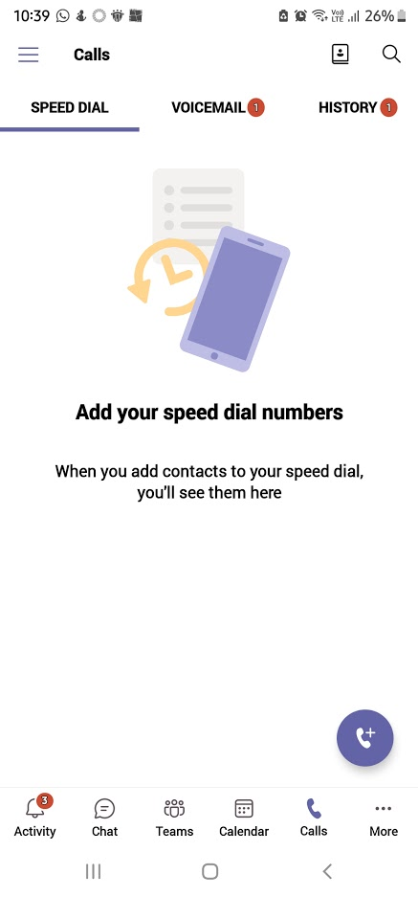
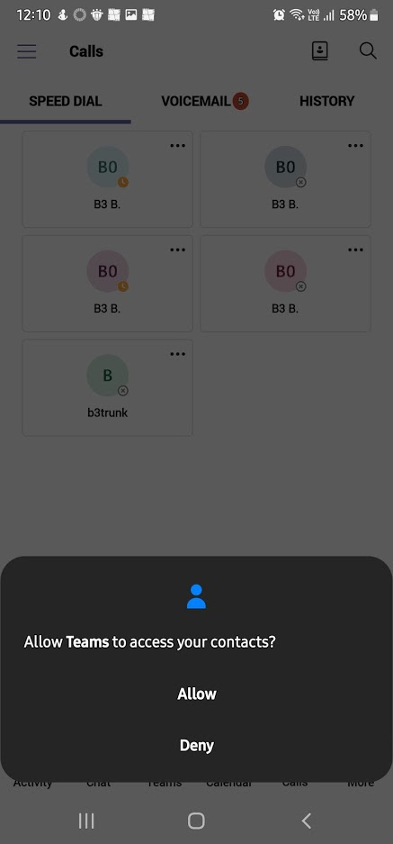
6. MS Teams Contacts (Directory) - Mobile App View

Slide 17
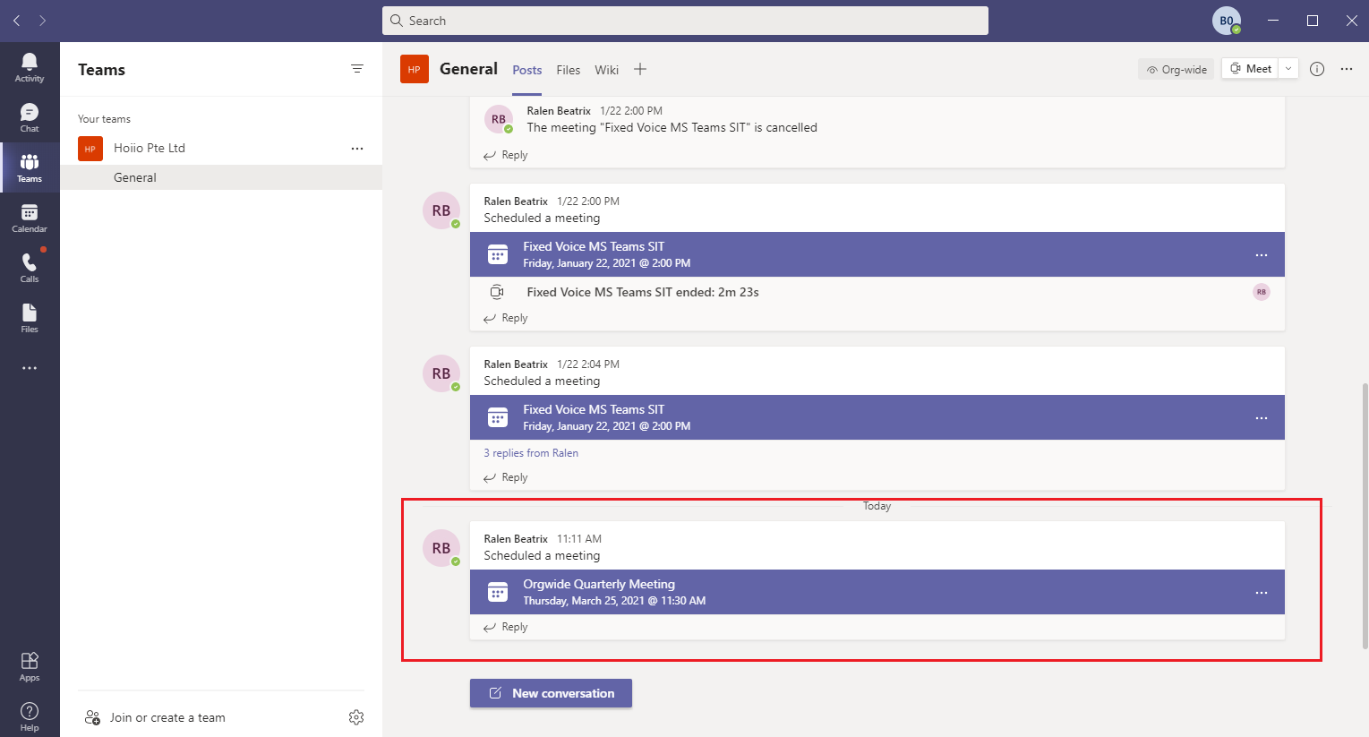
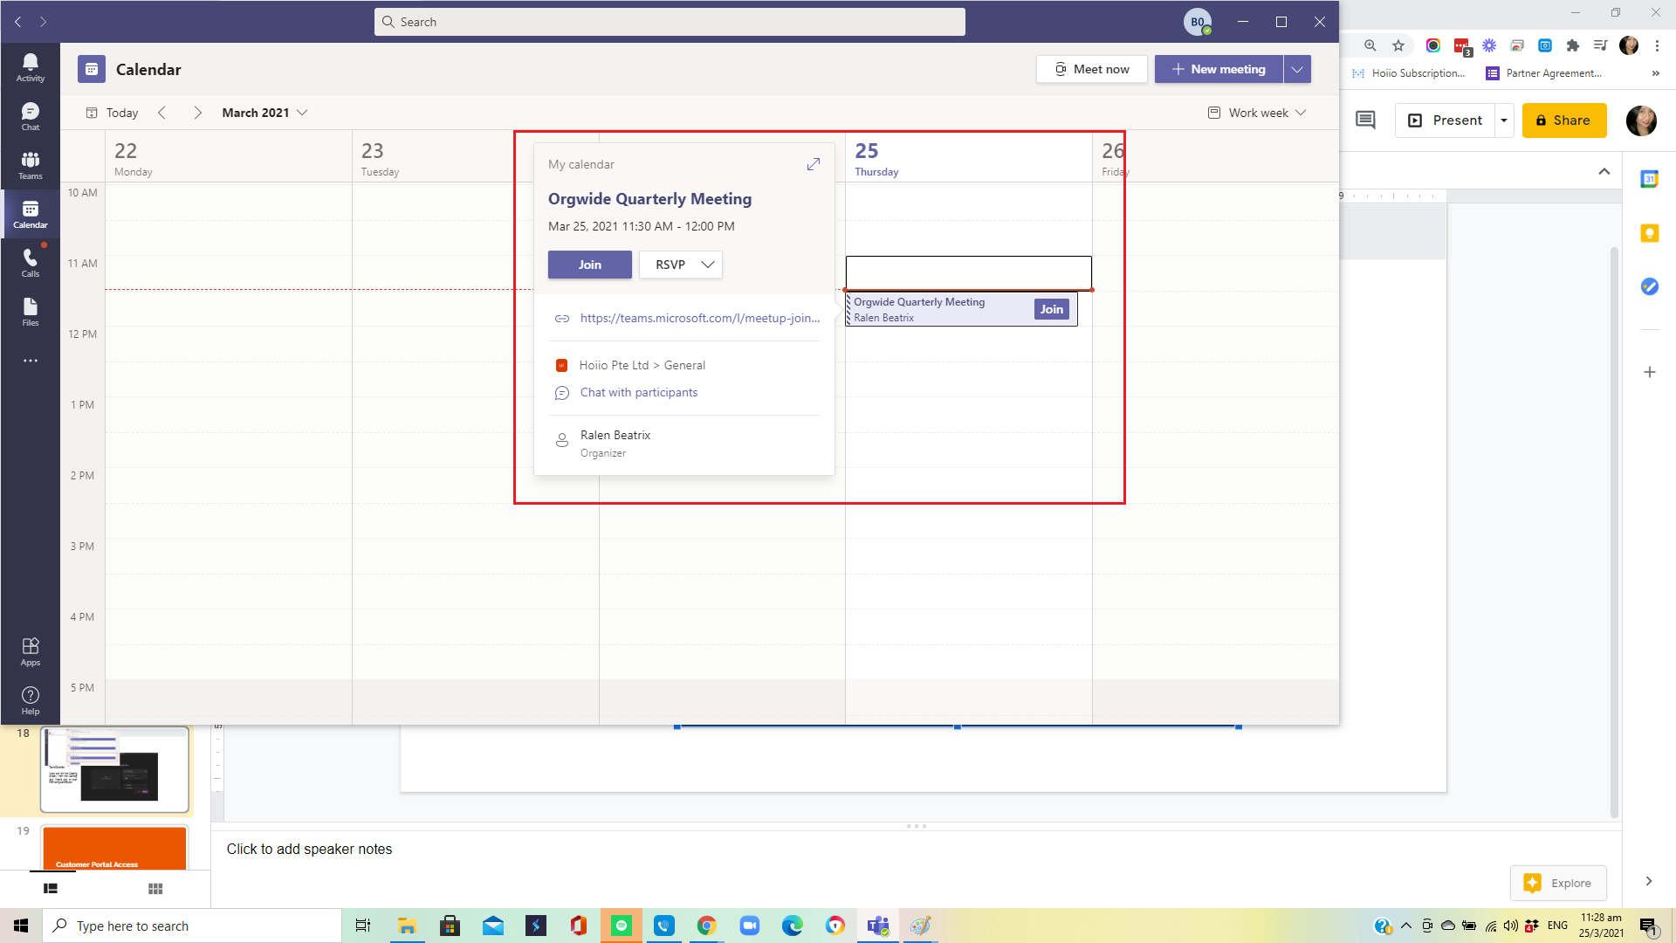
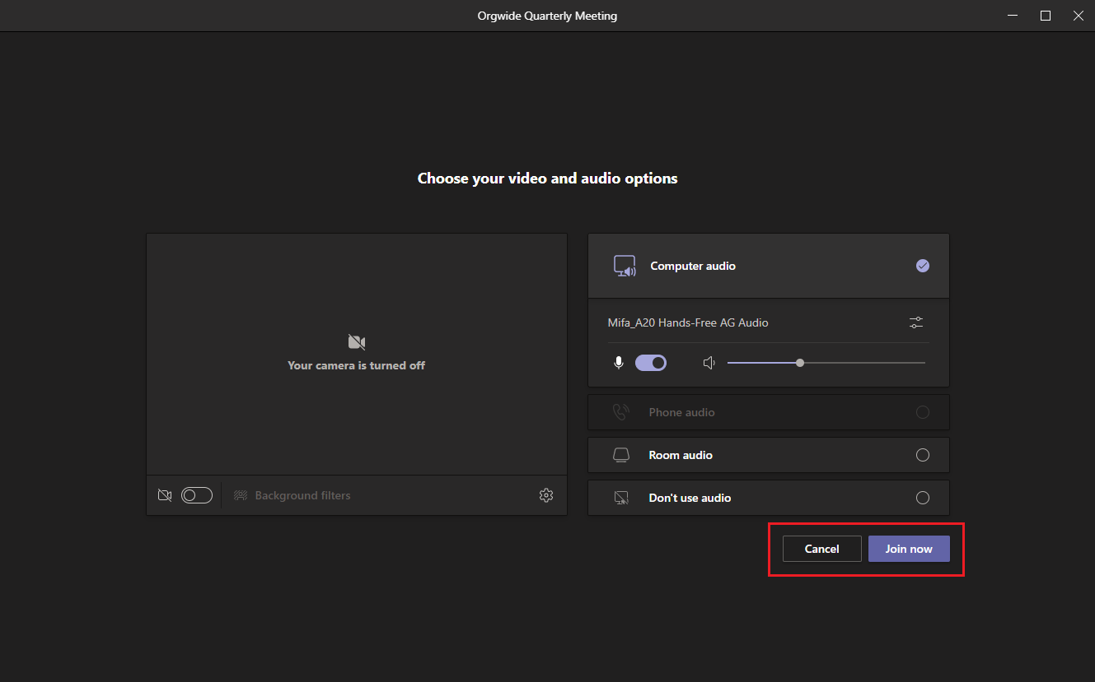
7. MS Teams Meeting
When an MS Teams Meeting is scheduled it can be viewed from the company’s Org-wide Posts or, sent to the required participants’ MS Teams Calendar.
Users can join the Meeting directly from the Desktop App, Mobile App, or even their computer browser.
(Desktop View)

Slide 18
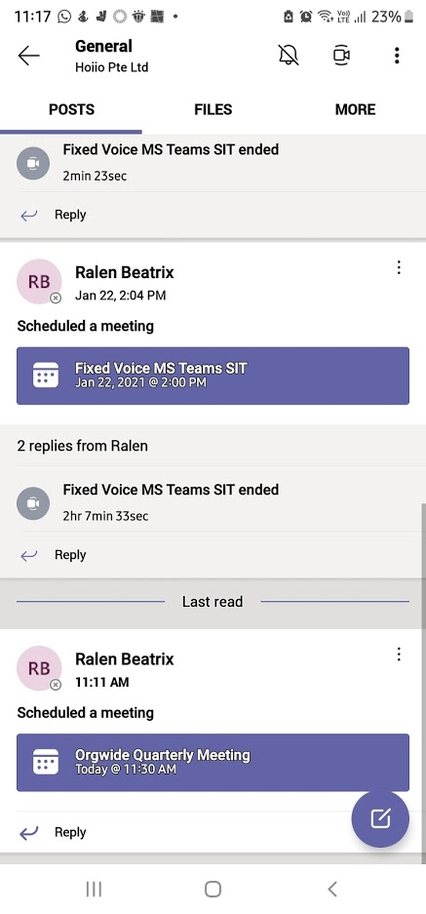
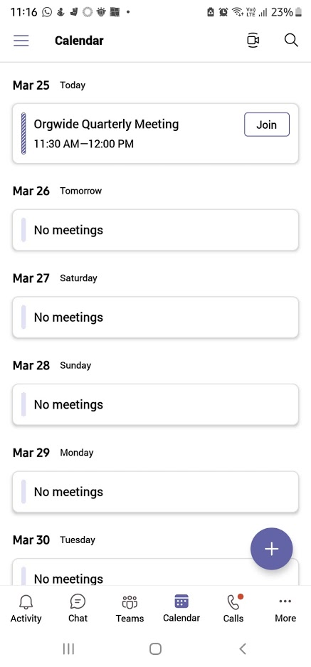
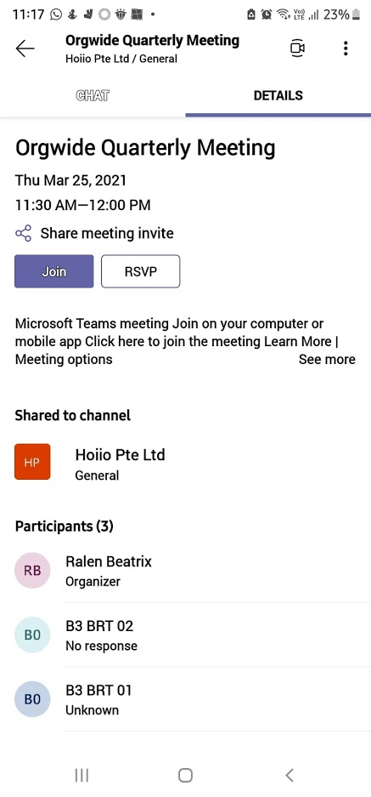
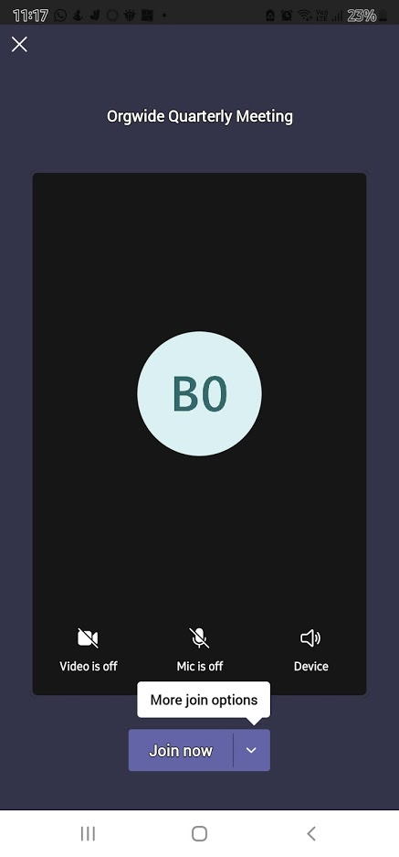
7. MS Teams Meeting
Mobile App View
Scheduled Meeting
Details
Join Meeting

Slide 19
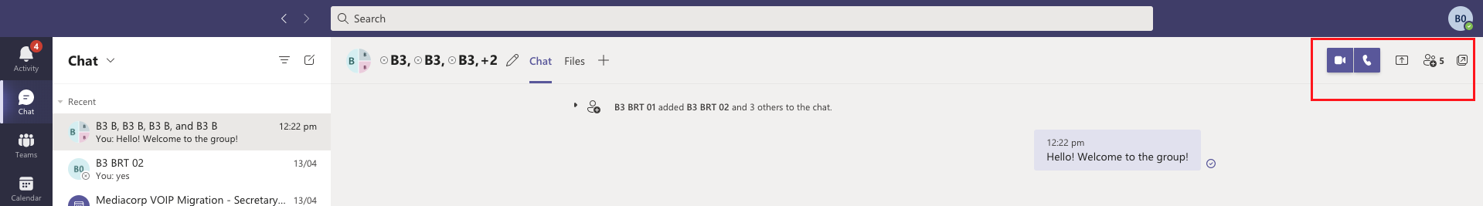
8. MS Teams Group Call
There are 2 ways to initiate a group call within MS Teams.
Calling a chat group
  On Desktop > go to Chat > New Chat > add Participants. Once group has been created, participants can chat amongst themselves, as well as initiate a voice call by clicking on the phone button.
  This method allows users to call/chat with Organization members at once
  Can support up to 20 participants
For more information, please visit: https://support.microsoft.com/en-us/office/start-a-call-from-a-chat-in-microsoft-teams-f5138c9d-df4c-43d8-9cf6-53400c1a7798

Slide 20
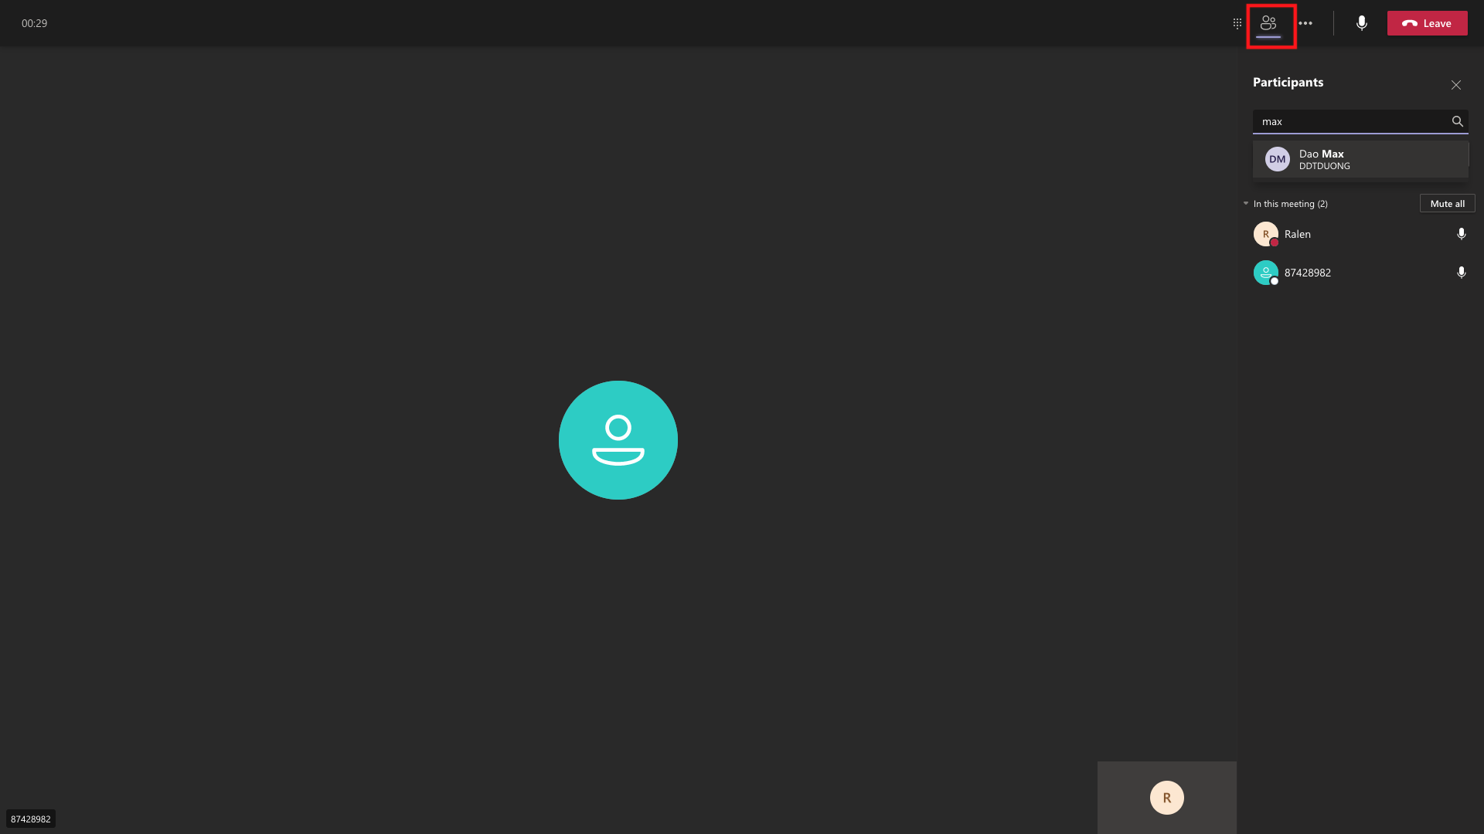
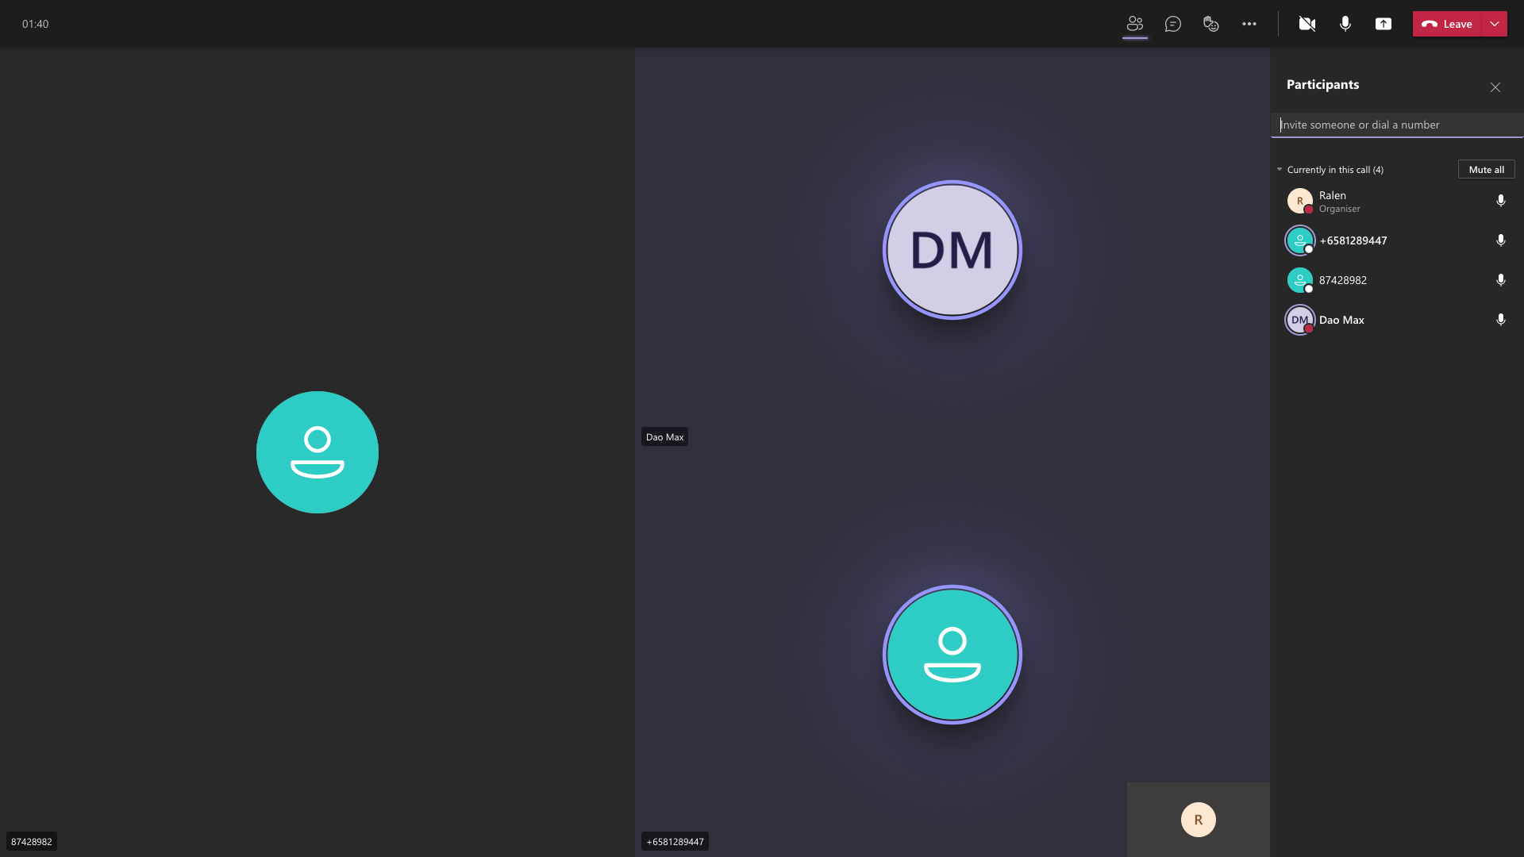
8. MS Teams Group Call (Cont’d)
2. During an ongoing call, users can add in more participants in needed.
This method allows users to initiate a group call w/ organization members as well as external parties (by dialing the phone number)
On desktop during an ongoing call > click on Participants (people icon) > type in the name (for Org member) or type in the number (for external) > then <Enter>.

Slide 21
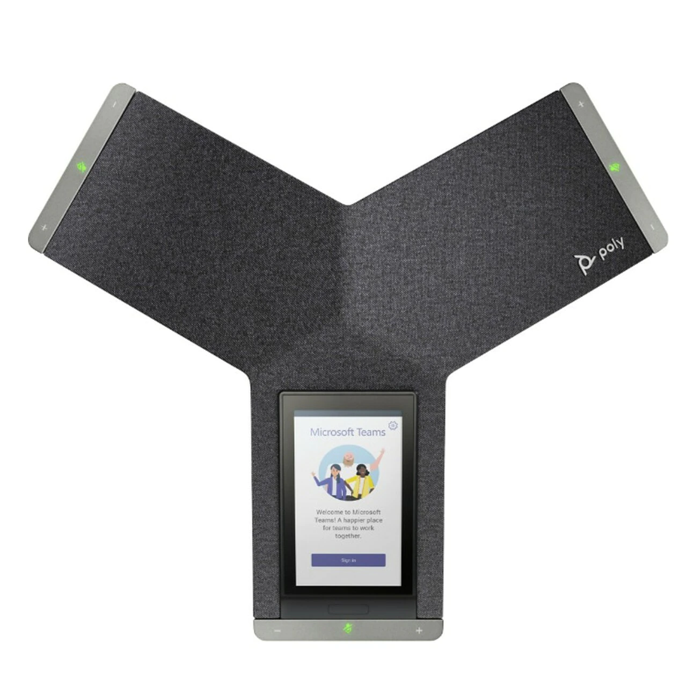
9. MS Teams Conference
For use in actual Conference/Meeting Rooms, organizations can purchase an MS Teams certified conference phone > log in to a dedicated MS Teams account > and dial the conference room number to initiate meetings.
Just the same, remote MS Teams users can initiate/join Conference Calls simply by dialling the Conference Room number + PIN number.
Conference Rooms are created in the CPaaS portal (refer to Admin Deck). Each Conference Room can accommodate up to eight (8) simultaneous parties.

