Slide 1

What Makes an Effective Principal:
The Evolving Role of the
School Principal
Jack States
Wing Institute

Slide 2
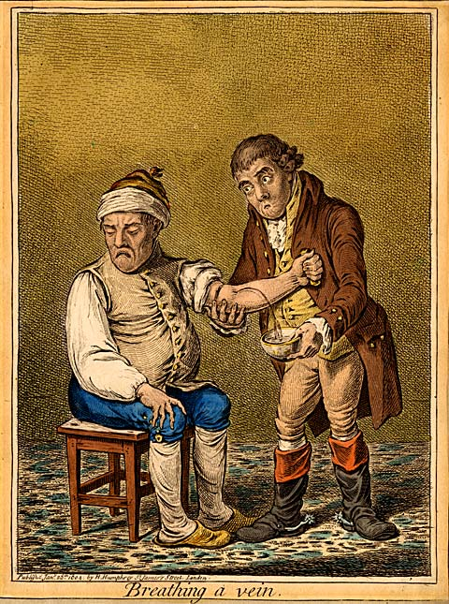



How Important Are Principals?
Notes:
Spectrum Story: Despite clear expectations: annual planning, written guidelines, manualizing the process, - Staff development: orientations, minimum standards, and on-going training including coaching (provide evidence based practices for instruction and classroom management) --- Feedback systems to monitor performances: direct observations, monthly key indicator reports, site reviews and performance management of contingencies: performance compensation quarterly individualized goals
Must be cautious: (convention wisdom) many strongly held beliefs are proven wrong. Four humours theory (Ayurveda system of medicine) gave rise to blood letting. Stress theory of ulcers, or sugar causes children to be hyperactive

Slide 3
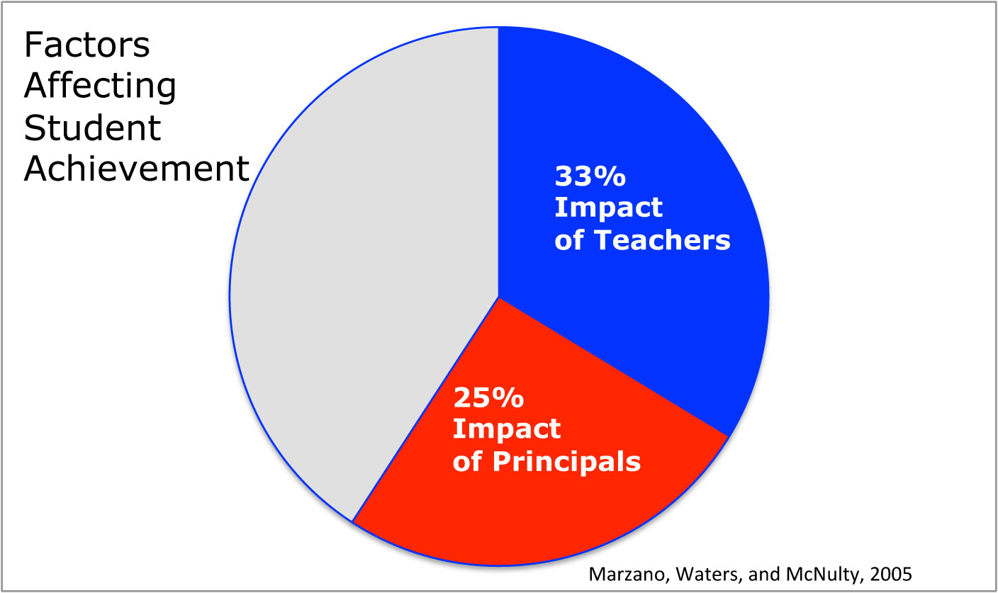
Notes:
-- Neglected field of study - 1975 and 2002 on 296 studies only 27% were empirical quantitative. Spectrum experience

Slide 4
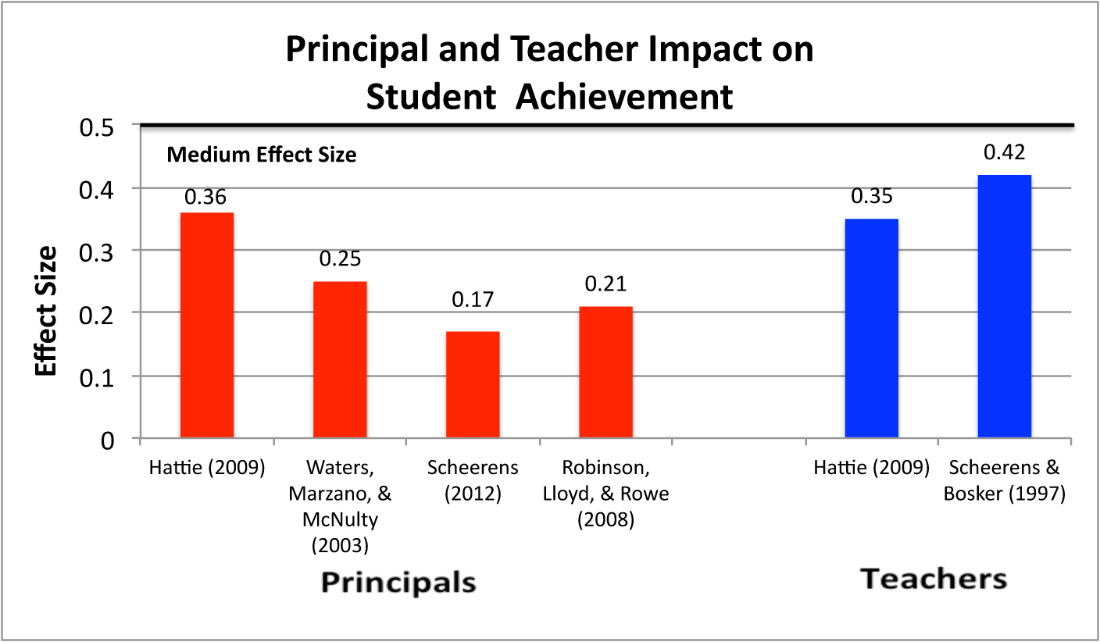
Principals Impact on Student Achievement
Notes:
Principals rank 2nd to teachers in impact (Leithwood, 2007)

Slide 5
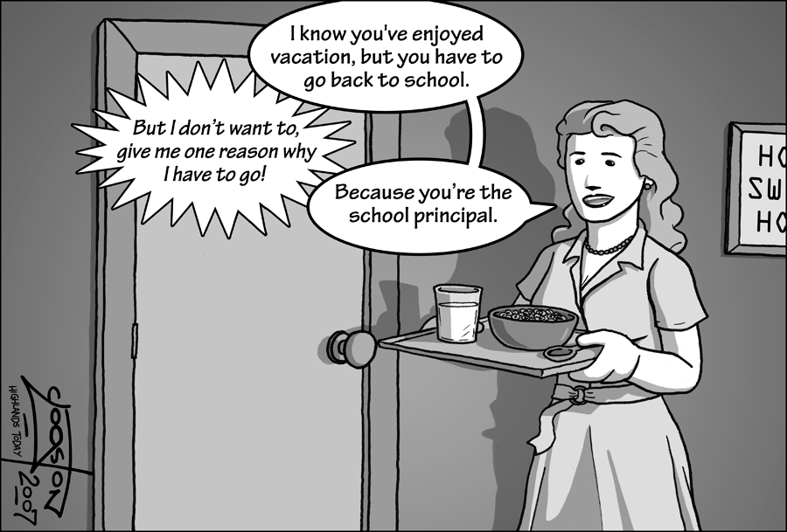
The Evolving Role of the
School Principals?
Notes:
Historically, principals were seen as school managers, and as recently as two decades ago, high standards were thought to be the province of the college bound. Attending college 1950 – 2010 rose by 227% from 2% of the population to about 7%. This explosion in college bound came at a time of concern for global competiveness resulting in “A Nation at Risk” and finally, in NCLB expanded concerns in response to the gap between have and have not in the US.
Principals held accountable for implement research-based curricula, and ensure teachers are trained in evidence-based instructional methods, and track the schools academic performance. Principals who fail can lose their jobs and those who succeed must prepare for sudden increases in student population.

Slide 6
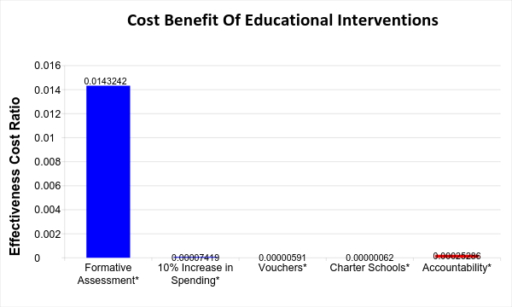
What Results Should We Expect From Accountability
Teaching Intervention
Effectiveness Cost Ratio = Effect Size/Cost Per Student
What Is The Impact Of Accountability?
Yeh, 2007

Slide 7
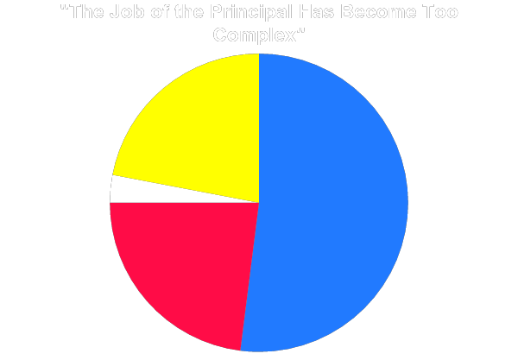
School Principal Overload
Principal | Responsibilities
Community relations | Fiscal management and budgeting
Liaison with school board | Student records keeping
Student intake and enrollment | Attendance
Parent relations | Testing
Conflict resolution | Technology
School safety and security | Data analysis
Student discipline | Regulatory compliance
Facilities | Implementation of new initiatives
Non-teaching personnel management | Resource management (other than curriculum)
Somewhat Disagree
22%
Strongly Disagree
3%
Somewhat Agree
52%
Strongly Agree
23%
MetLife Survey, 2012
Notes:
The number of new initiatives is staggering: class size reduction, technology, drug prevention, school discipline, professional development. Principals typically work 10 hour days and many believe the job is just not “doable” as it is configured now (Usdan, McCloud and Podmostko 2000).

Slide 8
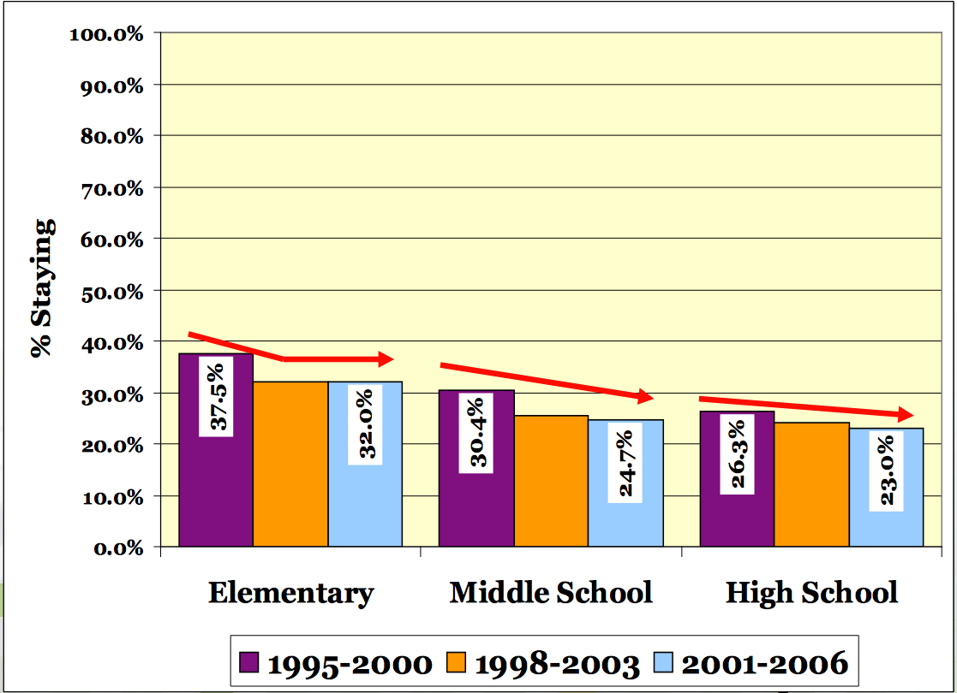
Retention of Principals Declining in Texas
Fuller, E.J. & Young, M.D. (2008)
Notes:
The average tenure for a high school principal in Texas is just over three years—the average high school principal will not see her/his first freshman class graduate

Slide 9
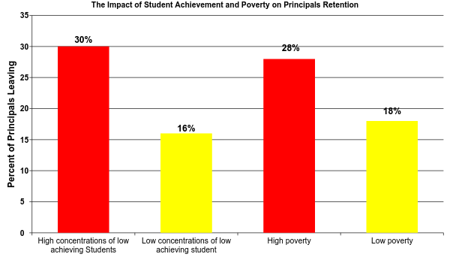
What is the Impact of Student Achievement and Poverty on Principal Retention?
Béteille, T., Kalogrides, D., & Loeb, S. (2012)
Notes:
Higher principal turnover in schools with low achieving student
Higher principal turnover in schools of high poverty
Unfortunately, these are the schools that require stable leadership

Slide 10
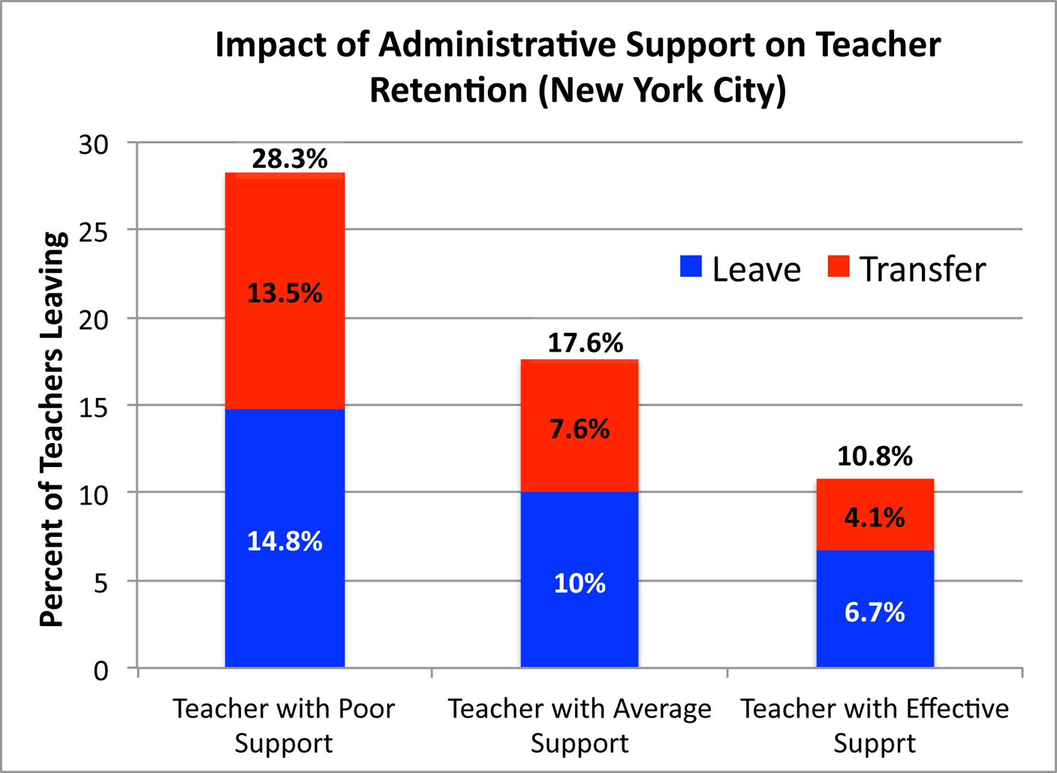
Administrators Impact on Turnover
Boyd, D., Grossman, P., Ing, M., Lankford, H., Loeb, S., & Wyckoff, J. (2011)
Notes:
Ineffective leadership is primary reason for teachers leaving, North Carolina Teacher Working Conditions Survey, (2008)
Less effective teachers tend to leave under an effective principal, while more effective teachers tend to leave when the school is taken over by an ineffective principal.
Furthermore, effective principals are more likely to replace teachers who leave with more effective teachers (Beteille, Kalogrides and Loeb 2011, Branch, Hanushek and Rivkin 2012, Portin, et al. 2003).

Slide 11
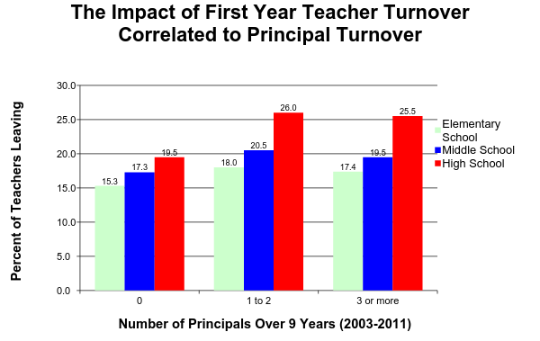
What is the Effect on Teacher Tenure
When Principals Leave?
Fuller (2012)
Notes:
Consequence: Greater chaos into the system, floundering initiatives, and greater teacher turnover

Slide 12
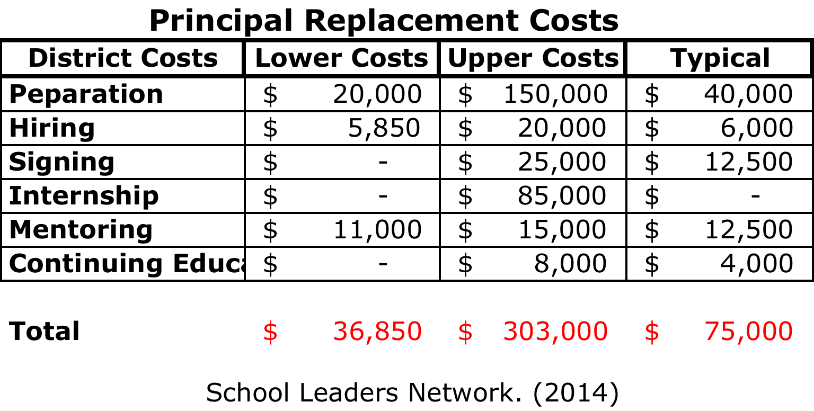
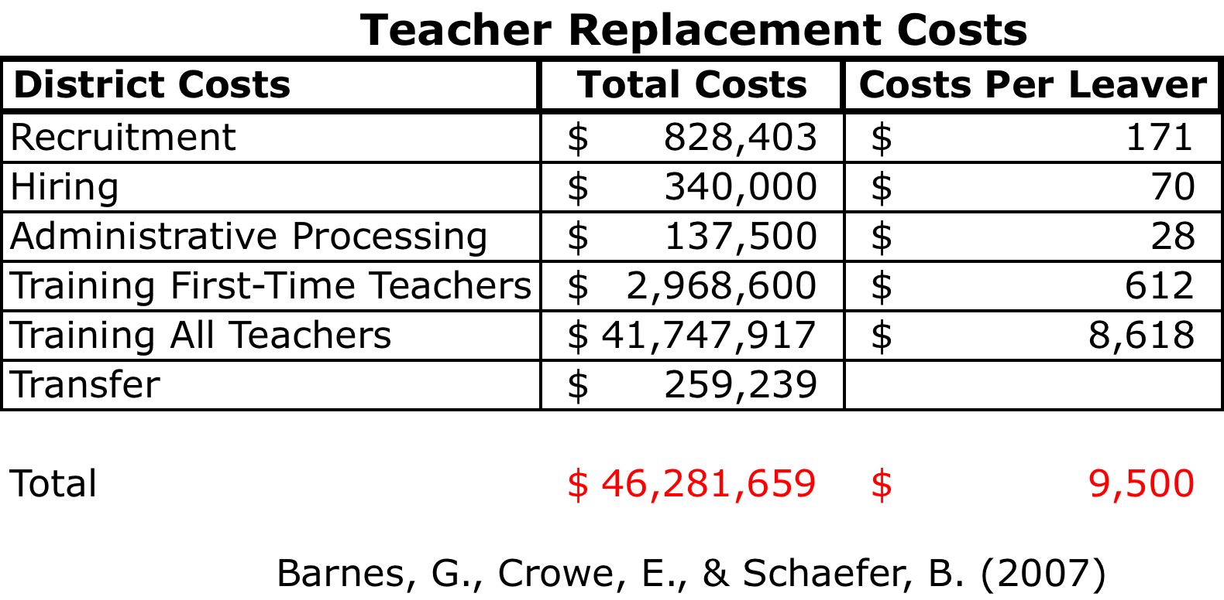
What is the Cost of Having an Ineffective Principal?
Notes:
* Principal turnover cost approximately $1.9 Billion annually
* Teachers U.S. Department of Labor (DOL) estimate leavers cost in 2005, 2.2 billion per year and when transfers are added, that number rises to approximately $4.9 billion per year. Ranges from $15,835 to $26,502 per teacher

Slide 13
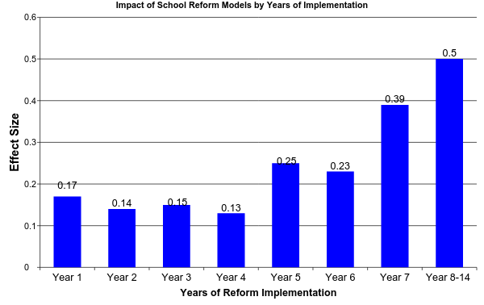
Impact of Sustained Implementation
(Borman, Hewes, Overman, and Brown, 2003)
Notes:
National Implementation Research Karen Blasé and Dean Fixsen

Slide 14
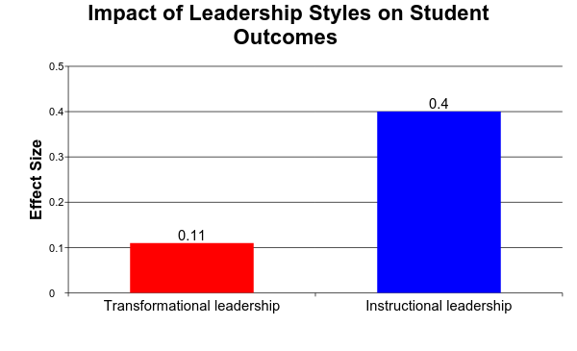
Do Leadership Styles Make a Difference?
Medium
Small
Robinson, Lloyd, and Rowe, 2008
Notes:
How does our research match up to this notion that instructional leadership is the key to effective principals
Instructional leadership: an approach in which the principal encourages educational achievement by making instructional quality the top priority of the school.
Transformational leadership: an approach in which the principal provides motivation through inspiration

Slide 15



What Organizational Performance Management Tells Us
Curriculum
Graduation
Teaching
Input
Process
Outcomes
Feedback
Loop
Rummler and Brache, 1990
Notes:
Process is conducted with integrity to evidence based practices

Slide 16
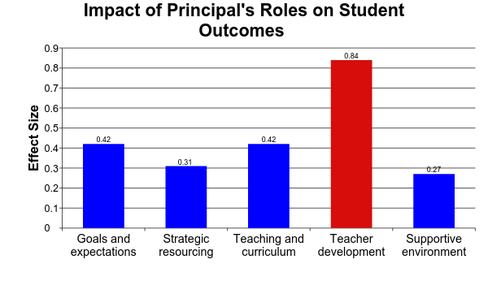
What Principals Do Makes a Difference
Large Effect Size
Robinson, Lloyd, and Rowe, 2008
Notes:
Setting the standards and goals, communicating expectations, sustain expectations over time, monitoring learning goals, and involve staff in the process
Strategic Resourcing: Aligning and allocating resources to teaching goals, and maintaining recruitment and hiring.
Teaching and Curriculum: Having a direct role in the support and evaluation of teaching, regular visits, on-going formative and summative feedback, direct oversight of curriculum, coordination across classrooms and levels, and aligning goals to curriculum and teaching.
Teacher Development: Promoting and participating in informal and formal development
Supportive Environment: Assuring and protecting time for teaching by reducing external pressures and interruptions, and establishing and supporting orderly classroom environments (classroom management and climate).

Slide 17
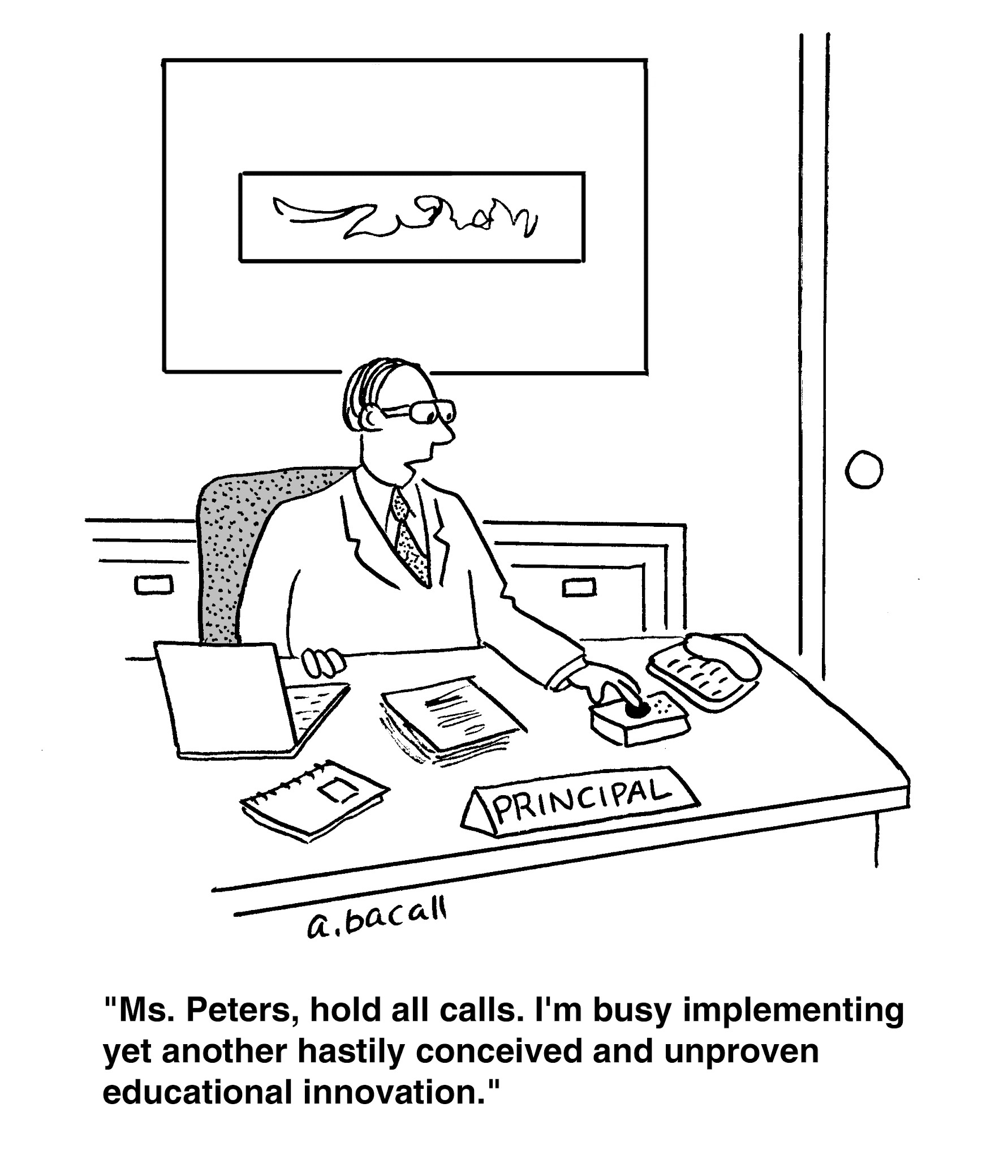
How Effective Is The Average Principal At Their Job?
Notes:
We have relevant research to suggest the conventional wisdom is right, Principals are powerful. But we need to know how effective they at their job if we are to look for continuous principal improvement

Slide 18
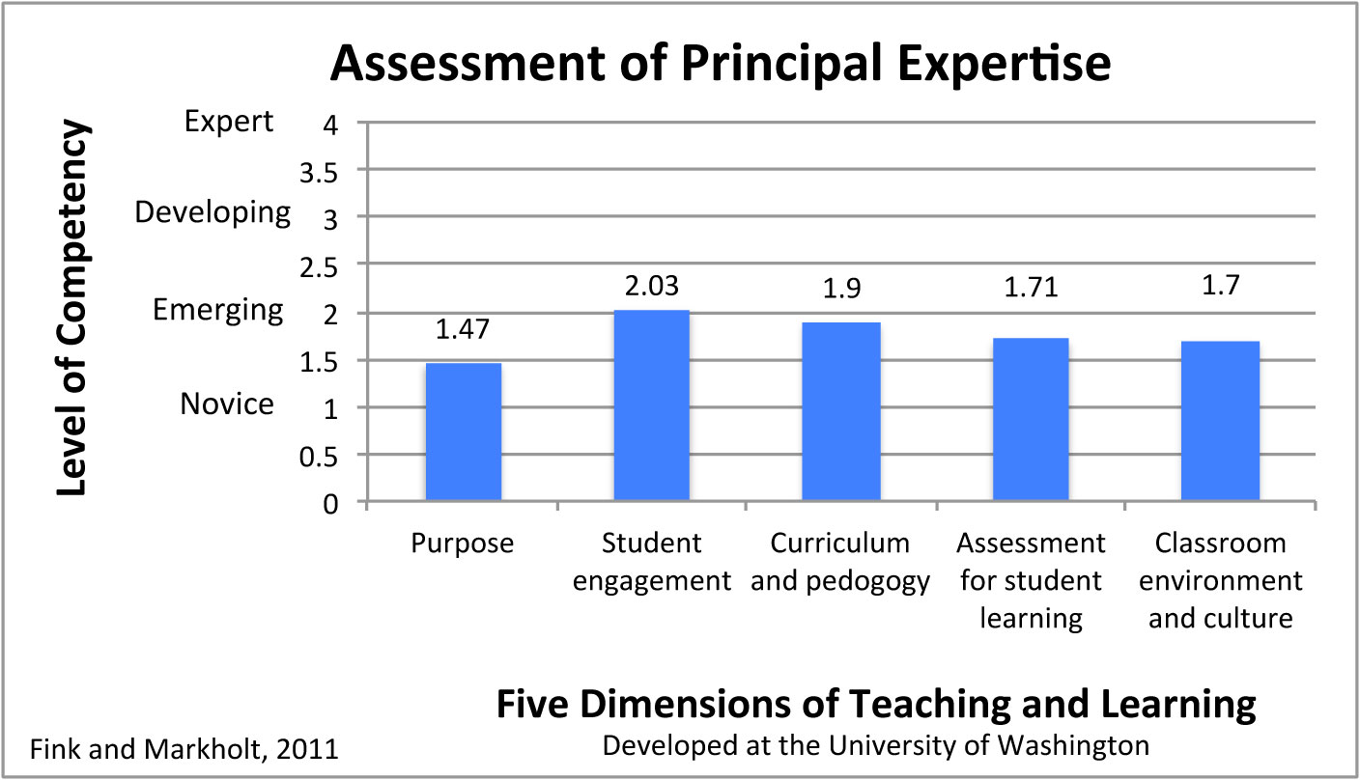
How Effective Are Principals at Identifying Valued Teachers
Notes:
Purpose: How lessons connect with external standards and The learning goals that are expected of a lesson
New Teachers Project, 2009 - 98% of teachers evaluations satisfactory or better (12 districts)
Principals 80% reported at least one teacher should not be teaching

Slide 19
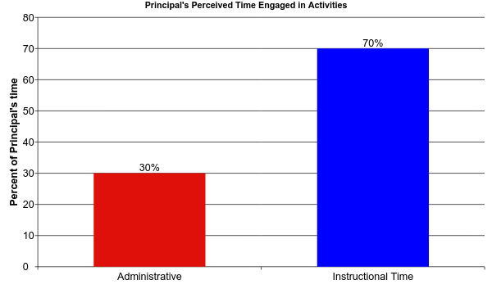
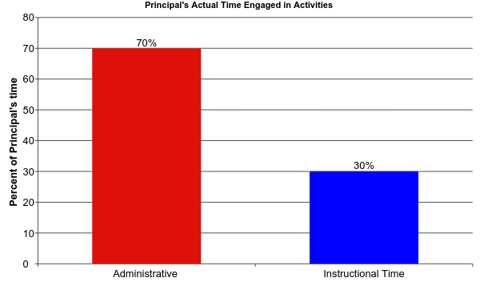
How Principals Spend Their Time
Turnbull et al., 2009

Slide 20
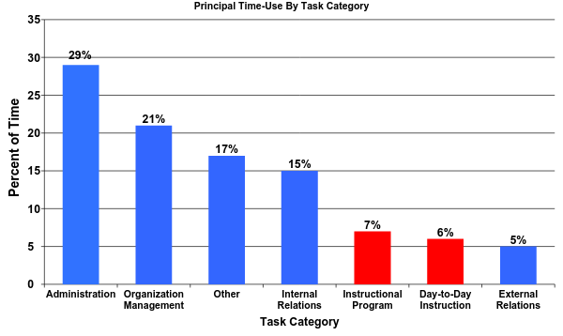
How Principals Use Their Time
Principals were directly engaged in classrooms improving teacher instruction only 13% of the time
Horng, E. L., Klasik, D., & Loeb, S. (2010)
Notes:
This is not a surprise as Randy will present; Principals aren’t trained in the area that make a difference and are not comfortable, find the other roles more reinforcing, and they are often redirected away from instructional roles into crisis intervention.

Slide 21
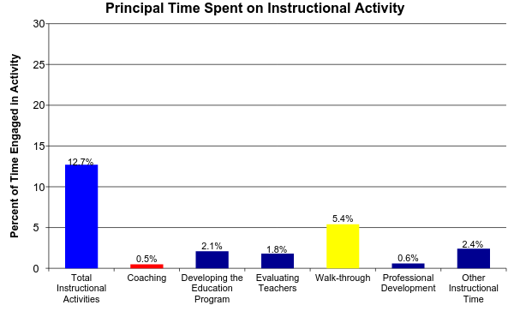
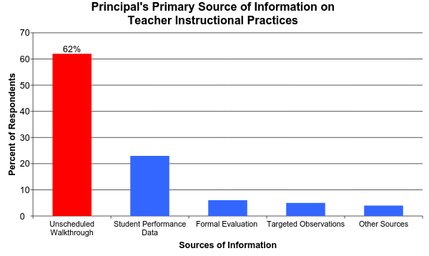
How Much do Principals Spend on Instructional Activities?
An increase of 1% time spent coaching increased math achievement by 1.4 percent of standard deviation
Grissom, Jason A., Susanna Loeb, and Ben Master. (2012)
Notes:
Observation data - Overall Instructional Time = 12.7
Walk-through: the most popular method of sampling can function for error detection, but not effective for improving performance
Coaching: Joyce and Showers and Jim Knight
Where does that leave us? Change what the principal does or change the model

Slide 22
Summation
Professional judgment and research both support the importance of principals and leadership
The role of the principals has expanded dramatically, but the stress of the job is increasing principal turnover and in turn is impacting teacher tenure, costing dollars, and impacting student achievement
In spite of the heavily load, we know what is critical to principal success, focus on instruction, but that isn’t where principals are investing their time.
Success requires well trained principals, working with a team to implement best organizational practices
Notes:
Where does that leave us? Change what the principal does or change the model. I believe we can discount the The Heroic Leader model is flawed. We need research to tell us how many of the pieces need to be in place for significant change.

