Slide 1
· MARKET ·

Slide 2







Drag the items into the cart.
Bread
Milk
Jam
To edit the price tags, go to Slide > Edit Master (Google Slides) or View > Slide Master (PowerPoint)

Slide 3









Drag the items into the cart.
3 apples
2 oranges
1 carrot
To edit the price tags, go to Slide > Edit Master (Google Slides) or View > Slide Master (PowerPoint)

Slide 4
HOW MUCH IS IT?
Can you calculate the total?

Slide 5

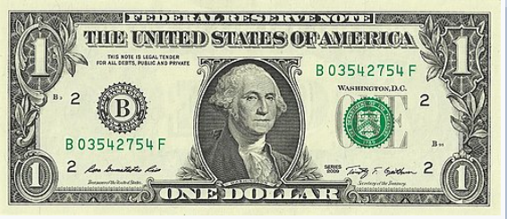
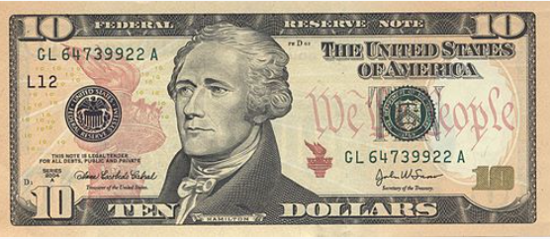

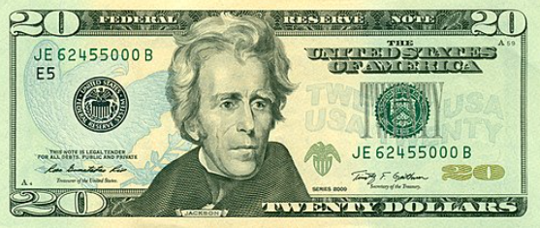
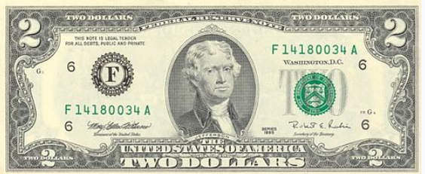


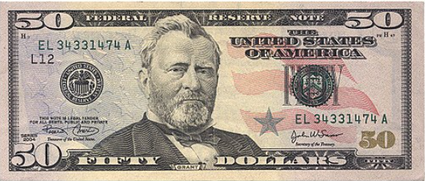
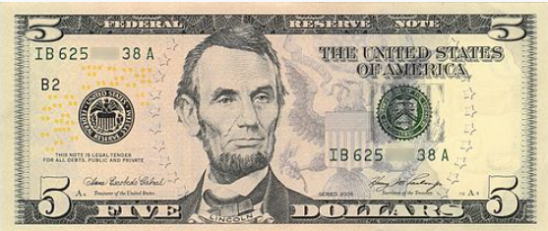

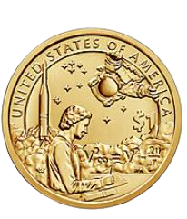
TIME TO PAY!

Slide 6
IF YOU PAY WITH…
Calculating change.

