Slide 1
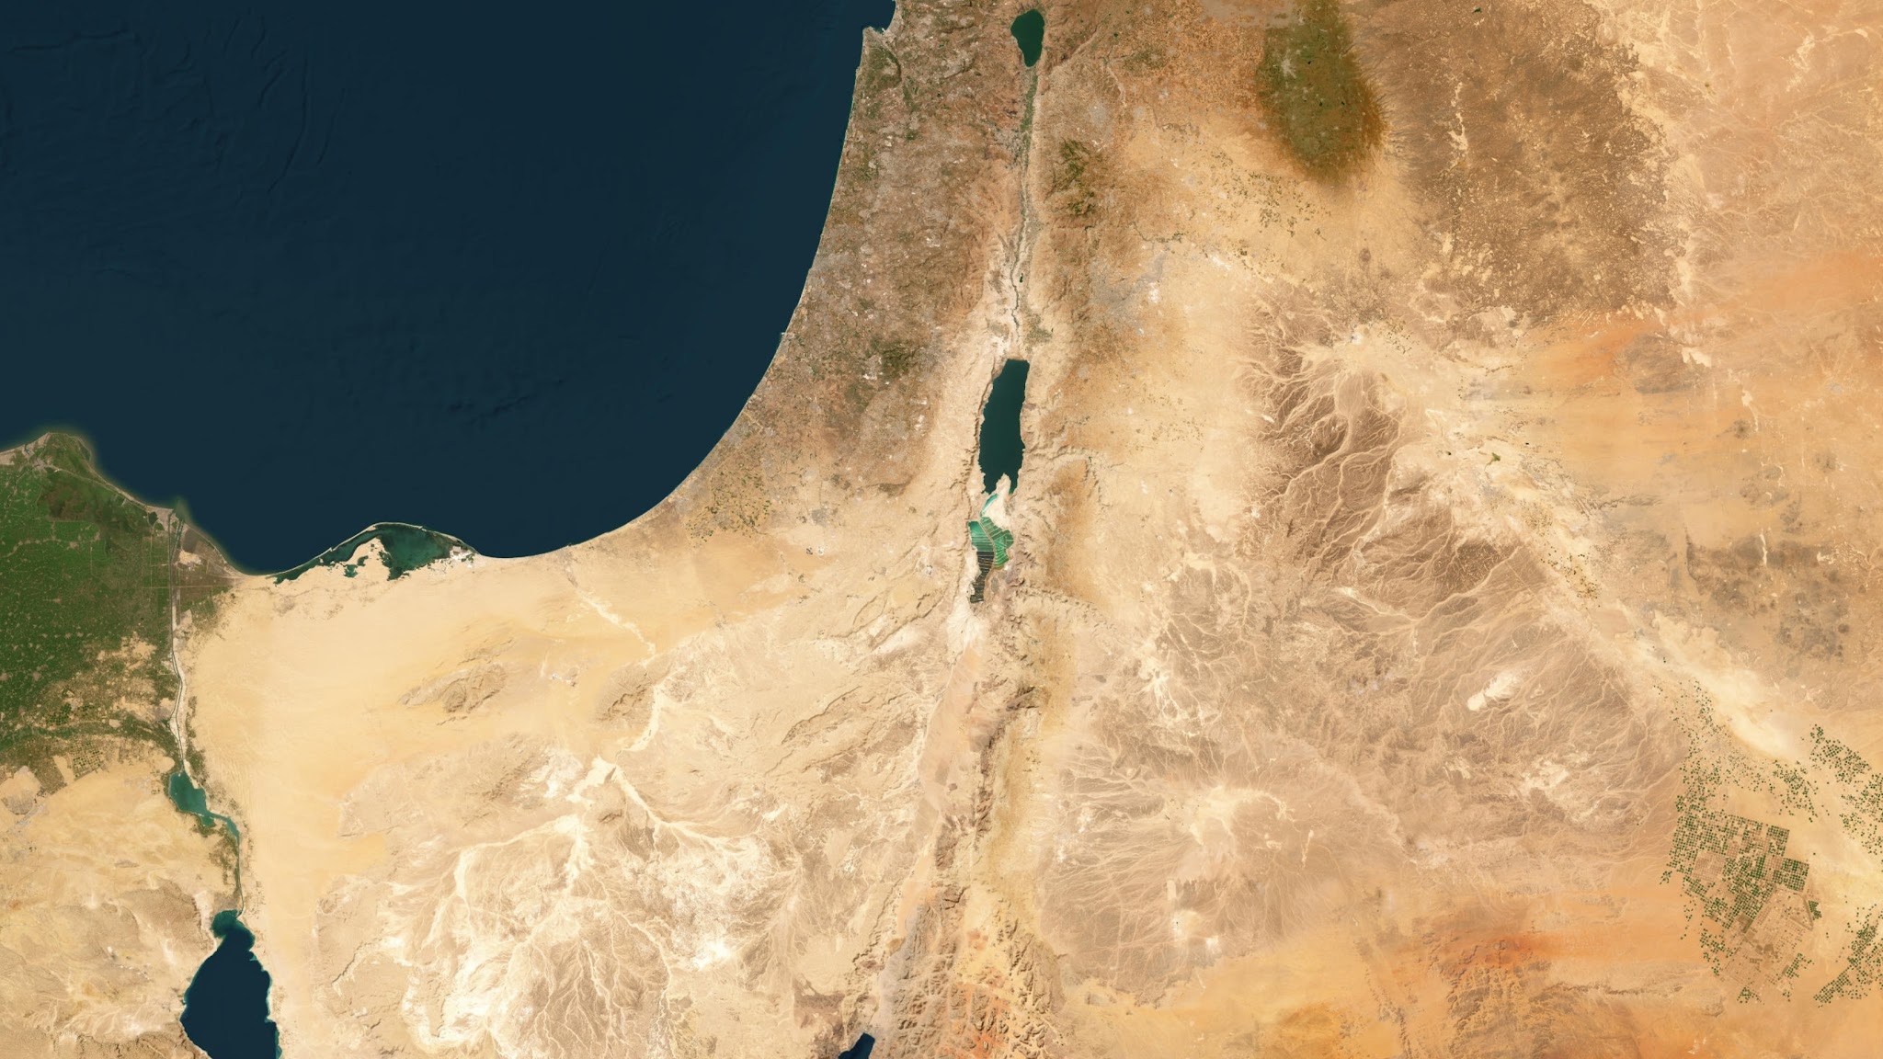

Slide 2
Instructions
On your map, mark the locations using the map on page 45 in The Essence of the Old Testament as a guide:
Regions
Canaan
Amalek
Amalek
Wilderness of Zin
Gulf of Aqaba
Arabah
Edom
Moab
Mishor
Plains of Moab
Gilead
Bashan
Cities/Sites
Megiddo
Shechem
Jericho
Jerusalem
Hebron
Beersheba
Kadesh-barnea
Ezion-geber
Bozrah (capital of Edom)
Kir-hareseth (capital of Moab)
Rabbah (capital of Ammon)
Jahaz
Medeba
Heshbon
Abel-shittim
When you are done, draw an arrow that replicates the red lines on the map, tracing the possible route of Israel's travels. Note that this line will not connect with all of the cities and sites you labeled.

Slide 3
Customize Your Map
Additional Tips
Color Coding and Consistency:
Use consistent colors and styles for different types of features.
Zoom and Positioning:
Ensure your map image is large enough and centrally positioned for easy editing. Zoom in on specific areas if necessary to improve accuracy.
Layering:
Place regions and rivers first as they’re often larger, then add cities and landmarks last for clearer positioning.
Regions, Nations, or Large Bodies of Water
  Labeling: Add a text box over the correct area. For names of regions use a black font. For names of nations use a green font. For names of bodies of water use a white font.
Cities or Landmarks
  Use the Icon or Shape Tool for Markers:
    You can use a circle, square, or other small shape to mark the exact location of a city or landmark.
    Color Code: Choose a distinct color to differentiate cities from other elements.
  Add a Label: Insert a text box next to the marker with the name of the city or landmark in red.
Rivers
  Use the Line Tool: Select the "Line" or "Scribble" tool to draw the path of the river.
  Adjust Line Style:
    Line Color: Choose a blue color to represent water.
    Line Thickness: Increase the line thickness to make the river clearly visible.
    Transparency: Add transparency if needed to match the aesthetic of your map.
  Add a Label: Place a small text box near the line with the river’s name in blue.
Map Image Source: NOAA Data Access Viewer (https://coast.noaa.gov/dataviewer)

