Slide 1
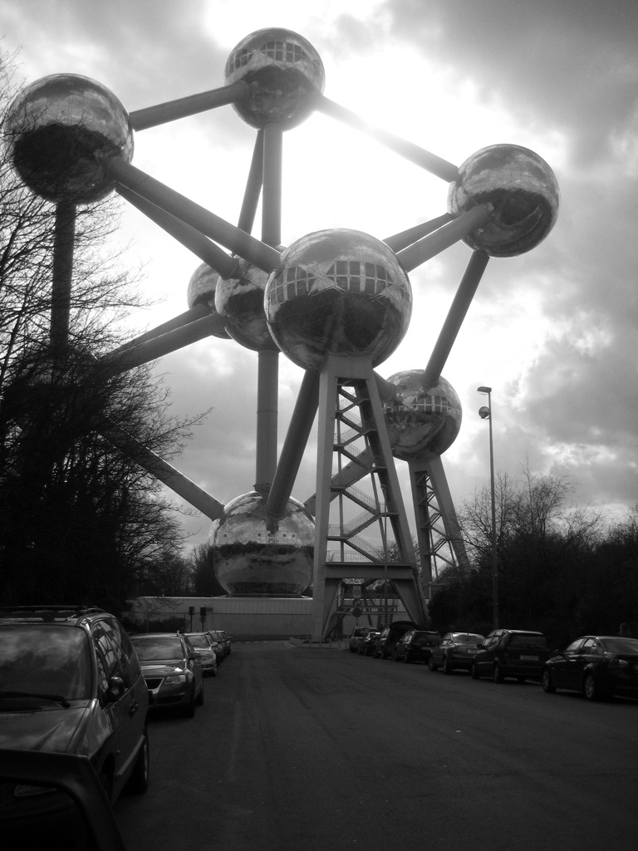
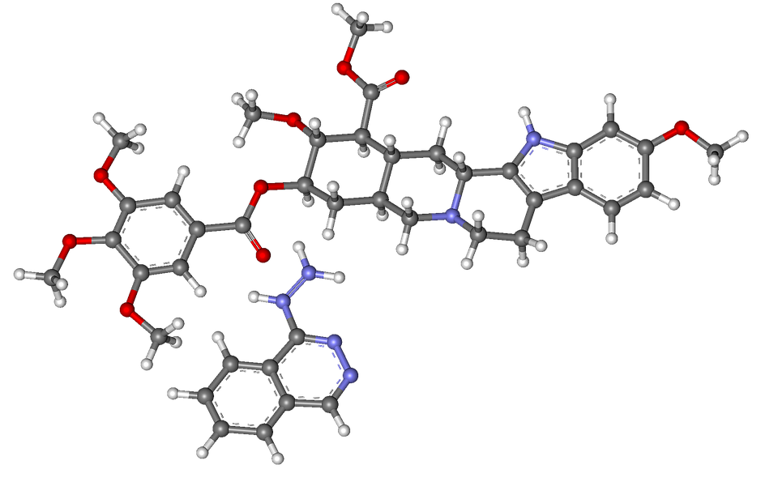
ATOM
Free Template

Slide 2
TABLE OF CONTENTS
01
02
OBJECTIVES
METHODOLOGY
You can describe the topic of the section here
You can describe the topic of the section here
03
04
RESULTS ANALYSIS
CONCLUSIONS
You can describe the topic of the section here
You can describe the topic of the section here

Slide 3
01
TITLE GOES HERE
You can enter a subtitle here if you need it

Slide 4
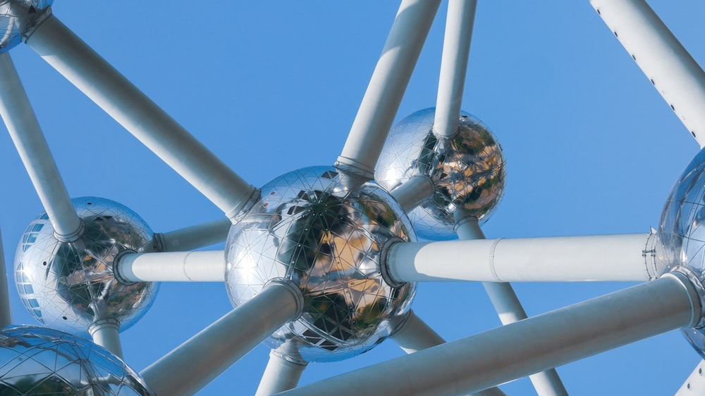
Whoa!
It could be the part of the presentation where you can introduce yourself. Keep it short and go straight to the point. Your audience will appreciate that

Slide 5
INTRODUCTION
Mercury is the closest planet to the Sun and the smallest one in the Solar System—it’s only a bit larger than the Moon. The planet’s name has nothing to do with the liquid metal, since it was named after the Roman messenger god, Mercury

Slide 6
BACKGROUND
MERCURY
MARS
It’s the closest planet to the Sun and the smallest one in the Solar System
Despite being red, Mars is a cold place. It’s full of iron oxide dust
VENUS
SATURN
Venus has a beautiful name and is the second planet from the Sun
Saturn is a gas giant, composed mostly of hydrogen and helium

Slide 7
GOALS
VENUS
Venus has a beautiful name and is the second planet from the Sun
JUPITER
SATURN
Jupiter is a gas giant and the biggest planet in the Solar System
Saturn is a gas giant, composed mostly of hydrogen and helium

Slide 8
METHODS
NEPTUNE
It’s the farthest planet from the Sun
VENUS
It’s terribly hot, even hotter than Mercury
MERCURY
Mercury is the closest planet to the Sun

Slide 9
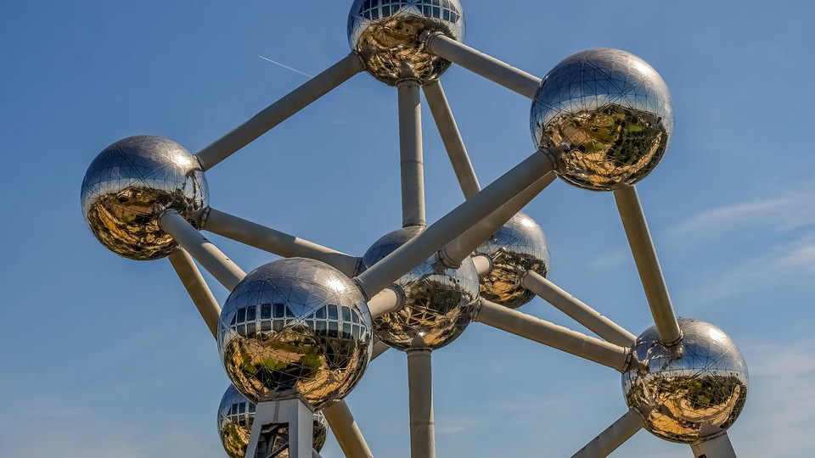
A picture is worth a thousand words

Slide 10
RESEARCH AND PUBLICATIONS
1.
2.
3.
The reason why Neptune is blue is due to the presence of gas methane
It’s an astronomical body orbiting Earth and is the planet's only satellite
Mercury is the closest planet to the Sun and the smallest of them all
by NEPTUNE
by MOON
by MERCURY

Slide 11
You could use three columns, why not?
Mercury
Mercury is the smallest planet of them all
Venus
Venus has a beautiful name, but it’s very hot
Saturn
Yes, this is the ringed planet. It’s a gas giant

Slide 12
RESEARCH RESOURCES
Here you can list your reference websites or publications
Here you can list your reference websites or publications
Here you can list your reference websites or publications
Here you can list your reference websites or publications
Here you can list your reference websites or publications
Here you can list your reference websites or publications

Slide 13
FACTORS TO CONSIDER
1.
NEPTUNE
3.
MERCURY
It’s the farthest planet from the Sun
Mercury is the closest planet to the Sun
2.
VENUS
4.
JUPITER
It’s the second planet from the Sun
It’s the biggest planet in the Solar System

Slide 14
FACTORS TO CONSIDER
NEPTUNE
MERCURY
SATURN
Neptune is the farthest planet from the Sun
Mercury is the closest planet to the Sun
Saturn is the ringed one and a gas giant
VENUS
JUPITER
MARS
It’s the second planet from the Sun
It’s the biggest planet in the Solar System
Despite being red, Mars is a cold place

Slide 15
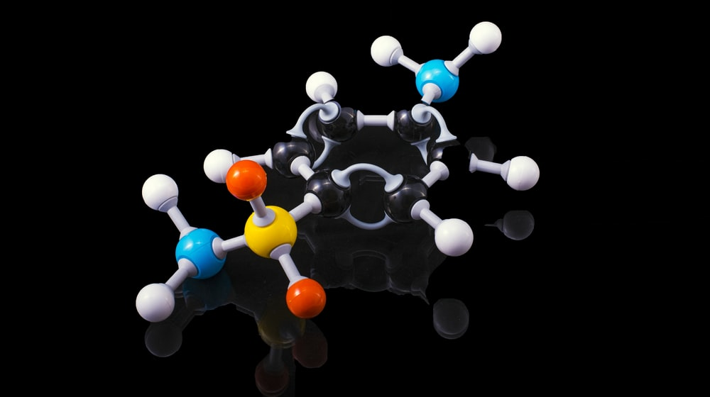
Awesome words
Because key words are great for catching your audience’s attention

Slide 16
CLINICAL TRIAL
PHASES
DOSE
SAMPLE SIZE
0
Preclinical
I
Safety
II
Dosing
III
Efficacy
IV
Long Term Safety

Slide 17
PHASE 1
SAMPLE SIZE
80%
Young healthy people
20 - 80 participants
Not expected to benefit from the medicine
GOAL
Study the safety of medication
SUCCESS RATE
SECONDARY EFFECTS
DOSE
RESULTS
Subtherapeutic, with ascending doses
Venus has a beautiful name and is the second planet from the Sun. It’s terribly hot and its atmosphere is extremely poisonous
Mars
Venus
Mercury
6 MONTHS
Jupiter
Saturn
Neptune
Experimentation time

Slide 18
TRIAL TIMELINE
RESEARCH
CONCLUSIONS
PRECLINICAL
Mercury is the closest planet to the Sun
Saturn is the ringed one and a gas giant
The Moon is an astronomical body
1
3
5
2
4
EXPERIMENTATION
RESULTS
Despite being red, Mars is a cold place
It’s the farthest planet from the Sun

Slide 19
Equity, diversity & inclusion
Diversity
Despite being red, Mars is cold
Equity
Venus has a beautiful name
Inclusion
Diversity
Jupiter is the biggest planet
Despite being red, Mars is cold

Slide 20
How to prepare your bike
1
2
Saddle area
Mercury is the closest planet to the Sun
Wheels
Venus has a beautiful name, but it’s very hot

Slide 21
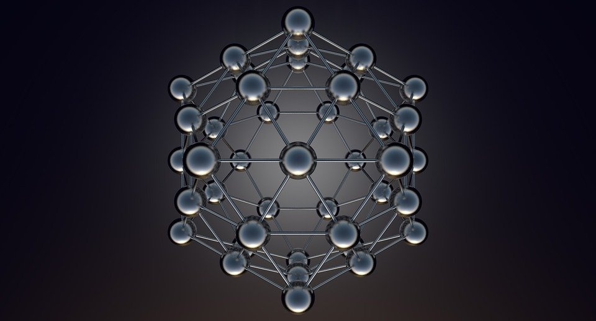
AWESOME WORDS

Slide 22
The number of bicyclists is growing rapidly
35%
65%
Non bicyclists
Despite being red, Mars is a cold place
New national users
Mercury is the closest planet to the Sun
If you want to modify this graph, click on it, follow the link, change the data and replace it

Slide 23
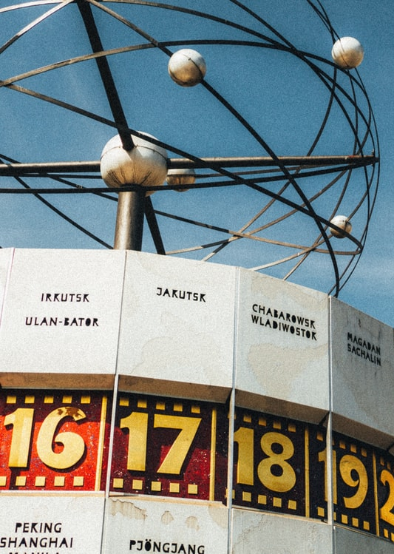
TENDENCY
Mercury is the closest planet to the Sun and the smallest one in the Solar System. The planet’s name has nothing to do with the liquid metal, since it was named after the Roman messenger god
To modify this graph, click on it, follow the link, change the data and paste the new graph here

Slide 24
RESULTS
EXPERIMENT A
EXPERIMENT B
TREATMENT | Test 1 | Test 2 | Test 3
Group 1 | 315 | 285 | 600
Group 2 | 210 | 390 | 600
Group 3 | 240 | 165 | 580
TREATMENT | Test 1 | Test 2 | Test 3
Group 1 | 189 | 285 | 474
Group 2 | 210 | 234 | 444
Group 3 | 367 | 123 | 396

Slide 25
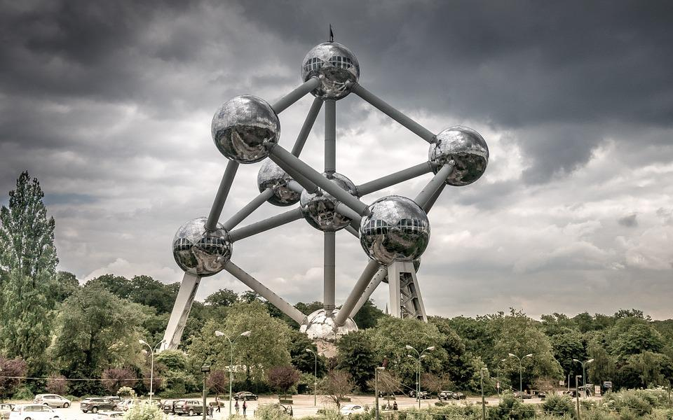
A PICTURE IS WORTH A THOUSAND WORDS

Slide 26
RESULTS ANALYSIS
SATURN
NEPTUNE
VENUS
25%
It has high temperatures
75%
MARS
Mars is a very cold place
JUPITER
60%
Venus
90%
Mars
50%
Mercury
Venus
Mercury
Mars

Slide 27
75%
97%
PATIENTS CURED
WITHOUT SECONDARY EFFECTS

Slide 28
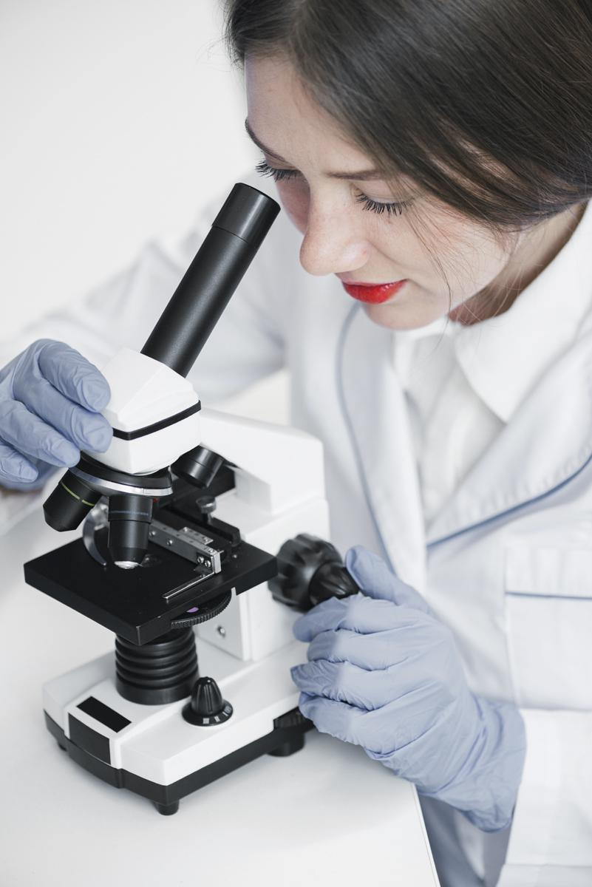
CONCLUSIONS
Saturn is a gas giant. It is made up of 94% hydrogen, 6% helium and small amounts of methane and ammonia. Hydrogen and helium are what most stars are made of

Slide 29
THANKS
Do you have any questions?
+91 620 421 838
Free Template

Slide 30
FUENTE
ELABORADO POR : plantillaspowerpoint.org
IMAGES :
unsplash.com
pixabay.com
flickr.com
FONTS :
Quicksand

Slide 31
RESOURCES

Slide 32
RESOURCES

Slide 33
RESOURCES

Slide 34
Fully Editable Icon Sets: A

Slide 35
Fully Editable Icon Sets: B

Slide 36
Fully Editable Icon Sets: C

