Slide 1
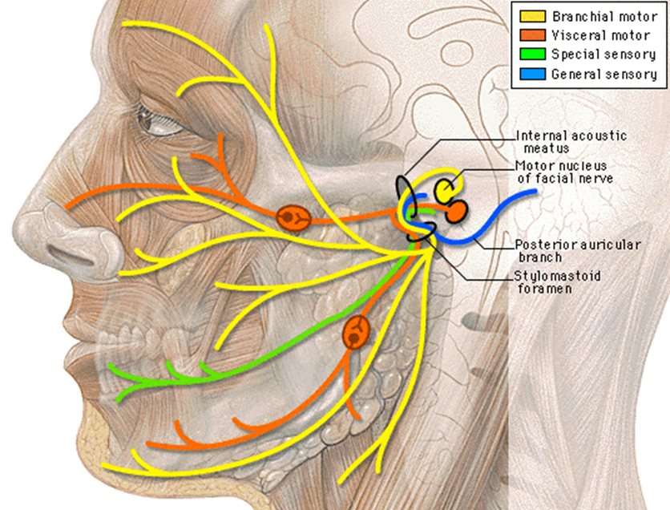
ANATOMY OF FACIAL NERVE

Slide 2
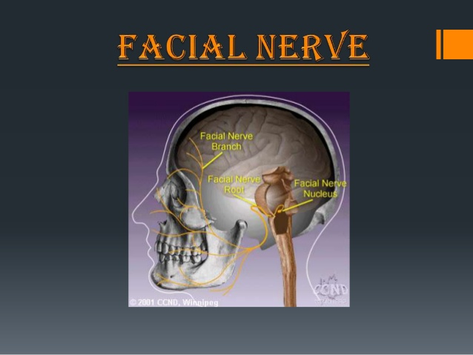

Slide 3
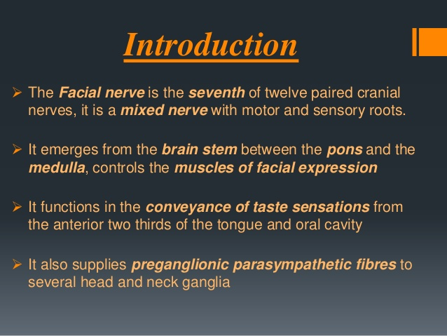

Slide 4
2nd only to vagus as the “busiest” cranial nerve of the human body.
Nerve of the 2nd branchial arch
The facial nerve consists of the facial nerve proper and the intermedius nerve
Both the facial nerve and the intermedius nerve emerge from the CNS in the cerebellopontine angle at the caudal border of the pons, b/w the abducens nerve and the vestibulocochlear nerve.

Slide 5
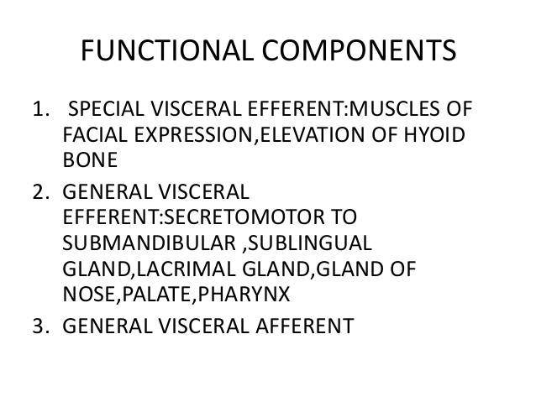

Slide 6
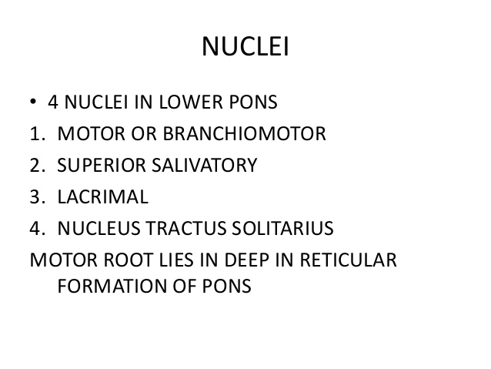

Slide 7
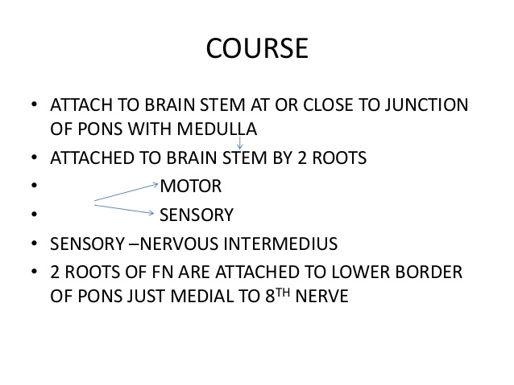

Slide 8
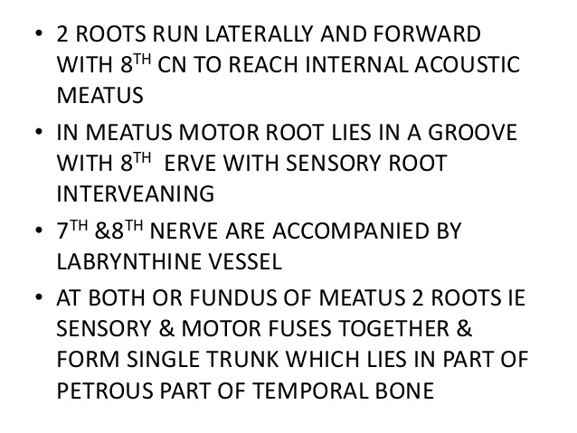

Slide 9
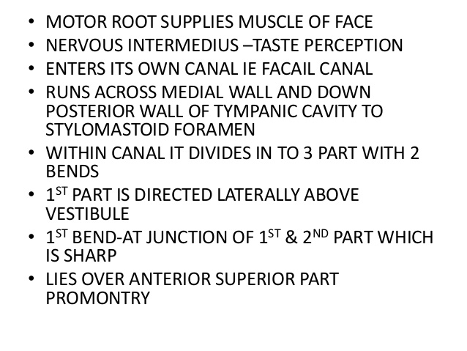

Slide 10
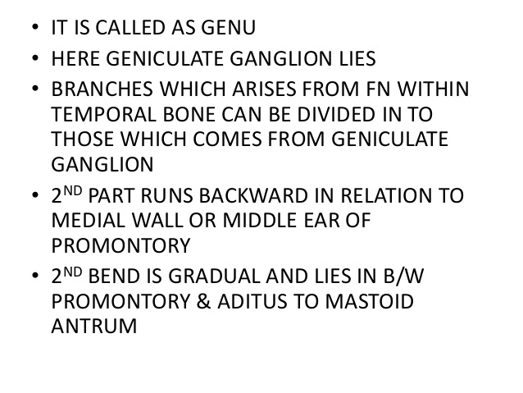

Slide 11
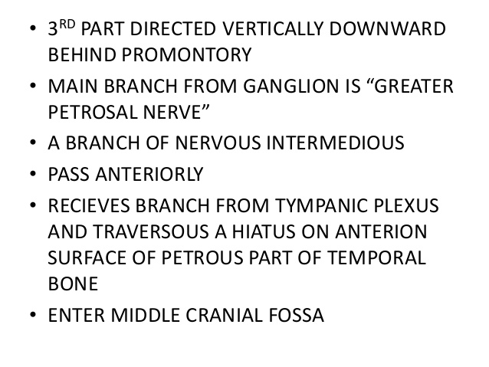

Slide 12
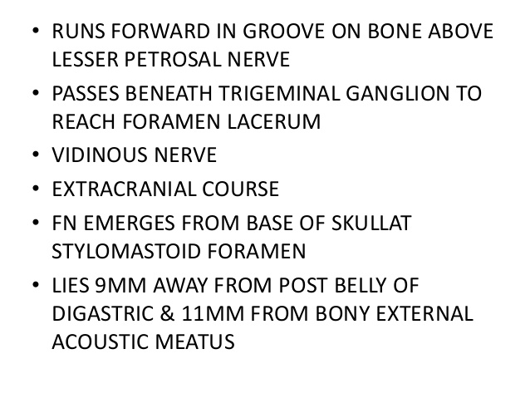

Slide 13
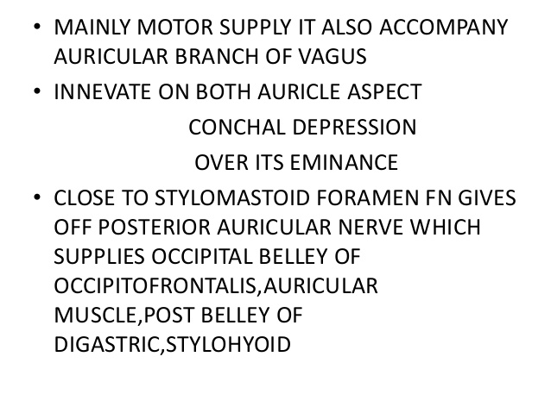

Slide 15
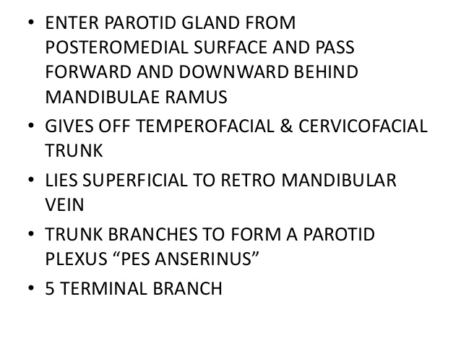

Slide 16
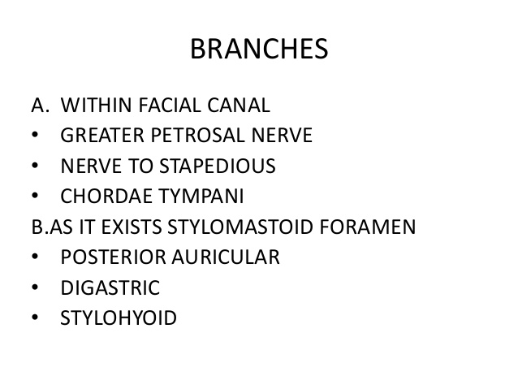

Slide 17
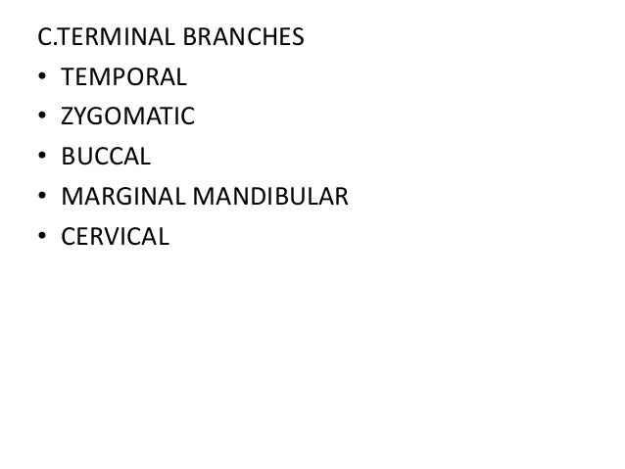

Slide 18
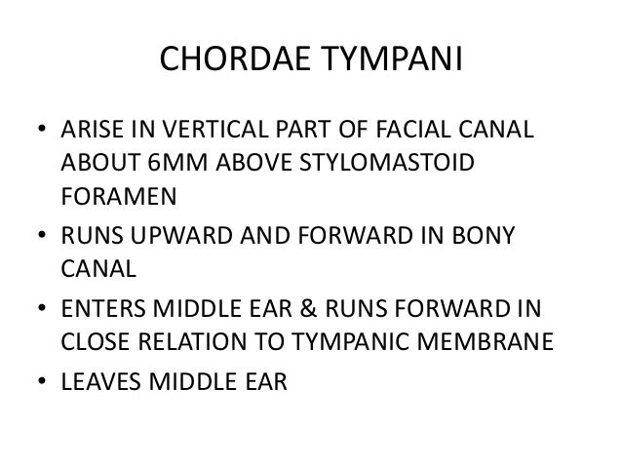

Slide 19
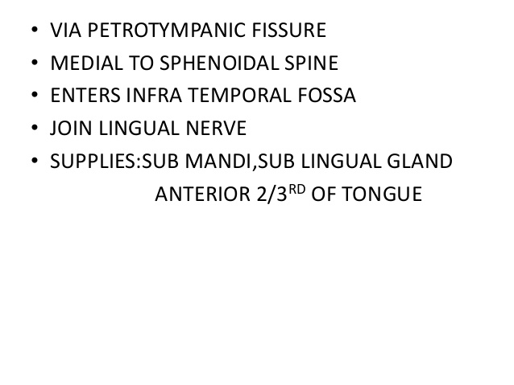

Slide 20
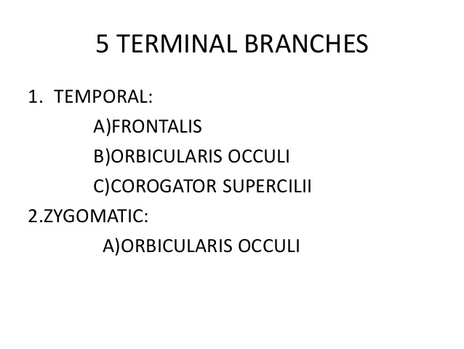

Slide 21
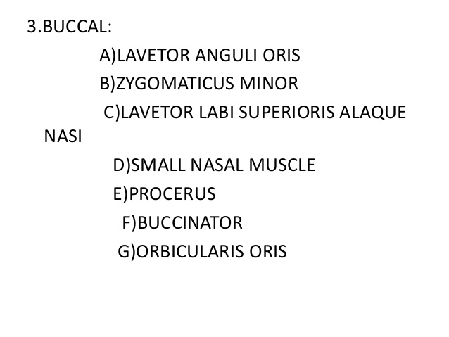

Slide 22
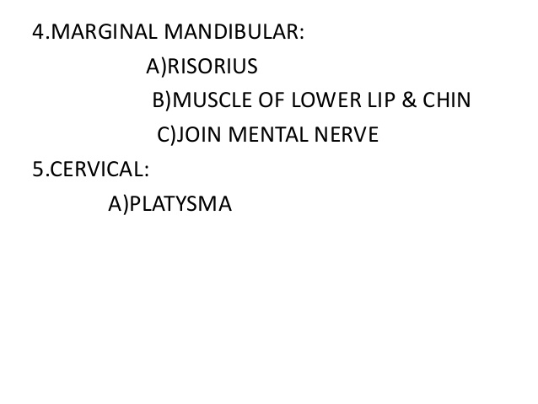

Slide 23
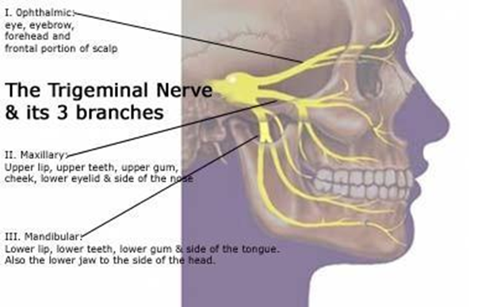
TRIGEMINAL NERVE ( CN V)

Slide 24
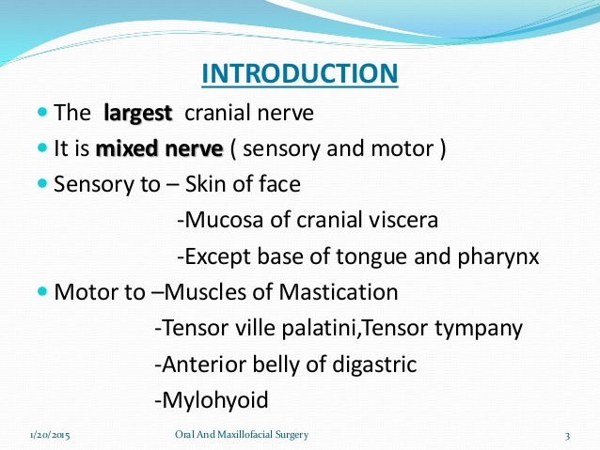

Slide 25
Sensory component has 3 divisions :
Ophthalmic
Maxillary
Mandibullar
Motor and principal sensory nuclei :
Midpons
Spinal tract and nuclei( pain, temp) pons to upper cervical cord.

Slide 26
NUCLEI
A cranial nerve nucleus a collection of neurons( gray matter) in the brain stem that is associated with one or more cranial nerves.
Axons carrying information to and from the CN form a synapse first at these nuclei
Lesions occuring at these nuclei can lead to effects resembling those seen by the severing of nerves they are associated with.

Slide 27
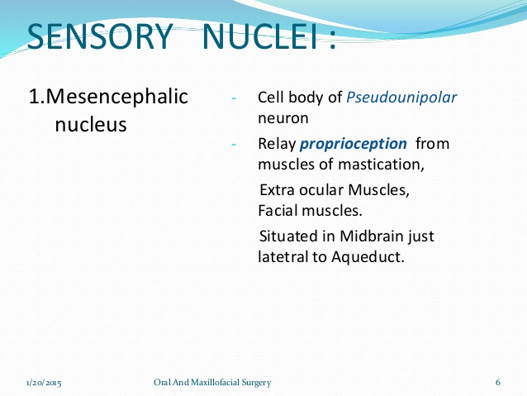

Slide 28
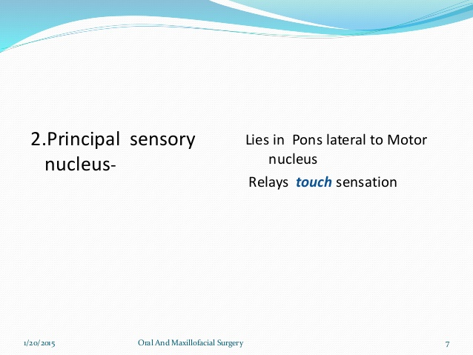

Slide 29
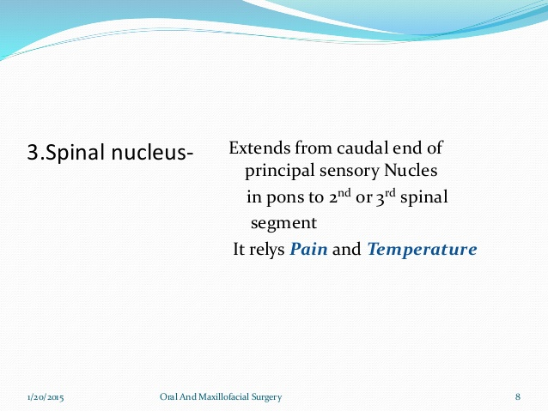

Slide 30
MOTOR NUCLEUS
Innervates muscles of :
Mastication
Tensor Tympani
Tensor Palatain
Derived from first branchial arch
Located in pons medial to principle sensory nucleus.

Slide 31
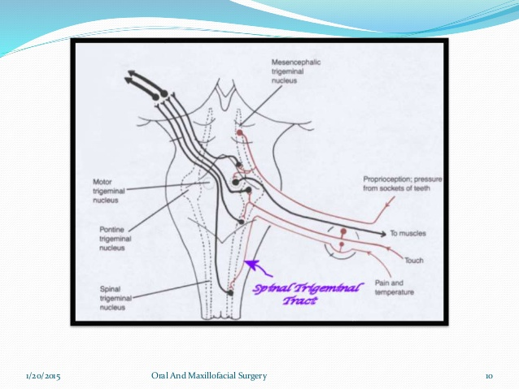

Slide 32
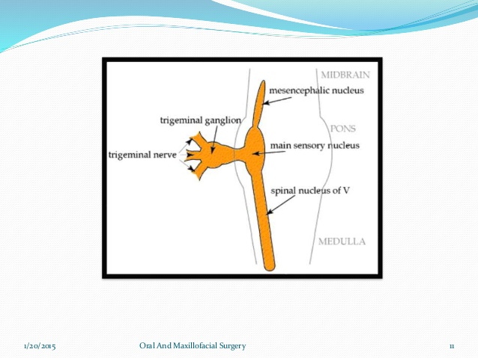

Slide 33
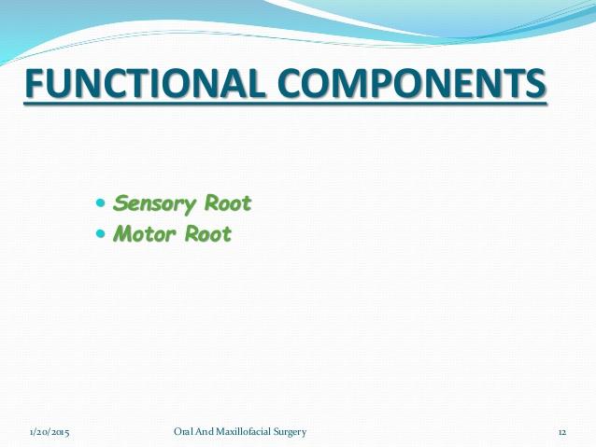

Slide 34
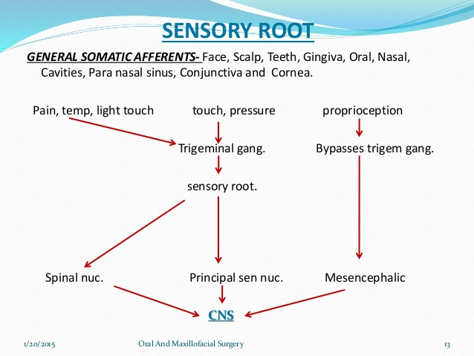

Slide 35
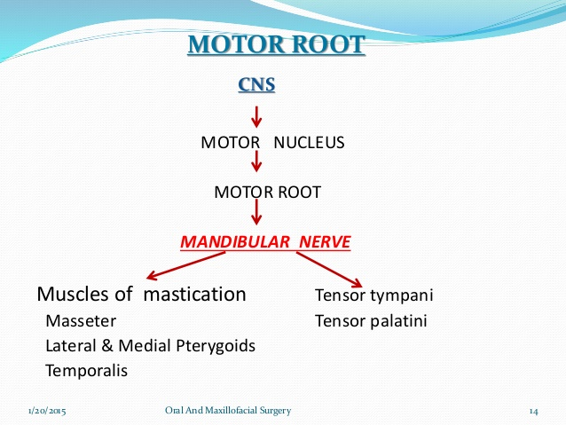

Slide 36
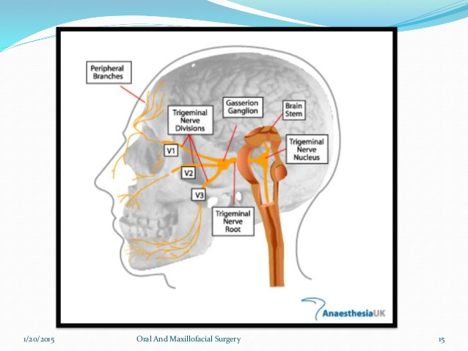

Slide 37
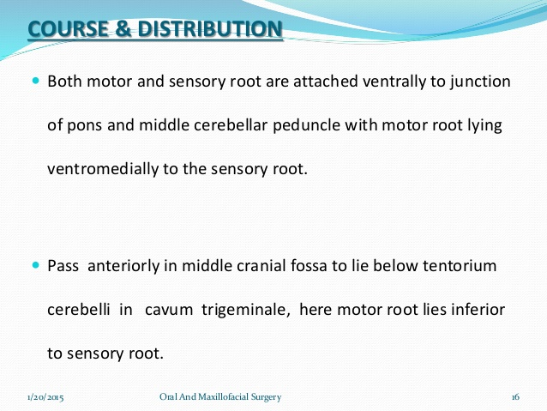

Slide 38
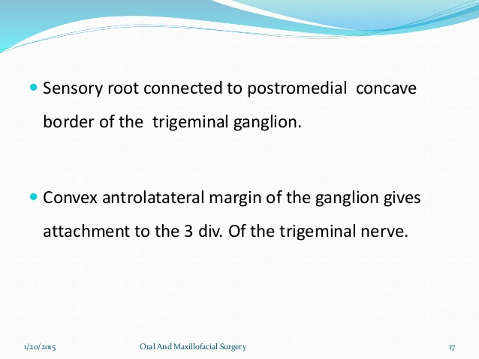

Slide 39
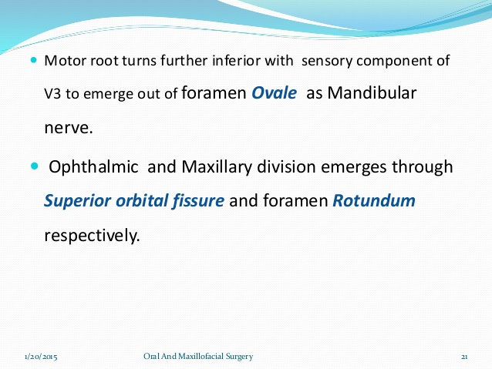

Slide 40
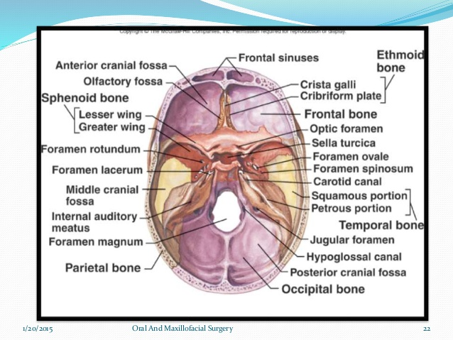

Slide 41
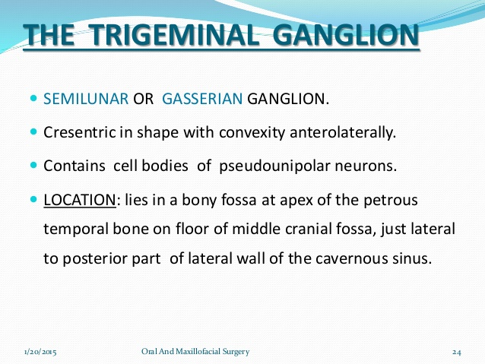

Slide 42
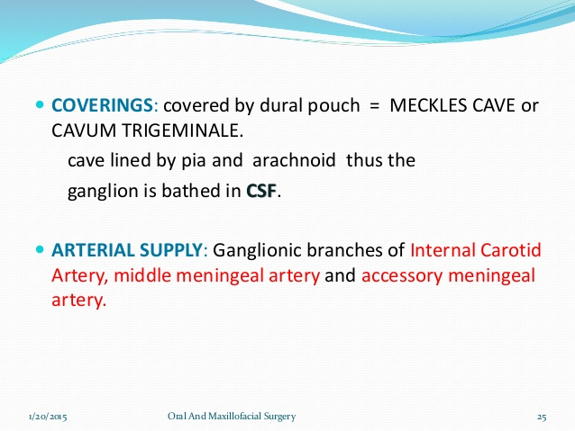

Slide 43
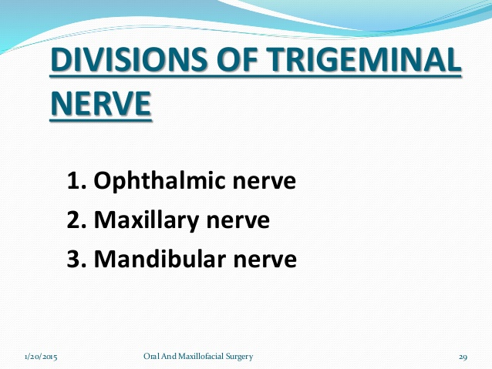

Slide 44
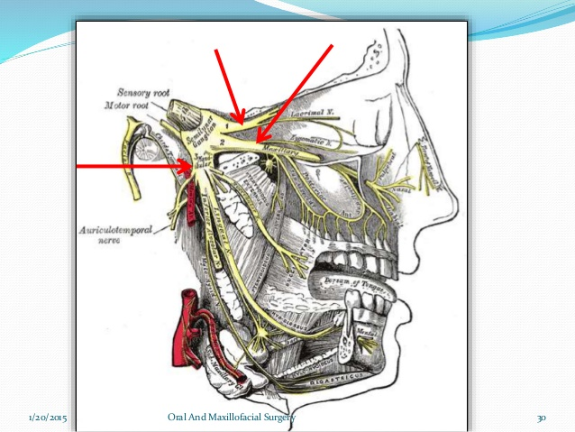

Slide 45
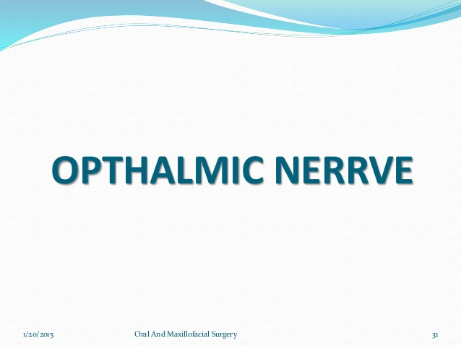

Slide 46
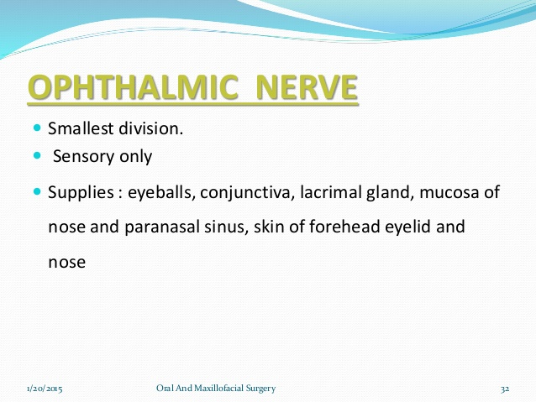

Slide 47
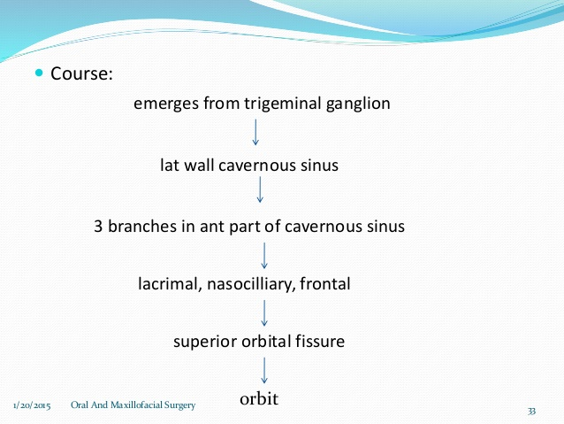

Slide 48
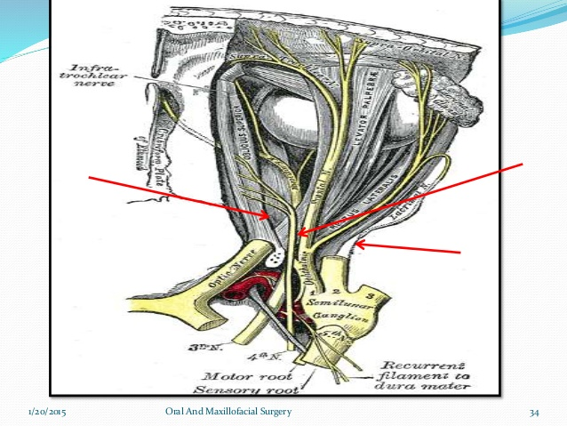

Slide 49
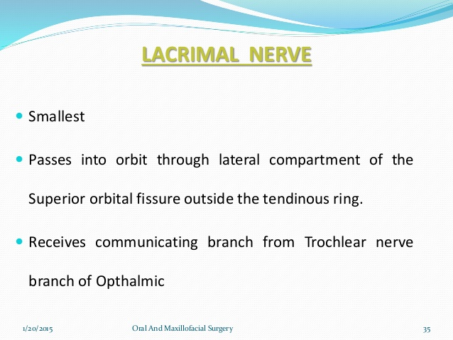

Slide 50
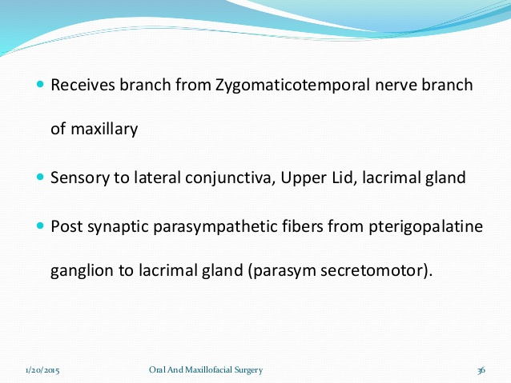

Slide 51
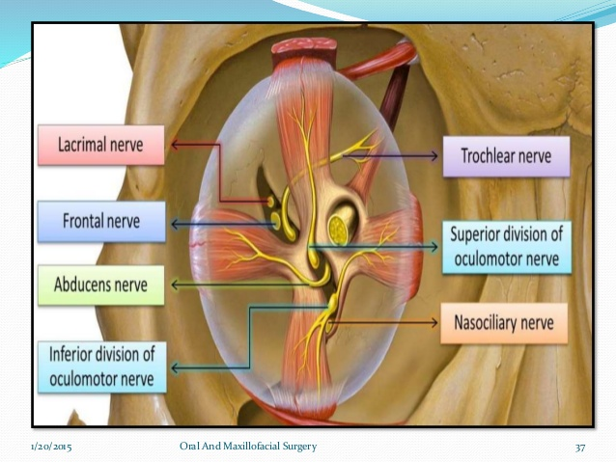

Slide 52
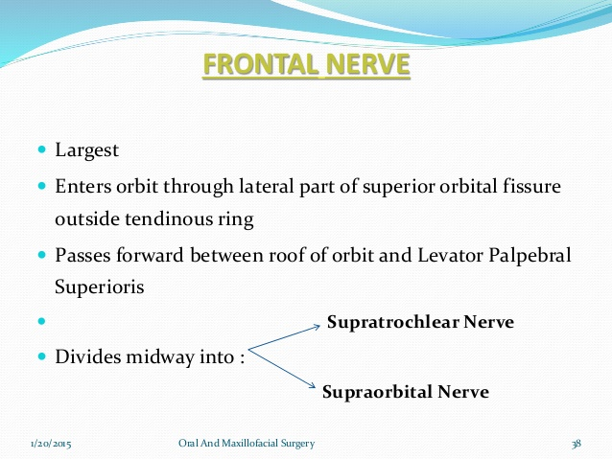

Slide 53
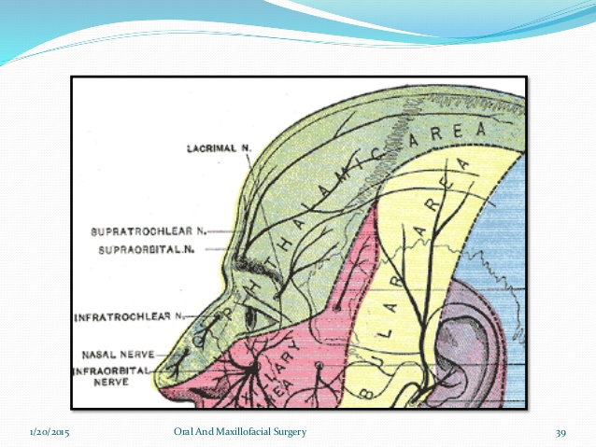

Slide 54
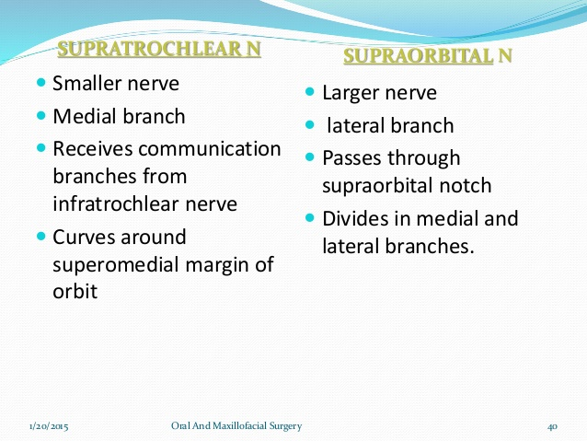

Slide 55
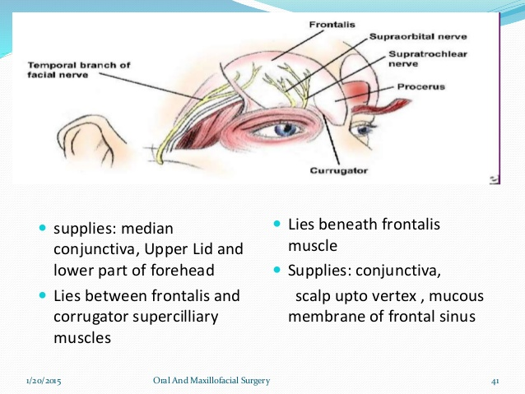

Slide 56


Slide 57


Slide 58


Slide 59


Slide 60


Slide 61


Slide 62


Slide 63


Slide 64


Slide 65


Slide 66


Slide 67


