Slide 1
Preparing for my financial future
This session is aimed at Key Stage Four and Five (recommended for Year 12 and above)
Notes:
Teacher delivery
Students should be invited to ask questions and they should be provided with an opportunity to ask questions anonymously. It is useful to have a question box or allocated space on the whiteboard for students to share questions.
It is suggested that students are provided with post-its or slips to write their questions on and as the teacher circulates throughout the lesson these questions can be collected and answered throughout the session or using an allocated ‘question time’ at the end of the session.
Students can be invited to respond to questions asked by their peers. If responses to questions are based on personal preference or opinion, the teacher should make this clear when answering.

Slide 2
Unit outline
Session 1 | Session 2 | Session 3 | Session 4 | Session 5 | Session 6
Managing Student Finance | Borrowing and Debt | Property: Renting and Buying | Cryptocurrency Risk and Reward | Money and Well-being | Financial literacy in the curriculum

Slide 3
Having a respectful learning environment
We will listen to each other respectfully
We will avoid making judgements or assumptions about others
We will comment on what has been said, not the person who has said it
We won’t put anyone on the spot and we have the right to pass
We will not share personal stories or ask personal questions
Notes:
Teacher delivery
Students should be invited to ask questions and they should be provided with an opportunity to ask questions anonymously. It is useful to have a question box or allocated space on the whiteboard for students to share questions.
It is suggested that students are provided with post-its or slips to write their questions on and as the teacher circulates throughout the lesson these questions can be collected and answered throughout the session or using an allocated ‘question time’ at the end of the session.
Students can be invited to respond to questions asked by their peers. If responses to questions are based on personal preference or opinion, the teacher should make this clear when answering.

Slide 4
Session 6:
Financial literacy in the curriculum

Slide 5

Learning objectives and outcomes
Learning objective: To weigh up how financial literacy education should be delivered and to argue a case for it
By the end of the session, I will be able to:
1
2
3
Identify the different ways young people can receive financial literacy education
Evaluate who is best placed to deliver financial literacy education
Present a case for the importance of financial literacy education

Slide 6


Financial literacy education
‘All young people should learn about the risks and opportunities of money at school.’
What is your first reaction to this statement?

Slide 7





Financial literacy education
Let’s use what you’ve learnt over the last few weeks. Take two minutes to:
Make a mind map of the information that young people should know about money

Slide 8
Learning objectives and outcomes
Learning objective: To weigh up how financial literacy education should be delivered and to argue a case for it
By the end of the session, I will be able to:
1
2
3
Identify the different ways young people can receive financial literacy education
Evaluate who is best placed to deliver financial literacy education
Present a case for the importance of financial literacy education

Slide 9
Financial literacy education
Who should be responsible for teaching young people about money?
Create and fill in this table in your books
 | Should be responsible for teaching young people about money? | Should not be responsible for teaching young people about money?
Parents and carers
Schools
Other

Slide 10
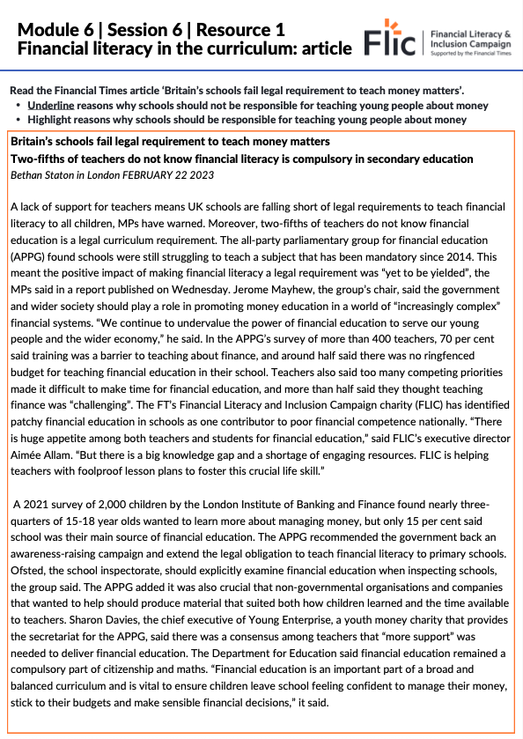
Financial literacy education:
A school’s perspective
Read the Financial Times article ‘Britain’s schools fail legal requirement to teach money matters’.
Underline reasons why schools should not be responsible for teaching young people about money
Highlight reasons why schools should be responsible for teaching young people about money
https://www.ft.com/content/320c43fa-2e12-43d0-baaf-4a37ca93917b

Slide 11

Financial literacy education:
Parents and carers perspective
Read the experience of the person below and identify why this person may or may not be the best person to teach a young person about financial literacy.
I am the owner of my local village convenience shop. It is a family business that I took over from my dad. I feel both proud and lucky to be able run a business as I wasn’t really academic and didn’t do very well in school. However, it can be stressful as business has really slowed down lately. I’ve had to take out a personal loan to cover my household costs but I’m sure things will pick up in the summer.

Slide 12
Financial literacy education:
Parents and carers perspective
Read the experience of the person below and identify why this person may or may not be the best person to teach a young person about financial literacy.
I am the owner of my local village convenience shop. It is a family business that I took over from my dad. I feel both proud and lucky to be able run a business as I wasn’t really academic and didn’t do very well in school. However, it can be stressful as business has really slowed down lately. I’ve had to take out a personal loan to cover my household costs but I’m sure things will pick up in the summer.

Slide 13
Learning objectives and outcomes
Learning objective: To weigh up how financial literacy education should be delivered and to argue a case for it
By the end of the session, I will be able to:
1
2
3
Identify the different ways young people can receive financial literacy education
Evaluate who is best placed to deliver financial literacy education
Present a case for the importance of financial literacy education

Slide 14

Debate
“All young people should learn about the risks and opportunities of money at school.”
Can or should parents and carers be responsible for ensuring that young people are educated on these topics?
How do young people teach themselves?
Why are schools considered an ideal place to teach young people about these topics?
What limitations or challenges do schools face?

Slide 15




Financial literacy education: Make a difference
You have the power to make a difference.
There are many students who are missing out on financial literacy education.
It would be life-changing for many young people and their families if they were to be guaranteed financial literacy education.
You can help this happen by writing a letter to your local MP sharing what you have learnt over the last six weeks and presenting reasons why more schools should include financial literacy in their curriculum.
Advice on how to write a letter to your MP

Slide 16
Learning objectives and outcomes
Learning objective: To weigh up how financial literacy education should be delivered and to argue a case for it
By the end of the session, I will be able to:
1
2
3
Identify the different ways young people can receive financial literacy education
Evaluate who is best placed to deliver financial literacy education
Present a case for the importance of financial literacy education

Slide 17



Services available for people who have concerns about their personal finances
Citizens Advice – Debt and Money – This resource contains links to advice on a number of topics, including financial difficulties, cost of living and communicating with creditors.
National Debtline – Debt and Money – a debt advice charity run by the Money Advice Trust, offering a free and confidential debt advice service.
Childline Helpline
0800 1111
At school, you can speak with an adult you trust.
This could be your form tutor, head of year or the school’s safeguarding officer.
Notes:
Read the moneysavingexpert debt problems guide
https://www.stepchange.org/
https://www.moneyhelper.org.uk/en/everyday-money/types-of-credit/overdrafts-explained

Slide 18
Links to learn more!
Articles to extend learning
Please visit the FLIC learning hub for further resources
Who is my MP?
Contact your MP

