Slide 1



Slide 2

TALK ABOUT 3 THINGS:
GROW YOUR MONEY
PROTECT YOUR LIFE
PROTECT YOUR RETIREMENT

Slide 3


Slide 4


Slide 5
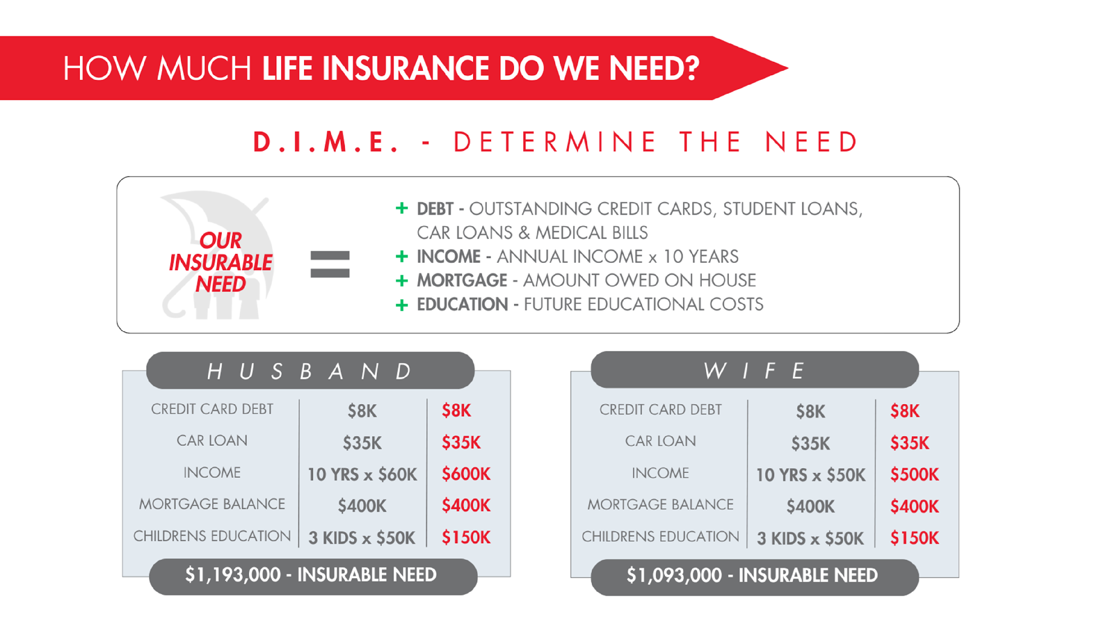

Slide 6



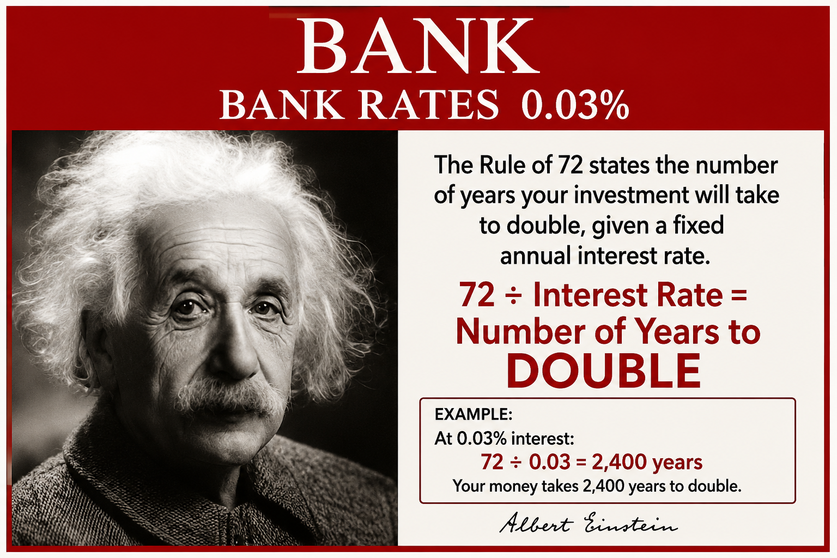
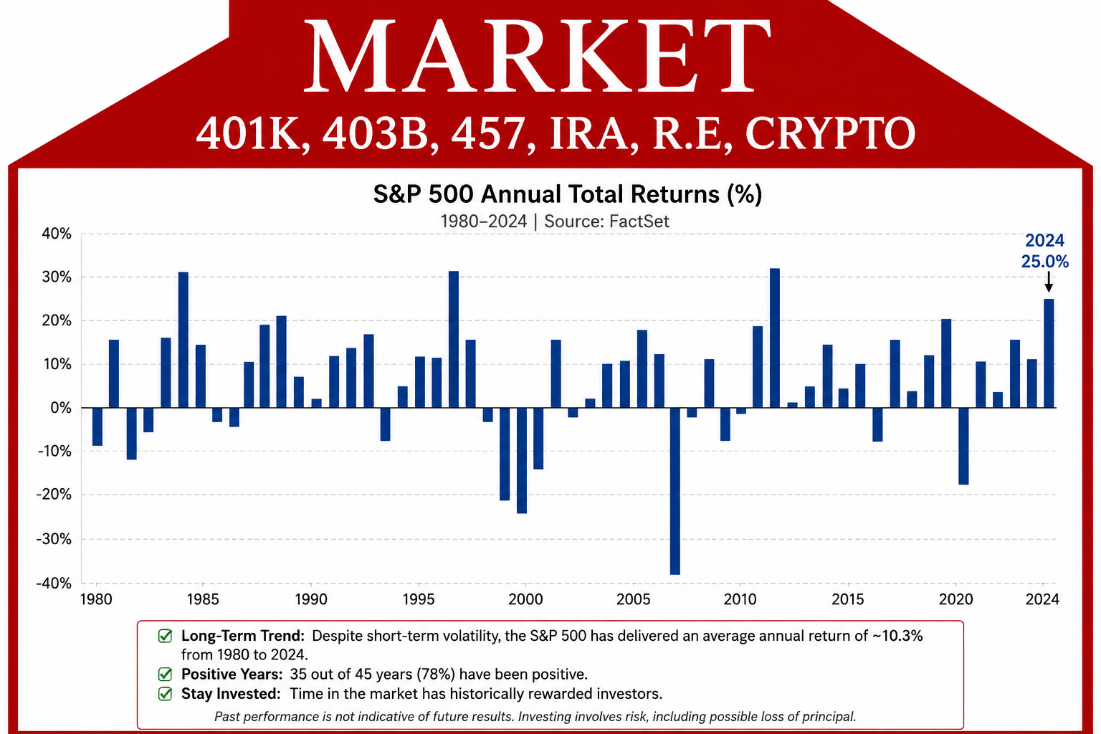
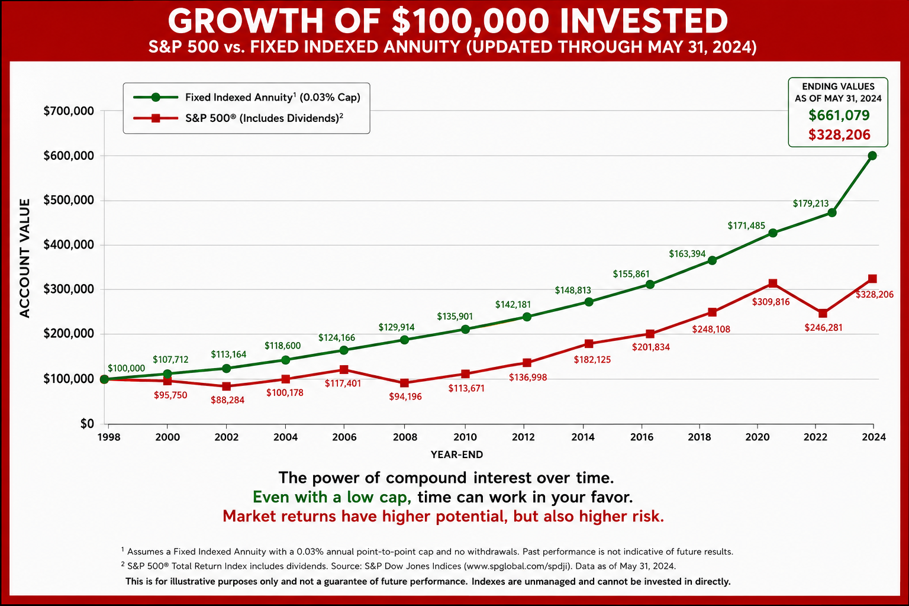
THREE WAYS MONEY GROWS
FIXED ACCOUNT
SAFE, ACCESSIBLE
FEES, LOW INTEREST RATES
VARIABLE ACCOUNT
HIGH REWARD
HIGH RISK
INDEX ACCOUNT
SAFETY OF THE BANK (NO RISK)
PORTION OF THE MARKET’S UPSIDE
BANK
BANK RATES 0.03%
MARKET
401K, 403B, 457, IRA, R.E, CRYPTO
INDEX
(HYBRID)

Slide 7

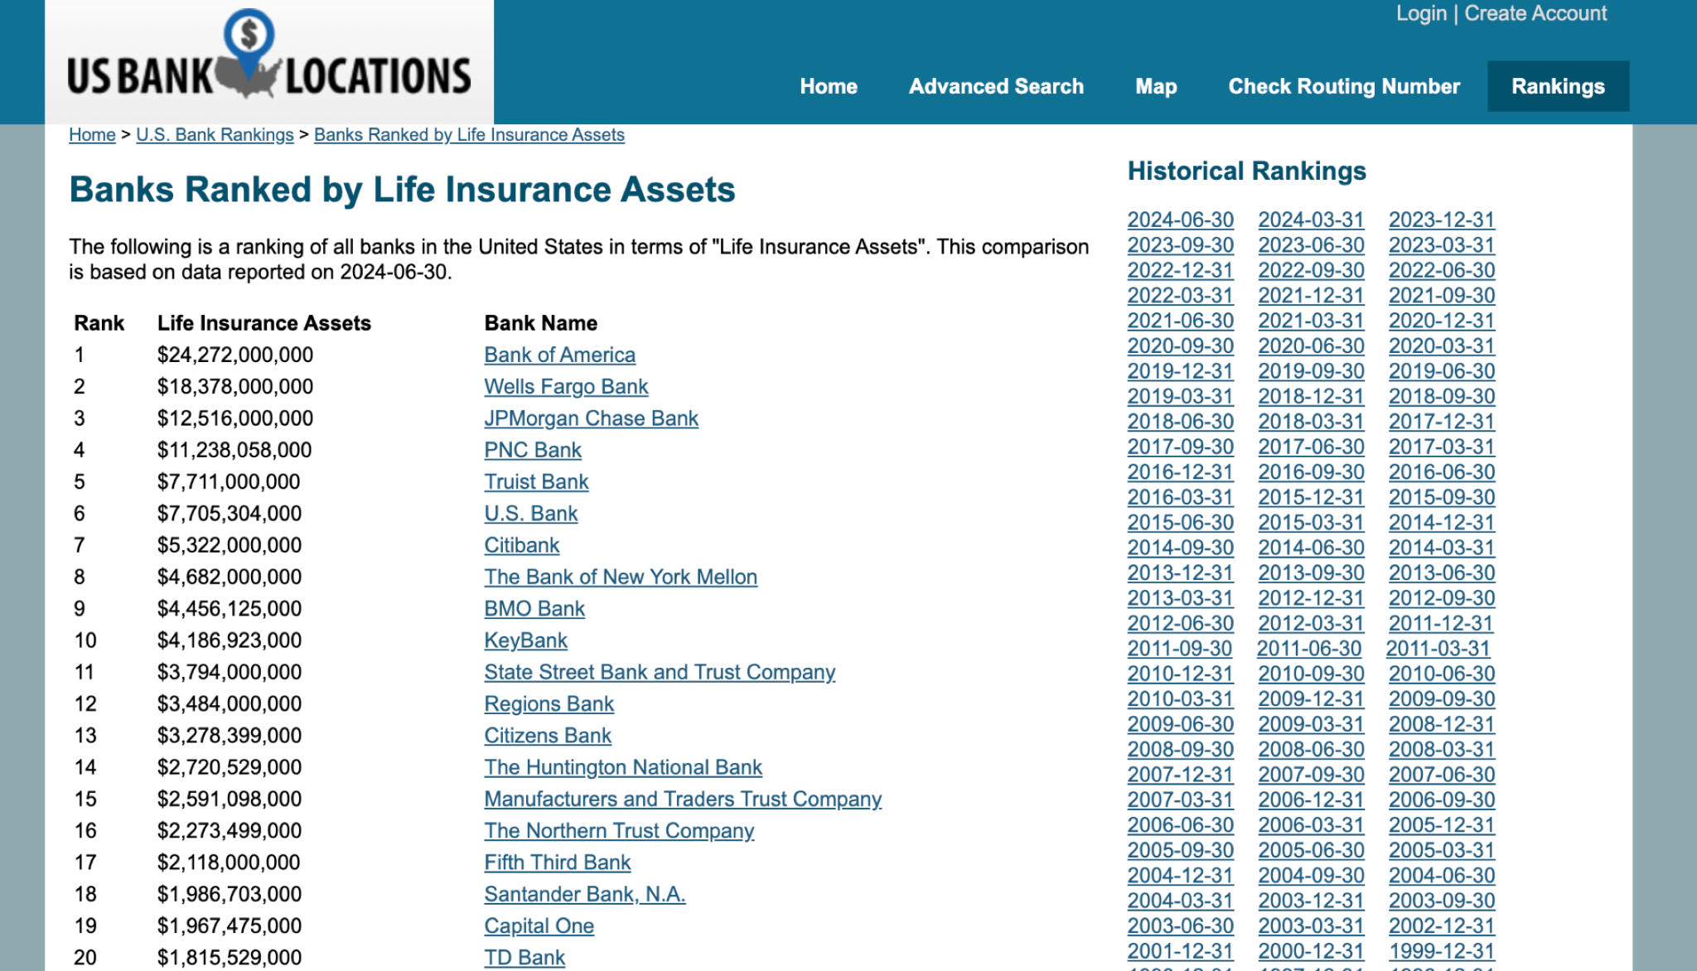






5 HOMES OF MONEY
F V V V I
BANKS
STOCK MARKET
QUALIFIED PLANS
REAL ESTATE
LIFE INS
2/5
2/5
3/5
2/5
4/5

Slide 8
CUT THE “MIDDLEMAN OUT” & GO STRAIGHT TO…

Slide 9

UNDERSTANDING LIFE INSURANCE
TERM
WHOLE
INDEX UNIVERSAL LIFE
10, 15, 20, 30 YRS
35 YR OLD BUYS A 30 YR TERM POLICY
@ AGE 65 POLICY EXPIRES
NOW WHAT?
IUL
WHOLE
2% -4%
S&P 500
INS/DB
CV
INS/DB
CV
2 OPTIONS:
Renew w/current company
@ age 65
  Purchase new policy with a different company
PERMANENT TO AGE 100
*Grows Slow
*High % Rate on Loans
*Loans decrease DB
*CV goes to Insurance Co.
PERMANENT TO AGE 121+
*Growth based on the Market
*Principal Protected
*Family Receives both
*TAX FREE!!!
LIVING BENEFITS!
Either way…

Slide 10
IMPORTANT INTERNAL REVENUE CODES
72(e) – Money inside of a life insurance contract accumulates tax free
7702 – When you access money while your alive out of that life insurance policy it can be totally tax free
101(a) – Life insurance proceeds transfer tax free to your beneficiaries

Slide 11
ANNUITIES SIMPLIFIED
PENSION
INDEXED ANNUITY
EMPLOYER
EMPLOYER
$$$$$
$$$$$, 401K, 403B, 457, IRA, TSP …
LIFE INSURANCE CO
LIFE INSURANCE CO
ANNUITY
INDEXED ANNUITY
INCOME FOR LIFE
INCOME FOR LIFE
*INCOME RIDER*
ANNUITIZED
NO ANNUITIZATION
ACCOUNT ACCESS
(NO ACCESS, ½ GOES TO SPOUSE OR CHILD)
GUARANTEED GROWTH
100% SAFE FROM MARKET LOSS
BENEFICIARIES
LEAVE A FAMILY LEGACY !!!

Slide 12
OUT OF THESE 3 WHICH STANDS OUT THE MOST?
GROWING YOUR MONEY
PROTECTING YOUR LIFE
PROTECTING YOUR RETIREMENT
OR ALL OF THE ABOVE?

