Slide 1
CREATING AN ENGAGED, VALUE-ADDED ALUMNI ASSOCIATION

Slide 2
AARON PROIETTI
Board member of YMCA Camp Cory
Alumni Association Co-Chair
100th Anniversary Celebration Co-Chair
Summer Camp Consultant
Author, Coach, Facilitator, Speaker
1995, Senior Counselor

Slide 3
AARON PROIETTI
Board member of YMCA Camp Cory
Alumni Association Co-Chair
100th Anniversary Celebration Co-Chair
Summer Camp Consultant
Author, Coach, Facilitator, Speaker
1995, Senior Counselor

Slide 4
AARON PROIETTI
Board member of YMCA Camp Cory
Alumni Association Co-Chair
100th Anniversary Celebration Co-Chair
Summer Camp Consultant
Author, Coach, Facilitator, Speaker
1995, Senior Counselor

Slide 5
ABOUT CAMP CORY
Began operating in late 19th century on various sites under the name Camp Iola.
Settled into it’s current location on Keuka Lake near Penn Yan, NY, in the summer of 1920, originally ~14 acres.
Named after Lieutenant H. Lawrence Cory, Machine Gun Company, 310th Infantry, US Army who was killed September 22, 1918 along the French-German battle line in WWI.
Dedicated YMCA Camp Cory in 1921.
Became co-ed in 1976.
The camp now sits on 36 acres and serves ~2,000 campers per summer with 100 to 130 staff.
Programs include resident camp, day camp, specialized sailing camp, and robust CIT program.

Slide 6
ALUMNI OF CAMP CORY
Prior to present day, the common notion of Camp Cory Alumni was of staff members.
An Alumni Association was spun up by YMCA staff in early 2000s.
The YMCA staffed an Alumni Engagement position for many years to run the Alumni Association.
Volunteer committees assisted in the development of the camp’s 80th, 90th, and 95th reunions.
These committees were informal and no specific charge or authority.

Slide 7
WHAT WE’LL COVER:
Benefits of an Alumni Association
Steps to building an Alumni Association
Designing and defining an alumni association
Building a solid alumni foundation
Formalizing an alumni association
Promoting alumni volunteerism But first,
Utilizing your alumni association to design and lead camp events and activities: Told through the story of a certain speaker being asked to chair Camp Cory’s 100th Anniversary Celebration.

Slide 8
2019
AUGUST During a summer visit, I recall sitting on the dining hall porch with the Director of Alumni and Donor Engagement. I recall making an offer to spin up another volunteer committee to help plan the 100th Anniversary Celebration. I began work right away getting a handful of alumni signed up.
DECEMBER The Director of Alumni and Donor Engagement and I apparently had different recollections of that conversation…

Slide 9
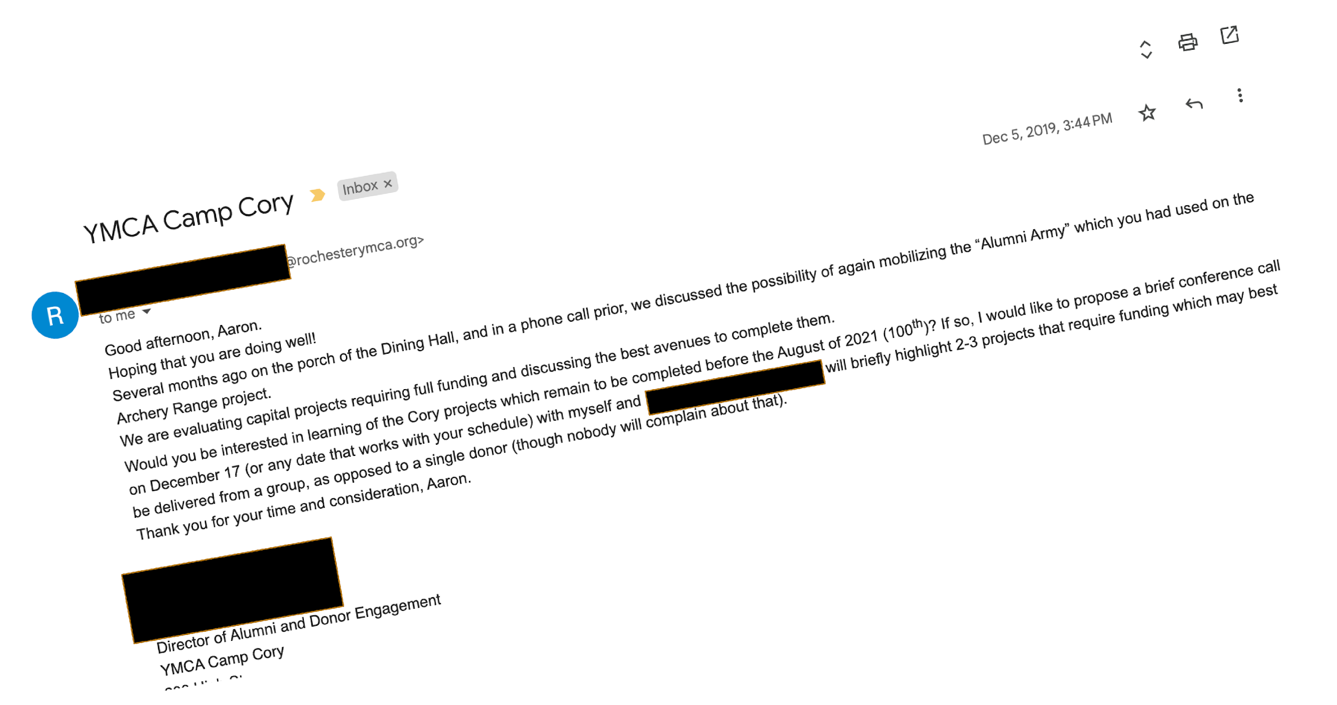
2019
During a summer visit, I sat on the dining hall porch with the Director of Alumni and Donor Engagement and made an offer to spin up another volunteer committee to help plan the 100th Anniversary Celebration.
The Director of Alumni and Donor Engagement and I had different recollections of that conversation.

Slide 10
2020
FEBRUARY Together with the Camp Director, we assemble a committee of five alumni to support the planning of the 100th anniversary celebration to take place June, 2021.
MARCH Our first meeting was March 26, 2020 by Zoom. The 100th Anniversary was NOT the main topic of conversation.
APRIL The pandemic impacts the year-round staff at Camp Cory. The Alumni Engagement position is eliminated. I am asked to join the Camp Cory board and to chair the planning for the 100th. I enlist a co-chair, Randi. She and I discuss the opportunity to develop and formalize a Camp Cory Alumni Association to assist in the planning.

Slide 11
BENEFITS OF AN ALUMNI ASSOCIATION
INCREASED ENGAGEMENT COULD DRIVE ATTENDANCE AT THE CELEBRATION
HIGHLY ENGAGED ALUMNI PRESENT MORE FUNDRAISING OPPORTUNITIES
DIVERSE ALUMNI PERSPECTIVES CAN PRESERVE OUR TRADITIONS AND HELP DEFINE THE FUTURE
SUPPORTIVE NETWORK OF EXPERTS AND VOLUNTEERS CAN ASSIST WITH EVENT DESIGN AND EXECUTION

Slide 12
2020, CONT.
MAY The decision is made to cancel overnight camping at Camp Cory. The day camp would continue in limited capacity.
NOVEMBER The decision is made to postpone the 100th anniversary celebration to 2022. This gives us a long runway to build up awareness of the Alumni Association and to bring alumni together (virtually) in advance. We conduct a “visioning meeting” to begin to make decisions about the formation of an Alumni Association, which had not yet been formally acknowledged by the board. The Alumni Association’s first activities are sending Thank Yous to the 2020 staff members, and hosting virtual events to engage with the alumni community.

Slide 13
STEPS TO BUILDING AN ALUMNI ASSOCIATION
DEFINE “ALUMNI”
CO-CREATE A PURPOSE STATEMENT
ALIGN PURPOSE WITH CAMP PERSONNEL AND BOARD
IDENTIFY KEY ACTIVITIES
ESTABLISH A STRONG ALUMNI FOUNDATION
IMPROVE/DEVELOP A DATABASE
FORMALIZE THE STRUCTURE/ GOVERNANCE MODEL
ENGAGE CURRENT STAFF
ENGAGE ALUMNI COMMUNITY
PROMOTE VOLUNTEERISM
GET BETTER AT EVERYTHING
FUNDRAISE

Slide 14
DESIGN AND DEFINE THE ALUMNI ASSOCATION
We conducted a Visioning Session to answer:
What is the purpose of the association? How do we fulfill that?
What does it mean to be a MEMBER of the Association?
How do we best engage alumni?
But first, what is the definition of ALUMNI?

Slide 15
WHAT IS THE DEFINITION OF ALUMNI?
YMCA Camp Cory Alumni are current and former campers, staff members, plus other program participants who cherished their camping experience at Cory.
Our Alumni events are open to Friends of Cory who include camper & staff parents & family members, our donors, our vendors, and others who have experienced Cory.

Slide 16
WHAT IS THE PURPOSE OF THE ASSOCIATION?
The purpose of this organization contains three key components:
Bring Camp Cory Alumni Together
Serve as Ambassadors of Camp Cory
Preserve Camp Cory’s Legacy
Be sure to align the purpose statement with the goals of the organization.
Notes:
By “Bring Camp Cory Alumni Together” we mean:
Build and maintain a welcoming community of alumni by offering engaged alumni opportunities to reconnect, form new connections, and maintain relationships among l alumni by building camaraderie within the community. Establish programs for mentorship and professional support for committee members and friends of Cory.
Support Camp Cory events and programs through leadership, promotion, and representation;
Unless otherwise noted, our Alumni events are open to Friends of Cory, including camper & staff family members, donors, our vendors, and others who wish to participate.
By “Serve as Ambassadors of Camp Cory” we mean:
Enlist alumni in efforts to live and promote the values and ideals of Camp Cory beyond the camp grounds. Seek to further the camp’s mission related to character development, community impact, and skill development.
Assist with recruitment of staff and campers
By “Preserve Camp Cory’s Legacy” we mean:
Share cherished experiences; commemorate and celebrate Cory history; make the history of Cory accessible to all.
Support the camp both financially and non-financially. In addition to supporting capital and annual giving campaigns, establish a culture of volunteerism with value placed on non-monetary opportunities to give back.

Slide 17
WHAT DOES IT MEAN TO BE A MEMBER?
The Camp Cory Alumni Association maintains the following:
All alumni are members.
And there is no financial commitment to be a member.

Slide 18
ALUMNI “ORBITS”
Alumni Committee
Sub-committee of Cory Board
Participants in Alumni Activities
Long-term goal of 1,000 active participants
Alumni of Camp Cory
Thousands of alumni
Friends of Camp Cory
Many thousands of friends

Slide 19
HOW DO WE BEST ENGAGE ALUMNI?
We identified the following activities for engaging alumni:
Establish regular communications, including social media and an alumni newsletter 🡪
Build and maintain a reliable database
Establish a presence at the camp
Host and sponsor events including an annual volunteer weekend
Promote the alumni cabin
Develop recognition awards
Conduct special gear promotions
Protect and share the camp’s history

Slide 20
2021
JANUARY The Alumni Committee has grown to 10 members. Work continues on building a solid alumni foundation.
APRIL The board approves the formation and governance model of the Alumni Association with Randi and myself appointed as co-chairs.
JUNE Camp Cory re-opens post-pandemic. I am selected as keynote speaker at staff week. This is the first introduction of the Alumni Association to the current staff. Two people from that room now serve on the Alumni Committee.
NOVEMBER New dates are announced for the 100th Anniversary Celebration: August 26th-28th, 2022

Slide 21
BUILD A SOLID ALUMNI FOUNDATION
Recruit committee members who are representative of generations/eras
Try not to overrepresent a given era
Allow members to be part of the design and definition phases
Try to enlist those who have shown a commitment to staying involved:
Generational Stewards: Those who organize informal reunions
Former alumni board members
Prospective alumni board members
Those who served in prominent positions
Other hand-raisers who have shown initiative

Slide 22
IMPROVE UPON OR DEVELOP A DATABASE
DATABASE FIELDS |  | OTHER "INDICATOR" FIELDS TO CONSIDER
Key | E-mail Address | Foreign Record
Last name | Alternate E-mail Addresses | Strong Address
First name | E-mail Indicator | Staff
Nickname | E-mail Permission | Parent
Alternate Names | Do Not Solicit | Sibling
Address 1 | Poor Record Flag | Camper
Address 2 | Record Classification | Donor
City | Affiliation Old | Current Camper
State | Affiliation | Vendor
Country | Date Last Update | Other Program Participant
Zip | Description Last Update | Deceased
Zip+4 | Comment on Data Quality | Friend of Cory
Date of Birth | Detail
Compile existing database records into a single database.
Some camp management software systems have alumni database capabilities.
Assign a single owner for data integrity.
Take data privacy seriously.
Manage communication permissions closely.
CampAlum.com is a website that offers alumni database management service.

Slide 23
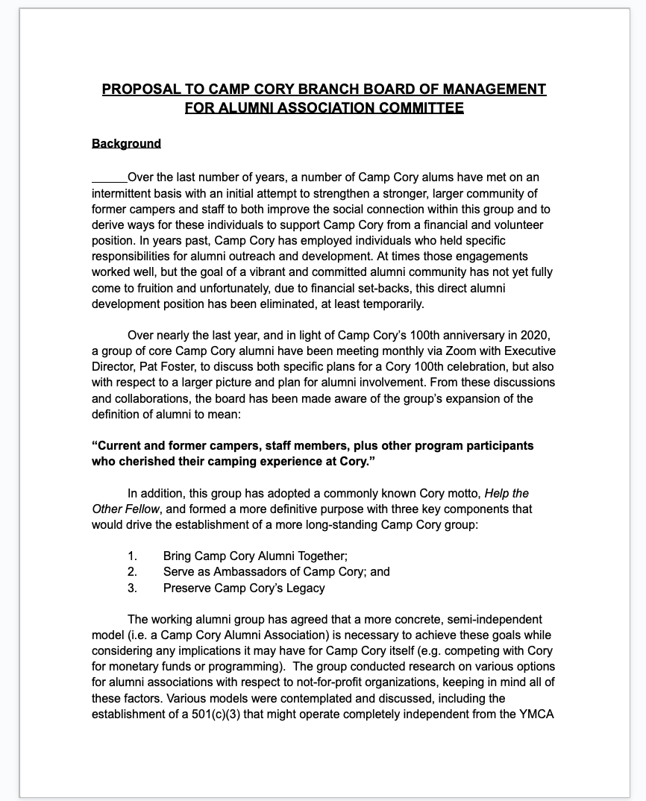
FORMALIZE THE STRUCTURE OF THE ALUMNI ASSOCIATION
Create a charter document which describes the Governance Model, including:
How it is defined and structured
How it is led, staffed, and managed
When it will be reviewed for effectiveness
Present the document to the board or equivalent for approval.

Slide 24
ALUMNI ASSOCIATION GOVERNANCE MODEL
DEPENDENT
HYBRID
INDEPENDENT
Governed entirely by the organization
Budget is part of organization’s operating budget
Activities are decided upon and led by organization
Exists largely for fundraising
Governed by the alumni with organizational representation
Budget is part of organization’s operating budget
Targeted campaigns can increase the budget
Activities are mutually agreed upon to balance the needs of the organization (fundraising) and the alumni association (community)
Governed by alumni
Can be a 501c3 nonprofit
Budget is funded by events, membership fees, and donations
Activities are decided upon and led by alumni
Exists largely as a community
Risk that the association can “go rogue”

Slide 25
ALUMNI ASSOCIATION GOVERNANCE MODEL
The committee shall remain a standing committee of the Board for five years, at which point the Board shall evaluate the efficacy and appropriateness of the committee
To fund our activities, we will look to the Executive Director to budget and approve spending, with reviews of budget by the Cory Board upon request. This spending will include support of planning the 100th Anniversary Celebration
The Alumni Committee will be composed of 6-15 members, with two co-chairs serving two year terms with no term limits. The committee will contain at least one member of Cory Board, plus high-ranking ex-officio staff member appointed by Executive Director
The Alumni Committee will meet monthly to fulfill the purpose of association. Occasional open meetings would allow any alum to learn more about the association and to participate in Alumni Association planning activities.

Slide 26
ENGAGE ALUMNI COMMUNITY
Develop a communication strategy for engaging alumni.
Utilize email, web, social media, videoconferencing, and in-person communications.
Consider hosting events that bring alumni together who have a shared experience:
CIT Reunions
Storytelling events
Decade Reunions
Design events for the first-time attendee. Use fun questions like “What’s your favorite camp meal?”

Slide 27
ENGAGE CURRENT STAFF AS ALUMNI
In the summer of 2021, Camp Cory staff recreated the photo from 100 years earlier
The entire camp participated in an overhead “100” drone photo
Alumni Association representatives were on site for staff training, the staff banquet, and check-out days
We continued the tradition of sending each staff member a Thank You from the Alumni Association after the summer

Slide 28
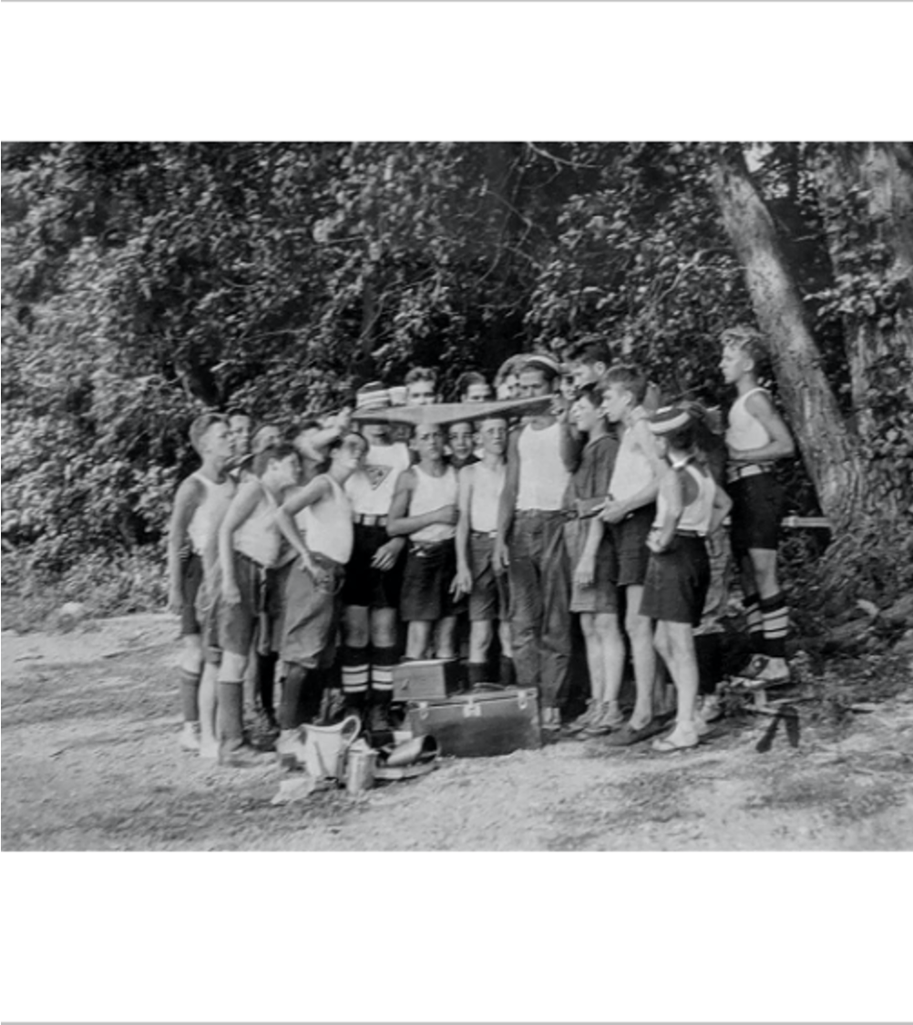
SUMMER 2021
Camp staff recreated the photo from 100 years earlier
The entire camp participated in an overhead “100” drone photo
Alumni Association representatives were on site for staff training, the staff banquet, and check-out days
We continued the tradition of sending each staff member a Thank You from the Alumni Association after the summer

Slide 29
2022
JANUARY Traditions are born. The second annual Virtual Alumni Holiday Party takes place. Additional Alumni Committee members added.
MAY 100 day countdown to the 100th anniversary. Alumni Association focuses on history exhibits, enlisting volunteers, and developing the event program.
AUGUST The 100th Anniversary Celebration is here. The weather is perfect. An army of volunteers made it all possible.

Slide 30
PROMOTE ALUMNI VOLUNTEERISM
Utilize alumni with unique professional skills or hobbies to contribute to events and projects.
Not all alumni are in a position to give back.
However small one’s contribution, their influence on the volunteerism culture could be substantial.
For our 100th Anniversary, we had over 50 volunteers contribute something. A couple dozen contributed significant time.

Slide 31
EVENT VOLUNTEER WORKSTREAMS
Planning & Logistics
History
Marketing & Communications
Resource Coordination Project Planning Status Updates Budgeting Vendors/Partners
Lodging & Ticketing Strategy Gear Strategy
Artifact Collection
History Content/Lists
Onsite Exhibit Design
Onsite Exhibit Build
Lectures/Storytelling
Signage
Web and Newsletter Content
Branding/Logo
Grass Roots Promotion

Slide 32
EVENT VOLUNTEER WORKSTREAMS
Experience & Activities
Media and Video Production
Other
Tours
Virtual Events
Plan the Celebration
Arrival Check-in/Check Out
Experience Brainstorming
Physical Space Usage Plan
Social Media
Video Production
News Media
Alumni outreach Community outreach Sponsorships Dedications Food & Catering Crowd management
Accessibility

Slide 33
CAMP CORY’S 100TH ANNIVERSARY CELEBRATION
AUGUST 26-28, 2022

Slide 34
100TH ANNIVERSARY CELEBRATION HIGHLIGHTS
Three-day event with Saturday as the main event
Designed as a celebration, not an alumni reunion
Lodging was made available, but limited
Saturday evening happy hour with band
Saturday evening banquet featuring videos, awards, and camp-style fun
Saturday night fireworks over Keuka Lake
Self-guided interactive tours
Full suite of camp programming, including several blocks of Kid Care
~$35K in donations to the camp directly from the weekend, without an ask. Thousands more in gear sales.

Slide 35
BRING CAMP CORY ALUMNI TOGETHER
Alumni attended from as far away as Alaska, California, and The Netherlands
90-year old Paul K. was recognized as the oldest alum in attendance. 10 of Paul’s grandchildren have attended the camp.
Over 400 people were on camp grounds. Many more followed along on Instagram and live streams.
Disney-style lanyards and pins were given out, Disney-style.
Featured alumni-led sailing regatta and alumni pop-up art show

Slide 36
SERVE AS AMBASSADORS OF CAMP CORY
Over 75 volunteers made the event possible
Kids of all ages experienced the magic of Camp Cory
Special edition gear promotions featured YMCA-approved off-brand and historically-inspired logos
Attended by Alumni, community leaders, YMCA leaders, donors, current staff, and current campers.
Attendees could write on a dedications wall called to remember their time spent at Camp Cory.

Slide 37
PRESERVE CAMP CORY’S LEGACY
The dining hall was converted into a history exhibit and lecture hall, including 14 permanent history panels and a permanent Camp Cory timeline
We collected attendees favorite memories through interactive exhibits.
The Alumni Association designed a new Spirit of Cory Award for recognizing alumni who embodied the principles of HELP THE OTHER FELLOW, SERVICE, and DEDICATION
4 recipients were honored with the award, each presented by Camp Cory alumni.

Slide 38
CAMP CORY ALUMNI ASSOCIATION TODAY
SINCE THE 100th
Hosted the Third annual Virtual Alumni Holiday Party.
Three new Alumni Committee members added.
Operations Manual developed.
Developed and launched the Camp Cory Hall of Fame for recognizing elements of Cory Life that should be remembered forever
UPCOMING
We are revisiting the purpose statement, possibly to include fundraising goals.
Database overhaul
Improvements to our unofficial website: Cory.Camp

Slide 39
LESSONS LEARNED
THE DATABASE WILL BE A PERSISTENT CHALLENGE. PLAY TO SURVIVE.
MAINTAIN CONTINUOUS IMPROVEMENT MINDSET OK TO FAIL
DEVELOP RELATIONSHIPS ACROSS GENERATIONS
ENGAGE SEASONAL STAFF AS ALUMNI
RESPECT THE “ALUMNI ORBITS”
ALIGN WITH THE BOARD AND CAMP PRIORITIES
ALUMNI HAVE OPINIONS! SOLICIT INPUT TO CO-CREATE EXPERIENCES
HAVE 1-2 EXTREMELY DEDICATED PEOPLE TO GAIN GROUND OUTSIDE OF MEETINGS
HELP THE CAMP HANDLE DIFFICULT ALUMNI
ALUMNI PRIORITIES ARE NOT ALWAYS CAMP PRIORITIES

Slide 40
DISCUSSION: MODERN CHALLENGES
What is the Alumni Association’s role in Diversity, Equity, and Inclusion work?
The camp of today doesn’t match the camp of one’s childhood. What’s the best messaging?
How do you sell to alumni the balance of tradition vs. progress?
What’s the best way to manage communications preferences?
How to resolve/ embrace generational differences?
How to maintain reliable database integrating disparate data sources, with data quality challenges, and varying communications preferences

Slide 41
THANK YOU
This presentation is available
QR Code to presentation

