Slide 1
1 Offsite fundamentals
Slides by Dr Mila Duncheva and Carola Calcagno, Edinburgh Napier University

Slide 2
1.0 Introduction and Glossary

Slide 3
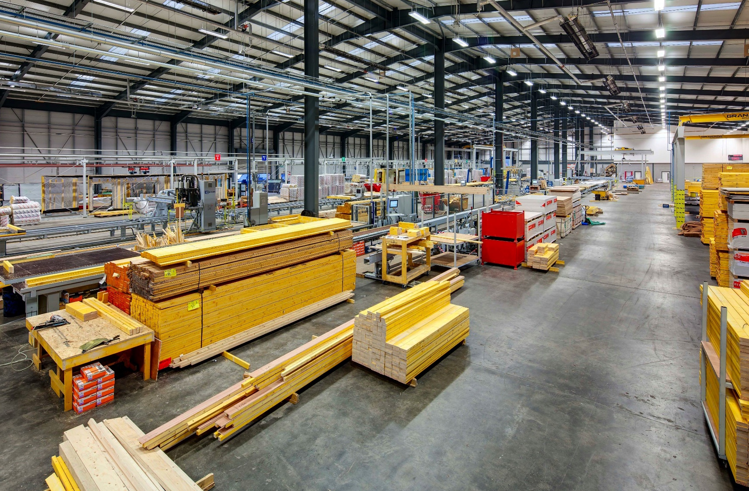
Image courtesy of CCG OSM

Slide 4
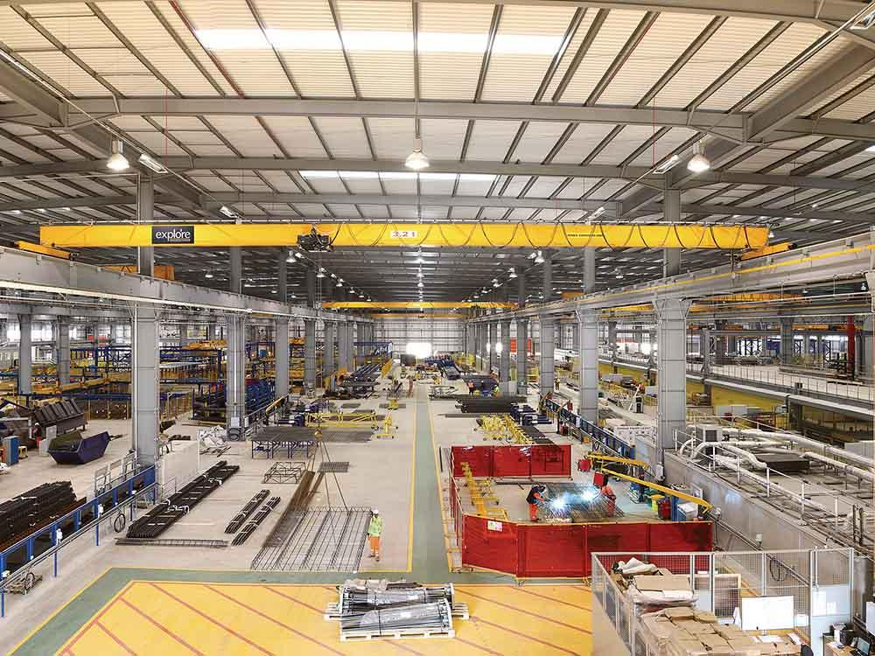
Image courtesy of Laing O’Rourke

Slide 5
“There is real confusion in terms of terminology with terms such as modular, offsite, prefabrication, modern methods of construction, volumetric and panelised all being used.”
House of Lords 2018
Large variety of terminologies: ‘offsite’, ‘Off-Site Manufacturing (OSM)’, ‘Modern Methods of Construction (MMC)’, ‘smart’, ‘Industrialised Building System (IBS)’, ‘pre-fabrication’, etc.
Lack of consistency in the use of offsite systems classifications

Slide 6
Modern Methods of Construction (MMC)
Modern methods of construction (MMC) are all the approaches that aim to optimise the construction process to obtain better products in less time
Business efficiency
Quality
Customer satisfaction
Environmental performance sustainability
Predictability of delivery timescale
MMC include but are not limited to offsite construction
Notes:
1.1.1

Slide 7
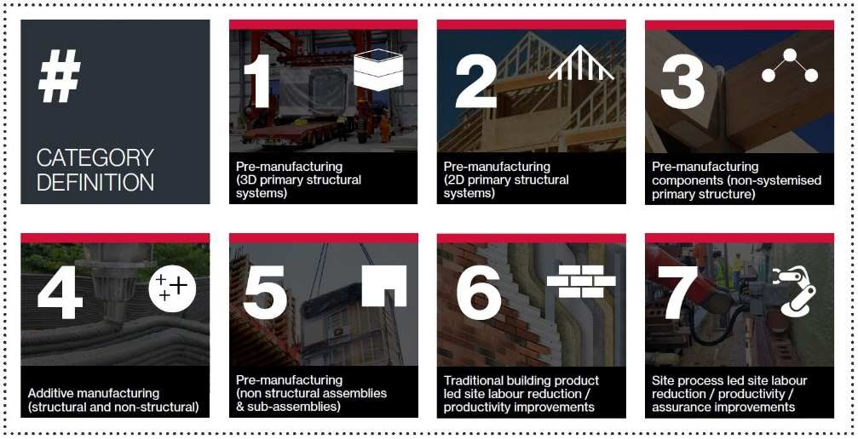
Modern Methods of Construction working group: developing a definition framework
Notes:
https://www.gov.uk/government/publications/modern-methods-of-construction-working-group-developing-a-definition-framework

Slide 8
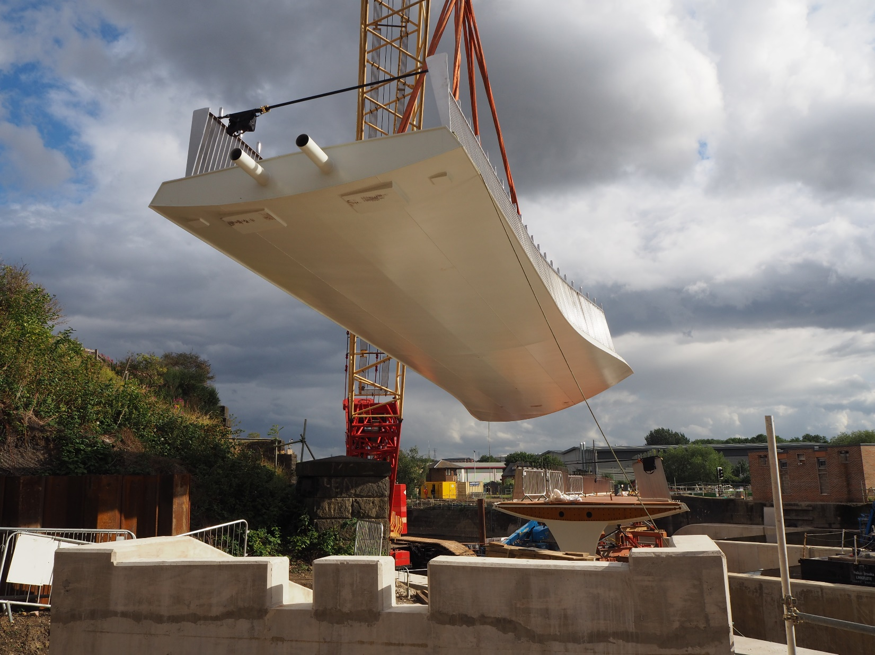
Offsite construction
Offsite is a construction method that adds substantial value to a product via the manufacture and pre-assembly of components, elements or modules in a factory, before installation into their final location.
Image courtesy of Offsite Awards - Mott MacDonald
Notes:
1.1.2

Slide 9
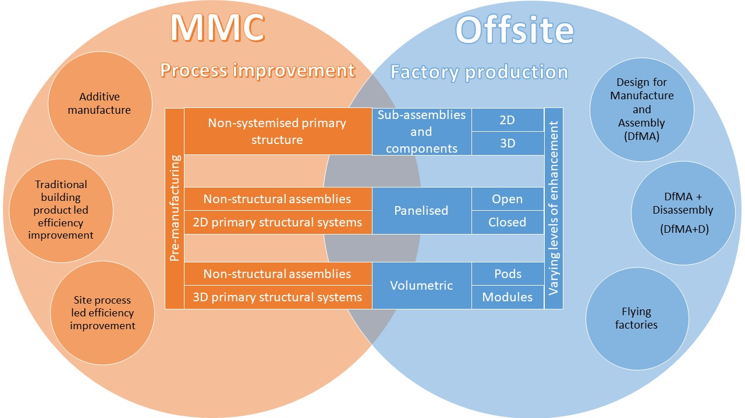

Slide 10
Other definitions
Design for Manufacture and Assembly (DfMA): the concept of designing products and systems that are tailored for ease of manufacture, transport and assembly
Understand the supply chain
Component-based design
DfMA+ Disassembly (DfMA+D): targets efficiency also in the maintenance and end-of-life stages
Considerations for de-construction, re-use and recycling

Slide 11
Other definitions
Flying factories: onsite or near-site temporary factories
Smart construction: approaches that make full use of digital technologies and industrialised manufacturing techniques to improve productivity, minimise whole life cost, improve sustainability and maximise user benefits
Regional differences:
Industrialised Building System (IBS) in Asia and Australia
Modular in North America

Slide 12
1.1 Appreciation of how buildings are constructed

Slide 13
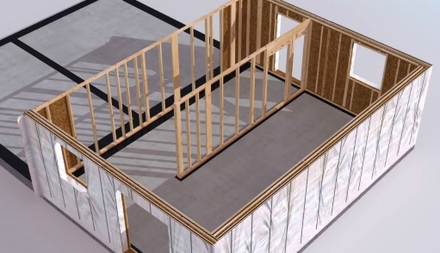
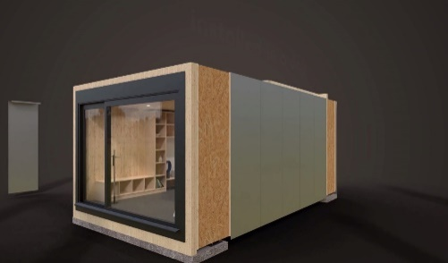
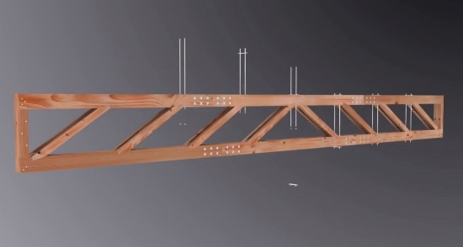
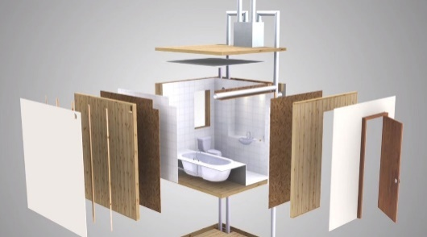
Four main categories of offsite construction:
Volumetric systems
Panelised systems
Can be made out of any typical construction material: concrete, steel, timber or hybrid
Sub-assemblies and components
Hybrid systems
Notes:
1.1.

Slide 14
Panelised systems
Planar unit which may or may not have a structural function
Open: usually when non-insulated with only the structural elements and if applicable sheeting on one side
Closed: include insulation, sheeting on both sides and a service zone; can be furtherly enhanced with the addition of internal lining, external cladding, windows and doors and services
SIPs (Structural Insulated Panels): variation of closed panels; solid insulation ‘sandwiched’ with two layers of OSB.

Slide 15
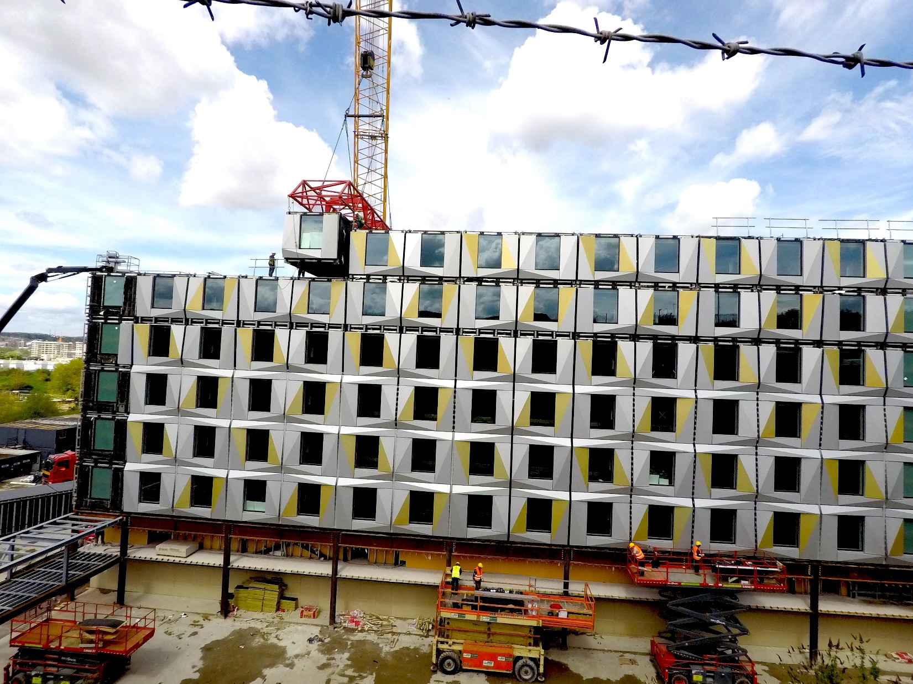
Volumetric systems
They represent three-dimensional units that enclose usable space.
Typically are fully finished internally and can also be finished externally
Can also be non-structural – pods: used for bathrooms, plant rooms and roof-top services
Image courtesy of Offsite Awards - Peter Dann

Slide 16
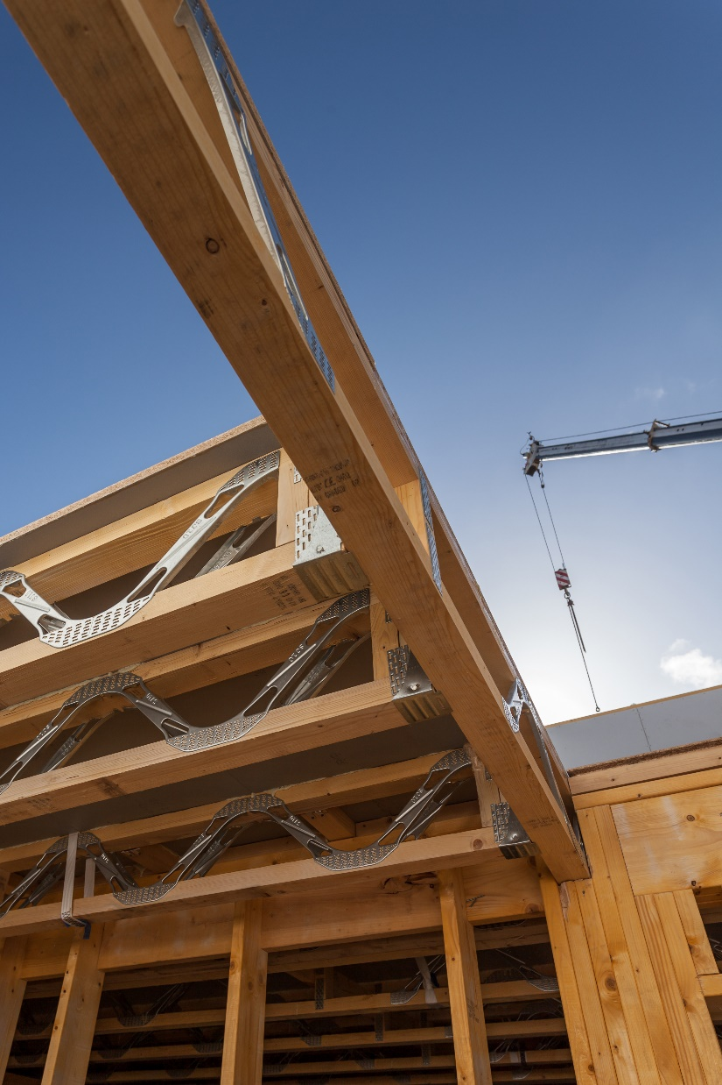
Sub-assemblies and components
Pre-manufactured elements that don’t fall in the previous categories
Stairs
Doors
Windows
I-joists
Steel elements

Slide 17
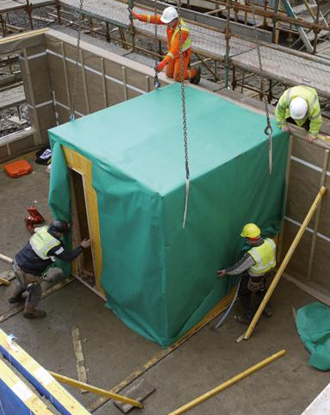
Hybrid systems
Generic term covering a wide variety of construction techniques, particularly where different systems and/or materials are used in combination to fulfil a specific function

Slide 18
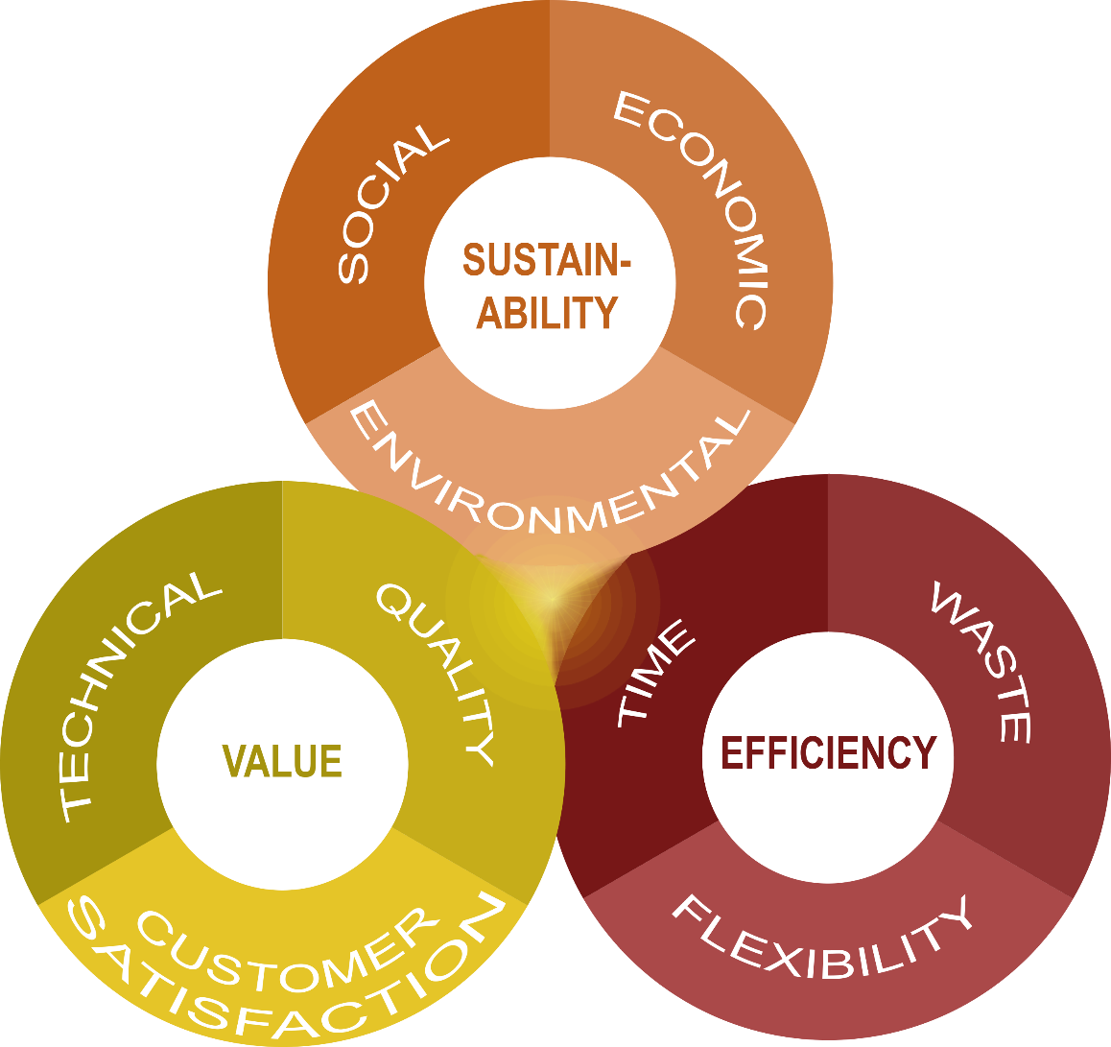
Benefits and drivers
the factory environment provides a cleaner and safer place of work. The production is more efficient and performance are enhanced, with consequent reductions in costs.
the optimised use of materials and the opportunity to carry some operations at the same time allows for time savings and reduction of waste. Additionally, the use of BIM and automation ensures flexibility.
the factory environment guarantees higher quality, more predictable product behaviour, better performance and little defects, with consequent higher customer satisfaction.

Slide 19
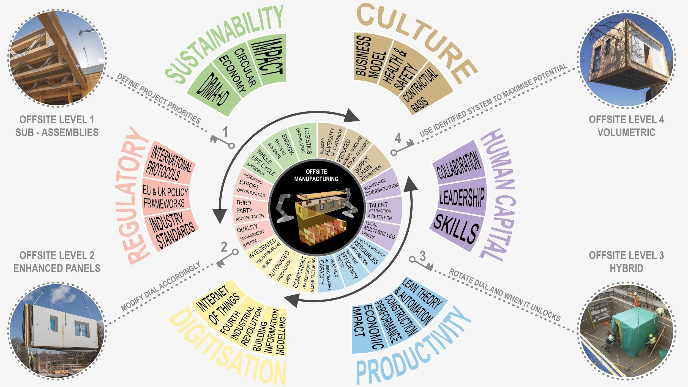
Drivers

Slide 20
Challenges and risks
The adoption of an offsite approach requires a change in culture that is still facing resistance.
Transformations: project management, scheduling
Investment decisions need to be more informed
Onsite risks: remote areas access, manufacture at fault
Meta skills: attention to detail, effective communication
YOU CAN BE THIS CHANGE!!!

Slide 21
Residential
Building types
The market demand for housing encourages the use of offsite construction for faster and more efficient delivery.
Due to the different form that residential buildings can assume, from single-family homes to apartment blocks, different offsite systems can be applied depending on the size and environmental performance that need to be obtained.
For example, volumetric systems are best suited when a high level of repeatability is required. They can be also used as service pods.

Slide 22
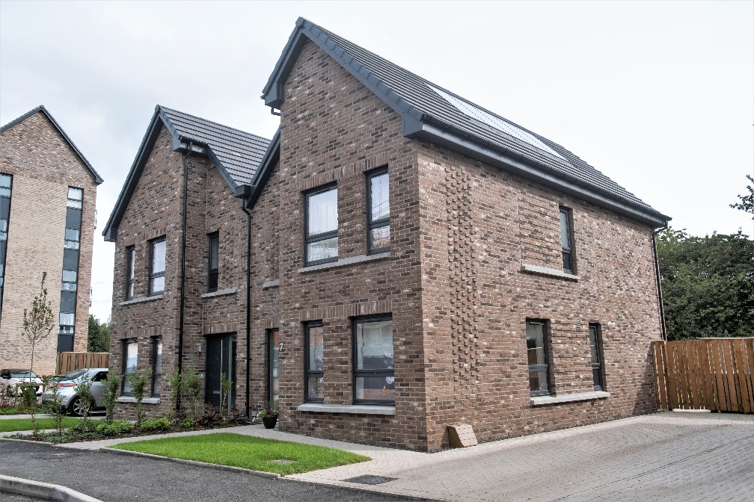
Residential low rise
Riverford Gardens
CCG + MAST Architects
Glasgow
panelised system
enhanced environmental and energy performance
156 homes:
- 10 one-bedroom flats
- 94 two-bedroom flats
- 12 three-bedroom semi-
detached homes
- 40 four-bedroom terraced villas
Image courtesy of CCG (Scotland) Ltd

Slide 23
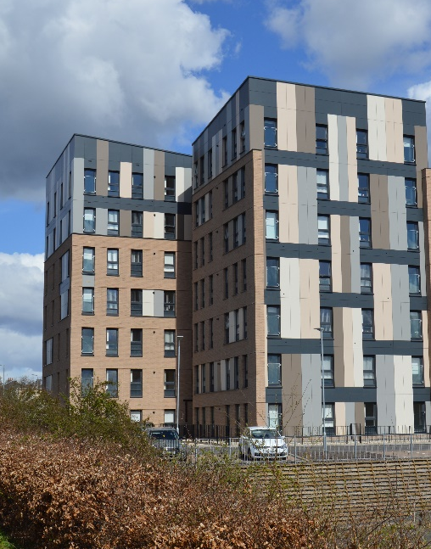
Residential mid rise
Yoker
CCG + MAST Architects
Glasgow
CLT
tallest timber building in Scotland
structural timber award winner 2018
42 apartments
reduced erection/construction time, reduced material wastage, inherent air tightness and thermal properties
Image courtesy of CCG (Scotland) Ltd

Slide 24
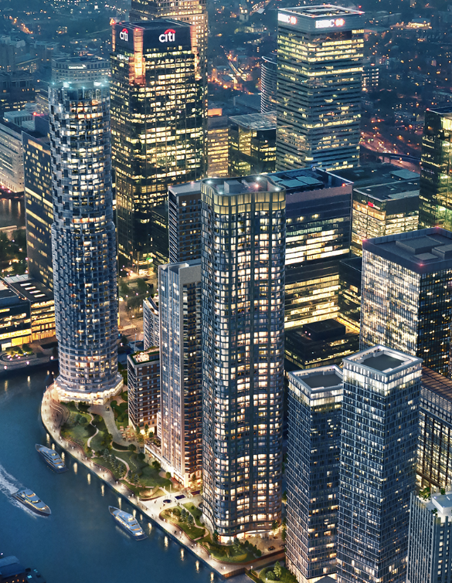
Residential high rise
Wood Wharf
Canary Wharf’s new district, Wood Wharf, has been designed to provide a new residential led, mixed use, waterside community defined by the quality of its public spaces, the diversity of its land uses and activities, and its exemplary architecture.
Image courtesy of
Canary Wharf Contractors

Slide 25
The masterplan, designed by Allies and Morrison Architects, creates a strong and complementary mix of uses, providing over 3,300 new homes, nearly 2 million sq ft of high quality commercial office space, and a further 490,000 sq ft of shops, restaurants and community uses.
The buildings use a combination of precast panels by Laing O’Rourke and volumetric steel bathroom pods.
Completion of the project is expected in 2023.
Image courtesy of
Canary Wharf Contractors

Slide 26
Non-residential
Non-residential buildings include offices, prisons, hospitals, and educational facilities, and typically have a high degree of repeatability ideal for offsite.
Additionally, the necessity for reduced time onsite frequently leads to the application of systems with higher levels of enhancement.
Offsite MEP systems are frequently applied, especially in hospitals, and can be easily integrated into existing buildings as well.

Slide 27
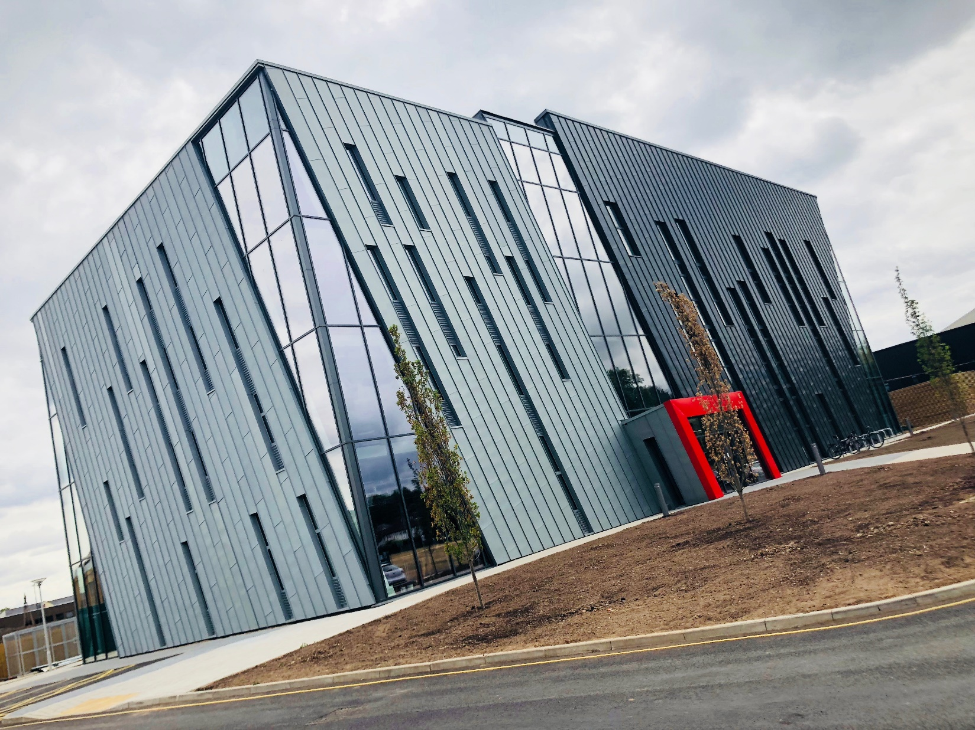
University of Nottingham building
Image courtesy of Offsite Awards - SIP Build UK

Slide 28
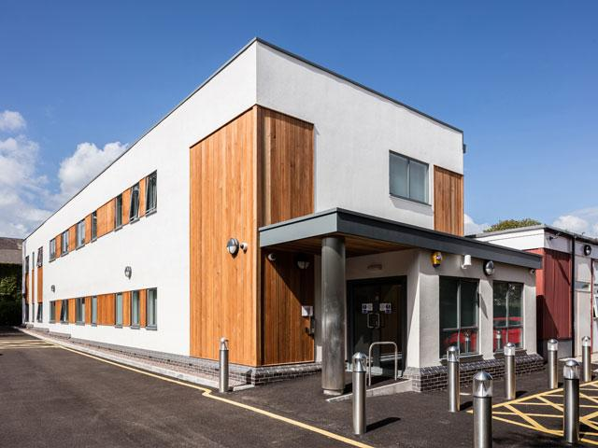
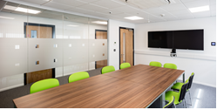
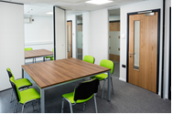
Velindre Cancer Centre – Post-graduate office building
Kindly provided by Wernick Buildings, Wales via CWIC
Notes:
Manufactured in Wales.
Velindre Cancer Centre required a new office facility as part of a strategic plan for more efficient use of its facilities.
The hospital chose modular construction due to the time of year construction would take place. A modular solution provided better deliverable guarantees through winter months opposed to traditional build.
The building was manufactured in just 6 weeks in Wernick Buildings’ factory, only 25 miles from the site and the project completed on the live site in 18 weeks.
The site adjoined a mental health hospital. Stringent requirements were fulfilled by Wernick. The site was also very tight and had a protected tree which the building was formed around making for a challenging installation.
The hospital and nearby residents are very happy.

Slide 29
Retrofit
Due to the reduced amount of work to be complete onsite, offsite construction systems are well-suited for working with existing buildings, also known as retrofit.
During construction, these offer the benefits of reduced disruption to the surrounding area and continuation of operations as early as possible, due to the rapid onsite installation times.

Slide 30
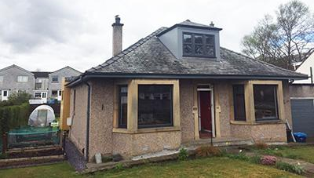
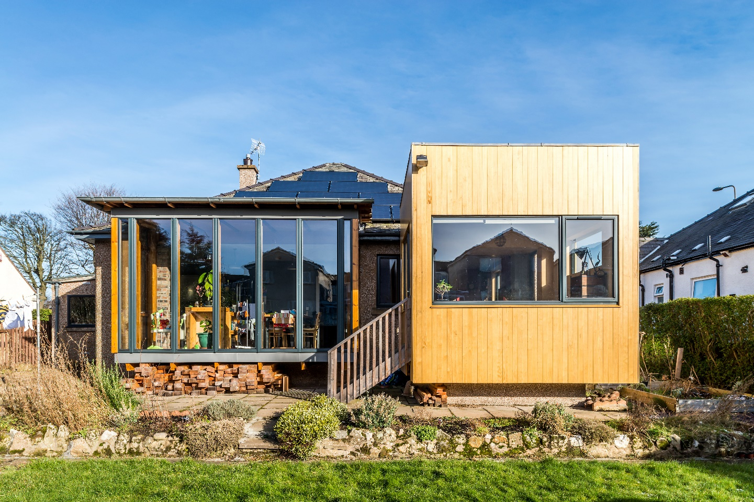
Retrofit
Howden Hall Road, Edinburgh
the house was reconfigured and turned back to front to create a new South/West facing open plan living, dining and kitchen area
energy rating improvement: new modern high specification windows, additional insulation to the fabric (cavity wall, loft top up and under floor), energy saving measures (LED light bulbs, solar PV array and wood burning stove)
new contemporary panelised sunroom
innovative cantilevered glass box with glulam structure
Image courtesy of Prof Robert Hairstans

Slide 31
Infrastructure
A variety of offsite solutions can be applied in infrastructure, more frequently with the creation of bespoke systems and hybrid forms, due to the size of the construction.
Infrastructures include bridges, roads, airports and train stations, which are constructed using mainly offsite steel and concrete elements.
Due to the scale of investment offsite construction can have a significant impact on the project parameters, and according to WPI economics use of offsite construction methods could reduce costs by 25% and time by 30%.

Slide 32
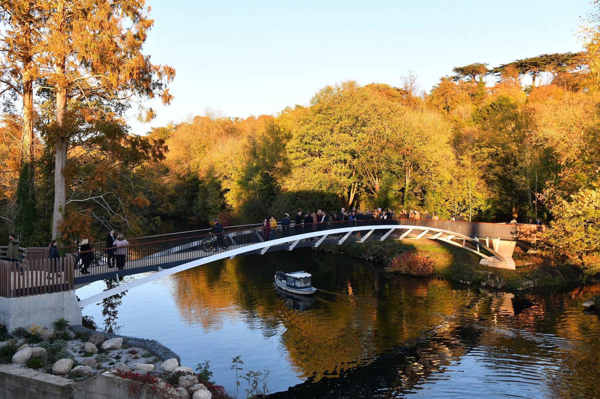
Image courtesy of Offsite Awards - COWI

Slide 33
1.2 Impact onsite if manufacturing is at fault

Slide 34
Possible issues
Dimensions of the product do not meet specification
Floor slab or foundation has not been constructed within the acceptable tolerances
Materials used in manufacturing are different to those specified
Misaligned connections for mains electricity and water
Thermal performance is lower than required by the project
If discovered onsite, these issues will be costly to remediate as offsite products may need to be sent back to the factory.

Slide 35
Solutions
To prevent these issues it is critical to embed meta skills in offsite construction:
Accuracy
Adaptability
Effective and ongoing communication
Process improvement

Slide 36
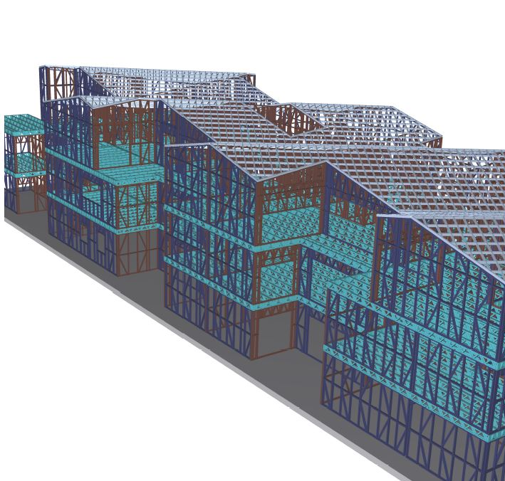
Solutions
A fully integrated Building Information Model can help to ensure that there are no discrepancies and clashes between the offsite and onsite components of the project
Image courtesy of
Offsite Awards - Steel Frame Buildings

Slide 37
1.3 Lean methodologies

Slide 38

Lean principles
Lean is a process improvement strategy centred around achieving customer requirements in a resource-efficient way.
5 process principles:
Customer value
Value chain
Make the value flow
Pull
Perfection
+ eliminate process wastes: transportation, inventory, motion, waiting, over-production, over-processing, defects, skills misuse.
Notes:
Image source: https://pixabay.com/illustrations/cog-wheels-gear-wheel-machine-2125178/

Slide 39
Lean tools
5S: it should be carried out by the people who use the work space to ensure usability; consists of 5 steps: sort, set, shine, standardise, sustain.
Visual management: involves easy to understand representations of work in progress, the status of each part of the work against the target dates, any challenges and how they are being resolved.
Process improvement: enabling resource-efficient organisational processes to reduce lead-in-times.
Notes:
Image source: https://pixabay.com/illustrations/cog-wheels-gear-wheel-machine-2125178/

Slide 40
1.4 Manufacturing processes

Slide 41
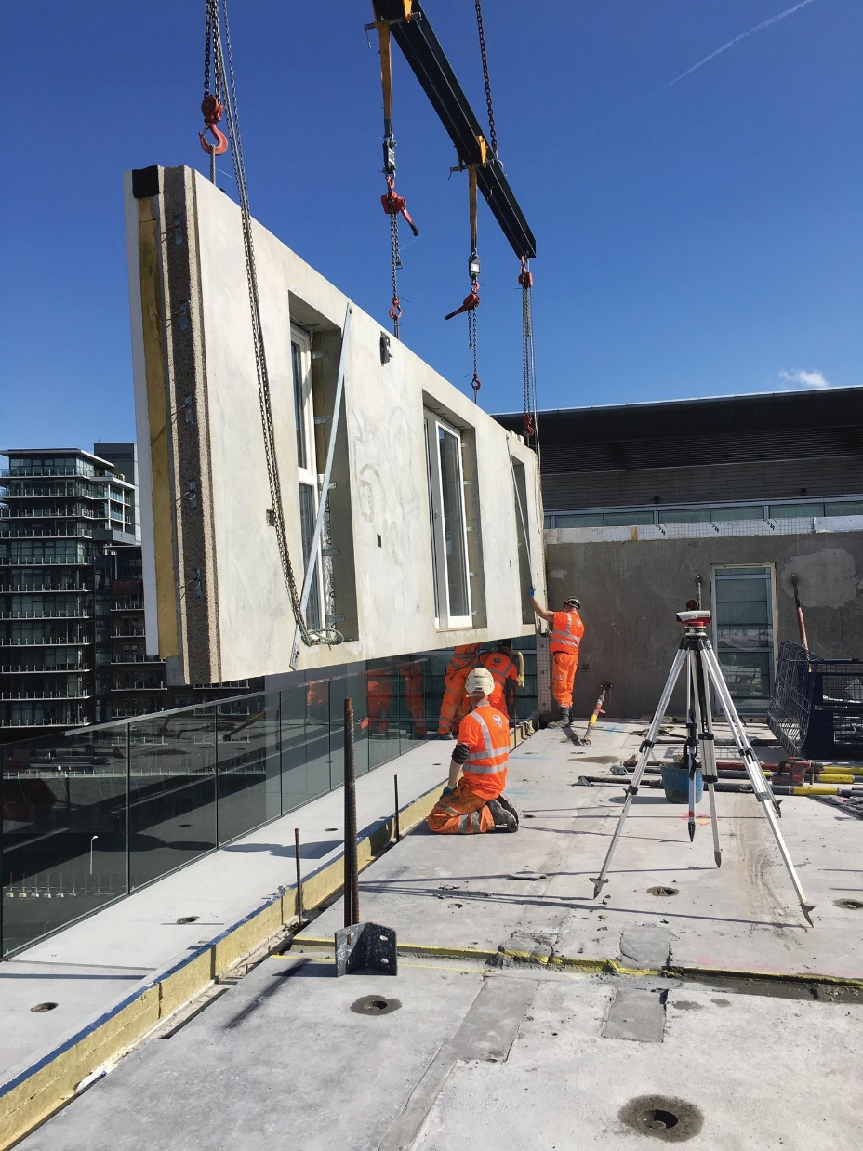
Offsite manufacture
Creation of elements in a factory environment provides opportunities for:
consistency of process
independence from adverse weather conditions
improved efficiency
reduced materials waste
Image courtesy of Offsite Awards - Dandara Group

Slide 42
Offsite manufacture
Key concepts:
production control
tolerances
Just in Time (JIT)
right first time
The manufacturing processes are typically enhanced by:
lean techniques
automation
quality assurance
safety management
Image courtesy of Offsite Awards - Dandara Group

Slide 43
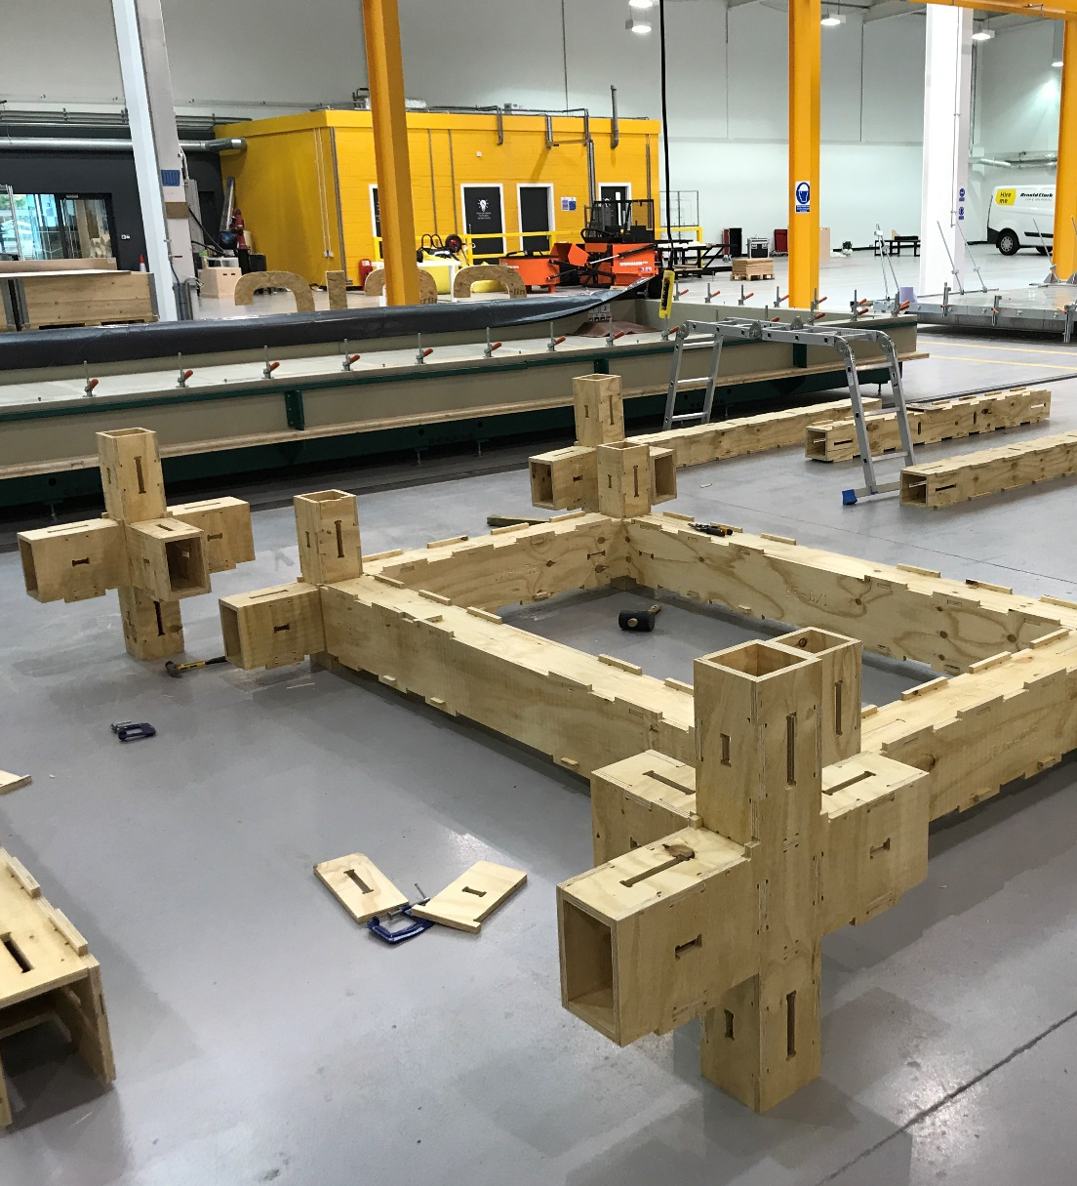
Mass customisation
Important to achieving efficiencies in offsite projects is mass customisation, the combination of standard systems with varying assembly options to provide choice to the client whilst maintaining manufacturing process control.
Image courtesy of the Construction Scotland Innovation Centre

Slide 44


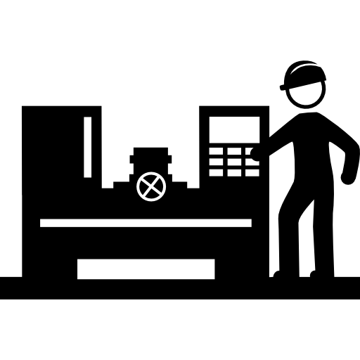

Levels of automation
Manual: performed by a human operator manually with a minimum of tools.
Mechanised: the worker employs mechanical assistance in performing an operation.
Semi-automated: a fixed program machine executes a sequence of operations and a human operator completes the task
Automated: under programmable control, a machine may execute a sequence of operations, without needing input from a human operator.

Slide 45
1.5 Order of sequence

Slide 46
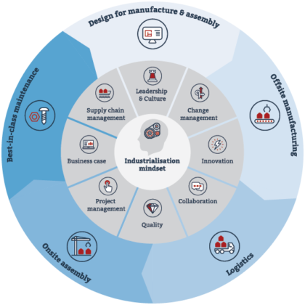
Image courtesy of the Supply Chain Sustainability School

Slide 47
Design considerations
The design process for offsite construction systems is often referred to as ‘front-loaded’.
When designing according to DfMA principles the following aspects should be considered :
Manufacturing process and standard sizing limitations
Dimensional tolerances of the chosen offsite system
Transportation restrictions
Assembly process
Supply chain
Manufacturing capacity
Site-specific restrictions

Slide 48
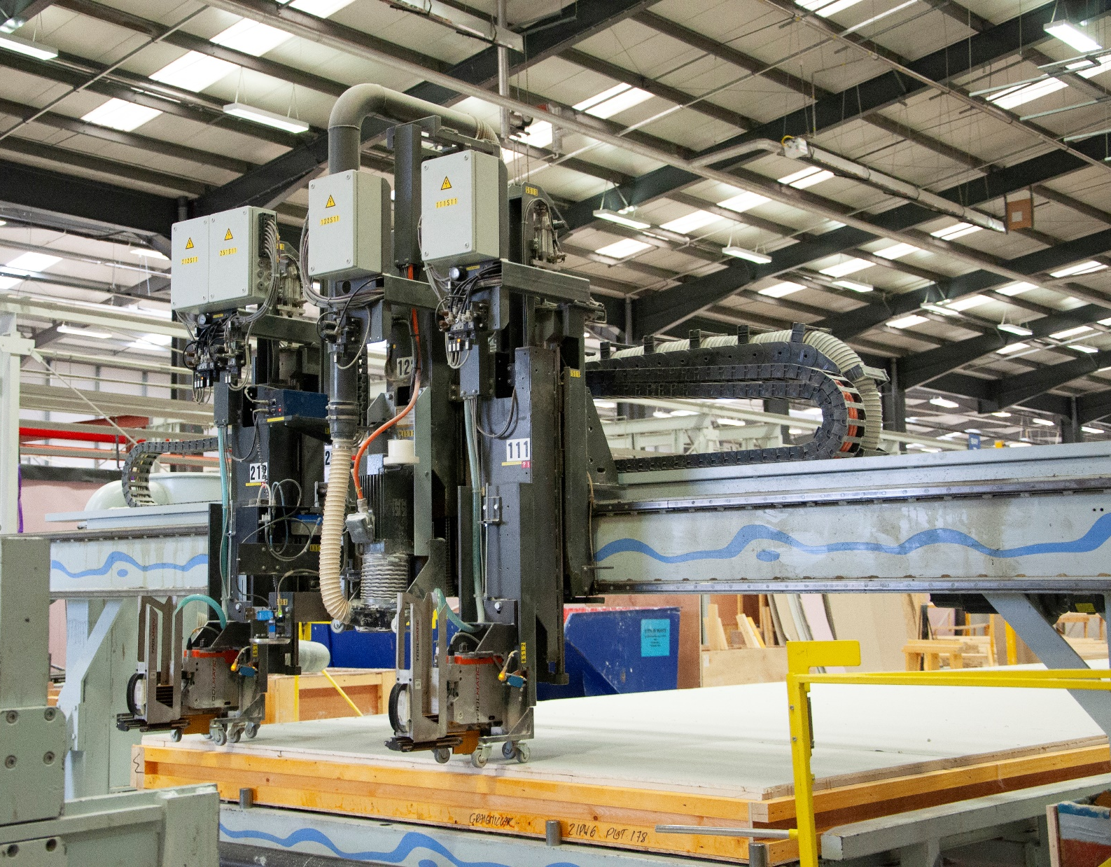
Manufacture
is the creation of elements in
a factory environment, before being transported and assembled on site. The factory provides
a controlled environment with some inherent benefits, such as consistency of process,
independence from adverse weather conditions, improved efficiency and reduced waste.
Image courtesy of CCG OSM

Slide 49
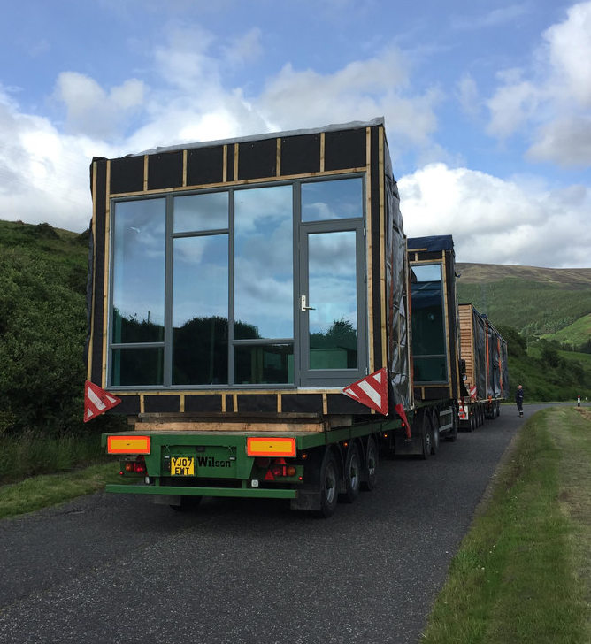
Logistics
Logistics can be defined as the point of connection between onsite and offsite activities.
This function is mainly about coordination and integration of multiple activities.
Image courtesy of Carbon Dynamic

Slide 50
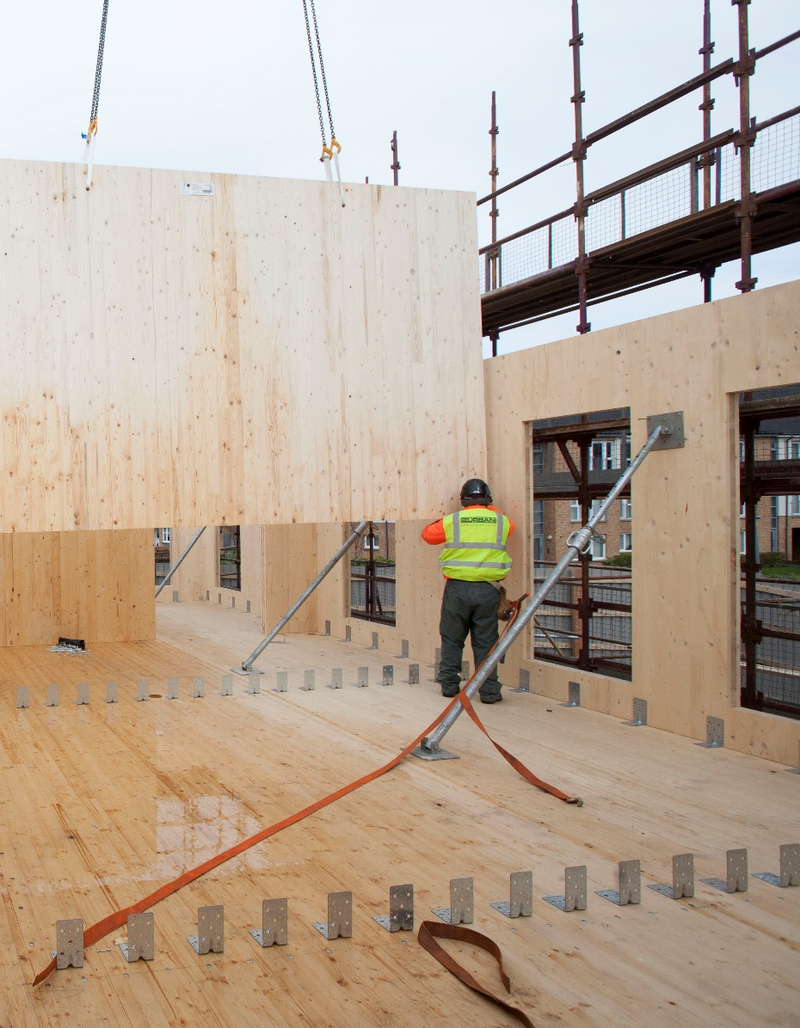
Onsite assembly
Assembly refers to the placement of offsite products in their designated location onsite and connection with the remaining structure.
Depending on the level of enhancement that is reached in the factory, assembly varies from the location of fully fitted volumetric elements that need little additional work, to the installation of open panels or sub-assemblies that need to be completed with internal/external linings, windows and doors and MEP services.
Image courtesy of Eurban

Slide 51
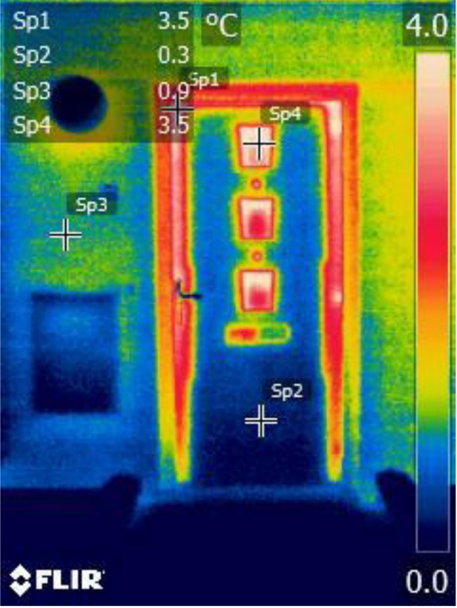
Design for maintenance
The production of building elements in a factory environment guarantees a higher level of performance and consequent ease of maintenance.
Thanks to the accurate design and the support of monitoring technologies, it’s possible to predict the behaviour of the building and plan repairs and maintenance accurately.
Image courtesy of Scottish Energy Centre

Slide 52
1.6 Quality assurance

Slide 53
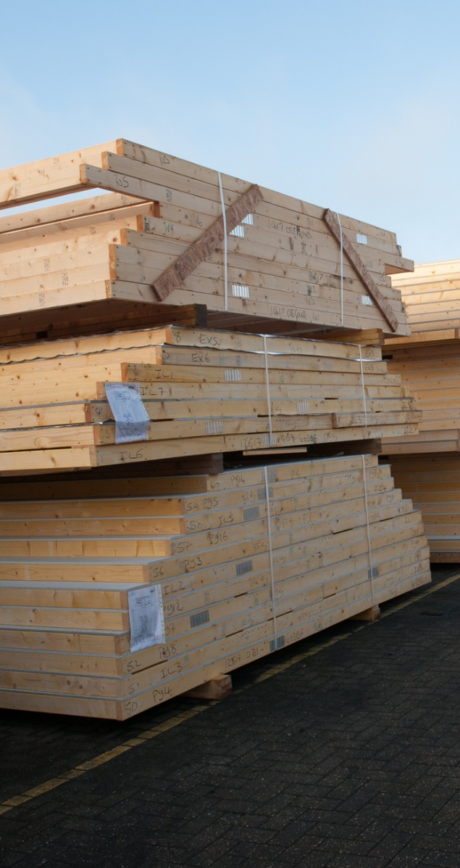
Quality assurance is integral to manufacturing environments and offsite manufacturers tend to comply with ISO 9001 Quality Management Systems, as well as other industry-specific standards and accreditations.
In addition, materials regulated by a harmonised European Standard need to have a CE mark to demonstrate compliance with the relevant manufacturing standards.

Slide 54
1.7 Codes and standards

Slide 55
Standards and regulations
Not all standards are suitable for the offsite approach and many of the applicable ones are out of date.
1. ISO 45001: occupational health and safety management.
2. BS EN ISO 14001:2015: specifies requirements for an environmental management system.
3. BREEAM: environmental assessment method and rating system for buildings.
4. BS EN ISO 19650-1: Organization and digitization of information about buildings and civil engineering works, including building information modelling.
5. RIBA Plan of Work: identifies the key stages of project development.
6. ISO BS 10007:2017 – Quality management systems guidelines for configuration management.
7. BS 5606:1990 – Guide to accuracy in building.
8. BS EN 1090-1:2009 – Steel and aluminium structures.
Notes:
Presenter check for updates before delivery and edit the slide as needed

Slide 56
1.8 Full range of materials and systems

Slide 57



Steel
particularly suitable for large-scale projects where large spans need to be covered
‘dry’ method: results in a clean work environment and a quick onsite assembly
transportation can become a challenge
components cannot be easily modified
steel has a high thermal conductivity: detail design and insulation installation need to be particularly accurate to avoid thermal bridging
corrosion is a risk

Slide 58
Concrete
removes the need for ‘wet’ construction with associated curing times
opportunity for buildings with special security and durability requirements (prisons, infrastructures, etc)
components are heavy: associated health and safety risks
usually includes only the concrete structure; the remaining work needs to be arranged and synchronised on site
Transportation issues; remote locations can become a barrier

Slide 59
Timber
high environmental credentials (e.g. carbon capture)
good thermal performance and air-tightness
special attention needs to be taken when designing with timber, because of its natural properties, which can result in differential movement due to changes in its moisture content
fire regulations prescribing the use of non-combustible materials can be a barrier

Slide 60
History of offsite construction

Slide 61
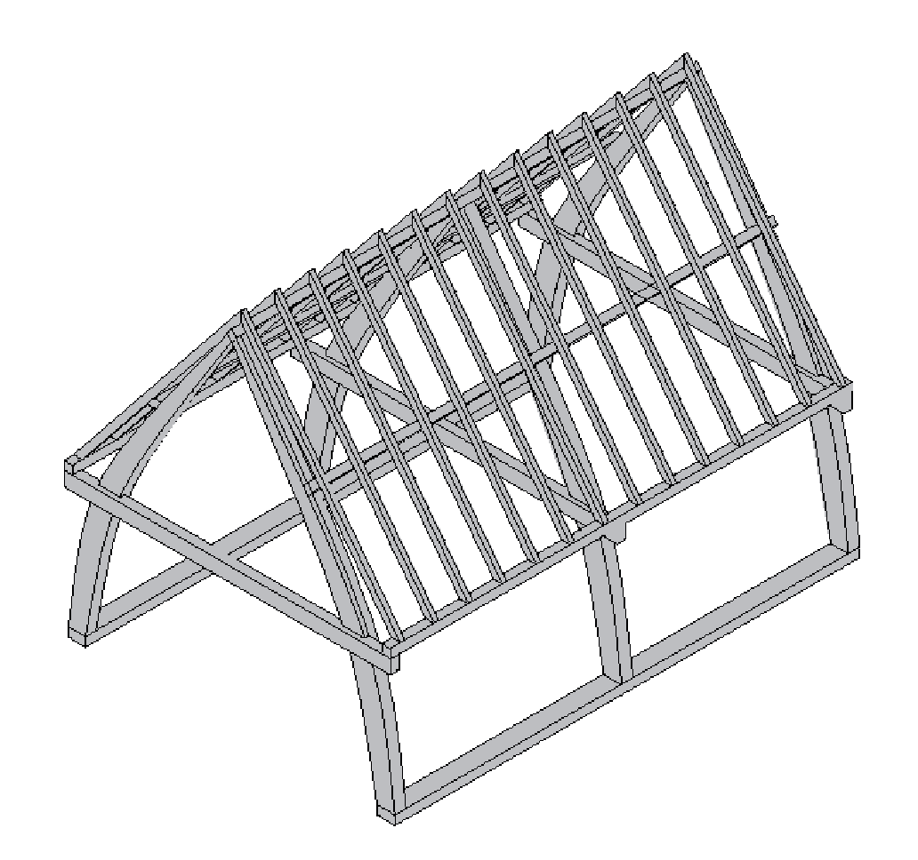
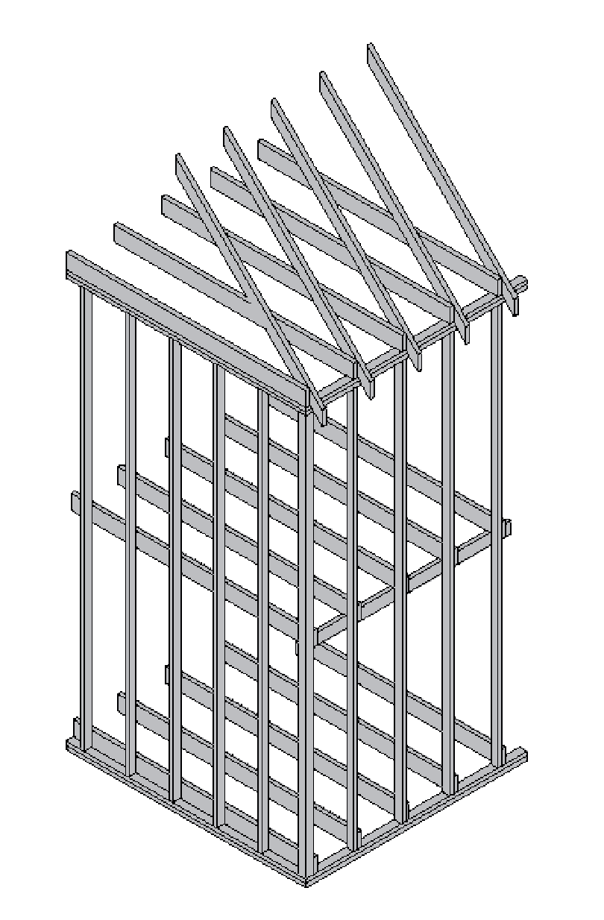
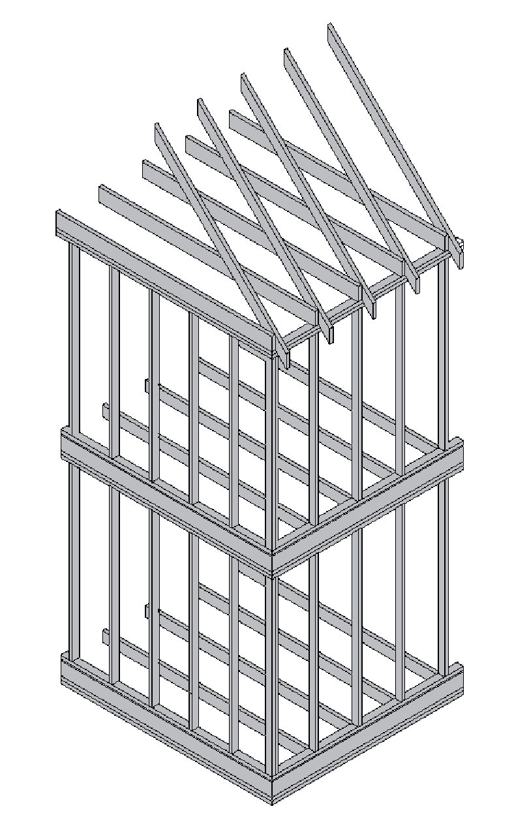
Middle Ages
Cruck frame: Carpenters would often assemble the frames of buildings in their yards to ensure that all the elements fitted together. The frames were then marked and dismantled to be transported to the site and reassembled.
19th Century
Timber balloon frame: With the North American population rapidly expanding, the pressure to build new homes resulted in the invention of ‘Balloon Frame Construction’, a 2- or 3-storey high vertical timber frame that supports the roof and floor joists.
Timber platform frame: Platform frame derives from the balloon frame and is built floor-by-floor, with single-storey vertical frames supporting the floor and upper structure.
Image courtesy of
Prof Robert Hairstans

Slide 62
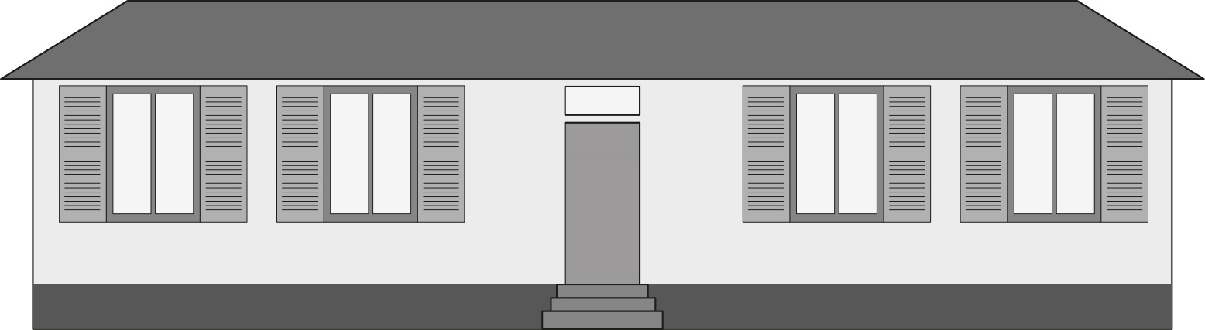
Before the World Wars
Manning Cottage: Due to colonial expansion, it became necessary for buildings to be produced, packaged and dispatched in large quantities to all corners of the world. John Manning, a London carpenter and builder, embraced the key concepts of offsite construction by producing the Manning cottage, a timber house that was standardised for efficiency and designed to facilitate transport and assembly by unskilled workers.
Historic building illustrations Image courtesy of Carola Calcagno

Slide 63
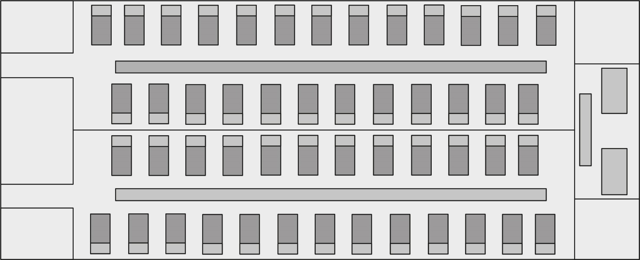
Before the World Wars
Renkioi Hospital: During the Crimean War, British engineer Isambard Kingdom Brunel designed and constructed the Renkioi Hospital on the coast of Dardanelles, Turkey. The timber frame structure was designed and produced in the UK, flat-packed, shipped and assembled onsite by unskilled workers in under 6 months.

Slide 64
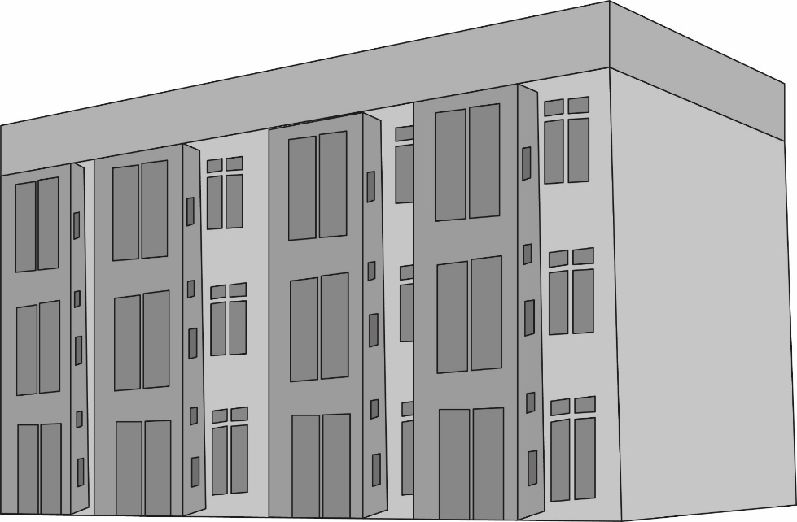
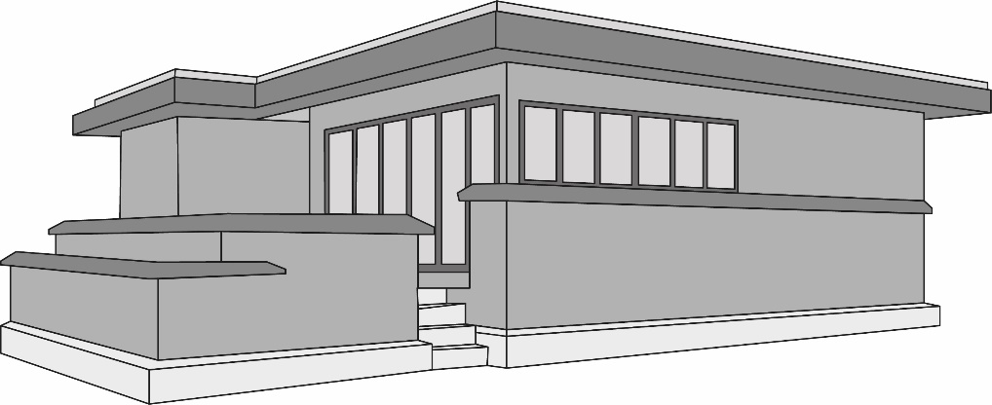
Before the World Wars
Eldon Street: Liverpool city engineer J.A. Brodie experimented with concrete wall panels and floor slabs, which were pre-cast for rapid onsite installation. These were first applied in the house on Eldon street in 1903. Trade unions opposed the idea heavily and UK pre-cast panel production did not advance much further at the time.
House type-based prefabrication: Architect F.L. Wright realized 7 houses, in partnership with the developer Arthur Richards, in order to make well-designed housing more affordable and accessible.
The Richards Company’s pre-cut lumber were sold via a car dealership-like model, shipped and assembled in the field, allowing for more a precise structure.
WWI material shortage marked the decline of this project.

Slide 65
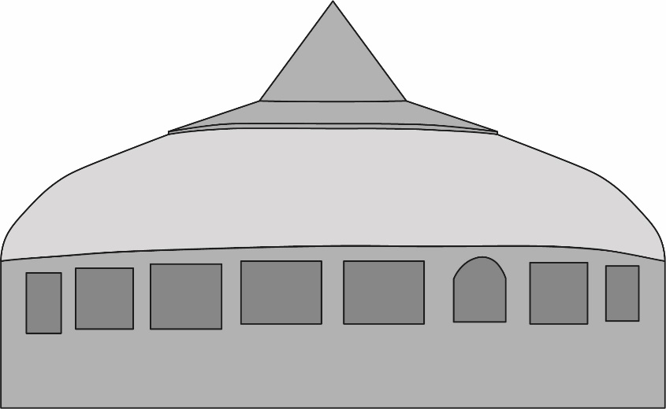
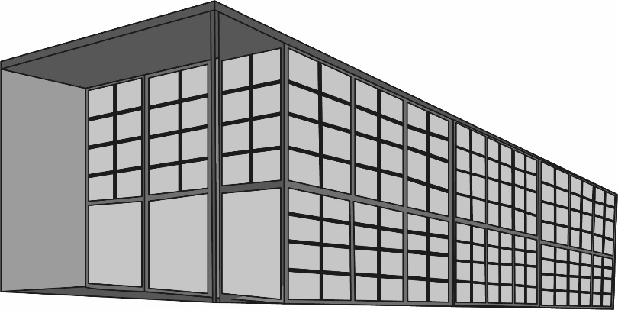
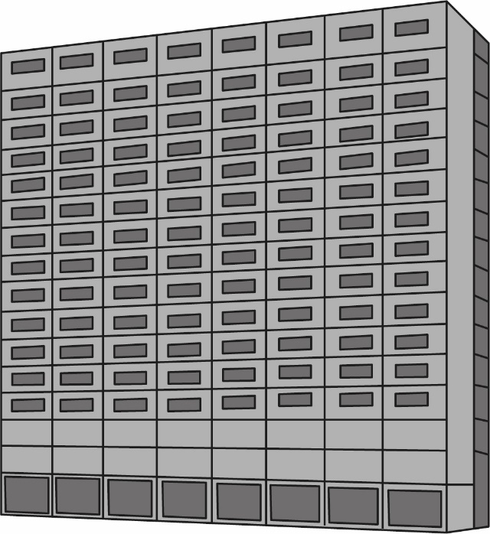
Post WWII
Dymaxion House – B. Fuller: self-sufficient single family dwelling that could be mass produced and flat-packaged. The house was to be constructed in aluminium and provided with wind turbines and water cisterns.
Eames House – C.&R. Eames: built for the Case Study House Program which focused on the use of new material and technologies developed during WWII. The project makes use of prefabricated materials.
Camus pre-cast panelised systems: patented in 1948 the system was produces around the globe and developed in different forms. Camus system with a steel frame was extensively used in high-rise UK residential construction.

Slide 66
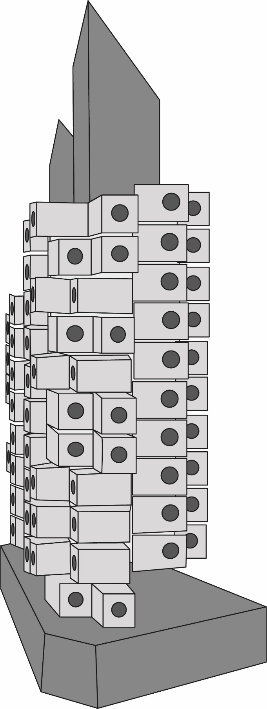
Post WWII
Nakagin Capsule Tower – K. Kurokawa: created to house traveling business men; represents the first example of capsule architecture. Each module can be plugged in to the central core and replaced/exchanged. All pieces of the pods were manufactured in a factory then transported to the site by truck.

Slide 67
Summary

Slide 68
Offsite construction
Offsite is a construction method that adds substantial value to a product via the manufacture and pre-assembly of components, elements or modules in a factory, before installation into their final location.
Image courtesy of Offsite Awards - Mott MacDonald
Notes:
1.1.2

Slide 69
Four main categories of offsite construction:
Volumetric systems
Panelised systems
Can be made out of any typical construction material: concrete, steel, timber or hybrid
Sub-assemblies and components
Hybrid systems
Notes:
1.1.

Slide 70
Benefits
the factory environment provides a cleaner and safer place of work. The production is more efficient and performance are enhanced, with consequent reductions in costs.
the optimised use of materials and the opportunity to carry some operations at the same time allows for time savings and reduction of waste. Additionally, the use of BIM and automation ensures flexibility.
the factory environment guarantees higher quality, more predictable product behaviour, better performance and little defects, with consequent higher customer satisfaction.

Slide 71

Applications of offsite construction include all construction sectors
Image courtesy of CCG (Scotland) Ltd
Image courtesy of Offsite Awards - COWI

Slide 72
Offsite order
of sequence
Image courtesy of the Supply Chain Sustainability School

Slide 73
Questions?
Dr Mila Duncheva,
Edinburgh Napier University

Slide 75

1 OFFSITE FUNDAMENTALS by DR MILA DUNCHEVA and CAROLA CALCAGNO is licensed under a Creative Commons Attribution-NonCommercial-ShareAlike 4.0 International License

